Slide 2
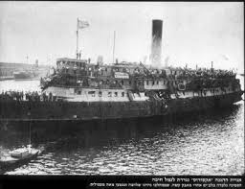
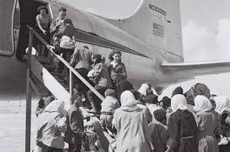
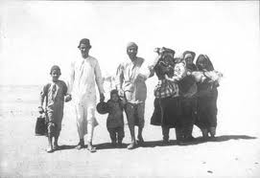
Geographical Deliverance
‹#›
Notes:
‹#›

Slide 3
Historical deliverance
‹#›

Slide 4
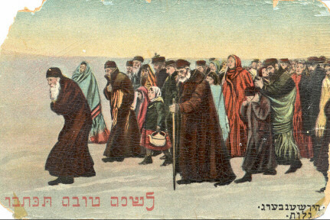
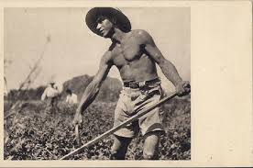
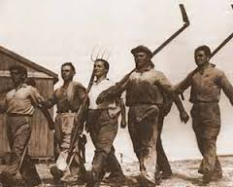
Personal Deliverance
‹#›

Slide 5
FANIA BERGSTEIN POEM 1936
אני הבת
לדורות של יהודים כפופים, כורעים
תחת עול-משא ימים כבדים,
אימת כל סטרז'ניק וכל שקץ עליהם,
חרדים לקול נבחת כלבו של השכן,
מפנים הדרך לקטן בפרחחי הרחוב
ומקדימים שלום למנוול ולשיכור,
ורועדים כרעוד עלה בסער
עם הדי פרעות והריגות באחיהם...
אני הבת
ליהודים מוחי הרוק מעל פניהם,
פולטי תודה שקטה, לוחשי סליחה נבהלת
לכל מצר לחייהם"...
‹#›

Slide 7
Prime Ministers (ot their parents) and their new names
 | Old Names | New Name
1948-1963 | David Grin | David Ben Gurion
1963-1969 | Levi Shkolnik | Levi Eshkol
1969-1974 | Golda Meirson | Golda Meir
1974-1977 | Yitzhak Rabin | Nehemia Rebizov (Father)
1977 | Shimon Persky | Shimon Peres

Slide 8
Prime Ministers (or their fathers) and their new names
 | Old Names
1977-1981 | Mieczysław Biegun/ Menachem Begin | Menachem Begin
1981-1986, 1988-1990 | Yitzhak Yezernizky | Yitzhak Shamir
1986-1988, 1995 | Shimon Persky | Shimon Peres
1996-1999, 2009-2021 | Benjamin Netanyahu | B.z Milikovski (father)
1999-2001 | Ehud Brug | Ehud Barak
2001-2006 | Ariel Sheinerman | Ariel Sharon

Slide 9
Prime Ministers (or their fathers) and their new names
 | Old Names | New Names
1977-1981 | Mieczysław Biegun/ Menachem Begin | Menachem Begin
1981-1986, 1988-1990 | Yitzhak Yezernizky | Yitzhak Shamir
1986-1988, 1995 | Shimon Persky | Shimon Peres
1996-1999, 2009-2021 | Benjamin Netanyahu | B.z Milikovski (father)
1999-2001 | Ehud Brug | Ehud Barak
2001-2006 | Ariel Sheinerman | Ariel Sharon

Slide 10
Prime Ministers (or their fathers) and their new names
 | Old Names | New Names
2006-2009 | Ehud Olmert | Ehud Olmert
2021-2022 | Naftali Bennet | Jim Bennet To Jacob Mirena Bennet to Leah Bennet (parents)
2022 | Yair Lapid | Tommislav Lempel to Yoseph Lapid (father)

Slide 11
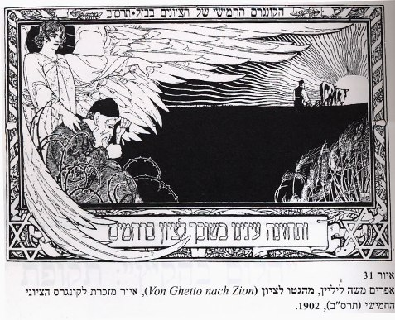
From Ghetto to Zion, 5th Zionist Congress 1902
‹#›

Slide 12
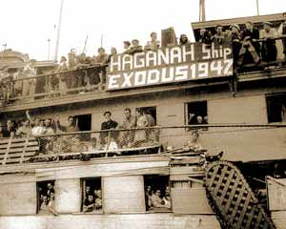
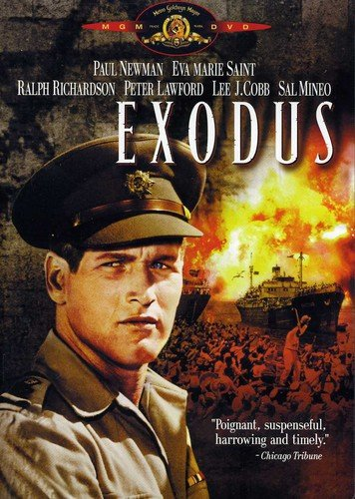
From Slavery to Freedom: then and now

Slide 13
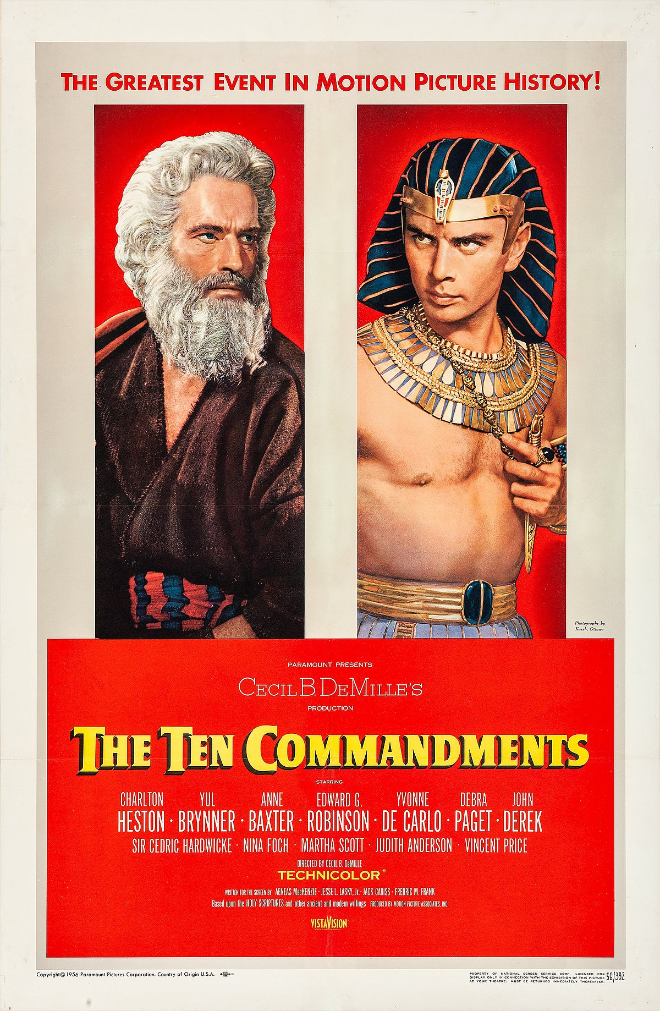
The ten commandments: Exodus as a transformation

Slide 14
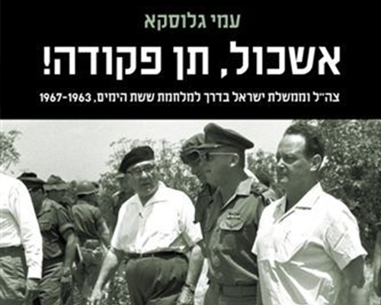
The generation of the desert
How is this evident in Israel ?

Slide 15
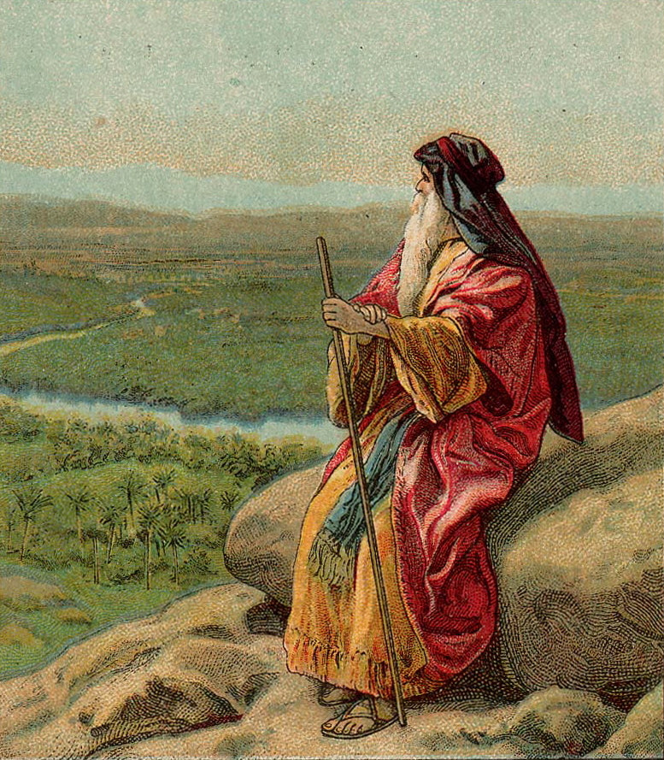
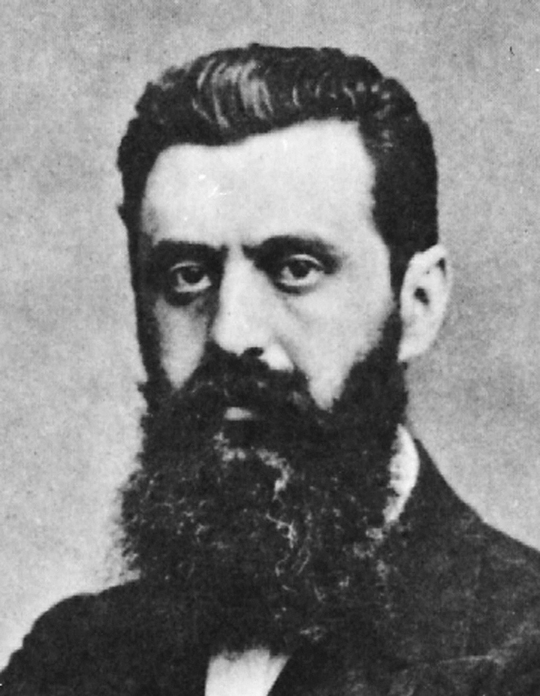
The Prophet: Moses, Herzel, and MLK
https://www.youtube.com/watch?v=FmkwI5ItCFk

Slide 16
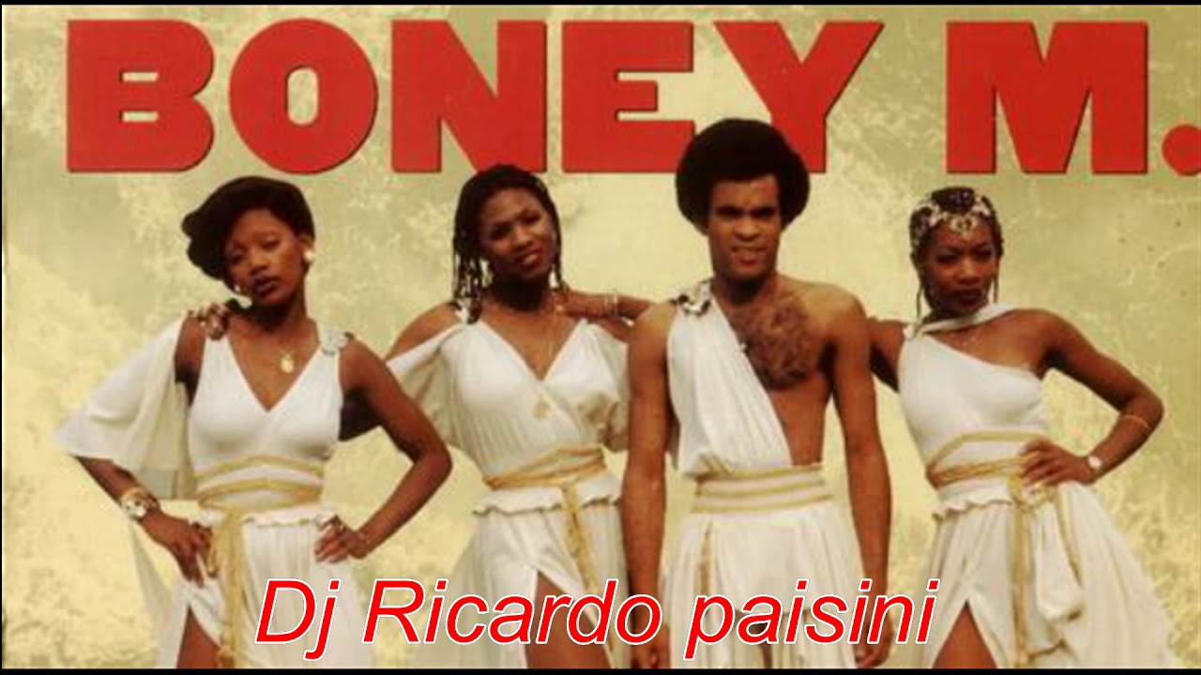
Ancient yearning to the old country, carried over to sectors of the Christian world
https://www.youtube.com/watch?v=vYK9iCRb7S4

Slide 17
What lines were relevant for the idea of return to the homeland ?

Slide 18
Psalms 19, and 137
By the rivers of Babylon, there we sat down
Yeah, we wept, when we remembered Zion
By the rivers of Babylon, there we sat down
Yeah, we wept, when we remembered Zion
There the wicked
Carried us away in captivity
Required from us a song
Now how shall we sing the Lord's song in a strange land?

Slide 19
Israel’s National Anthem
As long as deep in the heart,
The soul of a Jew yearns,
And forward to the East
To Zion, an eye looks
Our hope will not be lost,
The hope of two thousand years,
To be a free nation in our land,
The land of Zion and Jerusalem.

Slide 20
Internal view: Builds on the centrality of Israel in Judaism as interwoven into Jewish life

Slide 21
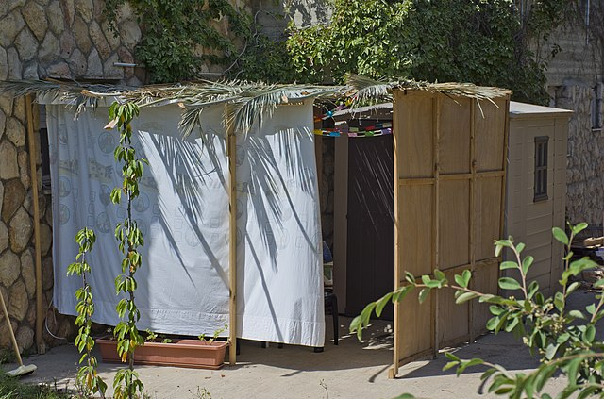
(Jewish ritual) three pilgrimage festivals (Sukkot, Passover, and Shavuot)

Slide 23
But, also a modern national movement
Born in the context of 19th century Central/Eastern Europe
Ethnic Nationalism vs. Civic nationalism

Slide 24
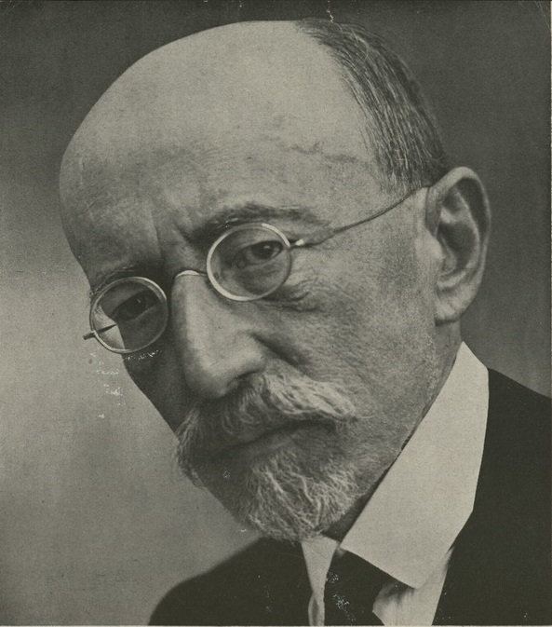
What were the main debates ?
Political Zionism Vs. Cultural Zionism
a Jewish state and not merely a state of
the Jews

Slide 26
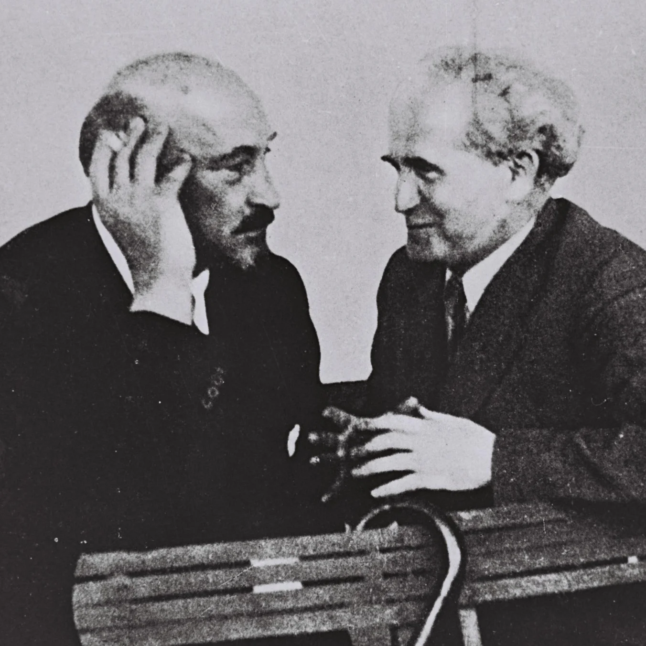
Political Zionism vs. Practical Zionism

Slide 27
What is the purpose of the state?
A solution for an immediate security challenge or an entity with a religious/long term mission?
How would that inform current debates, about territory etc.

Slide 28
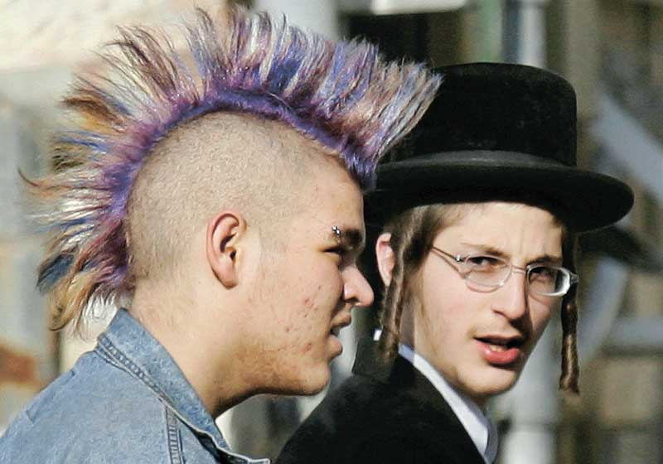
Revolution vs. tradition

Slide 29
Who is a member of the community ?
Civic notion: all citizens
Ethnic notion: only member of the ethnic group (Jews)

Slide 30
The triangle of Jewish values
People of Israel
Land of Israel Torah (religion)

Slide 31
Holocaust: recap ?

Slide 32
Holocaust: main issues ?

Slide 33
The shadow of the Holocaust 1
Significant event, but not the main reason for Zionism, or its evolution
By 1939 = 600K Jews in the land

Slide 34
The shadow of the Holocaust 2
Personal trauma for many, including second generation
Very much present in the public sphere
A central part of the way this country views itself
Both proves Zionism’s 19th century claims, but also its failure to evolve early enough

Slide 35
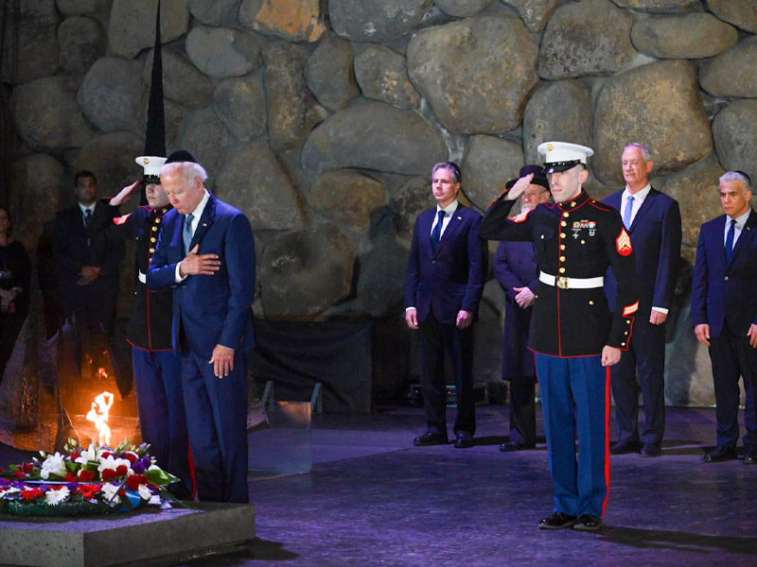
President Biden, July 13, 2022

Slide 36
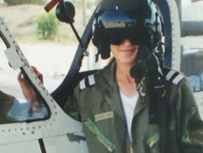
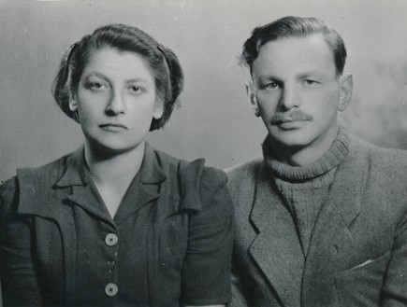
The shadow of the Holocaust 3
Justifies the centrality of power/security/military: Never again

Slide 37
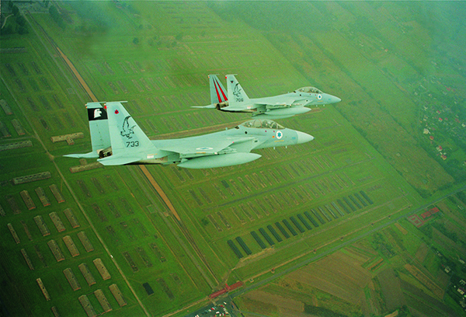
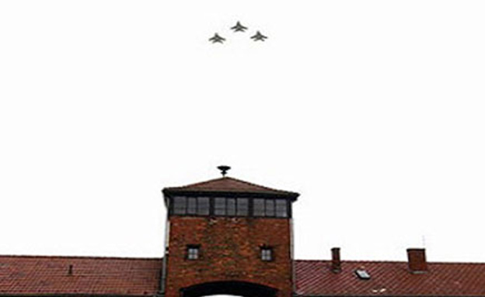
IAF above Auschwitz

Slide 38
The shadow of the Holocaust 4
Forces a moral debate: possible clash with other lesson of human rights
The black flag of illegality
A way to understand current realities: Begin in Lebanon, Erez Eshel’s ideas

Slide 39
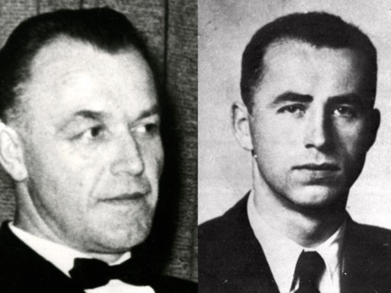
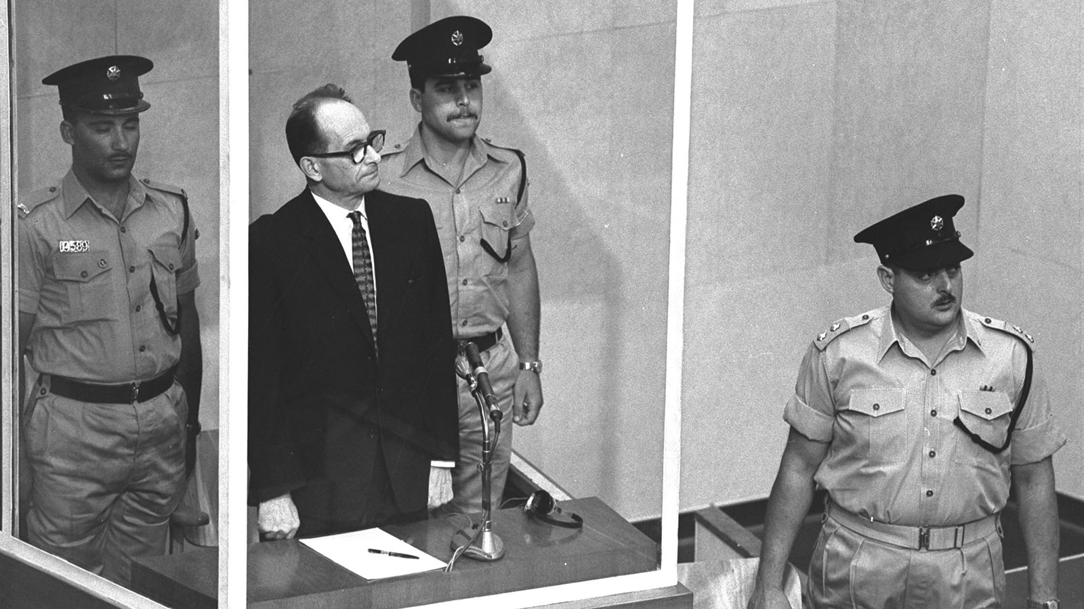
The shadow of the Holocaust 5
Informs some aspects of Israeli security

Slide 40
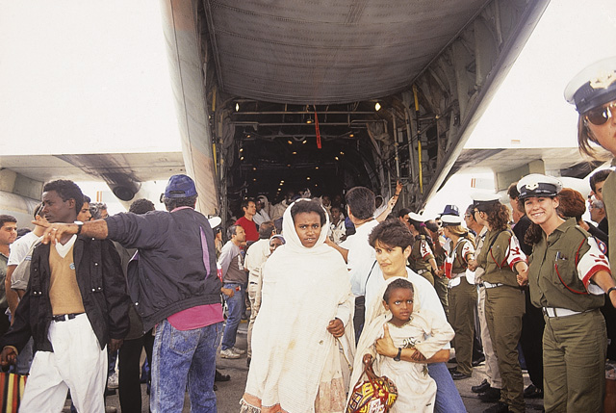
Operation Solomon (1991)

