Slide 1
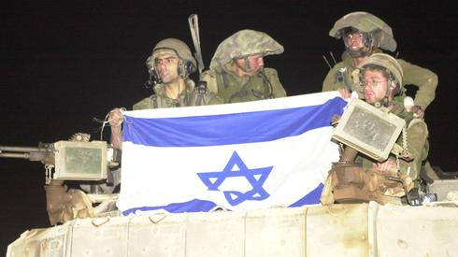
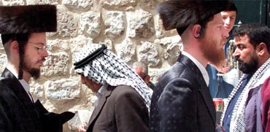
Israel: Politics, History and Society
Israel: Politics, History and Society
NDC
Dr. Ehud Eiran
15 Aug, 2022
Meeting 9
Four tribes
and the economy

Slide 2
The four tribes: Looking into Israel’s future
https://www.youtube.com/watch?v=Ci5zZi5Zpb0

Slide 3
First tribe: secular

Slide 4
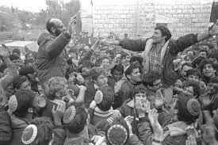
Second tribe: national religious

Slide 5
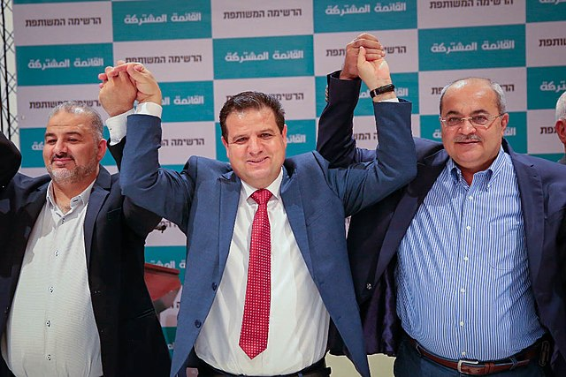
Third tribe: Israeli Arabs/Palestinians

Slide 6
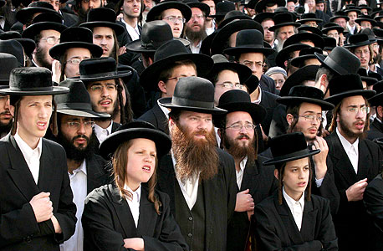
Fourth tribe: Ultra-Orthodox/Haredi

Slide 7
Main issues
Ethos: what is this state for ?
How they got here: immigration
Historical narrative
Education system
Military service
Academia
Labor force

Slide 8
Economy: Highlights
From poor and underdeveloped to rich and developed
From centralized to (generally) mixed/market economy
The rise of High Tech
The rise of the defense industries
Challenges: low participation in labor force, demographic future

Slide 9
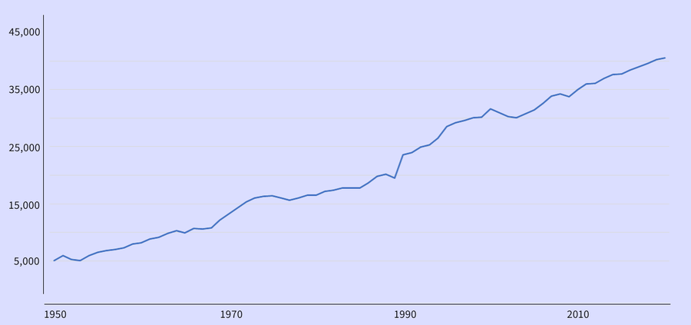
Israel: GDP per capita (source: World Bank)

Slide 11
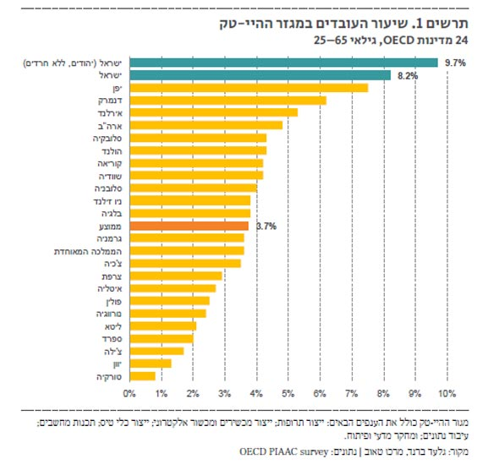

Slide 12
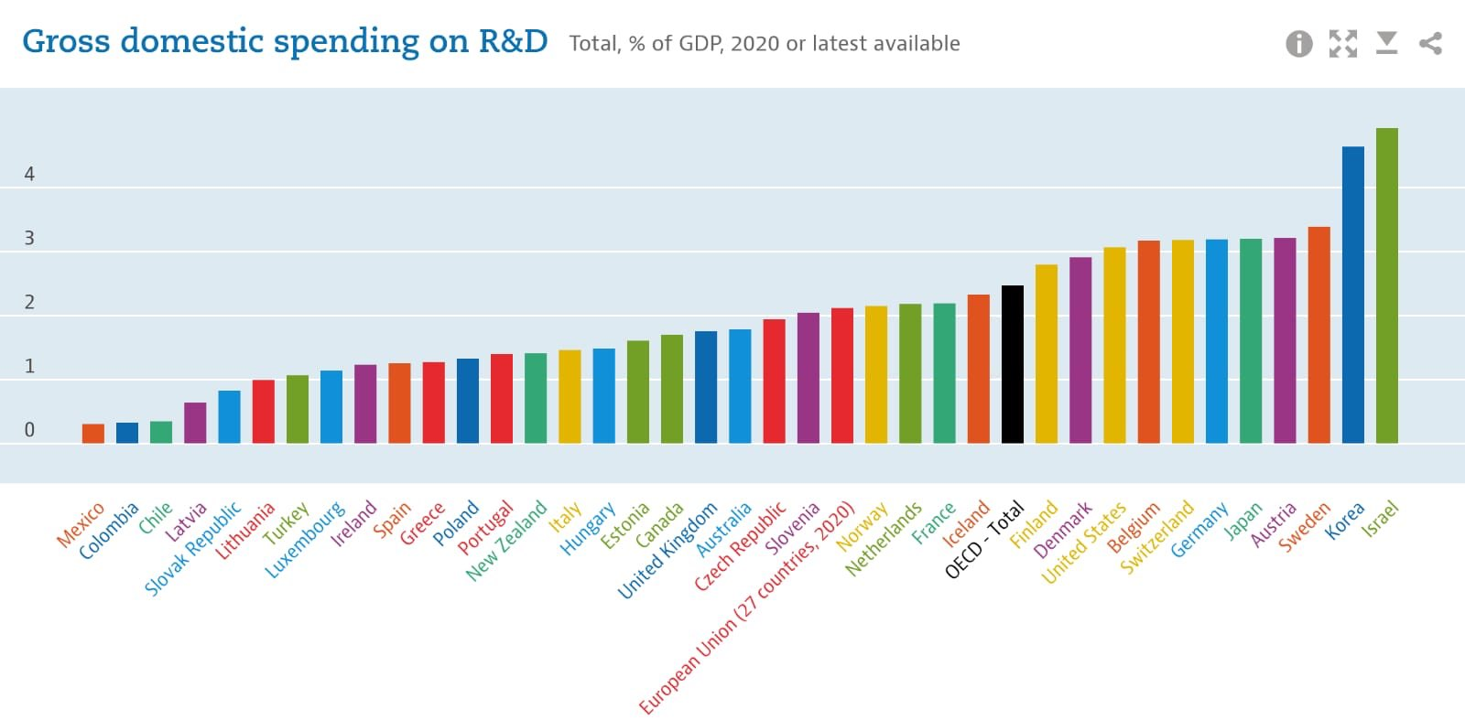
Effect of asymmetric conflict: reliance on education and technology

Slide 13
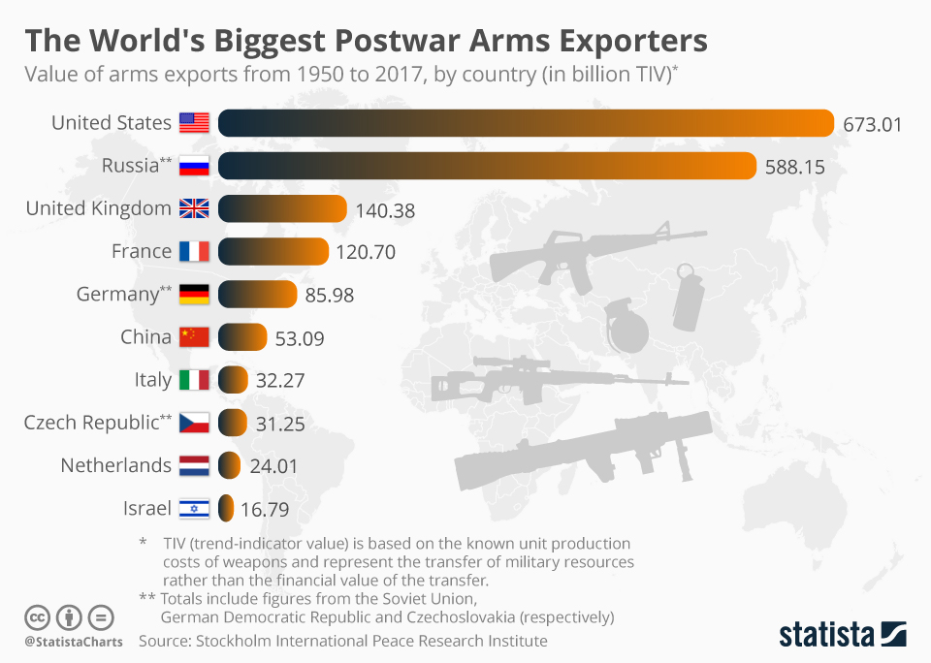
Effect of conflict with the region: arms industry

Slide 14
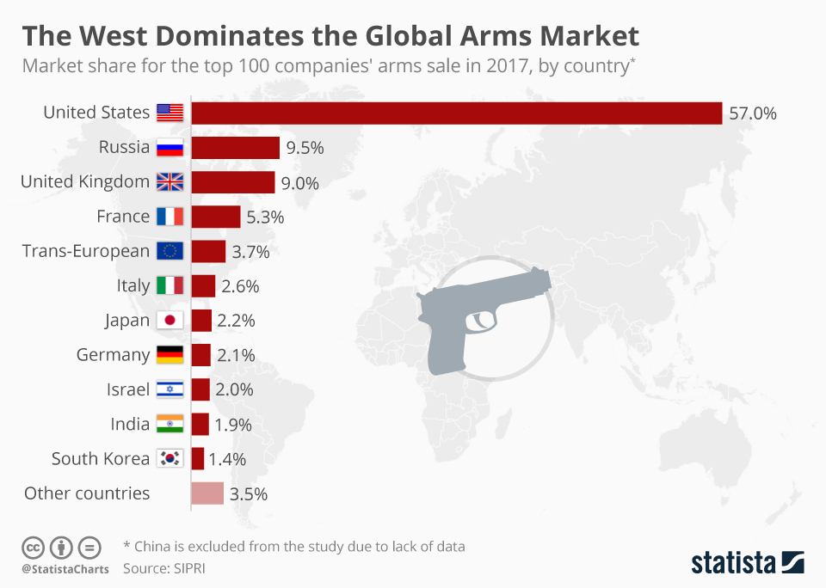
Effect of conflict with the region: arms industry

Slide 15
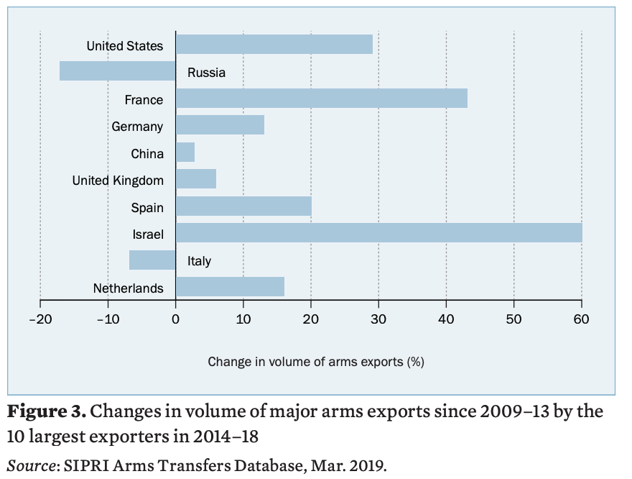
Effect of conflict with the region: arms industry

Slide 16
Challenges
Low participation in labor force
Demographic future
Two track economy
Inequality

