Slide 1
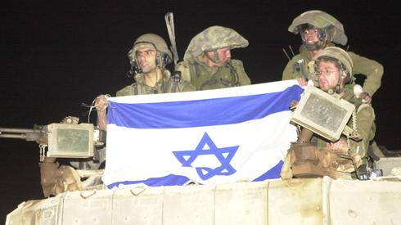
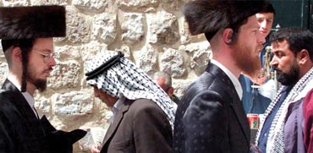
Israel: Politics, History and Society
Israel: Politics, History and Society
NDC
Dr. Ehud Eiran
8 Aug, 2022
Meeting 7
Gaza
Immigration and
Economy

Slide 2
Checking in? Current events

Slide 3
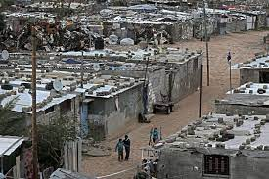
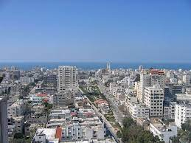
Gaza: A Brief History, current political and the immediate conflict

Slide 4
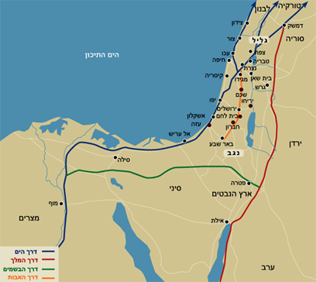

Slide 5
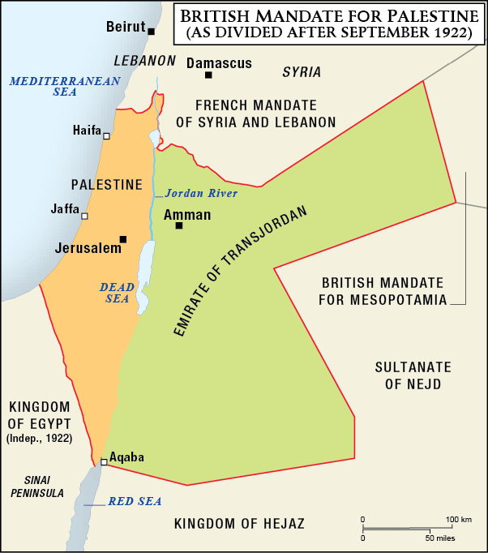
1917-1948: Part of the British Mandate over Palestine/Israel
1917-1948: Part of the British Mandate
over Palestine/Israel

Slide 6
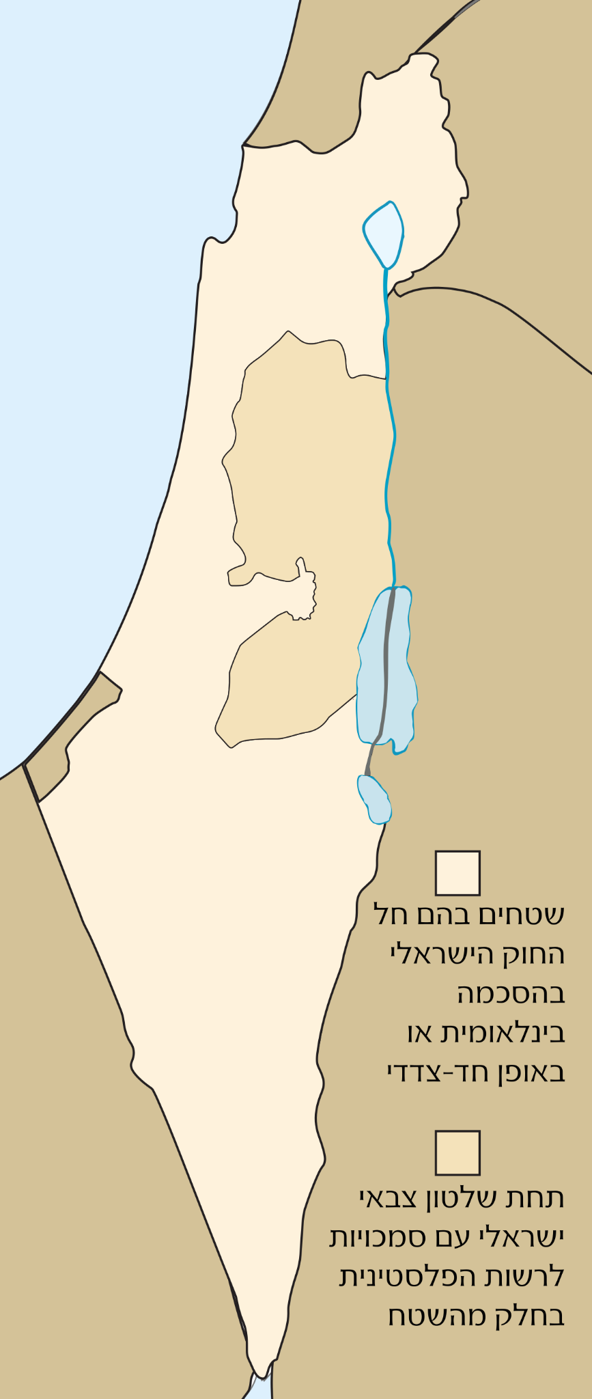

Slide 7
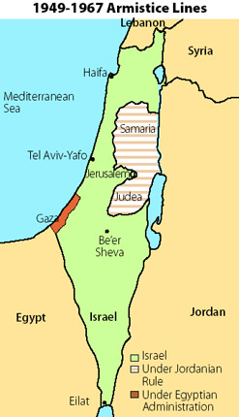
1949 (1950) Armistice line, and influx of refugees

Slide 8
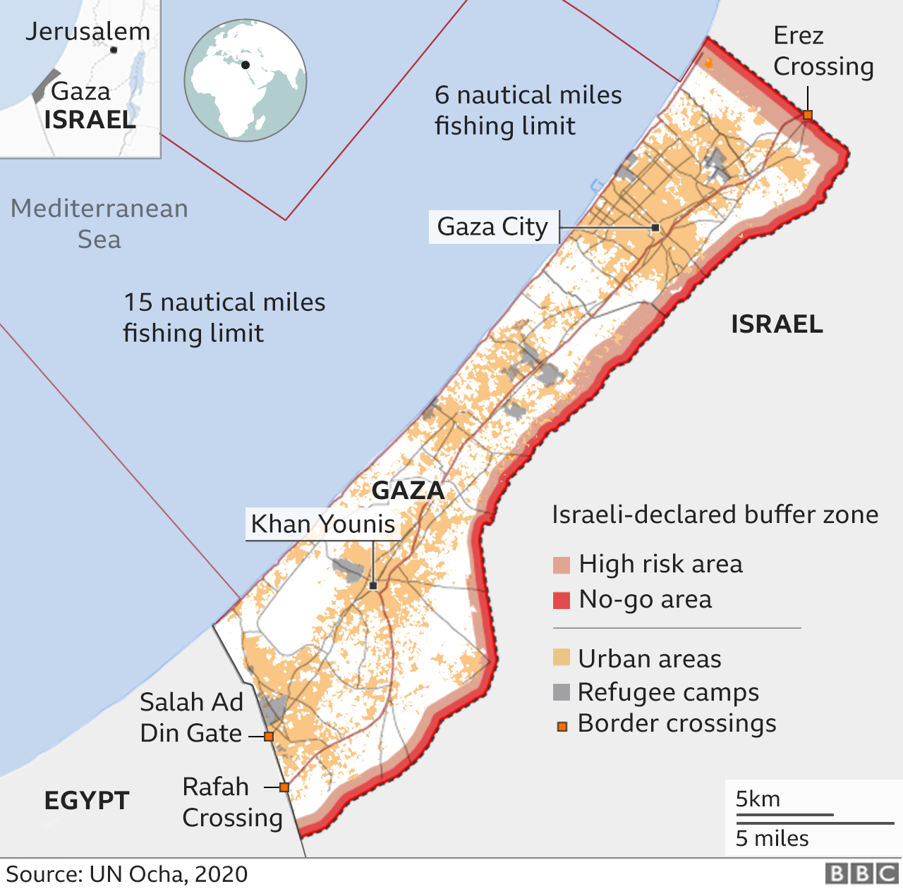

Slide 9
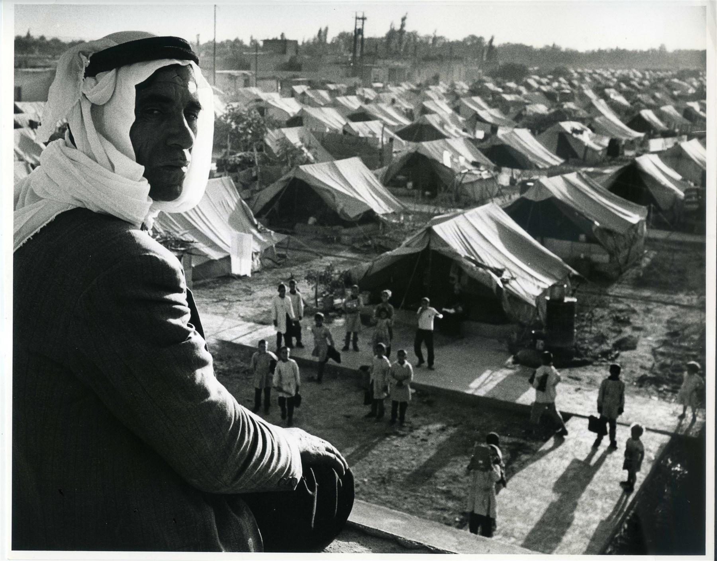
The Palestnain refugee problem

Slide 10
Israeli arguments:
Israeli arguments:
War time
All Jewish population was removed from Arab-controlled areas
Broader population exchanges (Jews from Arab nations)
Global population exchanges
They left on their own volition
Aran countries should absorb the refugees

Slide 11
Palestanin arguments
UN resolution 181 (1948): but requires “wishing to live in peace”)
Personal right
Jews have no right to the land

Slide 12
Solutions that were offered in peace talks
A menu options (Beilin-Abu-Mazeen talks 1990s)
Compensation
Return to Plestanin state
Return to areas in Israel that will be handed to Palestine
Third country resettlement
Limited family reunification

Slide 13
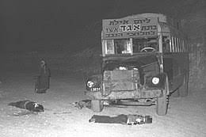
Early 1950s: Attacks from Gaza (and other places)

Slide 14
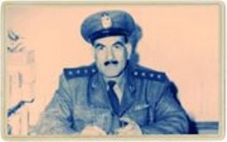
First Israeli Targeted assination: Gaza 1956

Slide 15
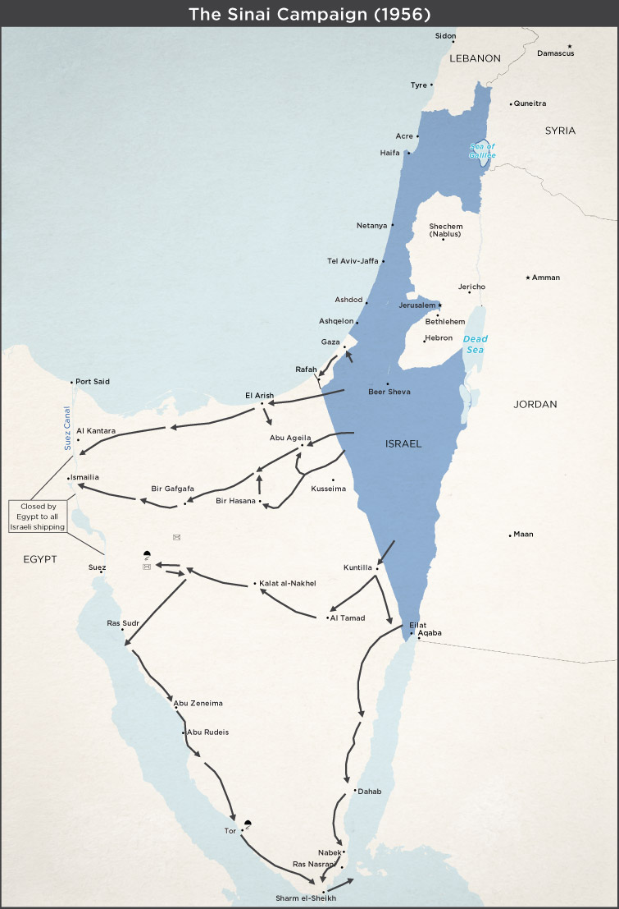
1956 War: Short Israeli control

Slide 16
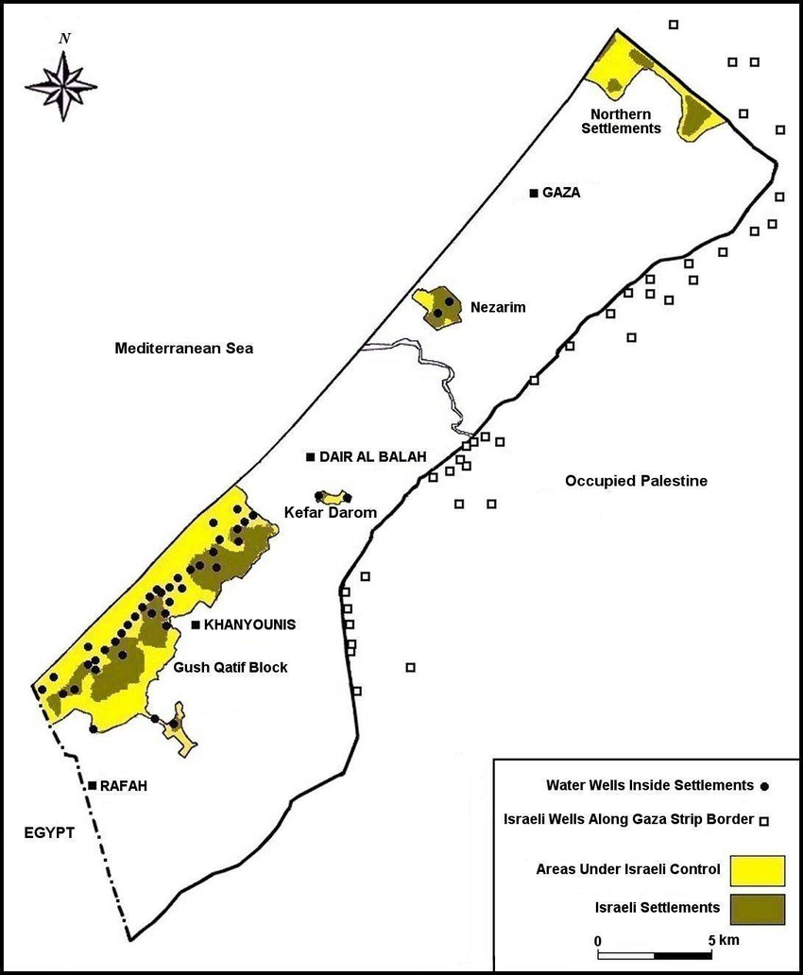
1967: occupation and settlement project

Slide 17
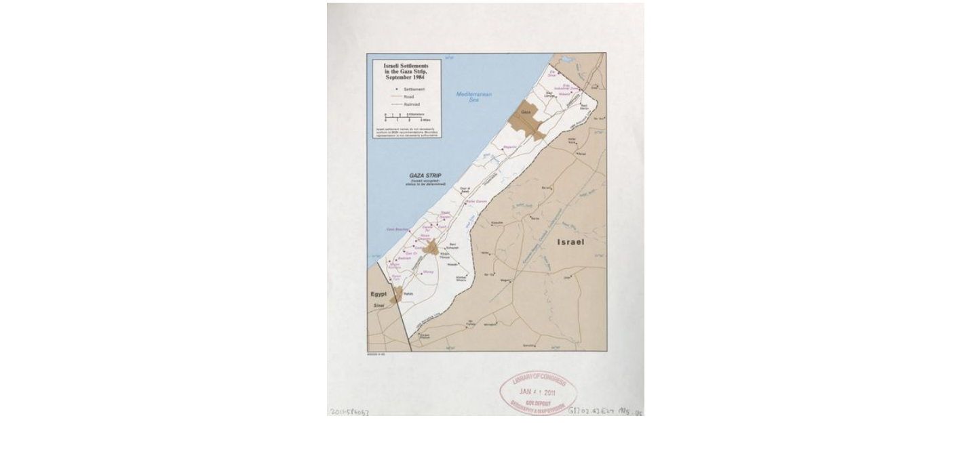
Oslo Accords

Slide 18
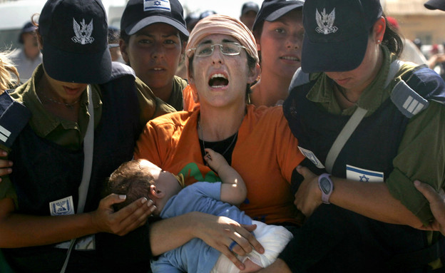
2005: Israel leaves Gaza

Slide 19
Hamas gains control over gaza

Slide 20
Armed clashes with Hamas
2008-2009: Cast Lead (3 weeks)
2012: Pillar of Defense (Amud Anan): 8 days
2014: Protective Edge (six weeks, began with kidnapping)
2021: Guardian of the Walls (Jerusalem)
2022: Breaking Dawn

Slide 21
Broad political situation
Hamas control
PA formal sovereign
PIJ competes with Hamas
Israel supplies the region + day workers in Israel
Funds from Qatar
Egypt’s role

Slide 22
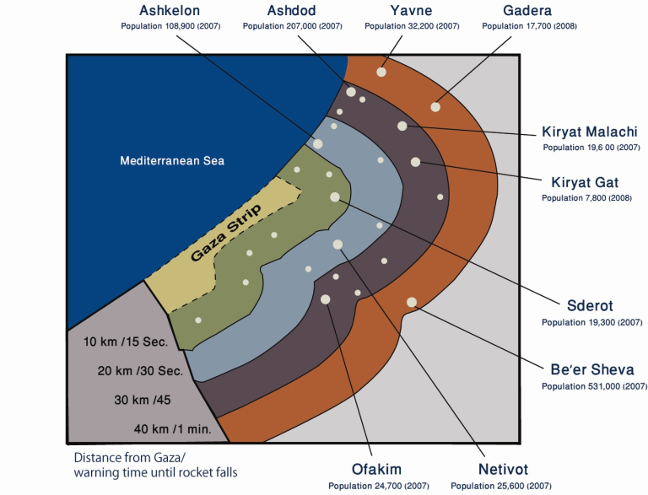

Slide 23
The internal Palestanin context
PA Vs. Hamas
Hama VS. Islamic Jihad

Slide 24
Palestinian Islamic Jihad

Slide 25
The internal israeli context
Elections are coming
Lapid’s status
Possible competition between PM and MOD

Slide 26
The regional context
PIJ - Iran and the resistance (Mukawama)
Egypt’s role
Qatar’s engagement
The rise of local mediators

Slide 27
The board military Questions
Deterrence
The disappearing enemy: non-state actor as an enemy
Fire vs. Maneuver

Slide 28
Back to immiggration

Slide 29
Pre - state immigration, and why matters ?
First wave: 1882-1905
Second wave: 1905-1917
Third wave: 1917-1920s
Fourth wave: 1924-1930s
Fifth wave: 1930s

Slide 30
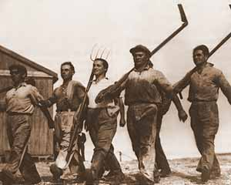
Shaped elites
Wave 2-3: led the state until 1974
Wave 1-3: Avant Garde, against all odds
Wave 2-3: revolutionary, experimental
(Kibbutz, family life, the work battalion
anti-religious ), self image as avant garde
Led and shaped the country: 1948-1977, 1977-1992

Slide 31
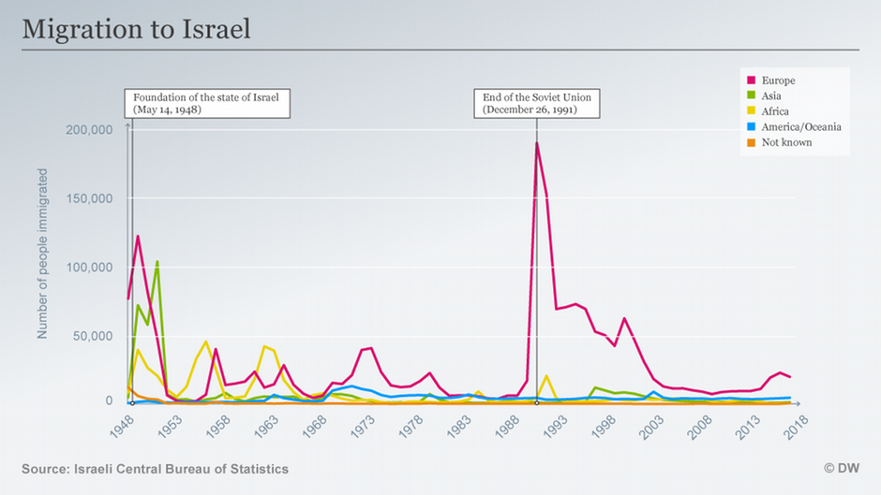

Slide 32
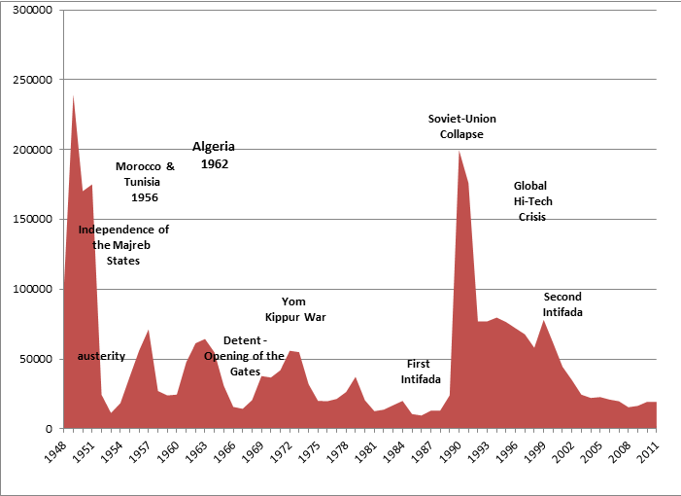

Slide 33
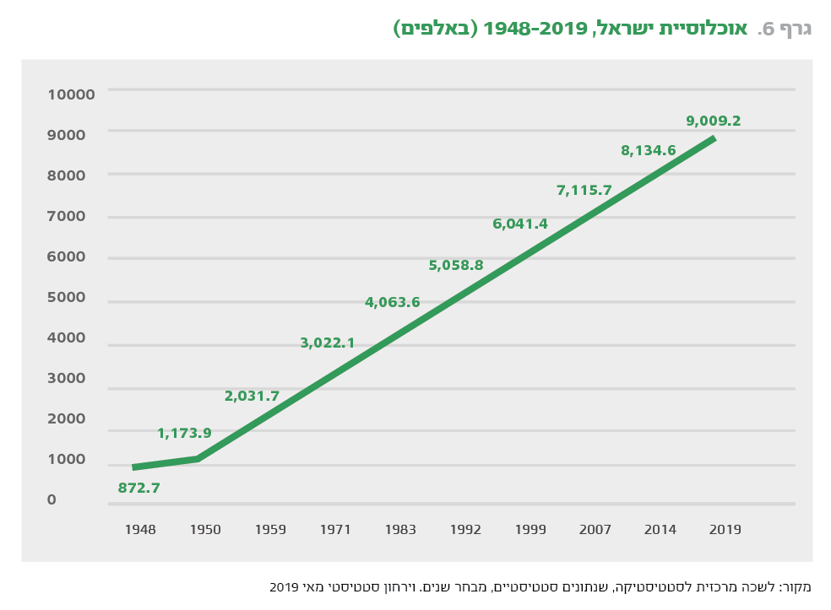

Slide 34
Effects on Israel
Constant growth
Challenge of national building
Know how from abroad: 1930s, 1990s
Mental map of a wider world
The possibility of moving away: 600K Israelis abroad
New ideas:

Slide 35
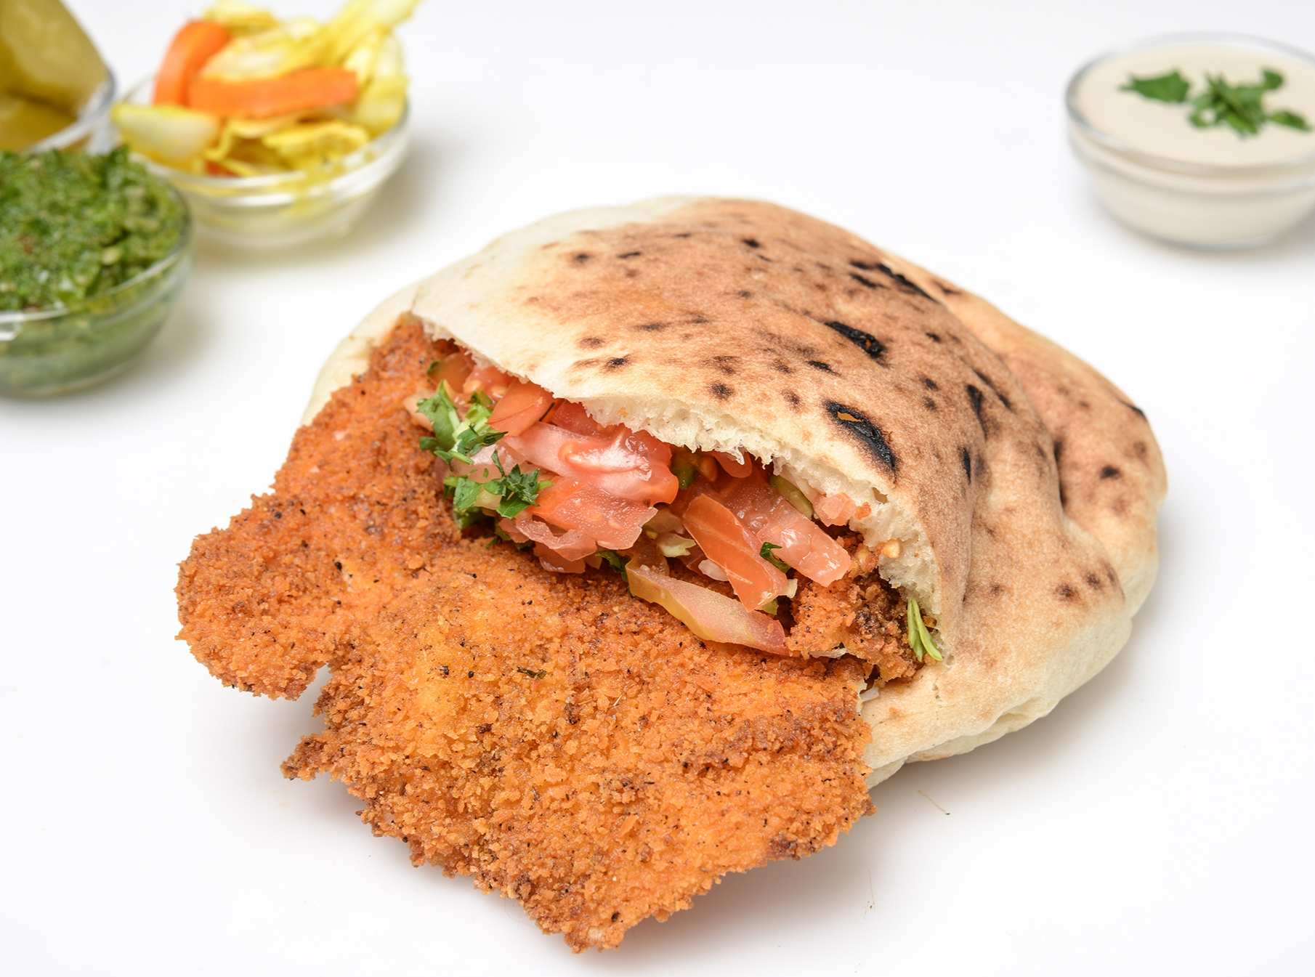

Slide 37
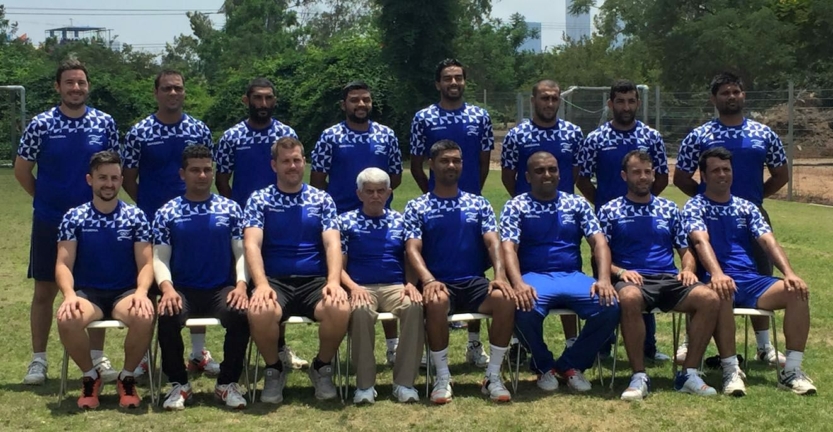

Slide 38
What are the social effects ?
Explains social structures:
First mover advantage
Dominance of Ashkenazim (16 out of 22 Chiefs of Staff. Until 1987 all European, all PMs)
Explains social tensions:
Between different waves of immigrants
Between different approaches to Judaism and tradition

Slide 39
Social tensions (Lul)
https://www.youtube.com/watch?v=msqZXJe-cFE

Slide 40
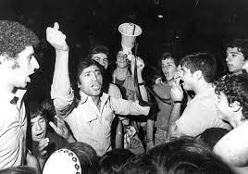
Israeli black panthers

Slide 41
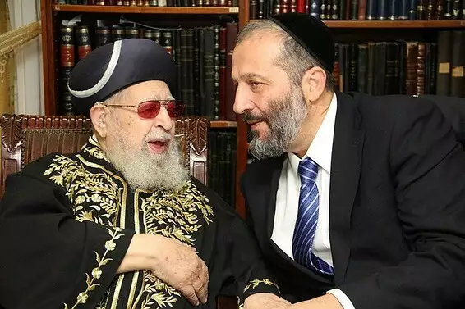
Shas: a traditional response

Slide 42
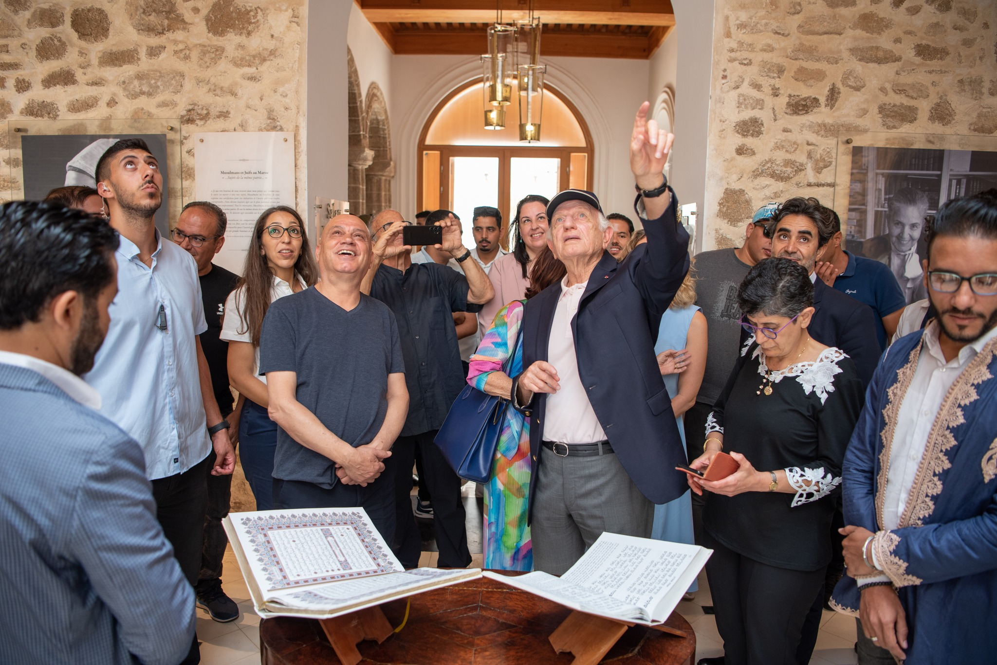
As a bridge to the Arab World

Slide 43
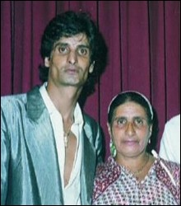
In the culture: Middle Eastern music - Zohar Argov
http://kol-hazamir.co.il/images/arti0102.jpg

Slide 44
Institutional
Law of return: what problems ?
Ministry of absorption
Jewish agency
Emissaries abroad
State effort: buying Jews - Morocco, Romania
Security establishment support immigration: Syria, Ethiopia, USSR (Nativ)

Slide 45
Ideological aspect
Aliya vs. Yerida
Rabin: Failed weaklings
Those who stayed against all odds
These who had a choice: what is at stake (kids, future, military, nation, Jewish continuity)
Decline in ideological discourse

