Slide 1
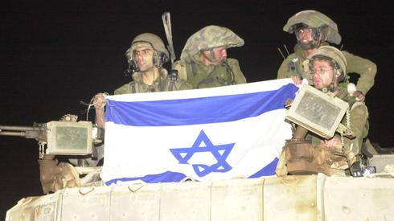
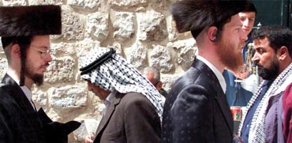
Israel: Politics, History and Society
Israel: Politics, History and Society
NDC
Dr. Ehud Eiran
1 Aug, 2022
Meeting 6
Immigration and
its legacy

Slide 2
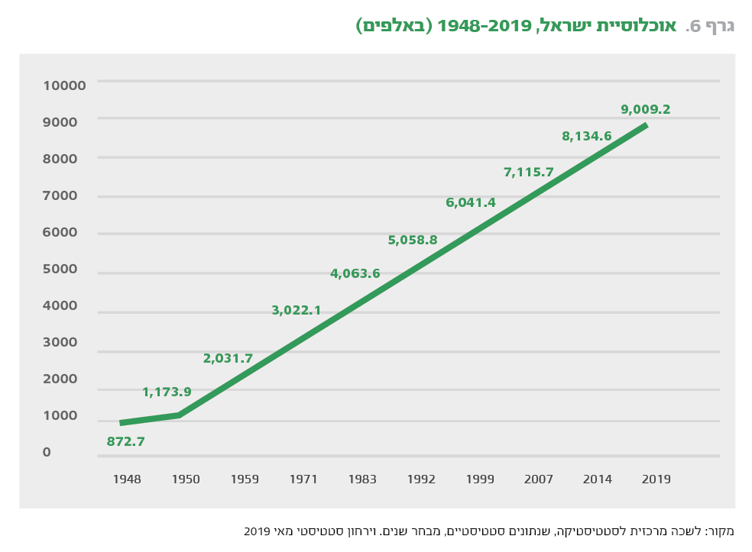

Slide 3
Why does immigration matter?

Slide 4
Pre - state immigration, and why matters ?
First wave: 1882-1905
Second wave: 1905-1917
Third wave: 1917-1920s
Fourth wave: 1924-1930s
Fifth wave: 1930s

Slide 5
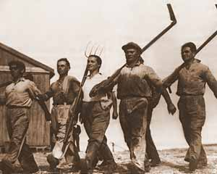
Shaped elites
Wave 2-3: led the state until 1974
Wave 1-4: Avant Garde, against all odds
Wave 2-3: revolutionary, experimental
(Kibbutz, family life, the work battalion
anti-religious ), self image as avant garde

Slide 6
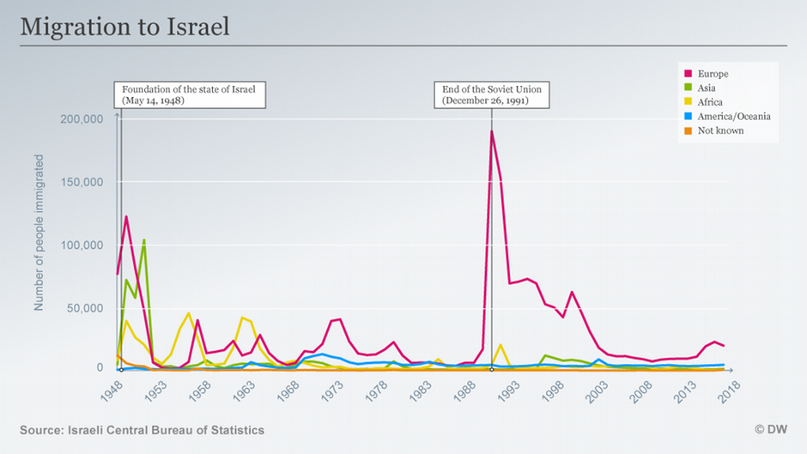

Slide 7
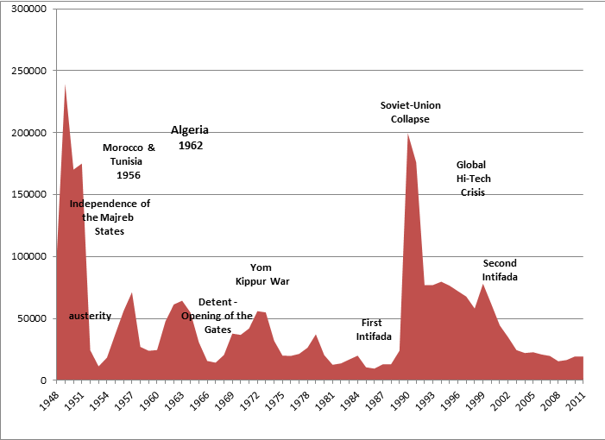

Slide 9
Effects on Israel
Constant growth
Challenge of national building
Know how from abroad: 1930s, 1990s
Mental map of a wider world
The possibility of moving away: 600K Israelis abroad
New ideas: Alice Miller,

Slide 13
What are the social effects ?
Explains social structures:
First mover advantage
Dominance of Ashkenazim (16 out of 22 Chiefs of Staff. Until 1987 all European, all PMs)
Explains social tensions:
Between different waves of immigrants
Between different approaches to Judaism and tradition

Slide 14
Social tensions (Lul)
https://www.youtube.com/watch?v=msqZXJe-cFE

Slide 15
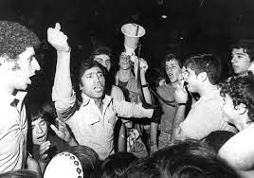
Israeli black panthers

Slide 16
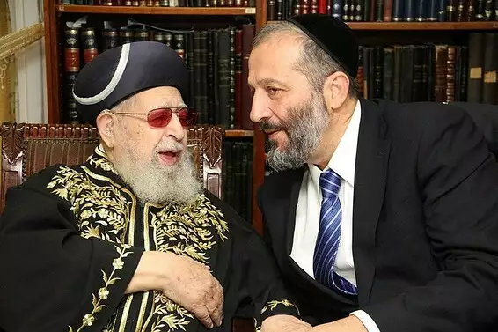
Shas: a traditional response

Slide 17
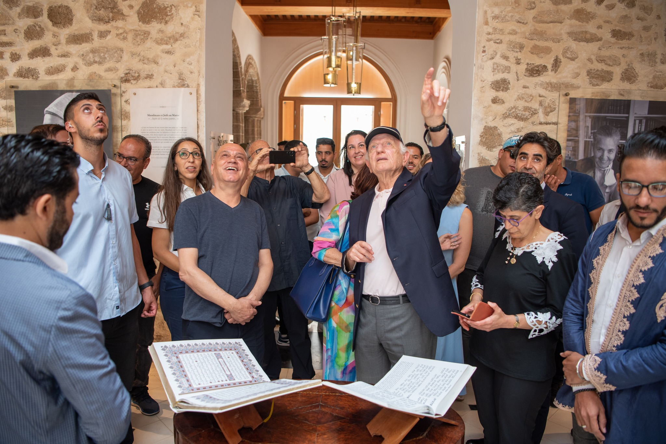
As a bridge to the Arab World

Slide 18
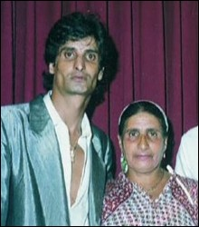
In the culture: Middle Eastern music - Zohar Argov
http://kol-hazamir.co.il/images/arti0102.jpg

Slide 19
Institutional
Law of return: what problems ?
Ministry of absorption
Jewish agency
Emissaries abroad
State effort: buying Jews - Morroc, Romania
Security establishment: Syria

Slide 20
Idologoal aspect
Aliya vs. Yerida
Rabin: Failed weaklings
Those who stayed against all odds
This who had a choice: what is at stake (kids, future, military, nation, Jewish continuity)
Decline in ideological discourse

