Slide 1
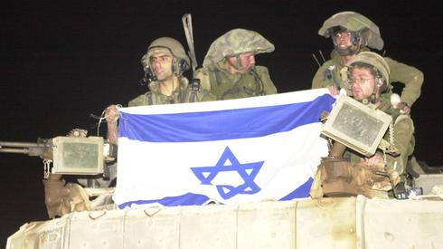
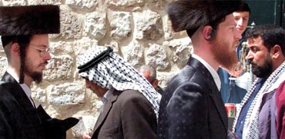
Israel: Politics, History and Society
Israel: Politics, History and Society
NDC
Dr. Ehud Eiran
1 Aug, 2022
Meeting 5
Holocaust
and Institutions

Slide 2
Questions/Current Affairs?
Degree in political science: an opportunity to reflect on your own systems
No grade
I am an academic, not government employee

Slide 3
Structure of this course:
Israel as an idea
How the idea was implemented?
Focus on one aspect of implementation: security

Slide 4
Israel as an Idea: Zionism
Jewish national movement
Goal: the creation and support of a Jewish national state in Eretz-Yisrael/Palestine,

Slide 5
Context
Security threat to Jews in Europe late 19th century: age old hatred and its modern forms (before the holocaust)
Rise of nationalism in Europe in the 19th century: various groups redefine themselves as nations:
A. excludes Jews,
B. allows Jews to think about themselves as a nation
Built on age-old yearning to “return”,

Slide 6
The triangle of Jewish values
People of Israel
Land of Israel Torah (religion)

Slide 7
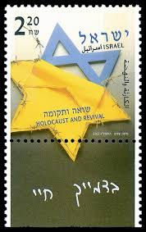
Ideas in light of the Holocaust

Slide 8
Holocaust: main issues?

Slide 10
Holocaust: Dramatic effect on the Jewish people
Physical destruction of some 6 million Jews out of 16. 6 Million
End of a millenium in which Europe as center of Jewish life
Centers moved to US, Israel

Slide 11
Holocaust and the idea of Zionsim
Significant event, but not the main reason for Zionism, or its evolution
By 1939: 450K Jews in the land (25-30% of the population)
Zionism settlement: 1882
Zionist Institutions: 1897
Zioonist Institutions in the land: 1910s

Slide 12
The shadow of the Holocaust 1
Both proves Zionism’s 19th century claims, but also its failure to evolve early enough
Personal trauma for many, including second and third generation
Very much present in the public sphere
A central part of the way this country views itself

Slide 13
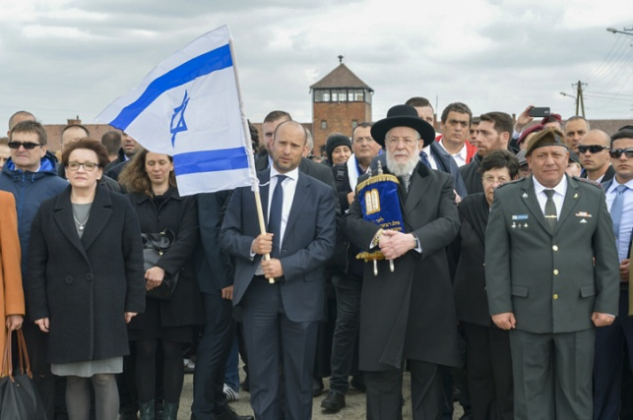

Slide 14
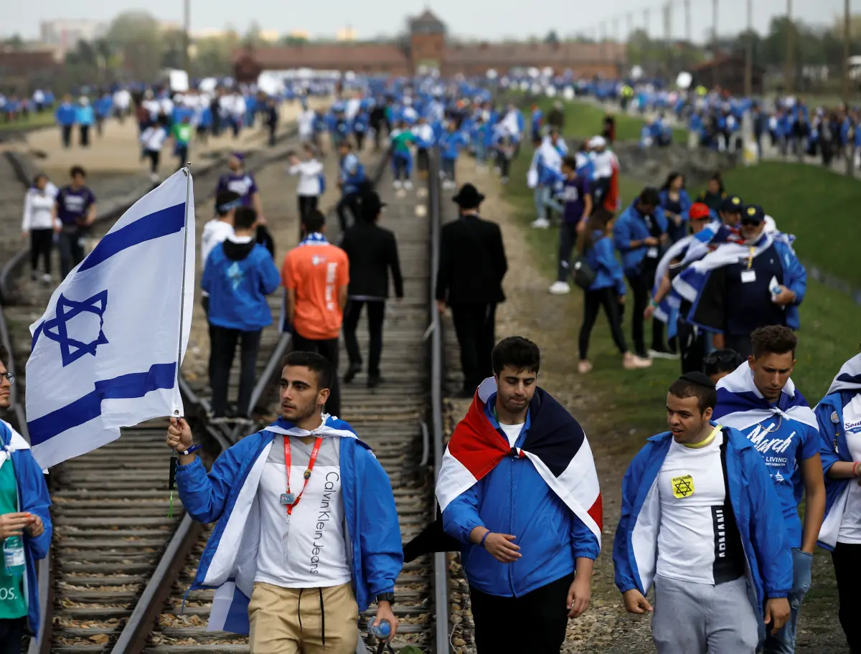

Slide 15
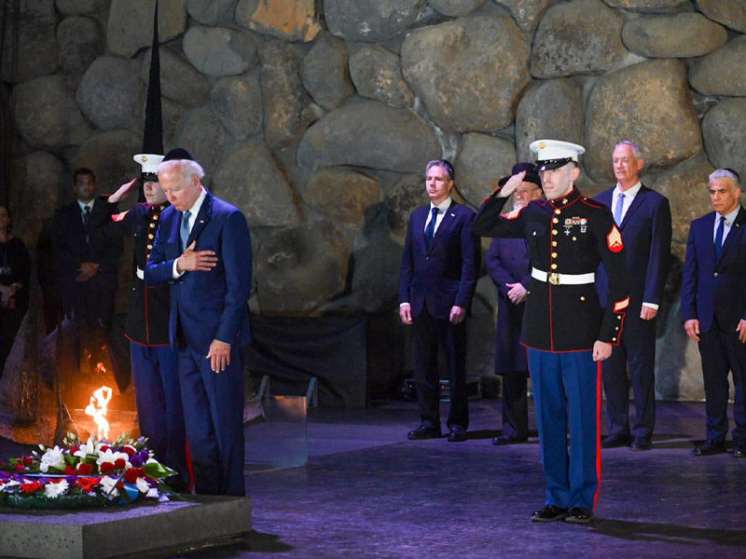
President Biden, July 13, 2022

Slide 16
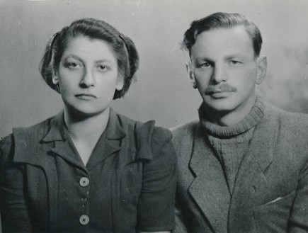
The shadow of the Holocaust 2
Justifies the centrality of power/security/military: Never again

Slide 17
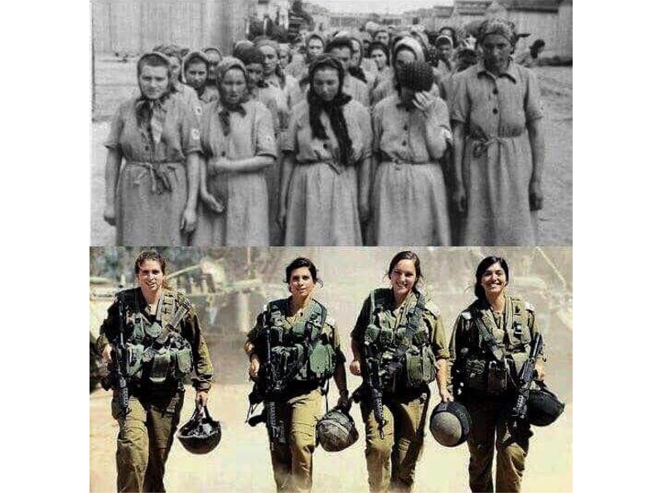

Slide 18
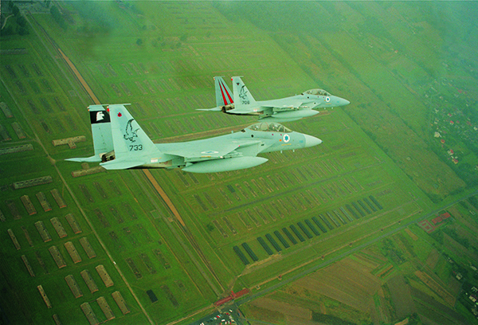
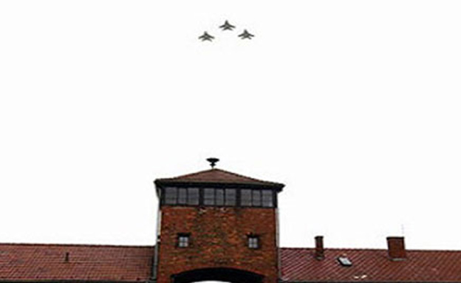
IAF above Auschwitz

Slide 19
Shadow of the Holocaust 3: A lens to understanding current realities
Menachem Begin: Lebanon, assistance to Vietnam refugees
Netanyahu and Iran

Slide 20
Netanyahu speech
https://www.youtube.com/watch?v=m-_nD7Z9cGI

Slide 21
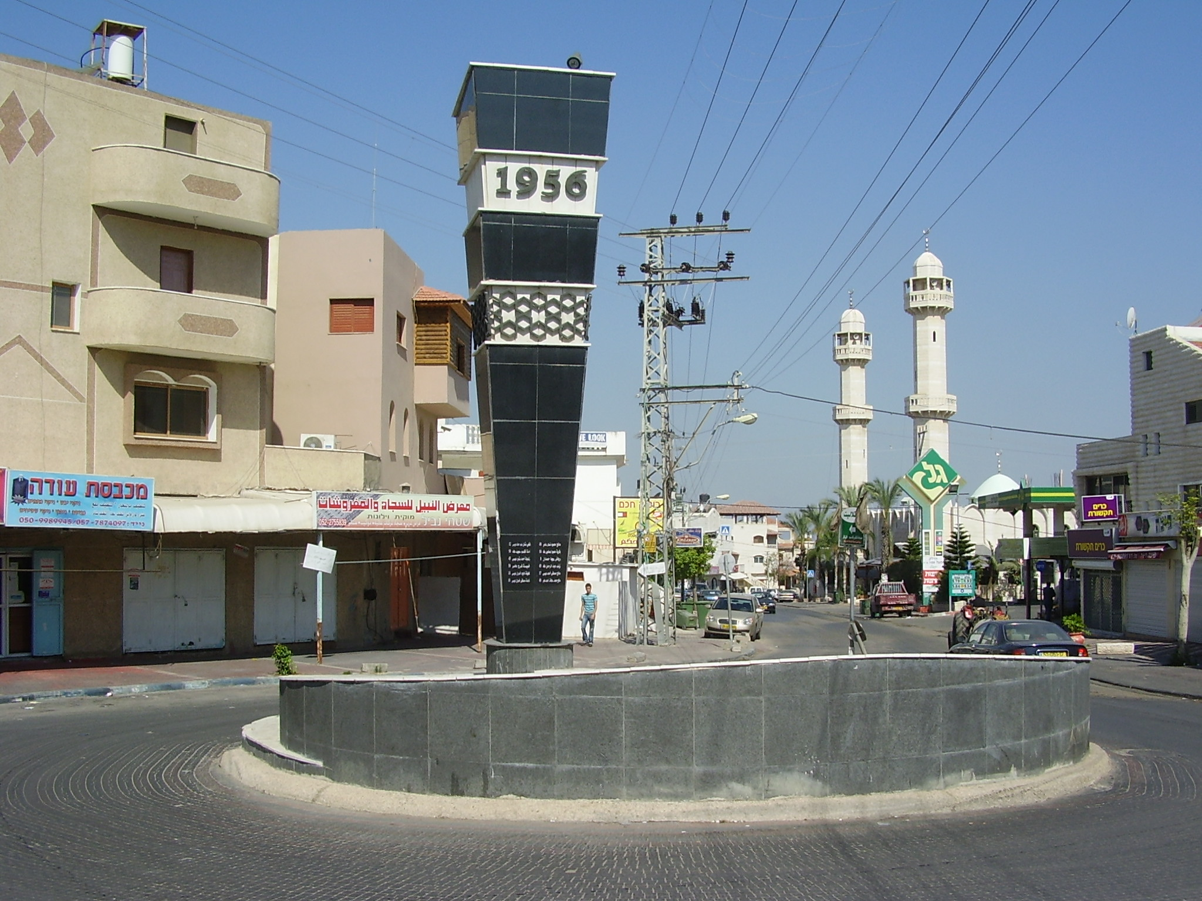
The shadow of the Holocaust 4
Forces a moral debate: possible clash with other lesson of human rights
The black flag of illegality

Slide 22
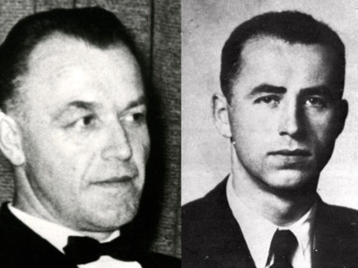
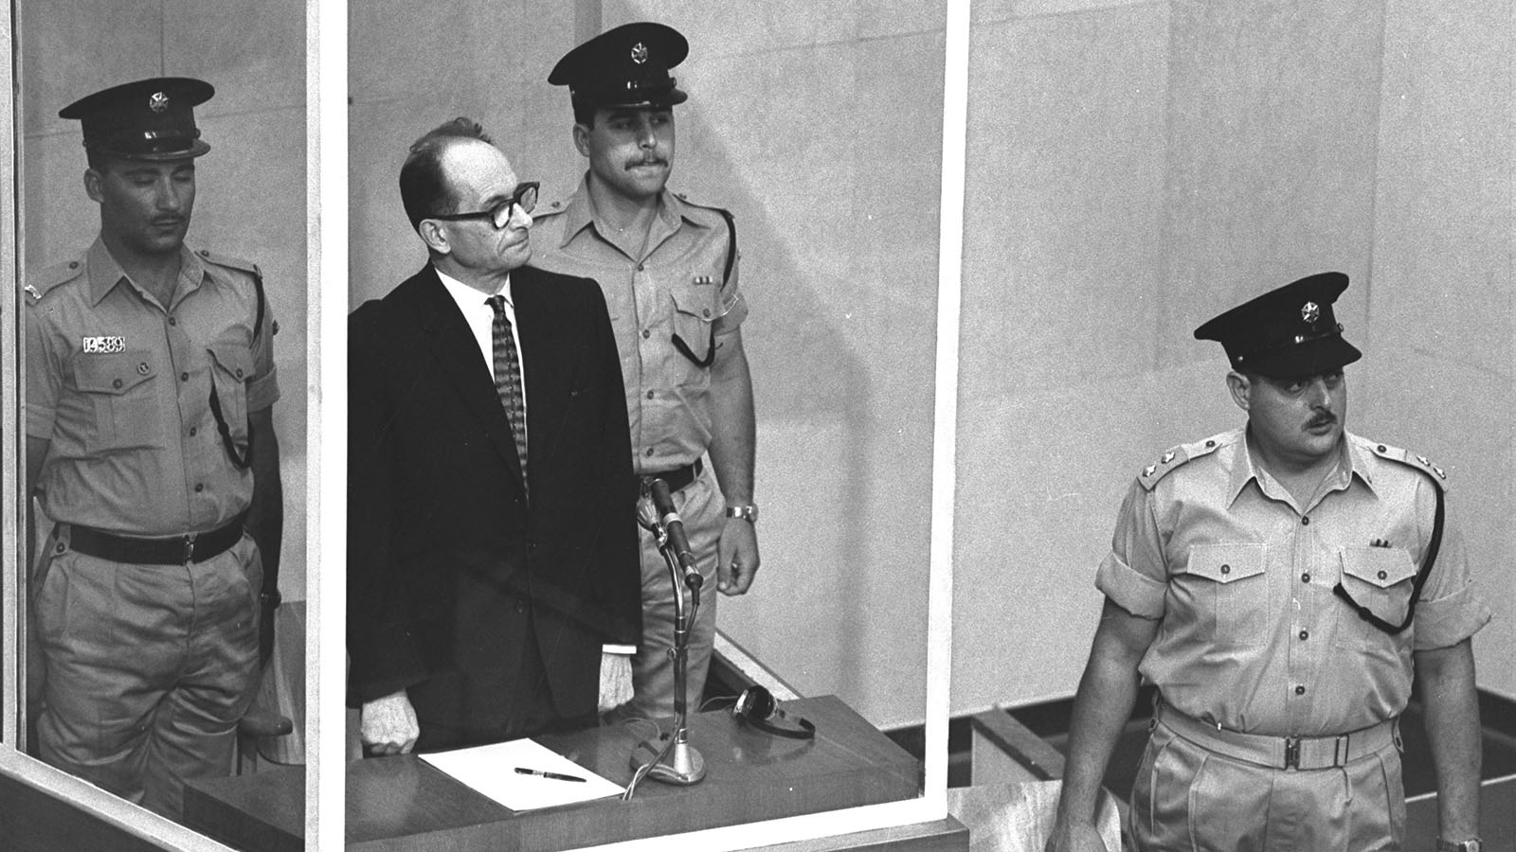
The shadow of the Holocaust 5
Informs some aspects of Israeli security

Slide 23
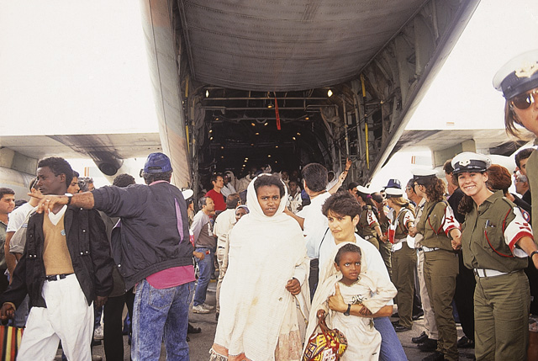
Operation Solomon (1991): Russia ?

Slide 24
But: self critical voice: can’t just focus on being a victim
https://www.youtube.com/watch?v=HEedHjsKZJs&t=141s

Slide 25
From ideas to implementation: What are possible effects ?

Slide 26
From ideas to implementation:
Debates about ideas matter (Kohelet, Tikvah Fund)
Room for entrepreneurs, competition
Much of the ideational debate: within camps
Constant change
Many of the arrangements: open-ended
Ideas: some borrowed and adapted from other places
Not oo rosy…shallow public discussion

Slide 27
Institutions:Looking through a Historical institutionalism angel
Centralized political project
Leading multiple parties

Slide 28
Israel’s political Institutions draw on two sources
The Pre-state Zionism Institutions
The institutions that evolved in Israel/Palestine under the British Mandate

Slide 30
A strong executive: Prime Minister
How do you get elected ?
Short experiment with direct vote
The authority is with the cabinet

Slide 31
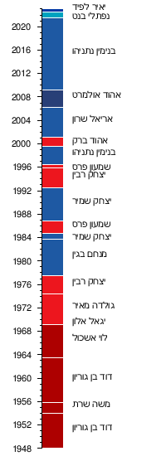

Slide 32
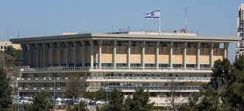
Legislature: the Knesset

Slide 33
HI: Pre state Zionist movment
Voluntary
No real power
N real assets
Competing ideas
Therefore: inclusive, low threshold

Slide 35
Three periods
1948-1977: one dominant party (left: labor)
1980s-1990s’: Two major parties (Likud and Labor)
2000s: Likkud biggest party, medium centric party, weakening of Israeli left
2021: Arab (Islamist!) party in coalition

Slide 36
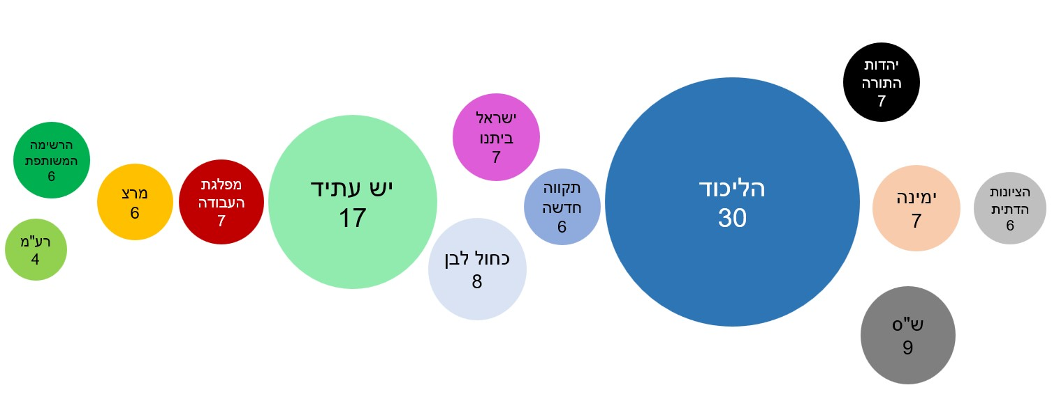
24th Knesset

Slide 37
What are the divisions about ?
West Bank
Socio-economic (?)
Undercurrents:
Universal vs, ethnocentric
traditional elite vs. new elites

Slide 38
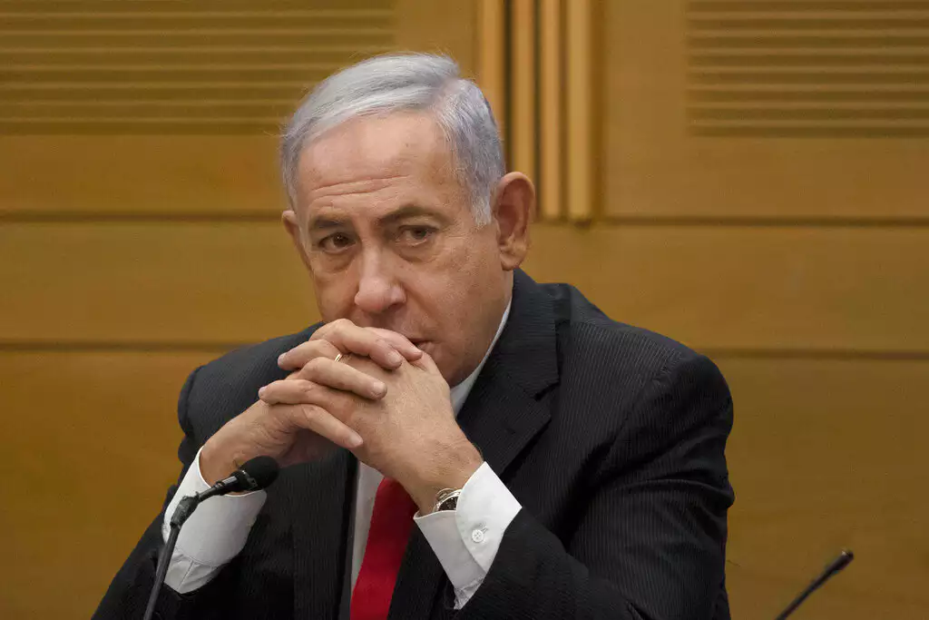

Slide 39
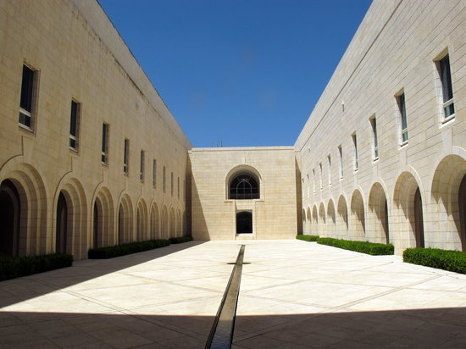
The Judiciary: The Supreme Court

Slide 40
Supreme Court
Court of last resort
Bagatz: defendor of rights
Since the 1990s: more powerful, die to gridlock, but more politicized

Slide 41
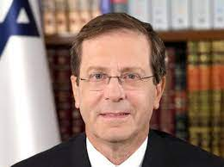
President: Head of state

Slide 42
Summarize evolution
Excutive/Legslature: Affected by Pre-Zionist institutions
Changed over time in response to security challenge
Judicial branch: British system, changed in israeli context, got stronger due to political gridlock in the 1980s

