Slide 1
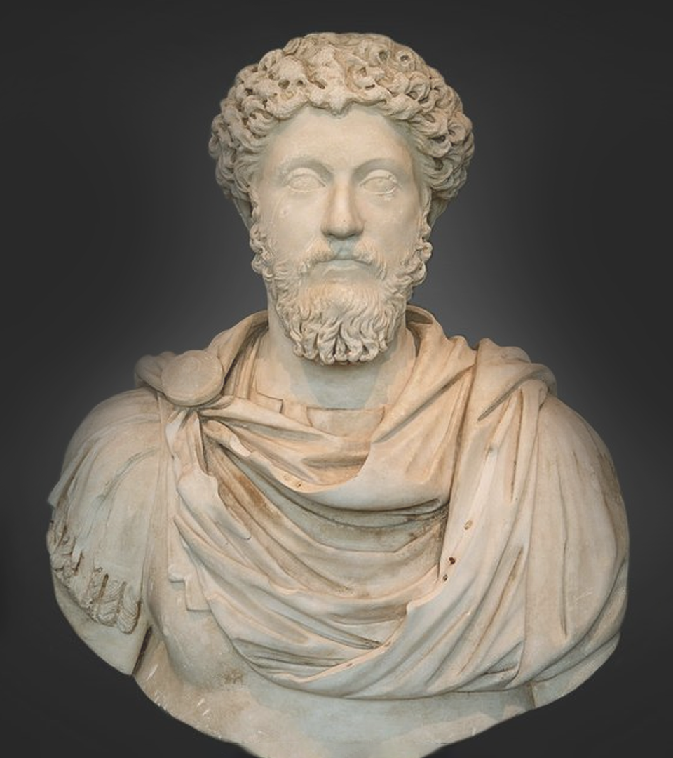

Strategic
Thinking
Strategy as designing, planning and executing (institutional learning and implementation)

Slide 2
Reading Material
Mandatory
Grove, S. Andrew. Only the Paranoid Survive. Crown Business, 1999, pp. 13-17, 35-43
Dr. Lanir Zvi. Relevance Gap (a chapter from a book that will soon be published.) (4 pages)
The Pentagram as a Cognitive Framework for Operative Investigation / Brigadier Generals Course
“Strategic Safari”

Slide 3
Strategic Studies Road Map
Strategic Thought
Prof. Dima Adamsky
Strategic Thinking
MG Amir Baram
Design Approach
“Dado Center”
First Experience
Northern Arena
Second Experience
The Israeli-Palestinian Conflict
Third Experience
A Tour and an Inquiry of the East
Public Corporate Strategy
The development of military strategic thought
Conceptualization and levels of action
Systematic inquiry as a methodology to a design a strategy
Background and references
Background and references
Background and references
The “evolution” of strategic thinking in the corporate world
The history of strategic thought and the development of conventional warfare
Strategic thinking challenges and competing approaches
Systematic inquiry as a methodology to a design a strategy
Experiencing the Design Approach
Experiencing the Design Approach
Tour to the East
New approaches
The history of strategic thought at the age of hybrid warfare
“Bulgaria” case study
Experience – Inquiring the relevance gap
Summary
Lifting of the veil summary
Summery
Diffusion of strategic thinking into the public sector
The history of strategic thought in the nuclear era
“Systems”: systematic thinking, complex system and the systematic level
Tasting menu.
A survey of the arsenal of tools used to support strategy
Intelligence diagnosis and strategic planning
Processing
Presentation, competition and discussion
Real life scenario
Russian strategy
Strategy as designing, planning and executing (institutional learning and implementation)
Case studies from the experience of senior officials

Slide 4
Strategic Studies Road Map
Strategic Thought
Prof. Dima Adamsky
Strategic Thinking
MG Amir Baram
Design Approach
“Dado Center”
First Experience
Northern Arena
Second Experience
The Israeli-Palestinian Conflict
Third Experience
A Tour and an Inquiry of the East
Public Corporate Strategy
The development of military strategic thought
Conceptualization and levels of action
Systematic inquiry as a methodology to a design a strategy
Background and references
Background and references
Background and references
The “evolution” of strategic thinking in the corporate world
The history of strategic thought and the development of conventional warfare
Strategic thinking challenges and competing approaches
Systematic inquiry as a methodology to a design a strategy
Experiencing the Design Approach
Experiencing the Design Approach
Tour to the East
New approaches
The history of strategic thought at the age of hybrid warfare
“Bulgaria” case study
Experience – Inquiring the relevance gap
Summary
Lifting of the veil summary
Summery
Diffusion of strategic thinking into the public sector
The history of strategic thought in the nuclear era
“Systems”: systematic thinking, complex system and the systematic level
Tasting menu
A survey of the arsenal of tools used to support strategy
Intelligence diagnosis and strategic planning
Processing
Presentation, competition and discussion
Real life scenario
Russian strategy in the Middle East
Strategy as designing, planning and executing (institutional learning and implementation)
Case studies from the experience of senior officials

Slide 5
Strategic
Strategy as designing, planning
and executing
Thinking
Required Achievements
What lies between “designing” and “planning”
Summarizing strategy as a learning process
1
2
3
4
5
What lies between the “ten-fold change” and strategic turning point, and the relevancy gap and strategic offset
Systematic inquiry as a feasible practice

Slide 6
Strategic
Strategy as designing, planning
and executing
Thinking
Required Achievements
What lies between “designing” and “planning”
Summarizing strategy as a learning process
1
2
3
4
5
What lies between the “ten-fold change” and strategic turning point, and the relevancy gap and strategic offset
Systematic inquiry as a feasible practice

Slide 7
5 Required Achievements
Getting acquainted with systematic inquiry and its components (key definitions)
Understanding the relations between design and planning and the relations between strategy and campaign
Presenting systematic inquiry as a cognitive tool through which it is possible to transfer from an unexamined and emerging situation, to a systematic understanding (“orientation”)

Slide 8
5 Required Achievements
Knowing when an inquiry needs to be done (self awareness and institutional culture), in face of the question – how does one implement a systematic inquiry
Summarizing strategy as an emerging process of learning

Slide 9
Strategic
Strategy as designing, planning
and executing
Thinking
Required Achievements
What lies between “designing” and “planning”
Summarizing strategy as a learning process
1
2
3
4
5
What lies between the “ten-fold change” and strategic turning point, and the relevancy gap and strategic offset
Systematic inquiry as a feasible practice

Slide 10



What lies between the “ten-fold change” and strategic turning point, and the relevancy gap and strategic offset
Time
The firm takes off to new heights
Reality
Offset
The firm declines
Strategy
Strategic turning point
Consciousness
Offset/surprise
Conception gap
Meta-conception
Cognitive biases affirmation
Gap in awareness

Slide 11
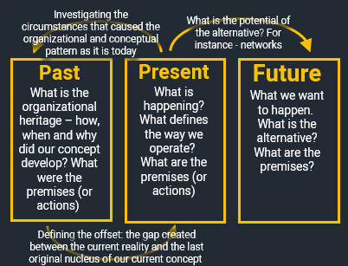
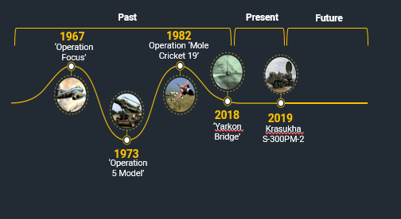
What lies between the “ten-fold change” and strategic turning point, and the relevancy gap and strategic offset
The change is constant (linear or emerging and chaotic)
Strategic pattern in face of strategic drifting

Slide 12
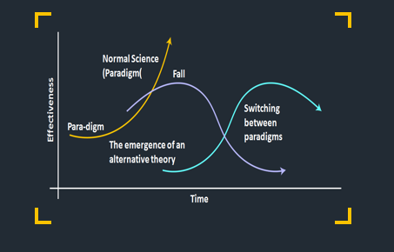

What lies between the “ten-fold change” and strategic turning point, and the relevancy gap and strategic offset
Conceptual change as a risk and an opportunity
The transition phase between two strategic concepts

Slide 13
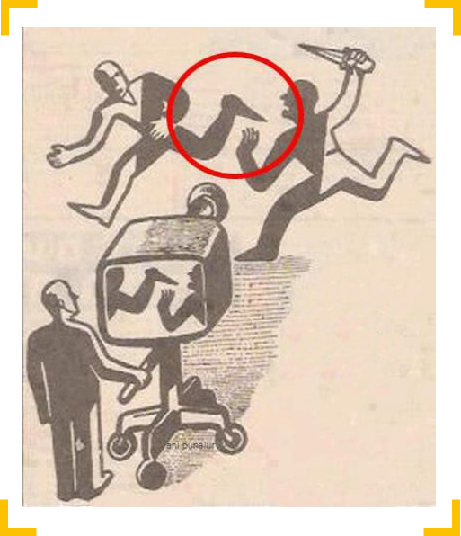
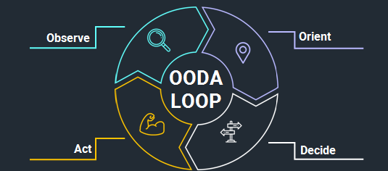
What lies between the “ten-fold change” and strategic turning point, and the relevancy gap and strategic offset
The change on its own offset
Embarrassment and “orientation”

Slide 14
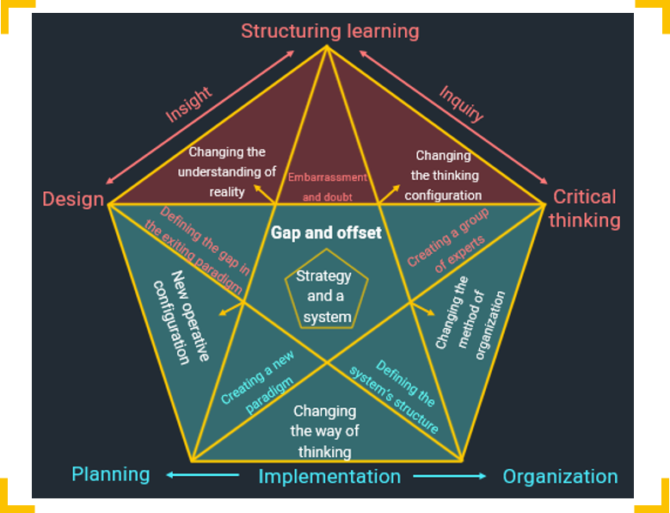
What lies between the “ten-fold change” and strategic turning point, and the relevancy gap and strategic offset
The response approach

Slide 15
Strategic
Strategy as designing, planning
and executing
Thinking
Required Achievements
What lies between “designing” and “planning”
Summarizing strategy as a learning process
1
2
3
4
5
What lies between the “ten-fold change” and strategic turning point, and the relevancy gap and strategic offset
Systematic inquiry as a feasible practice

Slide 16
What lies between “designing” and “planning”
“A problem of design continues to emerge as long as it is nourished and treated for, because the understanding of what needs to be accomplished and the ways of doing so, are constantly changing.”
Horst Rittel

Slide 17
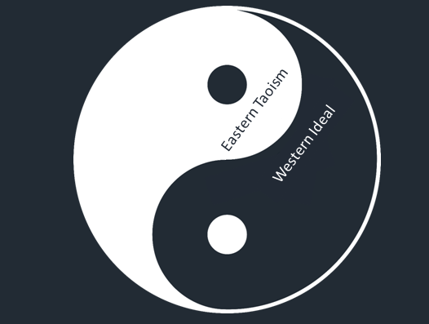
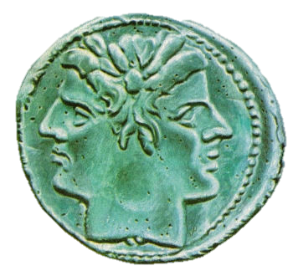
10 sayings on the distinction between “designing” and “planning”
The way of dealing with the “problem”
Paradigm
Thinking patterns
Type of “product”
The language
Procedure
What does the need stem from
Characteristics of learning
The process of learning
Summary
Planning
Designing

Slide 18
Strategic
Strategy as designing, planning
and executing
Thinking
Required Achievements
What lies between “designing” and “planning”
Summarizing strategy as a learning process
1
2
3
4
5
What lies between the “ten-fold change” and strategic turning point, and the relevancy gap and strategic offset
Systematic inquiry as a feasible practice

Slide 19



Systematic inquiry as a feasible practice
Gap
and
offset

Slide 20


Systematic inquiry as a feasible practice
Gap
and
offset

Slide 21
Systematic inquiry as a feasible practice
Structuring learning
Insight
Inquiry
Design
Critical thinking
Gap
and
offset
Planning
Implementation
Organization

Slide 22
Systematic inquiry as a feasible practice
Structuring learning
Insight
Inquiry
Curiosity
and skepticism
Design
Critical thinking
Defining the gap in the exiting paradigm
Gap
and
offset
Creating a group of experts
Creating a new paradigm
Defining the system’s structure
Planning
Implementation
Organization

Slide 23

Systematic inquiry as a feasible practice
Structuring learning
Insight
Inquiry
Changing the understanding of reality
Changing
the thinking configuration
Embarrassment and doubt
Design
Critical thinking
Defining the gap in the exiting paradigm
Creating a group of experts
Gap
and offset
פער
והיסט
Changing the method of organization
New operative configuration
Creating a new paradigm
Defining the system’s structure
Changing the way of thinking
Planning
Implementation
Organization

Slide 24

Systematic inquiry as a feasible practice
Structuring learning
Insight
Inquiry
Changing the understanding of reality
Changing
the thinking configuration
Embarrassment and doubt
Design
Critical thinking
Gap and offset
Creating a group of experts
Defining the gap in the exiting paradigm
Strategy
and a
system
Changing the method of organization
New operative configuration
Creating a new paradigm
Defining the system’s structure
Changing the way of thinking
Planning
Implementation
Organization

Slide 25
Systematic inquiry as a feasible practice
Reality changes and flows
Operation as involvement and affect on reality
Relevancy gap and offset awareness
The customary strategy
The Systematic Inquiry Model
Translation
Systematic Inquiry
Understanding the problem and defining the system and its boundaries
Systematic strategy
Contrasting
The system and campaign
Initial strategy

Slide 26
Systematic inquiry as a feasible practice
Structuring learning
Insight
Inquiry
Changing the understanding of reality
Changing
the thinking configuration
Embarrassment and doubt
Design
Critical thinking
Gap and offset
Creating a group of experts
Defining the gap in the exiting paradigm
Strategy
and a
system
Changing the method of organization
New operative configuration
Creating a new paradigm
Defining the system’s structure
Changing the way of thinking
Planning
Implementation
Organization

Slide 27
Systematic inquiry as a feasible practice
Reality changes and flows
Operation as involvement and affect on reality
Relevancy gap and offset awareness
The customary strategy
The Systematic Inquiry Model
Translation
Systematic Inquiry
Understanding the problem and defining the system and its boundaries
Systematic strategy
Contrasting
The system and campaign
Initial strategy

Slide 28
Systematic inquiry summary
Systematic inquiry might allow us to avoid “messing around” in an abstract and flowing world, to define the system and its boundaries, locate the gap in relevancy and formalize a new strategy
Systematic inquiry is a process of thinking (through social interaction), which has the potential to understand reality in a better way

Slide 29
Strategic
Strategy as designing, planning
and executing
Thinking
Required Achievements
What lies between “designing” and “planning”
Summarizing strategy as a learning process
1
2
3
4
5
What lies between the “ten-fold change” and strategic turning point, and the relevancy gap and strategic offset
Systematic inquiry as a feasible practice

Slide 30
Strategy as a learning process
11 concluding sentences
Learning as change
Because reality is constantly changing (in a non-linear way) and with it – us as well, new knowledge structures are created all the time, and with the continued emergence of the reality, they become irrelevant
Strategy = learning as a mechanism for the creation of new knowledge
Considering the gap will never close, learning is thus a critical mechanism that allows us to indentify the change

Slide 31

Strategy as a learning process
11 concluding sentences
The idea of ‘wholeness’ within systems requires us to draw boundaries
A conduct of learning as institutional DNA
An internal ability that expresses the organizational ability to reacquaint (conceptually), reorganize (structurally) and act (operatively)

Slide 32
Strategy as a learning process
11 concluding sentences
The architect metaphor
Debates will encourage ‘visible thinking’
Linear discussion will lead to concrete decisions
“learning about learning”
is stopping the learning process from time to time and discussing the status of learning in order to “exit ourselves”
“Praxis”
A holistic outlook on the written strategic concept and the means of its execution on the ground

Slide 33
Strategy as a learning process
11 concluding sentences
Institutional learning system – a continued, very wide range of learning interactions, with the purpose of promoting a shared topic
Contextual
Process
Disciplining
Structured contrast
Inductive process
Partnership
Open framing
Brain-storming and otherness

Slide 34
Strategy as a learning process
11 concluding sentences
Without motivation there is no learning
and with no offset there is no inquiry
The military leader
Is required to take upon himself the Sisyphean attributes of learning and the temporariness of knowledge, and to conduct himself as the main learner and educator

Slide 35
“understanding means getting to the bottom of things
But what happens if the bottom of things goes upwards?
Understanding then, means – climbing to the heights of things,
Through the seven heavens and above,
And there lies the thing, awaiting in a shining wrapping, untouched.
Understanding means reaching, and it’s a matter of logistics
But reaching does not mean understanding, and that’s a mystical matter.
So what does one do with all this?
First of all, don’t get to the bottom of things, but to the top.
And then, don’t touch the thing itself, but yourself
In sight of the great shining thing above.
And then, don’t forgive yourself for missing”
David Avidan

