Slide 1
GEOINT Services: Mobile Awareness GEOINT Environment (MAGE)
Mobile Development & Operations
2018
UNCLASSIFIED
Approved for public release, 18-258

Slide 2
MAGE Features
Collaborate
Track
Customize
Offline
Create geotagged field observations that contain notes, photos, videos and voice recordings and share them instantly with teammates.
Using the GPS in your mobile device, MAGE can track the location of you and your teammates providing real-time awareness of your team’s activity.
Observation forms, symbology, and map data are fully customizable allowing your to tailor MAGE to your team’s unique situation.
MAGE will upload your field observations and locations anytime a connection is established.
Approved for public release, 18-258

Slide 3
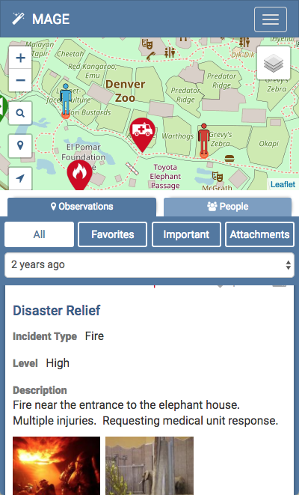
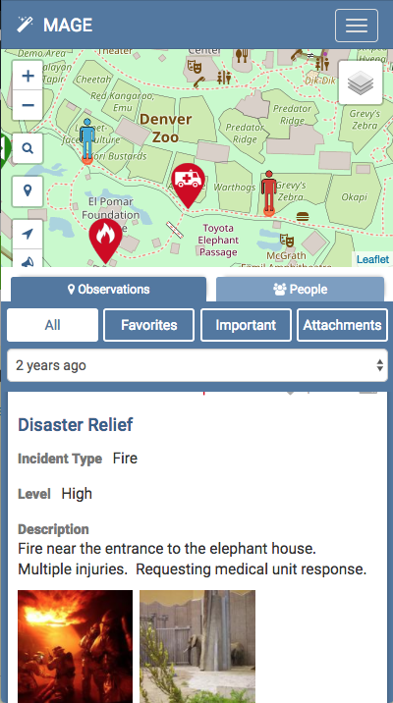
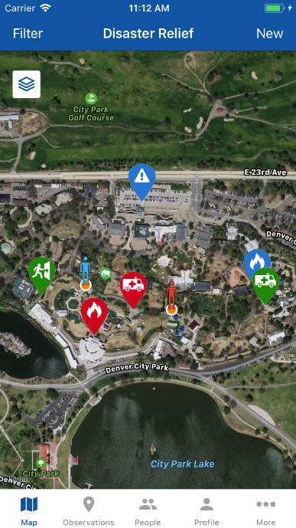
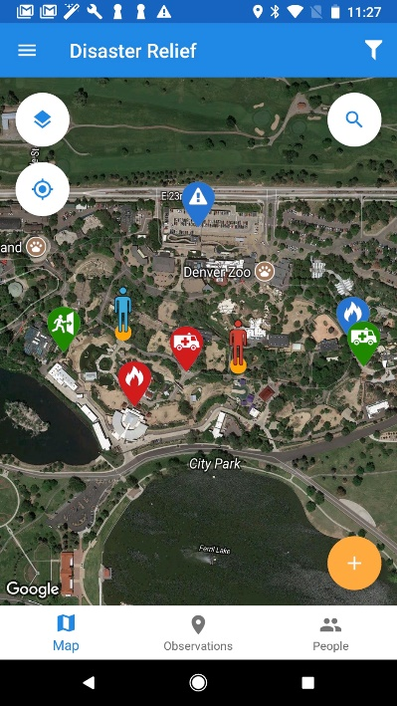
Multiple Platforms
Native support for Android and iOS as well as all current mobile and desktop browsers.
* Android KitKat and above
* iOS 10 and above
Source: GEOINT Services Disclaimer: Some images appearing in the MAGE app use map layers from OpenStreetMap or the native platform mapping services from the mobile device. Map layers from native platform mapping services are used in accordance with NGA’s respective developer license agreements with Apple and Google.
Approved for public release, 18-258

Slide 4
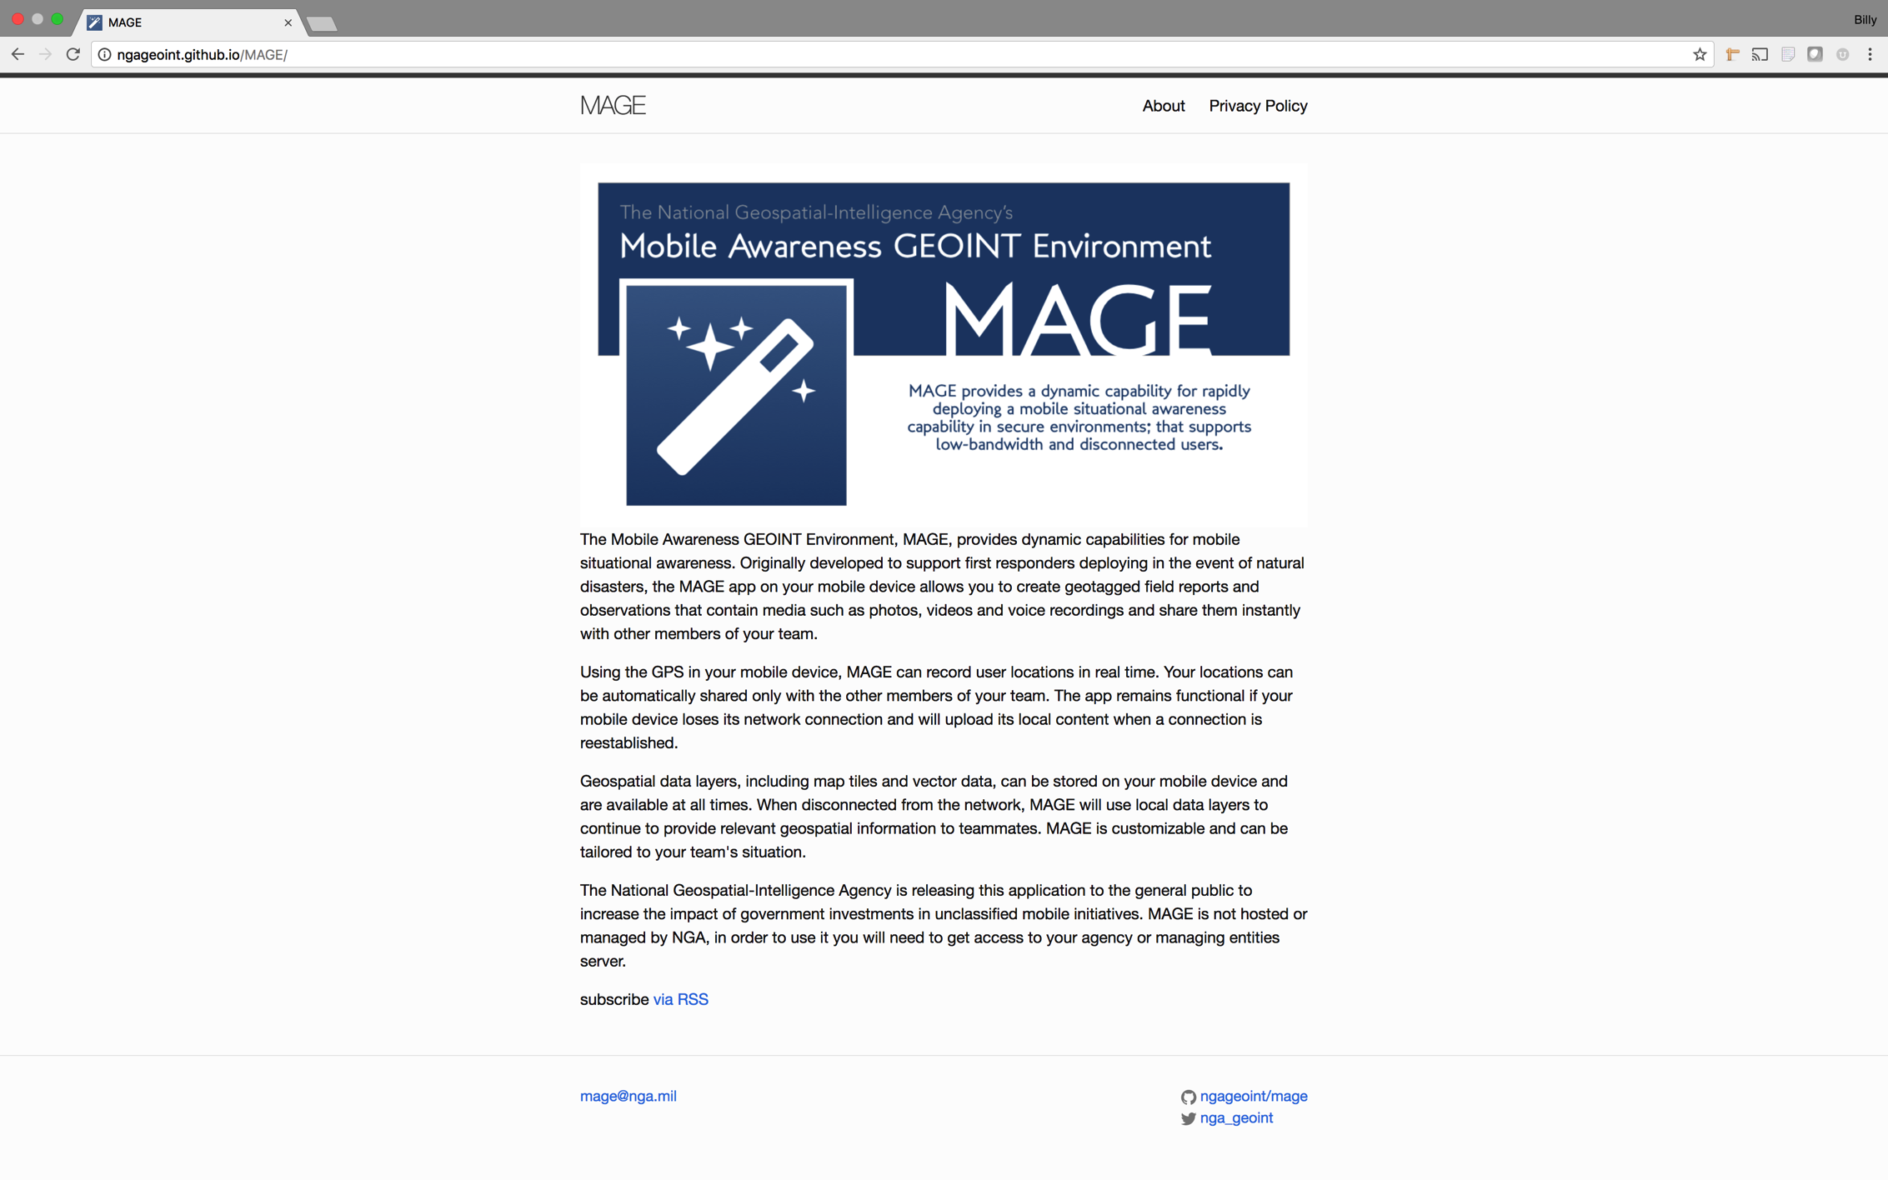
Fork me on GitHub
Approved for public release, 18-258
MAGE is completely free and open source. Permissive licensing means you can use the code as is, fork and modify, or just browse.

Slide 5
Secure
You control user access, authorize devices and restrict access to data by creating teams and events.
Approved for public release, 18-258

Slide 6
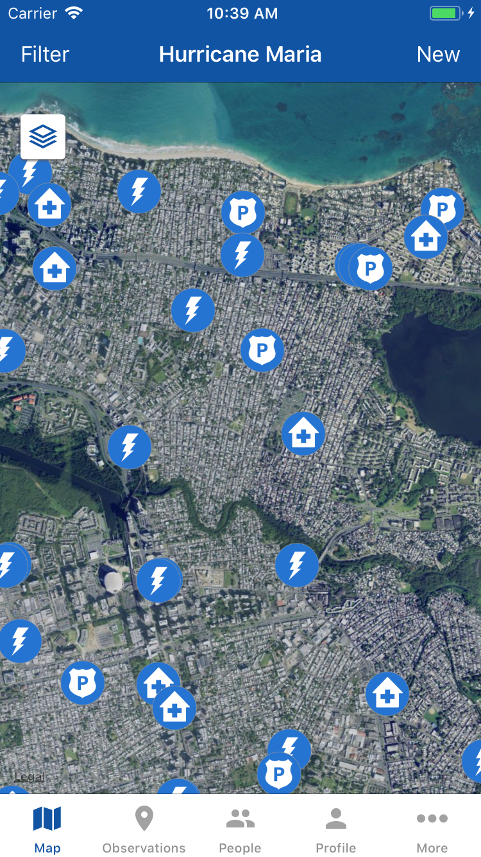
No Connection, No Problem
Display offline maps stored on your device to support operations facing limited or absent data connections. Formats include GeoPackage, XYZ, TMS and KML.
Source: GEOINT Services Disclaimer: Some images appearing in the MAGE app use map layers from OpenStreetMap or the native platform mapping services from the mobile device. Map layers from native platform mapping services are used in accordance with NGA’s respective developer license agreements with Apple and Google.
Approved for public release, 18-258

Slide 7
Customized For You
Define custom data forms to suit your specific mission. Create and arrange your own text, numeric, dropdown, checkbox, and date fields. Apply your own unique map symbology by linking these fields to custom icons.
Approved for public release, 18-258

Slide 8
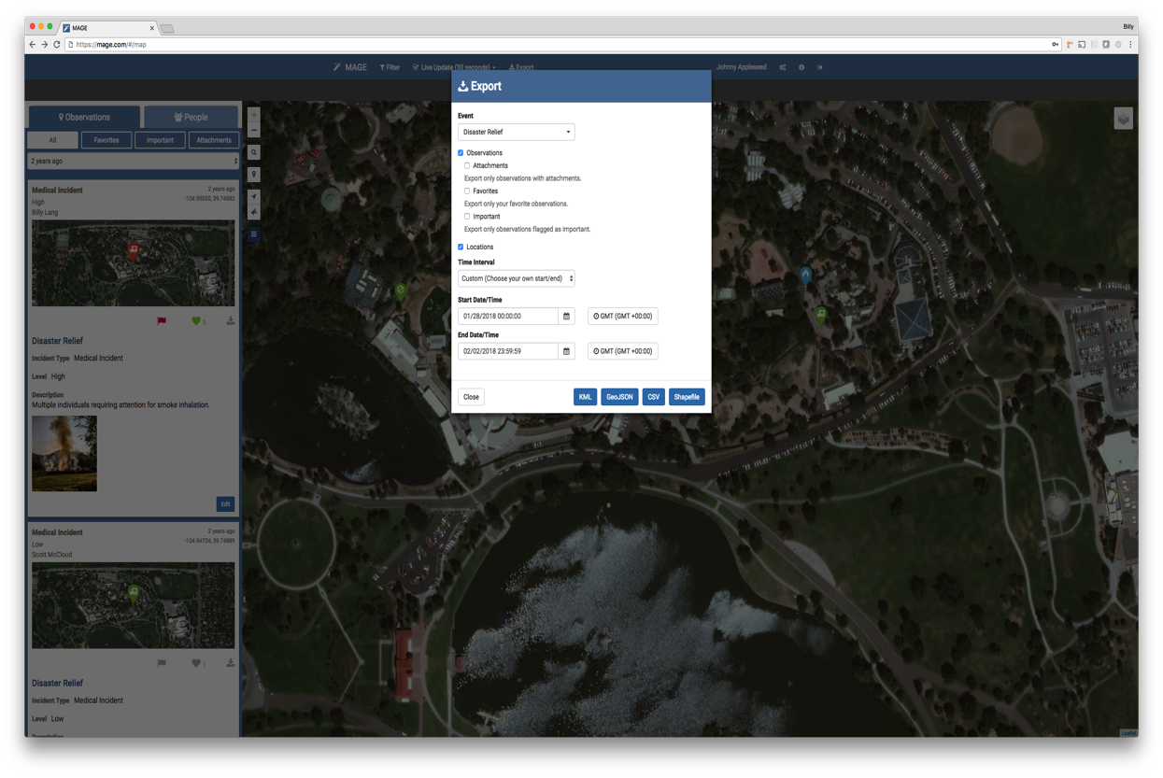
Analyze Your Data
Click icon to insert a picture
MAGE can export user location history and field observations for archival or analysis. Formats include CSV, GeoJSON, KML, or ESRI Shapefiles.
Source: GEOINT Services Disclaimer: Some images appearing in the MAGE app use map layers from OpenStreetMap or the native platform mapping services from the mobile device. Map layers from native platform mapping services are used in accordance with NGA’s respective developer license agreements with Apple and Google.
Approved for public release, 18-258

Slide 9
Disaster Response and Recovery
MAGE is specifically designed to be simple yet powerful, making it perfect for rapid adoption in an emergency.
After Hurricane Maria, FEMA needed help coordinating relief efforts in Puerto Rico. NGA deployed a custom MAGE server and FEMA teams were using MAGE on the ground in Puerto Rico within hours of initial contact. Over a few weeks, FEMA created more than 1800 field reports throughout Puerto Rico identifying survivors, damaged utilities, flooding, blocked transportation routes, landslides, and critical infrastructure.
https://youtu.be/-mxO4kDlfpI
Approved for public release, 18-258

Slide 10
Surveys & Studies
The USDA’s International Production Assessment Division is responsible for publishing monthly crop production, area and yield estimates for 17 commodities in over 150 countries. As of today, MAGE has supported this mission on 6 different continents and approximately 20 countries including Australia, Brazil, Egypt, Jordan, Israel, Lebanon, Iraq, Syria and India. USDA noted that “The [MAGE] application is user-friendly and the data is easily exportable to other systems.”
Approved for public release, 18-258

Slide 11
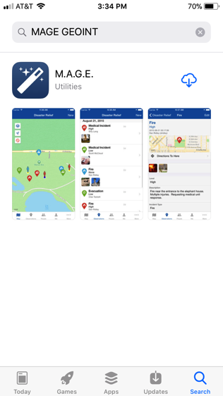
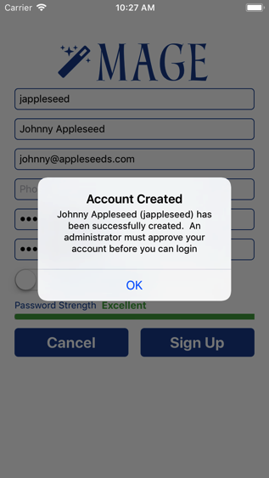
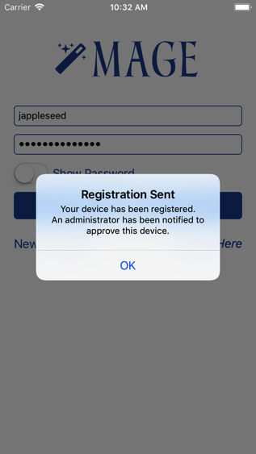
Getting started
Download the app*
Connect the app to a MAGE server
Signup and contact an admin for approval
Initial login will send a device registration request
* Download the app from GEOINT App Store, Apple App Store, or Google Play Store (Search “MAGE GEOINT”)
Source: GEOINT Services | Disclaimer: Some images appearing in the MAGE app may use map layers from OpenStreetMap or the native platform mapping service from the mobile device. Map layers from native platform mapping services are used with permission from Apple and Google, respectively, as documented in NGA’s developer licensing agreements.

Slide 12
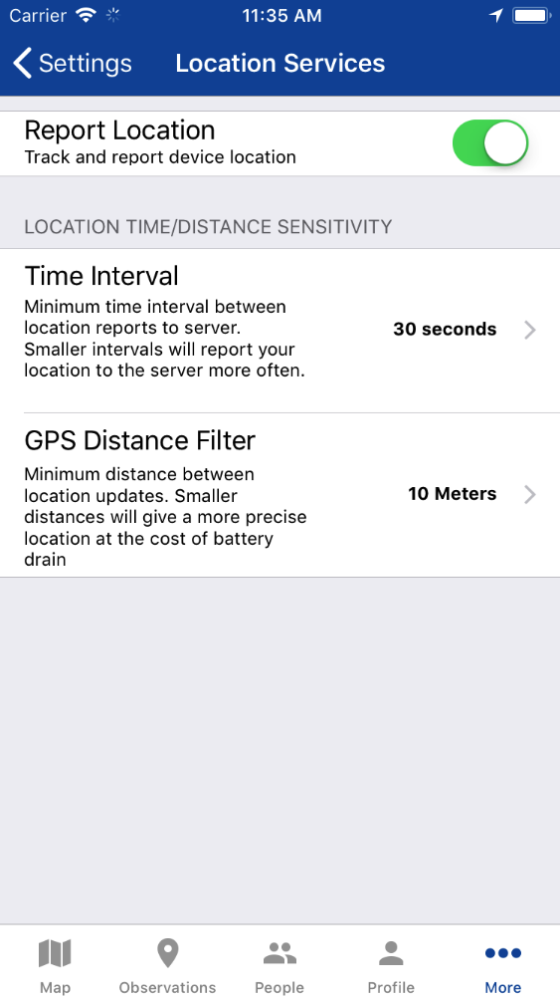
Track Your Location, Save Your Battery
With MAGE, each user can customize their GPS settings to find a perfect harmony between accuracy and battery life for their specific device.
Approved for public release, 18-258

Slide 13
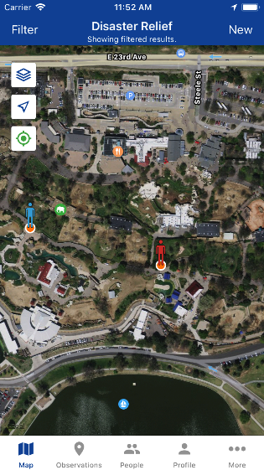
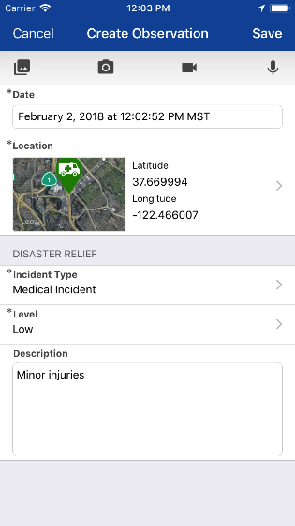
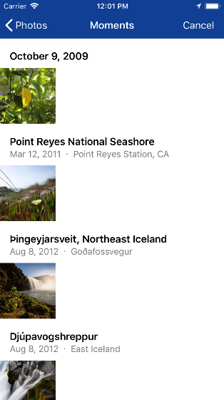
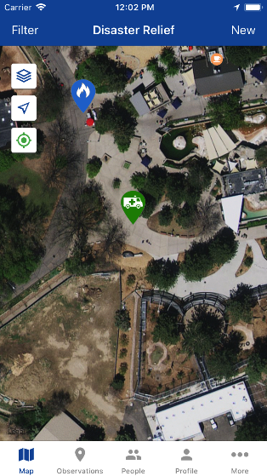
Creating an Observation
Tap ‘New’ or long press the map
Fill out your custom form
Attach media
Share with your team
Source: GEOINT Services Disclaimer: Some images appearing in the MAGE app use map layers from OpenStreetMap or the native platform mapping services from the mobile device. Map layers from native platform mapping services are used in accordance with NGA’s respective developer license agreements with Apple and Google.
Approved for public release, 18-258

Slide 14
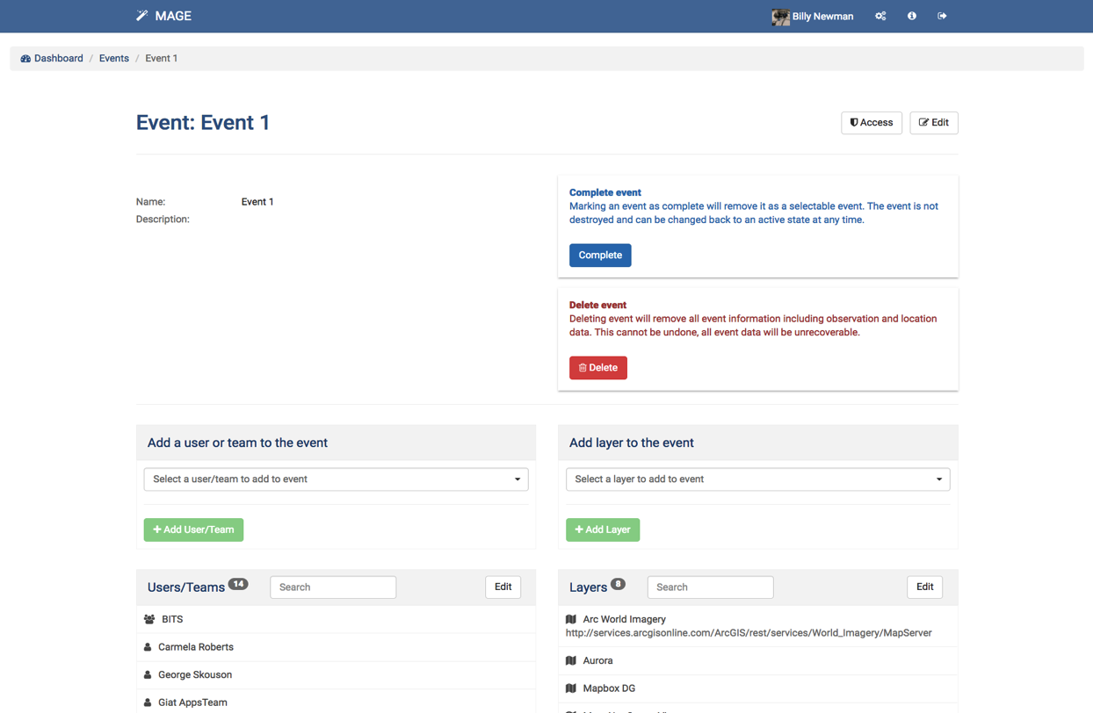
Events
Observations and user locations are grouped into events. Customize each event with team members, map layers and any number of custom forms.
Approved for public release, 18-258

Slide 15
Approved for public release, 18-258

