Slide 1
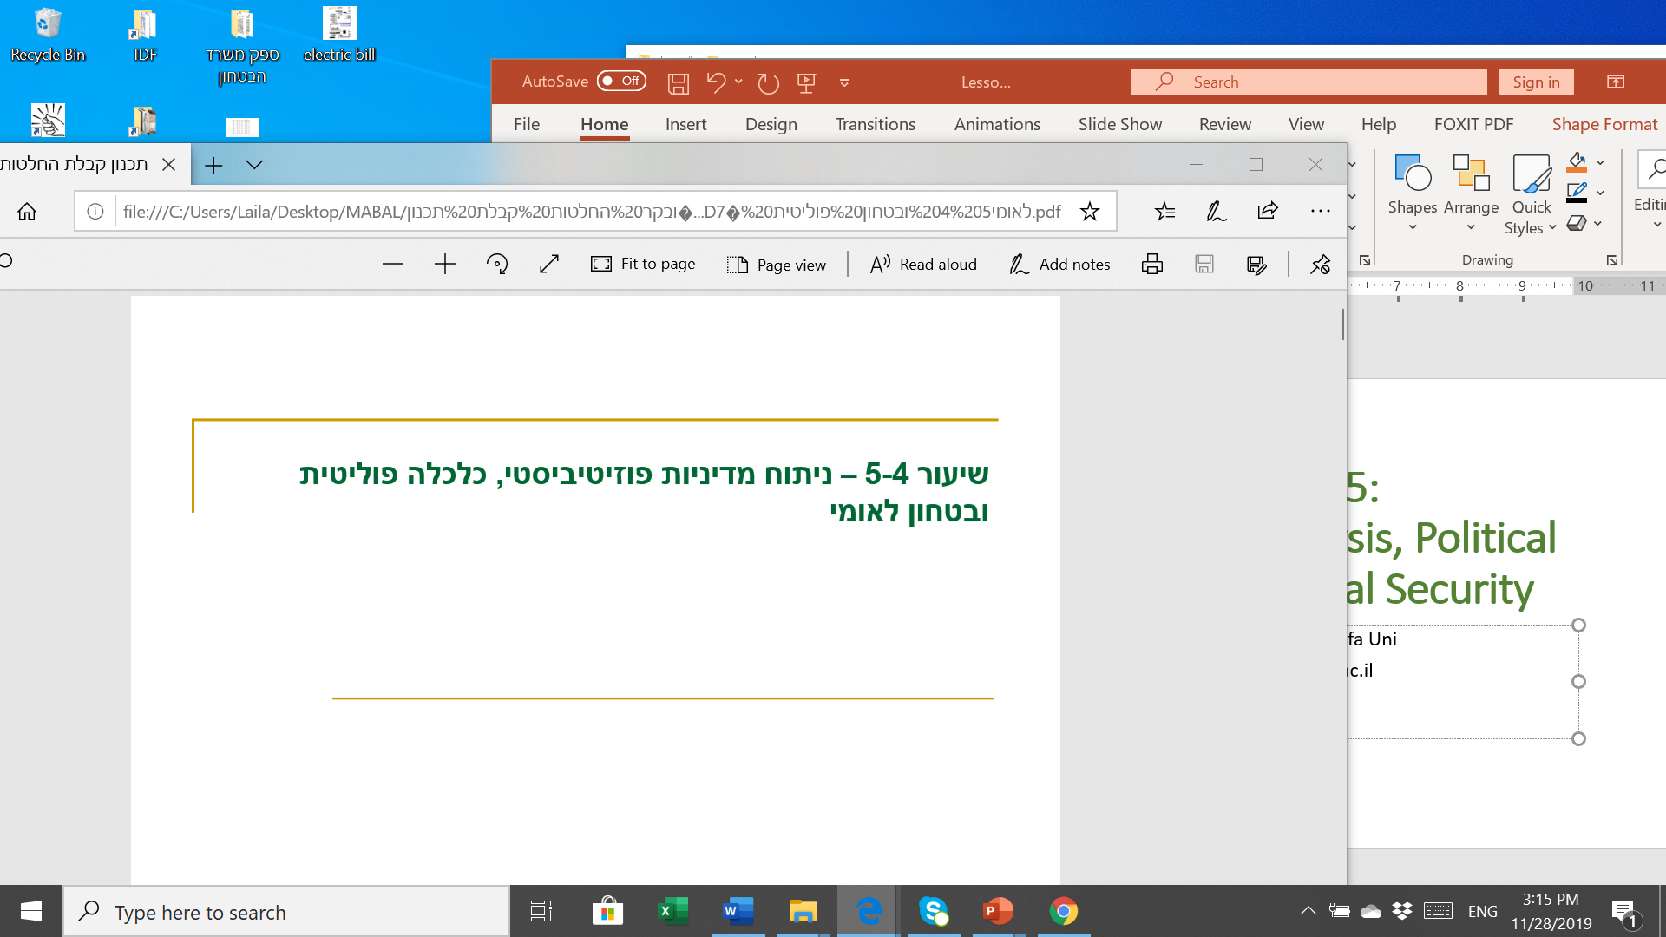
Lessons 4-5:
Positive Policy Analysis, Political Economy & National Security
Prof. Shlomo Mizrahi, Haifa University
shlomom@poli.haifa.ac.il

Slide 2
Positive Analysis - Basis
Any public policy analysis must refer to two fundamental questions:
  When and under which conditions should the state interfere in civilian life.
  How dependent is the nature of the policy on that of a specific problem
Traditional (Competitive) Approaches
Human reality is characterized by fear and the confrontation of the state should intervene in all areas in order to reduce the level of conflict (political science, Hobbes).
Human reality is characterized by cooperation and harmony. Therefore, the state should intervene in civilian life as much as possible and concentrate on the protection of natural rights to property - life, liberty and assets. (Classical Economics, Locke).
Public Choice Theory - Reality is characterized by the foundations of conflict and collaboration. The state should adopt a policy that will strengthen the cooperative foundations and weaken the conflict.

Slide 3
Market Failures
Public Goods Theory
Two definitions:
A product for which no property rights are defined.
A product which cannot be prevented or distributed.
Two types of Public Goods:
Public by nature - air, environment, water.
Government services provided as public goods under government/social resolution - security, roads, health, education.
The main model that describes the problem is the prisoner's dilemma.
The key problem is that given that players can use a public good without directly paying for it or participating in its production (or conserving it), they will adopt a wasteful and inefficient way of over-using the product. This behavior inevitably leads to a shortage of public goods and damage to social welfare.

Slide 4
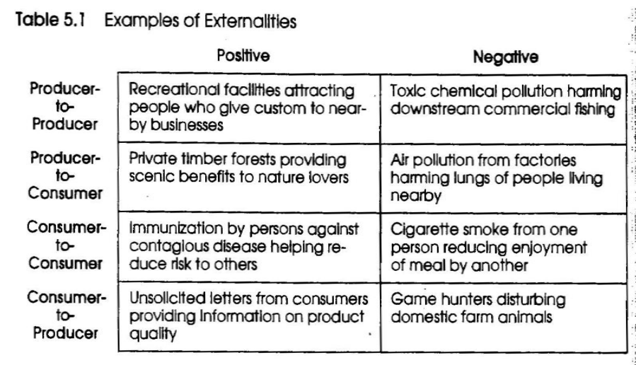
Externalities
Eternality – an impact of either positive or negative value caused as a result of any action (productive or consumer), on any person who did not agree to this influence fully by voluntary participation in an exchange.
External influences are in fact the influence of supply and demand in one (direct) market on the supply and demand in another market (indirect).

Slide 5
Natural Monopoly
A natural monopoly exists when the average price falls below the relevant demand range.
A natural monopoly is usually created in areas where competition, or private market production, is not worthwhile.
Inefficient allocation under natural monopoly.
Asymmetrical Information
Asymmetrical information exists when information about certain characteristics of a product (or service) is not shared equally between a seller and a buyer or between an actor that causes external influences and the one that is affected.
In cases where the price of information search is high compared to the purchase price, the price distribution and very heterogeneous quality and frequency of consumption relatively low asymmetrical information can lead to significant inefficiency.
Distributive Justice
Human Dignity: Equal Opportunity and Consumption Floor.
Equality in deliverables and services.
Preserving institutional values.

Slide 6
Government Failures
Direct Democracy - decision-making processes based on the majority rule tend to be unstable as the process is fairer and more democratic (Arrow's impossibility theory). Therefore, decision-making mechanisms always place limitations and barriers to the public's full participation in decision-making and the maximum process fairness. In doing so, the representation of the interests of the general public is impaired and there is an impairment of social welfare due to the violation of fairness.
Representative Democracy -The democratic system is built on demand and supply relations between the public and politicians (the median down-the-court trial). The main (and sometimes only) interest of politicians is to be elected and for that they need relevant public support. This means that they conduct policies that will retain the support of their constituency, that is, create a political policy bias that inevitably impairs social efficiency and welfare. Moreover, the public is largely indifferent and therefore active demand is mainly raised by economically strong interest groups that represent relatively limited interests.
Public Bureaucracy - Bureaucrats (superiors) are first and foremost interested in maximizing power and budget (budget maximization model - Niskanen). In their dealings with politicians, they use a monopoly on information and policy implementation to steer policy toward their own interests. The more centralized the system, the stronger the bureaucratic policy. The result is a major injury to social welfare.

Slide 7
Regularity Constraints; Interaction Between Interests Groups and Bureaucrats (regulators) and Politicians
Regulatory Services
Politicians
Interest Groups
Help getting elected
Budget
Information, policy implementation
Benefits, jobs
Regulatory Services
Bureaucrats

Slide 8
Positive Analysis Using New Institutionalism Tools
Institution – the rules of the game as they are manifested in laws and formal standards as well as formal and informal norms. Public policy includes, in many cases redesign and institutional change.
Historical Institutionalism – emphasis on the macro; historical processes; structural factors as key explanatory variables. Naturally inductive – comparable approach.
Critical Juncture
Path-dependence analysis
Policy feedback – negative or positive.
The developmental principle of path-dependent analysis: results at a critical junction accelerate feedback which strengthens (or weakens) pattern repetition in the future.
Long-term analysis due to the duration and character of social processes.
Long-term influences of institutions are in many cases a by product of social processes rather than an intentional process steered by the players. Moreover, even with institutional planning, the complexity of the process leads to unplanned consequences.

Slide 9
Rational Choice Institutionalism – Emphasis on the micro and explaining static situation; combination of structural as well as individual factors in the explanation.
SIE
Pivot Player
Induced Preferences as apposed to values.
According to the rational approach, priorities are given while according to the historical approach, priorities are influenced by structural factors.
Additional criticism of the historical approach over the rational approach claims that in many incidents, people follow the rules out of a force of habit even if it doesn’t coincide with their personal interest. In fact, it be a result of cost effectiveness calculations.
Integrative Approach
Both approaches can be integrated when using the historical approach to analyze processes and identifying critical junctions while the rational approach helps analyze players’ behavior and results in the critical junction.

Slide 10
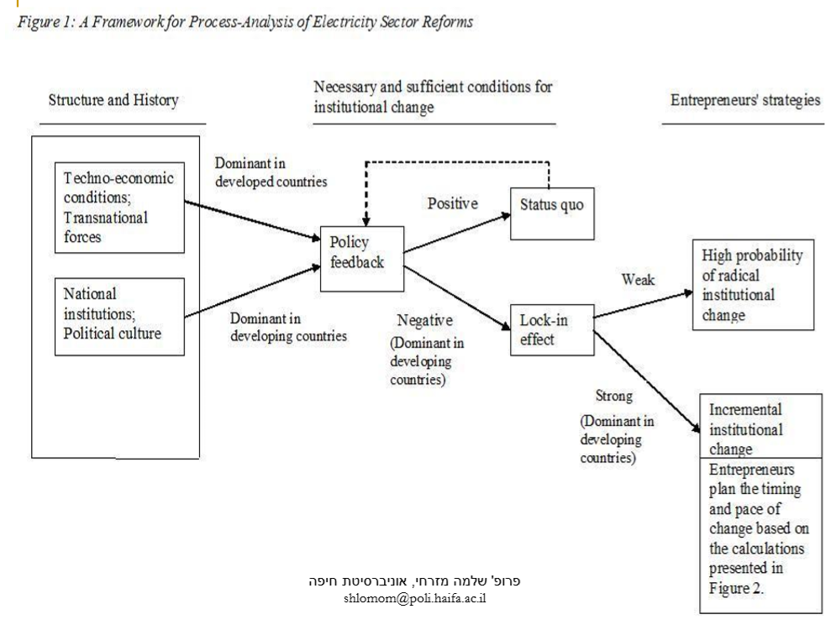

Slide 11
Typology of a gradual shaping change
Displacement
Definition: Growth in institution and secondary players’ visibility compared to dominant institutions.
Mechanism: Abandoning the existing institutional pattern.
Characteristics: 1. Institutional unclarity opens a gateway to abandoning the existing institutional pattern. 2. Development of a new operative rationale within the existing institutional framework. 3. Discovery and operating covert resources within the organization. 4. Invasion or percolation of external thought patterns. 5. Entrepreneurial activity.
Example: Shift to the Neo-liberalism approach in Britain in the early 80’s due to the undermining of the Keynesian Theory and the fact that neo-liberal ideas have always existed secondarily among the business sector.
Layering
Definition: Adding new components to existing institutions gradually changes their status and structure.
Mechanism: Differential growth.
Characteristics: 1. Rapid growth of new institutions based on the old ones. 2. New patterns eradicate the core of the old institution. 3. New components draw support on the expense of the old. 4. Compromise between old and new leads gradually to the defeat of the old.
Example: 1. US public pension plans expanding as many citizens joined. 2. Development of private education alternatives in Sweden which gradually gained dominance over the old establishment.

Slide 12
Drift
Definition: Neglect despite external changes leading to the failure of institutional patterns.
Mechanism: Deliberate neglect.
Characteristics: 1. Change of institutional results is influenced by (strategic) avoidance from the need to adapt the institution to the change of circumstances. 2. Embodying or operating institutional change not by reform or legislation but by existing laws due to changing external factors.
Example: The US public health system which shrunk in terms of insurance coverage as a result of conservative decision makers’ non-decision, thus deliberately avoiding growth gaps in insurance coverage.
Conversion
Definition: Recruiting old institutions to promote new goals attached to old structural patterns.
Mechanism: New direction, new interpretation.
Characteristics: Gaps between rules and the actual situations due to 1. Lack of long-term vision. 2 Intentional vagueness of rules. 3. Pressure and interpretation of rules from the bottom. 4. Change in conditions and coalitions opens a gateway to recruit institutions for new goals.
Example: 1. Professional training system in Germany in the 19th century and was changed gradually and additively to fundamental change as it is today. 2. Conversion of the Welfare State of France in a similar way.

Slide 13
Exhaustion
Definition: Gradual collapse of institutional systems over time.
Mechanism: Over usage.
Characteristics: 1. The normal action of the institution reduces its ability to handle change of conditions and circumstances. 2. Negative feedback causing high cost. 3. Limitations on growth and expansion.
Example: The Institutional system of early retirement in Germany, shaped in a time of full employment, however as unemployment grew, it was over-used, leading to the system to collapse financially.

Slide 14
Policy planning strategies/short and log term institutional change
Obstacles in the way of internal policy change
Low (High level of existing policy restraint and low support of coalitions in the existing policy) | High (Low level of existing policy restraint and high level of support of coalitions in the existing policy)
Conversion (Internal adaptation of existing policy) | Drift (Change of stable policy due to the change of circumstances) | High (Many veto players) | Obstacles in the way of enforced change (External)
Redesign | Layering (Designing a new policy without overriding the old one) | Low (Few veto players)

Slide 15
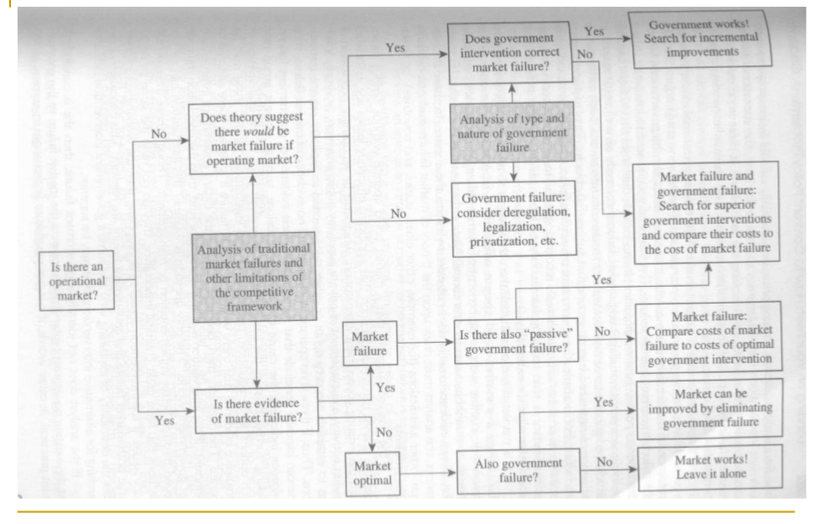
Associating market failure and government failure to policy strategy – process

Slide 16
Weimer and Vining Upper path of Figure 15.2
Yes
Is the government intervention fixing market failures?
Yes
Yes
The government is functioning! More improvement additives should be searched for
According to the theory, will there be a market failure should a (private) market be operated?
No
No
Analyzing the type and nature of government failures
Is there an active (private) market?
Government and market failures: Intervention strategies, locked or more complex should be found as well as comparing their costs to the costs of the markets’ failures
Analysis of market failure and other limits on the competitive market
Government failure: De regulation, legalization and privatization should be considered as strategies to open the market
No

Slide 17
Weimer and Vining Lower path of Figure 15.2
Yes
Government and market failures: Intervention strategies, locked or more complex should be found as well as comparing their costs to the costs of the markets’ failures
Yes
Analysis of market failure and limitations on the competitive market
Market failure
Is there a “passive” government failure?
No
Market failure: compare the cost of market failure to the cost of optimal government interventions
Is there an active (private) market?
Yes
Is there proof of market failure
Yes
The market can be improved by getting rid of the government failure
Yes
No
Optimal Market
Is there a government failure
No
The market is functioning! Do no intervene

Slide 18
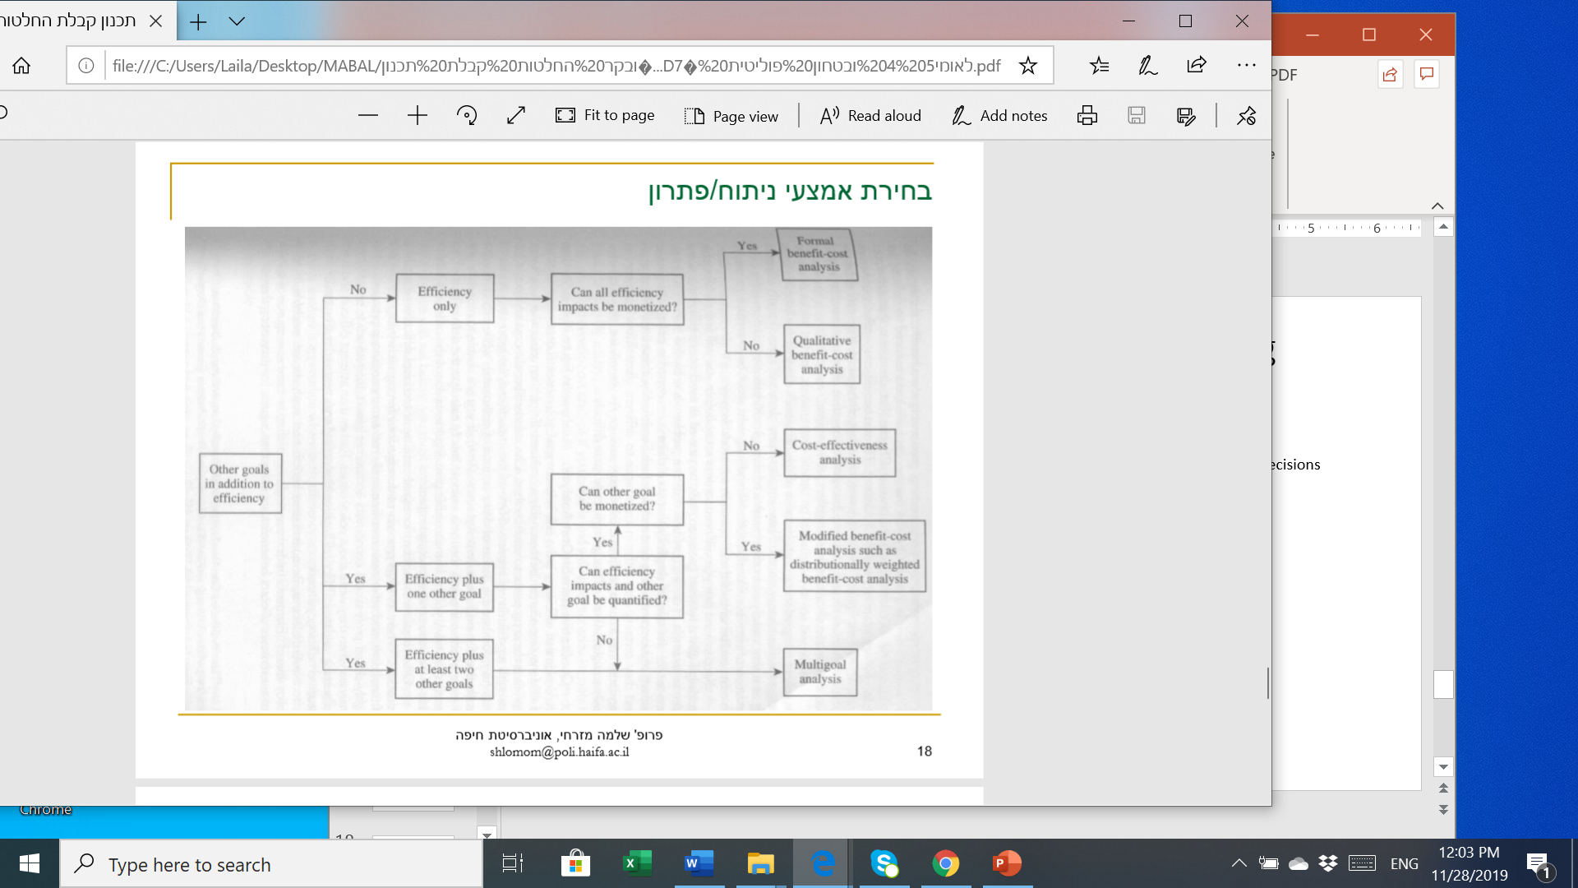
Choosing an analysis tool/solution

Slide 19
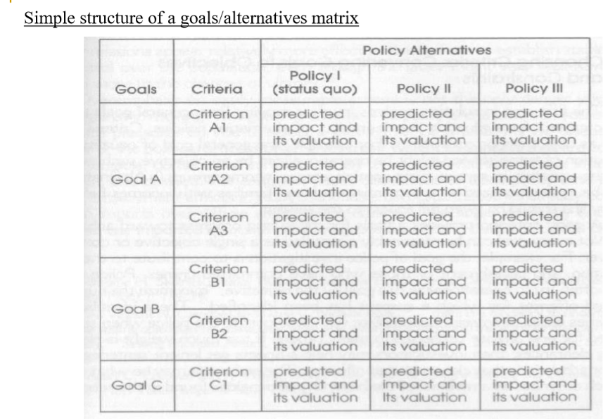
Solution Analysis

Slide 20
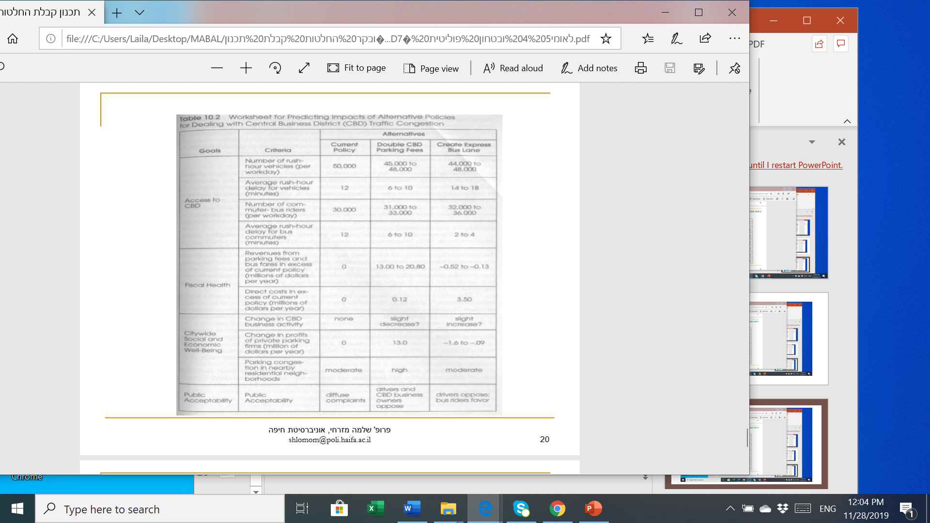

Slide 21
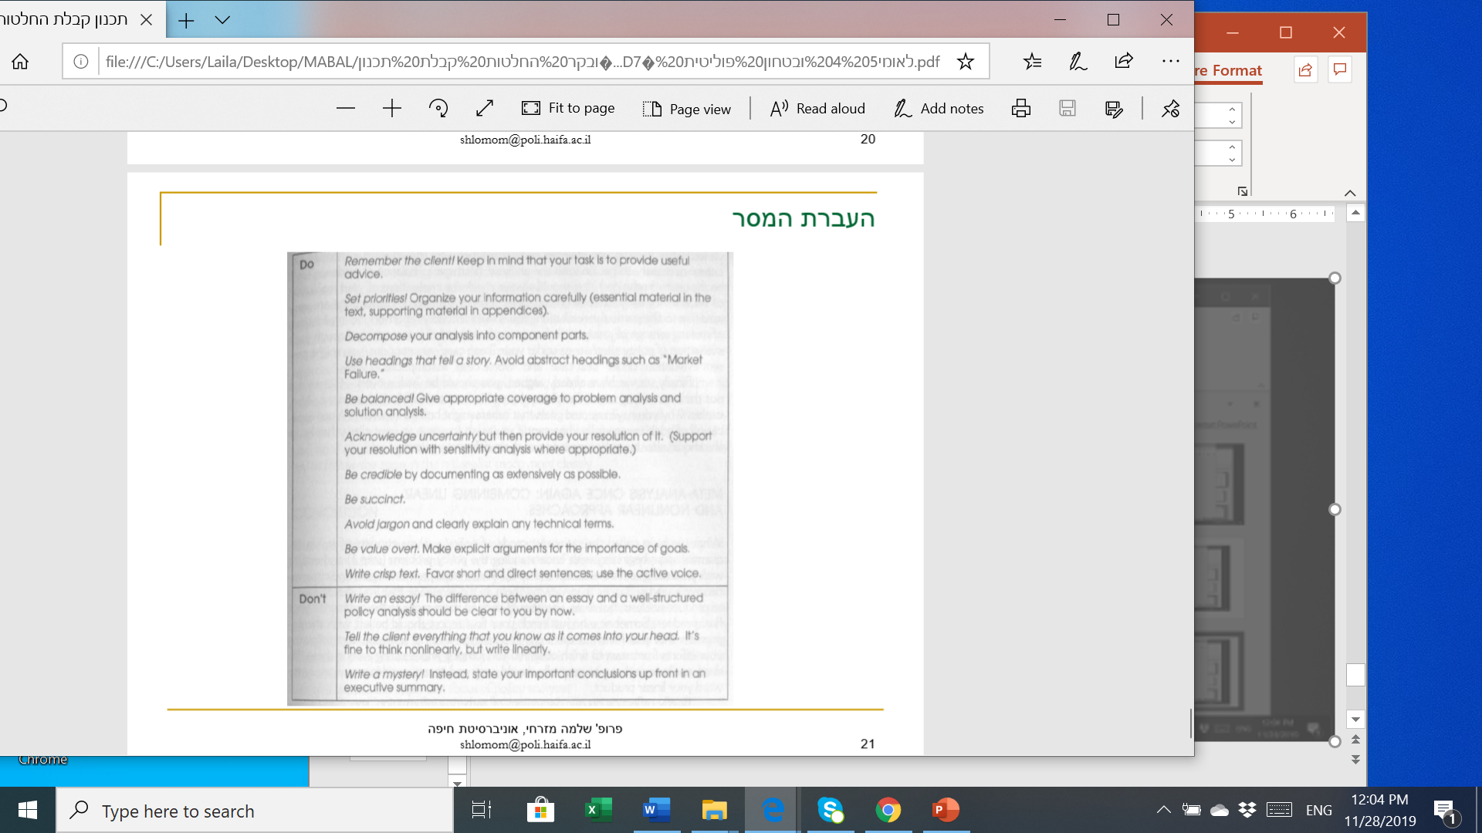
Getting the Message Across

