Slide 1

Lessons 10: Responsibility, Authority and Organizational Structure – Decentralization vs Centralization and Decision-making Mechanisms
Prof. Shlomo Mizrahi, Haifa Uni
shlomom@poli.haifa.ac.il

Slide 2
Definitions
Ethics (ἦθος), from Greek; Ethos – character. Ethics recommends rules of conduct that will guide human behavior. In other words, it suggests rules of conduct to answer the question of what is proper behavior.
There is a broad and general discussion on the issue of proper behavior, but over the years, specific behavioral norms for the group or profession have emerged - medical ethics, military code of ethics as well as business ethics and public administration ethics.
Public Responsibility is a principle that is based on the loyalty required of public servants to the public they serve or to groups in this public. A public figure derives their status, duties and powers by being a public trustee (Zamir, 2012). These were entrusted to them not as private property or personal benefit but to be used wisely for the benefit of the trust - that is, the public. Carrying responsibility means fulfilling this fiduciary duty in every action and providing account of how the duty is fulfilled as well as paying a price if this duty is breached.

Slide 3
Public sector ethics and public accountability are closely interrelated because in order to best fulfill the duty of fidelity norms and rules must be internalized regarding the proper conduct and proper conduct of public servants when fulfilling their duty.
Accountability is the duty of a public official to report to his senders on his actions and performance and to report on them. This is a necessary element of public responsibility and many times the concepts are used interchangeably. For example, the term: "I hold you accountable for this outcome means:" I see you as responsible for the outcome.“
Authority - includes the sum of actions and decisions that a person may make as defined in a set of rules or norms. Accordingly, formal and informal authority, hierarchical and decentralized authority structure and even authority derived from a person's character such as charismatic authority (Webber) can be characterized. In many cases, there is a tension between authority and responsibility and thus ethical dilemmas can be derived as well.

Slide 4
Accountability According to Mark Bovens
Accountability is a relationship between an actor and a forum, in which the actor has an obligation to explain and to justify his or her conduct, the forum can pose questions and pass judgement, and the actor may face consequences.
The behavioral expression of public responsibility:
  Taking self responsibility with personal recognition and free will, in their part form in a clear and public statement "I am responsible".
  Providing an account for the event / flop with emphasis on the role bearer’s relation to the actual event (extensive reporting).
  Utmost assurance that the event/ flop/ result will not reoccur in the future.

Slide 5
Organizational structure encompasses the set of rules and norms that define the authority and responsibility of each member of the organization. The challenge we face is to examine key elements of organizational structure and how they affect ethical behavior, responsibility culture, and the tension between responsibility and authority.
The complex relationship between ethics, authority and accountability in the public sector and the relationship of these elements to organizational structure must be analyzed. All this in order to offer a range of organizational structures that will allow a framework to adapt to changing conditions in order to strengthen ethical behavior and the culture of bearing public responsibility.

Slide 6
Approaches to Analyze Public Responsibility and Authority
  The Law Approach (and the Result - Teleology) versus the Behavioral Approach (and the Principles - Deontology ):
    According to the legal approach, the public responsibility of public servants is defined within the law and that is what is expected of them.
    According to the behavioral approach, public servants should be guided by principles and ethical values ​​that dictate ethical behavior and public responsibility. This is an approach that emphasizes the internal sources of ethical behavior. For example, research shows that people who tend to cheat (in an experiment) also tend to serve in the public sector.
  Hierarchical vs. Shared Responsibility:
    Hierarchical responsibility means that the scope of responsibility increases as the hierarchical rank is higher.
    This concept is based on the Weberian model. Joint responsibility means that the responsibility applies to all members of the body; in this context, Thompson has developed "The Problem of many hands" from which each player is responsible or that no player is responsible but the entire body. In any case, the responsibility of the individual is not a direct function of their actions.

Slide 7
  Personal responsibility - a responsibility that a person bears for his or her own obligations and actions, and / or obligations under other obligations that were expected to be taken and were not, as well as acts expected to be taken and were not.
  Ministerial Responsibility - Senior responsibility for the actions of his subordinates, even if they bear personal responsibility; this is due to the problem of “many hands” and the need to consolidate responsibility within specific factors. The public itself also has ministerial responsibilities because it appoints or selects its representatives and delegates authority and responsibility to them.
  Moreover, the concept of ministerial responsibility helps to overcome the tension between authority and responsibility because the commander is responsible for his subordinate acts even if the authority is decentralized and in fact not directly in him. That is, decentralization of authority may be possible while adhering to the principle of ministerial responsibility.
  Ministerial responsibility as defined above must be distinguished from collective responsibility which means the joint responsibility of all members of the body that decides on the decisions and acts of the body. This is usually a transversal responsibility that exists among officials of similar rank, for example, government ministers.

Slide 8
Organizational Structure, Authority and Accountability
  Ethical behavior, public accountability, and reporting are ultimately behavioral variables and depend on the decisions of the organization's members and various stakeholders. Therefore, in explaining the degree of ethics and responsibility in the organization (and not just saying what they should look like) by adopting a positivist approach, we must examine factors that influence behavior and can also bring about behavioral change.
  Studying the normative and positivist aspects will allow the adoption of an integrated approach to the planning of steps that will encourage ethical behavior and a culture of accountability.
  Literature suggests three main channels to explain behavior and behavioral change:
    Provide information regarding the desired behavior.
    Structural changes that lead a person to learn the benefits of behavior change.
    Providing direct (positive or negative) incentives that change a person’s utility function in the direction of desired behavioral change.
  A central approach that links organizational structure and behavior is a transaction cost approach, as well as an analysis of the issue of decentralization with public sector expertise and the analysis of reforms made in this area - especially regarding increasing coordination within and between public organizations.

Slide 9
Transaction Cost Economics
  The New Institutional Economics approach is based on the central idea of "Transaction Cost” in the economic analysis (Williamson, 1980; North, 1990). According to this approach, the main analysis unit is not the organization or the firm but the transaction itself and its related costs. The approach analyzes the variables influencing these costs causing inefficiency and attempts to examine ways to lower costs.
  The transaction cost approach for organization analysis is implemented in three tiers: 1) organization structure; 2) methods of organizing organization activity (external and internal functions); 3) HR management.
  The key question at the heart of the discussion is whether the parties to the deal or the relationship work in harmony or are there common misunderstandings and conflicts that lead to delays and other malfunctions. Accordingly, the costs of designing, adjusting, supervising and completing tasks under various administrative structures should be examined and compared and the administrative structure where the costs are lower should be selected. This maximizes efficiency. The structure of the contract between the various players is of great importance.
  The behavioral assumptions in the basis of the approach are: 1) limited rationality; 2) many players acting for themselves rather than the greater good.

Slide 10
  The main dimensions for describing a transaction are: 1) The degree of uncertainty. 2) Frequency of transactions. 3) The degree of specificity of the transaction and the specific investments required.
  Asset Specificity constitutes the most important dimension in the description of a transaction, but also the most neglected in research. Resource uniqueness is expressed in three ways: uniqueness of space, uniqueness of physical resources, uniqueness of human resources.
  There are many uses for transaction management approach for enterprise management. Two aspects are discussed at this stage: the organization structure and the nature of the provision of public services.

Slide 11
  A key dilemma in the matter of organizational structure in the centralized structure vs. decentralized structure. Milgrom and Roberts (1988) suggest examining this matter using the term cost influence, i.e. the costs to the organization due to the will of the employees to influence management decisions. These costs are part of the larger sum of transaction costs and the goal is to reduce them.
  Influence costs can be caused by three main impact actions: Suppressing impact attempts by management involves management time costs; responding to demands to quell management diverts management from the administrative route;
  The model shows that impact costs are greater in centralized and hierarchical management structure while in decentralized structure and share costs are significantly lower. It follows that a decentralized structure has the potential to reduce transaction costs.
  A distributed structure that gives relative freedom of action to subordinates will be more efficient and effective than a centralized structure.
  In all related to the provision of government services, Williamson (1999) shows that public bureaucracy holds the efficiency advantage over private organizations in sovereign transactions such as security, enforcement and international (external) affairs.

Slide 12
  Responsibility and Accountability
    The main dilemma in this context arises when there is a deviation from the Weberian model of hierarchical authority and responsibility and beyond decentralized patterns.
    The dilemma largely concerns the organizational structure and the question of decentralization vs. expertise.

Slide 13
Authority and Expertise
  Hammond and Miller (1985) suggest a model to analyze this dilemma systematically. They attempted to located the necessary conditions in an organizational structure which tries to enhance expert positions from within it as a means to achieve professionalism. They suggest four conditions the organization must attain:
    Decentralization of the decision-making process i.e. if there are 4 alternatives, then one expert will determine between A and B (which are in his field of expertise); another expert between C and D and so on. this structure brings out the best of expert expertise.
    Weak Pareto (WP) – if all experts/officials prefer alternative A over B, then that should be the alternative chosen by the organization.
    Universal Domain (UD) – experts/officials may choose any rational preferences without limitation.
    Acyclicity – lack of circularity in the decision-making process.

Slide 14
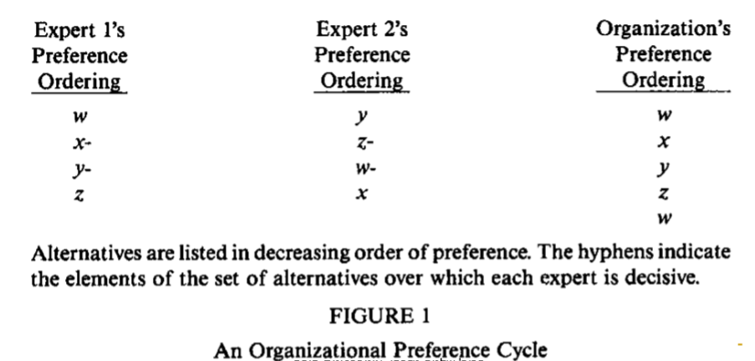
  Sen’s paradox:
  There is no decision method encompassing all four conditions: UD, D, A, WP.

Slide 15
Creating Coordination to deal with professional dilemma vs. Centralization
  Boutckaert, Peters and Vehoest (S2010) point out reforms in the new public management spirit as focused on enhancing organizations’ professional expertise. While these processes including decentralization of systems, they lead to a substantial need in improving coordination.
  In their book, they suggest a comparative analysis of the reforms that surfaced the need for coordination and the improvement methods adopted by various countries. They’ve identifies three main types of coordination mechanisms: HTM, NTM, MTM (Hierarchy, Network, Market).

Slide 16
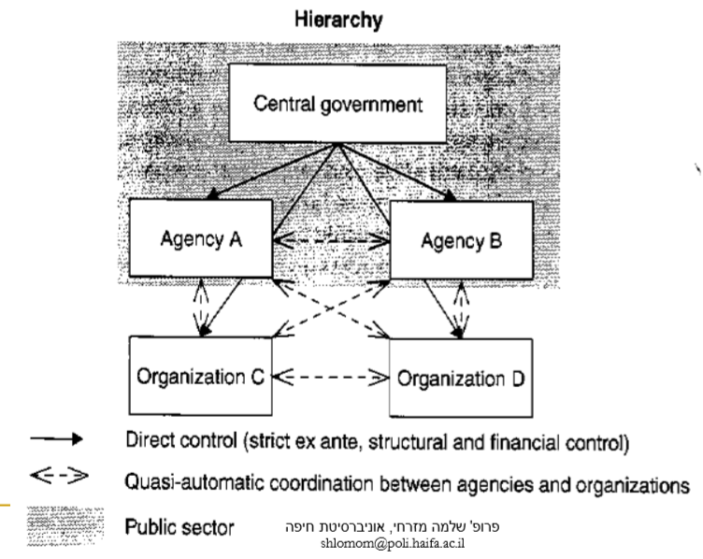
Coordination in a Hierarchical Structure

Slide 17
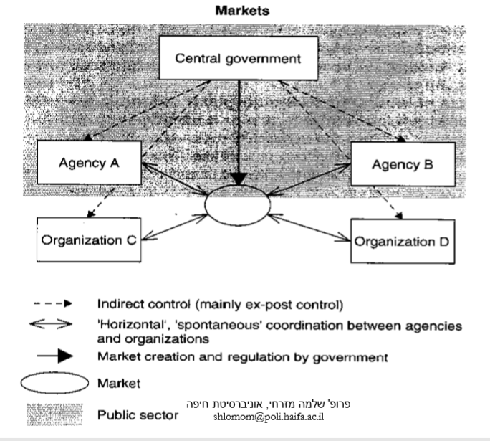
Market Coordination

Slide 18
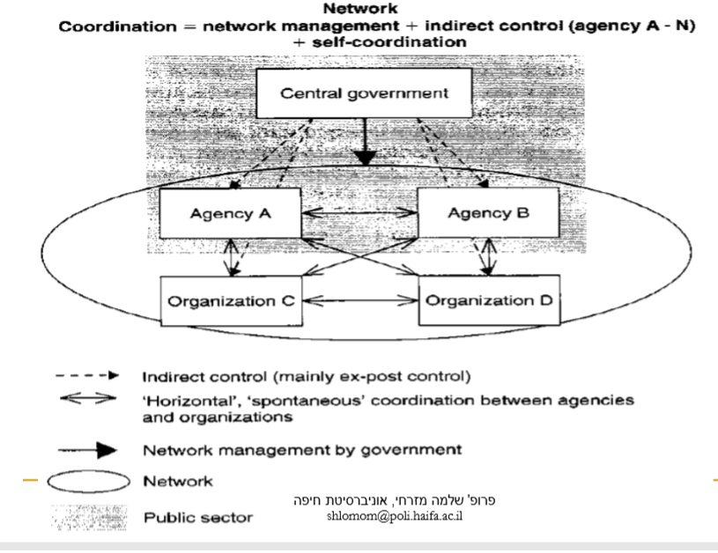
Network Coordination

Slide 19
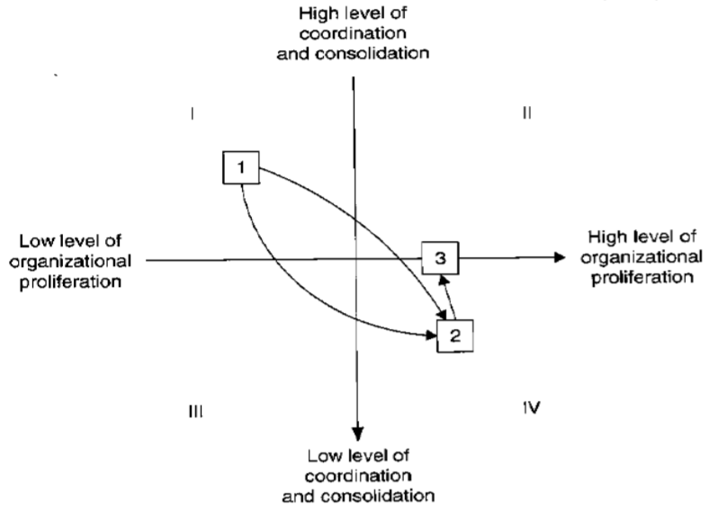
  Main Argument:

Slide 20
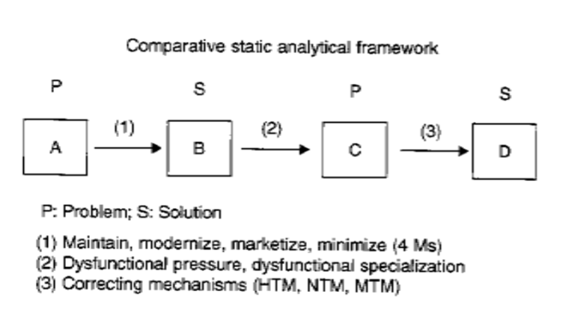

Slide 21
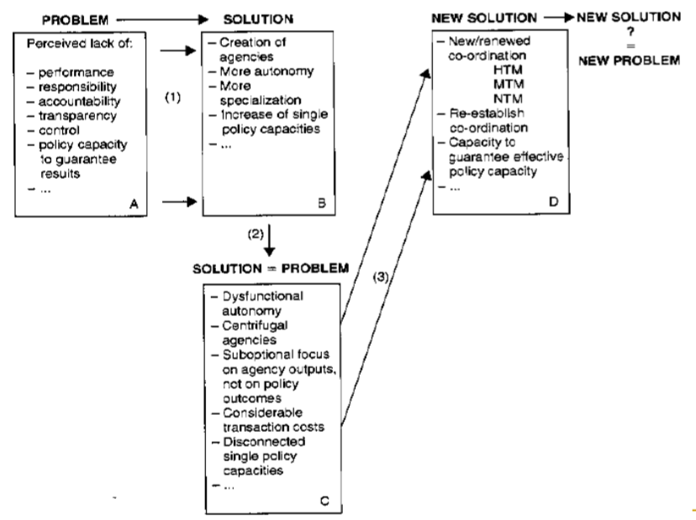

Slide 22
Case Study – Military Command in the British Army 2001-2020 Compared to the Second Lebanon War
  Defining goals and missions – vagueness on all levels
  Involvement of many factors in processes
  Strategic vagueness leading to tactical vagueness
  Tactical vagueness leading to local initiatives
  Control difficulties using bottom-up information feedback
  No responsibility taken by top military and political ranks

