Slide 1
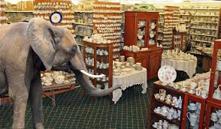
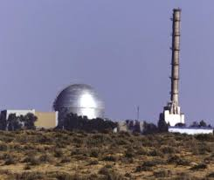
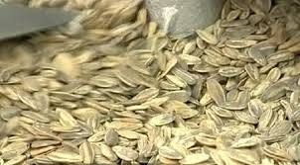
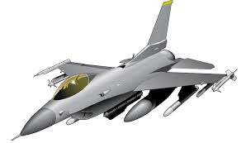
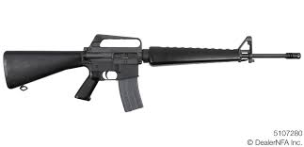
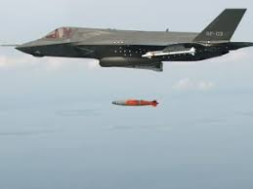
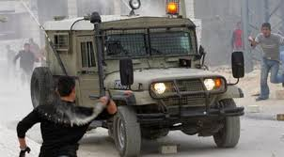
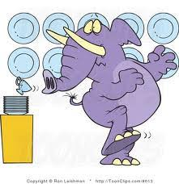
OUT
IN
Who knows what 16 is?
And what J is?
Israeli Nuclear Weapons
Israeli Nucleus
הגרעין הישראלי
הגרעין הישראלי

Slide 2
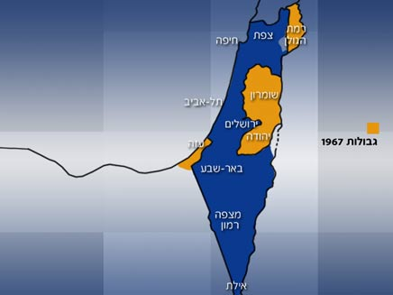
Preparatory Presentation for the Judea and Samaria Tour
26-27 December 2018
Samaria
Judea

Slide 3
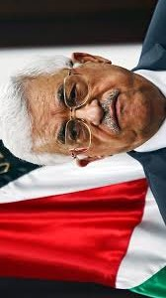
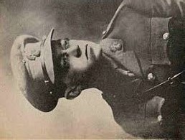
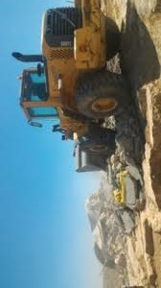
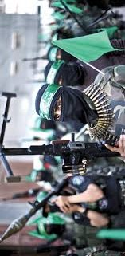
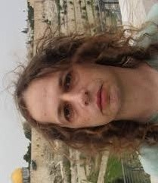
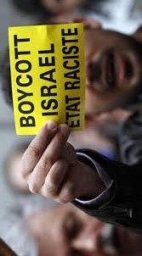
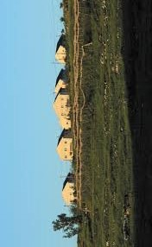
The Complexity of Judea and Samaria
Settlers 450,000
Palestinians 2,500,000
Security
A political campaign
Terror
Right
Illegal construction
Left
Legitimization
Quality of Life
Illegal immigrant

Slide 4
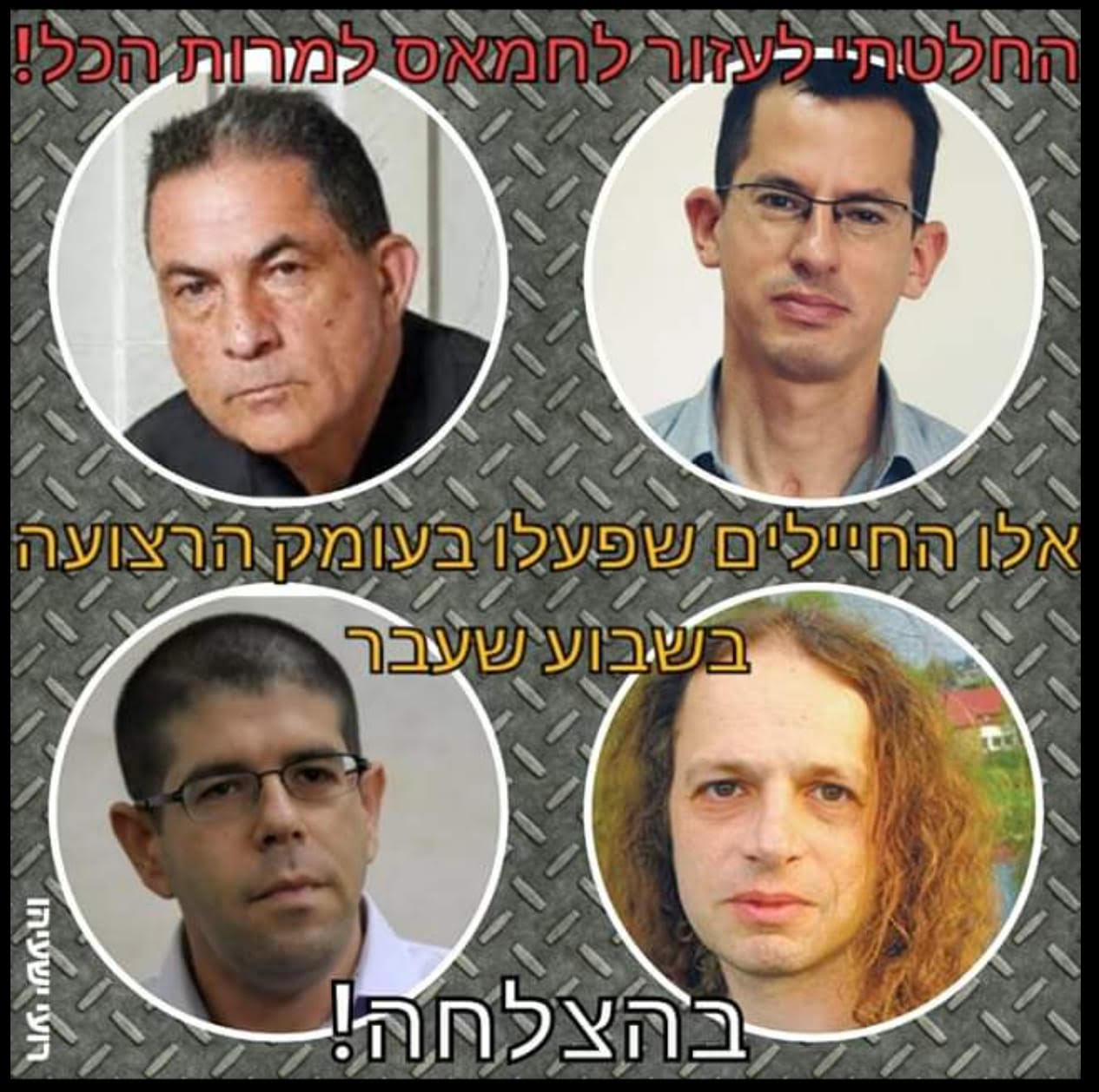
An example of a combination of politics and consciousness
A news item that ran after the incident in Gaza, after which Hamas published pictures of fighters on the internet
I decided to help Hamas despite everything
These are the soldiers who operated deep inside the Gaza Strip last week
Good luck!

Slide 5
The Managed Tensions in the Area
Mechanisms
IDF
Terror
legitimization
Quality of Life
Security
Palestinians
Israel
Left
Right
A Delicate Balance

Slide 6
Outline
  On December 26-27, 2018, Wednesday through Thursday, a national security tour will be held in Judea and Samaria
  The tour is part of the INDC curriculum and is led by Team 1 under the supervision of Prof. Ben Artzi
  Two rounds of preparation (20 and 25 of December) will precede this tour, and one processing session will follow (January 1, 19) (hereinafter referred to as "the tour").
  Throughout the tour, we will deepen our research in all aspects of national security in a combined manner, as displayed in the reality of Judea and Samaria
  The International participants (except Klaus) will not take part in the tour during the Christmas holidays

Slide 7
Tour Objectives (1+5)
  Getting acquainted with this region, and the exploration of its characteristics and its impact on the components of national security.
  To deepen familiarity and research with the elements of the Israeli-Palestinian conflict, with an emphasis on Judea and Samaria, familiarity with the changing reality and the different positions in play.
  Getting acquainted with the Israeli and Palestinian settlement in Judea and Samaria in all its diversity.
  Understanding the Israeli and Palestinian challenges and interests in Judea and Samaria (examining the various paradigms).
  Understanding the role of the military commander as sovereign, and the main principles of his operating concept.
  Sub-objectives - Preparation for the second simulation

Slide 8

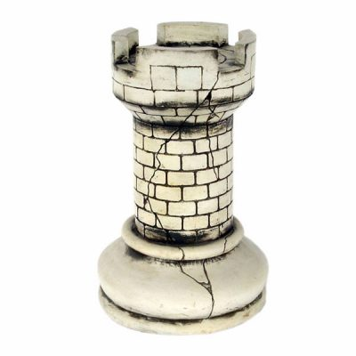
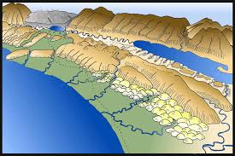


Organizing Idea
The preparatory sessions (at the NDC and later in the field)
with the four main legs of National Security
and with the geography of National Security, while
utilizing the tour for a direct impression
of the challenges the State of Israel faces in Judea and Samaria.
Political
Security
Geography of the National Defense
Social
Economic

Slide 9
Layout
Political preparation
Security, political, economic and social Preparation
Tour according to geographic rationale
A social evening in the spirit of Judea and Samaria
Team processing and tour summary
Notes:
לסיור יהיו כאמור שני פרקי הכנה שמטרתם לטעון את משתתפי הקורס בידע.
פרק הכנה ראשון – 20 בדצמבר – טעינת הזווית הפוליטית והתיישבותית, אשר תכלול הרצאות של שני נציגי הקצוות הפוליטיים מימין ומשמאל.
פרק הכנה שני – 25 בדצמבר – טעינת הזווית הביטחונית מדינית אשר תכלול בין היתר הרצאות של מפקד פיקוד המרכז ושל מתאם הפעולות בשטחים.
הסיור יתנהל ע"פ הגיון גיאוגרפי ולא תוכני – כאשר היום הראשון ייוחד לשומרון ובהמשך גם לבקעה, ואילו היום השני ייוחד למרחב יהודה.
הערב שבין שני ימי הסיור ינוצל לפעילות גיבוש והפגה.
העיבוד של הסיור יעשה ברמה הצוותית ויסכם את כל תכני הסיור.

Slide 10
Structure of the Tour
20/12
Presenting the tour, and two political preparation sessions (left and right)
26/12
Tour of Samaria - Peduel, Samaritans, Aesh Kodesh and Beit El
27/12
Lucifer Fortress, Hebron, preparation talks and tour of the city
25/12
1/1
Lecture from commander of the Central Command
Team Processing and summarizing the tour
Review by the 570 Unit and lecture by former head of COGAT (Yoav Poly Mordechai)
The legal status of Israel in Judea and Samaria
Arab-style evening at Kibbutz Ramat Rachel and sleeping at Kibbutz Ramat Rachel
Gush Etzion - The Millennium Observation Point (Neve Daniel)

Slide 11
First Preparation Day – Thursday 20.12
    08:30-09:00 - Presenting the Judea and Samaria Tour– Tour leaders
    09:00-10:00 - The left's perspective on Judea and Samaria and the Israeli-Palestinian conflict, and how it perceives the settlements - Yariv Oppenheimer
    10:30-11:00 - The legal status of the IDF in Judea and Samaria - Legal Advisor for Judea and Samaria
    11:00-12:00 - The right perspective on the Judea and Samaria and the Israeli-Palestinian conflict, and how the settlement of Judea and Samaria perceives itself and its role - Dr. Aryeh Eldad

Slide 12
Second Preparation Day - Tuesday 25/12
    08:00-09:00 - Israel's challenges in the territories, the security concept in the Judea and Samaria Area and the role of the sovereign – Commander of the Central Command (backed by the former commander of the Central Command or commander of the Judea and Samaria Division)
    13:30-14:30 - Challenges of public order in Judea and Samaria - Head of 570
    14:45-15:45 - Israeli and Palestinian interests in Judea and Samaria and the civil challenge - former head of COGAT (MG Poly Mordechai)
    16:00-17:00 - Farewell to the Chief of Staff

Slide 13
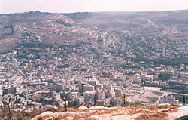
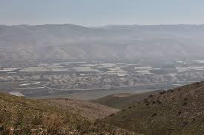

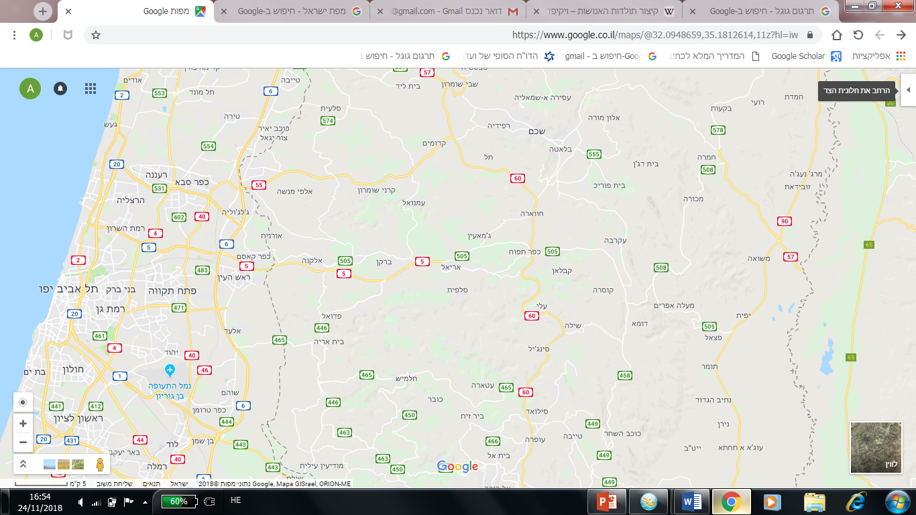
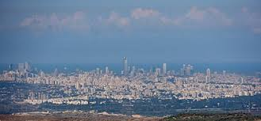


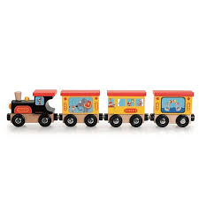
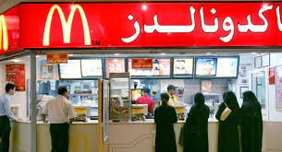




Slide 14
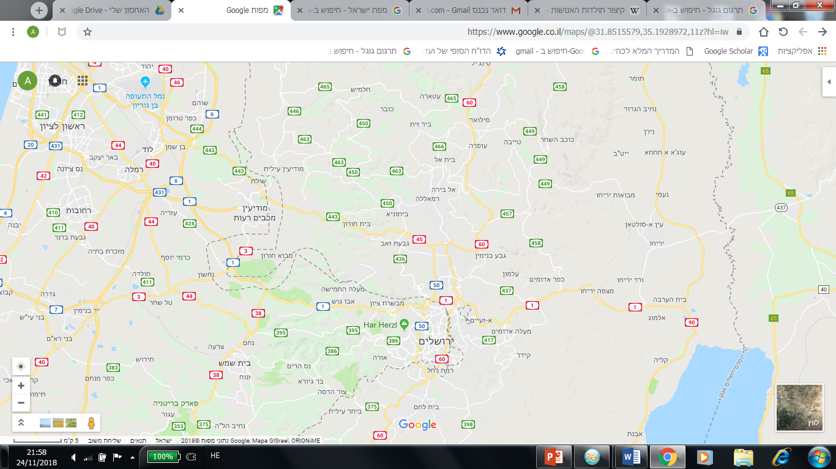
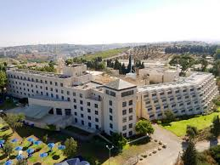
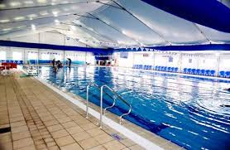
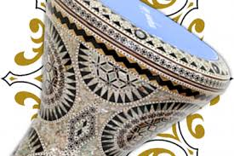
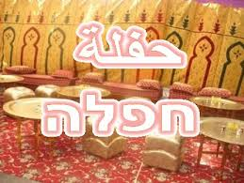
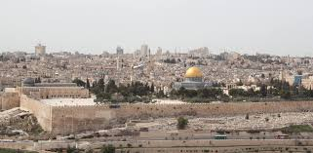
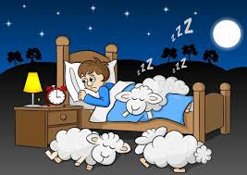
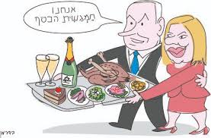
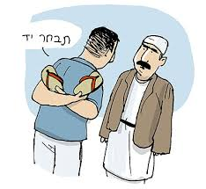
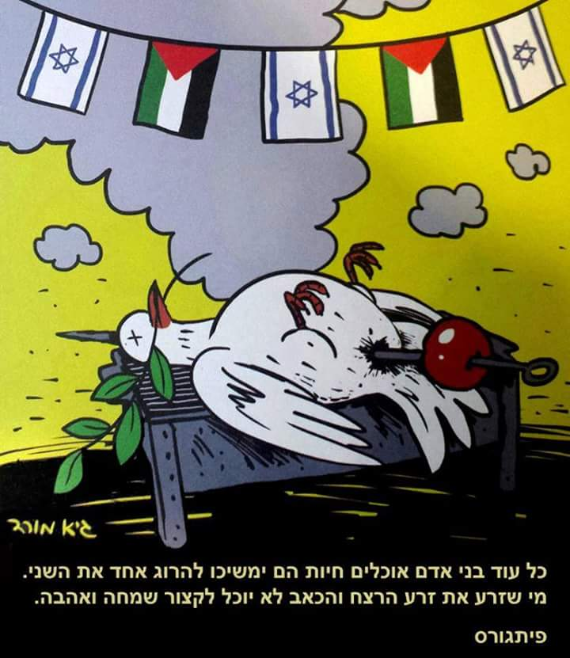

Feast

Slide 15
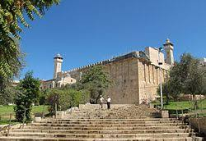
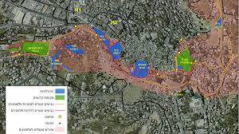
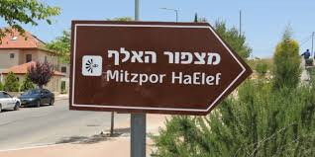
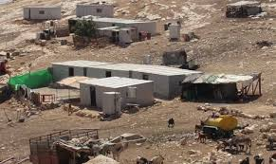
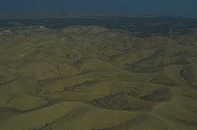
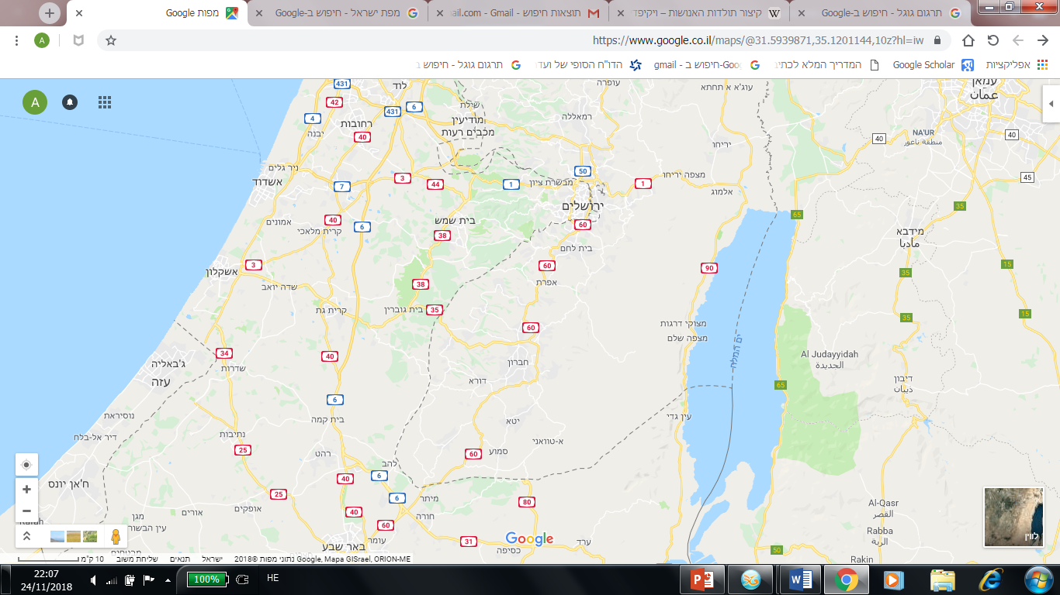
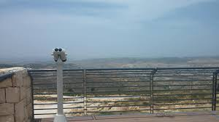
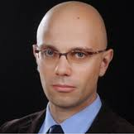
OK!
At this point you will be an hour away from the weekend vacation
Ramat Rachel
יתיר

Slide 16
First Tour Day – Samaria – Wednesday 26/12
    06:40-07:10 - Departure from the INDC and pickup from the Rosh Ha'ayin North Railway Station
    07:10-08:05 - Drive to the "Country Terrace" in Peduel and breakfast - High School Yeshiva "Eretz HaZvi“
    08: 05-08:50 - Lookout post of Israel's "narrow waist", a survey of the separation fence, and a conversation with the director of the Barkan Industrial Area- Prof. Ben Artzi, the Ephraim Brigade commander and the director of the Barkan Industrial Area
    08: 50-09:45 - Drive to the observation point on Mount Gerizim
    09:45 - 10:45 - A historical and geographical survey of Nablus and lessons learnt by battalion commander from "Defensive Shield" – MG Amir Baram
    10: 45-11:40 - Visit to the mill and talk about the Samaritans (rain does not affect) - Yaakov Cohen Shomroni
    11: 40-13:00 - A trip to Esh Kodesh to observe the valley and talk with a settler (will be canceled in the rain) - Professor Ben Artzi and resident
    13: 00-13:30 - A trip to Beit El

Slide 17
Day of Samaria Tour - Wednesday 26/12
    13:30-14:15 - Lunch - In the Judea and Samaria Division
    14:15-15:35 - The Palestinian state of mind- Khalil Shikaki
    15:30-16:00 - Break
    16:00-16:45 - The Israeli interests in the Jordan Valley and the challenges in this area - Head of a Regional Council from the Jordan Valley
    16: 45-17:30 - Nationalist crime briefing - Judea and Samaria INP Commander / 570
    17:30-18:30 - Traveling to the accommodation - Kibbutz Ramat Rachel
    18:30-19:30 - Getting organized in the rooms
    19:30-20:30 - Team processing
    20:00-22:00 - Arab themed evening + dinner - sponsored by the Shabak

Slide 18
Day of Judea Tour - Thursday 27/12
    06:00-07:00 - Waking up, getting ready
    07:00-07:45 - Breakfast
    07:45-09:00 - Drive to the Fortress of Lucifer (Beit Yatir)
    09:00-09:45 - A review of the Book of the Desert and Area C - Professor Ben-Artzi and Rabbi Hagar
    09:45-10:30 - A trip to the Judea Brigade
    10:30 - 11:30 - A discussion about economics and Palestinian society - a Palestinian businessman from Hebron
    11: 30-12:00 - An overview of the challenges of the city of Hebron and how to deal with them – Judea Brigade Commander
    12:00-12:45 - Lunch

Slide 19
Yehuda Day Tour- Thursday 27.12
    12:45-14:30 - A tour of the city of Hebron (the market, Shuhada Street, a police block and the tomb of the Patriarchs) - led by the brigade commander and Noam Arnon
    14:30-15:15 - Traveling to Gush Etzion
    15:15-16:00 - Observation and review of the importance of the Gush, and the connection between Judea and Jerusalem - Professor Ben-Artzi and Etzion Brigade Commander / Head of Bethlehem Coordination and Liaison Headquarters
    16:00-17:00 - Driving to Rosh HaAyin north train station and dispersing.
End of the Tour!
1/1 Team
Processing

Slide 20
Team Tasks 1
  Thanking the brigade commanders
  View the tour
  Coordination of managers
  Security coordination
  Alon Madanes
  Presentation by Poly
  Coordination workout morning
  Preparing a tour booklet
  Coordination of an Arab evening
  Guy Levi
  Extracting a summary document
  Presentation by Noam Arnon
  View from Judea and Samaria
  Presented by Yariv Oppenheimer
  Kobi Peer
  Presentation of the Judea and Samaria District
  Presentation of Head of 570
  Presentation by Dr. Aryeh Eldad
  Presentation of the commander of the Central Command
  Shahar Shapira
  Quiz
  about the tour
  Review of the Palestinian economy
  Eyal Argov
  Thanking the Samaritan
  Presentation of the Legal Advisor for the Judea and Samaria Area
  Inbal De-Paz
  Review of an international organization
  Eliaz Loff
  Presentation of Rabbi Hagar
  Presentation of Palestinian Activist
  Presentation by Fathi Shaqaqi
  Samo Operation Overview
  Samuel Bumendil

Slide 21
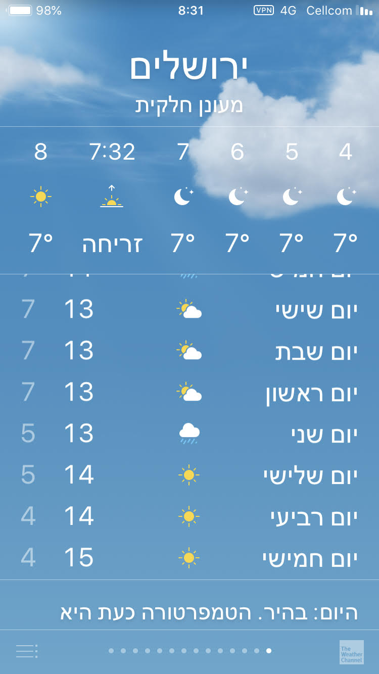
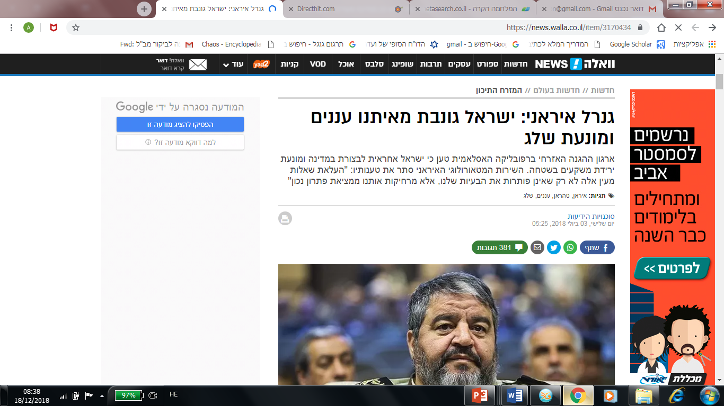
Good News for the Tour and in regard to Strategy and National Security
Jerusalem
An Iranian General: Israel is stealing clouds from us and preventing snow
On occasion of the INDC tour, the stealing of clouds will stop for several days starting next week

Slide 22
Team Processing
Three processing teams
Each team is divided into three groups
. The Israeli right-wing approach, the Israeli left-wing approach, and the Palestinian approach.
Process of processing
  Each group will be asked to present its position in a 15 minutes, regarding a series of issues that we will raise, as detailed below, and to present it in the team forum. This is in order to expose the participants in the team to all aspects relevant to each issue, and to sharpen understanding of the issues and their complexity.
  In the remaining 30 minutes, an effort will be made to formulate an "agreed" position of the entire team regarding the same issue.

Slide 23
Team Processing
Issues for discussion
Movement / passage of Palestinian vehicles and people throughout Judea and Samaria.
Entry of Palestinians into Israel or to Israeli areas for work purposes.
Israeli aid to the development of the Palestinian economy in Judea and Samaria.
Expansion of Palestinian construction in Judea and Samaria, including new settlements, and rehabilitation of existing infrastructure.
The maintenance of Israeli security control over the territory and the contiguity of Palestinian territorial c in Judea and Samaria.
Judea and Samaria - two separate entities or two components in one entity?
Processing summary- Collecting and processing the teamwork into a single summary document, which will be distributed to all participants.

Slide 24
Administrations
  On the first and second day of the bus, water bottles (75 per day) and sandwiches (50 per day) will be loaded.
  Transportation - a protected bus for the entire day and a vehicle for managers and evacuation accompanied by a driver, a manager and a medic with equipment and weapons.
  Each team signs a weapon and two binoculars (binoculars can be brought from home). Signature on Tuesday (25/12) and the possibility of crediting on Thursday (27/12 at the end of the tour).
  Breakfast at the "Eretz Hatzvi" high school meeting - coordinate (26/12 08: 00-08: 30).
  Administration for an Arab evening will be coordinated later with the Shin Bet and the Ramat Rachel Hotel.
  Lunch at the Judea and Samaria Regional Council in Beit El (26/12 13: 00-14: 00)
  Organization of gifts for civil lecturers and hosts.
  Accommodation includes dinner (26/12 from 20:00 to 22:00) and breakfast (27/12 07: 00-07: 30) at the Ramat Rachel Hotel.
  Winter set - mitt coats, stocking cap, gloves, umbrellas and thermal cup x 45.
  Layouts include cold and hot beverages (and hot dishes) at the observation points and at the entrance to the lecture rooms according to the above schedule. Also arrange hot water and hot dishes and / or soup and almonds.

Slide 25
Logistical Emphases for the Participants
  Watch a clip to be sent by Goodman through Whatsapp. Listening to "Catch-67" in I Cast (optional)
  Prepared for winter weather and in any case cold, including rain. Bring changing clothes
  Dealing with the research question of the tour (detailed below)
  Getting a winter set from the NDC
  Equipping with audio equipment in light of the winds at the observation points and as part of identification with the internationals
  Each team will be equipped with weapons and two binoculars
  (Can be brought from home or signed)
  Picking up from the INDC at 6:55
  And Rosh Ha'ayin North Railway Station 7.15
  It is not possible to arrive with private cars. Any need to leave the tour will be possible in Jerusalem on Wednesday evening

Slide 26
Security
  Movement in groups at the observation points and on the tour of Hebron.
  4 weapons on the force - one in each team, guns on the participants at all times - do not abandon weapons - on the bus or in the rooms
  Movement in groups at the observation points and on the tour of Hebron.
  The Bus is protected throughout the tour
  A safe and secure evacuation vehicle.
  Information security based on the regional divisions and in coordination with them
  Ways of communicating with all relevant parties from a security standpoint.
  Security briefing in the morning of the first tour
  Wherever a local military security force is present, the security response will be the responsibility of the commander of that security force
  "Iron numbers“ (count-off) between stops

Slide 27
Safety
  Dry clothes and body temperature should be maintained - change of clothes, warm clothing, and hot drinks. If it will rain, partial cancellation of observations will be considered.
Ensure that the administrative vehicles are properly maintained and loaded in a safe manner before traveling.
  Make sure to keep the guns on safety throughout the tour. It is forbidden to cock the gun besides from in operational event. The guns should be loaded at all times with the barrel blocked.
The commander of the administrative vehicle will represent the administration. He will also brief the driver and guide us.
  Despite the cold weather it is important to drink water
The administrative vehicle will also be an evacuation vehicle - therefore a medic with equipment will be present.
Try to get a reasonable amount of sleep at night
  It is prohibited to enter hostile areas in the duration of the navigation .
  A trip bag?/ medical personnel? Will be completed after the tour preparation and before it starts.
  Ensuring that we travel in accordance with the conditions of the road (bus and administrative vehicle), with an emphasis on rain.

Slide 28
Gantt Chart
December 19th
Receiving the 2nd organizing orders
November 25th
Confirmation of the chief instructor’s plans
September – October
Continued discussions
December 20th, 25-27
Preparation and the
tour itself
December 2nd
Material booklet and aids confirmation
October 15th
Initial coordination by Prof. Ben-Artzi
January 1st
Team processing
December 3rd
Confirmation of the MG’s plans
The 1st and 6th of October
Prep tour
January 20th
Tour summary
December 18th
Print out the booklets
November 13th
Coordination meeting
Notes:
קפ"ק 2 – 19/12 (יום רביעי שבוע לפני הסיור) בהשתתפות מובילי צוות 1 ומובילים צוותיים של המחזור, וכן רע"ן הדרכה ורמ"ד מנהלות.
סיכום הסיור – שבוע אחרי העיבוד הצוותי ולכל המאוחר עד שלושה שבועות מגמר הסיור) – תג"ב 20/1

Slide 29
Emphasis on a lecture by the Attorney General for Judea and Samaria
Emphasis was given to a lecture by the commander of the Central Command
  What is the legal meaning of the sovereign caliph?
  The sovereign's point of view and the significance of the sovereign's successor
  An explanation from the legal perspective on the campaign against terrorism
  What is the Israeli interest in the West Bank and the Jordan Valley?
  Explanation from the legal angle on illegal construction
  What are the main challenges you face every day?
  An explanation of the legal angle of war against nationalistic crime
  Where do the Palestinians aspire?
  The legal perspective on the Israeli law enforcement system and the emphasis on the High Court of Justice
  Reference to the issue of differentiation - security and political

Slide 30
Emphasis on the presentation of brigade commanders in Judea and Samaria
Emphasis on COGAT\Moses Isserles
  Not to engage in tactical aspects - less interesting
  What is the mood on the Palestinian street?
  Try to present tensions - for example, between security and quality of life, and the like
  How connected is the Palestinian leadership to the street?
  Judea Brigade commander - the melting pot of the city of Hebron, security between the tactical and the strategic, the economy and society in the city
  What is the Palestinian interest?
  Ephraim Brigade Commander - The issue of the separation fence and the phenomenon of the Israeli army. The tension between the security and the economic
  Differentiation - advantages and disadvantages
  Etzion commander - The geo-strategic importance of Gush Etzion, with regard to Jerusalem and the coastal plain and the Christians in Bethlehem
  What is the Israeli interest in Judea and Samaria and what should happen in order to have peace?

Slide 31
Have a fun and productive tour!

