Slide 1
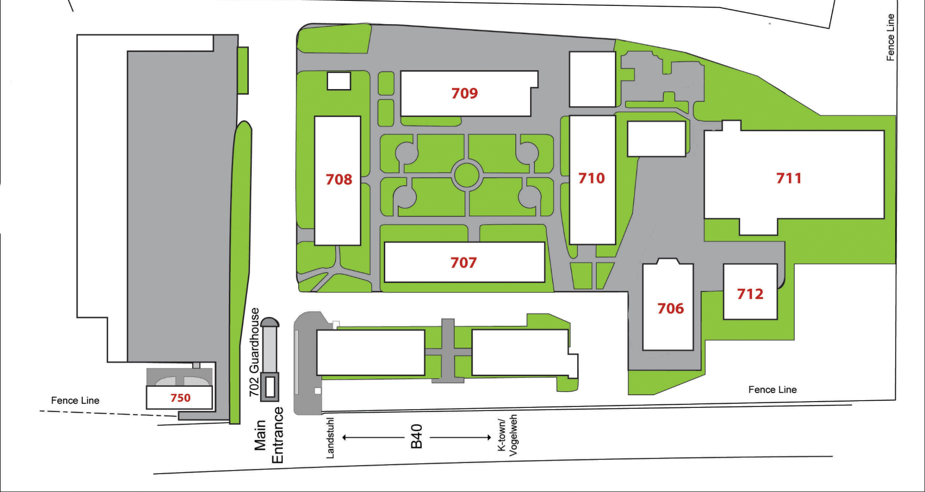
NO
Entrance
Parking
Theater
Participant Parking – LEAVE CELL PHONES IN VEHICLE
Evacuation
Point
Security In-Processing
begins at 0730
Theater (Bldg 706) will be open for participants from 0700 to wait for in-processing. Coffee and snacks will be available.
Entrance Turnstile
Parking
JF19 MSEL In-Processing, 29 Oct 18

