Slide 1
Israeli Support to the Return of UNDOF to the Area of Separation
(Golan Heights)
September 2016

Slide 2
Israel fully supports and will continue to cooperate and facilitate the operations of UNDOF in order to carry out its mandate safely and securely. Israel will continue to work with UNDOF in order to facilitate a gradual and coordinated redeployment in the area of separation.

Slide 3
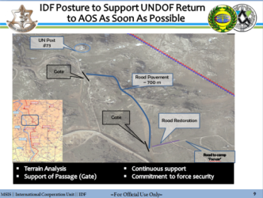
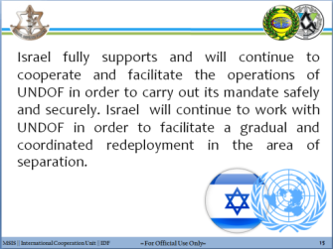
Overview
Area of
Separation
Israel Lines
Of Effort
Israel Support to
UNDOF Mission
UNDOF Contribution
to Stability
UNDOF –
Current status
UNDOF Return
to the AOS
Bottom
Line

Slide 4
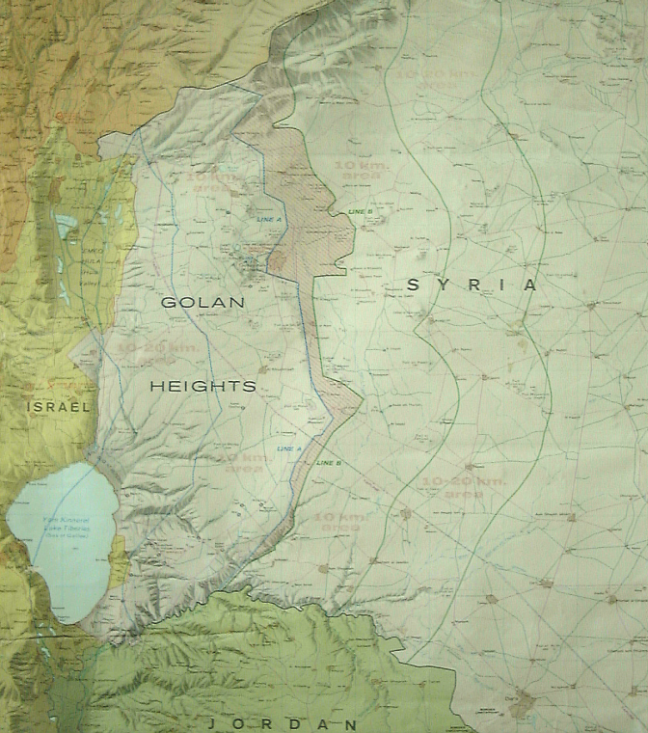
Golan - Area of Separation (AOS)
UNDOF Mandate
The United Nations Disengagement Observer Force (UNDOF) was established by UNSCR 350 (31.05.74). The forces mandate is renewed every six months.
Areas of Limitation
Alpha Line
AOS
C
B
A
A
B
C
Area of Separation
The ‘Area of Separation’ in Syrian territory is to remain demilitarized.
The Syrian army is to remain east of the Bravo Line.
The IDF is to remain west of the Alpha Line.
Bravo Line
Areas of Limitation

Slide 5
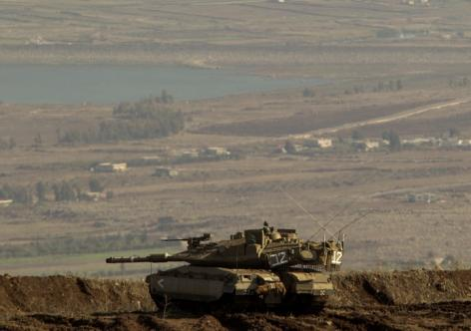
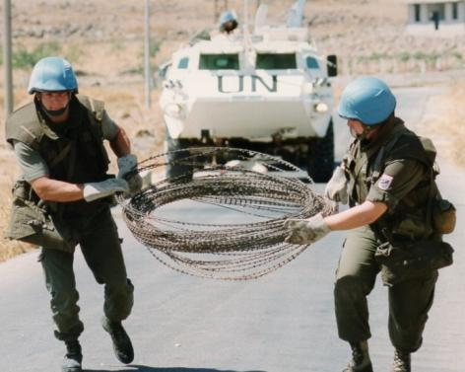
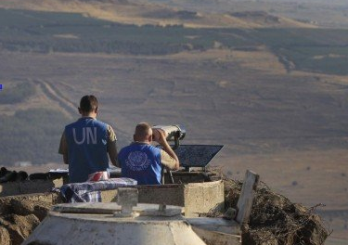
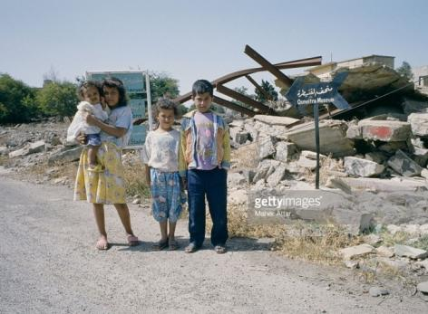
Israel Lines of Effort
Maintaining 1974 Agreement of Separation of Forces
Limiting misunderstandings
and prevention of war
Maintaining international presence on the Hermon
Civilian
Recovery

Slide 6
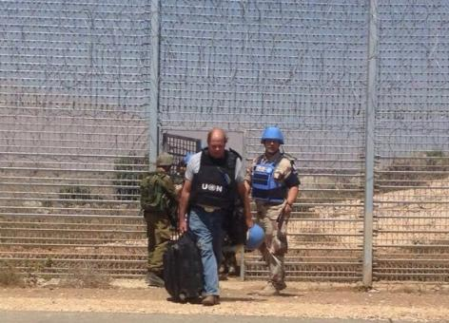
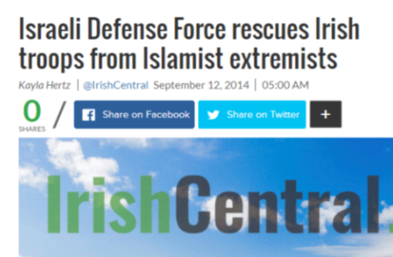
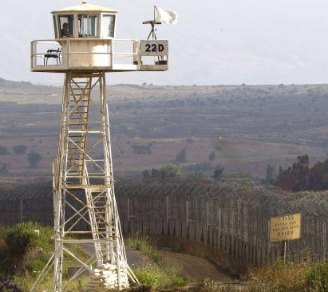
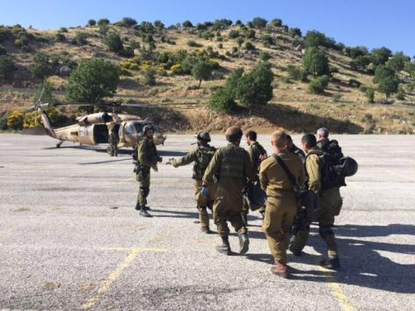
Israel Support to UNDOF Mission
UNDOF redeployment to
west of the Alpha Line
IDF support
to UNDOF extraction
Pic related to this help.. Get from markatz
Temporary UNDOF OP
on Israeli side
Medical Support
(Hermon)
Notes:
Show why UNDOF left
Aid pic – Irish Times article on how the IDF helped UNDOF/irish troops evade jihadists

Slide 7
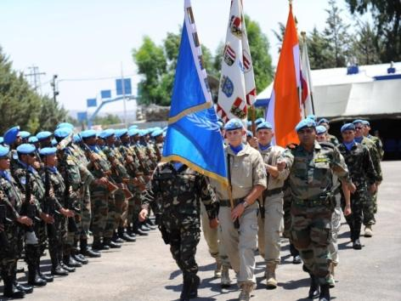
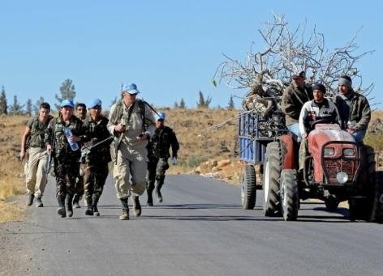
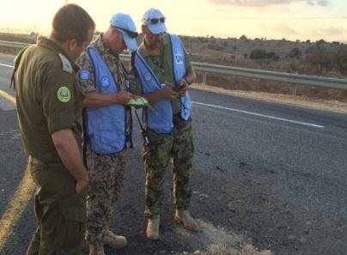
UNDOF Contribution to Stability
International
Presence
Limiting Misunderstandings and De-escalation
Platform for
Recovery
International
Monitoring
Notes:
Need to get slide from markatz called “Return of UNDOF & Israeli Support”
מפה של אזור החזרה???
Letter sent to erez where they thank him for the support (UNDOF commander?)

Slide 8
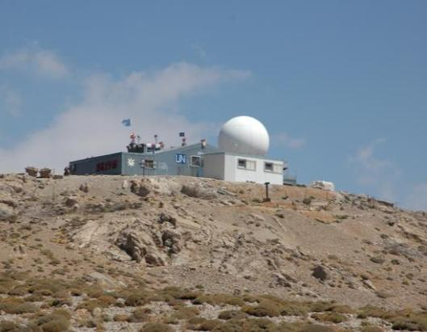
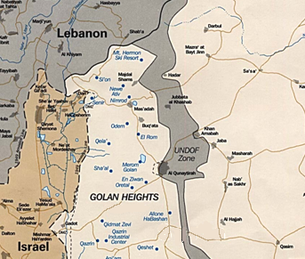
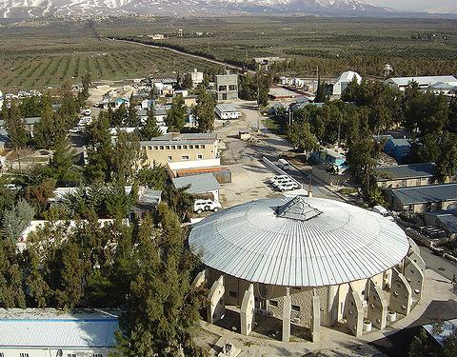
UNDOF Current Deployment
SYRIA
Camp Herman
Camp Faouar
“We do recognize that the much awaited approval of UNDOFs limited return to Camp Faouar has been substantially possible through your continued efforts of cooperation and appreciation in our mandate and resolutions.” -
UNDOF Appreciation Letter to the IDF (Aug 31st, 2016)
Notes:
Mark camp fawar on the big map

Slide 9
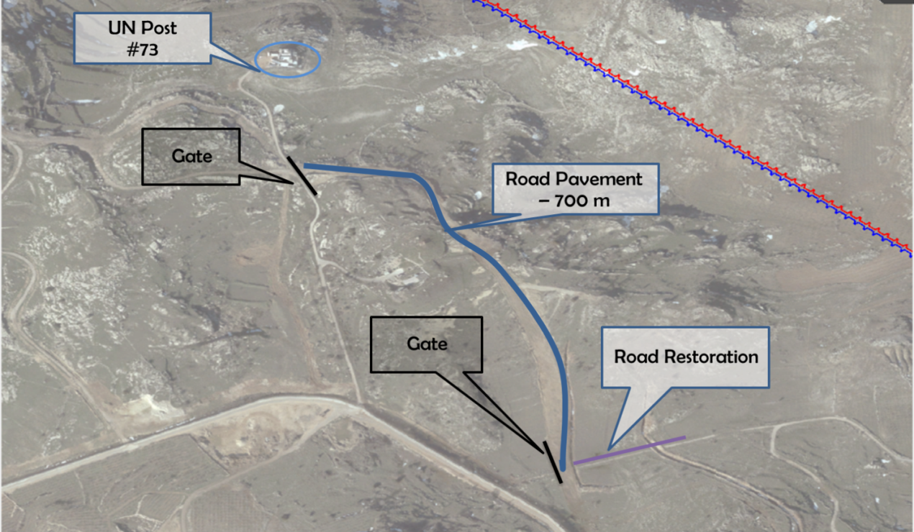
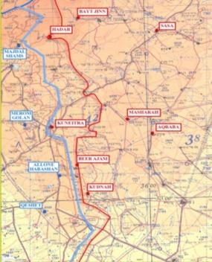
IDF Posture to Support UNDOF Return
to AOS As Soon As Possible
Road to camp ‘Faouar’
Terrain Analysis
Support of Passage (Gate)
Continuous support
Commitment to force security

Slide 10
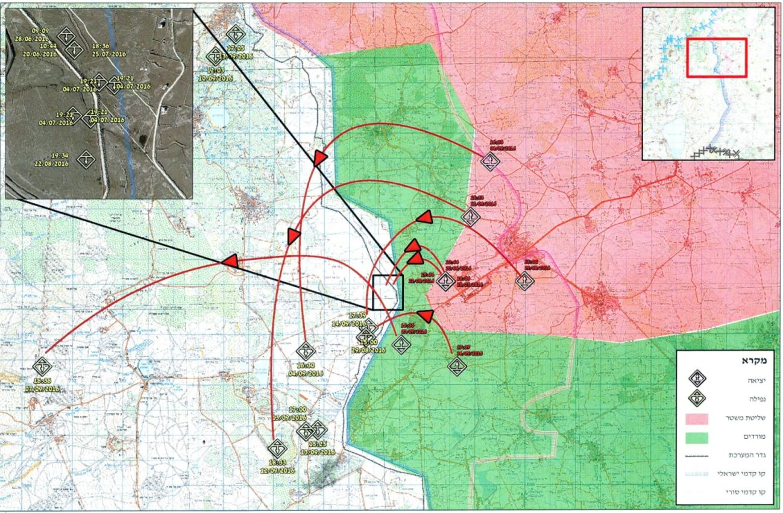
Cross-border Fire
Notes:
There have been many cross border incidents in recent months with Syria (including some which originated from territory held by the Syrian government), which demonstrate Israel’s cautious policy of restrained response and the utmost importance of the liaison channels with UNDOF
Israel will continue to defend its civilians and sovereign territory. It will act to minimize the threats originating from Syrian territory, with measured responses targeting the origins of the fires and with assistance of the liaison channels with UNDOF in order to prevent escalation.

Slide 11
Cross-border Fire
Israel holds the government of Syria responsible for all actions that take place on Syrian territory.
Israel has no interest in getting involved in the conflict in Syria nor does it seek an escalation, but will not tolerate cross-border fire from Syria of any kind and will take all necessary measures to protect its civilians, territory, and interests.
Israel demands that the Syrian regime abides by the 1974 Disengagement of Forces Agreement.
Cross-border Fire from Syria into Israel – per month
Notes:
There have been many cross border incidents in recent months with Syria (including some which originated from territory held by the Syrian government), which demonstrate Israel’s cautious policy of restrained response and the utmost importance of the liaison channels with UNDOF
Israel will continue to defend its civilians and sovereign territory. It will act to minimize the threats originating from Syrian territory, with measured responses targeting the origins of the fires and with assistance of the liaison channels with UNDOF in order to prevent escalation.

Slide 12
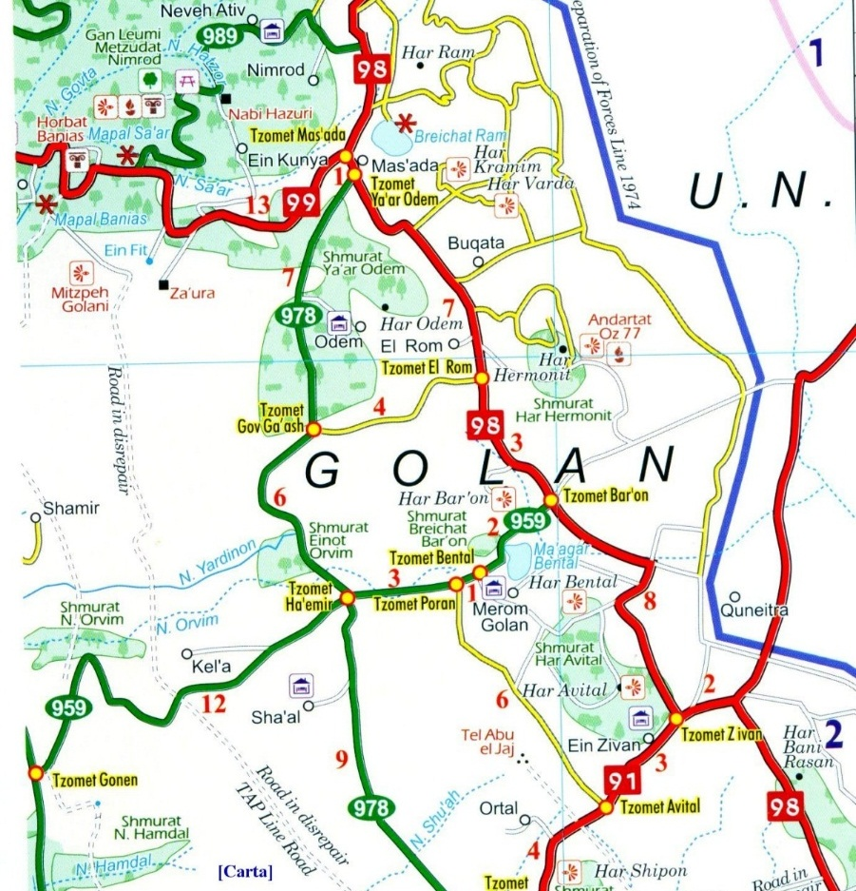
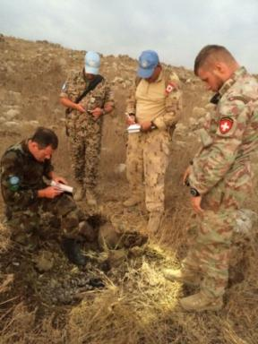
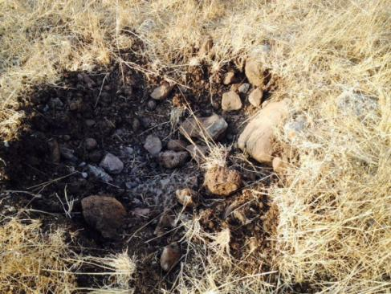
Cross-border Fire - Example
On September 7th at 16:49, a 100mm mortar shell was fired from Syria into Israeli territory and landed IVO the community of ‘Kela Alon’.
Kela Alon
Location of Attack

Slide 13
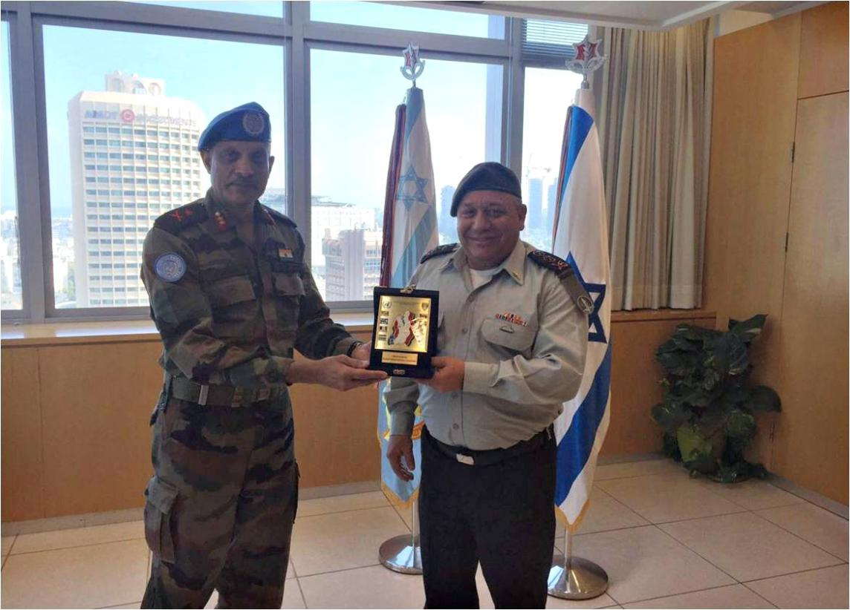
“I wish to express my appreciation for your continued cooperation and the assurance of UNDOFs highest impartiality and cooperation” (Excerpt from letter from MG Jai Shanker Menon, August 31st, 2016)
Photo of Major General Jai Shanker Menon, Head of Mission & Force Commander of UNDOF and
Lieutenant General Gadi Eisenkot, Chief of General Staff of the IDF

Slide 14
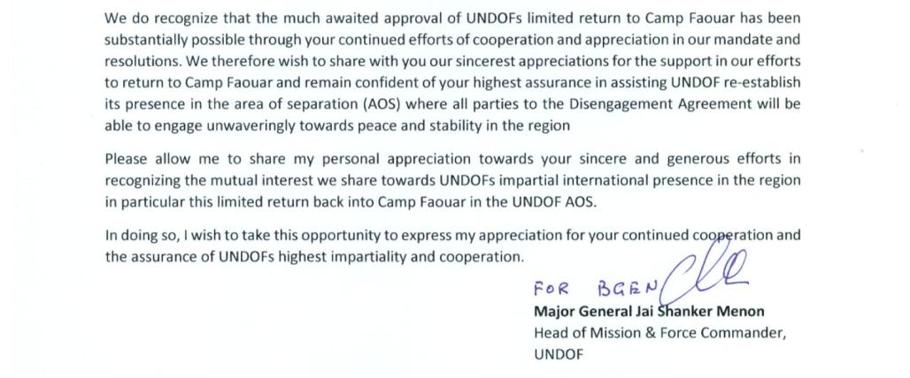
UNDOF appreciation Letter to the IDF
31 August 2016

Slide 15
Israel fully supports and will continue to cooperate and facilitate the operations of UNDOF in order to carry out its mandate safely and securely. Israel will continue to work with UNDOF in order to facilitate a gradual and coordinated redeployment in the area of separation.

