Slide 1
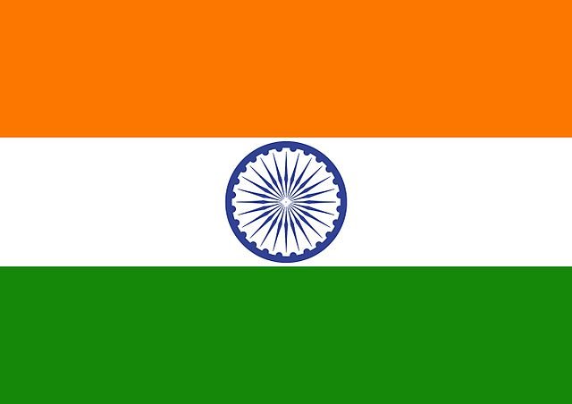
Prime Minister’s Office National Security Council
Israel-India Relations
From a low profile to the front of the stage

Slide 2
Prime Minister’s Office National Security Council
National Security Advisor
The office of the NSC
Special Functions Division
The intelligence division and ministerial committees
Deputy to the head of the NSC
Counter-terrorism, internal security, and home front division
Foreign Policy Division
Security Policy Section
Interior Depart-ment
Visits Depart-ment
Strategic Development and Organization
Intelligence and Middle East Relations Division
Law Division

Slide 3
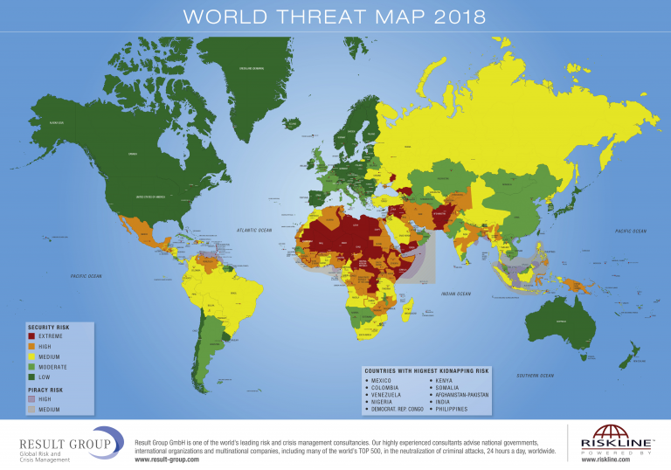
Interests
Components of National Security
Political
Security
Economic
Social
National Security Council
Exclude
Close cooperation with the executive bodies
Policy Planning
Government
Foreign Policy
Guidelines of the Prime Minister
Contacts
Initiatives and response to developments

Slide 4
Prime Minister’s Office National Security Council
Global Terrorist Hotspots
For official use only

Slide 5
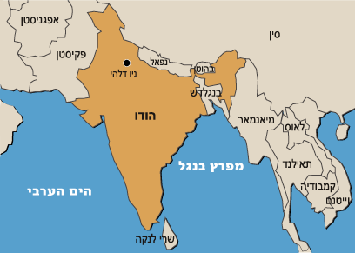
India - General data
The largest democracy in the world - 1.3 billion citizens (11% Muslims, the majority are Sunni at about 80%)
Area - 3,287,263 square kilometers (a land border of about 14 thousand square kilometers), bordering on 6 countries.
GDP per capita - $ 6,700
Growth -6.6%
India has 29 countries diverse ethnically, culturally, economically and linguistically

Slide 6
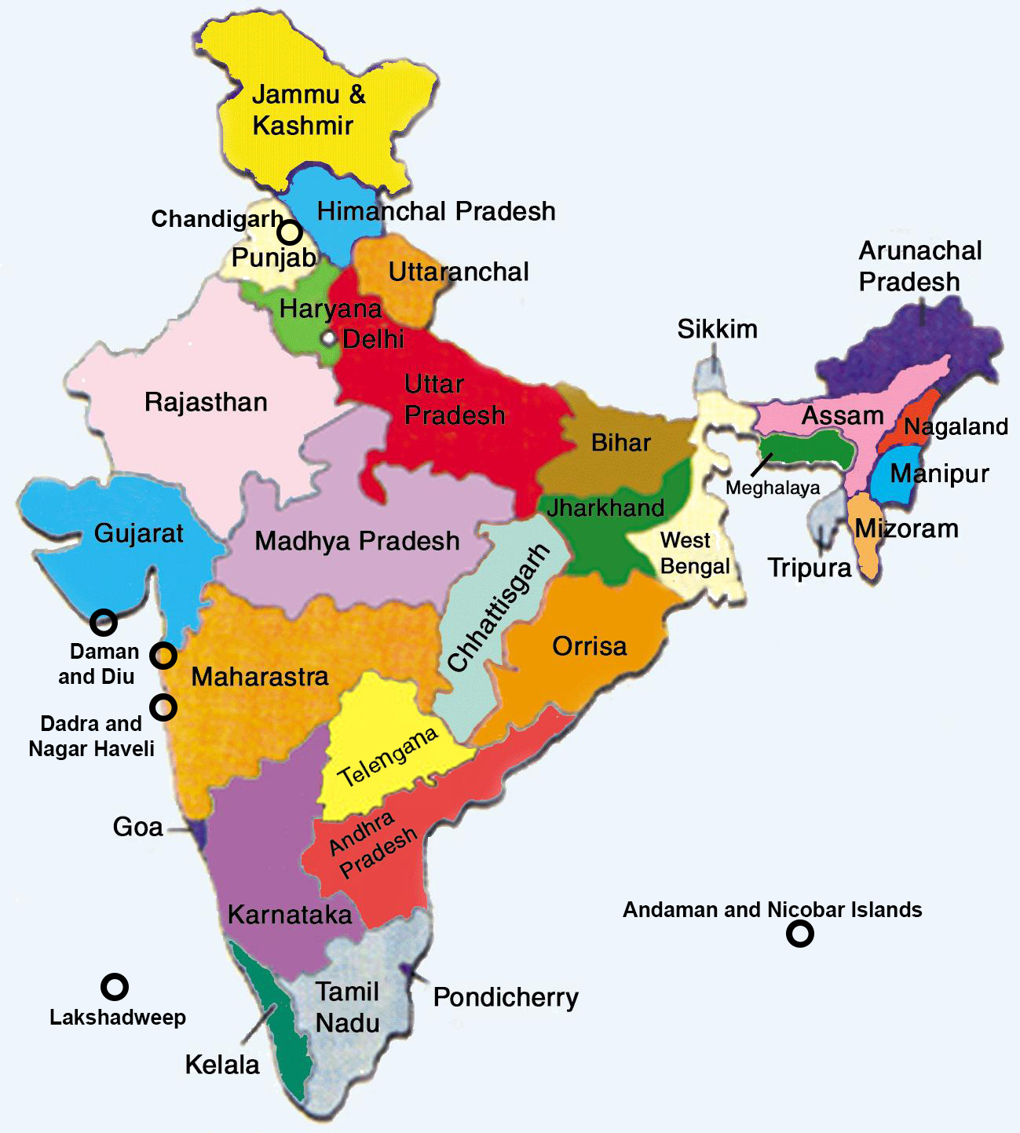
India - State Division

Slide 7
Historical Landmarks
The Partition Plan and the End of the British Mandate (August 1947)
India-Pakistan Wars on Kashmir (1947, 1965, 1971, 1999)
The Indo-China War (1962)
India's nuclear program (beginning in 1967, first experiment in 1974, total 6)
Nuclear Agreement with the US (2006)
Terror in Bombai - July 2006 ("6 Trains", 209 killed, 700 wounded), November 2008 (12 attacks in 4 days, 164 killed, 308 injured), July 11 (3 attacks, 26 killed, 130 wounded).
Crisis of Duklam (Sept’ 17’)
Almost exclusive control of Congress until the turnaround in '14.

Slide 8
Foreign Policy Highlights
The Aspiration to Become a Regional and Global Power:
Dealing with challenges from China (reference threat); From Pakistan (secondary threat); Radical Islam and terrorism.
Promotion of the economic development objectives of India
Upgrading its status in the international organizations: reform of the Security Council; Join the MCN Regimes
A balanced policy - talking to everyone
Changing the orientation of the curriculum to strengthen relations with the "containment belt" of China (US, Japan, Australia) and strategic partnership with Russia.

Slide 9
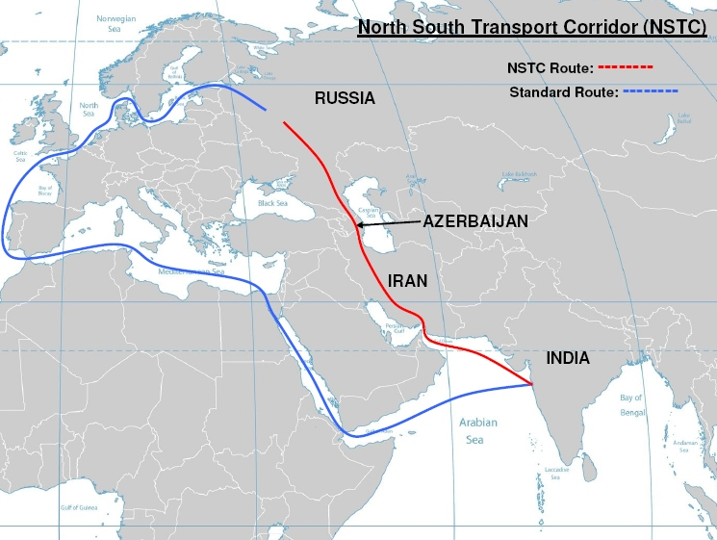
India and the Middle East
Distinction between the Levant and the Gulf State
About 7 Million Indian Workers who return millions of dollars to the Indian Economy
Gas and Oil Aspect
Iran:
Chubahar
Trade; WAIVER

Slide 10
The Interior Design
Parliament elections began (April 11th, 2019) and final results will only be revealed on May 23rd
Moody's position is strong but not as strong as his opening in the previous election
Frequent political elections; relying on regional and sectoral parties
Counterterrorism - radicalization, Islamic Caliphate, Kashmir
Economic reforms alongside the struggle against corruption

Slide 11
Israel - India
Relations were established in 1992
A gradual positive change in the United States
Expanding economic cooperation (Over 4 Billion, half of which is in Diamonds)
Security Cooperation– Over 11 Billion in the last decade
Obstructions - Indian Bureaucracy; Concerns about Arab Countries; Conservatism of the Indian ministry of education
.

Slide 12
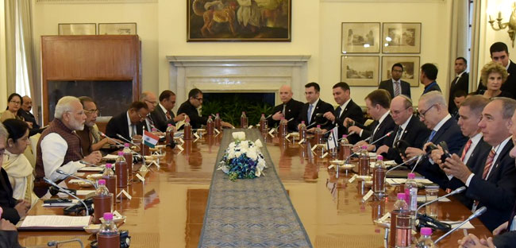
Some Characteristics of the Relationship
Top of senior visits: Mukherjee (Oct. 15’); Rivlin (Oct. 16’); Moody (July 17’); Netanyahu (Jan’18’)
Upgrading of the relationships and their visibility
Expanding the strategic space: from security to citizens as well

Slide 13
Bilateral Issues on the Agenda
The release of security transactions alongside an Indian desire for self-development
Fighting terrorism and protecting borders
Increasing trade and its mix
Offset
Innovation in agriculture, water and cyber
Expansion of Israel-India airports

Slide 14
Prime Minister's Office National Security Council
For official use only

Slide 15
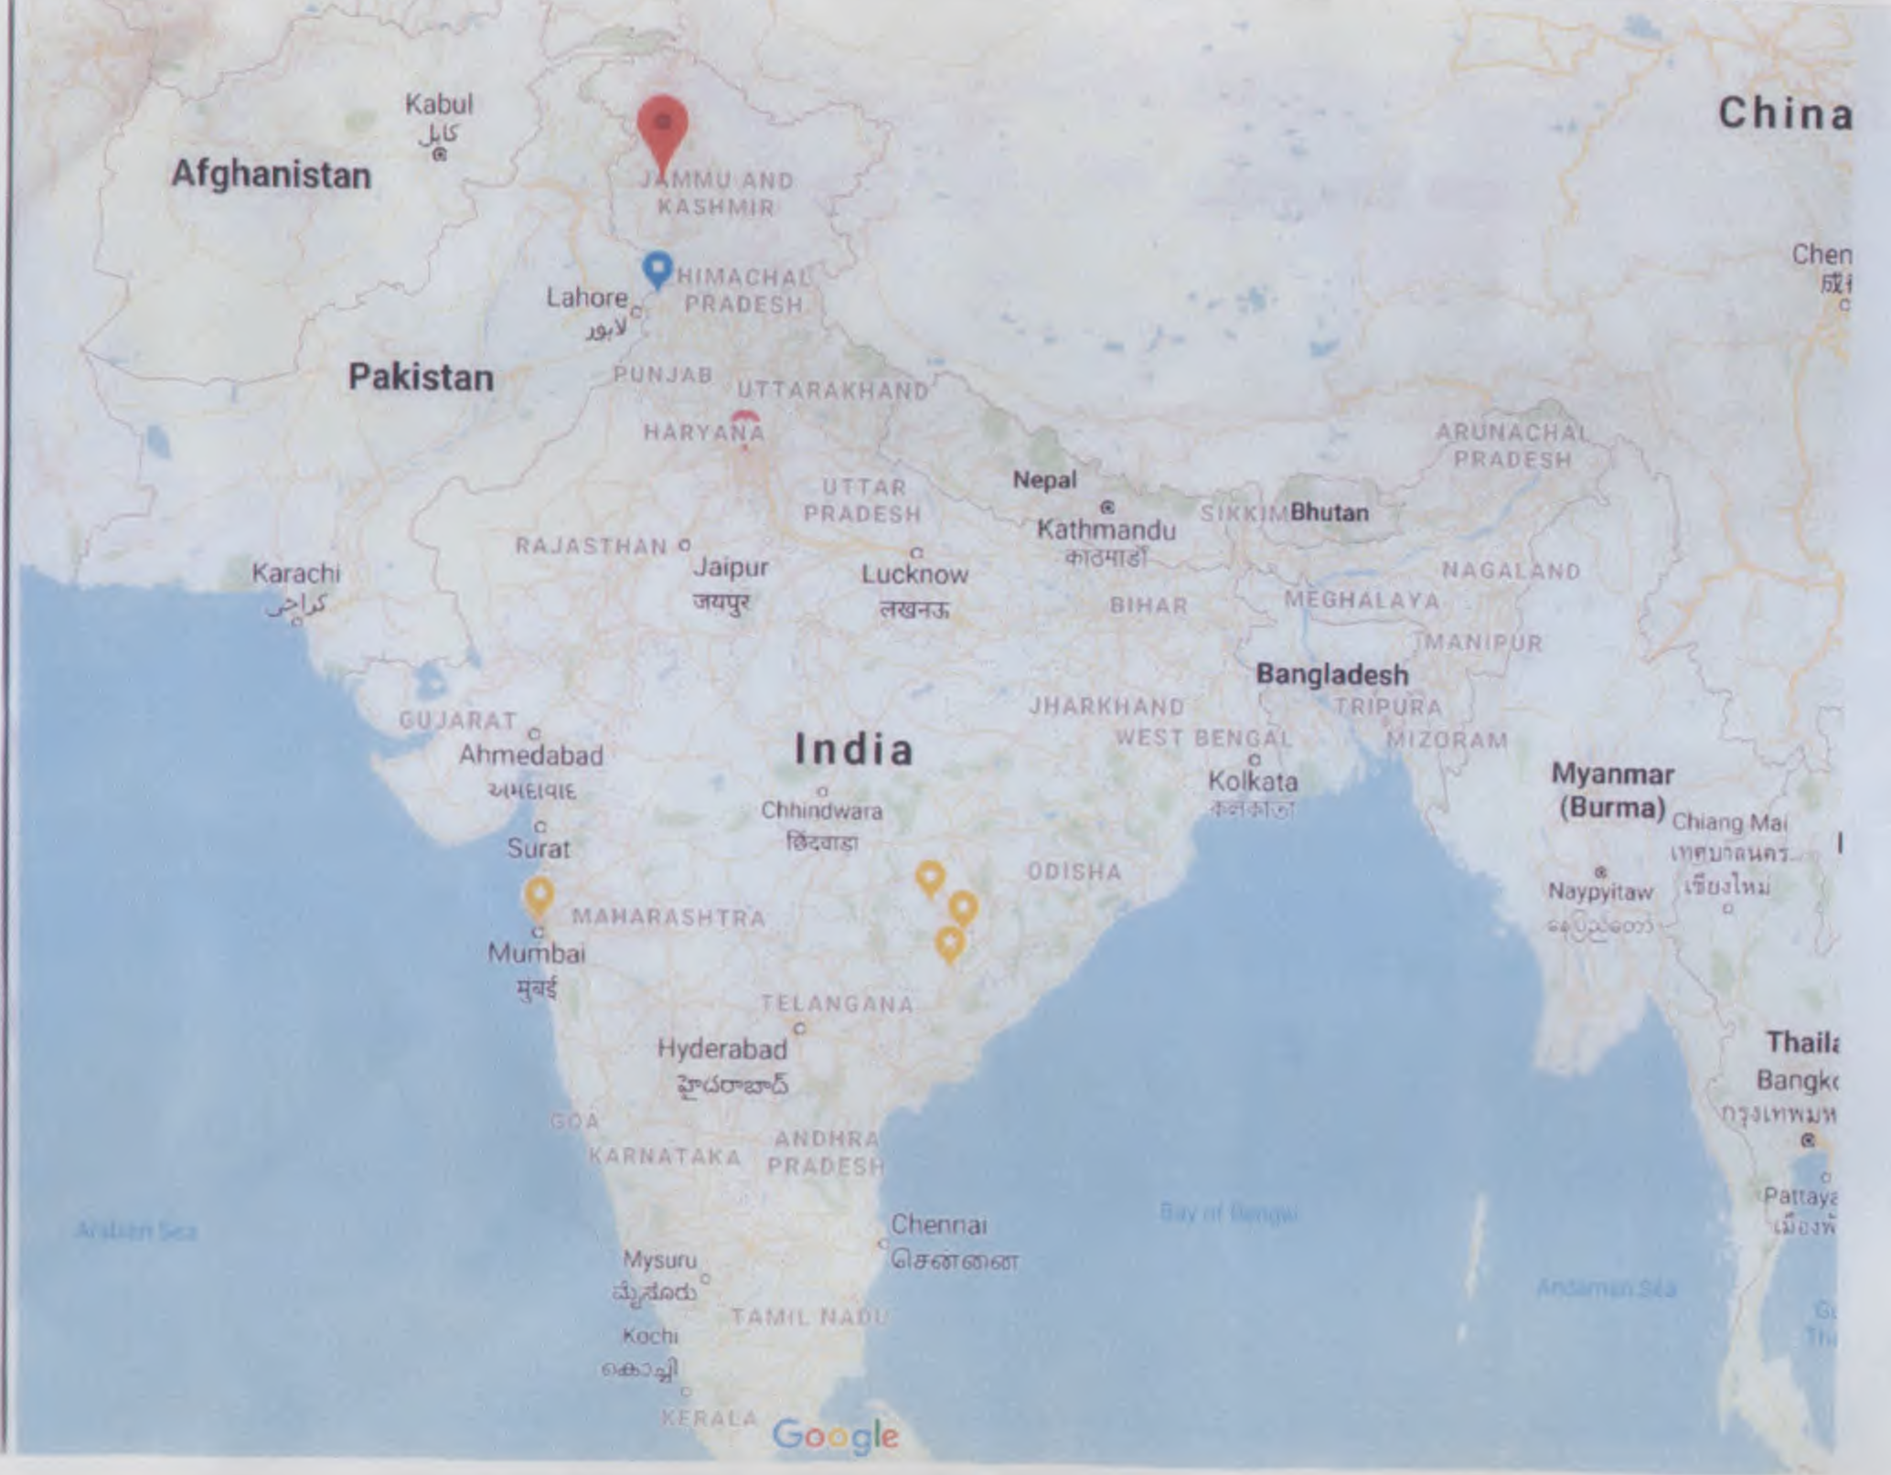

Slide 16
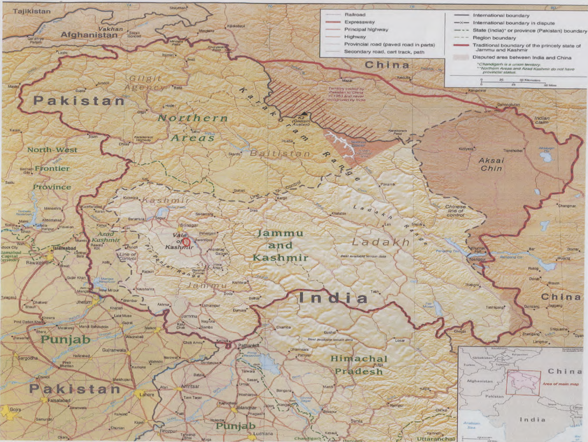

Slide 17
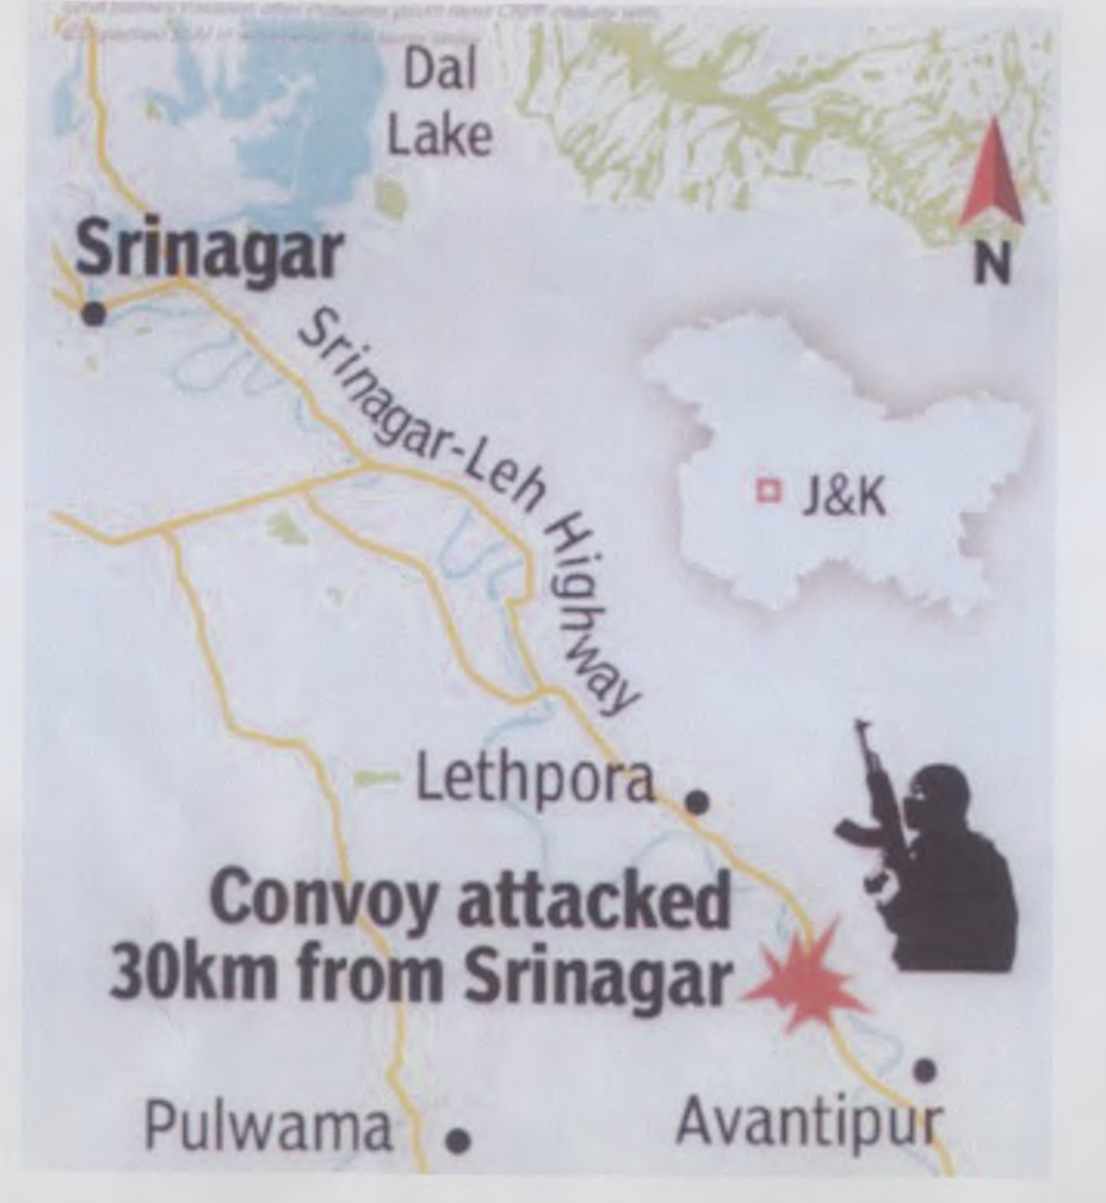

Slide 18
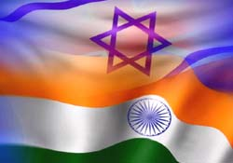
Key Development Data
Prime minster’s office
National security council
Division of CT and HLS
Prime Minister's Office National Security Council
unclassified
April 2014
Agreement on homeland and public security
September 2014
Agreed minutes of joint steering committee
March 2015
Visit of W.G from Israel in India
August 2015
Visit of W.G from India in Israel
July 2017
The Prime Minister of India arrives to Israel
January 2018
Visit of the Israeli Prime Minister to India
Establishment of four working groups
Activity of 3 work groups
Activity of 3 work groups

