Slide 1

Israel’s Labor Productivity Challenges
Dr. Eyal Argov
Research Department - Bank of Israel
Israel National Defense College
March 12th 2019
1

Slide 2


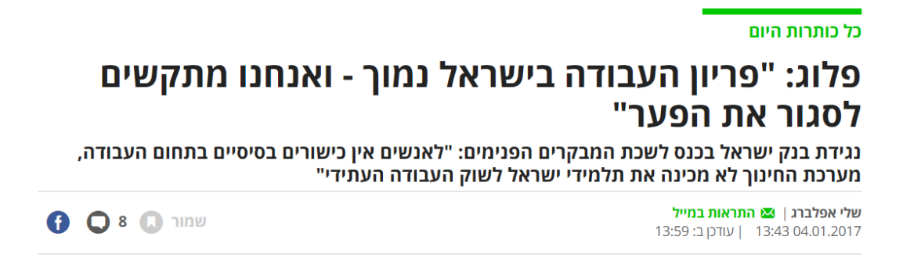


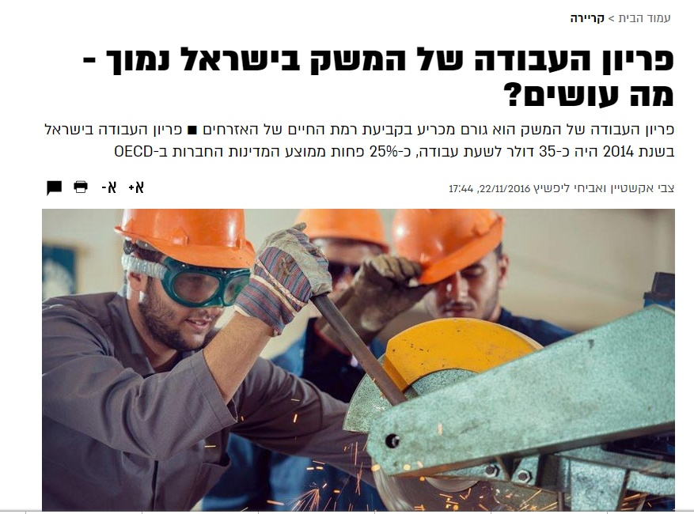
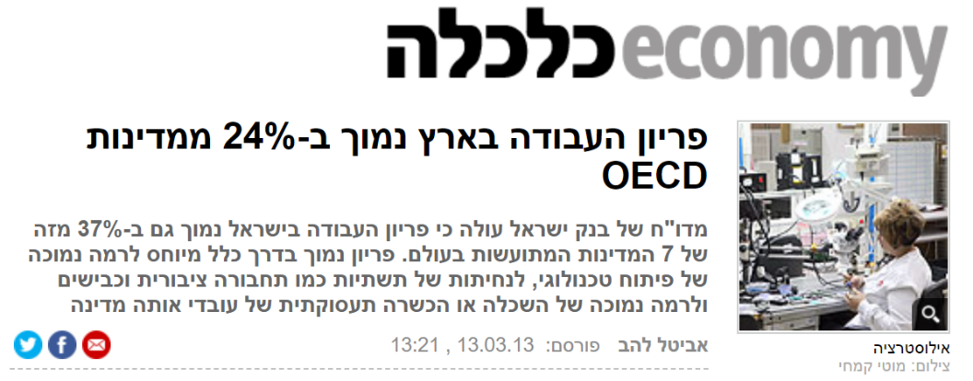

Labor Productivity Has Become a Buzz-Word
Flug: “Labor Productivity in Israel is Low – and We Find it Difficult to Close the Gap”
Labor Productivity in Israel is Low – What Should We Do?
Labor Productivity in Israel is 24% below of the OECD Countries

Slide 3
Why Talk About Labor Productivity?
GDP per capita is the standard measure for examining economic welfare in the economy.
In 2017 Israel's GDP per capita was 13% lower than the OECD average.
Work Intensity
Labor Productivity
GDP Per Capita
Labor Input
X
Product
=
Product
Population
Labor Input
Population
In 2017, work intensity in Israel is higher than the average in the OECD (narrowing the gaps in the employment rate and the increase in working hours).
The lag in GDP per capita lies in Israel's low Labor productivity
Notes:
תוצר לנפש: 14% מתחת ל-OECD, 38% נמוך מארה"ב.

Slide 4
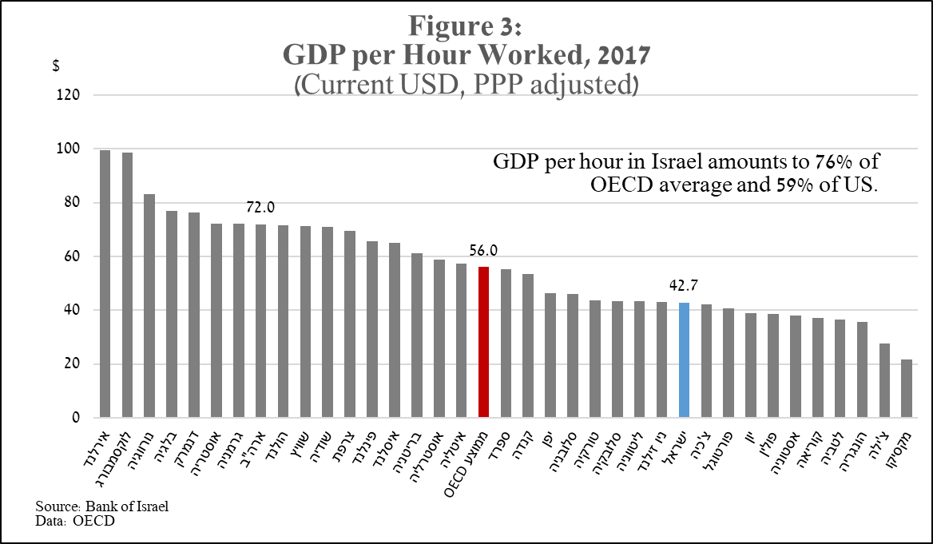
The Level of Labor Productivity in Israel - GDP Per Work Hour - is in the Lower Third of Developed Countries
Ireland
Luxembourg
Norway
Belgium
Denmark
Austria
Germany
U.S.
Holland
Switzerland
Sweden
France
Finland
Iceland
England
Australia
Italy
Average OECD
Spain
Canada
Japan
Slovenia
Turkey
Slovakia
Lithuania
New Zealand
Israel
Czech Republic
Portugal
Greece
Poland
Estonia
Korea
Latvia
Hungary
Chile
Mexico
Notes:
פער: 24% מהOECD, ו45% מארה"ב
יעילות פוחתת עם עליית היקף העבודה: ממוצע שעות העבודה בישראל (37.1) גבוה מממוצע ה-OECD (33.6), וכאשר בוחנים את הקשר בין הפריון לשעות העבודה מוצעים מתאם שלילי ברור (0.85-).
שיעור ההשקעה ביחס לתוצר מתואם עם קצב הגידול בפריון העבודה: בין השנים 2000 – 2011 שיעור ההשקעה בישראל (17 אחוז) היה נמוך ממוצע ה-OECD (22 אחוז). שיעור ההשקעה הנמוך בישראל יכול להסביר כמחצית מהפער ברמת הפריון בין ישראל ל – OECD.
הסבר אפשרי לשיעורי ההשקעה הנמוכים הוא נטל הסיכון הביטחוני והזעזועים הגיאו-פוליטיים באזור הפוגעים בתשואה שניתן להשיג על השקעות.
השפעת גורמים תשתיתיים ובירוקרטיים: הפער לרעת ישראל ברמת הפריון משקף פער לרעת ישראל בענפי המשק (למעט ענף התעשייה שם רמת הפריון זהה כמעט לחלוטין). לאור הפער האחיד בענפים השונים, יתכן שקיימים גורמים תשתיתיים ובירוקרטיים שמשפיעים לרעה.
סביבת הפעילות העסקית: דו"ח הוועדה להגברת התחרות במשק הצביע על רמת תחרות נמוכה בישראל – בשל ריבוי קבוצות עסקיות השולטות במגוון רחב של שווקים.
סביבת הפעילות העסקית עשויה להשפיע על הפריון גם דרך הבירוקרטיה, הרגולציה ומערכות החוק. מדד ה – Doing Business של הבנק העולמי מלמד כי בישראל נושאים אלו טעונים שיפור.
התרחבות כוח העבודה: בשנים האחרונות התרחש בישראל תהליך ברור וייחודי של עליית שיעורי התעסוקה כתוצאה מעליית שיעורי ההשתתפות. המשתתפים החדשים נכנסים עם מעט ניסיון תעסוקתי, והדבר פוגע בפריון שלהם בשוק העבודה.

Slide 5
Work Productivity in Israel Does Not Converge to the Level of Productivity in Developed Countries
G7
Israel
Source: Update to Bank of Israel Annual Report, 2012
Notes:
נראה לי מיותר

Slide 6
Model for Assessing Israel's Long-Term Growth
The Roles of the Model:
Assessing Israel's expected growth rate in the horizon of fifty years ahead.
Assessing the impact of exogenous policy measures or events on long-term growth.
Source: Argov and Tsur (2019)
Notes:
נראה לי מיותר

Slide 7
Israel's Long-Term Growth Rate is Expected to Slow Due to Demographic Changes and Exhaustion of Growth Engines
Source: Argov and Tsur (2019)
Notes:
נראה לי מיותר

Slide 8
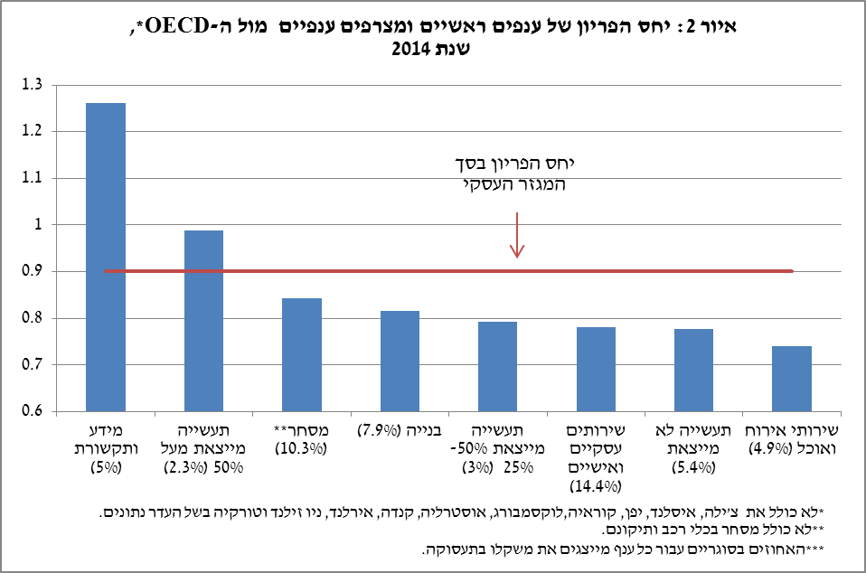
The Lag in Israel's Productivity is Evident in Non-Tradable Industries Serving the Local Market
Figure 2: The Productivity Ratio of the Industry’s Main Industries and aggregated Industries in Relation to the OECD, 2014
The Productivity Ratio in the Total Business Sector
Information and
communications (5%)
Industry exports over 50% (2.3%)
Trade** (10.3%)
Construction (7.9%)
Industry exports 50% -25% (3%)
Business & personal services (14.4%)
Industry that does not export (5.4%)
Accommodation Services and Restaurants (4.9%)
*Excluding Chile, Iceland, Japan, Korea, Luxembourg, Australia, Canada, Ireland, New Zealand, and Turkey due to lack of data.
**Excluding trade in vehicles and repair thereof.
***The percentages in brackets for each industry represent its weight in employment.

Slide 9


The Government Committee for Increasing Labor Productivity in the Economy
The productivity committee began working in January 2016.
Members: Director General of the Ministry of Finance (Chairman), Budget Department, Bank of Israel, Chief Economist, Council for Economics, Ministry of Economy and Industry.
The committee deliberated over time (albeit irregularly) about the productivity problems of the economy.
The committee was unable to reach a final report.

Slide 10

Human Capital:
Education and Skills

Slide 11
Despite the High Rate of Educated People in the Population, the Basic Skills of Workers in Israel are Low Relative to the OECD

Slide 12
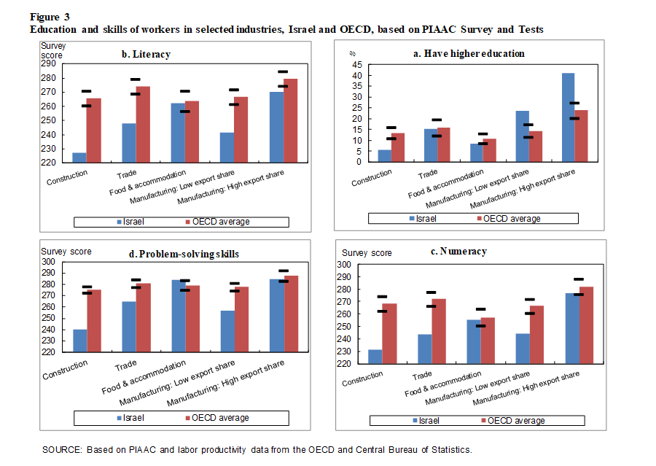
Work Productivity is Low in Places where the Basic Skills of Workers are Low

Slide 13
Israel Lagged Behind Most of the OECD Countries in the Results of International Tests in Mathematics and Science.
Israel’s lag behind the OECD median reduced 0.4 to 0.6 percentage points from the yearly long-term growth rate (according to Hanushek and Woessmann (2012))

Slide 14
The Variance in Student Achievement in Israel is Very High - Not Only Because of Arabs and Ultra-Orthodox.
Arab
Religious
National
Israel Overall
Haredi Women
Total Hebrew Speakers

Slide 15
Israel is Weak in Bringing Students From a Weak Socio-Economic Background to High Educational Achievements.

Slide 16



Desired Policy Directions
Increasing the affirmative action component in education budgeting.
Incentives to divert good teachers to educational institutions from a weak socio-economic background.
Introduction of diffrentialty in the management of schools.
Empowering the pedagogical component in early childhood education (0-3).
Expanding the scope of computer intensive studies in high school.

Slide 17
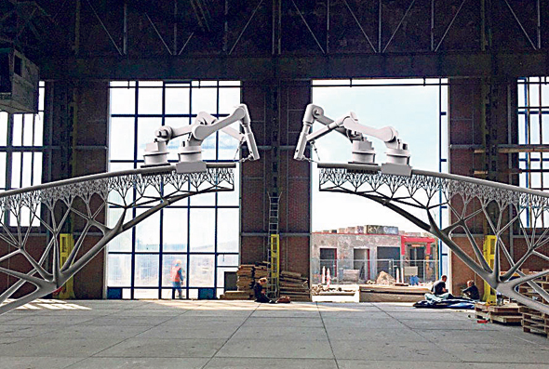


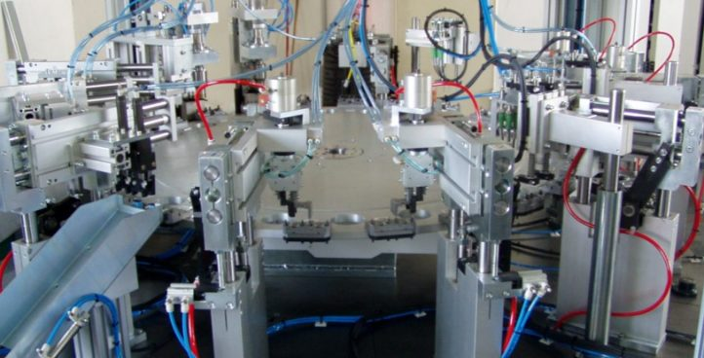
Business Investments and infrastructure

Slide 18
Compared to developed countries, investment in physical capital (machinery, buildings, infrastructure, etc.) is low
Gross capital formation in terms of GDP
(2000-2014)
%
OECD
Comparative
countries *
Israel
* Comparison countries (small, with high work productivity): Ireland, Switzerland, Belgium, Sweden, France, Denmark and the Netherlands.
מקור: Penn World Tables
Notes:
הערה של קובי: השקעה כוללת בנייה.. חלק מהגידול בארה"ב קשור לעודפי בניה. כדאי להוריד את ארה"ב ולשים את מדינות ההשוואה.
ההון לעובד בישראל ביחס להון לעובד ב-OECD הוא 58%, וביחס להון לעובד בארה"ב הוא 50%

Slide 19
Encouragement of Capital Investments Law
Strategic Track: Grants and / or tax benefits for multinational strategic companies (Intel).
Tax benefits for exporting companies (25% exports).
Distortion in the allocation of resources in the economy, which impairs investments and productivity of companies designated for the domestic market.
The alternatives:
1. Expansion of the law to companies that manufacture for the domestic market in industries with competing imports.
2. Providing incentives for research and development.

Slide 20
Infrastructure: Satisfaction with low public transportation
Palermo, Italy
Napoli, Italy
Jerusalem
Hollo ,Finland
Bucharest, Romania
Verona, Italy
Nicosia, Cyprus
Volta, Malta
Anakra,Turkey
bartislova,Slovakia
Diarbikur,Turkey
Moskoltz,Hungary
Antlia, Turkey
Lisbon,Potrugal
Lisbon, Portugal(Area)
Lig,Belgium
Marseille, France
Tel Aviv area
Hayarklion,Greece
Braga, Portugal
Torino, Italy
Haifa
Brussels, Belgium
Sofia,Bulgaria
Atuna ,Greece
Paris, France
Madrid, Spain
Barcelona, Spain
Bolonia,Italy
Zegrab,Croatia
Ovedo,Spain
talin,Estonia
Zubi,swizeterland
Krakow,Poland
Dublin,Ireland
Paris, France
Malmo, Sweden
Asin,Germany
Clognipoka,Romania
Grartz,Austria
Stolhkom,Sweden
Balfest,Ireland
Kobenhangen,Denmark
Lobleana,Slovenia
Gadnesak,Poland
Haroninegan,Holland
Liel,France
Galzego,Britian
Bordeau,France
Luxemberg
Amsterdam,Holland
Bialistock,Poland
Prague,Czeck
Berlin,germany
Oslo, Norway
Ran,France
Shtarsberg,france
Lipsieg, Geramny
Manchester,UK
London,Uk
Munich,Germany
Dortmond,Germany
Hamburg,Germany
Helsinky,Finland
Rustick,Germany
Viena,Austria
Zurich,Switzerland
A measure of satisfaction with public transportation in large and medium-sized cities in Israel and Europe

Slide 21
Infrastructure: The use of public transportation in Tel Aviv is low compared to similar cities around the world

Slide 22
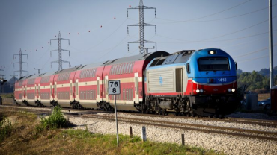

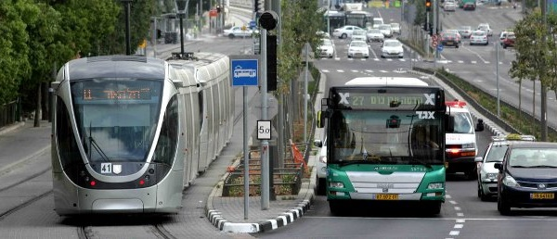
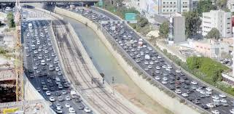
Policy directions in the field of transportation infrastructure
Increasing investment in mass transportation - with an emphasis on trains.
Improved planning ability. Establishment of metropolitan authorities.
Improving coordination between the different transportation systems.
Promoting a program to regulate demand in busy areas and hours of the day.

Slide 23
Additional Topics
Bureaucracy and ease of doing business.
Making the public sector more efficient.
Work productivity in the ultra-Orthodox and
Arab sectors.
4. Foreign workers.
5. Technological education for adults.

Slide 24
Thank You
24

