Slide 1
Intro to NATO
Tommy Steiner
IDC Herzliya

Slide 2
Introduction to NATO
NATO’s History: The Cold War and its Legacy
NATO after the End of the Cold War
The 1990s: “Europe Whole, Free and at Peace”
Post September 11: NATO and the War on Terror
Emerging from Irrelevance? Revisionist Russia and the Southern Flank

Slide 3
NATO’ History: The Cold War and its Legacy
“To keep the Americans in, the Russians out, and the Germans down”
Article V –
“an armed attack against one or more of them in Europe or North America shall be considered an attack against them all…” [but] … “such action as it deems necessary”
A difficult alliance – asymmetry and burden-sharing
Suez Crisis
Nuclear Strategy
The French Departure

Slide 4
The 1990s: “Europe Whole, Free and at Peace”
Triumph and Challenges:
German Unification
The Transition of Central and European Countries
Conflict and Crisis in the Balkans
NATO’s responses:
New Raison d'être
Open Door – Enlargement
Out of Area: The Use of Force to Stabilize former Yugoslavia
Bosnia
Kosovo

Slide 5
Post September 11: NATO and the War on Terror
Invoking Article V
War in Afghanistan:
From a “coalition of willing” to allied operation
Merging Operation Enduring Freedom (OEF) with NATO-led ISAF
Burden Sharing – the new dimension:
Risk Sharing
From Surge to Withdrawal:
Issues, dilemmas, and the mixed balance sheet
Out of Area or Out of Business?
Discovering the Middle East:
The Mediterranean Dialogue, ICI …

Slide 6
Emerging from Irrelevance? Revisionist Russia and the Southern Flank
The Russian Challenge – Refocusing on Collective Defense:
Ukraine – The First Stop?
NATO’s Deployment to East Europe and the Baltics
NATO and its Southern Flank
Maritime security
Partnership, Defense-Building Capacity (DBC – training)
Assurances and Peacekeeping (wishful thinking?)
Will NATO withstand political challenges?
The “Trump Factor” and Burden Sharing – the 2% gap
Populism, values, Brexit – Is there a future for Transatlantic Relations?

Slide 7
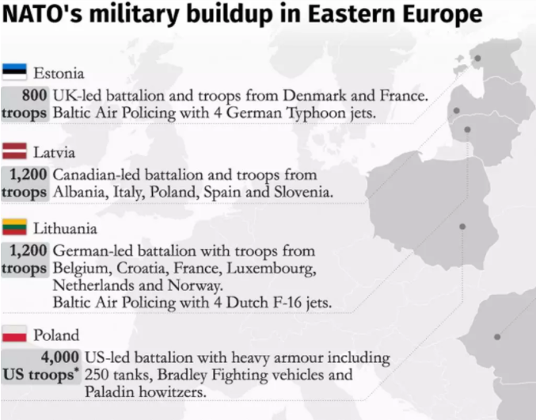
NATO’s New Deployment

