Slide 1
Structure of the National Unit of International Crime Investigations
Head of the Unit of International Crime Investigations
Brigadier General (INP)
Manpower Officer
Head of Investigations
Commander (INP)
Bureau Chief
Manpower NCO
Assistant
Secretary
Legal Advisor
Head of Information Disclosure
Commander (INP)
Investigations Unit- Chief Super-intendent
Assessment and Evaluation Unit - Chief Superintendent
Intelligence Reconnaissance Team
Information Gathering Unit - Chief Superintendent
Organized Crime A.- Chief Superintendent
Organized Crime B.- Chief Superintendent
Security- Chief Superintendent
Task Force of Criminal Organizations
Task Force of Money Laundering
Task Force of Financing Terrorism
Explosive Devices Unit
Force Build-up - 164

Slide 2
Areas of Focus
People who prepare Explosive Devices
Security Cases / Terror
Financing
Crime Organizations
Judicial Inquiry
BMS Crimes
YAHBAL
Nazi Crimes
Money Laundering
Organized Inter-national Crime
Import / Trade

Slide 3
Criminal Organizations – YAHBAL 2018
8008
905
4004

Slide 4
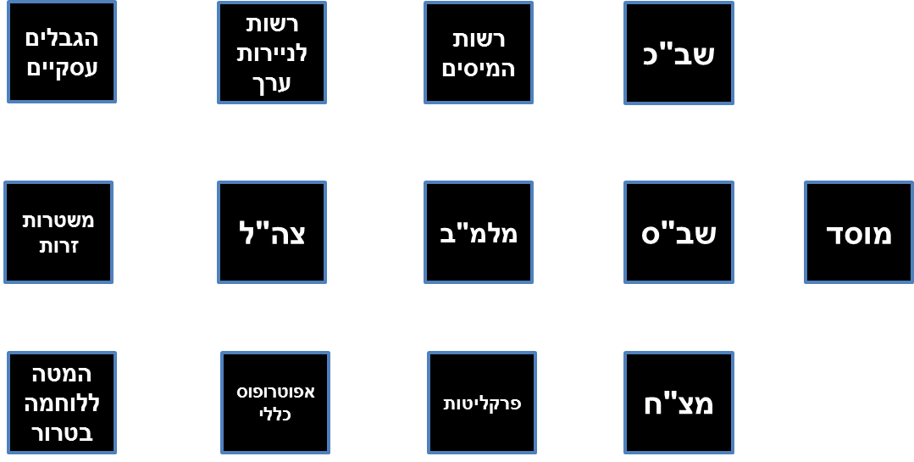
Interfaces/Partnerships
Work Limits
Israel Securities
Authority
Taxes Authority
The ISA (Shabak)
Foreign Police Agencies
The IDF
Director of Security of the Defense Establishment
The IPS
Mossad
The Counter-Terrorism Bureau
The General Guardian
Attorney's office
Investigative Army Police

