Slide 1

Iinnovation & simulation
BG. Eran Niv
“Shiluach” Division, IDF-J5

Slide 2

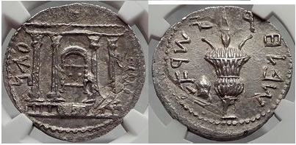
Bar kokhba revolt 132-136 CE
“To build a bridge up to half the river” / Harkabi

Slide 3
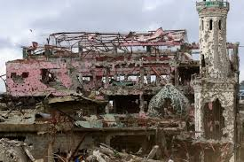
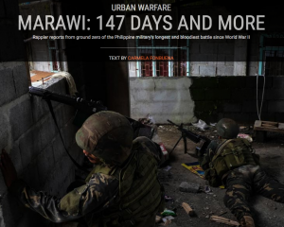

representation
Where are the troops?
Is there a line of sight?
Collateral damage?

Slide 4
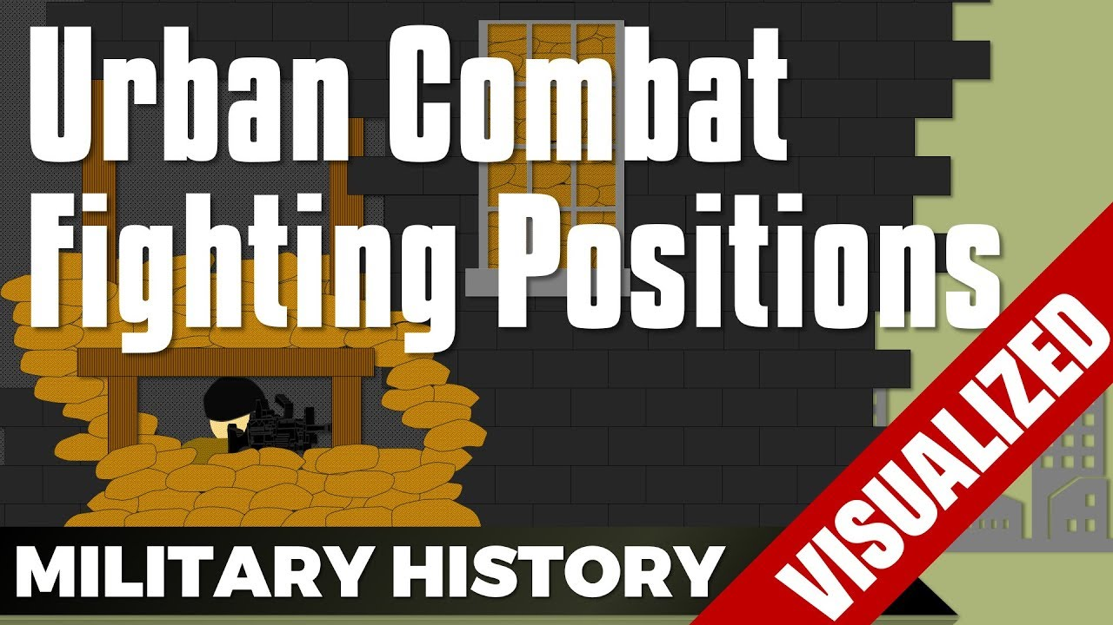
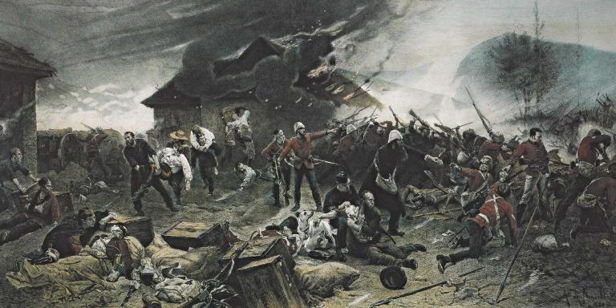
judgment
Be reasonable!

Slide 5
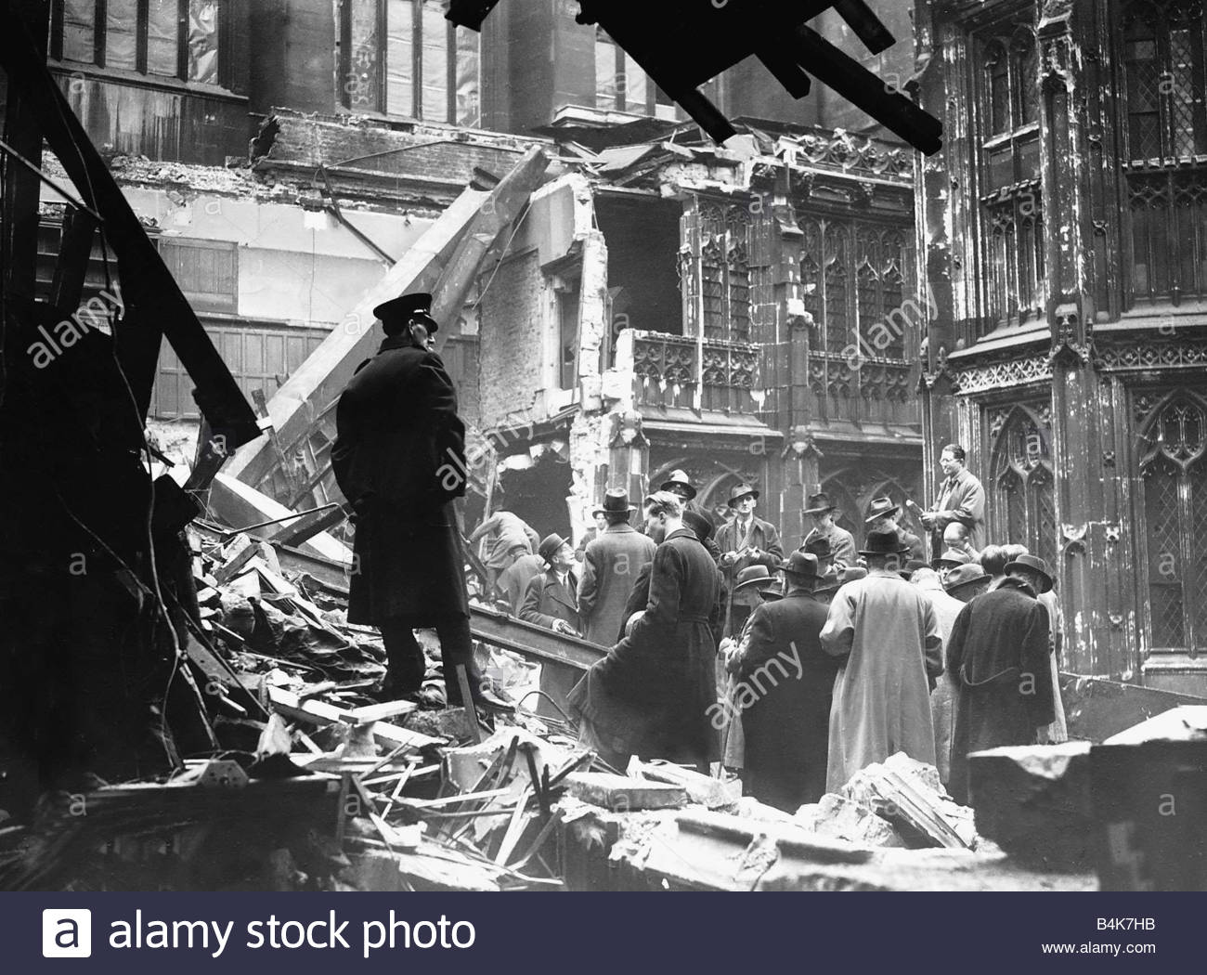
assessment
Bombing of London, house of commons
What is happening in the first 5 minutes?
30 minutes?
60 minutes?
4 hours?

Slide 6
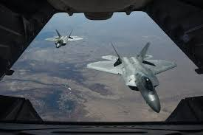
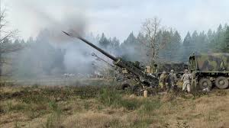
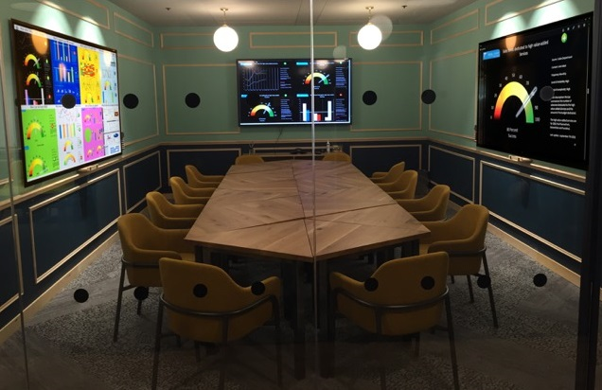
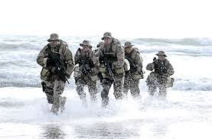
joint
At the same time
On a shared system
From different places

Slide 7
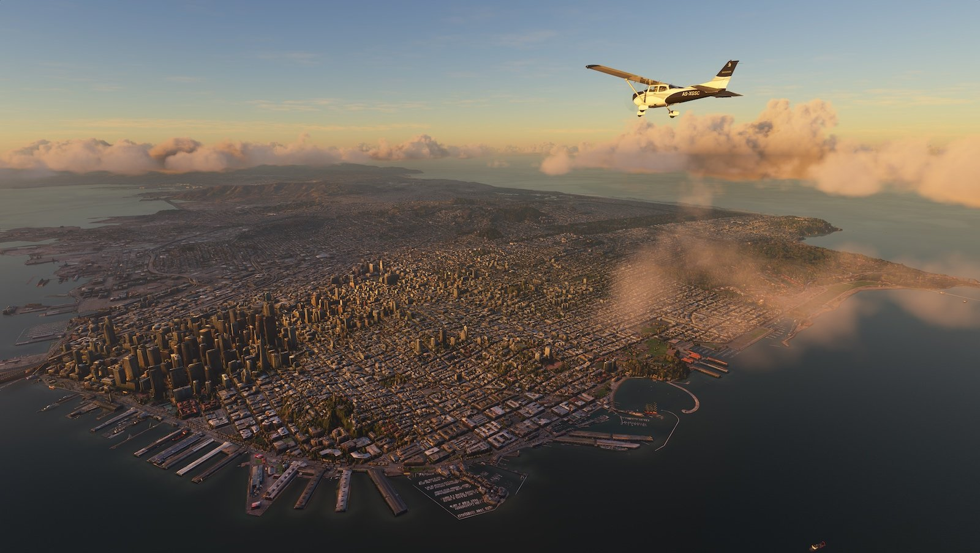
So, we want it…
Accurate
Reasonable
Professional
Simultaneously
decentralized
continuous
Easy-going
And … Cheap
STE, OWT, AR, TSS,TMT…

Slide 8
STILL, THERE ARE CHALLENGES…
Evaluating the Enemy’s COA
Full use of combat means
Management of uncertainties
Act faster than the enemy
Win the learning competition

Slide 9
What is next - ai
There is a need to build simulations
that are themselves learning agents -
Able to compare their outcomes with
actual results, assign “blame,” and
adjust parameters in a semi-automated
or automated way” (Surdu, 2007)

Slide 10
What next - ai
“We all know that with VA, AR, LVC,
AI, and the development of machine
learning, we in the military, in the DoD
are just too slow to take advantage…
It’s a challenge we are all going to
have to continue to face and work
through.” (Drummond, 2017)

Slide 11
To summarise…
There is a need to examine new trends
There is always more than one solution
the insights have a powerful influence on the build up planning
The cost of mistake is enormous
We need to develop simulations that train, educated and support our decisions.
The development of the data science and simulation enable us to examine new concepts faster and more accurate
The IDF will be happy for fruitful collaborations

Slide 12
Questions?

