Slide 1
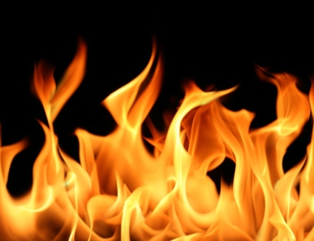
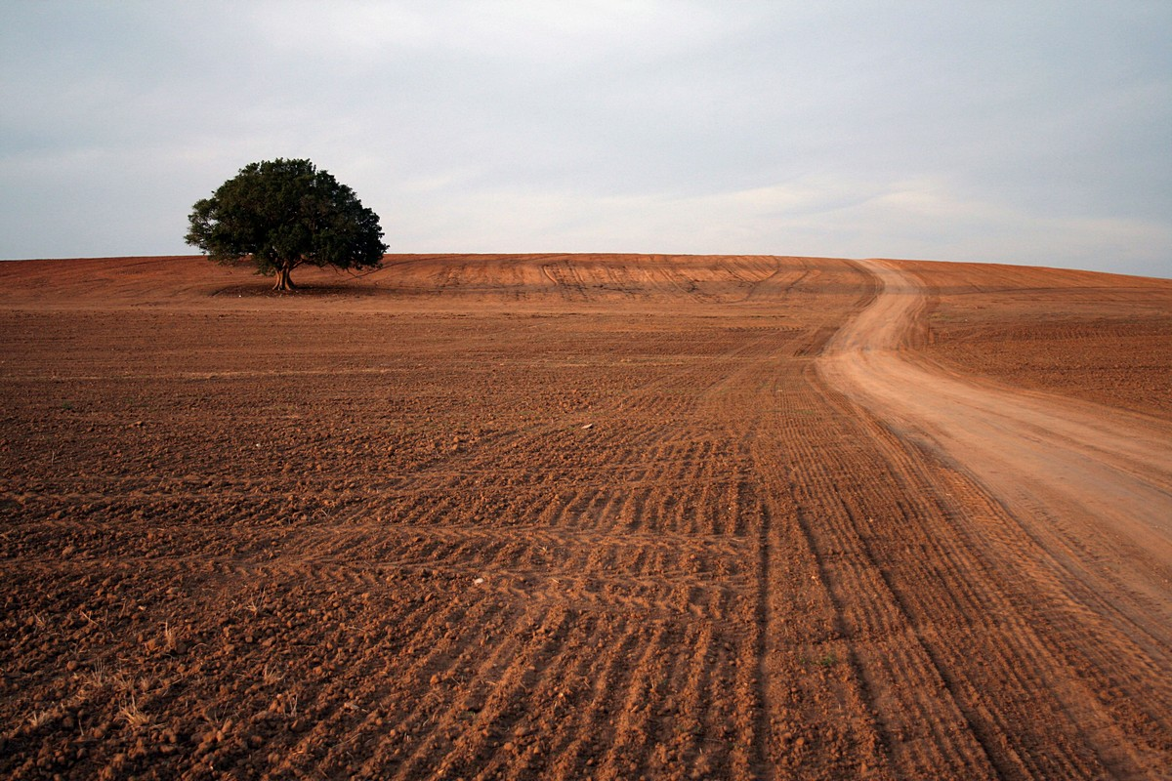
National Infrastructure Tour
6.6.2019

Slide 2
המטרה
The Goal:
Exposure to the world of national infrastructures in the State of Israel, focusing on the world of energy and transportation.
In order to enable a national-systematic-infrastructural observation, long-term among senior officials

Slide 3
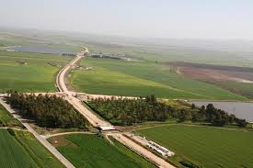
Definition
National Infrastructure Defined in the Law: “As Infrastructure facilities, airports, ports, water desalination facilities, water and sewage installations including reservoirs, waste disposal and treatment facilities, communications facilities, power station, gas and fuel storage facilities, natural liquid gas facilities, mining and quarrying sites.
And all, if the Prime Minister, the Minister of Finance and the Minister of the Interior declared about each of them, that they are of national importance."

Slide 4
Planning processes of national infrastructures undergo approval processes until government approval.
The committee is delegated all the powers of the National Council, it can change national outline plans and its status is equal and even exceeds the status of any National Outline Plan.
The committee consists of 15 members: representatives of ministers and ministries (Interior, Prime Minister, Justice, Ministry of National Infrastructures, Environmental Protection, Transportation, Housing, Finance, Agriculture and the Ministry of Defense)

Slide 5
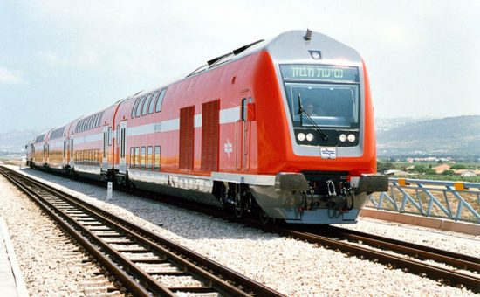
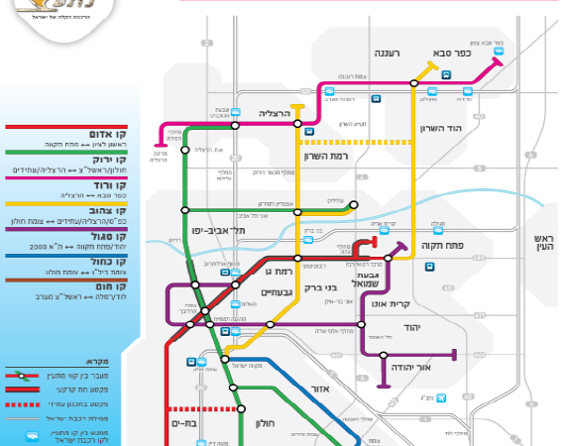
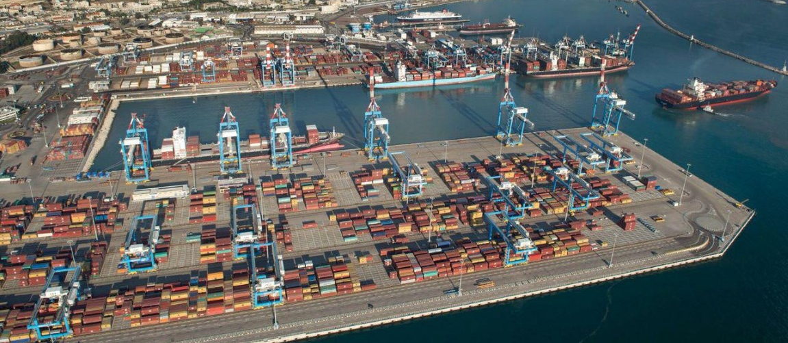
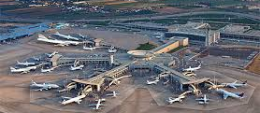
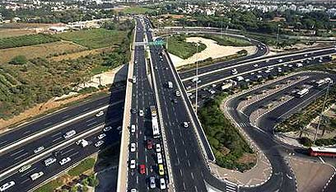
Transportation

Slide 6
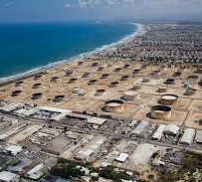
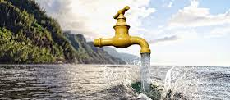
Power and water

Slide 7
Preparatory Lectures for Infrastructure tour
08:30-09:30 Chairman of the Israel Electrical Authority Dr. Assaf Eilat
09:30-10:30 CEO of the Energy Ministry, Mr. Udi Adiri
10:30-11:00 Break
11:00-12:30 Ministry of Transport – Mr. Assaf Asher, Senior Head of Division, Development Budgets, Infrastructure Management at the Ministry of Transport

Slide 8
Tour Schedule
Travel :
Departure by bus from the INDC
An option to join at the train station at Lehavim at 07:30.
Back by bus from Ashdod to the INDC.
Another bus will travel to Lehavim and stop at the train station in Kiryat Gat / Ashdod.
Prohibition on carrying weapons
Sailing in three ‘Dvora’ boats
Time | Activity
06:30-08:30 | Travel from the INDC to Ashalim
08:30-09:00 | Breakfast in Ashalim
09:00-09:15 | View and overview of the thermo-solar power plant
09:30-09:45 | A tour of the power plant
10:00-10:30 | Travel to 'Givat Shemen'
10:30-12:00 | Overview and sightseeing at the gas terminal
12:15-13:00 | Lunch at the school for Air Defense
13:00-14:30 | Travel to Ashdod
14:30-17:00 | Review + Oil platform
17:00-19:00 | Travel back to the INDC

