Slide 1


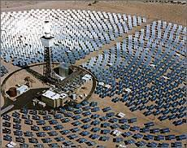
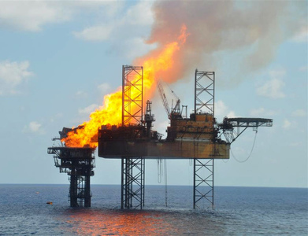
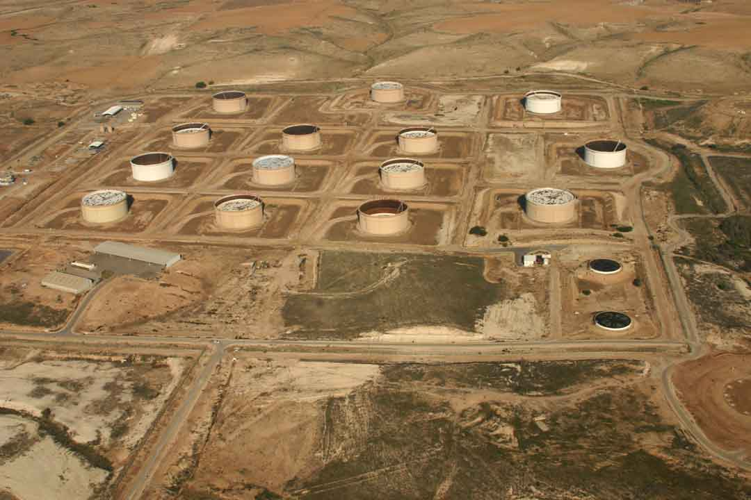
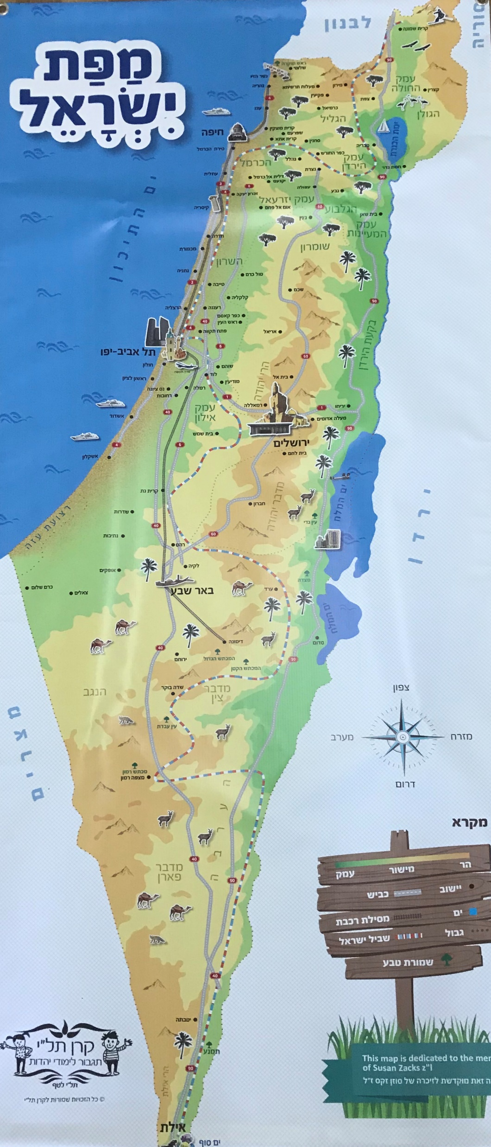

Infrastructure Tour
Schedule, June 6th, 2019
Time | Activity
06:30-08:30 | Travel from the INDC to the town of Ashalim
08:30-09:00 | Breakfast at Ashalim
09:00-09:15 | View and overview of the thermo-solar power plant
09:30-09:45 | A tour of the power plant
10:00-10:30 | Travel to 'Givat Shemen'
10:30-12:00 | Overview and sightseeing at the gas terminal
12:15-13:00 | Lunch at the School for Air Defense
13:00-14:30 | Travel to Ashdod
14:30-17:00 | Review + Sailing to the oil platform
17:00-19:00 | Travel back to the INDC
INDC
Oil Platform
Navy Base
Givat Shemen
Ashalim

Slide 2
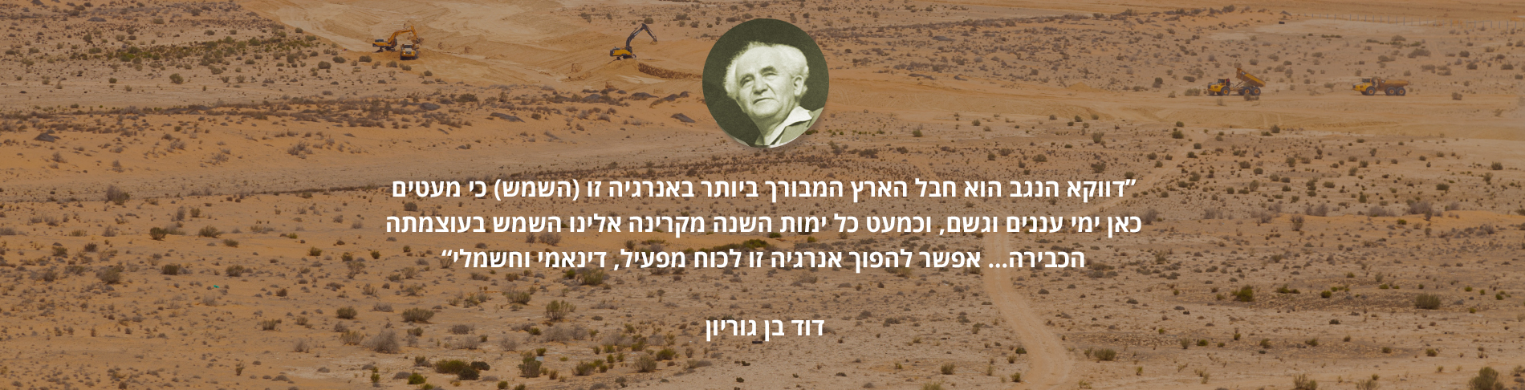
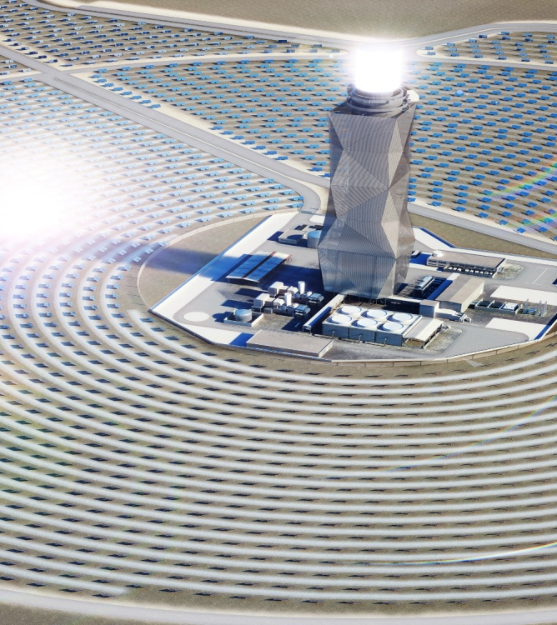
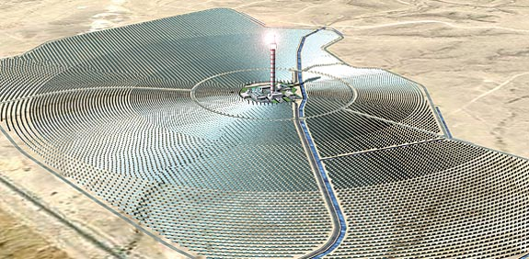
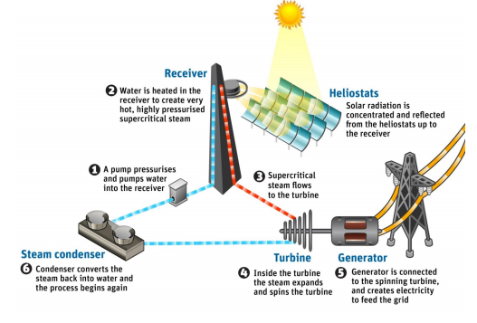
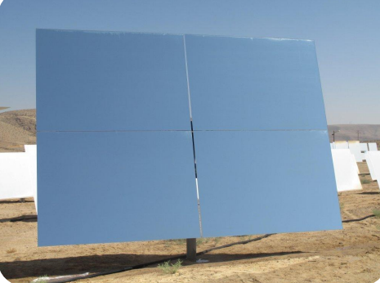
Solar technologies in Ashalim
“The Negev is the most blessed region with this energy (sun) because there are almost no days of clouds and rain, and almost every year the sun radiates to us with its tremendous power ... This energy can be turned into an active, dynamic and electric force”
David Ben Gurion
The state decision (Decision No. 4450) of 2009 is aimed at generating electricity of the renewable energy sources that make up 10% of the country's electricity sector, by 2020. This is part of the commitment during the Paris conference (December 2015) to reach 17% by 2030.
The platform demonstrates 3 different technologies and produces about half a percentage of the electricity consumption in the State of Israel
Photovoltaic Plant (PV)
Thermoelectric Plant
Thermo-Solar Power Plant

Slide 3
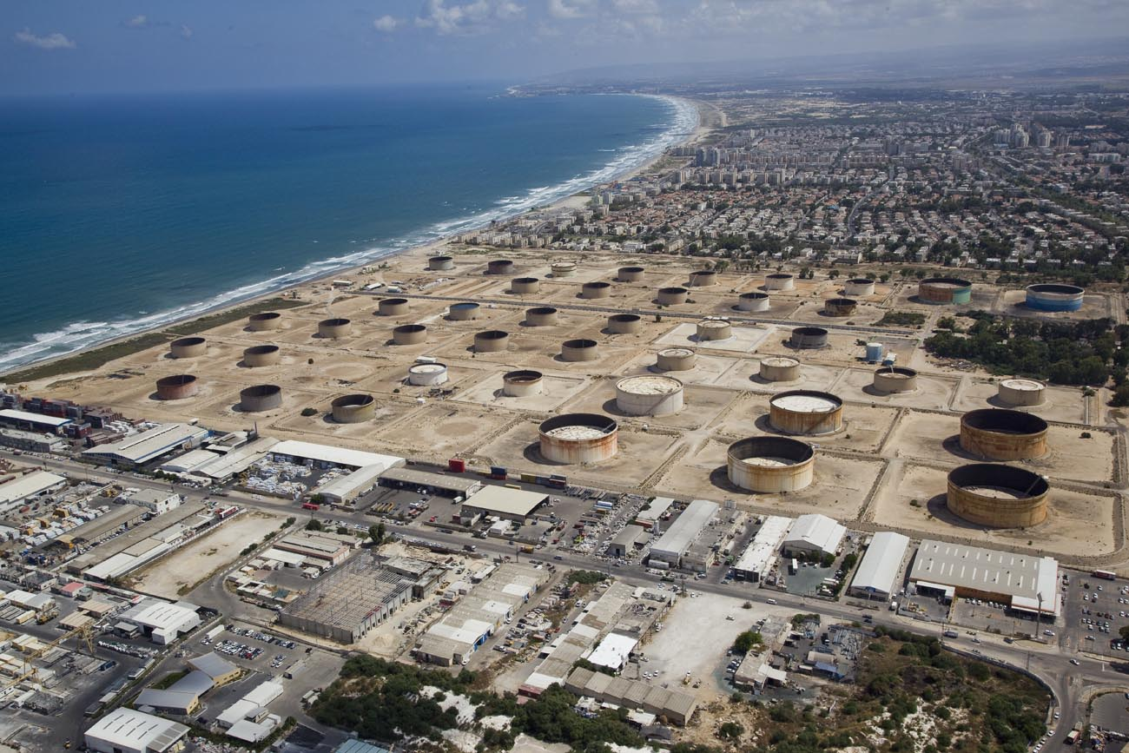
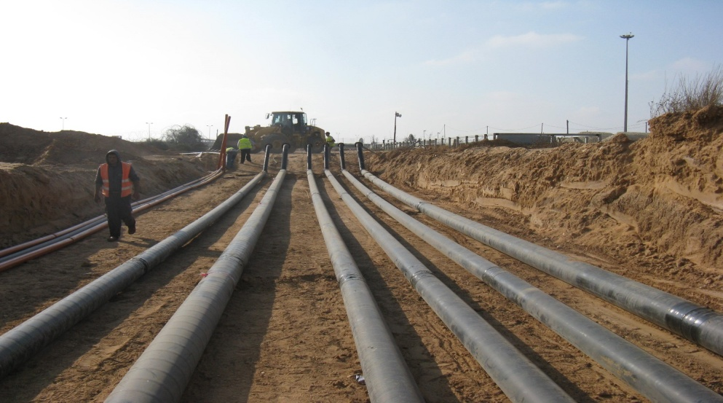
Fuel Industry
The Fuel Industry
The Israeli fuel industry is an integral part of our daily lives and thanks to the energy produced from crude oil and its distillates, from coal and natural gas, we are can live normative lives. However, for these raw materials to reach the producers, be processed and then reach the consumers, the government of Israel operates Petroleum & Energy Infrastructures Ltd (PEI).
PEI is the national infrastructure corporation for the fuel and energy economy in Israel (100% State-owned). PEI is responsible for providing Israel’s energy requirements, both routinely and in emergencies, with its activities focusing on four main areas which include:
Offloading at the port- Port services that include loading and unloading of crude oil and its products.
Storage - Storage of crude oil and its products: fuel oil, diesel fuel, kerosene and gasoline.
Transmission - The flow of crude oil and its products into a national network linking the oil refineries, the storage sites and the large consumers (IEC, the defense establishment, Ben-Gurion Airport, a supply depot for road tankers, etc.)
Distribution - distribution of fuel products to the various marketing companies
PEI owns a subsidiary called Petroleum Products Pipeline Ltd. The company is fully owned by PEI and is responsible, among other things, for the planning, establishment, operation and maintenance of the many pipeline systems for transporting distillates the companies’ activities include the handling of fuel and its products. In view of the sensitivity involved, a great deal of attention is paid to environmental and safety considerations. Therefore, the companies collaborate with the many relevant authorities including the Ministry of the Environment, local municipalities and the Home Front Command, operating according to guidelines and requirements of the law. In addition, the companies focus extensively on preventing pollution, control and monitoring and, if the need arises, treating pollution.

Slide 4
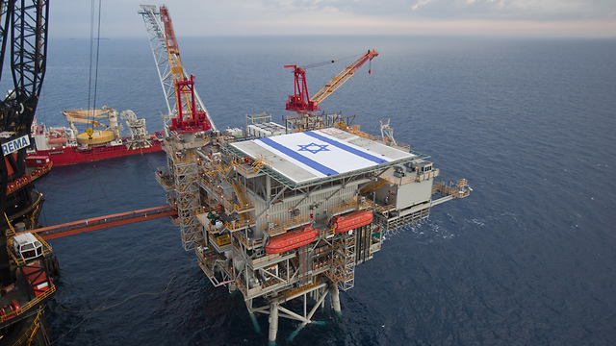
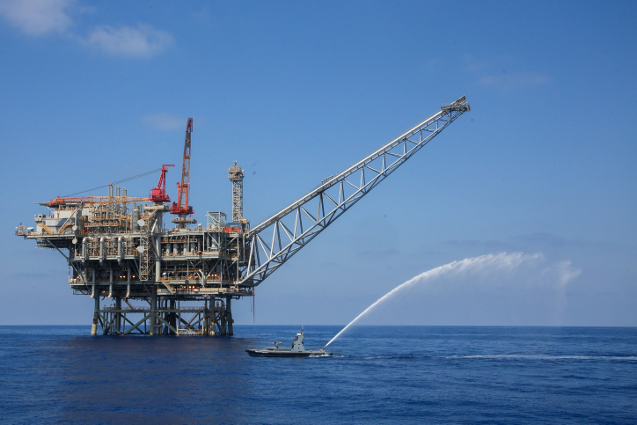
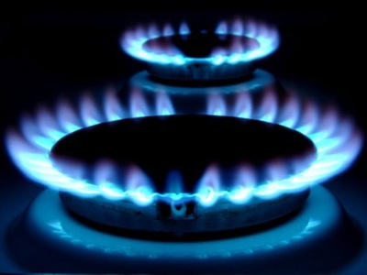
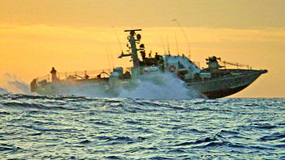
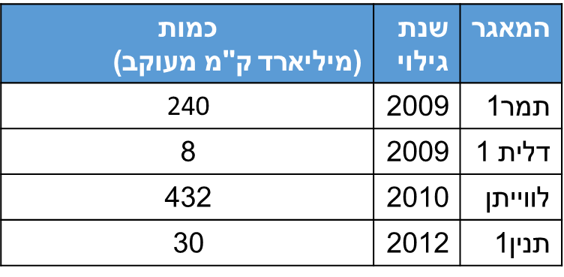
Platforms and gas transmission infrastructure in Israel
Israel Natural Gas Lines
National transmission system for natural gas
Amount
(Billion cubic km)
Year
of
discovery
Reservoir
Tamar 1
Dalit 1
Leviathan
Tanin 1

