Slide 1
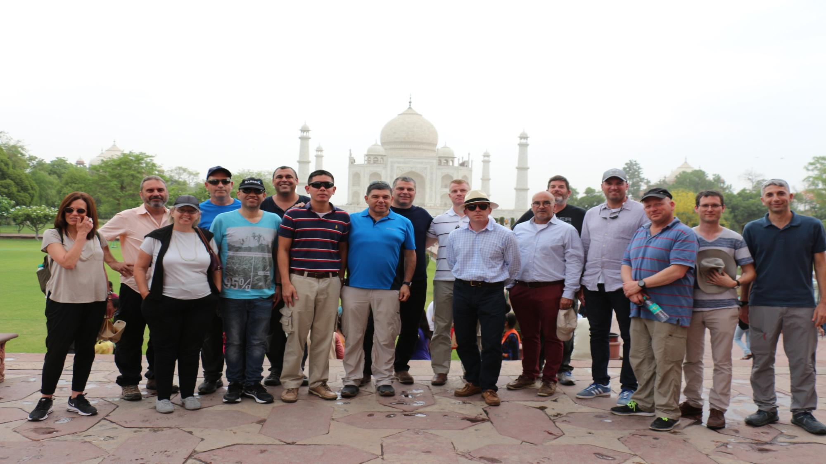
TEAM INDIA

Slide 2
The purpose of the tour
Recognizing India as a central player in the international system characterized by "different" strategic thinking:
Knowledge of culture, heritage and roots – the “DNA”
Understanding national security and strategic culture

Slide 3
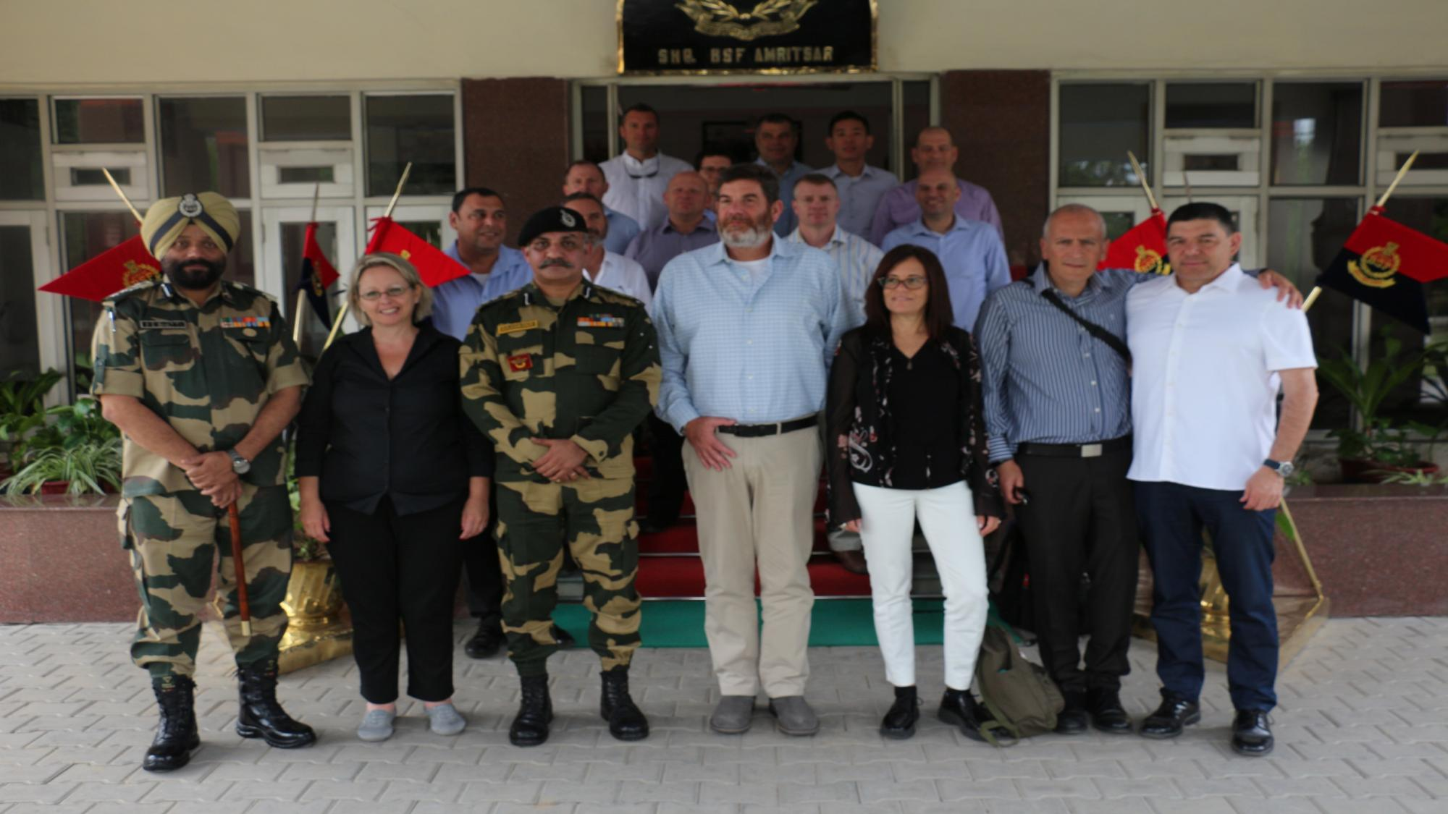
Tour participants
Dganit Shai Eran Kamin
Rachel Shani Shai Fairezan
James Priest Ido Soceanu
Patrick Lemyre
Klaus Harrer
Seth MacCutcheon
Shin Fong Teng
Assaf Raffeld
Dror Friedler
Igal Hadad
Kobi Peer
Eliaz Luf
Yehuda Elmakias
Tzvikah Israeli

Slide 4
The Preparation Plan According to the National Defense Echelons
Hour | Tuesday 29/4 | Wednesday 30/4 | Thursday 2/5 | Sunday 5/5 | Monday 6/5
 |  | 8:00 - Vaccines
8:30-10:00 | Introduction to India\ Evaluation of the Indian situation– Eyal Calif | National Security and Border Defense Lecture - Yosef Rosen and Eitan Yitzhak | 10:30 Holocaust Day Ceremony until | Independent Learning Day | India-Israel Trade Relations - Ministry of Economy, Tzafrir Asaf
10:30-12:00 | Israel’s Former Ambassador to India - Daniel Carmon India-Israel relations | 10:45-15:00 Cooking Workshop | 11:00-12:30 India as a Nuclear State - Shaul Horev |  | Indian Culture - Mrs. Sigal Manor-Bonga
13:00-14:15 | Geopolitical Conflicts - Raju |  | Team meeting on the questions |  | The Strategic Challenges of India - Zevik Mavetsri
14:45-16:00 | Movie- Slumdog Millionare |  |  |  | India Security Cooperation - Zevik Mavetsri
 | 18:30 Reception of India’s Ambassador in Israel
כחול – חוייתי , אדום - בטחוני, כתום – חברתי , חום – כלכלי , ירוק – מדיני

Slide 5
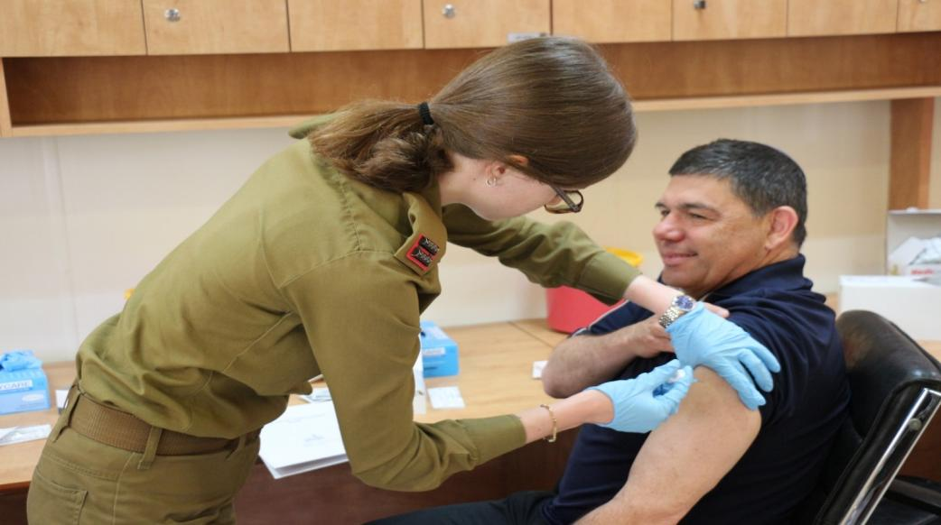
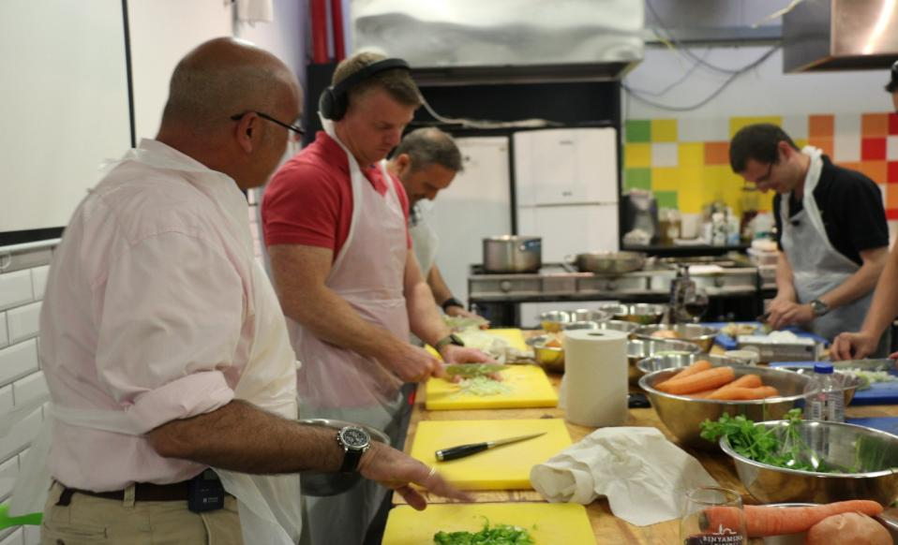
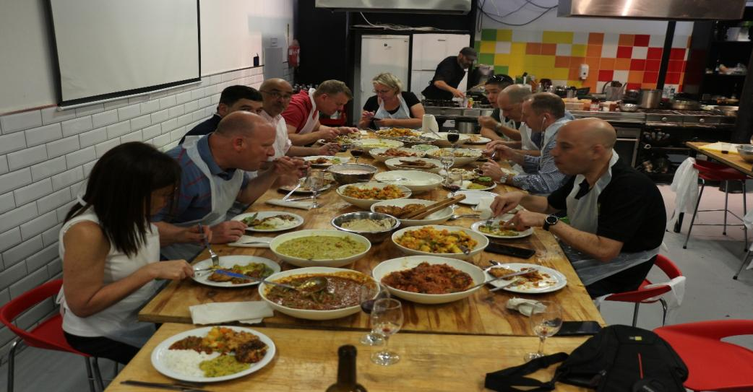

Slide 6
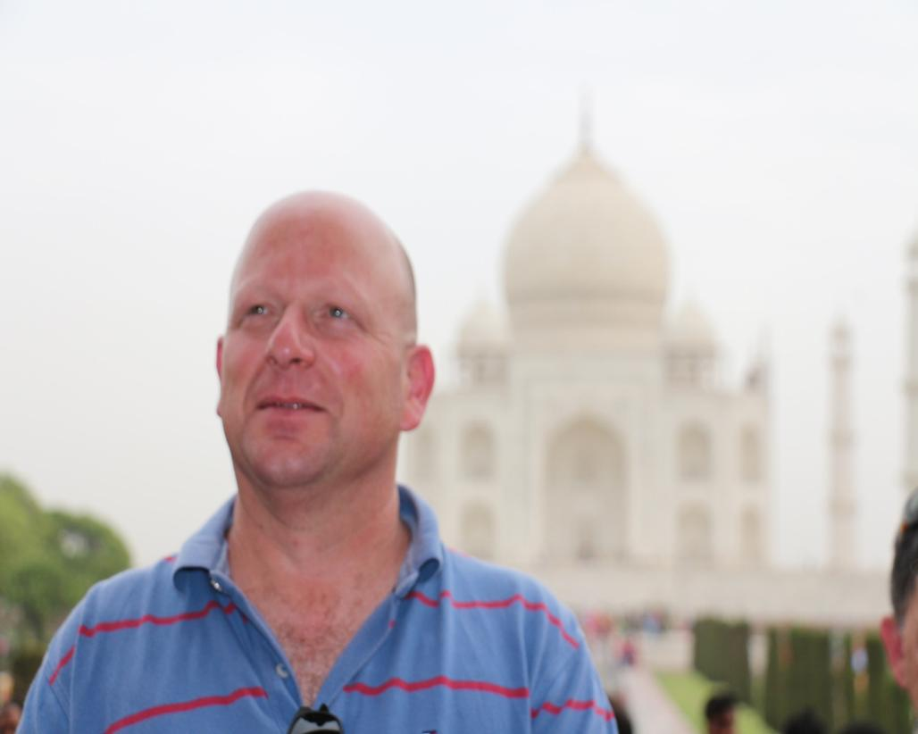
סיור יום ראשון- 12/5
Sunday - 12/5
A visit to the Taj Mahal
חניך תורן: דרור
Blue- Experience, Red- Security, Orange- Social, Brown- Economic, Green- political

Slide 7
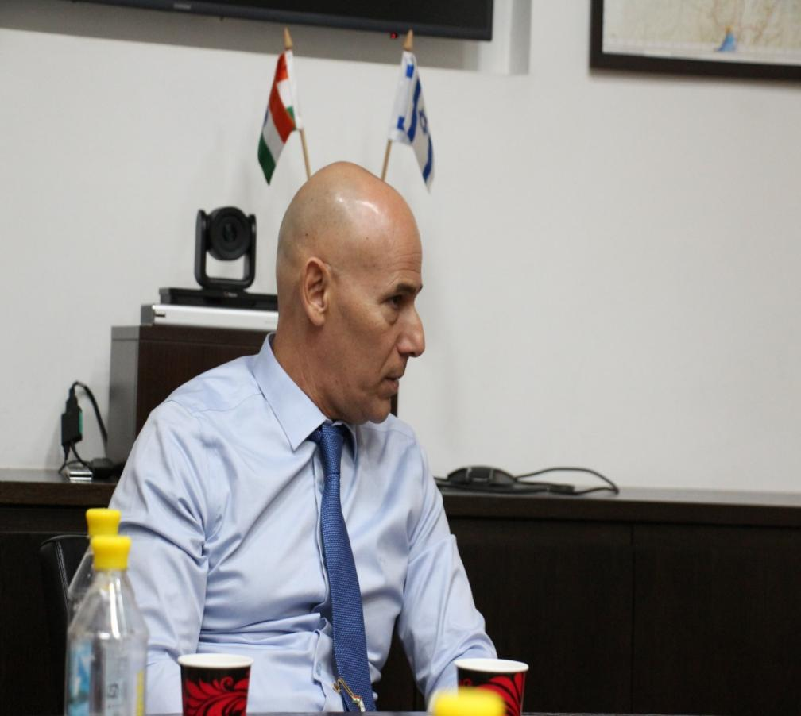
סיור יום שני- 13/5
סיור יום ראשון- 12/5
Monday - 13/5
A visit to the NDC and an ambassador's lecture in the plenum
A visit to the embassy and an ambassador's lecture
Visit to the Indian General Staff and a receiving of a briefing of security challenges
Joint meal with the NDC students in the attaché's house
Blue- Experience, Red- Security, Orange- Social, Brown- Economic, Green- political

Slide 8
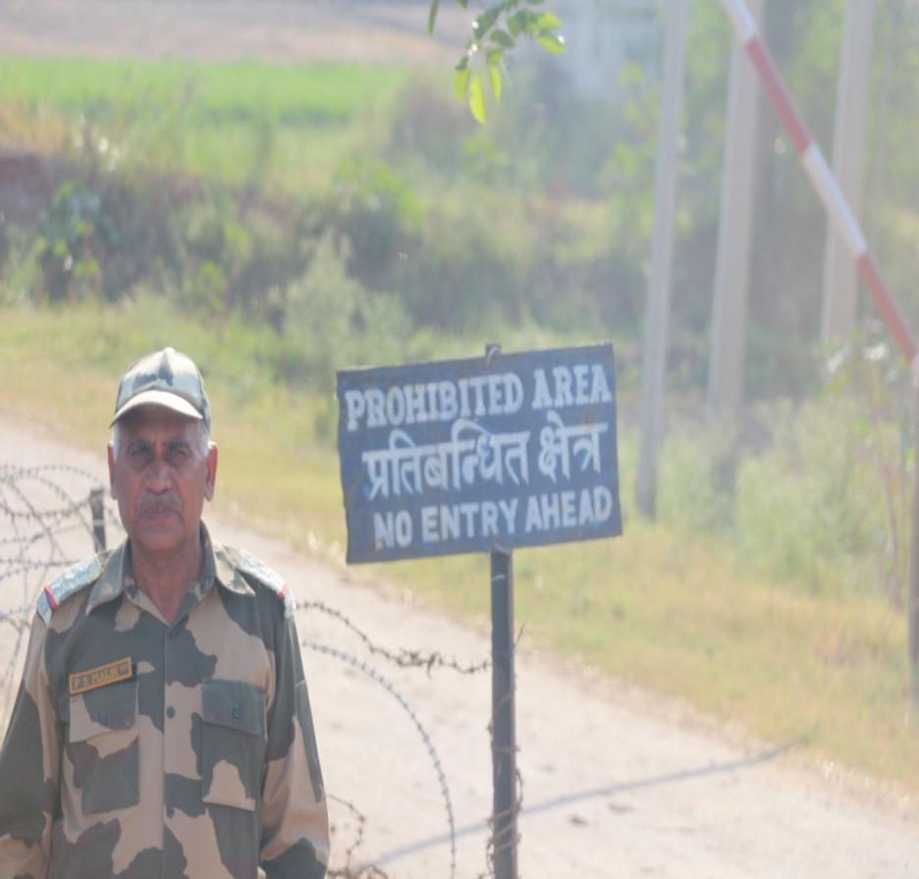
סיור יום שלישי- 14/5
Tuesday - 14/5
Journalist lecture on the situation in India
A lecture by a member of the Institute for Research on Geopolitical Aspects in India
Visiting a post on the India-Pakistan border
Ceremony at the border crossing between Pakistan and India
A visit to the Golden Temple and a lecture on Sikhism היסקית
חניך תורן : אסף
Blue- Experience, Red- Security, Orange- Social, Brown- Economic, Green- political

Slide 9
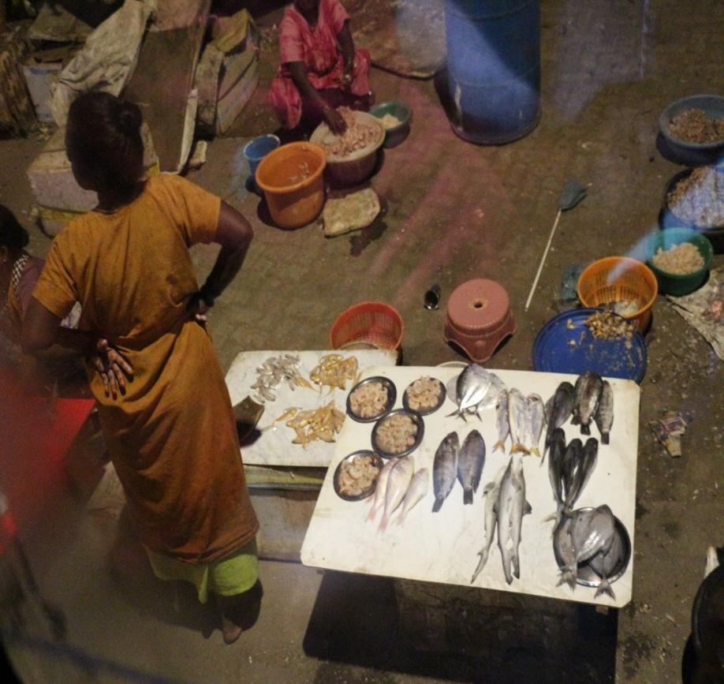
סיור יום רביעי- 15/5
Wednesday– 15/5
Review of border security
Tour of Mumbai
חניך תורן: פט
Blue- Experience, Red- Security, Orange- Social, Brown- Economic, Green- political

Slide 10
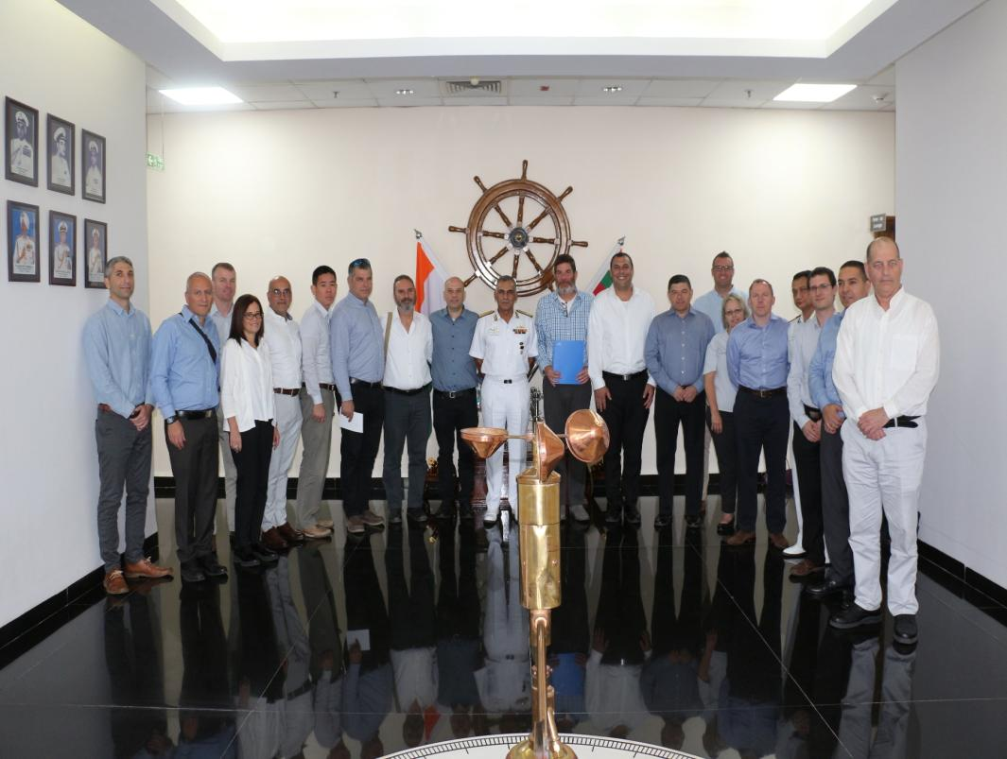
סיור יום חמישי- 16/5
Thursday– 16/5
Review of the Maritime Challenges of India
A tour of the stock market and a review of the Indian economy
Blue- Experience, Red- Security, Orange- Social, Brown- Economic, Green- political

Slide 11
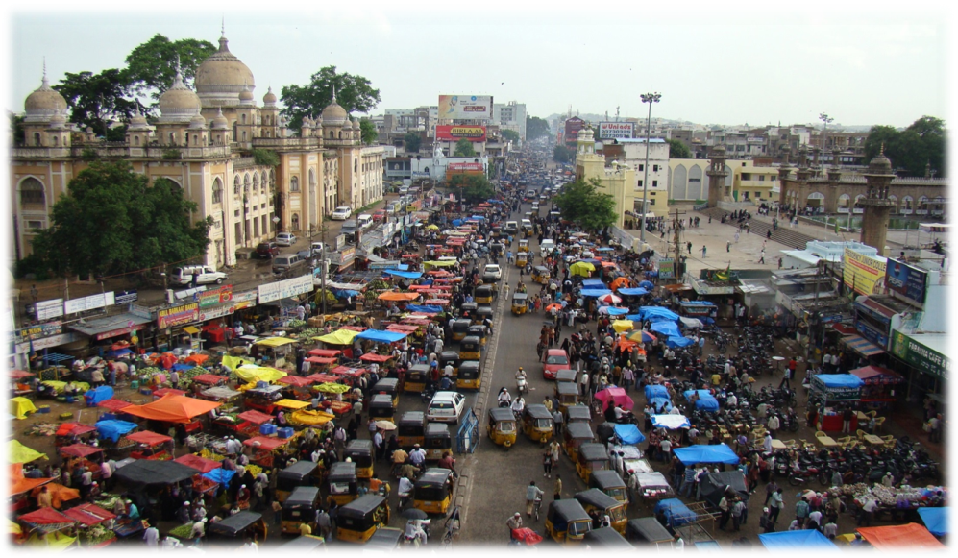
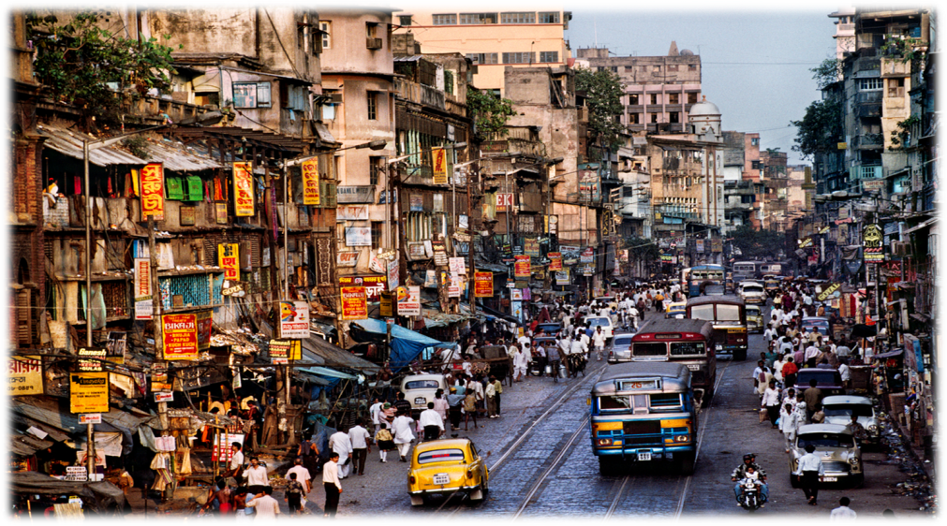
Many people
India has about 1.27 billion people living in it
(About 400 million in the 1950s)

Slide 12
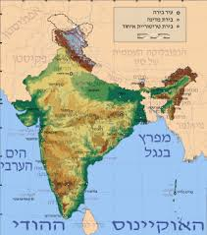
Size
Subcontinent
3.28 million square kilometers

Slide 13
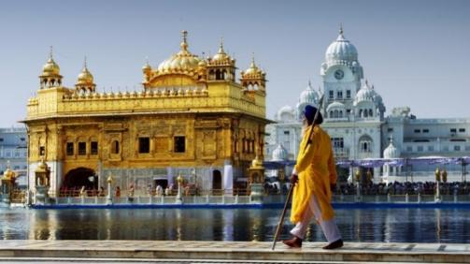
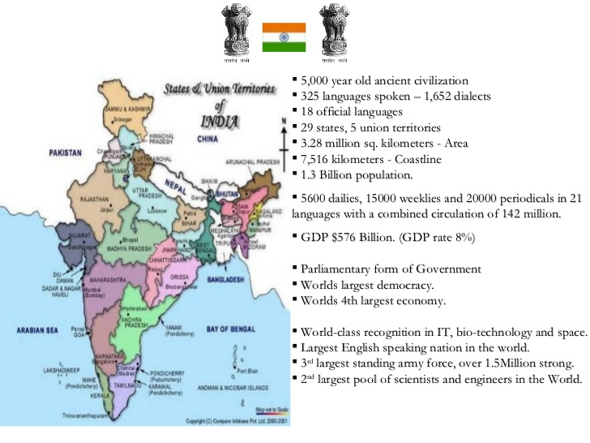
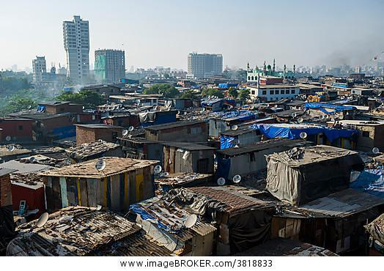
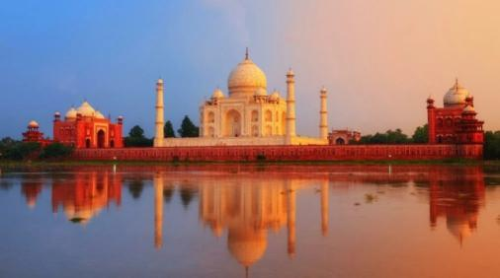
The Real Size of India

Slide 14
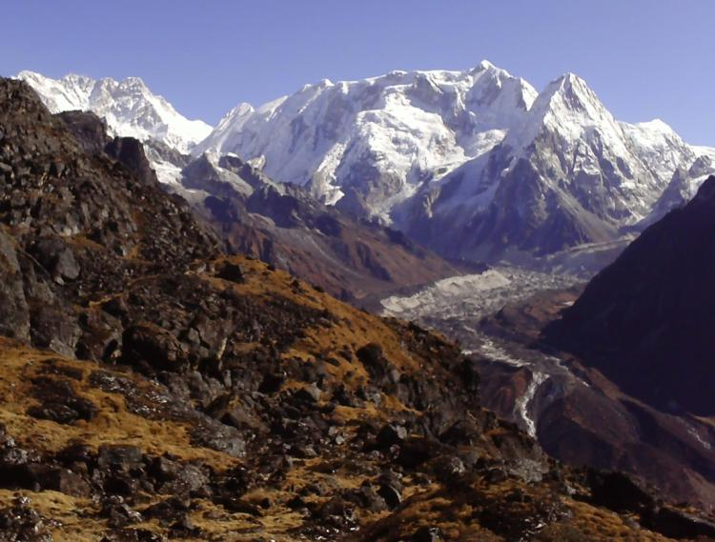
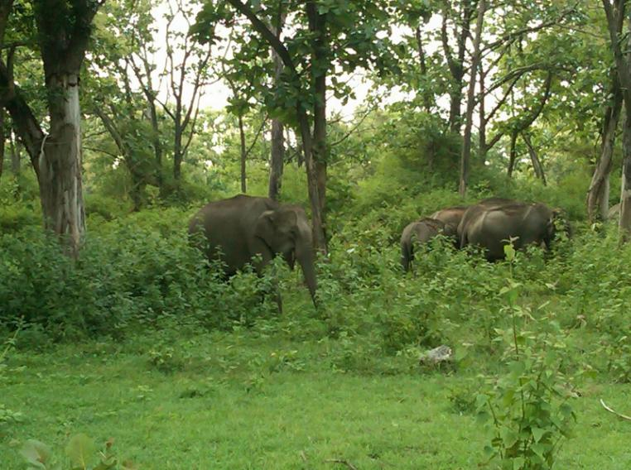
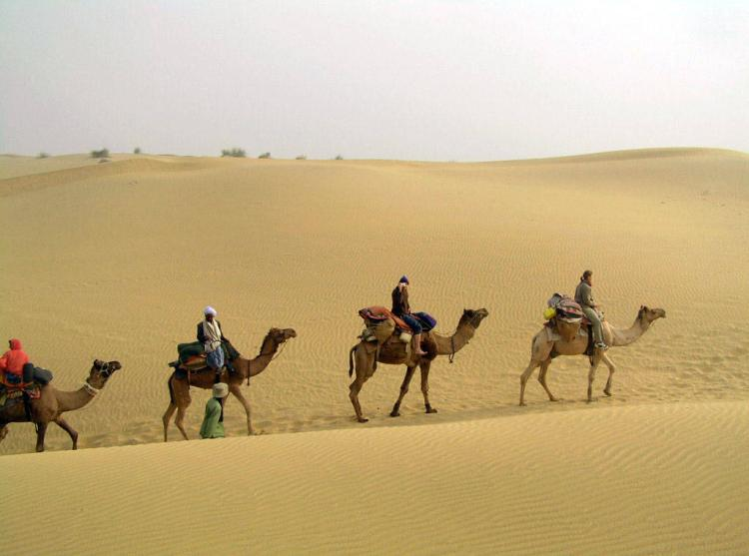
Hot and humid in the south, snow in the mountains to the north, desert to the west and jungles to the east

Slide 15
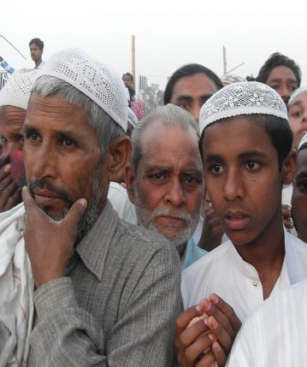
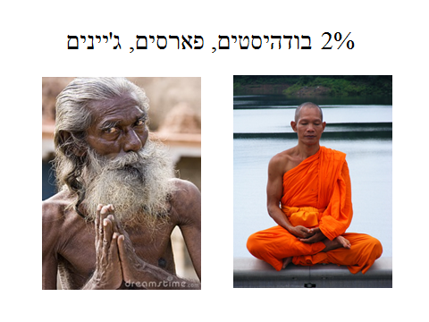
India in a nutshell – many languages and many religions
Languages - Hindi, English and 22 more languages ...
2% Buddhist, Persian, Jain
2% Sikh

Slide 16
The largest democracy in the world

Slide 17
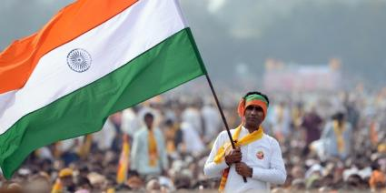
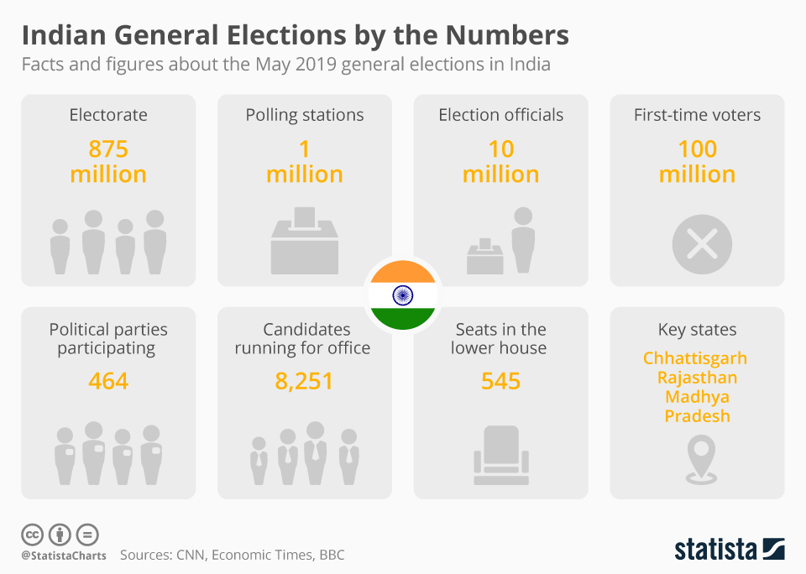
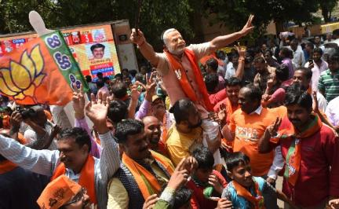
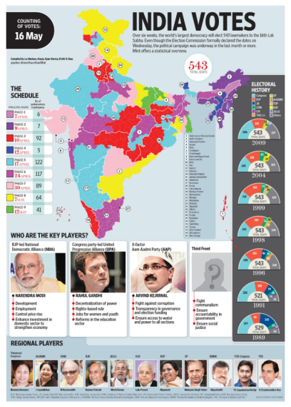
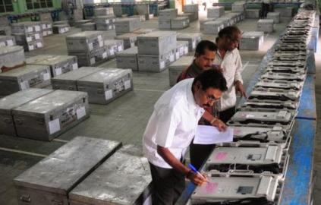
The Real Size of India
More than Israel´s population
More than the entire population of Europe
One third of the
Population of USA
Less than the German Bundestag

Slide 18
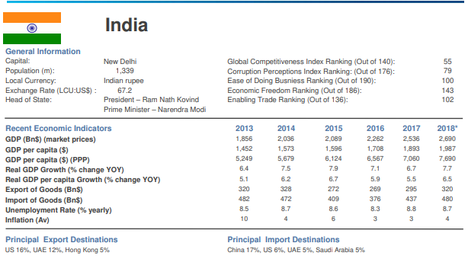

Slide 19
India – A few words about economy – Karma is everything
Average GDP of a superpower
GDP per Capita – third world

Slide 20
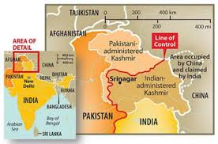
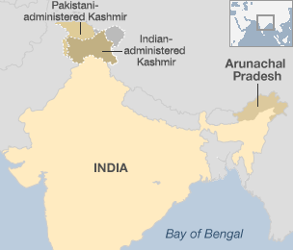
India in a nutshell - two external security conflicts and an internal threat
Key threats
China
Pakistan
Internal terror

Slide 21
Terrorism - the main events in recent years
The hijacking of a plane - December 1999
Attack on the Indian Parliament - December 01
Combined attack in Mumbai - November 08
Attack on an Air Force Base in Vanuatu - January 16
Attack on the brigade base in Uri and the raids that followed - September 16
The attack on the bus in Floror and the subsequent air attacks - February 19 19

Slide 22
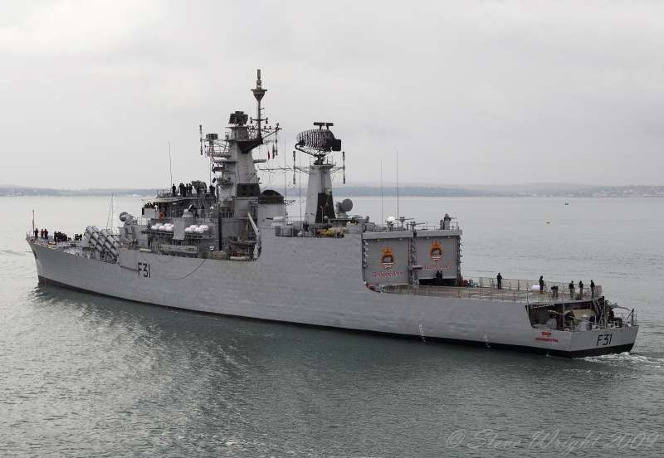
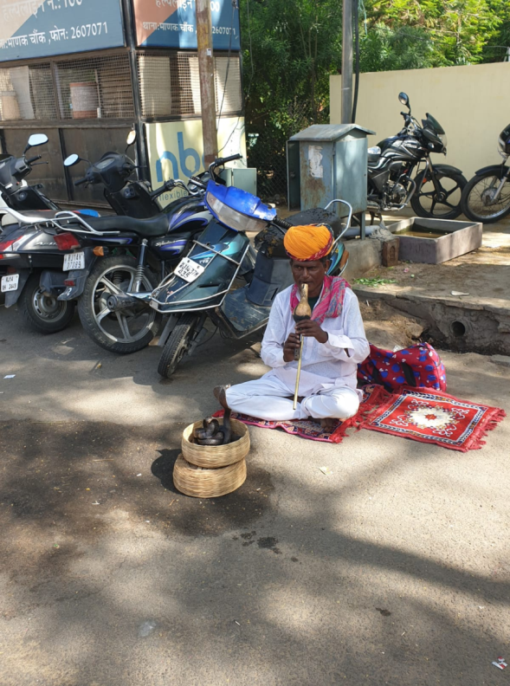
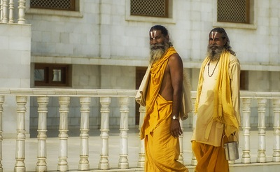
What is the strategic culture, the strategic approach, and how does the "other" manifest itself?

Slide 23
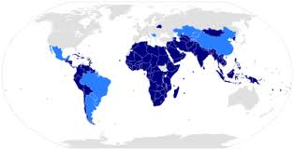
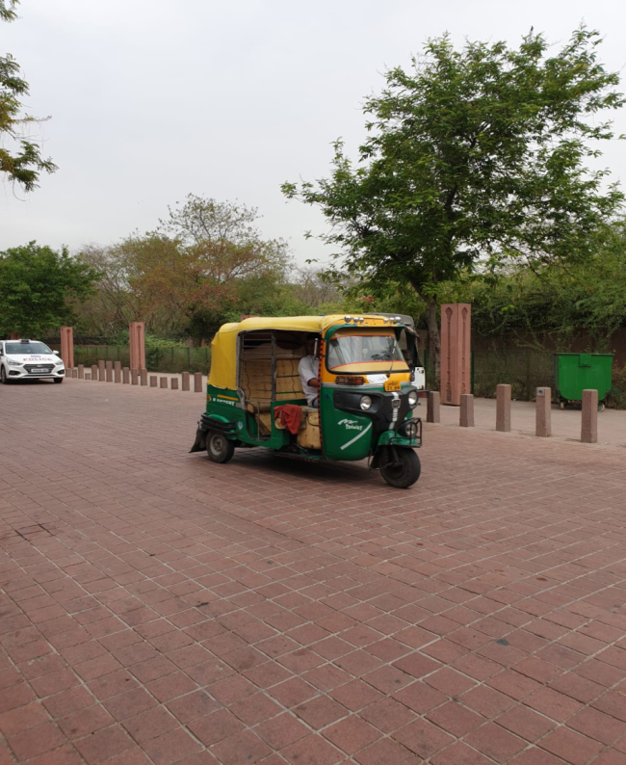
Research questions – Presenting the structure the government, both internally and externally, and how decisions are made

Slide 24
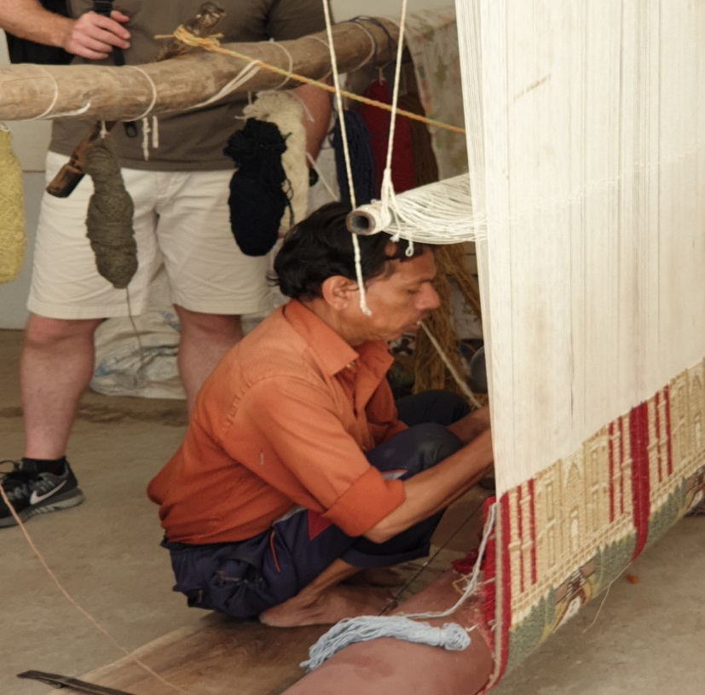
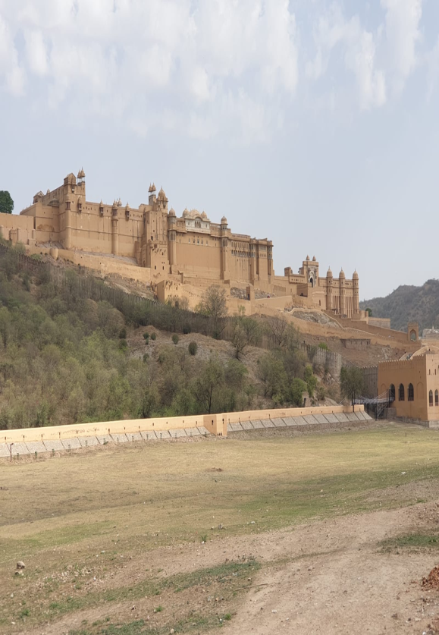
Research question – Economic – A country that wants to become a power, how is it expressed?

Slide 25
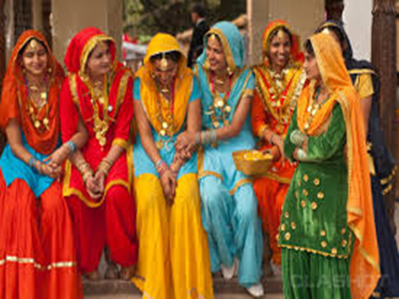
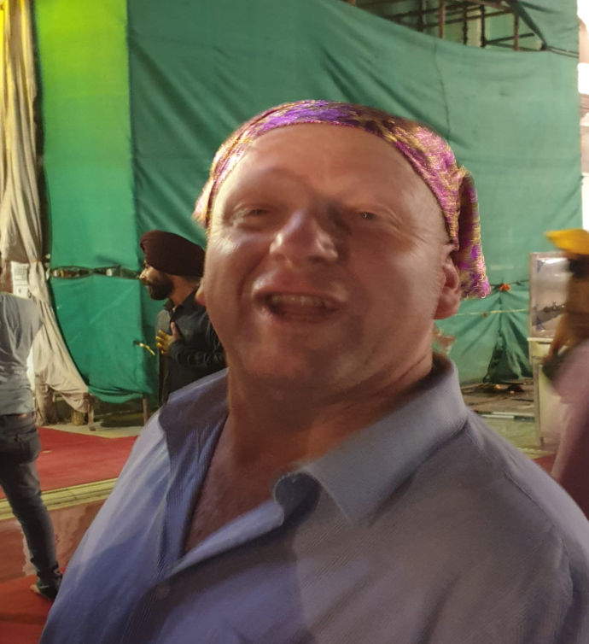
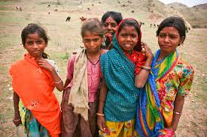
Research question – Social – Social challenges and trends in India and the risks inherent in them?

Slide 26
Research question – political – How are India’s foreign relations facing the powers expressed in relation to us?

Slide 27
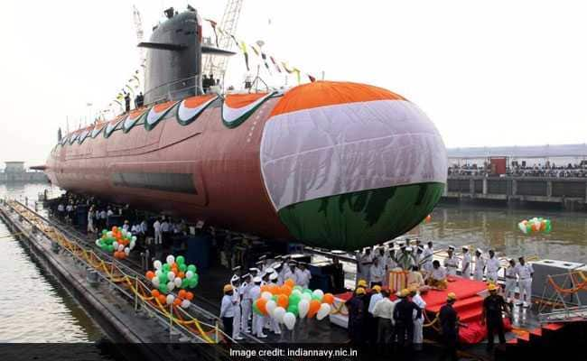
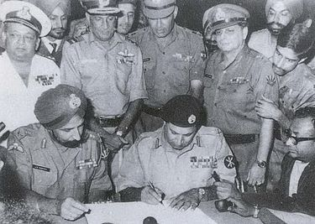
Research question - security- a country that is in a prolonged conflict with Pakistan and China, How does it manifest itself and how does it affect the relationship with us?

Slide 28
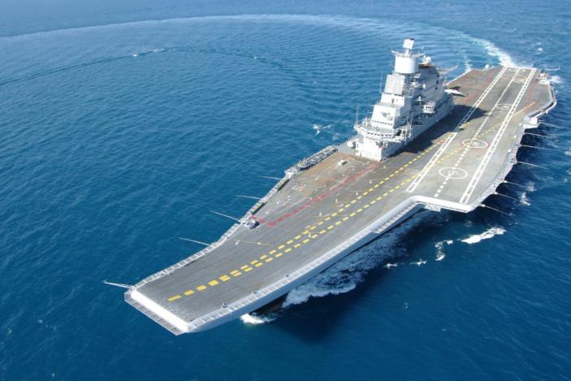
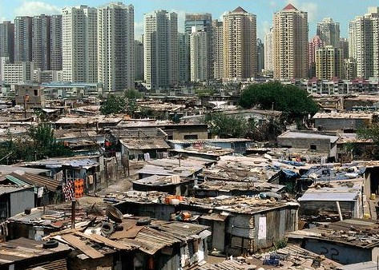
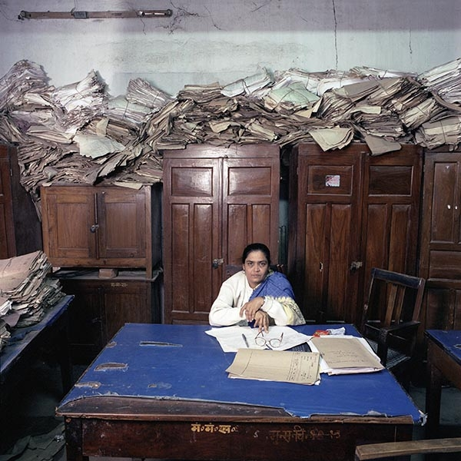
In conclusion
India is the land of unlimited possibilities and impossible limitations from the rickshaw to space and back!

