Slide 1
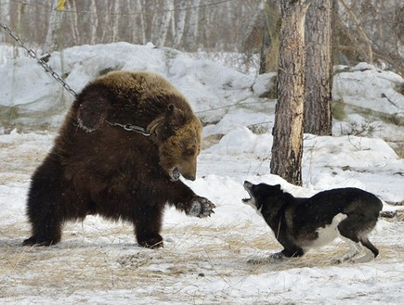
The Russian Bear
The neighborhood bully and the hotheads -
A continued love story....

Slide 2
Strategic Studies Road Map
Strategic Thought
Strategic Thinking
Design Approach
”
First Experience
Second Experience
Third Experience
Public Corporate Strategy
The development of military strategic thought
Conceptualization and levels of action
Systematic inquiry as a methodology to a design a strategy
Background and references
Background and references
Background and references
The “evolution” of strategic thinking in the corporate world
The history of strategic thought and the development of conventional warfare
Strategic thinking challenges and competing approaches
Systematic inquiry as a methodology to a design a strategy
Experiencing the Design Approach
Experiencing the Design Approach
Tour to the East
New approaches
The history of strategic thought at the age of hybrid warfare
“Bulgaria” case study
Experience – Inquiring the relevance gap
Summary
Lifting of the veil summary
Summery
Diffusion of strategic thinking into the public sector
The history of strategic thought in the nuclear era
“Maarachot”: systematic thinking, complex system and the systematic level
Tasting menu.
A survey of the arsenal of tools used to support strategy
Intelligence diagnosis and strategic planning
Processing
Presentation, competition and discussion
Real life scenario
Russian strategy in the Middle East
Strategy as design, planning and execution (institutional learning and implementation)
Case studies from the experience of senior officials
Cyber

Slide 3
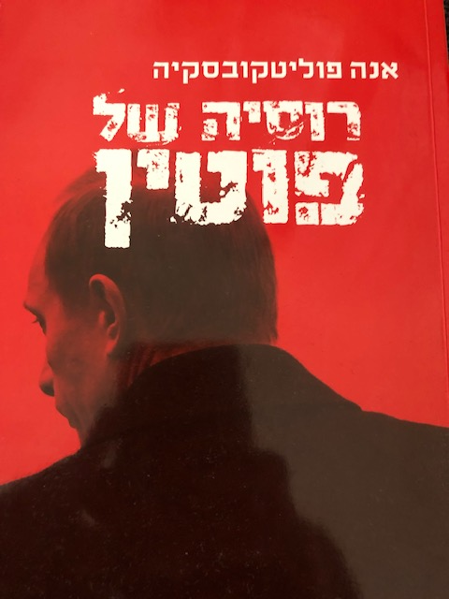
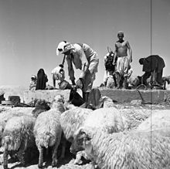
Reading Materials
Optional
Mandatory
What ever you want….
“A strategy of war and peace”

Slide 4
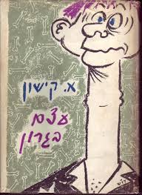
Outline
The East-Russia tour of the INDC 46th class will take place on 12-16 May 2019
The tour is part of the strategy echelons of the INDC curriculum and is led by Chen Almog, under the guidance of the staff instructor Rafi Shcutz
This tour will be preceded by five days of preparation to be conducted at the Institute for National Security Studies (INSS), the National Intelligence Institute and external tours
Academic course of 3 weakly hours- Group final assignment

Slide 5
Outline
Objective: To recognize Russia as a central actor in the international system characterized by "different" strategic thinking.
Knowledge of culture, heritage and roots , “DNA”
Understanding national security and the strategic culture
A meaningful experiential learning (I didn’t say fun ...)

Slide 6
Participants
 | Rafi Shcutz - Leading Instructor | 1
Week end | Chen Almog (4) - Leading Participant | 2
Week end | Eyal Argov (1) | 3
 | Raju Baijal (1) | 4
 | Eros Zaniboni (2) | 5
 | Teng Shin Fong (2) | 6
 | Omer Tishler (2) | 7
Kosher | Itzik Cohen (2) | 8
Week end | Michael Shafshak (2) | 9
 | Shay Hannuna (2) | 10
 | Yair Nathans (3) | 11
Weekend | Maya Goldschmidt (3) | 12
Kosher | Yehuda Wach (3) | 13
Weekend | Eyal Calif (4) | 14
Kosher / Vegetarian, Weekend | Anat Chen | 15
Kosher / Vegetarian, Weekend | Ester Hagag | 16
17 | Yonathan Sayada Marom – Chief Instructor | 17

Slide 7
' 16/05 | '15/05 | ' 14/05 | ' 13/05 | ' 12/05
INDC dress code |  |  | SדSuitA
 | Uniform | Suit |  | INDC dress Code
Victory Park The Great Patriotic War Museum (World War II) |  | הEconomic situation and its impact on internal policy | Ambassador of Israel in Russia
 | Military Academy Tour | Foreign policy and security | Internal political situation
 |  |  |  | Landing at DME (LY 611)
 |  | Russian policy in the Middle East | Foreign Policy Russia in Middle East
En route to the Jerusalem restaurant |  | Lunch | Travel to the Foreign Ministry +lunch
 |  |  |  | Lunch
 |  |  | Russia - Middle East Deputy Foreign Minister for the Middle East and Africa and the President's envoy to the region, Mr. Michael Bogdanov Foreign Policy Planning
 |  |  |  | Defense attaché
 |  | Guided tour of the Kremlin
Concluding lunch (Jerusalem Restaurant) | Walking to the city center + Lunch
Metro Tour And the old Arbat street
 | INDC dress Code
 |  |  | Free time + | Introductory tour Central Moscow / Kremlin Complex
 | Strategy and national security
Driving to the airport ׁ
 | Processing teams | Representation measures
 | A ride to the show | Independence Day Reception at the Embassy of Israel in Moscow | Night tour in Moscow
 | Culture - performance
 |  |  |  | Free evening dinevening (Indepenner)
Landing in DME
 |  | Bus: Pick up the hotel for those interested

Slide 8
' 5/5 | ' 6/5 | ' 7/5 | ' 8/5 | ' 9/5
INSS |  |  | Memorial day for Israel's fallen soldiers . | Independence day
Vera Michlin Shapir "Russia - people Society and Identity | Shlomo Kashi - "Russia's Involvement in the Middle East" | The time of the commander of the IDF
Zvi Magen "Russia - Interests, economy" | Yaakov Livneh Ministry of Foreign Affairs "bilateral relations Israel and Russia" | Memorial Day and Independence Day
 | Lunch
Lunch in a Russian restaurant -PT | Processing teams - preparation summary
 | Preparation of simulation documents
' 28/4 | ' 29/4 | ' 30/4 | ' 1/5 | ' 2/5
 | Introductions and introductions | Dima’s Day | INDC Schedule | Information Security
Independence Learning | Presentation of the tour and research questions (Chen) | Dima - background lecture "Russia in the Three Stressing Periods" | Rafael Tour | Holocaust Remembrance Day
 | Russia - Government Structure and |  |  | Information Lecture - Shin Bet
 | Lunch |  |  | Lunch .
 | "The Russian and Middle Eastern Security Concept" | Dima – The Movie “Brother 2” |  | Lecture of internal threats (Shin Bet - Gift)
 | Anna - Dado Center "The new Russian strategy" | Dima - Discussion and Summary of the Day
"

Slide 9
Learning Outcomes
Before the trip -
Structuring learning and learning in Israel vs. the target country in national security contexts (the "Pantheon" Model)
Basic data booklet - Russia - Eyal Calif
Formulation of research and ratification questions
After trip - to view (the day after landing ...)
Insights - what we observed, what we learned, what surprised us, how we changed, how we see ourselves following the visit
Responding to research questions - Presentation up to 15 slides
After the trip - for submission - a short group summary of the learning including answering questions.
Slideshow - Eyal Calif + Chen
Summary Tour Report - Maya + Eyal Calif + Chen
Tour itinerary - Chen

Slide 10
Learning Products - Unification
What is the strategic culture, the strategic approach, and how the "others" are expressed
Presentation of the structure of the government vis-a-vis the outside and the interior, and how decisions are made (slide 1)
(Responsibility - Maya, Shay Hannuna, Nathans)

Slide 11
Research Questions
Political Aspect – Russian-US influence, Russian-NATO - Implications and Influence on Israel's Foreign Policy.
(Responsibility - Itzik Cohen, Eros)
Security aspect - What are the Russian interests in the Middle East and Israel, and their influence on Israel's security concept
(Responsibility - Tishler, Wach)
Economic Aspect - Economic Significance and Potential for Israel - Russia Trade.
(Responsibility - Eyal Argov, Shin Fong, Raju)
Social Perspective - Challenges and trends of social depth in Russia and the potential and risks inherent in them from an Israeli perspective.
(Responsibility - Shafshak, Anat Chen)

Slide 12
Highlights
Planning of days of preparation - Chen Almog
Building a Tour Portfolio - Chen Almog
Photographic documentation - Eyal Calif
Written documentation lectures - Maya
Dress code
Codes of behavior and discourse
Security emphasis
Phones
Research questions and reading materials - preparation before, accuracy and other improvement
Research after the trip and a group summary for submission

