Slide 1
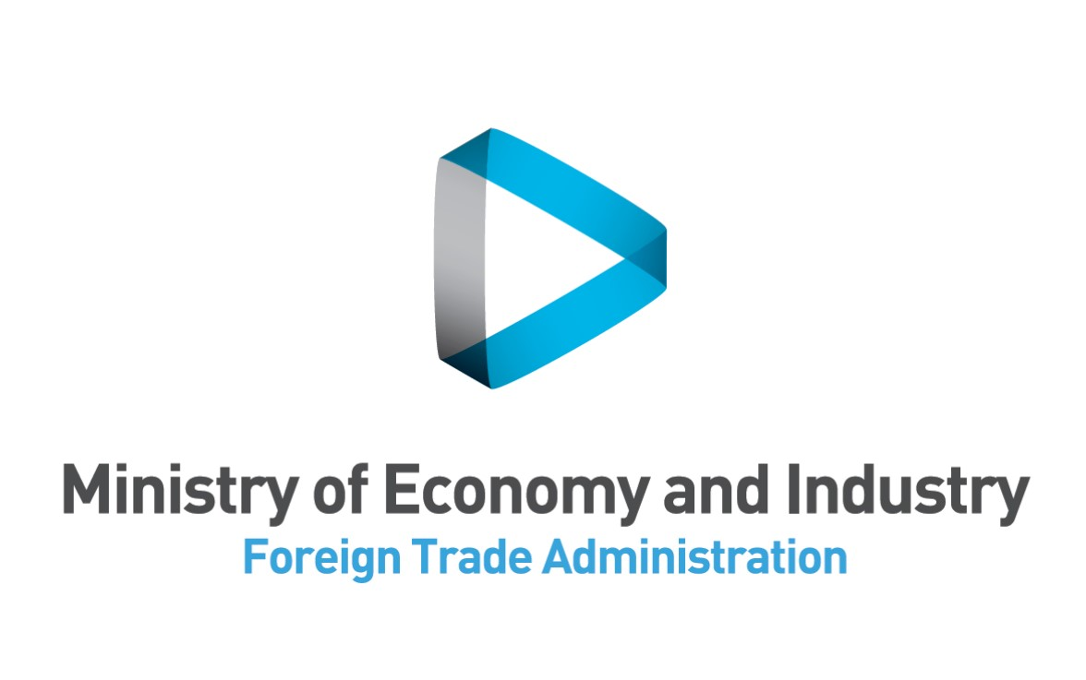
Business
& Politics
In India
Zafrir Asaf
Director of Financing for Development and Emerging Markets
Ministry of Economy and Industry
Economic and Trade Mission, New Delhi
Activity Tracker
Notes:
Good Morning everyone!
Where is Sigalit Berenzon?!
So

Slide 2
Agenda
Who are we?
Governance- With whom is the power?
Where the middle class?
Winds of change- India in the digital age
(If there is time left: trade and economic relations with Israel)
2

Slide 3
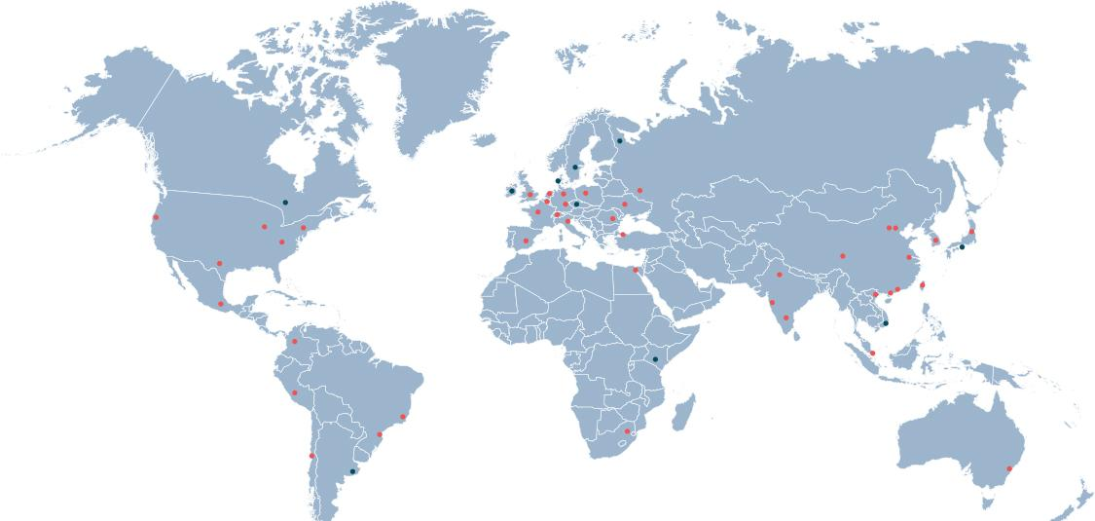
The Foreign Trade Administration operates 45 offices
Assisting exporters via:
Connection to distributors, importers, integrators
Solving trade barriers
Providing professional information
Incoming/outgoing delegations
Arranging B2B meetings at exhibitions
Connection to foreign investors
Connection to governmental entities
Front Office
Commercial Office
3
3
3

Slide 4
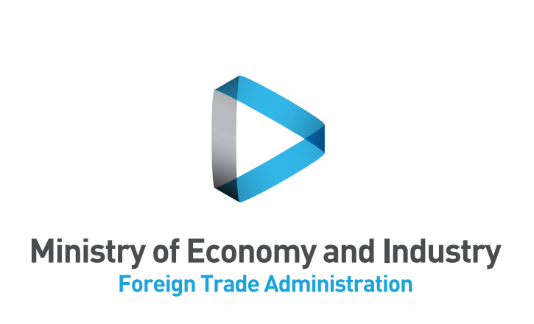
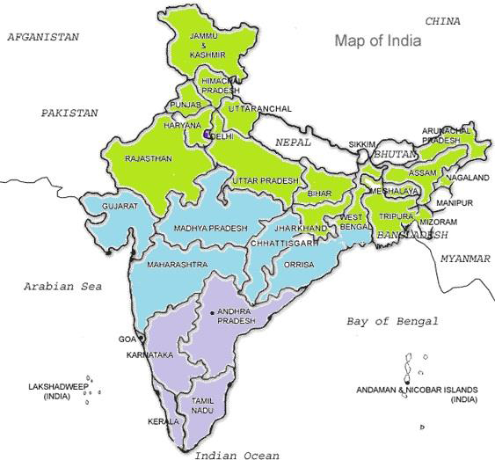
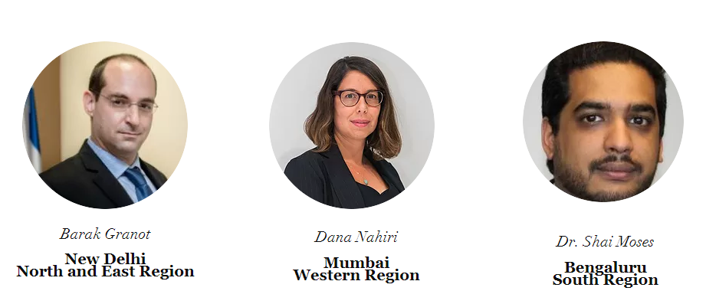
Israeli Aid to India: Operation ‘Outstretched Hand’ has begun
Saturday, March 03 2001, 6:53
Six planes arrived yesterday in the afternoon in west India; the delegation compromises of about 170 people; Medical Corp Officer: “We missed the time for rescuing, so we are sending a Medical delegation.”
By: Tuli Shargai, Walla! Delegate Sent to India
The Medical Corps and the Home Front Command's aid delegation went to the earthquake zone in western India. Four Hercules aircrafts and a Boeing aircraft will fly the 65-tonne equipment.
A sixth plane will fly the delegation, which has about 170 members. The delegation is scheduled to operate in the quake zone for two weeks, but senior officials in the delegation said it would stay where it was needed. The code name given to the delegation is "Outstretched Hand".
Two of the members of the delegation are members of the Home Front Command, so that the purpose of the delegation is mainly medical assistance. "In the case of the earthquake in India, we are too late for rescue and rescue, which are a function of distance and time, so we are sending a medical mission, whose main goal is to deploy one of the largest field hospitals we have ever sent," Major General Giora Martinovitch told reporters. : 27 specialists, 24 paramedics and paramedics from the IDF and Magen David Adom. The commander of the hospital will be Colonel Yehuda Baruch. The hospital will have 100 beds, and it will be able to respond to all the medical problems, including surgery. "The hospital will begin operating within four hours of the plane landing tomorrow morning.

Slide 5
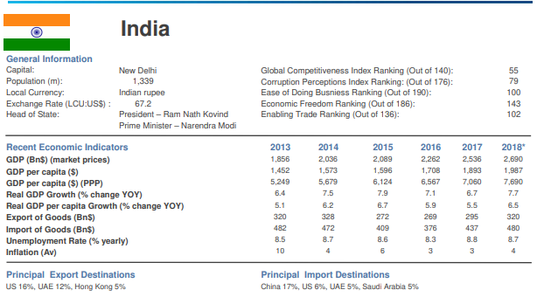

Slide 6
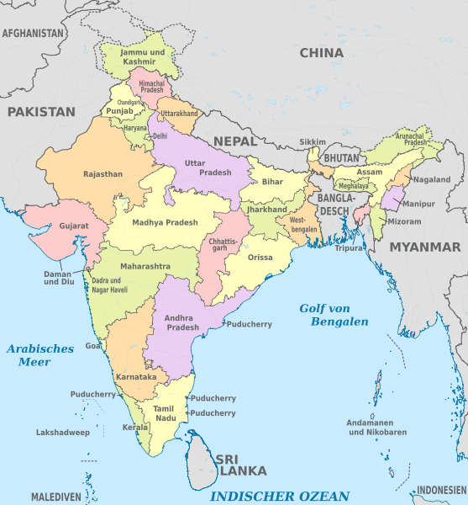
Who Has the Power?
Federal - State
The GST-Goods & Services Tax reform on goods and services instead of a series of indirect taxes (at different rates in different countries) in order to turn India into a more uniform market with a fixed tax regime known in advance Throughout the Republic.
UPI - a payment system developed to facilitate the transfer of funds between the banks and the reduction of the use of cash and credit cards, in addition to making real-time payments from mobile devices.
Make in India - A government program for attracting foreign investment and encouraging foreign companies to produce in India. This plan is designed to reduce India's dependence on imports, reduce the trade deficit and encourage economic growth.
DIGITAL INDIA - a program whose main focus is the transfer of production lines in electronics to India under the title of NMCG - The National Task Force for the Rehabilitation and Cleaning of the Ganges River - the most sacred river purification program for Hindus led by Modi. This program offers pilot financing of local and foreign companies, subject to success in the process of proving the feasibility and challenge that will be presented to the participating companies by the decision makers of the Genga Rehabilitation and Purification Task Force. Learn more
The 100 smart cities plan - the government's plan to build 100 smart cities, rehabilitate and develop 500 cities / villages and rehabilitate cities with tourism potential.
Demonetization - In November 2016, the Government of India announced the cancellation of the legal status of 500 and 1,000 rupees - about 86% of the cash in circulation - immediately.
The Health Care Reform (ModiCare) - the most comprehensive reform in India's health system, providing basic and advanced medical coverage to some 500 million impoverished Indian citizens. The reform will provide access to free medical treatment for any family or individual below the poverty line and will upgrade 150,000 medical centers by 2022. For more information
The plan to stabilize the banking system - injecting $32.4 billion into government banks suffering from unsecured debts in order to allow them to increase the amount of loans and stimulate the economy.
6

Slide 7
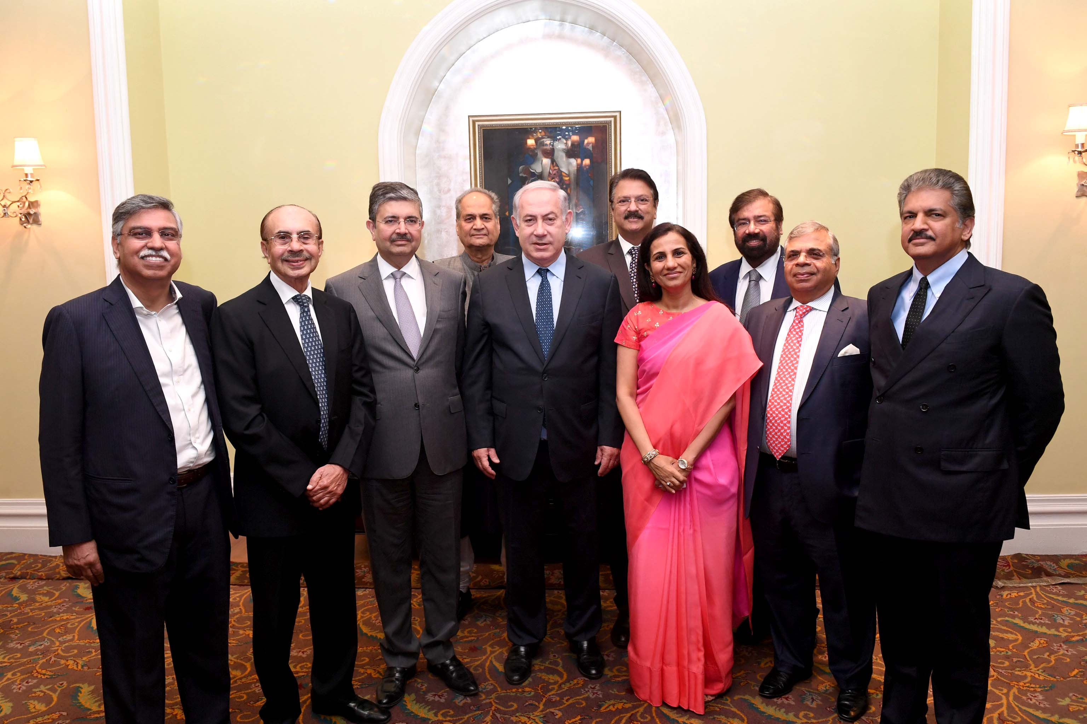
Who Has the Power?
Business- Government
78th place in the global corruption index
(Like Burikana-Paso and Kuwait, lower than Romania and Morocco)
1% of the population holds about 58% of the wealth
84 billion = $ 248 billion
7

Slide 8
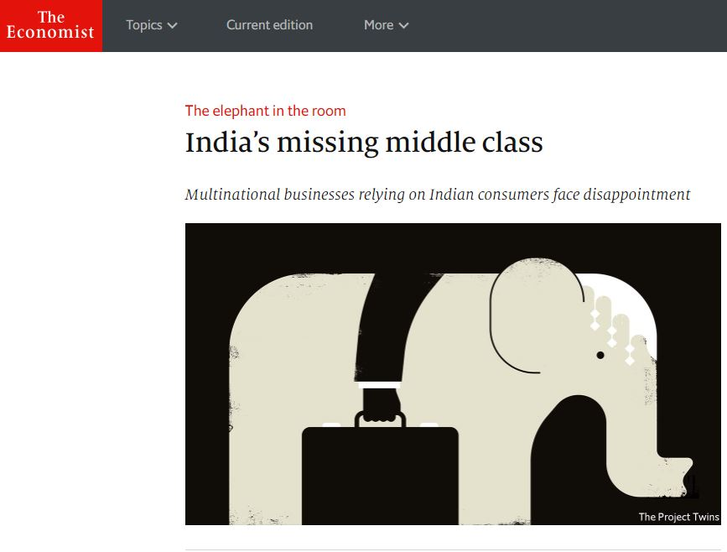
Where is the middle class?
Ethnic tensions
Internal migration
Status of women
Unemployment of young people
urbanization
Population aging
Soil and water pollution
Population reduction
https://www.economist.com/briefing/2018/01/11/indias-missing-middle-class
8

Slide 9
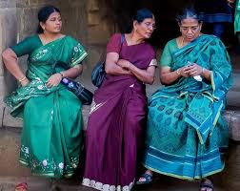
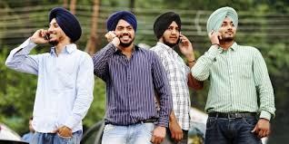
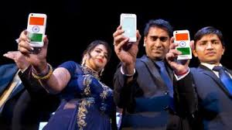
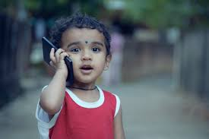
Digital Economy in India
Financial Inclusion:
Bankability
DeMonitization
Democracy:
Service Provision
Privacy
9

Slide 10
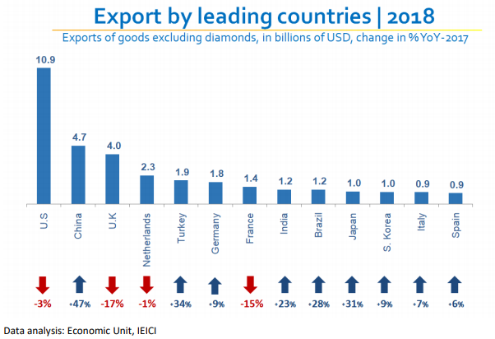

Slide 11
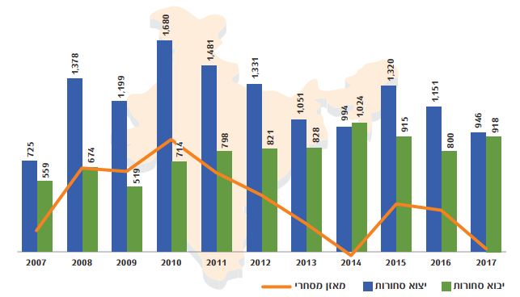
Commercial balance
Exports
Imports

Slide 12
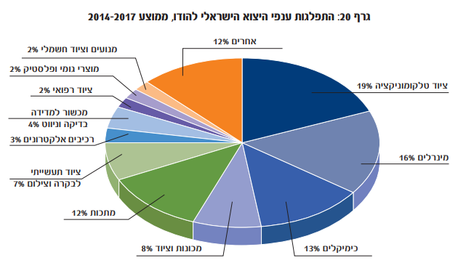
Graph 20: Distribution of Israeli Export Industries to India Average 2014-2017
Engines and electrical equipment 2%
Others 12%
Rubber and plastic productions 2%
Technological equipment 19%
Medical equipment 2%
Information equipment
Testing and Navigation 4%
Electronic Components 3%
Minerals 16%
Industrial equipment
For control, and photography 7%
Metals 12 %
Machines and equipment 8%
Chemicals 13%

Slide 13
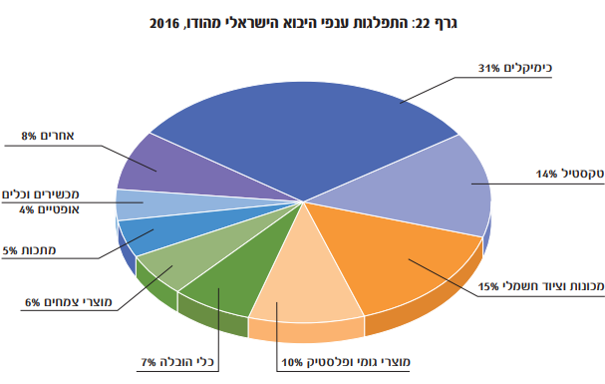
Graph 22: Distribution of Israeli Industries Export from India 2016
Chemicals 31%
Others 8%
Textile 14%
Optical Equipment 4%
Metals 5%
Electronic equipment 15%
Herbal products 6%
Transport equipment 7%
Rubber and plastic productions 10%

Slide 15
Thank you
Zafrir.asaf@economy.gov.il

