Slide 1
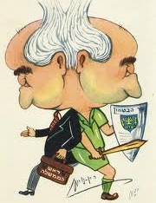

INDC 46th Class
Peer Consultation
2019
Malop
inside

Slide 2

Peer Consultation Technique
  Analyzing a dilemma/failure of a participant through a structured group discussion:
Emphasis | Topic | Leader | Runtime
Continually, with no interfering comments | Short introduction and presenting the consulting topic | Participant | 00:15- 00:00
Collecting questions Collective response | Clarification questions only! (no solutions) | Participant | 00:25- 00:15
No repetition amongst the participants | Remarks and discussion | Peers | 00:40- 00:25
How has his view changed in light of the consultation | Personal summary | Participant | 00:45- 00:40
45
min

