Slide 1
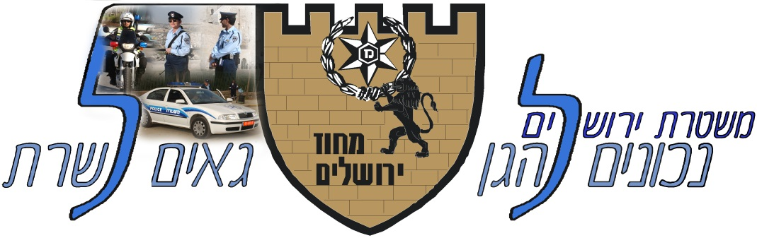

Jerusalem District Briefing
INDC
Jerusalem District HQ
January 2020

Slide 2
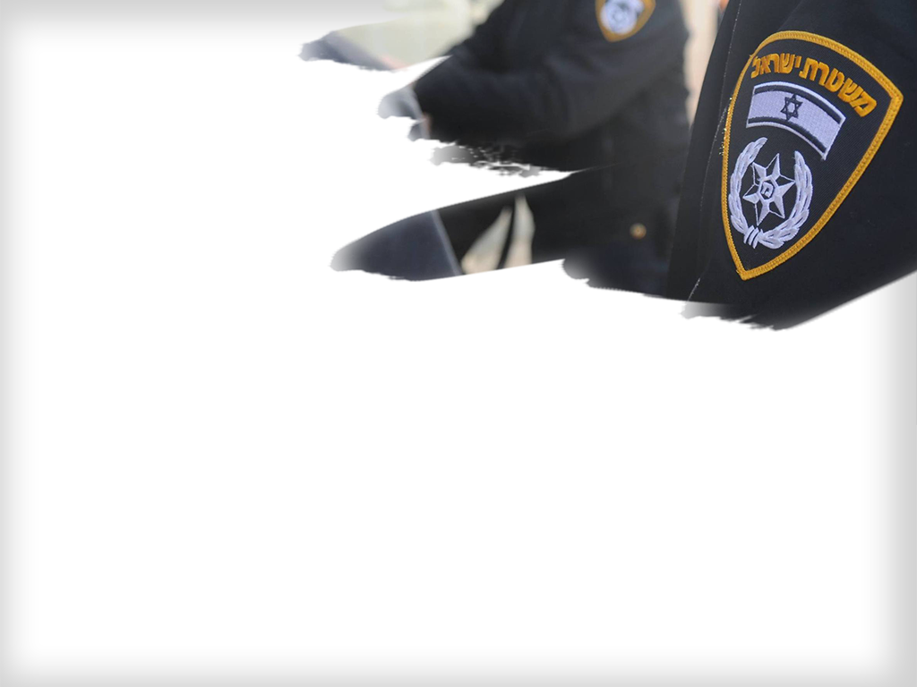

Clip

Slide 3
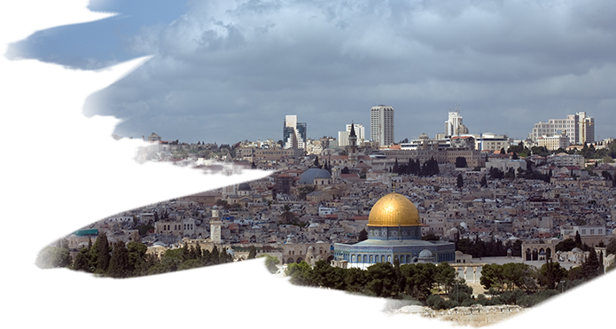
Jerusalem District Characteristics
Israel’s Capital
Sovereignty
Population
Threatened City
Holy to All Religions
Jerusalem’s Surroundings

Slide 4
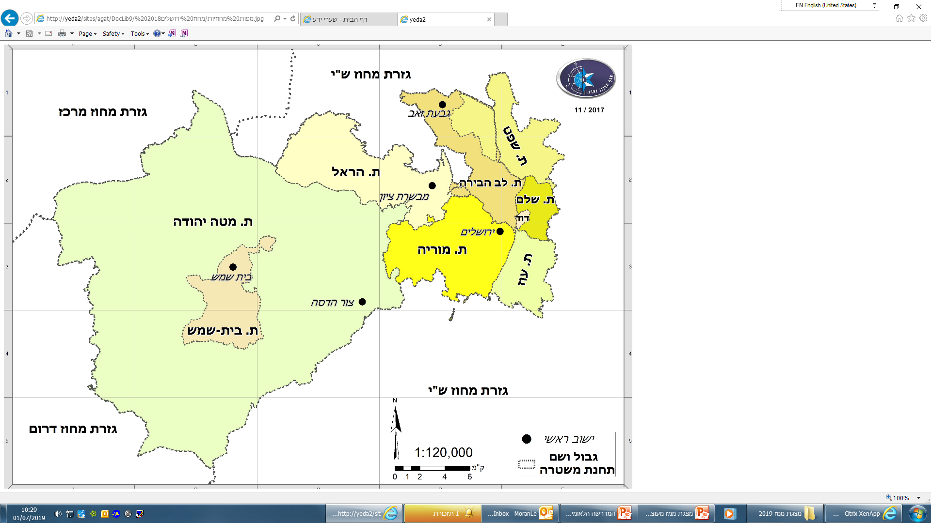
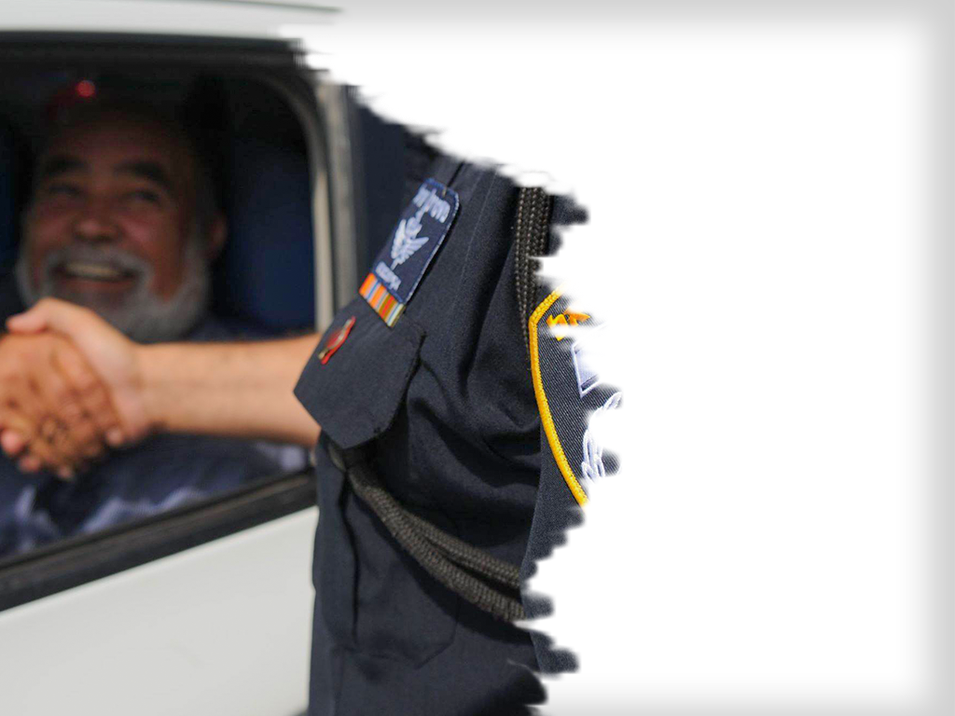

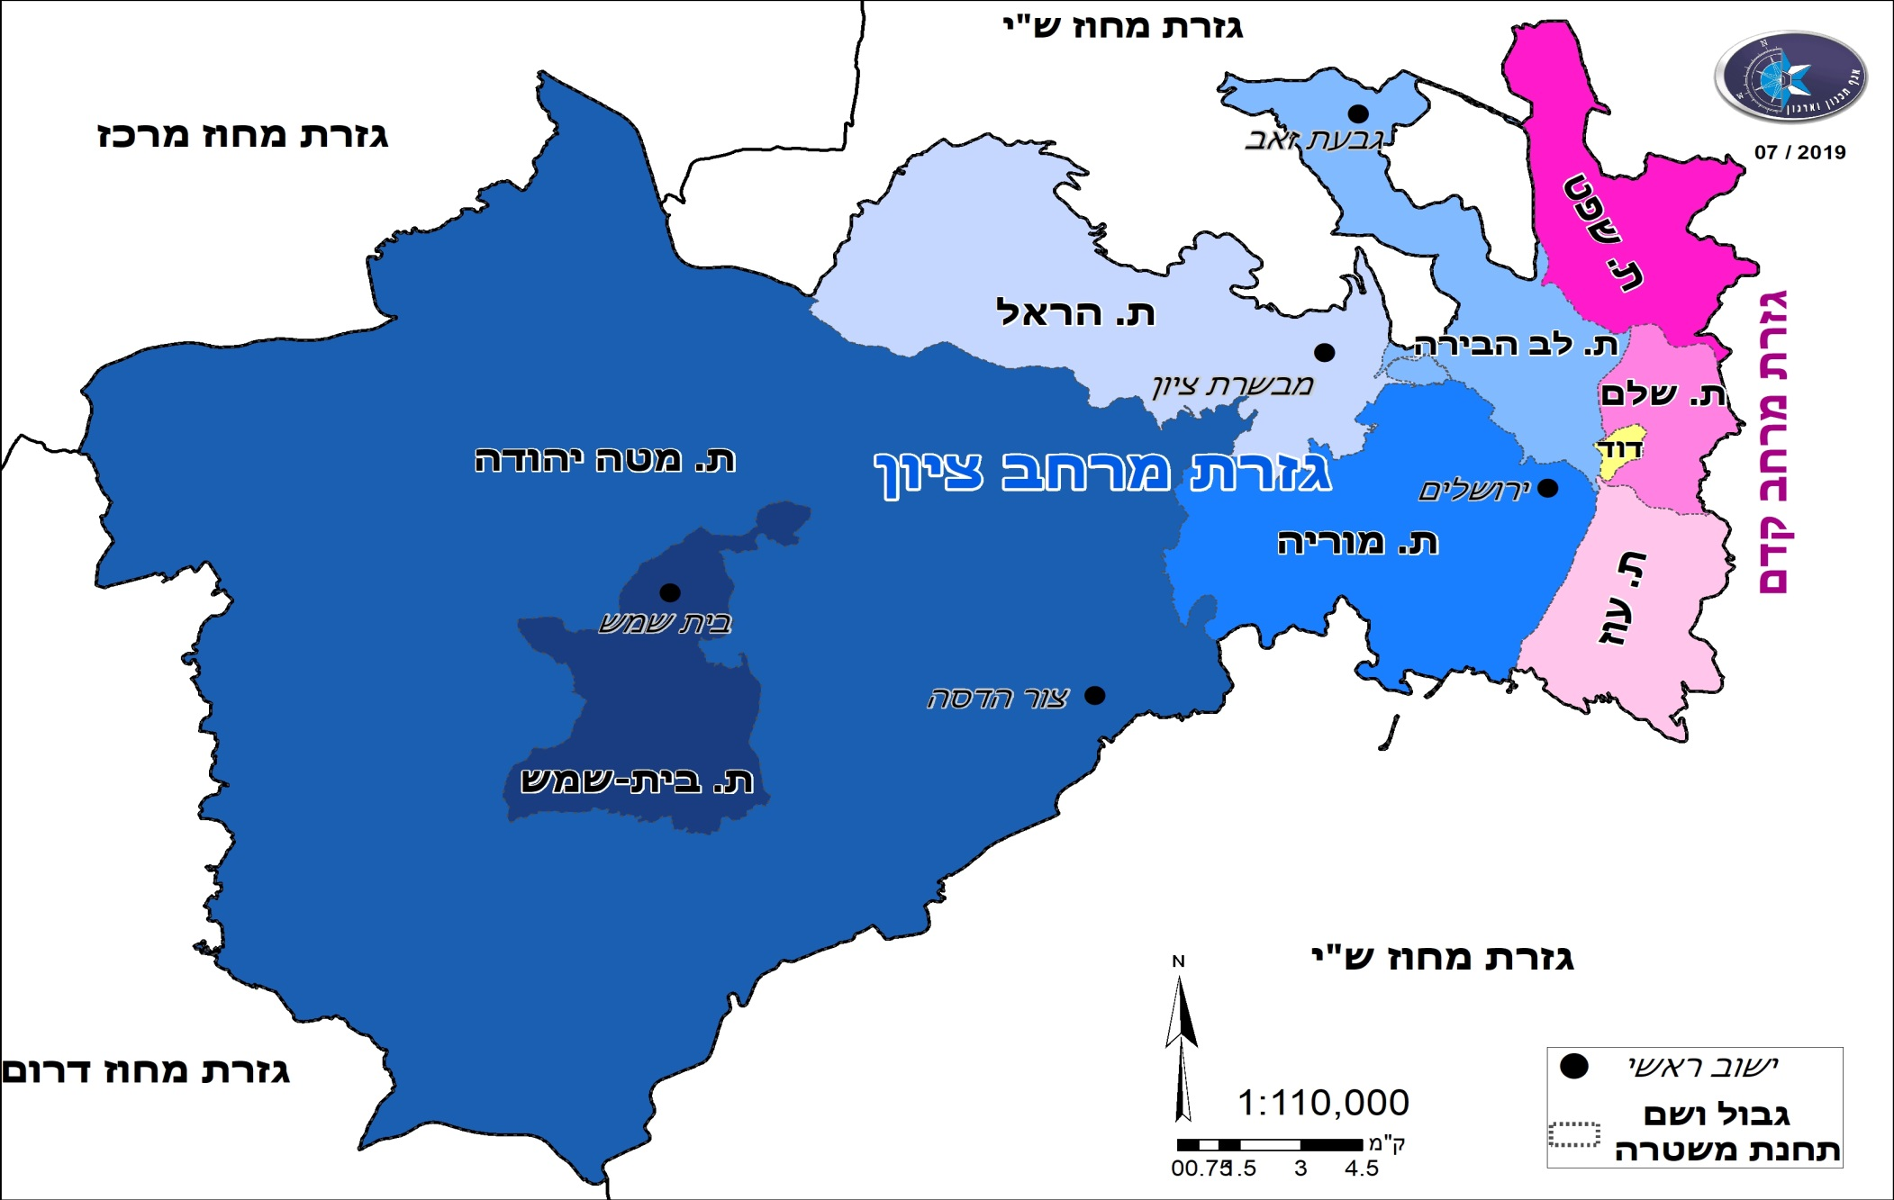
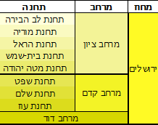
Administrative Borders
Center District
גבעת זאב
Kedem Area
Judea and Samria District
Southern District

Slide 5
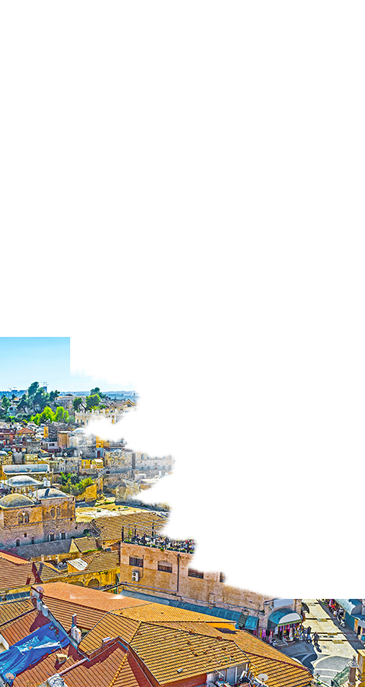
Population
Population/ Unit | Jews | % | Muslims | % | Other | % | Total
Jerusalem | 673,231 | 66% | 314,196 | 31% | 28,572 | 3% | 1,015,999
Other Localities | 38,114 | 97.7% | 62 | 0.2% | 823 | 2.1% | 39,000
Total | 711,345 | 67.4% | 314,258 | 29.8% | 29,395 | 2.7% | 1,055,000

Slide 6
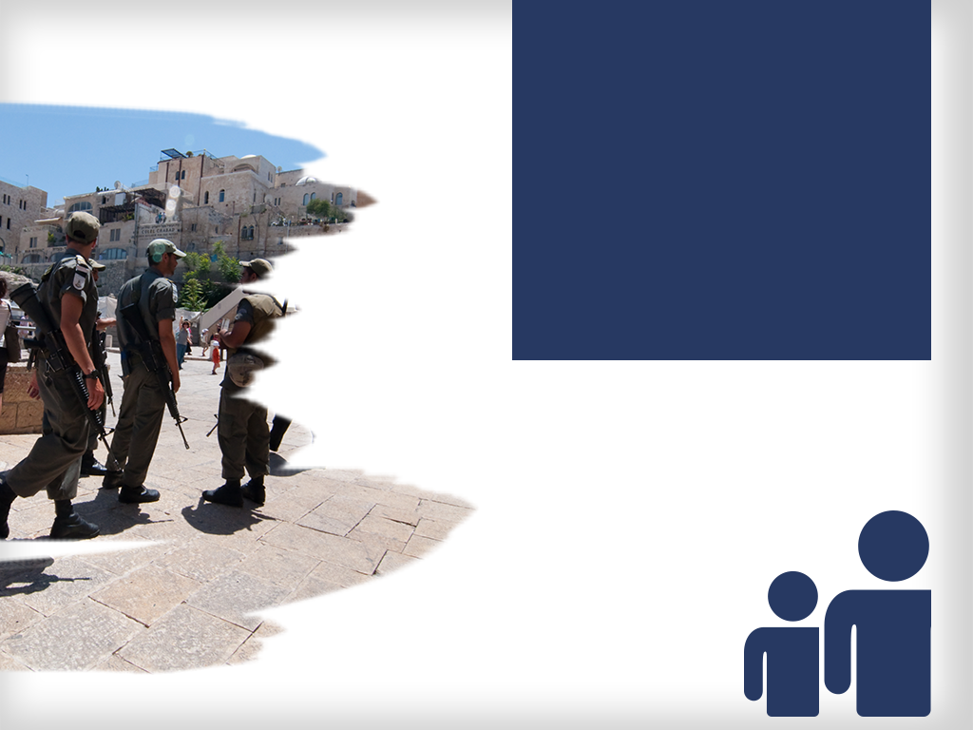
Human Resources
Technologies
District Commander
Safety
Border Police– 2090
Officers -2922
Total – 5012
Personnel
Deputy
Logistics
Planning
Assistant
Service
Traffic
Department
Central
Intelligence
Unit
Intelligence
Branch
Operations
Surroundings
Border
Police
David
Area
Kedem
Area
Zion
Area
Intelligence
Operations
Northern
Battalion
“Yamas”
Holy Sites
Unit
Shalem
Precinct
Lev HaBira
Precinct
Policing
Shafat
Precinct
Moria
Precinct
Southern
Battalion
“Sayeret”
Special Patrol Unit
3rd Company
Oz
Precinct
Shahar 101
Beit Shemesh
Precinct
Crossings
Adomim
Battalion
Volunteers
Patrol
Units
Hoshen
Battalion
HArel
Precinct
Explosives
Homa
Battalion
Licensing
Judea
Precinct
Arab Affairs Advisor
Legal Advisor
Spokesperson
Control
Public Inquiries Officer

Slide 7

Timeline of Main Events
April
Passover
Crusaders
Bircat HaCohanim
Shabbat Or
Prep. For Elections Round 1
May
Holocaust Remembrance Events
Memorial Day
Independence Day
Flag Dance
Ramadan
Lag BaOmer
January
Winter Readiness
“Pnei HaAtid”
March
Purim Marathon
February Gur Celebrations
June
Eid el Fitr
Pride Parade
Shavuot
December
Christmas
Hanukkah
August
9th of Av
Hutzot Hayotzer
Tu BeAv
Eid el Adha
September
Beginning of the School Year
High Holidays
Elections
Prep. For Elections round 2
October
High Holidays
Jerusalem March
Bircat HaCohanim
November
Rachel Celebrations
Sigd
Rabin Memorial
July
Summer Events
Light Festival

Slide 8

Main Threats
Temple Mount
Jews/Arabs
Terror
Riots
Orthodox/Secular
Sovereignty
Fighting Crime
Jerusalem Suburbs Events

Slide 9
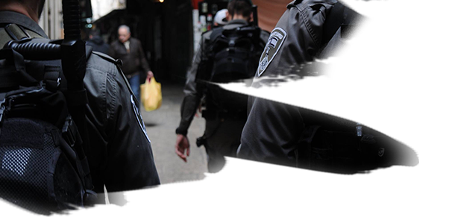
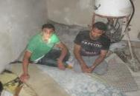
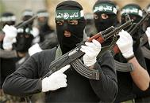
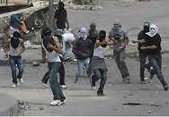
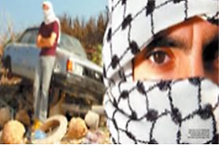
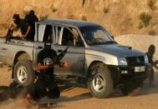
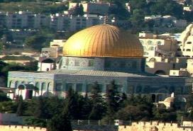
Terror Attacks
The City’s fabric and unique nature have lead it to be a number one target destination for terror attacks guided and assisted by external factors
Illegal Aliens
Terror Organizations
Unorganized Terror
Lone Wolf
Abductions

Slide 10
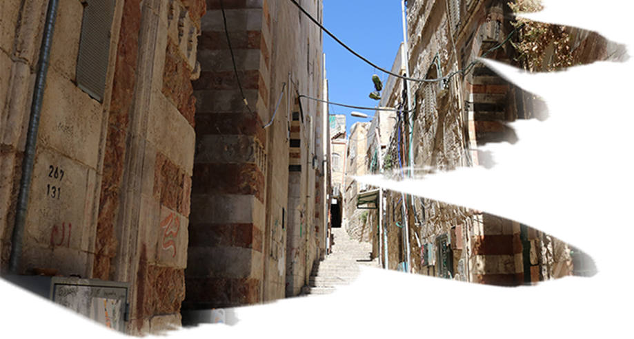

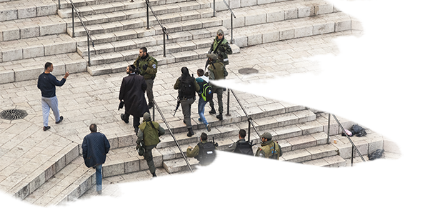
Terror Attacks
Multi-year Trend

Slide 11
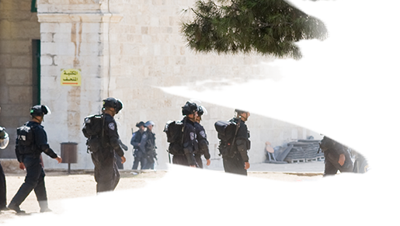
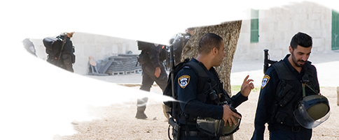
Temple Mount
Main Issues
General
Muslims
Jews
  Muslim-Jews Relations
  Temple Mount Security
  Operational Routine in Temple Mount
  Jordan/Waqf
  Waqf/Street
  Waqf Council Changes
  Maintenance Work on Temple Mount
  Essential “Maintenance” Work
  Visits
  Change of Status Quo
  Activity on Temple Mount
  Activity outside of Temple Mount
  Crime/Nationalistic Incidences

Slide 12
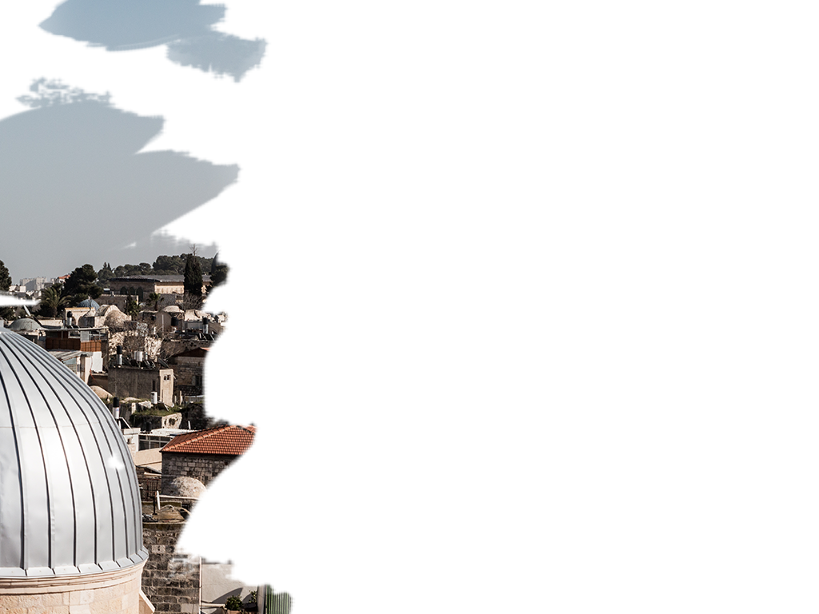
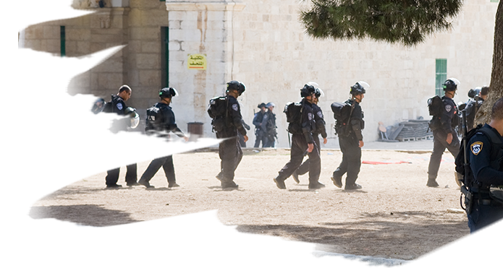
Temple Mount
Central Events of 2019
Change in Waqf council members.
Opening of the Golden Gate.
Burning of the police depot.
Opening for visitors on some of the last 10 days of Ramadan.
Opening for visitors during Jerusalem Day.
Terror Attack in the Old City on the last Friday of Ramadan.

Slide 13
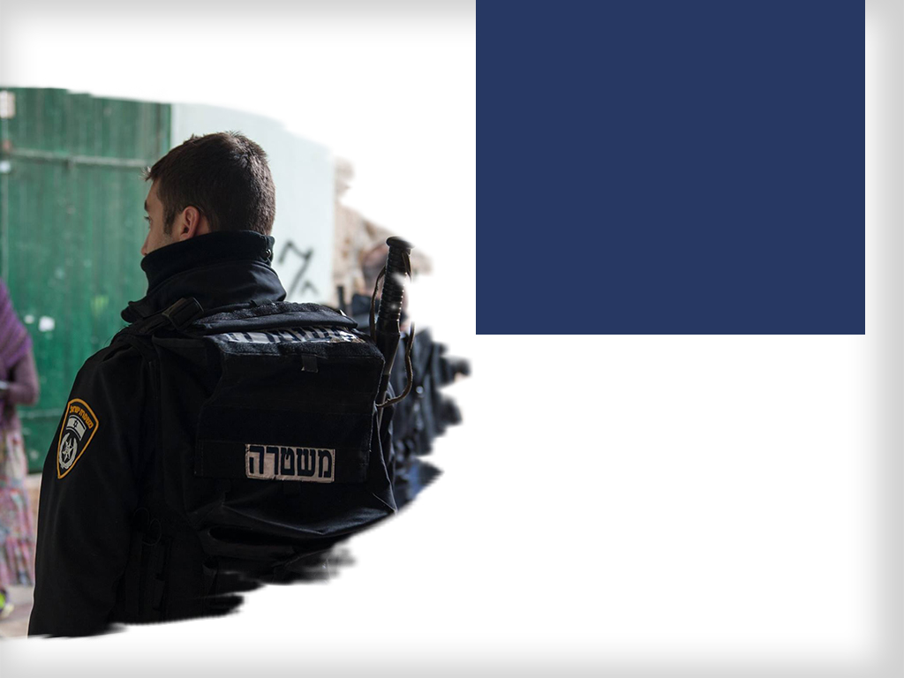
Table Mount
Visitors - 2019
Jews Visiting During 9th of Av
2019 | 2018
1,729 | 1,440
Visits During the Jewish High Holidays
Tourists |  | Jews
2018 | 2019 | 2018 | 2019
3,852 | 5,267 | 15,015 | 40,164

Slide 14
Temple Mount
Removals from the premises – Arab Sector
Removals from premises – Arab Sector

Slide 15
Temple Mount
High Holidays removals from the premises – Arab Sector
High Holidays removals from the premises – Jewish Sector

Slide 16
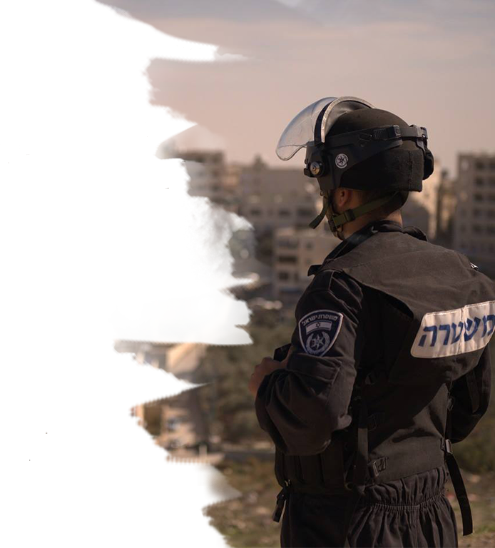
Riots
Stone Throwing
43%-
37%-
Molotov Cocktails
6.6%-
44.5%-
Riot Arrests
% | 2019 | 2018
22.7+ | 1,179 | 961

Slide 17
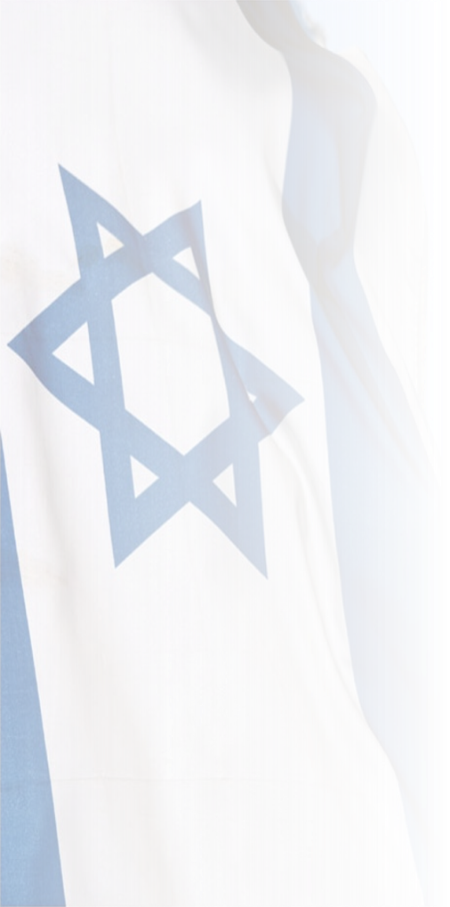
Sovereignty
Targeted Activity against the PA
Conferences and Events
Prisoner Releases
Government Offices
Flag Removals
Education
Media
Break in Events

Slide 18
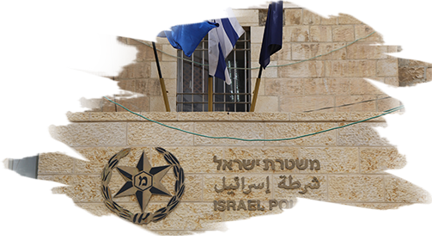
Crime - Trends
Criminal Offenses
12%-
17%-
1%-
16%-
15%-
Criminal Arrests
% | 2019 | 2018
23% | 647 | 519
* מע' ענף, לפי טריטוריאלית, ת. אירוע

Slide 19

Main Challenges
Protecting freedom of worship
Preventing harm to Sovereignty
Protecting the rule of law
Not widening the circle of hate while handling rioters with determination
Providing residents with a sense of security
Temple Mount
Orthodox Community
Emergency Readiness
Defending the fence outline

Slide 20
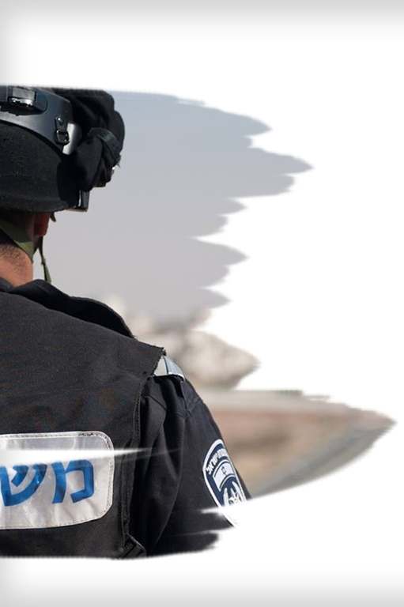
2020 Directives
Preventing Harm to Sovereignty
Strengthening the Sense of Security
Cultivating Service Men and Women
Improving Service Accessibility to the Community
Improving Police Officers’ Professionalism
Streamlining

Slide 21
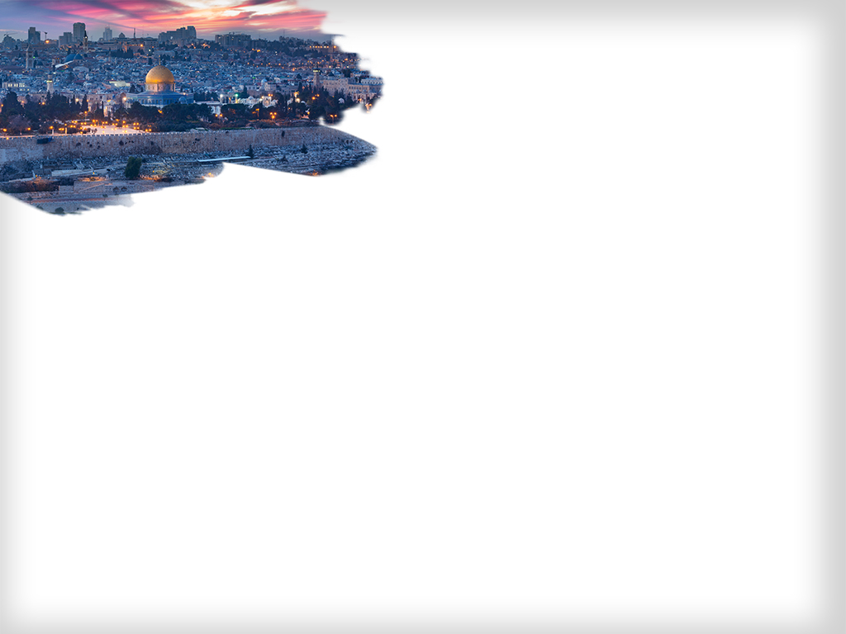


Dilemmas
Political Level
Policy
Balances
Balance and Use of Power
Containment and Restraint; Determination

Slide 22
“Generations have dreamed to get to Jerusalem, and we have the privilege to protect it”

