Slide 1
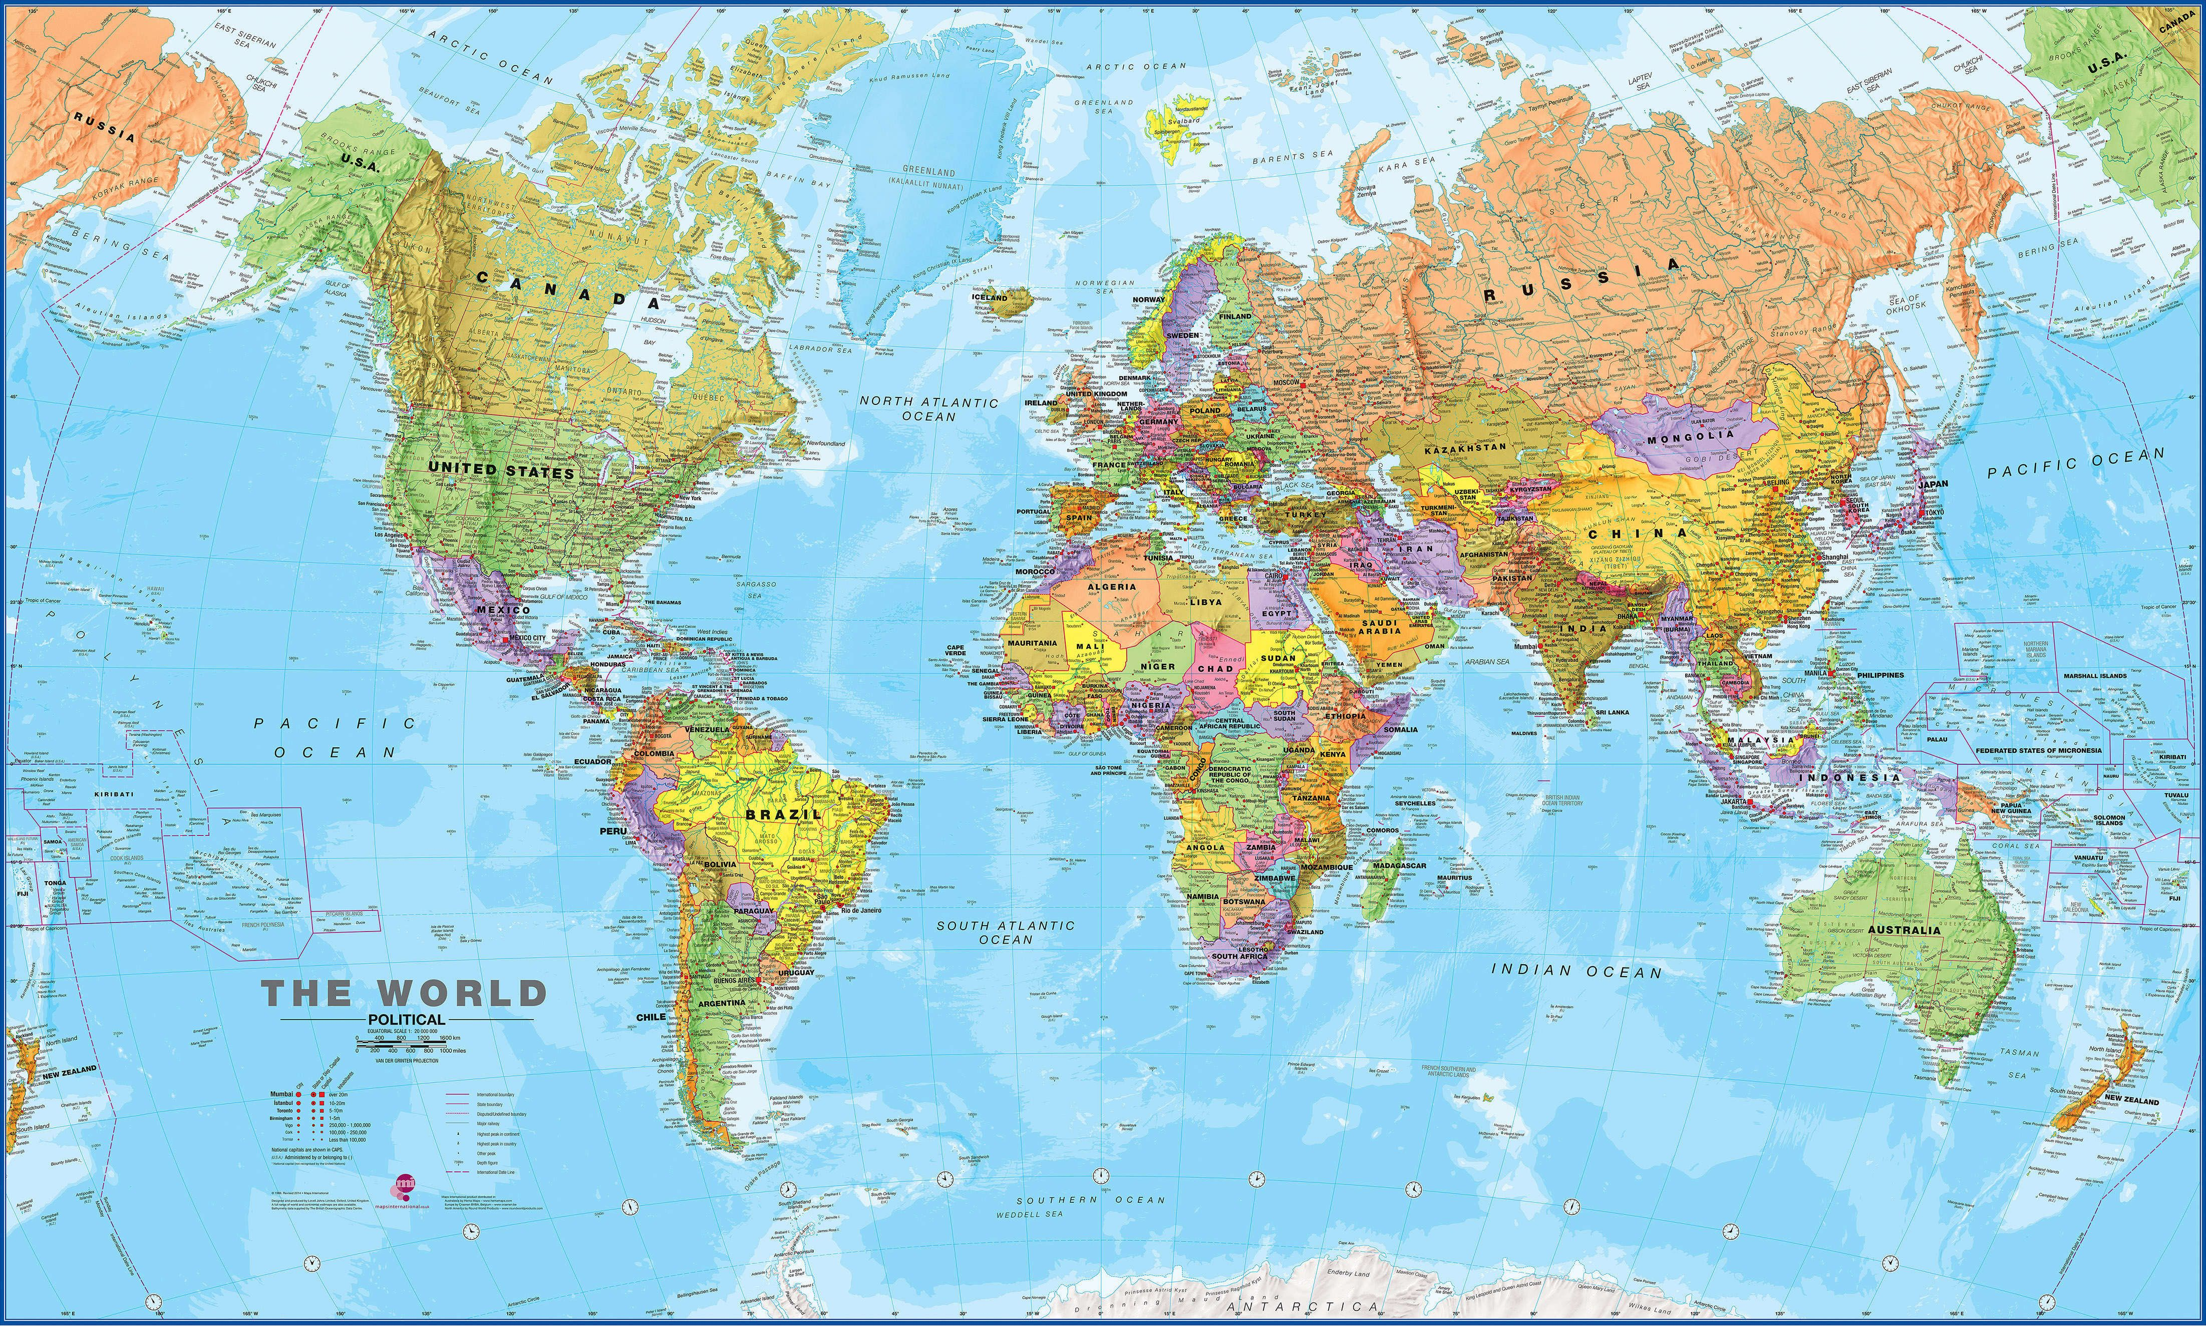
Geopolitics and Geostrategy
In National Defense View
INDC 48
Merav Zafari-Odiz
Yossi Ben - Artzi

Slide 2
Goals of the Course
Purpose and essence of the course
The aim of the course is to illuminate the fields of geopolitics and geo-strategy as significant components in understanding the fabric of national security. The course will reveal to participants the traditional and contemporary role of geography (physical and human) in the formation of national security perceptions, in the crystallization of the whole of international relations and in shaping the strategy of state and other forces in the global arena.
Sub-objectives
elaborating the various definitions of geopolitics and geostrategy and their implications on National Defense
Acknowledgment of the changes that have taken place in the study and research of these areas and in issues that are influenced by geographical considerations in National Defense.
Understanding the relationship between international relations, political science, national security policy, history, political and economic geography, geopolitics and geostrategy.
Creating awareness to the geostrategic implications of contemporary international issues in geographical dimensions such as space, energy and the sea.

Slide 3
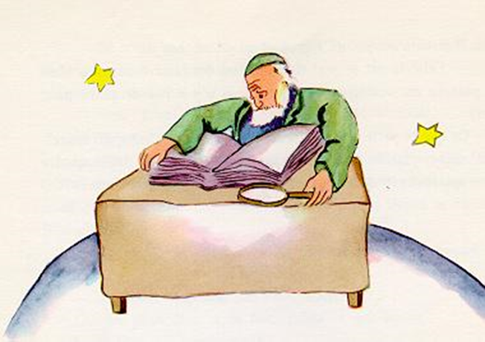
What is a Geographer?
"Where are you from?" The old man asked him.
"What is this big book?" The little prince asked, "What are you doing?"
"I am a geographer," the old man replied.
"What does a geographer mean?" Asked the little prince.
"A geographer is a person with an extensive education,
who knows the place of all the seas, rivers, cities,
mountains and deserts.“
"It's very interesting," said the little prince,
"at last a true professional!

Slide 4
On the nature of Geography
Geography is the study of places and the relationships between people and their environments. Geographers explore both the physical properties of Earth’s surface and the human societies spread across it. They also examine how human culture interacts with the natural environment and the way that locations and places can have an impact on people. Geography seeks to understand:
where things are found?
why they are there?
how they develop and change over time?

Slide 5
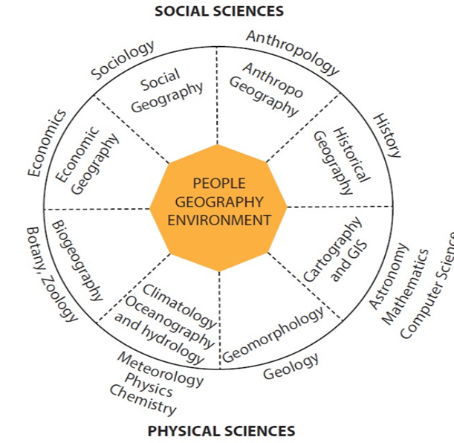
Links between geography and other disciplines

Slide 6
Regional Geography

Slide 7
What is a region?
A region is an area with a unique character that makes it different from other areas.
The criteria that distinguish regions are natural/ physical attributes and human environment.
Regions are complex and often blend into one another, with their borders sharing common characteristics and changing over time
Defining an area depends on the scale and freedom of the researcher

Slide 8
Political Geography
Political geography deals with issues that are at the meeting point between geography and politics.
At the international level:
The Impact of Geography on Political Relations between Countries, International Organizations, Official Organization of Countries on a Geographical Basis Formally (e.g. EU) or not (e.g. Third World Countries)
The political arena:
The impact of geography on intra-state political affairs: the functional-geographical structure of a state and its division into administrative regions; The interrelationship between the system of government and the people; The impact of a state's geographical conditions on the ideologies of its citizens; Mapping election results
The regional-local level
Core-periphery relations, the impact of politics on planning, resource allocation and landscape design

Slide 9
So what is Geopolitics?
Exploring the impact of geography (human and physical) on politics and international relations.
A method for studying foreign policy to understand, explain and predict international political behavior using geographical variables.
Geopolitics focuses on a political force linked to the geographical space combined with the study of diplomatic history.
Geopolitics deals with the relationship between the interests of international political factors focused on region, space or geographical element that create a geopolitical system

Slide 10
Evolution of the discipline
The German axis:
Friedrich Ratzell [1844-1904]: The state as a living organ that spreads, grows and needs a 'living space' [Lebensraum]
Rudolf Kjelln the Swede (1864-1922]: coined the term geopolitics: as one of five scientific conceptions for understanding a country's foreign policy: demography, economics, "social politics" and "political power" ... in our words: The Pillars of the National Defence
Karl Haushofer: [1849-1946]
The United States, Germany, and Japan as world superpowers that have not exercised their power and privilege, and are inequality with the empires of Russia, Britain, and France;
Improvement of the ‘living space’ - a debate over whether it will be marine or land
Significant impact on Japan as well!
Extremization the concept by the Nazis, also in light of the racial theories
[investigation after 1945 ...]

Slide 11
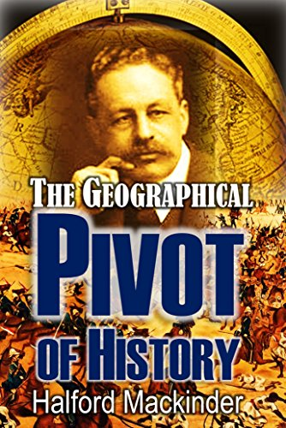
Cont.
Halford Mackinder [1861-1947]:
Sea Powers and continent Powers and the advantage of Sea Powers
The impact of technological innovation: trains as a means of mobilizing forces and resources, hence the need to strengthen terrestrial power
1904 - The theory of the 'geographical pivot of history': the division of the world into core, margins and 'islands’
Adopting the term HEARTLAND:
"He who rules Eastern Europe commands the Heartland; he who rules the Heartland
commands the world island; he who rules the world island commands the world"
In defense of the liberal democracies
Influence on Geopolitical thinking today - What have you read in GRAY?

Slide 12
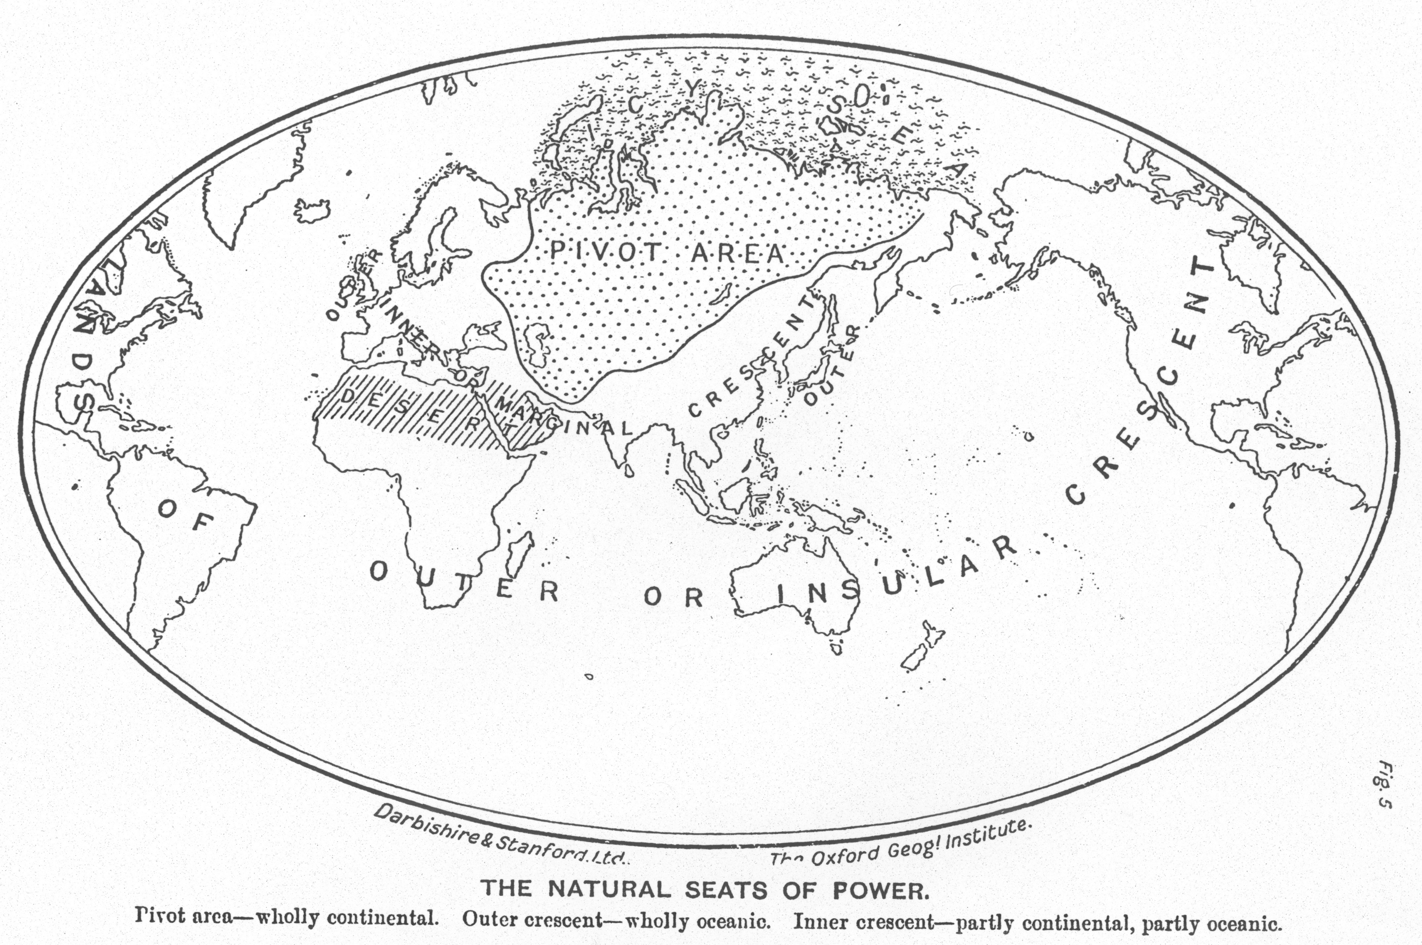

Slide 13
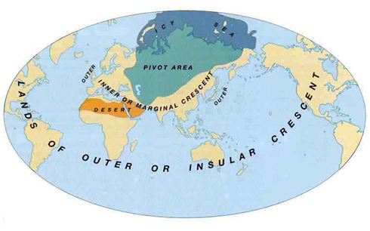

Slide 14
Sea Vs. Continent
Alfred Mahan [1894-1914] USA:
Admiral and strategist
The "powers of the sea" will always finally overcome the "continent powers" [Rome and Carthage; Napoleon and Britain]
If Russia and Germany do not develop a significant navy, they will not be able to defeat countries like Britain and the United States.
At key strategic points, especially in the case of the Egyptians and sea crossings. Their control makes it possible to weaken the enemy's naval power: the Bosporus, the Danish Strait in the North Sea, the Panama Canal
It is worth remembering Mahan when discussing the Chinese initiative ...

Slide 15
Let’s think together about Europe in WW2
Germany took over the adjacent countries
When the East was secured - invaded west and south and north up to Norway - isolating GB!
British naval force neutralized, air force restricted, full Anti-Air Defence from Norway to Spain
In the East the Japanese did the same in Manchuria, China and Singapore
But! here Hitler made the big geo-strategic wrong decision: the attempt to take over the Russian and to control the Heartland.. and Japan hit the American front defender in Hawai
Key question :
Did Hitler make a geopolitical or geo-strategic mistake?
Politically he was not wrong .. he made right alliances with Italy and Japan
Strategically - he made a big mistake, and only Churchill understood that ... and was also waiting for Japan's mistake ...

Slide 16
Later Developments
Decline and reservations about the term 'geopolitical’ - identified with the 'axis of evil' of the war
Growth in the Cold War: What to do now with the USSR and the development of Spykman and Kennan 'Theory of Containment'
Kissinger: Geopolitics is a synonym for "global balance of power" and fixed national interests in the global balance of power “;
neglecting the anti-Soviet line, the turn to China and the conflict in the Middle East: from a bipolar world to a tripolar world.
New and contemporary concepts: new dimensions of technology, non-state powers, space, cyber and the deep sea

Slide 17
Geo-strategy
"Geography is the Mother of Strategy" [Gray and Sloan, [1999]
Geo-strategy includes comprehensive planning, allocation of means to achieve national goals or security of assets of military or political significance
The impact of the geographical complicated system on the planning of political and operational moves
Exercising power over particularly critical spaces on Earth and creating a political presence in the international system.
The debate over the types of power and their impact: aerial, marine, terrestrial and outer space
Brzezinski: The words geopolitics, strategy and geo-strategy are used to convey the following meanings: Geopolitics reflects the combination of geographical and political factors that determine the state of a country or region, and emphasizes the influence of geography on politics; Strategy refers to the comprehensive and planned implementation of means to achieve a central goal or to create vital assets of military significance; And geo-strategy merges strategic consideration with geopolitical considerations.

Slide 18
criticism
Charles Clover in: "Dreams of the Eurasian Heartland", Foreign Affairs 78 (9),1999:
"There are only a few of the modern ideologies that are comprehensive,
vaguely intellectually sloppy romantic, and likely to cause development of
World War III - like the theory of geopolitics" ...
and:
Marxists: The invention of a concept that would allow for American imperialism
The Ancient Debate: Determinism and Possibility in Geography:
Is "Egypt the gift of the Nile"?

