Slide 1
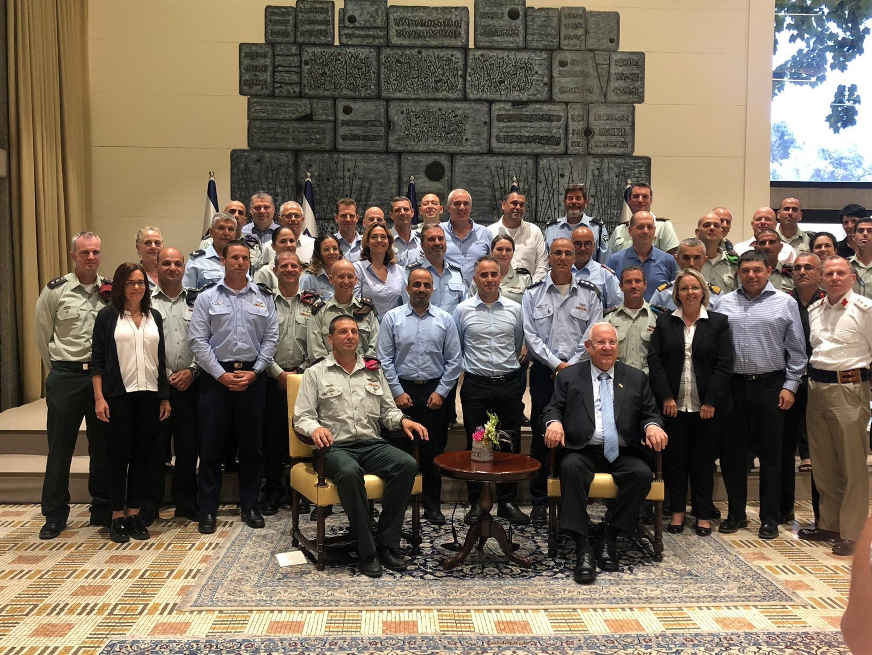
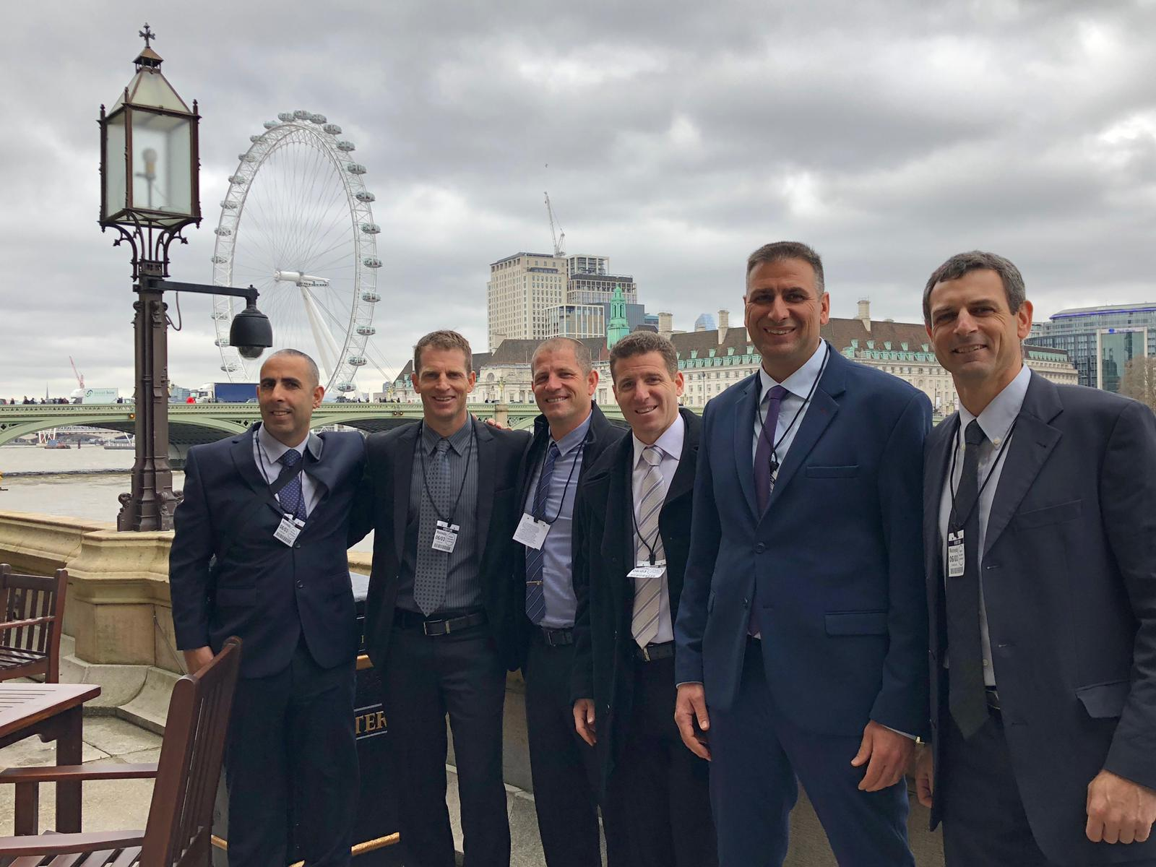
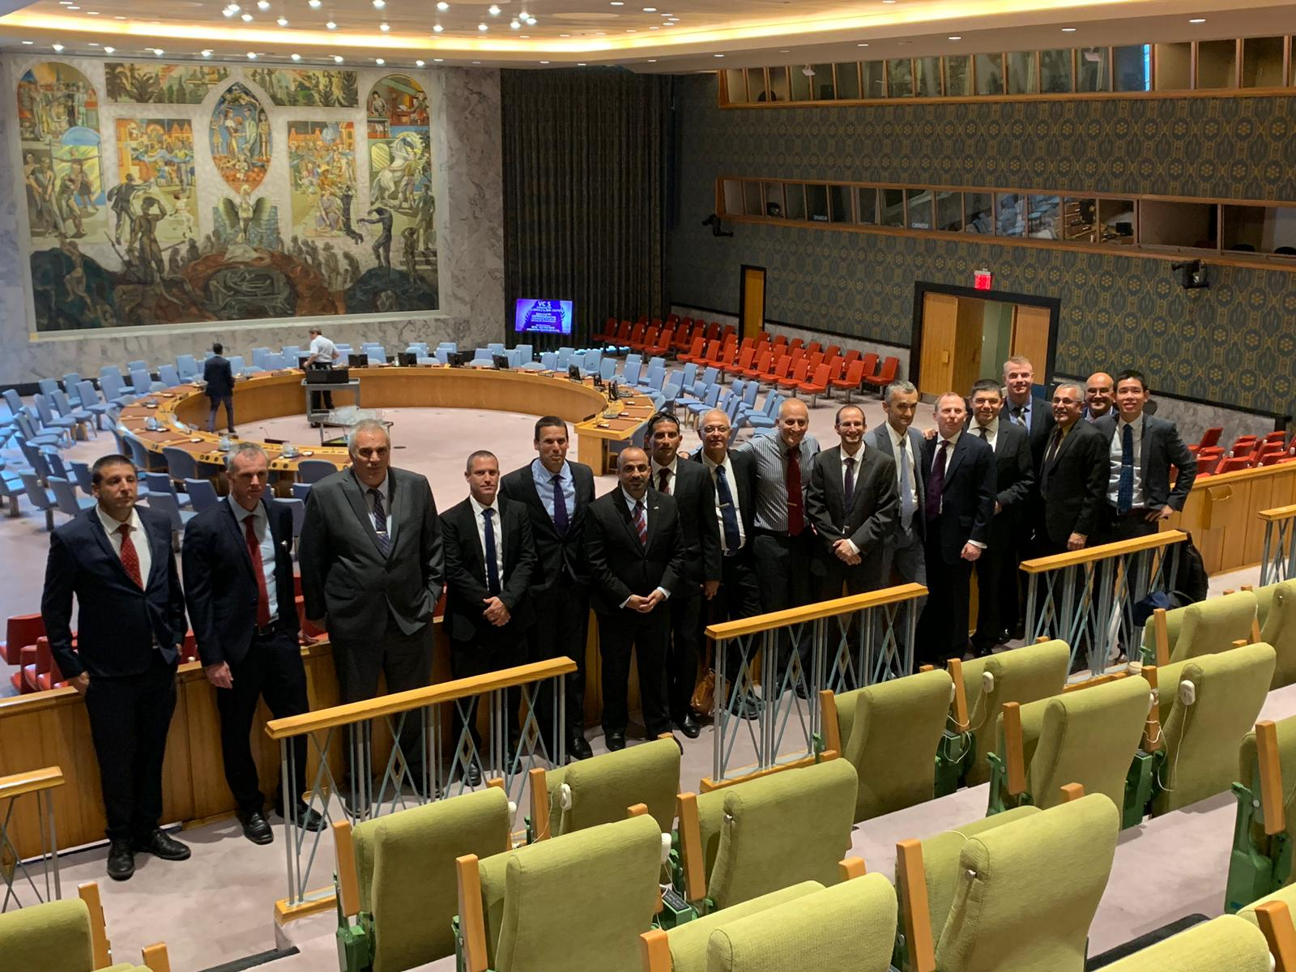
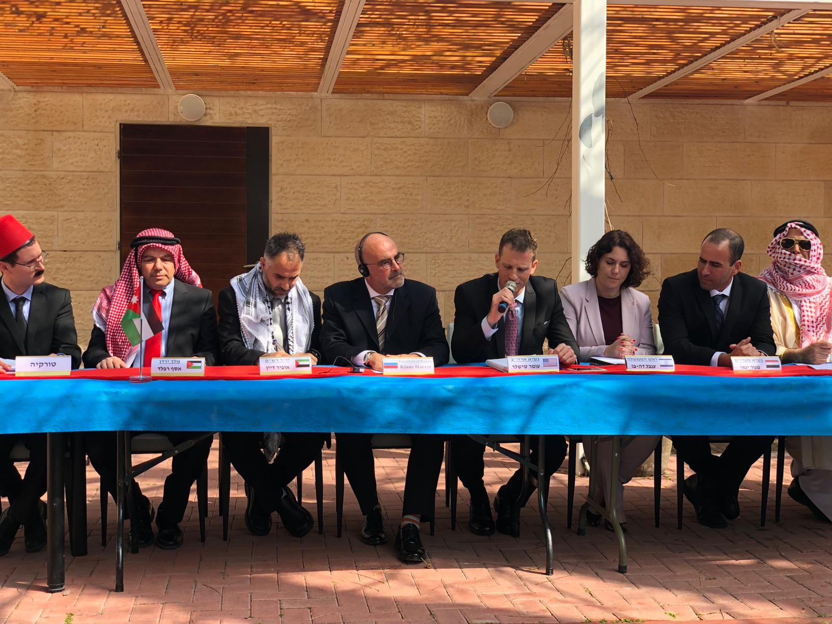
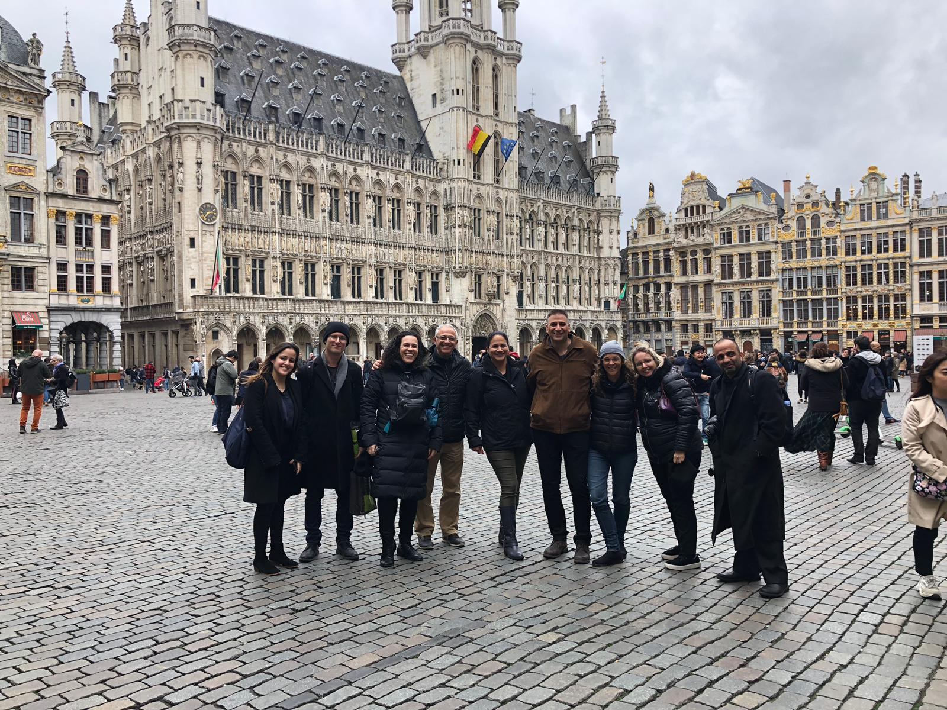
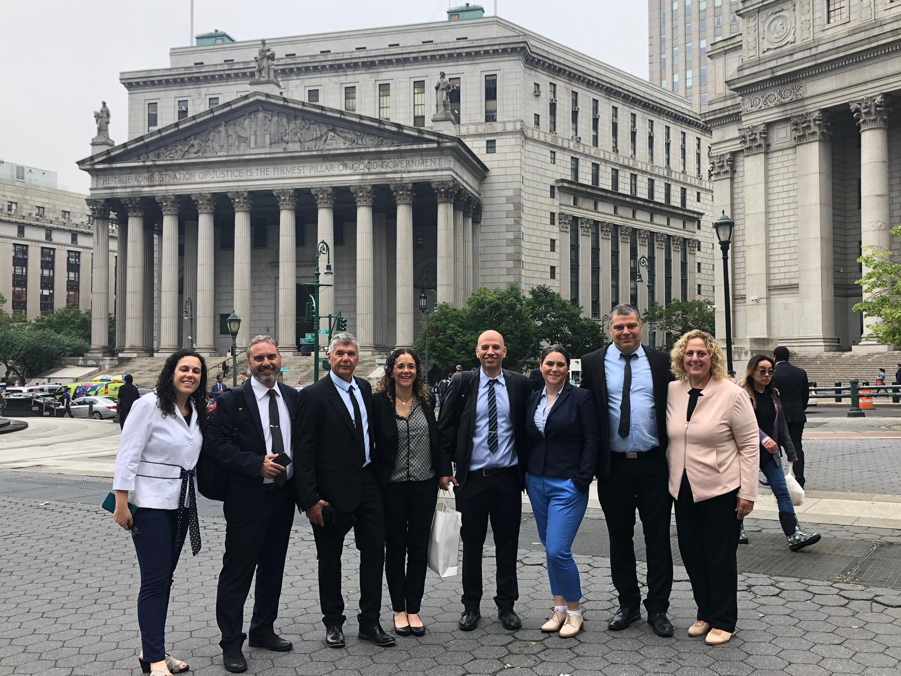
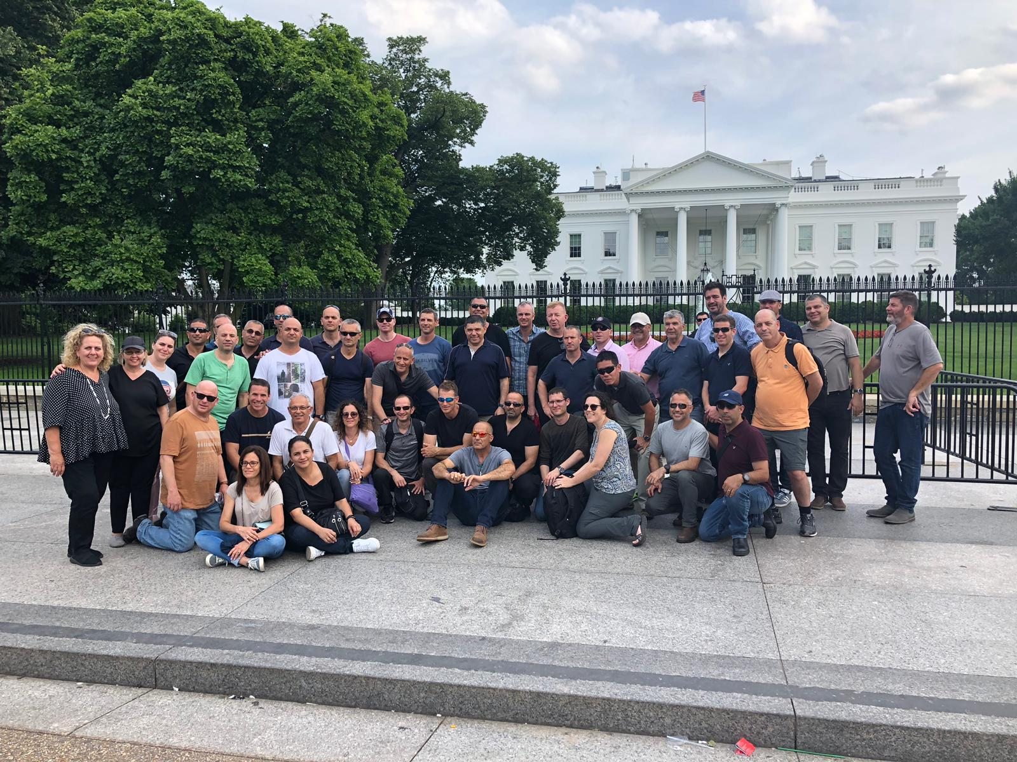
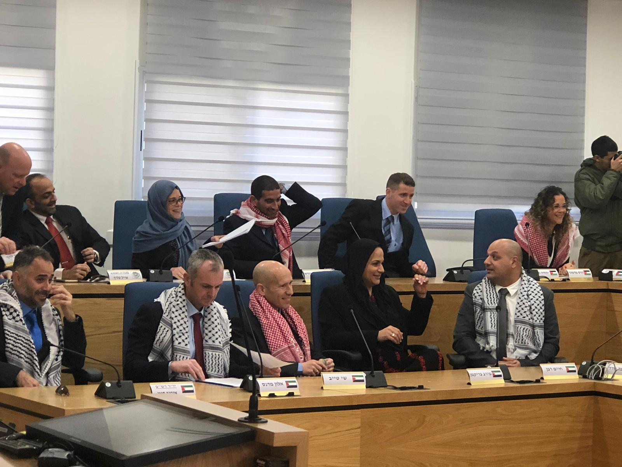

Slide 2

Opening Remarks
By the Commandant
INDC 47th Class
August 8th, 2019

Slide 3

In Favor of Embarrassment
 | Thus is the way of movements, as is the way of people, whose thinking lags behind events. The thought depends on inertia, routine, habit [...] The thought is always lazy and it assumes that what was will also be. Which is not the case with events. Although events have inertia, there is also dynamics. Life and nature are always full of conflicts, competing forces. The world does not freeze, and history does not freeze, nor does nature and man freeze. But the thought usually lags behind, and when, in a known time, a known system begins to falter, the thought still refuses to see it, because it requires it to make great efforts, to find new paths, which is difficult because there is a limited amount of energy to a person and they need to invest it in their war of existence . They cannot refer their mind and see the changes that have been made in history. David Ben-Gurion

Slide 4
In Favor of Embarrassment
I am afraid to say: When I see a person walking amongst us as one who has solved all the questions, or as one who's a "Guide to the Perplexed" (a book by Maimonides), or as one who needs no guide, like his clear mind has never known embarrassment - I see them as living in different worlds. Outside of our sad world and its harshness and stolen hopes.
And as for me, I prefer a humble and restless soul than a soul with no blemish that is silent.
Berl Katznelson

Slide 5
On Questioning
“And I’ve learnt that doubt – is the most important and eternal of my tools,
And the answer – Is temporary and fleeting.
And between them – between the question and the answer – I’ve learnt that, there is a refined and obligating moment, a moment of doubt.
A moment of undermining truths, of examining foundations, a moment of collapsing pillars, of great difficulty, of risk of opportunity.”

Slide 6
Expectations:
Curiosity
Innovative Thinking
Leadership
Taking Opportunities
Accountability

Slide 7
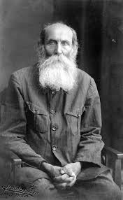
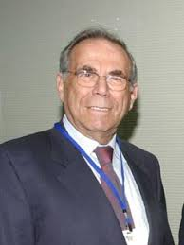
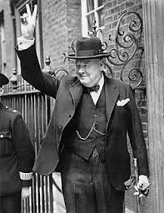
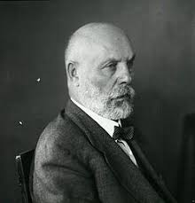
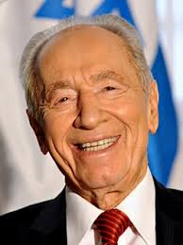
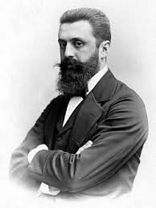
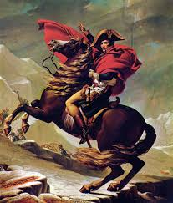
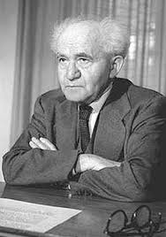
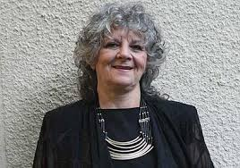
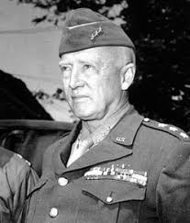
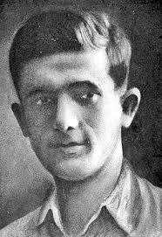
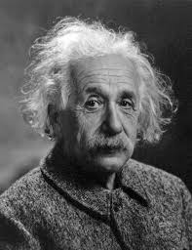
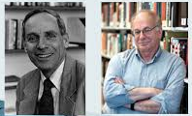
Who is a Senior?
A person with greatness?

Slide 8


Slide 9
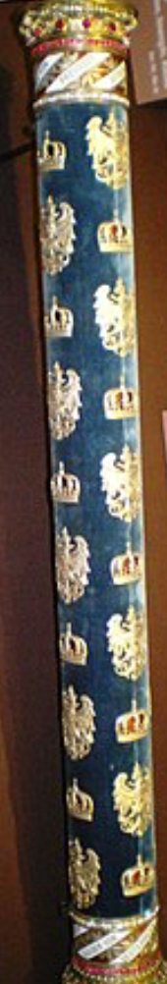
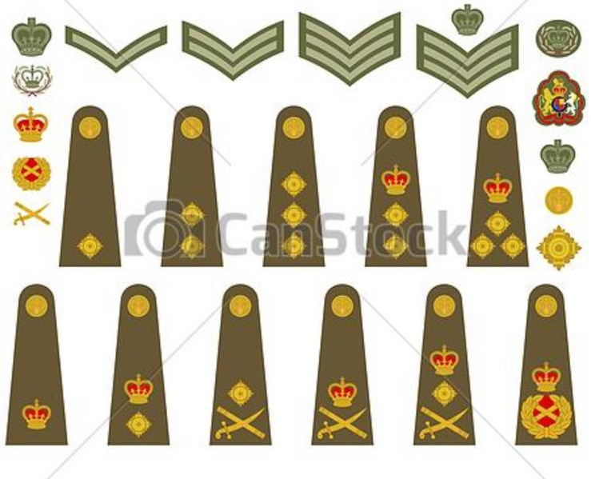

Slide 10
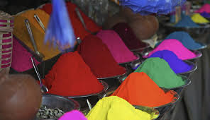

Slide 11
Describing the Journey
Attempt Number One

Slide 12
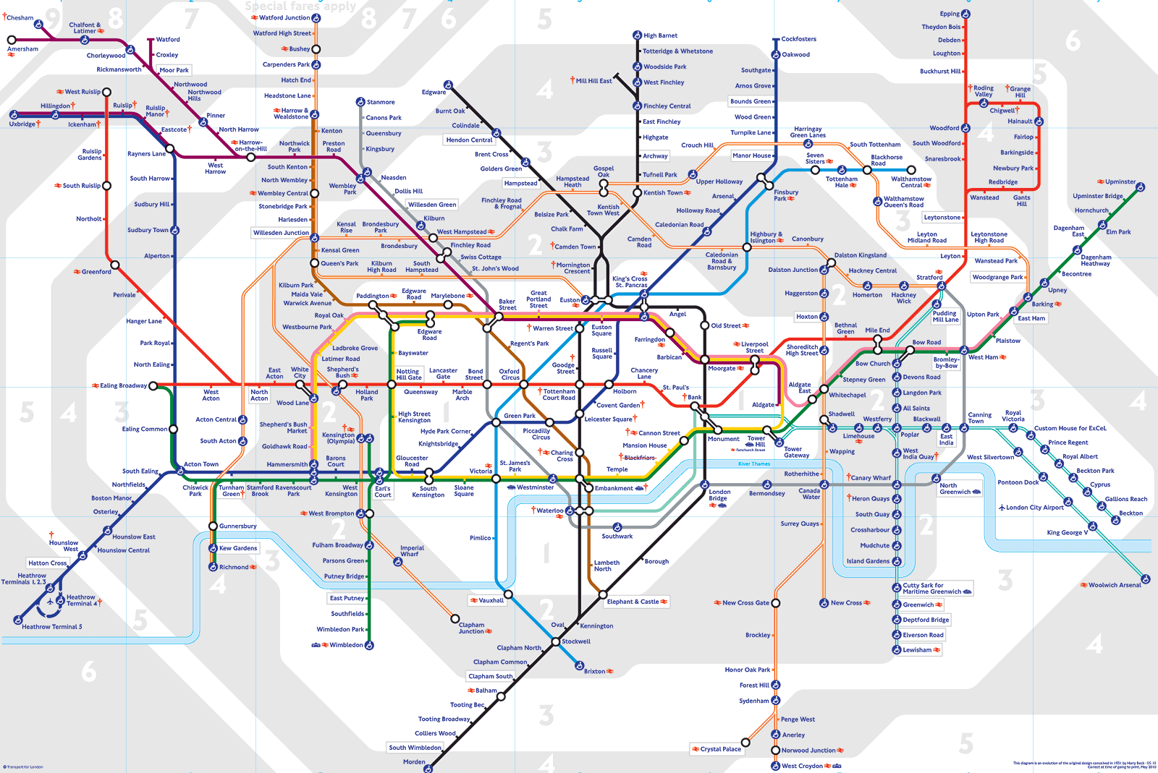
The Metro Metaphor
The Visual Image of the INDC Year – Metro Map
INDC

Slide 13
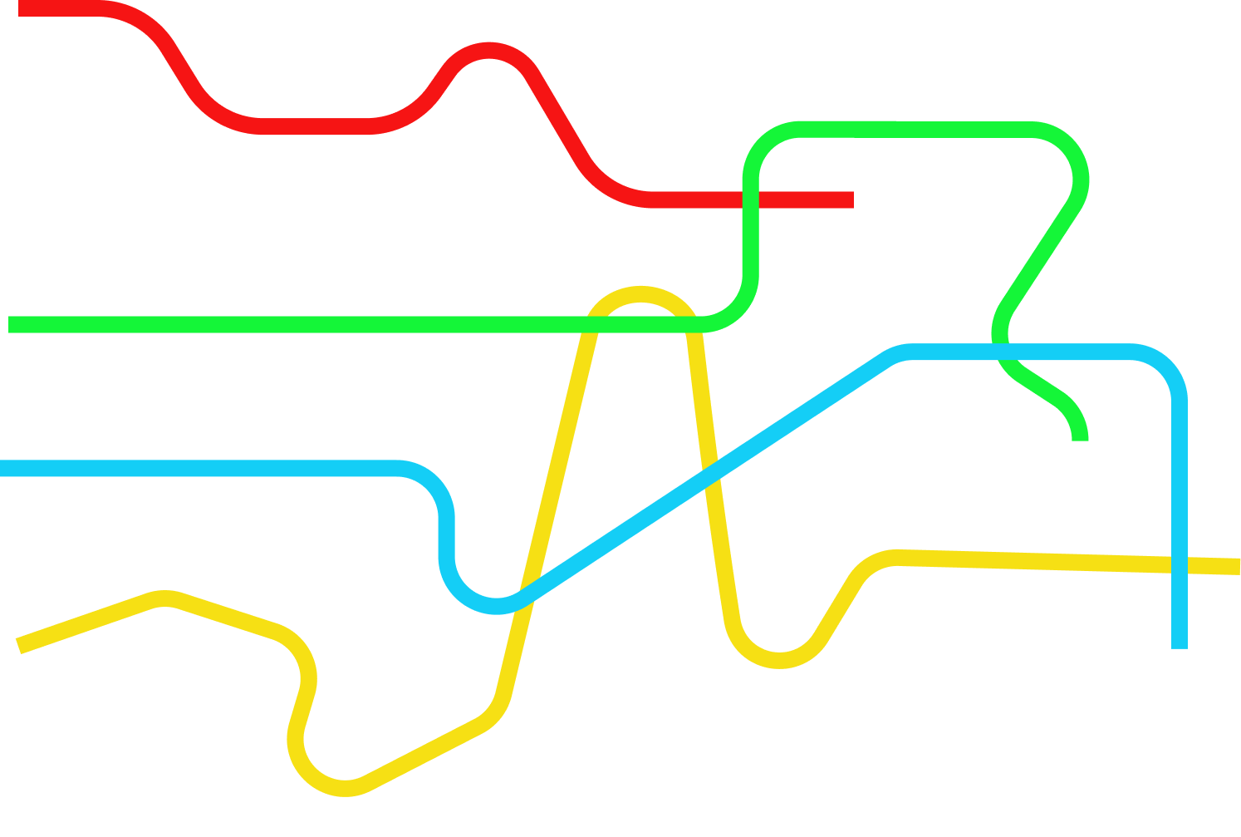
The Seasons
T1 Global Season
T2 Israeli Season
T3 Specialization
T4 Integrative
Season

Slide 14
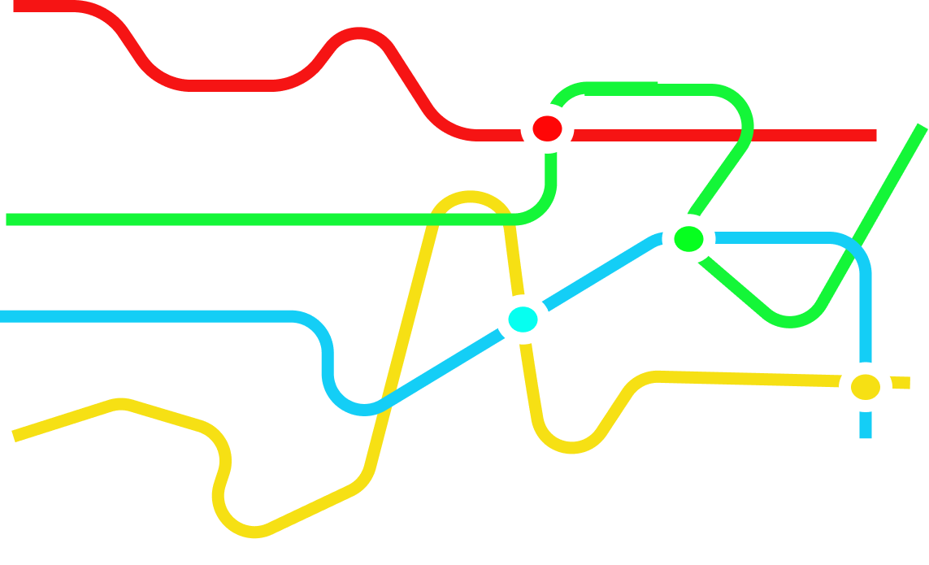
The Seasons and Major Stations
T1 Global Season
Europe Research Seminar
T2 Israeli Season
Simulation
T3 Specialization
East Seminar
USA Research Seminar
T4 Integrative Season

Slide 15
Courses and Seminars by Seasons
Global National Security
T1 Global Season
Politics /
Diplomacy
From Polis to Globalization
European Research Seminar
Personal Skills
Strategic Thought
National Security Tours
Founding Fathers
National Security
T2 Israeli Season
Strategy
Simulation
Digital World
Optional Seminar
T3 Specialization
Main Seminar
East Seminar
USA Research Seminar
T4 Integrative
Season
Final Project

Slide 16
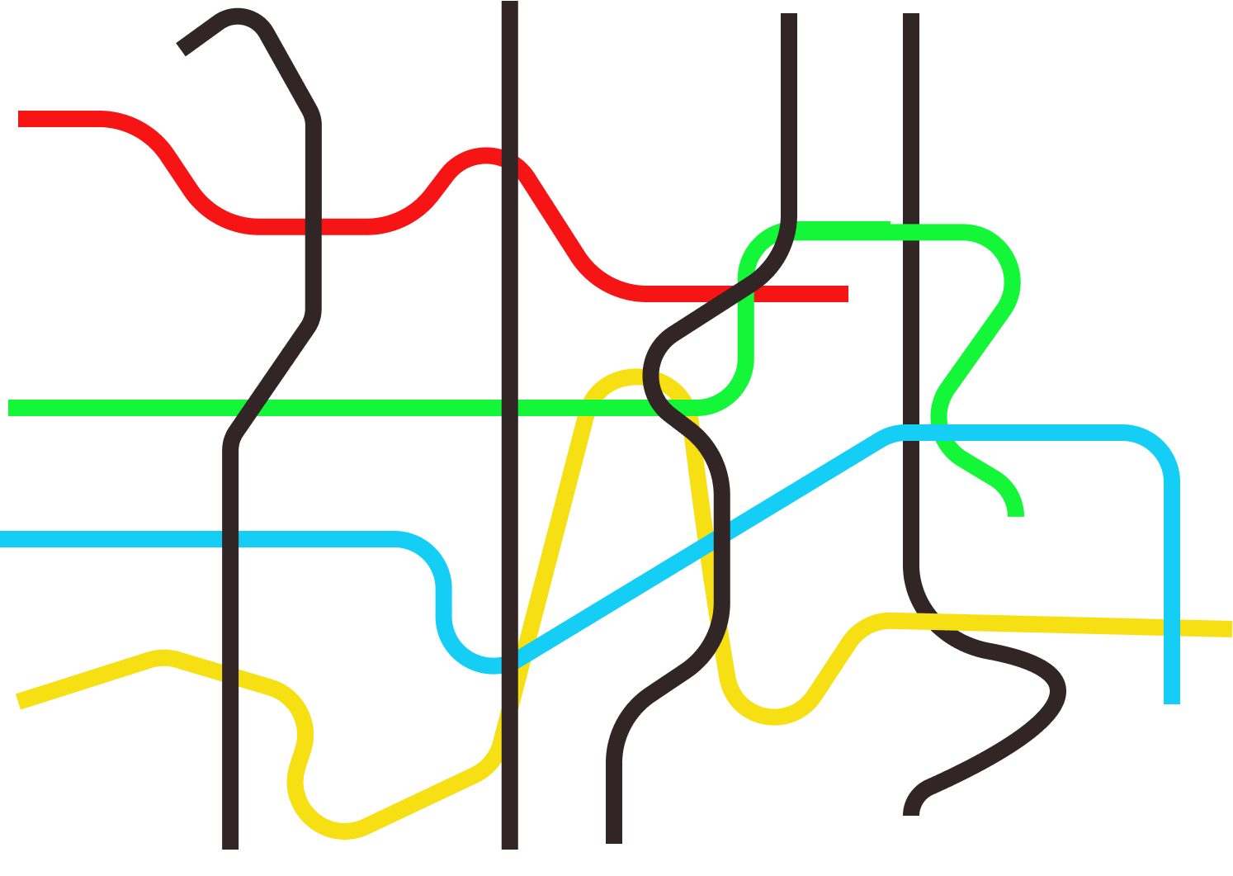
4 Fields of Study – National Security Components
T1 Global Season
T2 Israeli Season
T3 Specialization
T4 Integrative Season
National Defence
Economy
Society
Diplomacy

Slide 17
The Purple Line - Strategy
T1 Global Season
T2 Israeli Season
T3 Specialization
T4 Integrative Season
National Defence
Economy
Society
Diplomacy

Slide 18

The Orange Line - The Personal Learning Process
T1 Global Season
T2 Israeli Season
T3 Specialization
T4 Integrative Season
National Defence
Economy
Society
Diplomacy
Strategy

Slide 19





Learning Methods
Plenum
Team
Teams
Individual
Integrative

Slide 20
The Vision of the Academic Year at the INDC
Europe Research Seminar
T1 Global Season
Simulation
East Seminar
US Seminar
T2 Israeli Season
T3 Specialization
T4 Integrative Season
National Defence
Economy
Society
Diplomacy
Strategy

Slide 21
The Vision of the Academic Year at the INDC
Europe Research Seminar
T1 Global Season
Simulation
East Seminar
US Seminar
T2 Israeli Season
T3 Specialization
T4 Integrative Season
National Defence
Economy
Society
Diplomacy
Strategy

Slide 22
Another Number Two

Slide 23
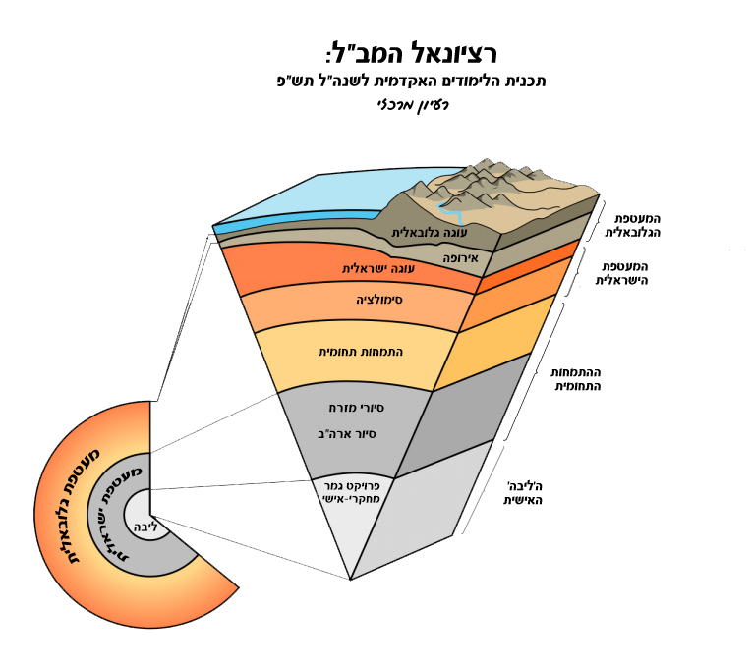
INDC Rationale:
Academic curriculum for the year 2019-2020
Main Idea
Global
sphere
Global cake
Israeli cake
Europe
Israeli
sphere
Simulation
Disciplinary specialization
Disciplinary specialization
Tour to the East
USA tour
sphere
sphere
Individual final research project
The individual 'core’
Global
Core
Israeli

Slide 24
Seasons
Global
Israeli
Specialization
Integrative
Senior

Slide 25
T 1
Global
T 1
Europe
Israeli
T 2
Simulation
T 3
Specialization
T 3
East Tour
T 4
Integrative
USA Tour
Senior

Slide 26
Learning Environment
T 1
Global
Plenum
T 1
Europe
Israeli
Team
T 2
Simulation
Assigning Teams
T 3
Specialization
T 3
East Tour
T 4
Integrative
Individual
USA Tour
Inquiry
Senior

Slide 27
Influence
Learning Environment
T 1
Global
Plenum
T 1
Europe
Israeli
Team
T 2
Simulation
Assigning Teams
T 3
Specialization
T 3
East Tour
T 4
Integrative
Individual
USA Tour
Fusion
Senior

Slide 28
“For no tranquility my brother will know, neither peace nor pleasure. Because for your awakening I come, for your awakening to say: Ask a man, for, directions of the world, ask, what is the way, what?”
On the Road/Yosef Haim Brenner

