Slide 1
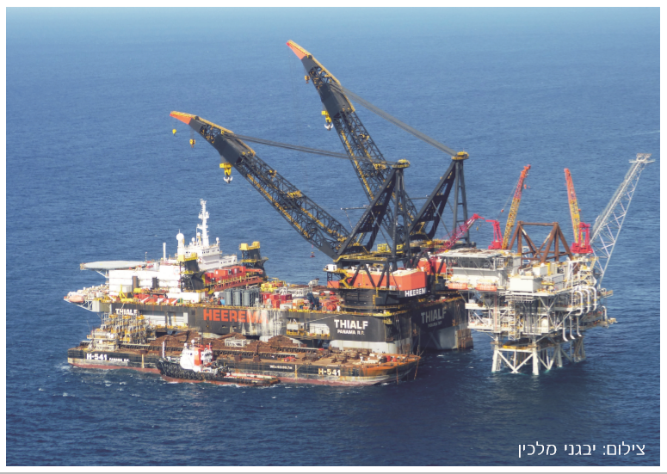
Exercise
Photographer: Evgeni Malkin

Slide 2
Teams: 1 + 2 The mission: a presentation including the following slides: 1. What considerations took part in this recommendation? 2. The influence of the decision on Israel’s balance of power (4 types of power) 3. Presenting an example to this step and analyzing it based on the terms and concepts studies in class (soft/hard power, state budget, etc.)
Recommendation #1
Using the resource of gas for the purposes of the economy, with no export whatsoever
Notes:
המלצה 1 : שימוש גז למטרות המשק בלבד ללא ייצוא כלל

Slide 3
Teams 3 +4 The mission: a presentation including the following slides: 1. What considerations took part in this recommendation? 2. The influence of the decision on Israel’s balance of power (4 types of power) 3. Presenting an example to this step and analyzing it based on the terms and concepts studies in class (soft/hard power, state budget, etc.)
Recommendation #2
Using the resource of gas for export purposes only
Notes:
המלצה 1 : שימוש גז למטרות המשק בלבד ללא ייצוא כלל

Slide 4
Mission:
Presenting your slides and convincing the forum to follow your policy recommendation (in no longer than 10 minuets)

Slide 5
*Some background information

Slide 6
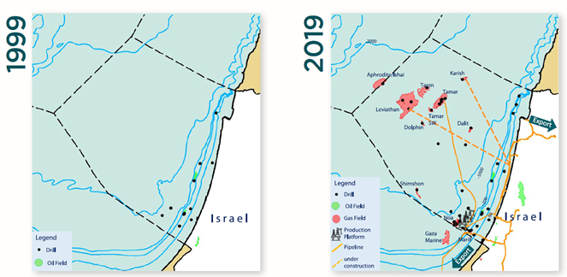
The Gas Market Revolution in Israel

Slide 7
Electricity Market
Industry & Distribution
Transportation
Petrochemical Industry
Total

Slide 8
Export
Options

Slide 9
Liquefied Natural Gas (LNG) Global Export, According to Countries (2016)

Slide 10
Liquefied Natural Gas (LNG) Global Export, According to Countries (2016)

Slide 11
Prices of Gas in Israel between 2005-2016
(US Dollar to mmbtu – British Thermal Units)

Slide 12
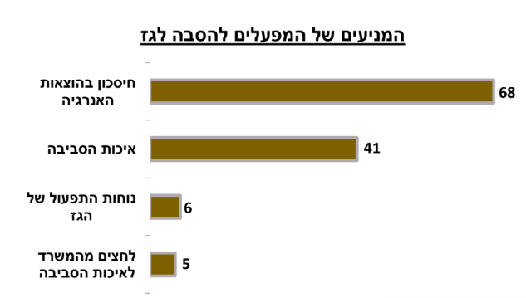
Survey by the Ministry of Energy Motives for converting factories to natural gas
The Factories’ Motives for Converting to Gas
Saving in Energy Expenses
The Environment
The Convenience of Operating Gas
Pressure by the Ministry of Environmental Protection

Slide 13
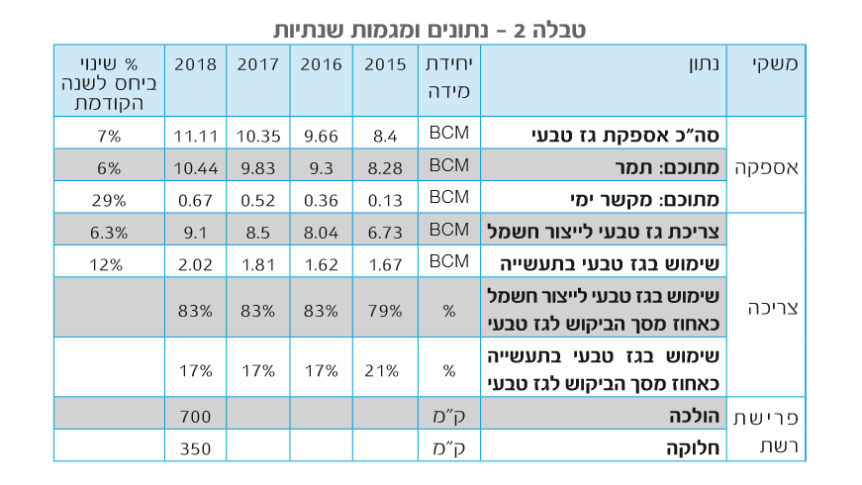
Table #2 – Annual Trends and Data
Change in % from Previous Year
Unit of Measurement
Data
Economy
Total supply of natural gas
Supply
From the total: Tamar
From the total: Maritime connecter
Consuming natural gas for electricity production
Use of natural gas in the industry
Use of natural for electricity production as % from total demand
Demand
Use of natural gas in the industry as % from total demand
Km
Conduction
Network Deployment
Km
Distribution

Slide 14
The Norwegian Wealth Fund has Reached a Worth of One Trillion Dollars
The Central Bank has confirmed that the fund, that manages the country’s income from oil, has crossed tonight the trillion dollar threshold – among others due to the weakening of the dollar and the rises in the financial markets since the year started

Slide 15
Thank you
נח הקר

