Slide 1
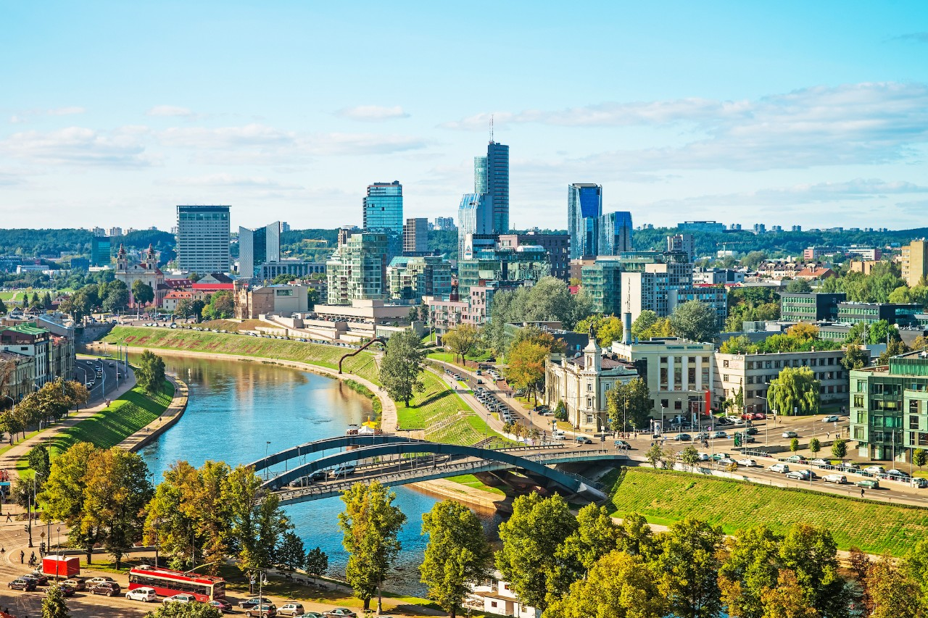
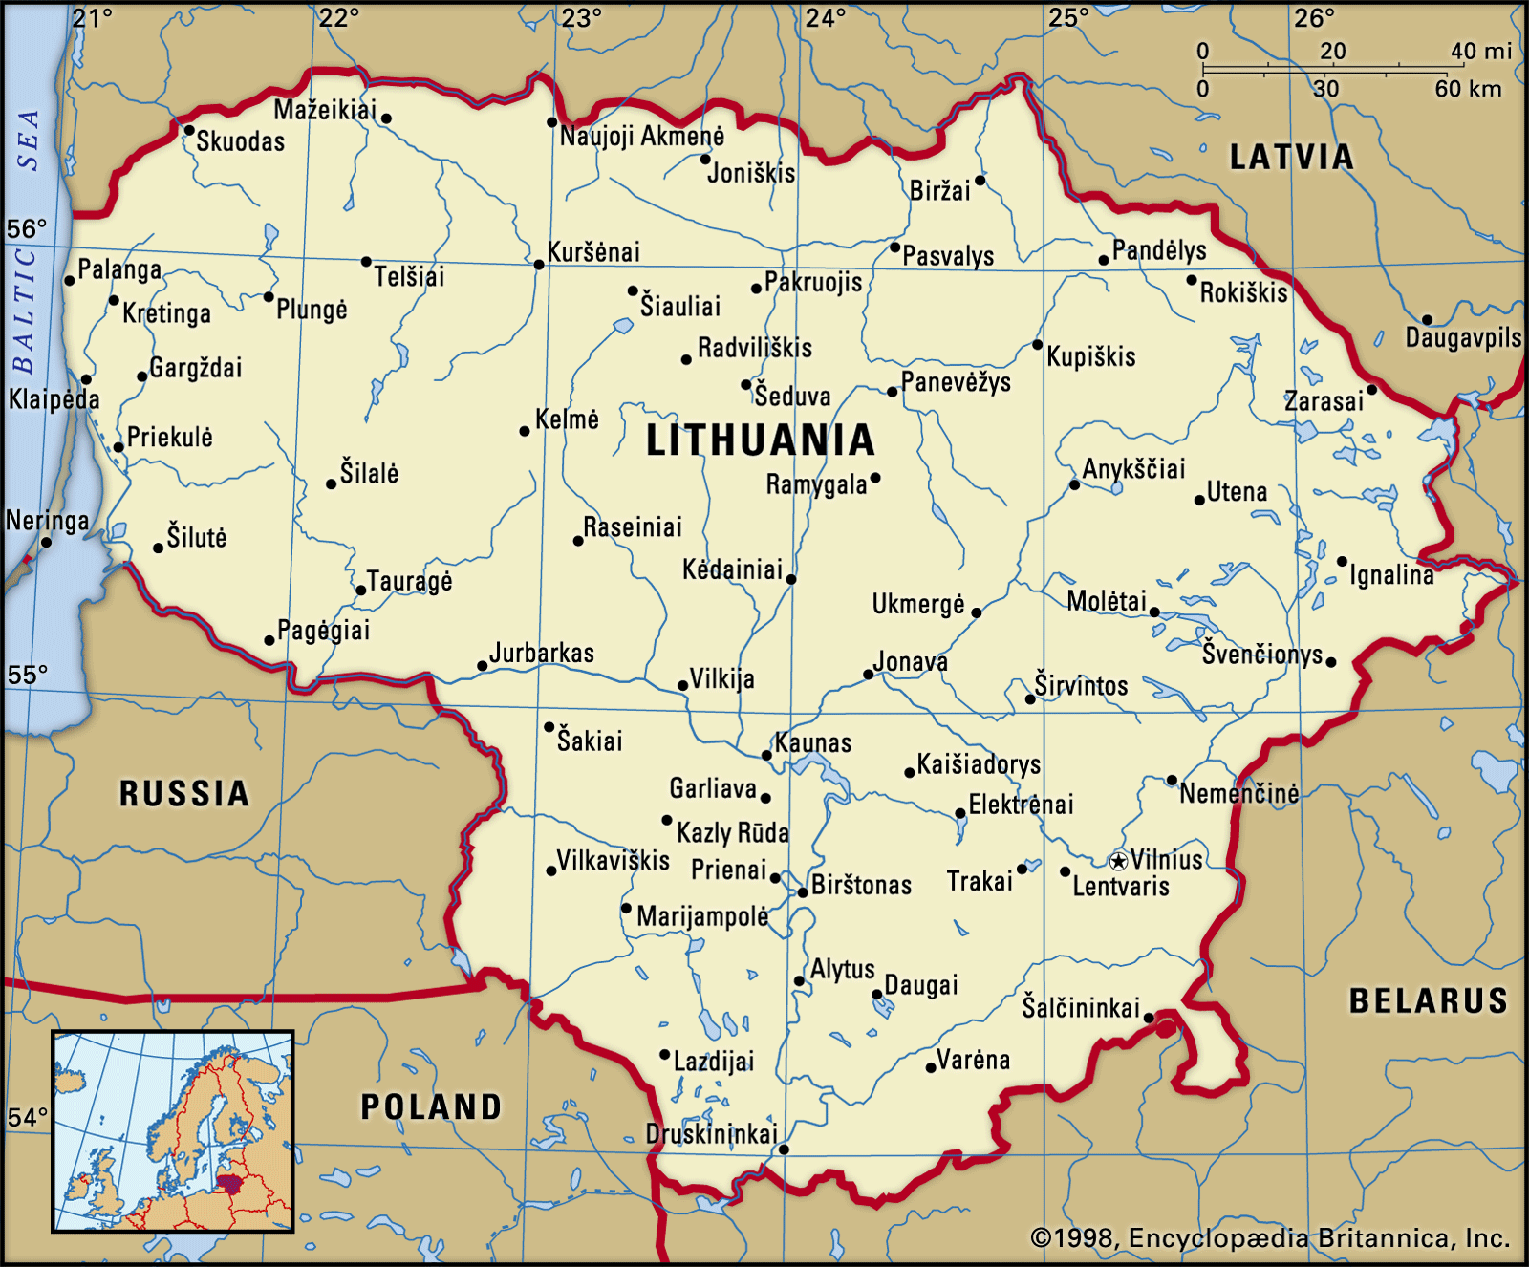
Europe Seminar - Lithuania (7-11.11.2021)
Oct. 2021
Mabal 49th Class
Team 2

Slide 2
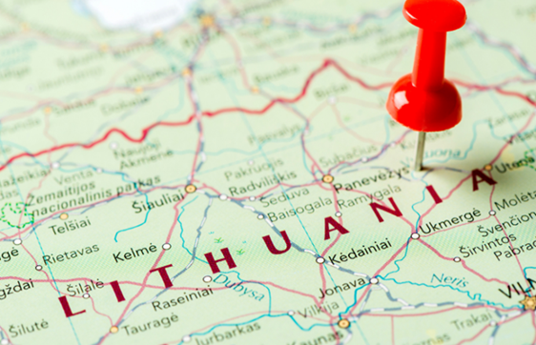
Agenda
Background
Methodology
Research questions

Slide 3
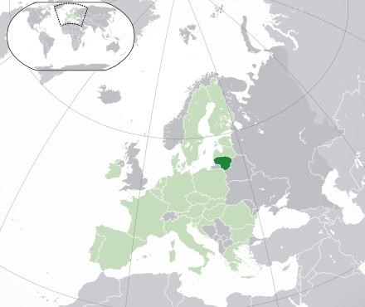
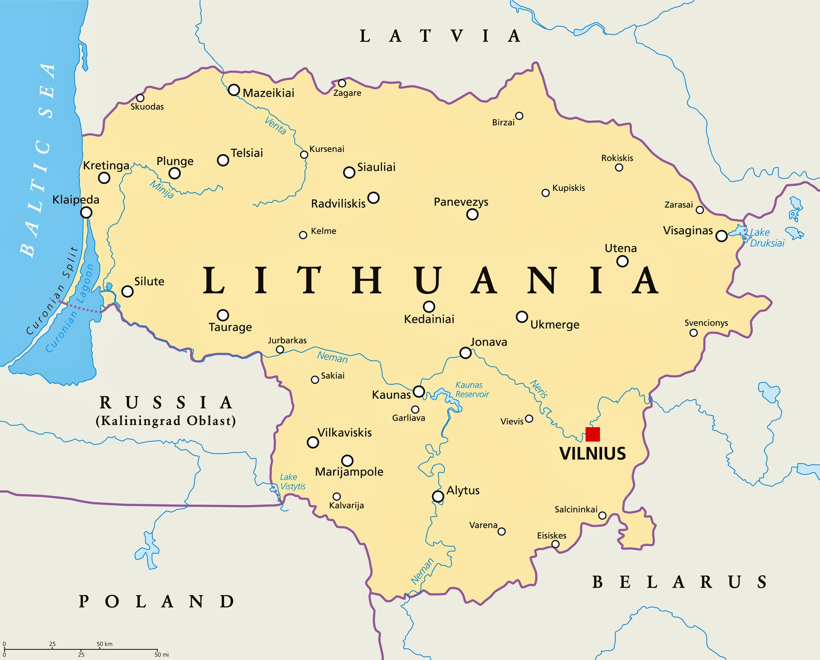

Slide 4
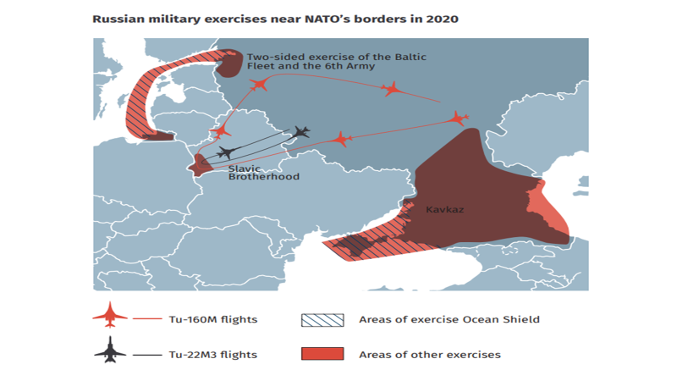
Lithuania

Slide 5
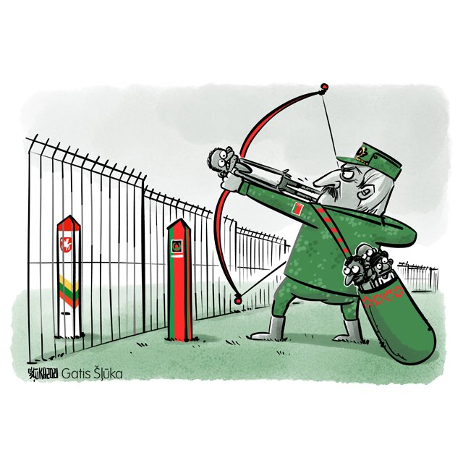

Slide 6
Methodology
Reading materials
Interviews & meetings
Team and sub-teams discussions
MABAL instructors’ consultations
“Loading” process - TED Lectures
Analysis

Slide 7
TED lectures
Lithuanian location (geography) & demography (including immigration)
Lithuanian political system (domestic and membership of international organizations)
A history of the Soviet occupation
Confronting COVID19 in Lithuania
NATO and the Enhanced Forward Presence; UK Joint Expeditionary Force
Chinese current involvement in Lithuania
Lithuanian Energy policy
Lithuanian Defense policy and Armed Forces
Belarus - recent history, links with Russia and its perspective on Lithuania
Kaliningrad - History and links to the main Russian territory
Lithuanian location (geography) & demography (including immigration)
Lithuanian political system (domestic and international organizations)
A history of the Soviet occupation
Confronting COVID19 in Lithuania
NATO and the Enhanced Forward Presence; UK Joint Expeditionary Force
Chinese current involvement in Lithuania
Lithuanian energy policy
Lithuanian defense policy and Armed Forces
Belarus - recent history, links with Russia and its perspective on Lithuania
Kaliningrad - history and links to the main Russian territory

Slide 8
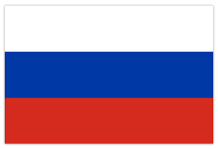
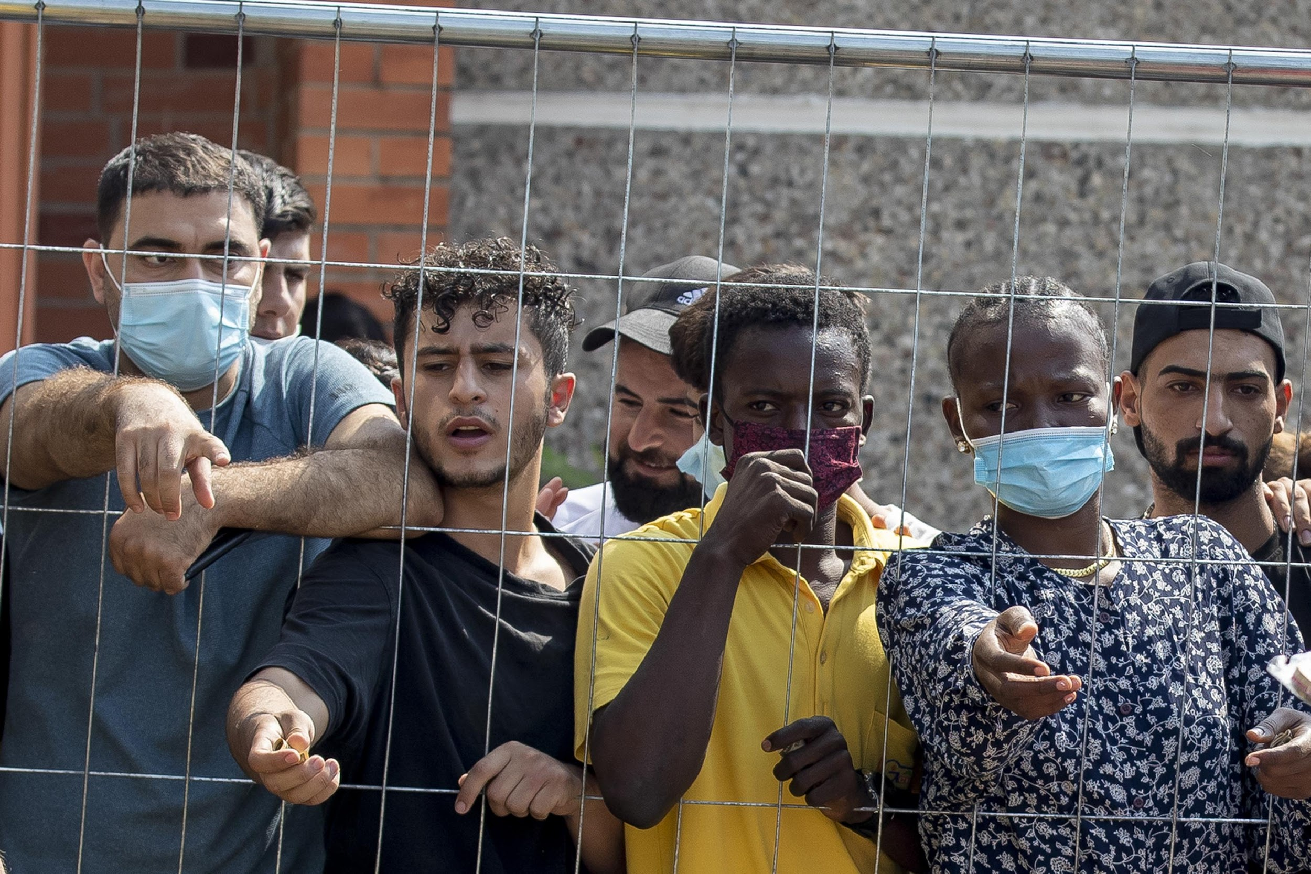
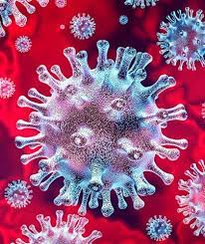
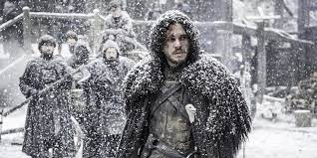
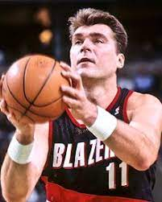
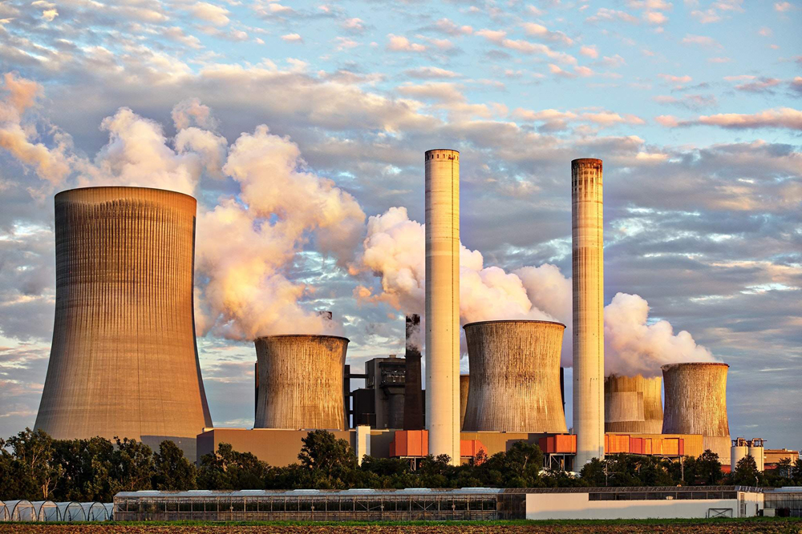
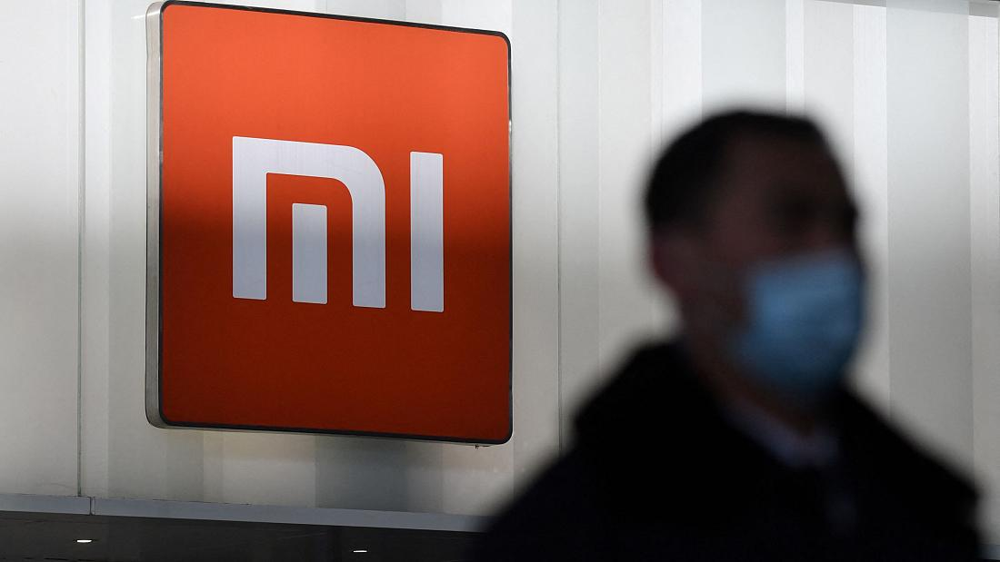
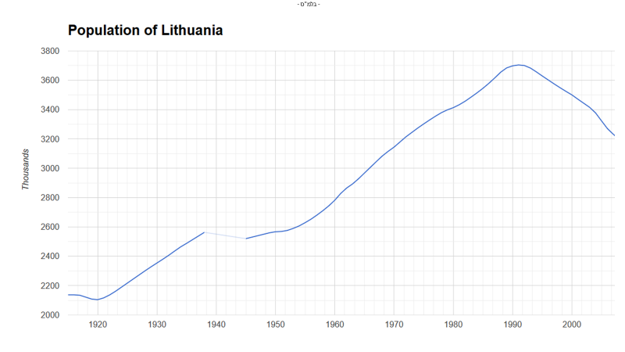
KEY-PLAYERS & INTERESTS
PHENOMENONS

Slide 9
General Research Question
How and to what extent do Russia and China affect Lithuania’s national security policy?

Slide 10
Sub-questions
Social axis
How does Russia-directed immigration shape Lithuania’s immigration policy?
What impact does the prolonged Russian occupation have nowadays on Lithuanian society?
Economy axis
To what extent do Chinese investments in Lithuania influence its economy?
How does Lithuania’s energy dependence on Russia affect its economy and its national security?
Military axis
What is the concept of ‘total defense’ in the event of Russian invasion, and how does it manifest itself in the military domain?
How are Russian and Chinese challenges affecting the development of Lithuania forces?

Slide 11
November 11th Thursday |  |  | November 10th Wednesday |  |  | November 9th Tuesday |  |  | November 8th Monday |  |  | November 7th Sunday
Military sub-team | Economy sub-team | Social sub-team | Visit to Ponary (16km) |  |  | Military sub-team | Economy sub-team | Social sub-team | Meetings with senior officials - President & Prime Minister |  |  | TLV-VNO | Morning
Meetings with officials, legislatures, journalists, academics and experts | Meetings with officials, legislatures, journalists, academics and experts | Meetings with officials, legislatures, journalists, academics and experts | Military sub-team | Economy sub-team | Social sub-team | Meetings with officials, legislatures, journalists, academics and experts | Meetings with officials, legislatures, journalists, academics and experts | Meetings with officials, legislatures, journalists, academics and experts
 |  |  | Meetings with officials, legislatures, journalists, academics and experts | Meetings with officials, legislatures, journalists, academics and experts | Meetings with officials, legislatures, journalists, academics and experts
Visit to Trakai (27km) |  |  | Visits in sub-team | Visits in sub-team | Visits in sub-team | Visit to the NATO battalion in Rukla (90km) | Visit to the Chinese Chamber of Commerce | Visits in sub-team | Military sub-team | Economy sub-team | Social sub-team | Arrival in Lithuania and administration | Noon
 |  |  |  |  |  | Meetings with officials, legislatures, journalists, academics and experts | Meetings with officials, legislatures, journalists, academics and experts | Meetings with officials, legislatures, journalists, academics and experts | Visiting NATO energy Security Centre of Excellence | Observation of the Astravets Nuclear Power Plant in Belarus (34km) | Visiting refugee center
Processing time - summary (whole team)
VNO-TLV |  |  | Meetings with officials, legislatures, journalists, academics and experts | Meetings with officials, legislatures, journalists, academics and experts | Meetings with officials, legislatures, journalists, academics and experts | Meetings with officials, legislatures, journalists, academics and experts | Meetings with officials, legislatures, journalists, academics and experts | Meetings with officials, legislatures, journalists, academics and experts | Meetings with officials, legislatures journalists, academics and experts | Meetings with officials, legislatures, journalists, academics and experts | Meetings with officials, legislatures journalists, academics and experts | Meeting with Israel’s ambassador to Lithuania | Evening
 |  |  | Processing time (whole team) |  |  | Processing time (whole team) |  |  | Processing time (whole team) |  |  | Visit to Vilnius old town
 |  |  |  |  |  | Visit to Kaunas |  |  | Basketball game

Slide 12
Discussion

Slide 13
