Slide 1
Foreign Policy and Diplomacy Course Opening
Introduction to the International System and Diplomacy in the 21st Century
INDC 46th Class
31/10/2019
Eran Etzion: eranetzion1@gmail.com
GS2A

Slide 2
Important Disclaimer
The contents of the presentation reflect the personal evaluations and positions of the lecturer, and him alone
These contents do not represent the evaluations and positions of the Foreign Ministry, or any other organization in which the lecturer worked or works for

Slide 3
What will we talk about today?
Foreign Policy, Diplomacy and International Policy course - Overview
Foreign policy as part of "national security"
Assessment of the political-strategic situation - the international and regional arena
Implications for Diplomacy in the 21st Century
Israeli Foreign Policy - Operational Operating Environments

Slide 4
Goals of the Political Echelon
Developing political thinking from a broad perspective and instilling awareness of the role of political tools in the combined campaign for Israel's security.
The introduction of basic concepts of basic patterns and historical layers in the structure of the international system, the development of inter-state relations, and the formation of today's diplomatic practice.
To understand the origins and characteristics of Israeli foreign policy and to identify the main challenges facing it.
Deepening the understanding of policy shaping mechanisms in Israel on key political issues on the agenda, and the reciprocal relations between the relevant governmental centers - both in decision-making and implementation.
Understanding the diplomatic work and the challenges of the Foreign Ministry.

Slide 5
Components of the Political Echelon
Advanced Season:
March - June
Tours abroad
Advanced Season:
March - April
Visits to intelligence organizations
Advanced Season:
February
Second strategic experience - political security simulation
Advanced Season:
February
Tour in Jordan
Core season:
January
Visit to the Foreign Ministry
Core season: January
First strategic experience
Core season: October - January
Content in national defense tours and supporting content
Core season: November - January
Academic course - Mr. Eran Etzion

Slide 6
The Course – Foreign Policy, Diplomacy and International Relations
Num | Date | Time | Lesson | Lecturer
1. | 4.11.18 | 13:00-14:15 | Introduction to the international system and diplomacy in the 21st century | Eran Etzion
2. | 4.11.18 | 14:30-16:00 | Political Zionism and its contribution to shaping Israeli foreign policy | Uri Bialer
3. | 11.11.18 | 13:00-14:15 | The multilateral arena and the UN | Alon Bar
4. | 11.11.18 | 14:30-16:00 | International law and its implications | Daniel Taub
5. | 18.11.18 | 13:00-14:15 | Writing a policy document for the captain | Avi Gil
6. | 18.11.18 | 14:30-16:00 | Brand Israel - The Israeli brand in the world | Ido Aharoni

Slide 7
The Course – Foreign Policy, Diplomacy and International Relations – Recommended Durations
Num | Date | Time | Lesson | Lecturer
7. | 5.12.18 | 13:00-14:15 | International media as a factor in shaping policy | Nadav Eyal
8. | 5.12.18 | 14:30-16:00 | Israel in an International Diplomatic Perspective | Panel of Ambassadors
9. | 12.12.18 | 13:00-14:15 | Israel and the region - regional alliances in the Middle East | Hagai Tzuriel
10. | 12.12.18 | 14:30-16:00 | Writing a policy document for the captain (2) | Avi Gil
11. | 2.1.19 | 13:00-14:15 | The Politico Military Campaign | Eran Etzion and Yoram Hamo
12. | 2.1.19 | 14:30-16:00 | Political strategy and national strategy in the Israeli captain's circle | Eyal Arad
* The course provides the participants two Master's degree weekly hours

Slide 8
Course Requirements
Attendance and active participation in the lessons;
Submission of a final paper, which meets the criteria of academic writing, in the format of a ‘preparatory paper for a senior decision maker’ on an selected political issue.

Slide 9
What will we talk about today?
Foreign Policy, Diplomacy and International Policy course - Overview
Foreign policy as part of "national security"
Assessment of the political-strategic situation - the international and regional arena
Implications for Diplomacy in the 21st Century
Israeli Foreign Policy - Operational Operating Environments

Slide 10
National Defense - the Broad Context
Constitution / Basic Laws
The structure of the regime
Values
Culture
History
Religion
National power
National Resilience
Human Security & Human rights
Global security
& Peace
National Defense

Slide 11
Components of the National Security Concept
National Defense Goals
"A Jewish-democratic state within secure and recognized borders"
Social Cohesion Strategy
National Economic Strategy
Perception of Foreign Policy
Security Perception
Political-Diplomatic Campaign
Military Campaign

Slide 12
מדיניות החוץ מול מדיניות הבטחון
יעדי הבטחון הלאומי
"מדינה יהודית-דמוקרטית בגבולות בטוחים ומוכרים"
אסטרטגיית
לכידות
חברתית
אסטרטגיה כלכלית לאומית
לאומית
מדיניות חוץ
?
?
?
?
מדיניות בטחון
הרתעה
התרעה
הכרעה
התגוננות
שת"פ
בינ"ל
("רך"
ו"קשה")
תפיסת מדיניות
חוץ
תפיסת
בטחון
"עוצמה רכה"
מדינאות
דיפלומטיה
דיפלומטיה ציבורית
כלכלה
תרבות
"עוצמה קשה"
צבא
ושירותים
מערכה מדינית-דיפלומטית
מערכה צבאית

Slide 13
What will we talk about today?
Foreign Policy, Diplomacy and International Policy course - Overview
Foreign policy as part of "national security"
Assessment of the political-strategic situation - the international and regional arena
Implications for Diplomacy in the 21st Century
Israeli Foreign Policy - Operational Operating Environments

Slide 14
Israel & Global Trends
Ad-hoc
coalitions
G-Zero
Old Intl’ rules and inst’ contested
“Frienemies”
Multi-Crisis
world
Regional Powers (global ambitions)
“TechCentury”
Capitalism 2.0?
ISRAEL
De-Globalization
“Truth Decay”
Terrorism and religious
extremism
Energy Revolutions
“Transparent “
world
Demographic & Environmental
Crises
Blurred lines between Domestic & Foreign
Diff. attitudes to use of force
Global Political Awakening
DemoCrisis

Slide 15
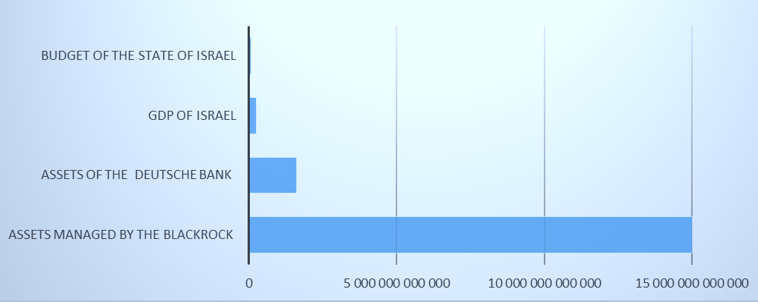
Centralized financial power
Sources: The Economist Jan 14, 2014
http://en.wikipedia.org/wiki/List_of_government_budgets_by_country

Slide 16
Israel & regional Trends
Post Sykes
Picot
Post
“Two State Solution”
Post JCPOA
ISRAEL
Post “Americana”

Slide 17
Israel & Internal Trends
Jewish
Identity
“Start-Up
Nation”
Inequality
ISRAEL
Democratic
Identity

Slide 18
What will we talk about today?
Foreign Policy, Diplomacy and International Policy course - Overview
Foreign policy as part of "national security"
Assessment of the political-strategic situation - the international and regional arena
Implications for Diplomacy in the 21st Century
Israeli Foreign Policy - Operational Operating Environments

Slide 19
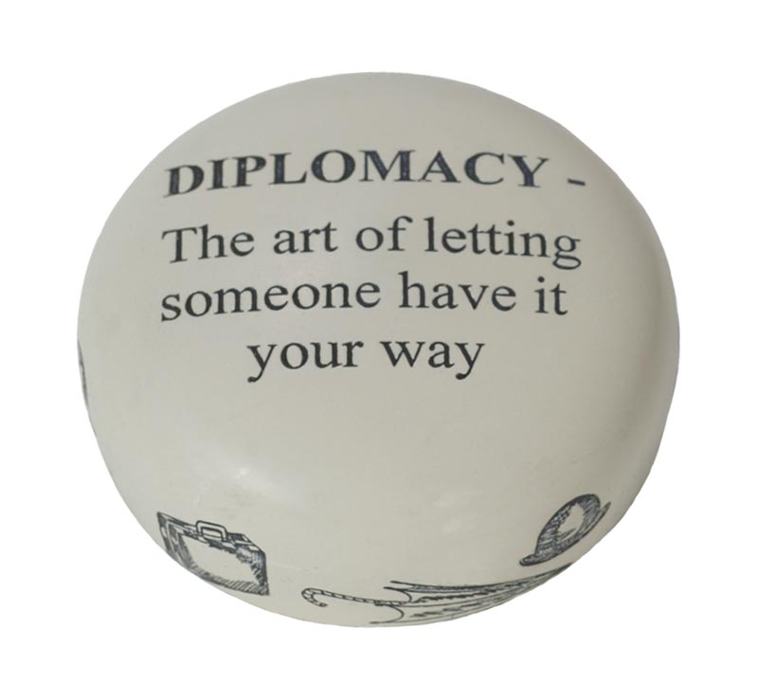
Definitions of Diplomacy

Slide 20
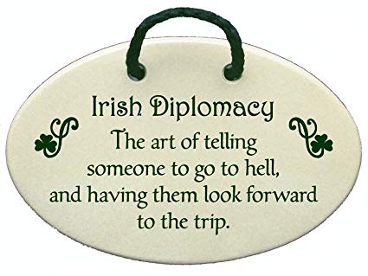

Slide 21
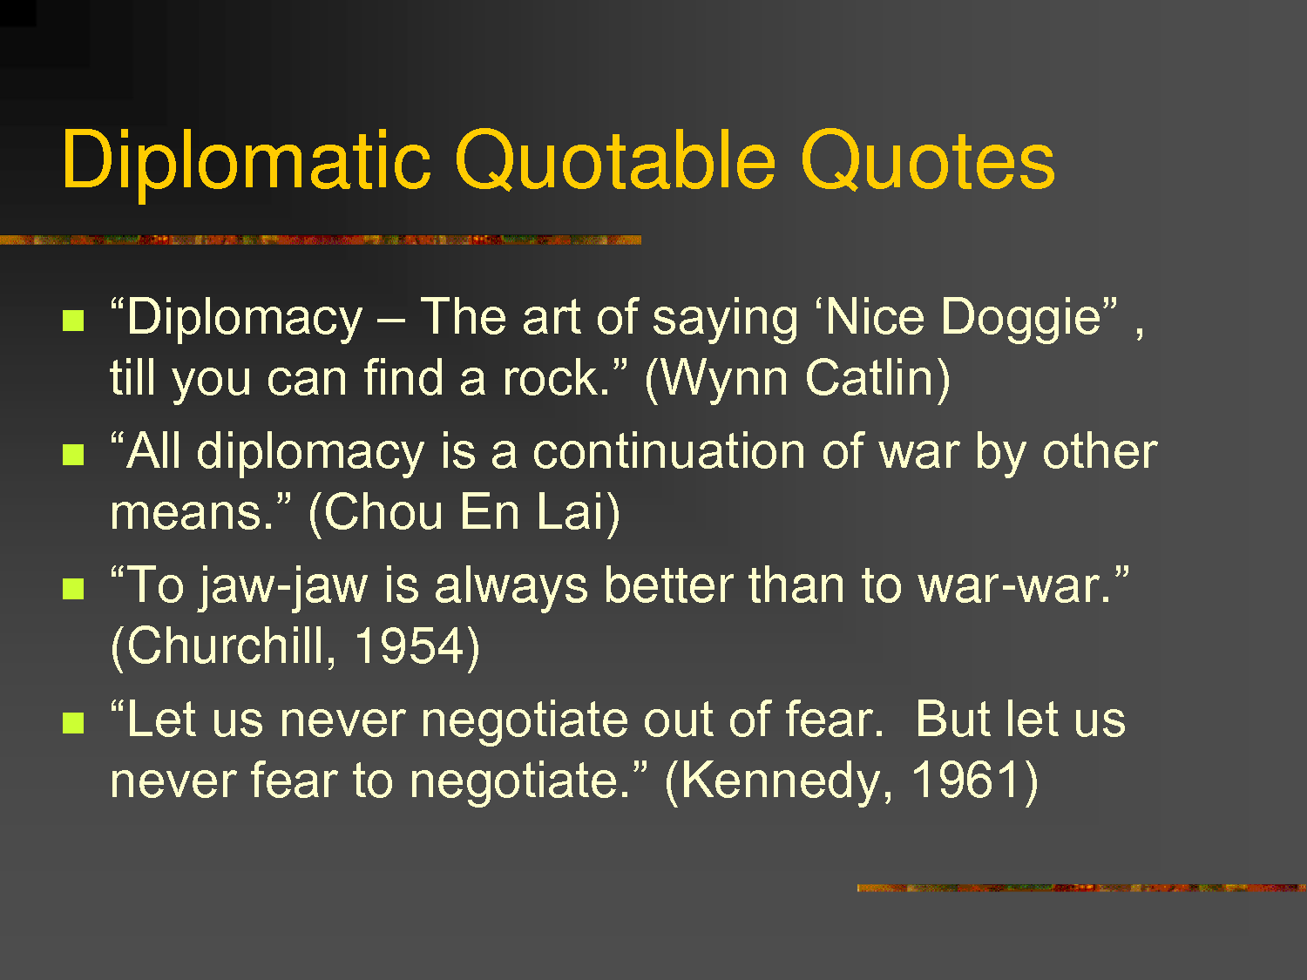

Slide 22
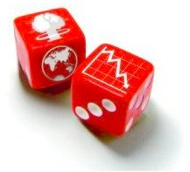
Diplomacy in the ‘Age of the Unthinkable’
In the past we might have believed that the best preparation for a career in foreign policy was a fluency with European history, an ability to speak French or Russian, an understanding of the roots of world order. The future demands a different resume. Today the ideal candidates for foreign-policy power should be able to speak and think in revolutionary terms. They should have expertise in some area of the world – be it China or the Internet or bioengineering – where fast change and unpredictability are the dominant facts of life. They should have experienced the unforgiving demands for precision and care that characterize real negotiation – as well as the magical effect of risk-taking at the right moments. They should have mastered the essential skill of the next fifty years: crisis management…Most of all however, we need policy makers and thinkers who have that intuitive revolutionary feel for the inescapable demands of innovation…believing for instance, that the triumph of democracy and capitalism is inevitable should disqualify you immediately from a serious position in foreign policy.
(Joshua Cooper Ramo)

Slide 23
George Schultz on Diplomacy
The conduct of diplomacy requires a clear understanding of what is happening and the ability to make a clear record of it and report it honestly and in depth. This may seem obvious and easy. It is not: it requires exceptional intellectual skills and qualities of character and discipline. As former Senator Daniel Patrick Moynihan describes, “The true diplomatist [is] aware of how much subsequently depends on what clearly can be established to have taken place. If it seems simple in the archives, try it in the maelstrom.”

Slide 25
Varieties of Diplomacy
A
Appeasement
C
Checkbook diplomacy
Citizen diplomacy
Coercive diplomacy
Commercial diplomacy
Cricket diplomacy
Cultural diplomacy
United States cyber-diplomacy
D
Defence diplomacy
Deference
Digital diplomacy
Dollar diplomacy
E
Economic diplomacy
Engagement (diplomacy)
F
Facebook diplomacy
Freelance diplomacy
G
Gift basket diplomacy
Global Innovation through Science and Technology initiative
Guerrilla diplomacy
Gunboat diplomacy
P
Paradiplomacy
Pilgrimage diplomacy
Ping-pong diplomacy
Public diplomacy
Public diplomacy of the United States
Public talks
R
Regional diplomacy
S
Science diplomacy
Shuttle diplomacy
Stadium diplomacy
T
Team Canada Mission
Track II diplomacy
Trade mission
Transformational Diplomacy

Slide 26
The Ten Commandments for Diplomat in the 21st Century
Know where you come from.
It’s not always about us.
Master the fundamentals.
Stay ahead of the curve.
Promote economic renewal.
Connect leverage to strategy.
Don’t just admire the problem — offer a solution.
Speak truth to power.
Accept risk.
Remain optimistic.

Slide 27
Operating Concept - The Variety of Options
Policy Implementation
Policy Design
Moving Society
Content Society
Another Civil Government Office
Part of the National Security Establishment
Administrative
Political
Geographic
Functional
Representations
Staff
Information and Services Abroad
Diplomacy and Strategy

Slide 28
Ministry of Foreign Affairs - Tensions
Politico Security
Local government officials
Mossad
PMO
National Security Council
National Security: Strengthening the Political Dimension
Political Foiling
Mossad
Shin Bet
Local Research Institutes
Bilateral Diplomacy
Ministry of Defense
Communications and Designers
IDF
International Law
Multi-lateral Diplomacy
Shin Bet
Policy Implementation
(Representative)
Organizational Preparations
Policy design
(Staff)
The Jewish World and the Struggle Against anti-Semitism
Civil administration
Israel Export Institute
Finance
Public Diplomacy and Branding
Israel as a Partner in the New World Order
Commercial Industrial Employment
Civil society entities
Economic Diplomacy
Agency
Chief Scientist
Public Diplomacy
(Civil-Political)
Head of Science
Others…

Slide 29
What will we talk about today?
Foreign Policy, Diplomacy and International Policy course - Overview
Foreign policy as part of "national security"
Assessment of the political-strategic situation - the international and regional arena
Implications for Diplomacy in the 21st Century
Israeli Foreign Policy - Operational Operating Environments

Slide 30
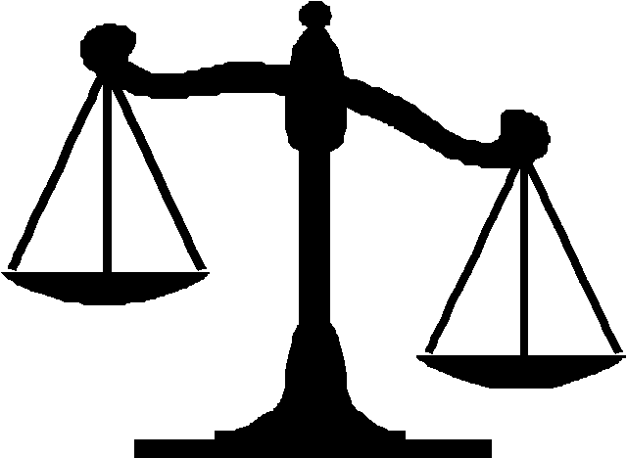


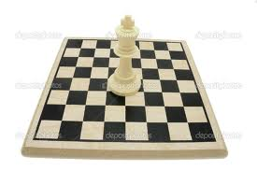

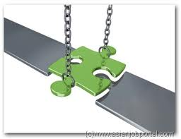

The Three Weights Against Foreign Policy
Foreign Policy
Security Policy
Foreign Policy
Internal Policy
Foreign Policy
Hasbara

Slide 31

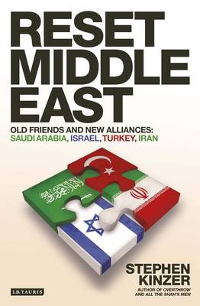
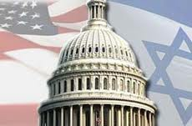
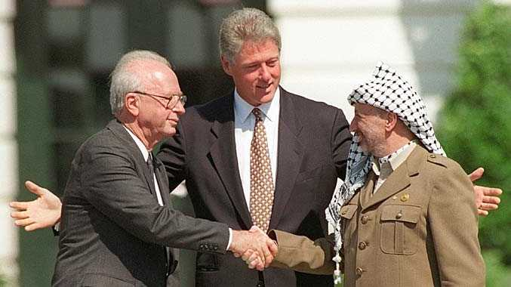
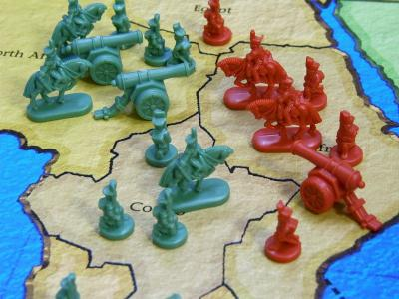
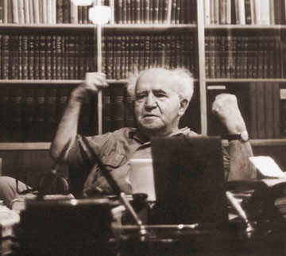
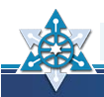
Israel’s Traditional Foreign Policy
Distinguishing between friends and foes
“It doesn’t matter what the gentiles say, it matters what the Jews do.”
Relying on the USA
Political Process Arrangements+ end of conflict + normalization and recognition
Hard power:
Military deterrence against armies and terrorists

Slide 32

Israel’s Foreign Policy – Operative Environment
Awareness
Social medias
GPS to GPS
Regional arena
Strategic Silence Engaging “Frenemies”
Searching for opportunities
Keeping agreement
International arena
G zero;
making coalitions; fitting in the global agenda
Military diplomacy
Iran, preventing WMD and CT crisis management and readiness for emergencies

Slide 33

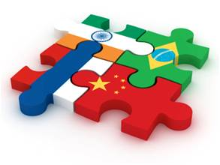
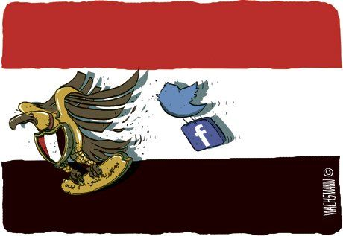
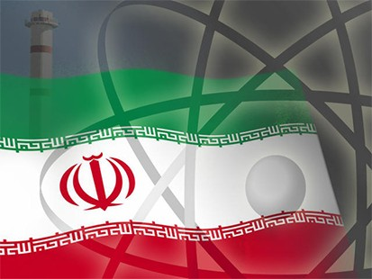
Israel’s Foreign Policy – Operative Environment
Awareness:
Public diplomacy
Awareness -
New powers and social platforms
1
International relations
Regional arena
International arena
Multi – polar world; many crisises; Making alliances and fitting in the global agenda
Regional arena
Strategic Silence Engaging “Frienemies”
2
4
Military diplomacy
Military diplomacy Readiness for emergency situations and crisis management
3

Slide 34

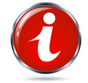
Perception of Foreign Policy in Israel - Proposal
USA
Coalition alliances
The Jewish people abroad
Common values
Likeminded
The ultimate objectives of foreign policy
Concentration of effort to the Foreign Ministry
Influence
Legitimization
Global agends

Slide 35
Glocalize your world
Global competence
An interconnected world requires global competence. — Tony Jackson
Global learning takes on greater significance as the world flattens. Nothing – and I mean nothing – occurs in isolation anymore. — Leslie Nicholas
We are all connected in a global web of interdependency. — Tony Jackson

Slide 36
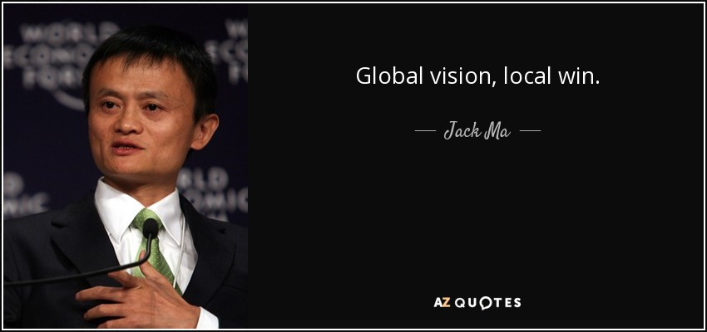

Slide 37
לחניכי מב"ל (הישראלים)
לקרוא ולראות חומרים – הכי טוב ספרים - על מדיניות חוץ ועל בטחון לאומי באנגלית (רצוי גם בעוד שפות)
ללכת למקור – לא להסתפק בפרשנויות ישראליות
לשאוף ללמוד ולהשתלם במוסדות בינ"ל
לשמור על חשיבה עצמאית
לעבוד בשת"פ עם משה"ח, עם דיפלומטים זרים וגופים בינ"ל
בהצלחה!

Slide 38
Fin

