Slide 1
Dr. Anat Stern
Foundations of National Security in Global Perspective

Slide 2
Goal:
Lay Theoretical and conceptual framework to the foundations of National Security as a phenomenon connected to the Age of Globalization

Slide 3
Course Outline:
6 meetings, 12 lessons
Guest lecturers and group work
Targeted Reading Materials
Academic Course (2 Credits)

Slide 4
Introduction
National Security
Globalization

Slide 5
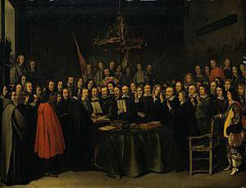
Security

Slide 6
A collective term encompassing both national defense and foreign relations of the United States with the purpose of gaining:
a. A military or defense advantage over any foreign nation or group of nations;
b. A favorable foreign relations position; or
c. A defense posture capable of successfully resisting hostile or destructive action from within or without, overt or covert. See also security.
(Joint Publication 1)

Slide 8
A secure and resilient nation: a networked government, a cohesive society, an engaged people
[National Security Coordination Secretariat NSCS]

Slide 9
National Security Interests
protect the citizens, sovereignty and territorial integrity of our country
protect the territorial integrity, sovereignty and citizens of our allies
Maintain the rules-based international order on the basis of international law
Ensure prosperity for our citizens through a strong German economy as well as free and unimpeded world trade
Promote the responsible use of limited goods and scarce resources throughout the world
Deepen European integration
Consolidate the transatlantic partnership

Slide 10
National Interests
Preserve the sovereignty, unity and territorial integrity of India
Preserve the democratic, secular and federal character
Safeguard existing and emerging strategic, political’ military and economic goals
Ensure a stable, secure and peaceful internal and external environment for economic growth and prosperity
Contribute towards promotion of international peace and stability

Slide 11
Protection, preservation and promotion of national interests against internal and external threats and challenges using all available tools be it diplomatic or military. In addition to military security national security involves and influences security of water, food, energy, economy, health, cyber, space, technology, environment and nuclear deterrence.

Slide 12
“Italy rejects war as an instrument of aggression against the freedom of other peoples and as a means for the settlement of international disputes. Italy agrees, on conditions of equality with other states, to the limitations of sovereignty that may be necessary to a world order ensuring peace and justice among the Nations. Italy promotes and encourages international organizations having such ends.”
[Italian Constitution Art.11]

Slide 13
“The Parties to this Treaty…are determined to safeguard the freedom, common heritage and civilization of their peoples, founded on the principles of democracy, individual liberty and the rule of law. They seek to promote stability and well-being in the North Atlantic area. They are resolved to unite their efforts for collective defense and for the preservation of peace and security.”
– North Atlantic Treaty, 4 April 1949

Slide 14
Definitions of National Security

Slide 15
National Security Defined
Preparedness for external threats by states and enemies and internal factors that could jeopardize the existence of the state, its’ identity and vital interests including economy, society, diplomacy, ethics and technology”
[Gen, (Ret.) Yaacov Amidror, Introduction to National Security]

Slide 16
Characteristics
Dynamic
Subjective
Relative

Slide 17
Tensions

Slide 18
Expansion of the Term

Slide 19
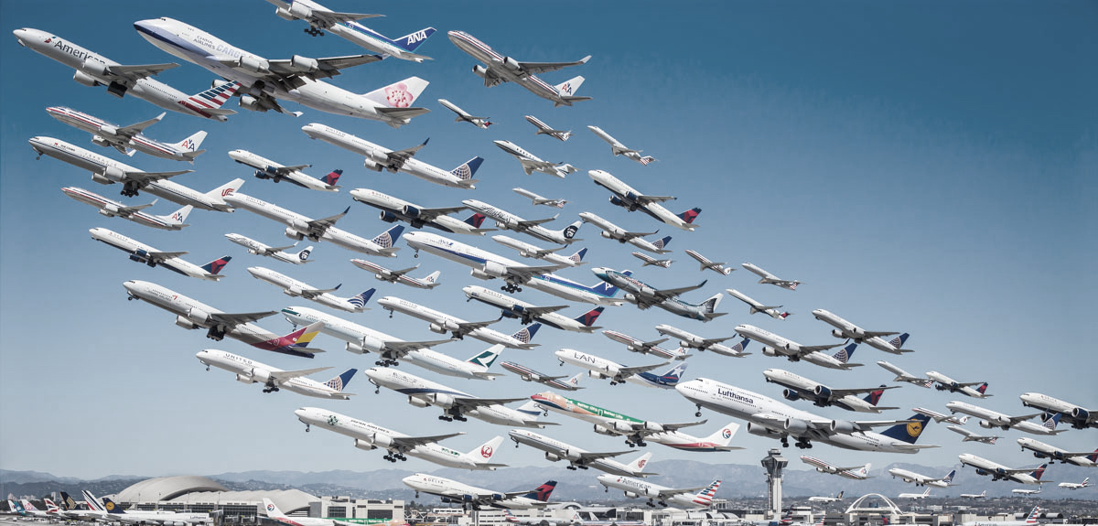
Part II - Globalization

Slide 20
What is Globalization?
כפר https://www.youtube.com/watch?v=jy96ZB8Zs_A
אקספו https://www.youtube.com/watch?v=KmrrzqljFm8
גלובליזציה ☺ https://www.youtube.com/watch?v=IuyBosQ86Fs

Slide 21
Characteristics
Blurred Boundaries
Expansion and Stretching
Compression of Time and Space
Affiliation Consciousness

Slide 22
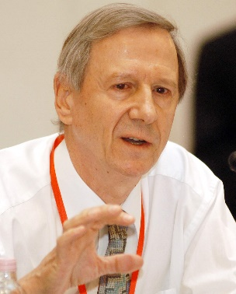
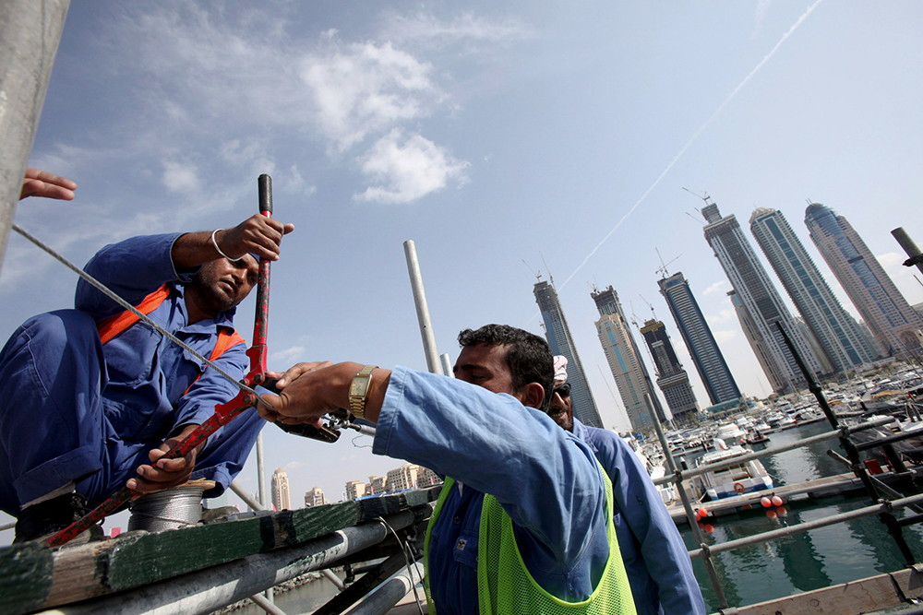
Manifestations of Globalization
Capitalist Economy
International workforce
Complexed Governance
Interconnected Military Force
Cultural Standardization

Slide 23
What is Globalization?
כפר https://www.youtube.com/watch?v=jy96ZB8Zs_A
אקספו https://www.youtube.com/watch?v=KmrrzqljFm8
גלובליזציה ☺ https://www.youtube.com/watch?v=IuyBosQ86Fs

Slide 24
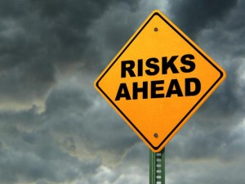
Consequences
Weakening of the Nation State
Risk Society
Detached Reality

Slide 25
Course Contents:

Slide 26
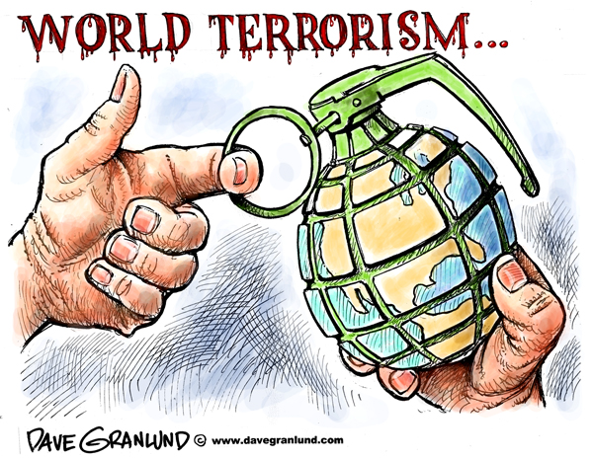
National Defense Foundation (11.9)
Fighting Global Terror
Group Work

Slide 27
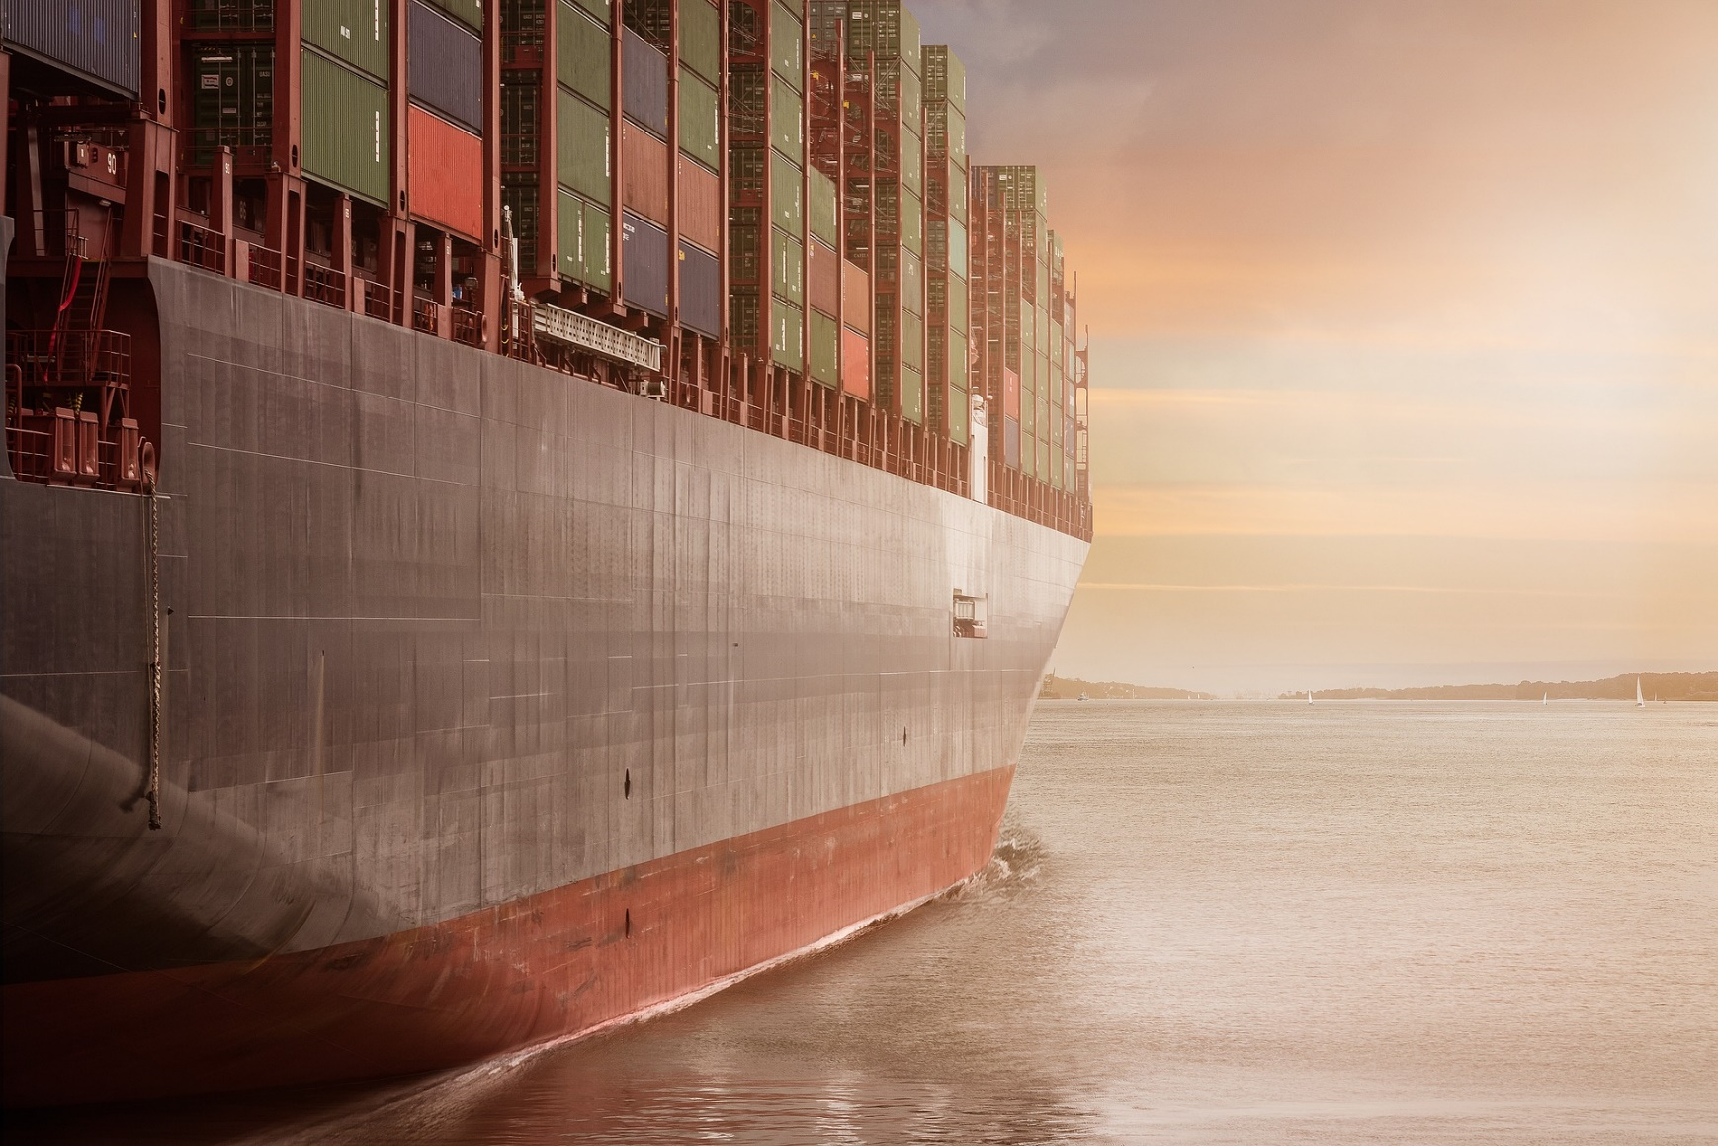
Economy Foundation
International Trade
Energy

Slide 28
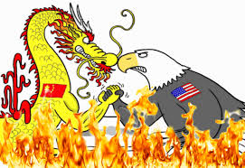
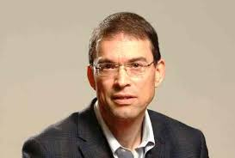
Senior Lecturer- Economy Foundation

Slide 29
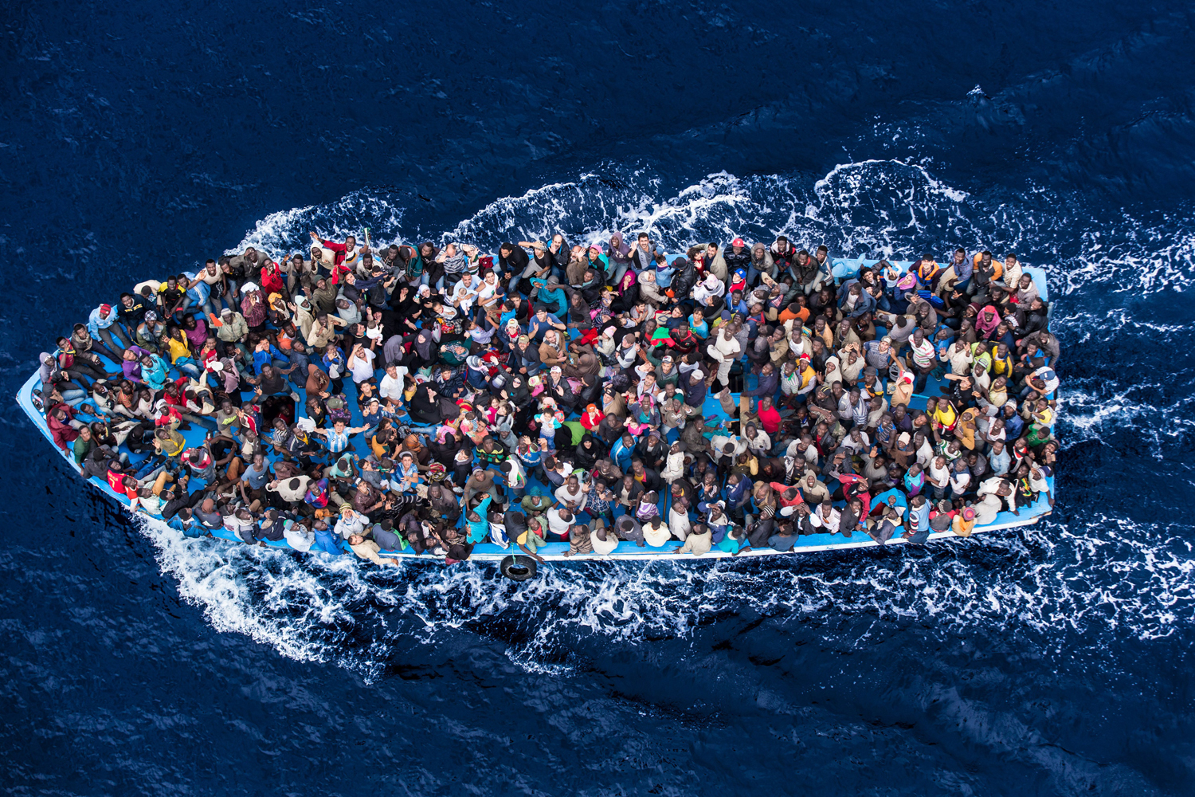
Society Foundation
Immigration - Mobilities
Group Work

Slide 30
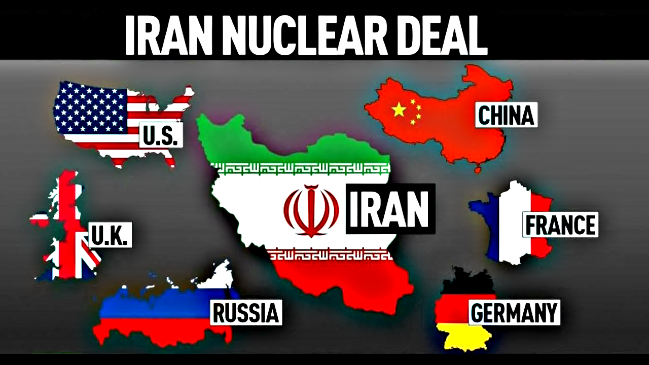
Diplomacy Foundation
World Nuclear Order
Iran Nuclear Deal
Guest Lecturer

Slide 31
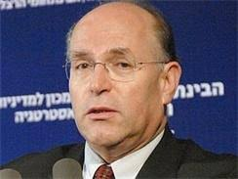
Senior Lecturer- Diplomatic Foundation

Slide 32
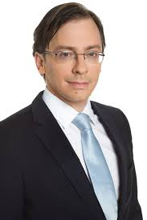
Conclusion: The Revolt Against Globalization
Guest Lecturer
Course Conclusion

Slide 33
Reading Materials
Final Assignment
Thank You ☺

