Slide 1
ETE Coordination Brief to Desk Officers
Lt Col Robert Robert Piekarniak (POL–AF)
Lt Col Angel “Mango” Santiago (USA-AF)

Slide 2
Agenda
Purpose
Processes
MTEP-OTP
Exercise Inputs
Training & Exercise Support
Funding

Slide 3
Purpose
To inform desk officers (at SHAPE/PD and outstations) of coordination efforts, best practices, and requirements to support PN training and exercise requirements.
Notes:
3

Slide 4
MTEP-OTP
MTEP 2019-2023 – OTP – 1 April 2019
Provides all current NAC approved NATO exercises and provides details
If ‘OTP’, no coordination is required
If ‘OTP, w/ limitations’, NAC approval required, and can take 4 months: coord w/ us!!
OTP does ‘not’ cover national exercises
ETE also does not provide support for such exercises
Notes:
4

Slide 5
Exercise Inputs
Current PN inputs:
Come from multiple sources and is incomplete
Lack of data = min support by exercise planners
Incorrect phraseology leads to confusion
Intent:
Standardize desired requirements from partners and have them provide detailed inputs
ensure desk officers can track/follow-up
Have a record of desired inputs that can be tracked and updated (as required)
Provide ex planners w/ details to script PN in exercise
Method:
Exercise Request Form (excel spreadsheet)
Notes:
5

Slide 6
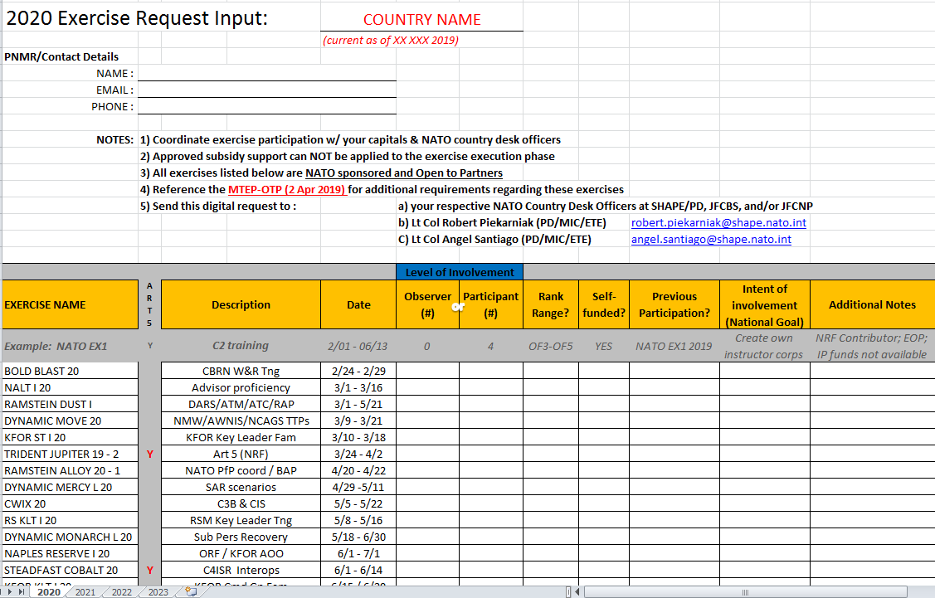
Exercise Inputs (cont)
File intended to be MAINTAINED digitally (no print-outs!)
Have PNMRs email inputs to Robert/Mango and CC you!
Notes:
6

Slide 7
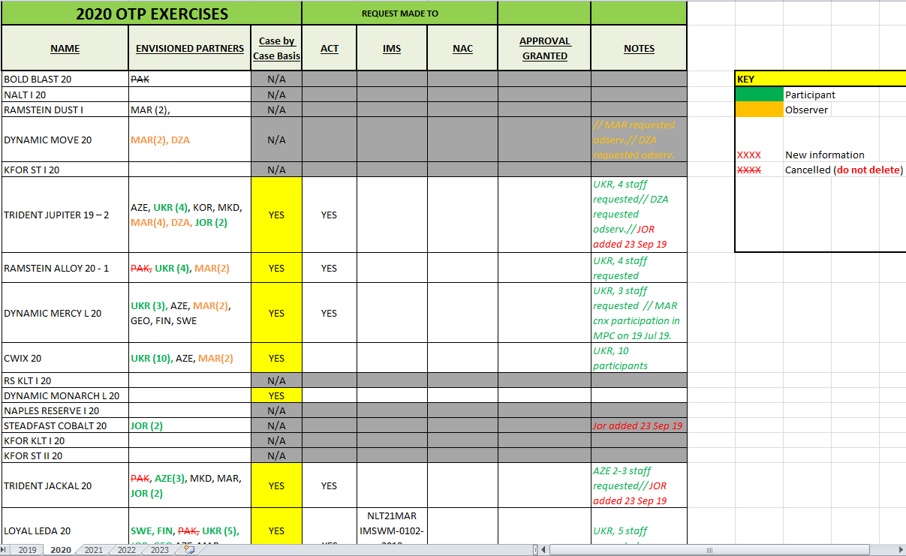
Exercise Inputs (cont)
Go to Q Drive: XXXXXXXX to view tracker and have SA on inputs
Notes:
7

Slide 8
PD Tng: All Courses//All Requirements
Robert is lead for coordinating school training courses in NSO
When making requests, have PN milreps email Robert and CC Mango and yourself so all can be aware and track requests
Mango is lead for coordinating PNMR Seminars, Fam Pgms, and IMPC
Invites are published and loaded into ePRIME
Participants need to FOLLOW THE INVITATION instructions
Notes:
8

Slide 9
PD Tng: Familiarization Programme
FOCUS: To provide Partner Staff Officers (exclusively) a general understanding of current developments in NATO, Partnership Policy, and an introduction to the “toolbox” of mechanisms and activities used for cooperation w/ Partners
STATS:
Program ongoing for 10 years
Sponsored/coordinated by IMS and SHAPE PD
25-30 students per offering
1-week program w/ 2 offerings annually
17-21 Jun 19
18-22 Nov 19
LOCATION: NATO HQ (Brussels, Belgium) &
SHAPE PD (Mons, Belgium)
Notes:
9

Slide 10
PD Tng: Intro to Military Partnerships Course (IMPC)
FOCUS: To provide NATO & Partner Staff Officers w/ training necessary to directly contribute in their role to support partnership programmes
STATS:
ACT accredited, 200-level course; ongoing for 3 years
Sponsored/coordinated by SHAPE PD
30-45 students per offering
1-week program w/ 1 offering annually
03-08 Nov 19
LOCATION: Finnish Defence Forces International Centre (FINCENT) Helsinki, Finland
Notes:
10

Slide 11
Side-by Side
Familiarisation Programme
IMPC
Exclusively for Partner Staff
OF2–OF-5 / Civ equivalent
17-21 Jun 19 (ACO.3545.17)
18-22 Nov 19 (ACO.3534.18)
IMS & PD led programme
Location: NATO HQ / SHAPE PD
Primarily for NATO Staff
OR8-OF6 / Civilian equivalent
03-08 Nov 19 (ACO.4228.1)
PD led accredited course
Location: FINCENT
Attendance in either will accelerate the understanding of NATO structures and processes, expose the ‘tools’ used to conduct daily business, and increase network w/ NATO colleagues.

Slide 12
Funding
IP funding
Deadline:
Partner Nations affected
Subsidy
Requests are made as a group
Typically, we have asked for 80% subsidized partners to get matched to those that are 100%
Realize that 2020 will expose SHAPE/PD to fiscal challenges where some programs may NOT be able to be funded
Notes:
12

Slide 13
Conclusion
Help us to help you!!
Stay informed, keep us informed!
Follow-processes ETE has outlined to ensure continuity and provide a level of detail that will assist all parties involved to plan/support PNs.
Questions?
Notes:
13

Slide 14
THANK YOU FOR YOUR ATTENTION

