Slide 1
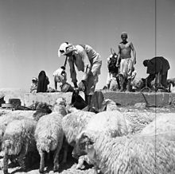
Team 4 is the best, even when not making it into four…”
First Strategic Experience - The Northern Arena
School solution

Slide 2
Liberation of Fallujah and Mosul
ISIS is defeated
Release of a-raka
Genealogy analysis
ISIS
ISIS in battles of braking
נפילת המדינה האיסלאמית
Retirement from an agreement
The core 8.5
Trump!!!
The beginning of consolidation
Iranian conflict
Downing an airplane
Russian 17.9
Iran
Weak but determined
Assistance in Syria
התבססות קרקעית בסוריה
A barrage of rockets
Iranian from Syria 9.5
תחת סנקציות
הליכה לאחור בסוריה
The Russians are here
Syrian air defense
Against Israel 17.13
U.S
Receded 28.12
A barrage of rockets
Syrian to Galilee
Attacking cooperation
Iranians are killed
Downing an airplane
Syrian conflict in the Golan Heights
Syria
Towards sovereignty
Civil war, leaks to Israel
Syria regains control, responds to Israel
In a swing back to power
חדירת מל"ט
איראני מסוריה
S300
Assad returns
To the Golan Heights
Hezbollah
Hezbollah in battles in Syria
returning home
Reducing the presence in Syria
Maximize precise occupation
tunnels
North Shield 4.12
Israel
The colonization is solidified
Precise Public Security
Under increasing restraint
מב"מ מדוייקים עמום, אוגדת בט"ש
נפילת מטוס קרב
ישראלי10.2
End of operation
Good neighbors 13.9
2016
2017
2018
2019

Slide 3
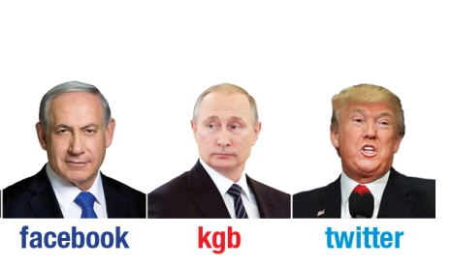
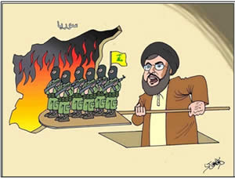
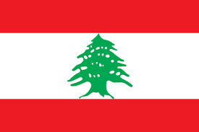
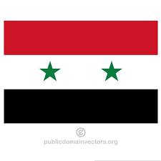
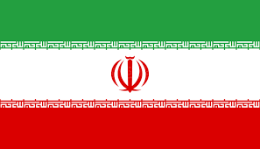
Lebanon
Syria
Iran
?
Iraq

Slide 4
1.Syria is in the process of rehabilitation and return to sovereignty (military, political). 2.Restricting freedom of action in Syria - a growing interest of many players 3.US port at the expense of strengthening Russian and Turkish ... not the end of the verse! 4.Russian contrast and breathing time is reduced 5.Iranian distress (economic, isolation, nuclear agreement) 6.Sunii vs. Shiite echelon 7.Hezbollah in the Golan Heights Faced with Confusion and its Influences ... 8.What does the Shiite echelon look like tomorrow morning? 9.A security strip in northern Syria. 10.A northern arena with an identity of undesirable interests for Israel
Major Trends

Slide 5
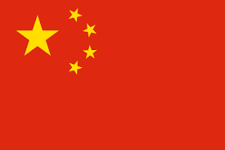
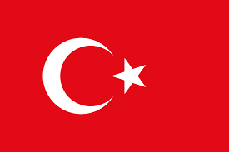
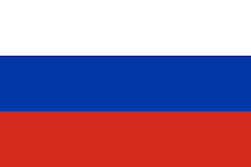
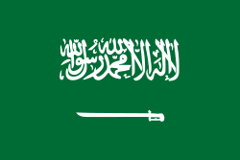
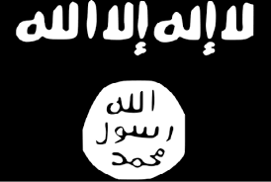
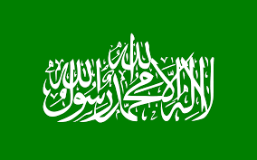
China
Turkey
Russia
US
?
Kurds
Saudi Arabia
Lebanon
Syria
Iran
?
Iraq
Jordan
Egypt
Hamas
דעאש
Links and Trends
PA

Slide 6
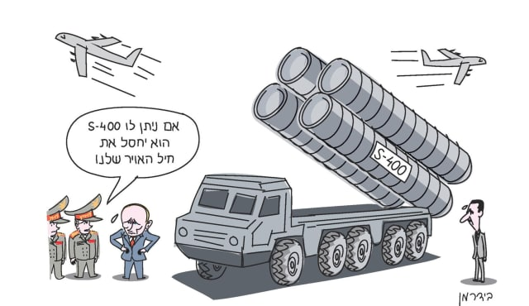
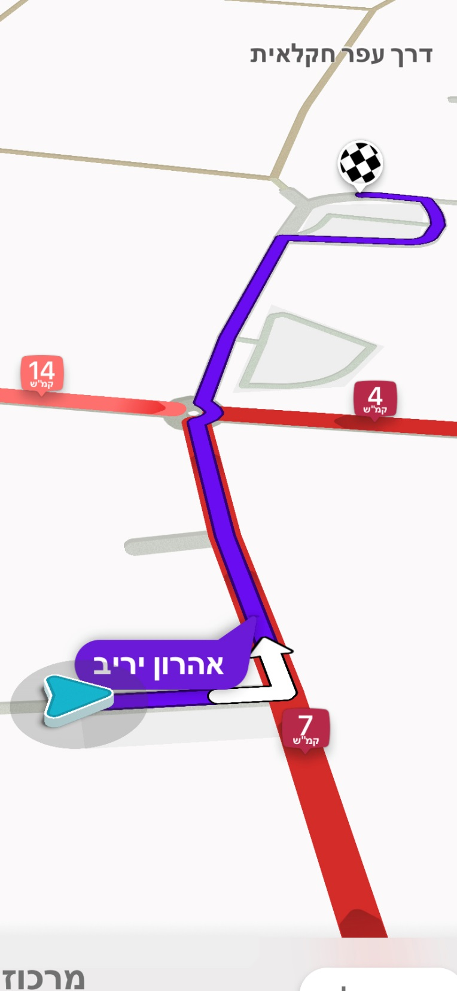
Strategic Offset
During That :
We exploited the in the Syrian territory freedom of action.
We dealt with defense and influence on the northern border in the Golan Heights.
We dealt with the prevention of Iranian consolidation and the strengthening of Hezbollah.
We relied on security coordination with the Russians and relied on American involvement.
Emerging:
Reducing freedom of action in Syria.
Syria's return to sovereignty (security, political).
An increase in the Russian interest and a willingness to realize it.
Reducing the American interest in Syria (in the Middle East in general).
Hezbollah is a regional strategic player.
Iran is weakened but determined, promotes religious / civil establishment in Syria, Lebanon and Iraq.

Slide 7
Positive Potential | Negative Potential
Russian influence against Iranian consolidation in Syria | Confrontation with Russia
Russian desire for stability - Russia as leverage | Syrian reinforcement - its return as a military threat
A common interest with the Sunni echelon | Iranian consolidation in Syria
Syria as a striped wedge | A united front (Iraq-Syria-Hezbollah)
Syria as a country> influence what is happening there | Prevention of military freedom of action
Political-economic pressure: protest Iran first | Syrian "return of debts" to the Shiite echelon
US departure: turning tactical space? | US exit: reducing leverage vis-a-vis Russia
Restoration of Syria: | Restoration of Syria: Resources for the Shiite echelon
Lebanon = Hezbollah - Creating Lebanese pressure restraining Hezbollah (threat of destruction of Lebanon) | Lebanon = Hezbollah - limiting our activity by the West
USA - Compensation for exiting | The deterioration of Jordan
Sunni-Shiite tension | Shiite Iraq
Potential damage | Hezbollah as a strategic player

Slide 8
Interests and objectives
The weakening of Hezbollah - regional, military, political and economic
Preventing an accurate threat in the northern arena
A clear regional Israeli military superiority, including operational freedom of action
Preventing Iran from establishing itself in Syria (and Iraq?), Interfering with Iran
Syria is sovereign (and weakened?)
Strengthening relations with Russia in order to leverage the Russian interest in our favor.
American leverage and regional backing (especially Russia and Iran)
Hezbollah's Conquest to Lebanon (Legitimization) - Hezbollah == Lebanon.
Stability of Jordan.
Strengthening relations with Sunnis / Gulf States.

Slide 9
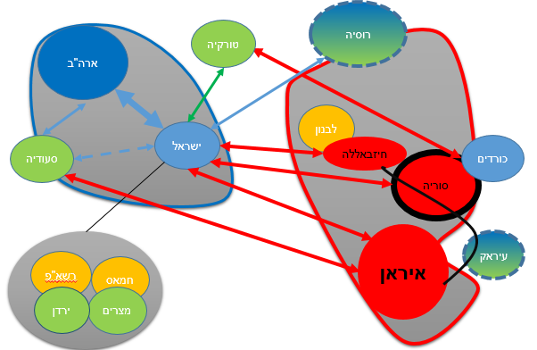
Promoting and harnessing the political and economic interest in sovereign Syria in order to create a wedge and block the Shiite axis.
Preserving Israeli supremacy in the region, while creating international legitimacy for action in Lebanese territory to the extent required (the right to self-defense)
A secret campaign focused on intensifying the Iranian dilemma between foreign-domestic targeting
Russia
maximizing the campaign between wars short term – Loss price
US
Turkey
Lebanon
Israel
Hezbollah
Saudi Arabia
Kurds
Syria
Iraq
PA
Hamas
Iran
Jordan
Egypt

Slide 10
Promoting and harnessing the political and economic interest in sovereign Syria in order to create a wedge and block the Shiite axis.
Preserving Israeli supremacy in the region, while creating international legitimacy for action in Lebanese territory to the extent required (the right to self-defense)
A secret campaign focused on intensifying the Iranian dilemma between foreign-domestic targeting
Russia
US
Turkey
Lebanon
Israel
Hezbollah
Saudi Arabia
Kurds
Syria
Iraq
PA
Hamas
Iran
Jordan
Egypt

Slide 11
Promoting and harnessing the political and economic interest in sovereign Syria in order to create a wedge and block the Shiite axis.
Preserving Israeli supremacy in the region, while creating international legitimacy for action in Lebanese territory to the extent required (the right to self-defense)
A secret campaign focused on intensifying the Iranian dilemma between foreign-domestic targeting
Russia
US
Turkey
Lebanon
Israel
Hezbollah
Saudi Arabia
Kurds
Syria
Iraq
PA
Hamas
Maximizing interest and contracts for the reconstruction of Syria
Iran
Jordan
Egypt

Slide 12
Promoting and harnessing the political and economic interest in sovereign Syria in order to create a wedge and block the Shiite axis.
Preserving Israeli supremacy in the region, while creating international legitimacy for action in Lebanese territory to the extent required (the right to self-defense)
A secret campaign focused on intensifying the Iranian dilemma between foreign-domestic targeting
$
Russia
US
Turkey
$
Lebanon
Israel
Hezbollah
Saudi Arabia
Kurds
Syria
Syria
Iraq
PA
Hamas
Maximizing interest and contracts for the reconstruction of Syria
Iran
Jordan
Egypt

Slide 13
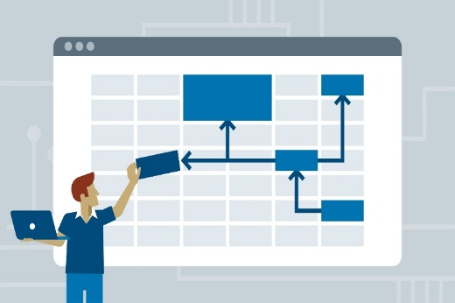
Insights on The Process
Formation of knowledge - the theoretical lectures are important and relevant and have provided a good basis for professional discussion in the team.
The process of instruction - clear, systematic, precise, conceptualized, focuses on the learning process. Creates an opportunity for friction with the model and self-exploration.
The picture becomes clearer gradually, which increases the importance of the tool and the methodology of action.
The team - the heterogeneity of the team allows us to examine the subject from many different angles.
Product - The process of building the cognitive map enables us to understand the complexity of the system, the tensions and the weights among the players in the arena. We have actually met a cognitive map for the first time in a simulation.
Understanding the totality and dynamism and changing reality even during the process and the need to set basic assumptions (severe - reasonable) in order to progress.

Slide 14
Insights on The Process
Formation of knowledge - the theoretical lectures are important and relevant and have provided a good basis for professional discussion in the team.
The process of instruction - clear, systematic, precise, conceptualized, focuses on the learning process. Creates an opportunity for friction with the model and self-exploration.
The picture becomes clearer gradually, which increases the importance of the tool and the methodology of action.
The team - the heterogeneity of the team allows us to examine the subject from many different angles.
Product - The process of building the cognitive map enables us to understand the complexity of the system, the tensions and the weights among the players in the arena. We have actually met a cognitive map for the first time in a simulation.
Understanding the totality and dynamism and changing reality even during the process and the need to set basic assumptions (severe - reasonable) in order to progress.

