Slide 1


FOUO
The State of Israel
Israeli Security Agency
INDC Presentation
January 23rd, 2020

Slide 2
FOUO
Israeli Casualties

Slide 3






FOUO
Attacks Prevented by Type
357
Shooting
94
Vehicle-ramming attack/Stabbing
106
IED
4
Abduction
10
Suicide

Slide 4


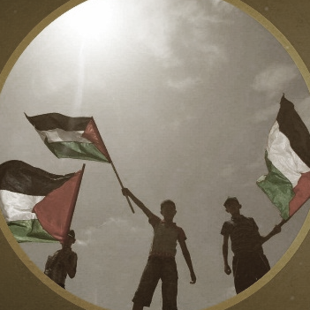
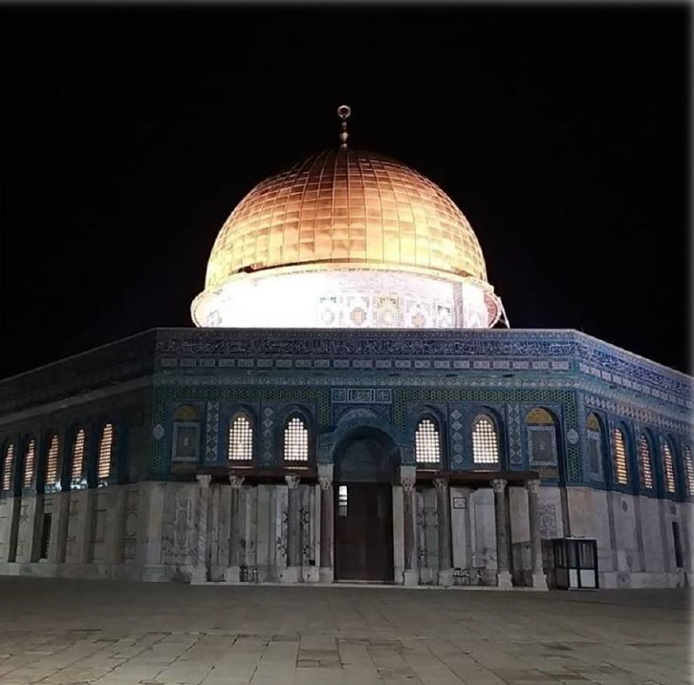



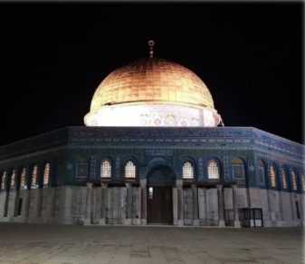
FOUO
Main Players – Judea & Samaria and Jerusalem
Palestinian System
Popular Front/PIJ
Hamas
Palestinian Public
Jerusalem

Slide 5
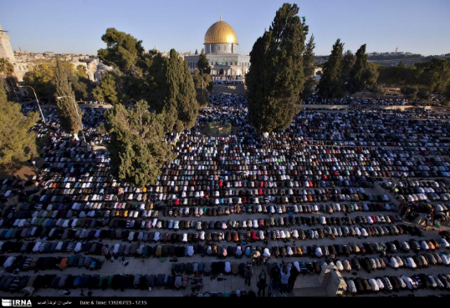
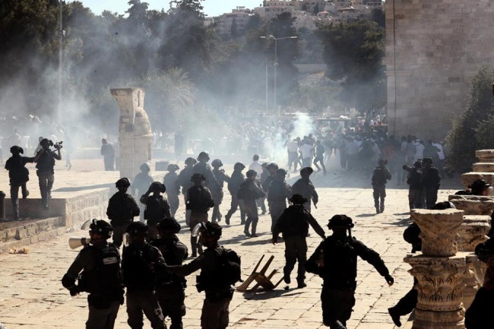
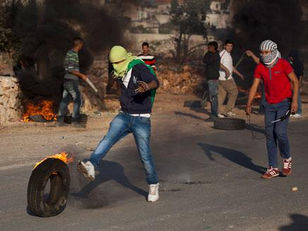
FOUO
Jerusalem
Temple Mount
Terror in East Jerusalem

Slide 6
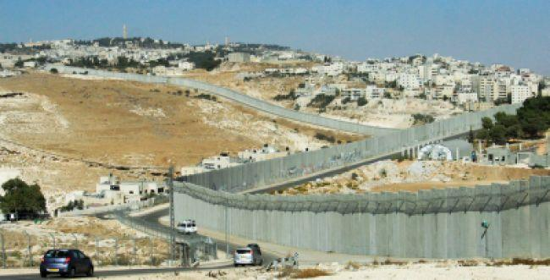
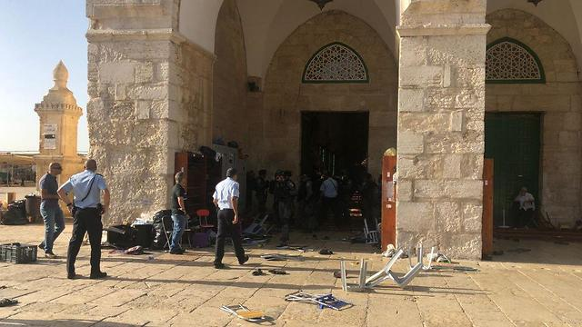
FOUO
Jerusalem
Security Fence
Golden Gate

Slide 7

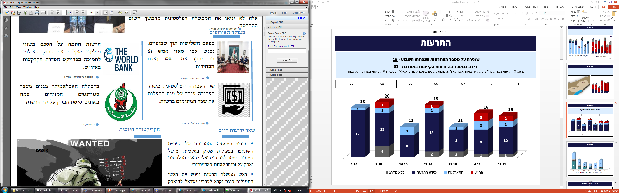

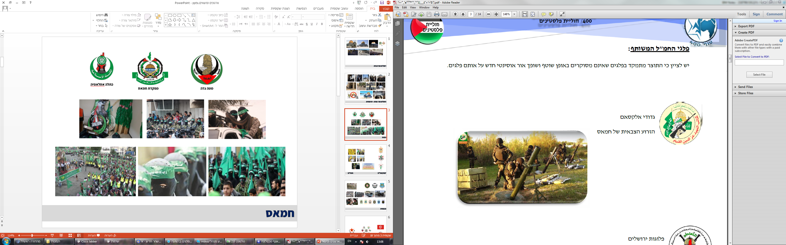
FOUO
Hamas
Hamas HQ
Ktla Islamia (Hamas Student Cell)
West Bank HQ
Izz ad-Din al-Qassam Brigades

Slide 8
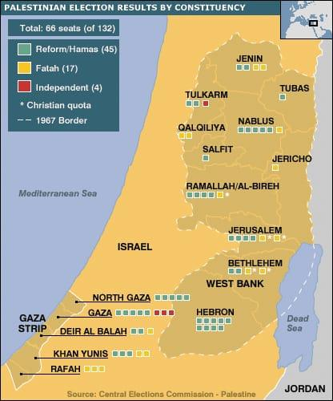
FOUO
Hamas
2006 – Hamas Wins Elections
2007 – Gaza Strip Takeover
2011 – Gilad Shalit Deal
2014 – Op. Protective Edge
Yahya Sinwar Appointed Leader - 2017

Slide 9
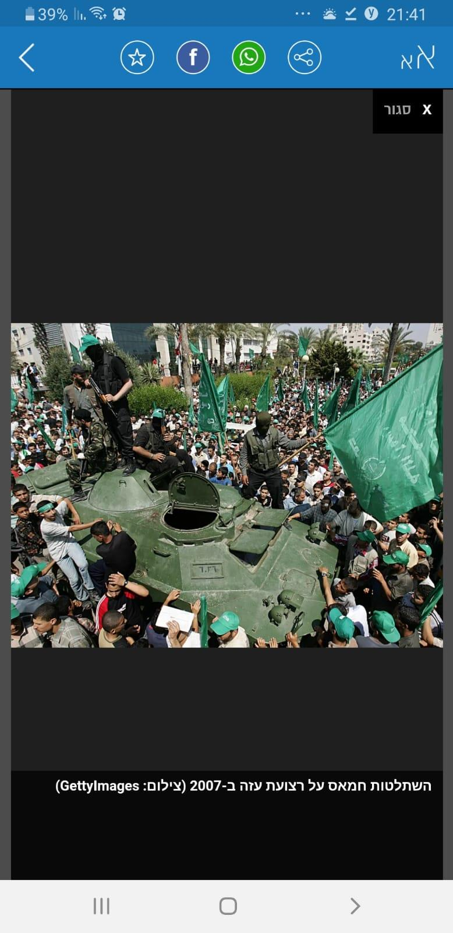
FOUO
Hamas
2006 – Hamas Wins Elections
2007 – Gaza Strip Takeover
2011 – Gilad Shalit Deal
2014 – Op. Protective Edge
Yahya Sinwar Appointed Leader - 2017

Slide 10
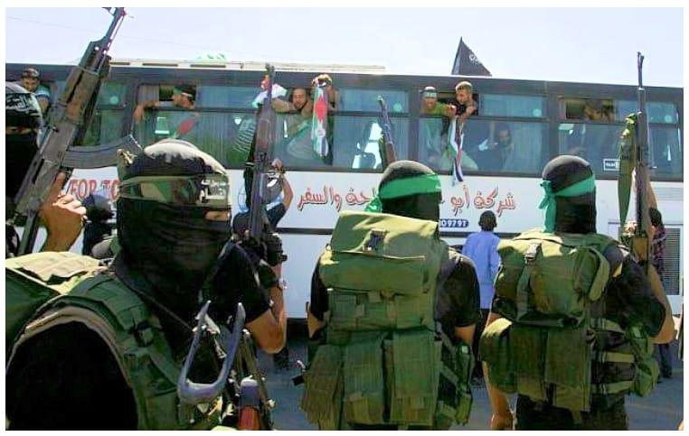
FOUO
Hamas
2006 – Hamas Wins Elections
2007 – Gaza Strip Takeover
2011 – Gilad Shalit Deal
2014 – Op. Protective Edge
Yahya Sinwar Appointed Leader - 2017

Slide 11
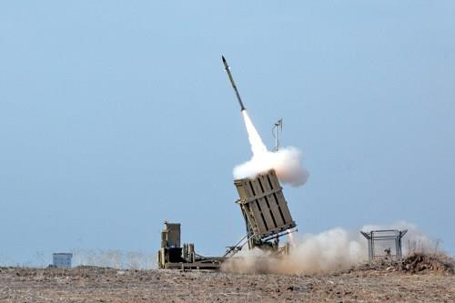
FOUO
Hamas
2006 – Hamas Wins Elections
2007 – Gaza Strip Takeover
2011 – Gilad Shalit Deal
2014 – Op. Protective Edge
Yahya Sinwar Appointed Leader - 2017

Slide 12
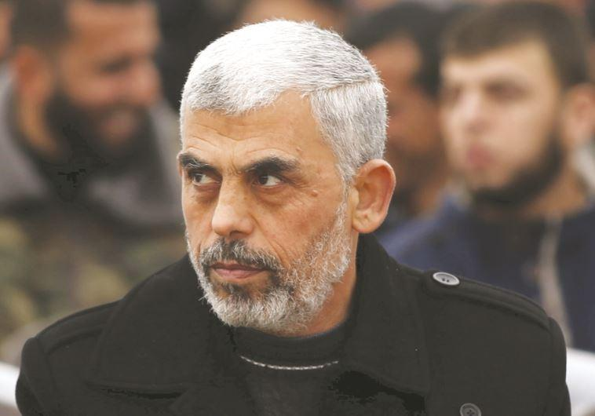
FOUO
Hamas
2006 – Hamas Wins Elections
2007 – Gaza Strip Takeover
2011 – Gilad Shalit Deal
2014 – Op. Protective Edge
Yahya Sinwar Appointed Leader - 2017

Slide 13


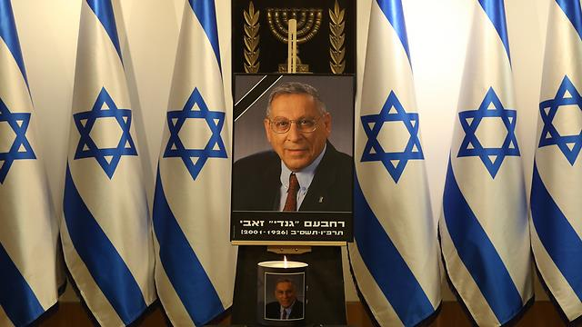
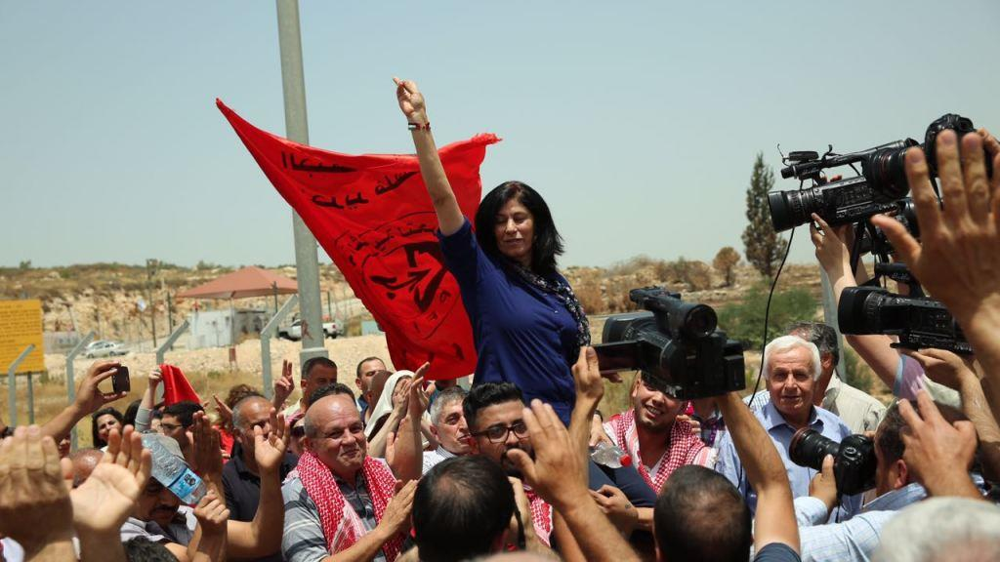
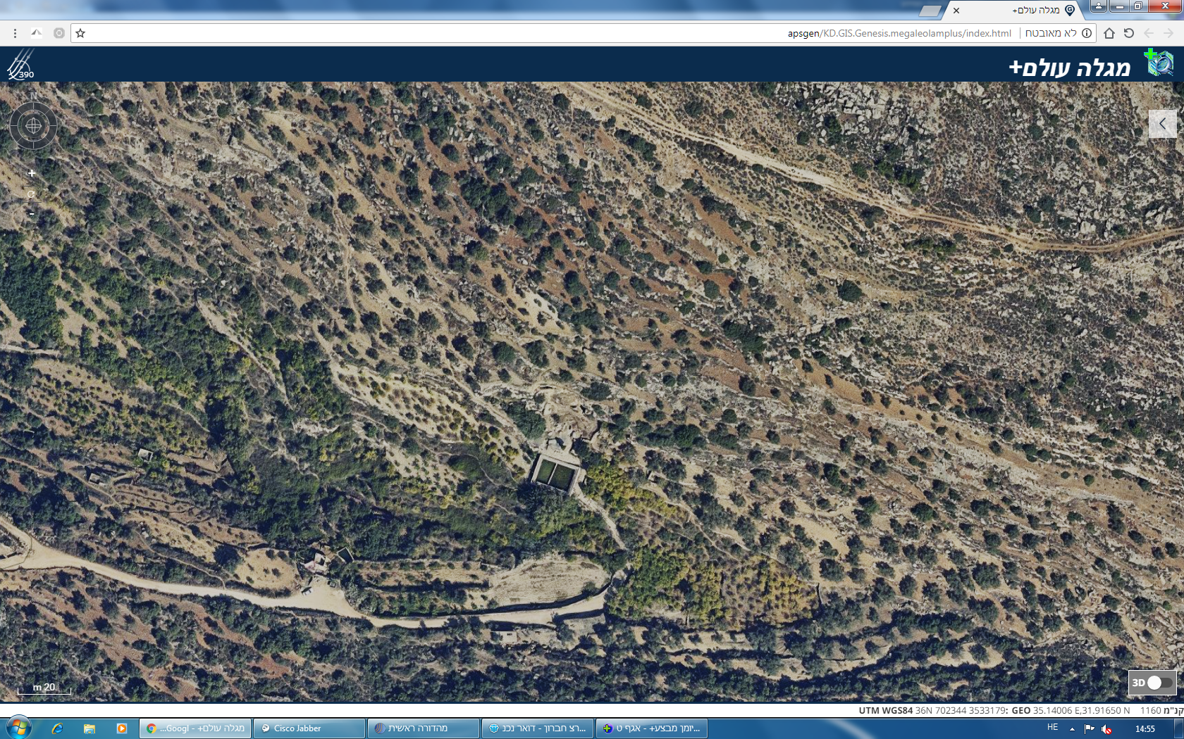
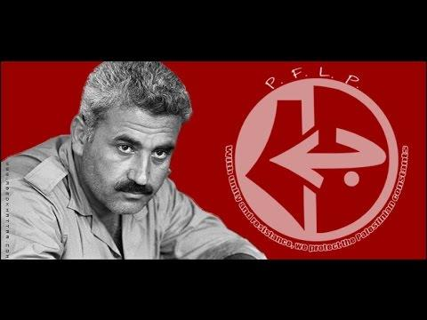
The Palestinian Popular Front

Slide 14
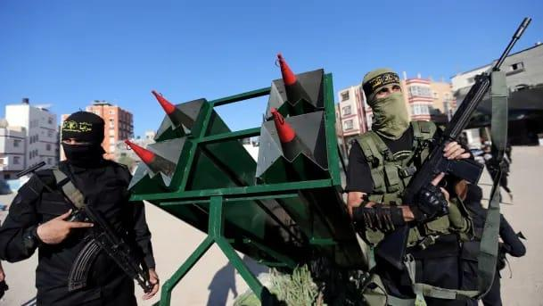
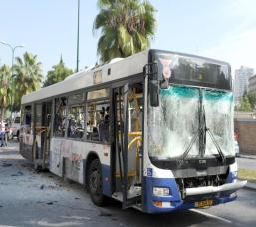
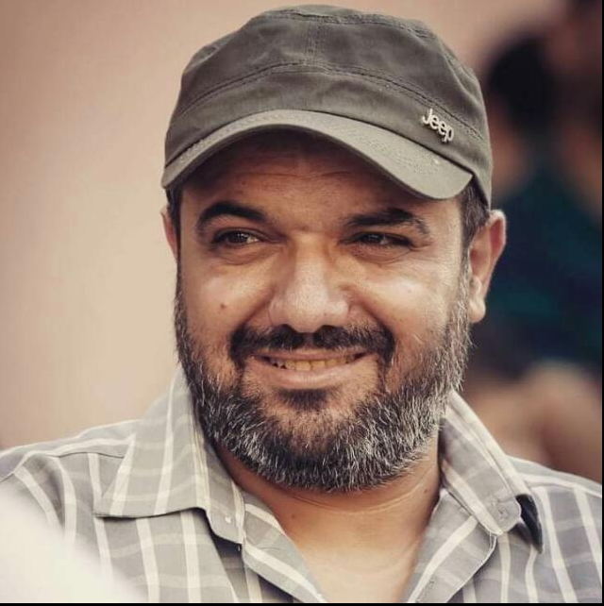
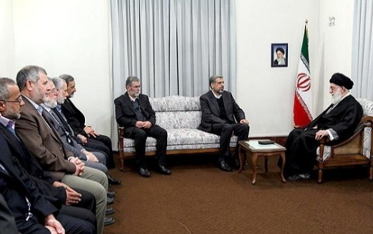
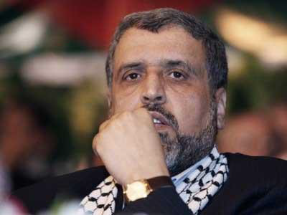
FOUO
PIJ
2019
2017
2013
2000
1989

Slide 15



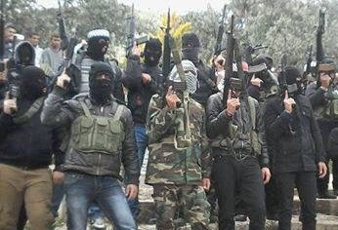
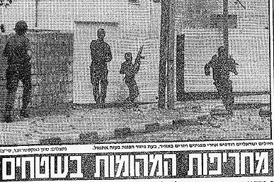
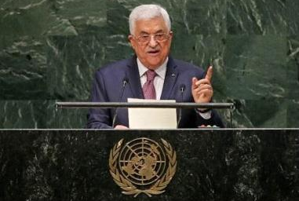
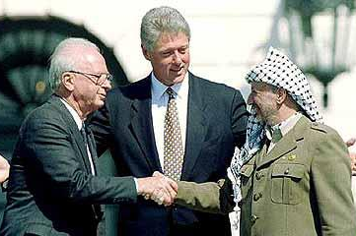
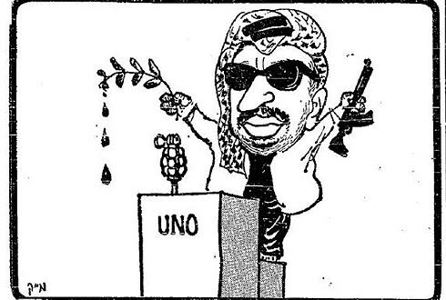
FOUO
Fatah
2005
2000
1993
1987
1969
.
.
.

Slide 16
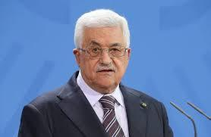







FOUO
Fatah
Chairperson
Security Mechanisms
National Institutions (PLO, Government)
Fatah Movement

Slide 17
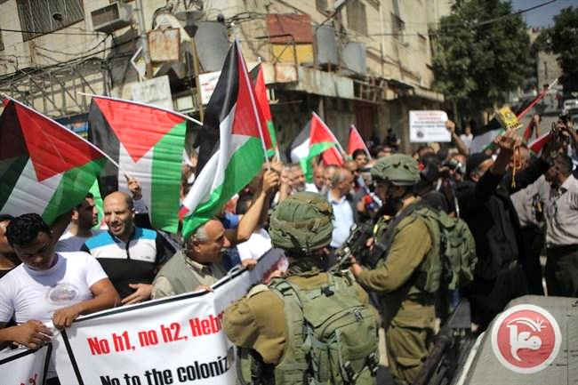
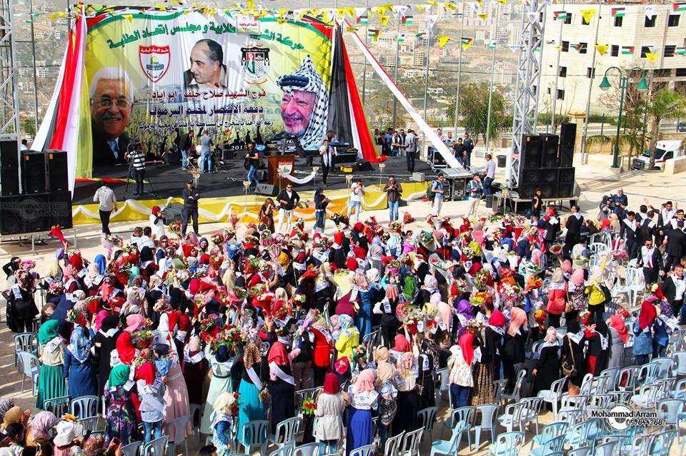
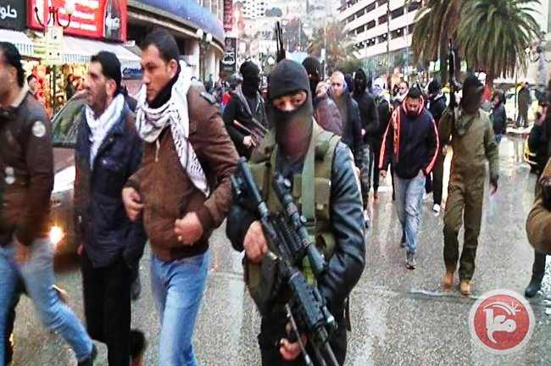
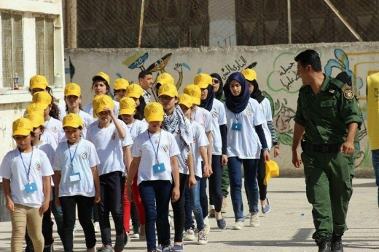
FOUO
Fatah
Protests
Political Rallying
Force Demonstrations
Public Engagement

Slide 18
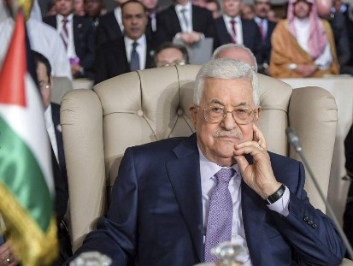

FOUO
Palestinian System as of Now…
Ahead of the “morning after” Abbas
Election talk

Slide 19
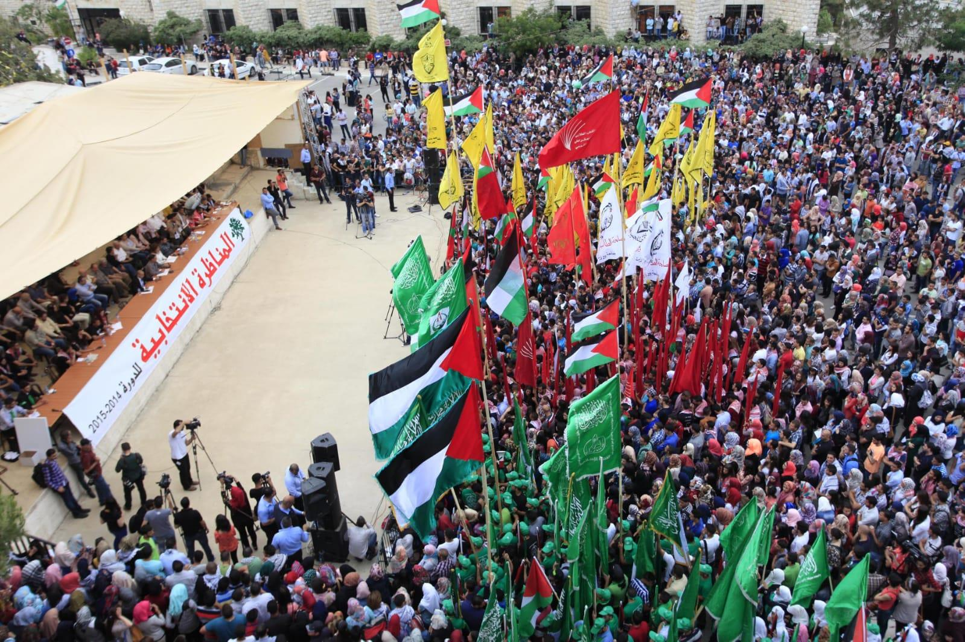
FOUO
Palestinian Public

Slide 20

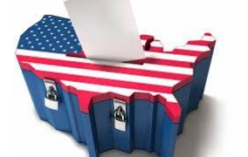
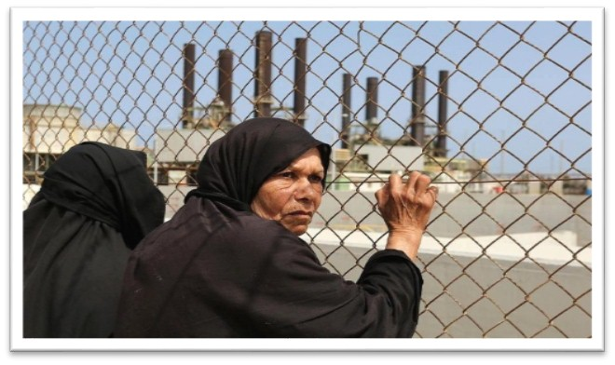
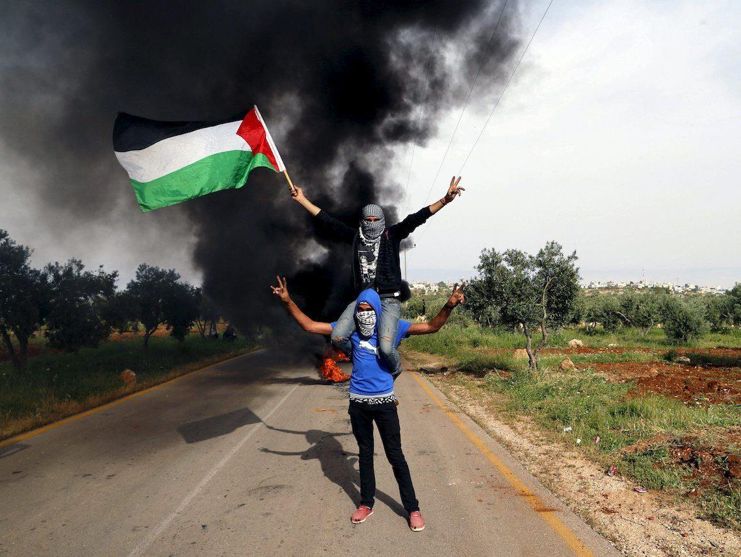
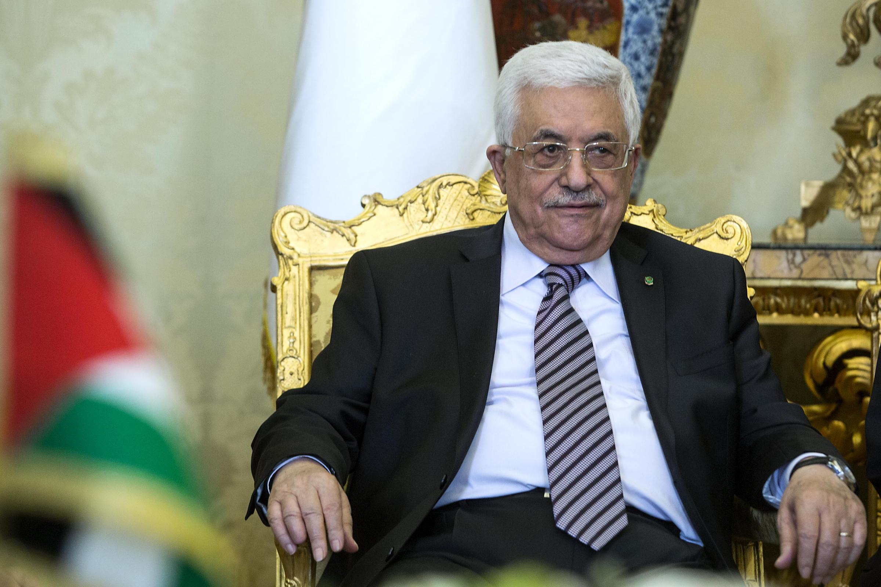
FOUO
Turns that may change the vector
US change of Administration
Humanitarian Crisis in Gaza
Civil Unrest in Judea & Samaria
The Morning After Abbas
…and we can expect surprises yet to come….

