Slide 1
46th Class Graduation Ceremony Presentation

Slide 2
Col. Samuel Boumendil Recipient of the Award for Excellency. Commander of the Education Corps. In his thesis, he studied the moral behavior of soldiers and commanders in the IDF. Member of the Presidium of the 46th Class. During the tour in the US he made a moving speech at the synagogue in New York.

Slide 3
Eyal Calif Exemplary Student Award recipient. He wrote his annual work on defense exports. Head of the Asia, Africa, and Pacific regions of the Department of Defense Exports. He has taken close to 20,000 pictures documenting all the experiences of the Year in the INDC.

Slide 4
Brigadier General Raju Baijal Recipient of the International Student Excellency Award. Wrote the longest thesis of the 46th class. Studied the persecution of the Rohingya in Myanmar and contributed greatly to the success of the India Tour.

Slide 5
Assistant Commissioner Eran Kamin Group Leader of Team 1. In his previous position, he was head of the Police Investigations Division. He led the economic axis and was the tour guide responsible for the tour of Judea and Samaria and the tour of India.
Good luck, Eran!

Slide 6
Dr. Eyal Argov He is returning to be the Head of Sector at the Bank of Israel. He helped lead the economic axis. Graduated with honors. In his thesis he wrote about the employment of Orthodox men in the Israeli economy.

Slide 7
Col. Inbal De-Paz In her next position she will be the chief military advocate. Led the "Army and Justice" seminar. Was the prime minister of Israel in the political simulation.

Slide 8
Col. Klaus Harrer Head of the International Cooperation Department, Information and Cyber Service Division in the German Army. In the political simulation he played the role of the prime minister of Russia- Vladimir Putin. Wrote his thesis on Israel-NATO relations

Slide 9
Col. Guy Levy In his next position he will be Commander of Submarine Special Forces. In his thesis he wrote about the Chinese involvement in the Haifa port. Successfully led the East China tour.

Slide 10
Eliaz Luf He completed his position as director of defense export supervision and was appointed to the position of the economic department of the Foreign Ministry. A well-known amateur of Israeli music and film.. He is writing a research thesis on the supervision of trade in arms and defense equipment

Slide 11
Col. Patrick Lemyre Commander of the Logistics Division of the Canadian Army. Moved the plenary with his personal and family story. Wrote his thesis on immigration policy of Canada.

Slide 12
Col. Alon Madanes He completed his academic studies as an outstanding student. In his next post, he was appointed the Defense Attache in the United States. Wrote a thesis paper, in record time of three months, on the Palestinian demographic campaign. Has successfully led the United States tour.

Slide 13
Kobi Peer In his previous position, he served as Deputy Director of Human Resources and Nanagement, and now as the legal adviser of the Atomic Energy Commission.Wrote annual work on the preservation of technological personnel in security organizations. In the plenum it is customary to say: "When Kobi says Kobi knows." Kobi is the first person to text everyone on their birthday.

Slide 14
Lt. Col Dr. Shahar Shapira Begins his duties as a medical officer in the Air Force. He managed to heal most of the back pain of the staff and participants. Wrote annual work on a program to promote health in the IDF.

Slide 15
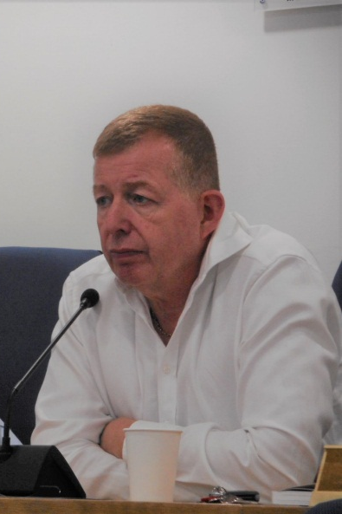
Rafi Schutz Team Leader of Team 2. From the Ministry of Foreign Affairs. Served as Israel's ambassador to Spain and Norway. He led the South and Russia tour.
Good luck, Rafi!

Slide 16
Col. Eros Zaniboni Staff Officer, Italian Air Force Department, Rome. He runs every day and trains on the beach in Tel Aviv. He wrote his thesis on an F-35 plane.

Slide 17
Col. Shay Hannuna In his upcoming position, he will be an intelligence officer in the Northern Command. In his thesis he wrote about the information revolution in the civil service. This year his princess daughter was born. Outstanding athlete.

Slide 18
Brigadier General Omer Tishler Commander of the Nevatim Base. Member of the Presidium of the 46th Class. Lead the South Tour and played the American president in the political-security simulation.
In his thesis he wrote about the Esh-Modi'in complex with an emphasis on the northern arena.

Slide 19
Col. Shin Fong Teng Wrote his thesis on social resilience in Israel compared to Singapore. Head of the Operations Department of the Singapore Army Ground Force. At home a little girl is waiting for him, whom he has not seen in almost a year.

Slide 20
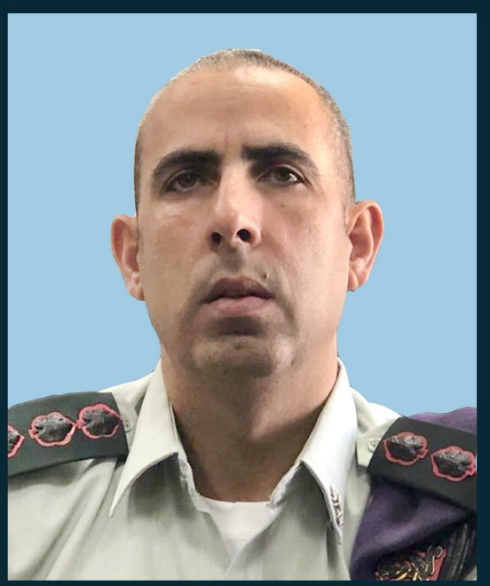
Col. Itzik Cohen In his previous position he was the Hebron brigade commander. He has now begun his position as the commander of the Givati Brigade. In his thesis he wrote about possible scenarios in the Jordanian arena.

Slide 21
Junior Commissioner Levana Levy Shay Her last position was as the Commander of the Hermon prison. One of the leaders of the society tour and the visit to the Ayalon prison and Neve Tirza prison. She wrote her annual work on the living space of prisoners.

Slide 22
Lt. Col Seth MacCutcheon Commander of the Eastern Mediterranean Division, US Army Planning Division. Wrote his thesis on the US attitude towards Russia's actions in the Middle East. Has contributed greatly to the success of the United States tour including a lecture on baseball.

Slide 23
Col. James Priest Defense Attaché of the British Army in Israel. Contributed greatly to the success of the tour in England and to the understanding of Brexit.
Wrote his thesis on anti-Semitism in England today.

Slide 24
Col. Haim Raban In his next position he will be the Commander of the Training Base in the south. Wrote his annual work on the "Profession for Life" project, which trains soldiers on how to work in the Israeli economy. Also known as the "Master Chef" of the 46th class.

Slide 25
Dganit Shai Director of the Audit Department of Government Ministries and Government Institutions in the State Comptroller's Office. One of the leaders of the Ben-Gurion seminar. Contributed to the deliberations in the plenum with information on government and state control. She wrote her annual work on political appointments of legal advisors.

Slide 26
Assistant Commissioner Michael Shafshak Completed his position as Head of the Training Division and Deputy Head of the Police Training Division. Became a grandfather to his first grandchild this year. In his thesis he wrote about the training of senior police officers.

Slide 27
Reserves Colonel Yehuda Yohananoff Team leader of Team 3. Former Commander of the Staff and Command College. He led the Axis Strategy Studies and was the instructor in charge of the North Tour and China Tour.

Slide 28
Col. Gilad Biran His next position will be commander of the Air Defense School. In his final paper he wrote about the Soviet missile defense system's learning. Participated in the "Dov Hatzafon" seminar. At the political simulation he was the only Israeli participant in the Russian delegation. Graduated with honors.

Slide 29
Lt. Col Maya Goldschmidt Vice President of the military courts in the Northern and Navy jurisdictions. One of the leaders of the "Army and Law" seminar. In her thesis she wrote about the legal status of career soldiers. Led the "Army and Justice" seminar.

Slide 30
Ofir Dayan Director of the Iron Dome program in Rafael. . In the political simulation he was the head of the Palestinian Authority. Enthusiastic listener of "Shema" books during long trips. In his thesis he wrote about the Iron Dome.

Slide 31
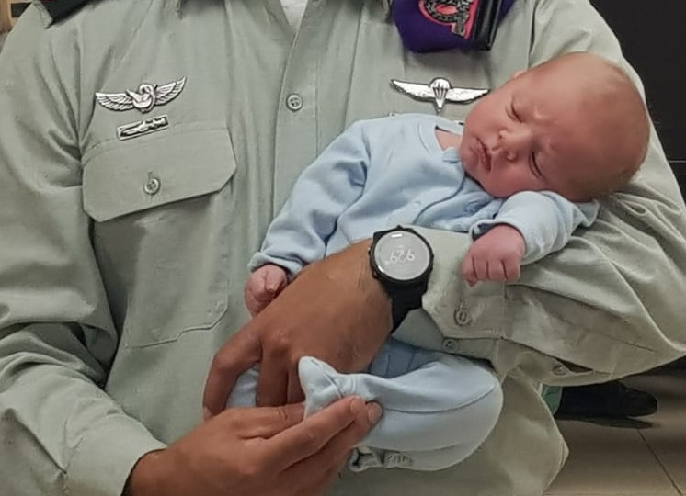
Col. Yehuda Wach Commander of the Hiram brigade. In his thesis he wrote about the security fences on the borders of Israel. When he was on a tour of the United States, his son was born, the sixth child in the family. In his thesis he wrote about the security fences on the borders of Israel

Slide 32
Commander Igal Hadad He completed his position as commander of the Kinneret region of the Israel Police. Lead the police tour. Wrote a thesis on illegal possession of weapons in the Arab sector.

Slide 33
Col. Shai Taieb Head of the Manpower Directorate of the Ground Forces. In his thesis he wrote about "The Ethos of the Warrior" in the context of military revolutions. When he entered the plenum always at the beginning of the lesson.

Slide 34
Col. Manor Yanay He will be the Commander of Yahalom the Combat Engineering for Special Forces Unit. In the simulation, he was the president of Egypt.
His thesis was written on the civil war in Syria.

Slide 35
Tzvika Israeli From the Prime Minister's Office. Wrote annual work on Russian influence. Participated in "Dov Hatzafon" seminar. Led the tour to India. Won first place in the costume competition at the Purim party.

Slide 36
Col. Nathans Yair During his studies at the INDC, he served as an Artillery Reserves Commander. Now he will be serving as Commander of the 282 Brigade. Despite being on reserve duty in the IDF he was always the first to submit the annual work and the first to complete his studies in the INDC 46th class. He wrote a thesis on reserve duty in light of the challenges of the hour.

Slide 37
Rachel Shani In her previous role, she was a consul in London. In the next position she is director of the Foreign Ministry's Situation Room. Member of the 46th class presidium and the adoptive mother of the international participants. In her annual work she wrote about the responsibility of the state towards its citizens living outside its borders.

Slide 38
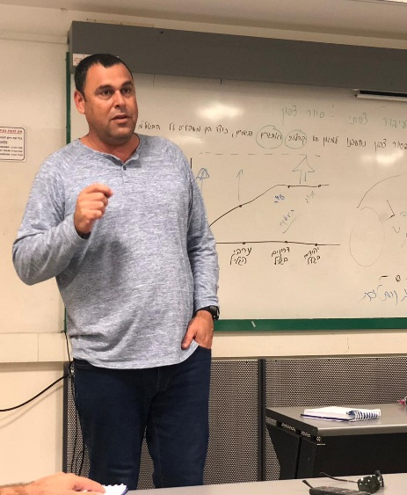
Shay Fireaizen Team leader of Team 4. From the Prime Minister’s Office. He is a graduate of the 45th class. He is writing a doctorate on the Temple Mount. He led the National Defense Axis and was the tour guide responsible for the Jerusalem tour and the Jordan tour.
Good luck, Shai!

Slide 39
Col. Hen Almog
In his last position he commanded the "Kela David" Artillery Regiment (UAV training unit). He left the IDF after 25 years of service. In his thesis he wrote about the establishment of another international airport in Israel. He successfully led the East Tour to Russia and is a well-known host of international wine tours in the north.

Slide 40
Col. Yehuda Elmakias In his next position he will be the head of the IT and cyber network at the Administration for the Development of Weapons and Technological Infrastructure. He lead the infrastructure tour.
In his thesis he wrote about the use of artificial intelligence in the IDF.

Slide 41
Col. Yariv Ben Ezra In the past he was the commander of the Judea Brigade and from now on he will be a team commander at the Staff and Command College. Was one of the leaders of the Jerusalem tour. Wrote his thesis on the impact of the economic situation in the territories on terror activity and was among the tour guides to Jerusalem.

Slide 42
Brigadier General Meirav Brikman In her next position, she will serve as commander of the IDF's Supply Center. She graduated with honors. In her thesis she wrote about cooperative economics and its application in the IDF. Member of the Presidium of the 46th Class and lead the Infrastructure tour.

Slide 43
Dr. Ronen Harari Senior project manager at the Nuclear Research Institute. In his thesis he wrote about the party interested in building a nuclear power plant in Israel.

Slide 44
Col. Guy Levy Completed his studies early at the INDC in order to begin his new position as Commander of the Officer Training Base.

Slide 45
Commander Hadas Madmoni Graduated with honors. Israel Police Force, she wrote her annual work on public trust in the Israel Police. She was one of the leaders of the Jerusalem tour and the police and society tour. Her personally written birthday blessings are always invested in.

Slide 46
Dror Friedler Civil Service Commission. In his thesis he wrote about the strategic applications of artificial intelligence in decision-making processes.

Slide 47
Assaf Raffeld Head of the Jerusalem Region in the Israel Lands Authority. In the political simulation, he was "King of Jordan". In his thesis he wrote about the housing crisis as an opportunity for change. Was a initiator and lead player in the basketball team.

