Slide 1
Lt COL Aviad Atia
Current position- Commander of the southern monitoring unit (יב"א 509)
Professional
Background
Previous position- Air Force flight supervisor since 2000
Previous position- Commander of the Air Force control unit
BA in government, diplomacy and strategy from the I.D.C (graduated with honors)
Academic
Background
Year of birth- 1978, residence- Tali camp, Ramon Air Force base
Personal
Background
Married to Yael and father to Mika, Maayan and Rona
Hobbies- reading, running and photography

Slide 2
COL Benjamin Da Levi
Current position- wing commander
Professional
Background
Previous position- Squadron commander
BA in industrial engineering and management from Ben Gurion university
Academic
Background
Courses and educational programs- Senior state intelligence course (בין שירותי)
Year of birth- 1974, residence- Beni-Ram
Personal
Background
Married with five children

Slide 3
Mrs. Michal Mustey
Current position- legal adviser for the Ministry of Diaspora Affairs
Professional
Background
Previous position- supervisor (legal consulting), of the legal bureau of the prime minister office, responsible of the legal consulting in the ministry of Jerusalem and Diaspora Affairs office including the Government Journalism Bureau and the information center on behalf of the legal bureau of the prime minister’s office
Previous position- independent lawyer
BA in law, LL.B from the Hebrew university in Jerusalem
Academic
Background
Master’s degree, LL.M from the Hebrew university in Jerusalem
Courses and educational programs- directors training and functionary course in corporations, authorization as a director, graduate of the “Vaksner” foundation program for senior officials in public service, management training course for senior lawyers in government offices, קורס בדיני מכרזים, the academic center for law and business, השתלמויות במגוון תחומים של השירות הציבורי, במכון להשתלמות פרקליטים ויועצים משפטיים, משרד המשפטים, השתלמויות במכון להשתלמות עורכי דין בישראל, של לשכת עורכי הדין והפקולטה למשפטים, אוניברסיטת תל אביב וקורס גישור, האוניברסיטה העברית בירושלים.

Slide 4
Mrs. Michal Mustey
Year of birth- 1970, residence- Adaret
Personal
Background
Married with four children
Hobbies- reading, sports and traveling

Slide 5
COL Amit Yamin
Current position- School of infantry corps professions commander
Professional
Background
Previous position- commander of an infantry corps operational battalion, “Lavi” battalion of “kfir” brigade
Previous position- Battalion commander in the training base of the Paratroopers Brigade. commanding five companies in their training stage, approximately 600 soldiers and commanders. Providing a close initiation to the different commandment levels at the company level and coordinating the activities of the companies in front of the special staff
BA in Logistics- Economy and Educational administration from Bar Ilan university
Academic
Background

Slide 6
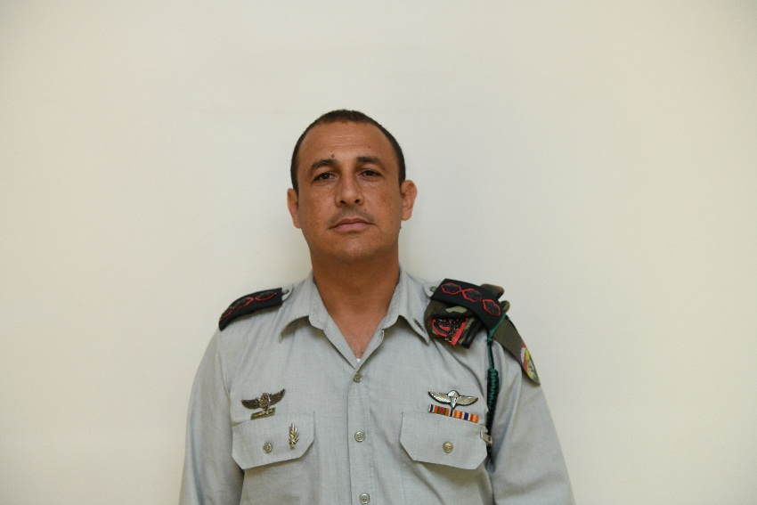
COL Amit Yamin
Year of birth, city of residence: 1974, Netanya
Personal
Background
Family situation: Married to Reut, father to Shira, Talia, Yehudah-Yair and Levi-Eliah

Slide 7
Mr. Shachar Batz
Current position- Head of the operations wing of the ministry of defense
Professional
Background
Previous position- Commander of an operational unit
Previous position- District Archaeologist, staff officer of archeology
BA- In Archeology and Geography (Dean’s exceptional)
Academic
Background
Master’s degree in Classical Archeology
Year of birth, city of residence- Kfar Adumim
Personal
Background
Family situation- Married + four children
Hobbies- Field trips, cooking (mainly meat)

Slide 8
Commander Shlomo Toledano
Current position- Deputy commander of Zion area\ Jerusalem district
Professional
Background
Previous position- Beit Shemesh station commander\ Zion area\ Jerusalem district
Previous position- operation wing officer of Zion area\ Jerusalem district
BA in business administration from Derby university
Academic
Background
MA in middle east studies from the university of Tel Aviv
MA in social science from the School of Political Science in the university of Haifa
Year of birth- 1974, residence- Givat Ze’ev
Personal
Background
Married with four children
Hobbies- reading, sports and trips with the family

Slide 9
COL Shlomi Ben Moocha
Current position- Commander of Yam and center district
Professional
background
Previous position- Rescue and training brigade deputy commander
Previous position- Commander of Hachsena Base העורף- פקע"ר
BA in Government and human resources from Bar Ilan university
Academic
background
Master’s degree in political science from the university of Haifa
Courses- פו"ם ברק
Year of birth, city of residence- 1978, Kiryat Ata
Personal
Background
Family situation- Married + five children

Slide 10
Mrs. Sima Shpitzer
Current position- Director of the Licensing and new banks unit, banks supervision, Bank of Israel
Professional
background
Previous position- Director of banks supervision- money laundering and terror financing, Bank of Israel
Previous position- director of the Institutional Assessment Unit, banks supervision, Bank of Israel
BA in Economy- Accounting (graduated with honors)
Academic
Background
Master’s degree in Economy (specialization in Business Economics), within a direct economics PhD track (finished all the requirements except the PhD dissertation)
Year of birth, city of residence- 1971, Givat Shmuel
Personal
Background
Family situation- Married with three children
Hobbies- reading, spinning, cooking and baking

Slide 11
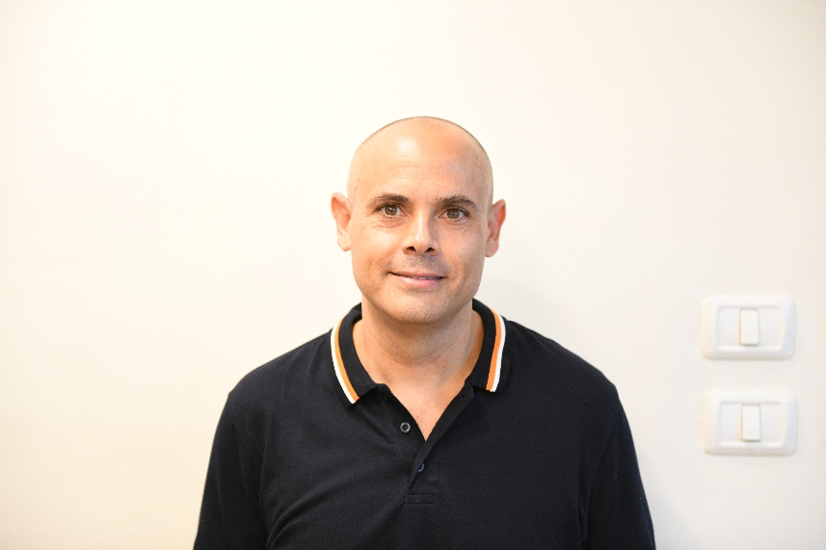
COL Ofir Lewis
Current position- Head of the planning department\ planning wing
Professional
background
Courses and educational programs- דמש ק. שיפוט בכיר, בניין הכוח.
Academic
Background
Year of birth- 1975, residence- married with six children
Personal
background

