Slide 1
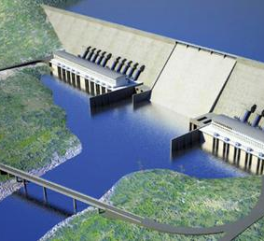
The Complex Geopolitics of Damming the Nile Team 4 Research

Slide 2
Agenda
Introduction
Geography & History
The Conflict Research
Conclusions

Slide 3
Phenomenon and Scope of Research

Slide 4
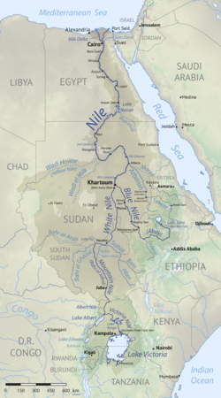
The Complex Geopolitics of Damming the Nile Team 4 Investigation
100%
30%
15%
55%
GERD

Slide 5
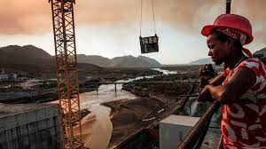
The Grand Ethiopian Renaissance Dam project
Main goal – produce 5.15 GW
Electricity, to lift Ethiopians out of poverty.
Kickoff – 2011 expected to complete
in 5 years
Status (2022) – Power production
and 3rd fill complete
Cost – about 4.8 B US$ funded by local bonds and private donations

Slide 6
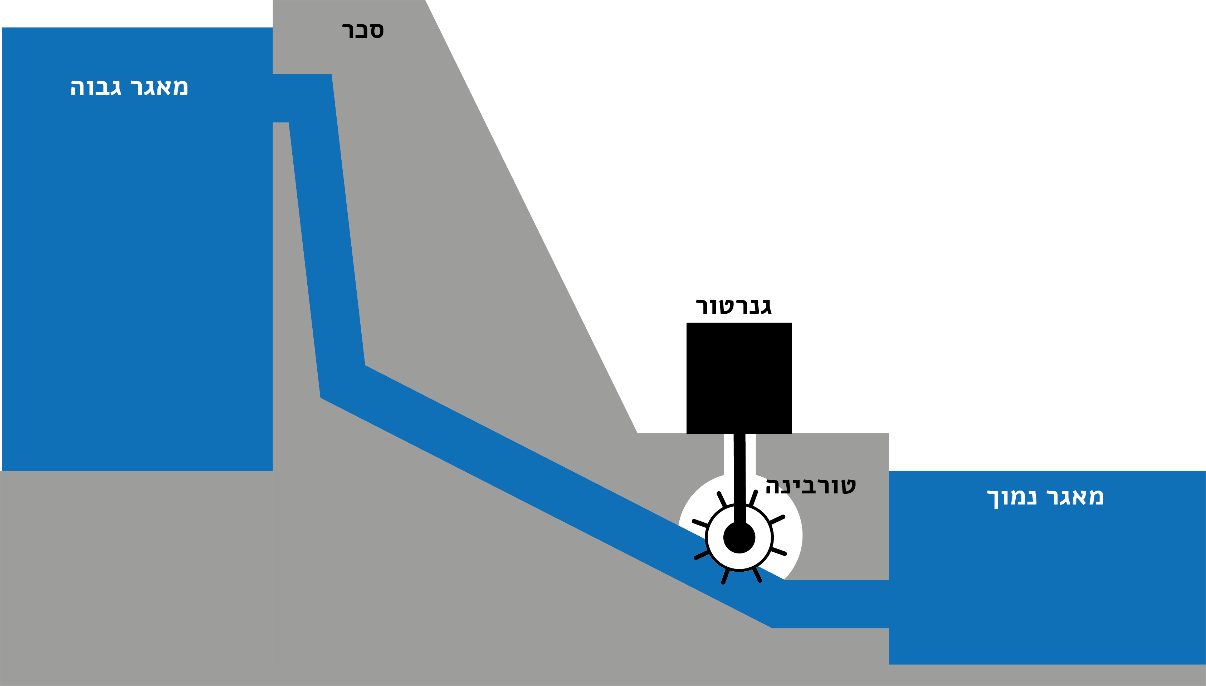
Key parameters Issues

Slide 7
Key parameters Issues
Fill duration
Minimum Water to release
Drought Management
Ethiopia:
Fast Electricity production
Egypt:
Lack of water
The Key to the NILE

Slide 8
Analysis

Slide 9
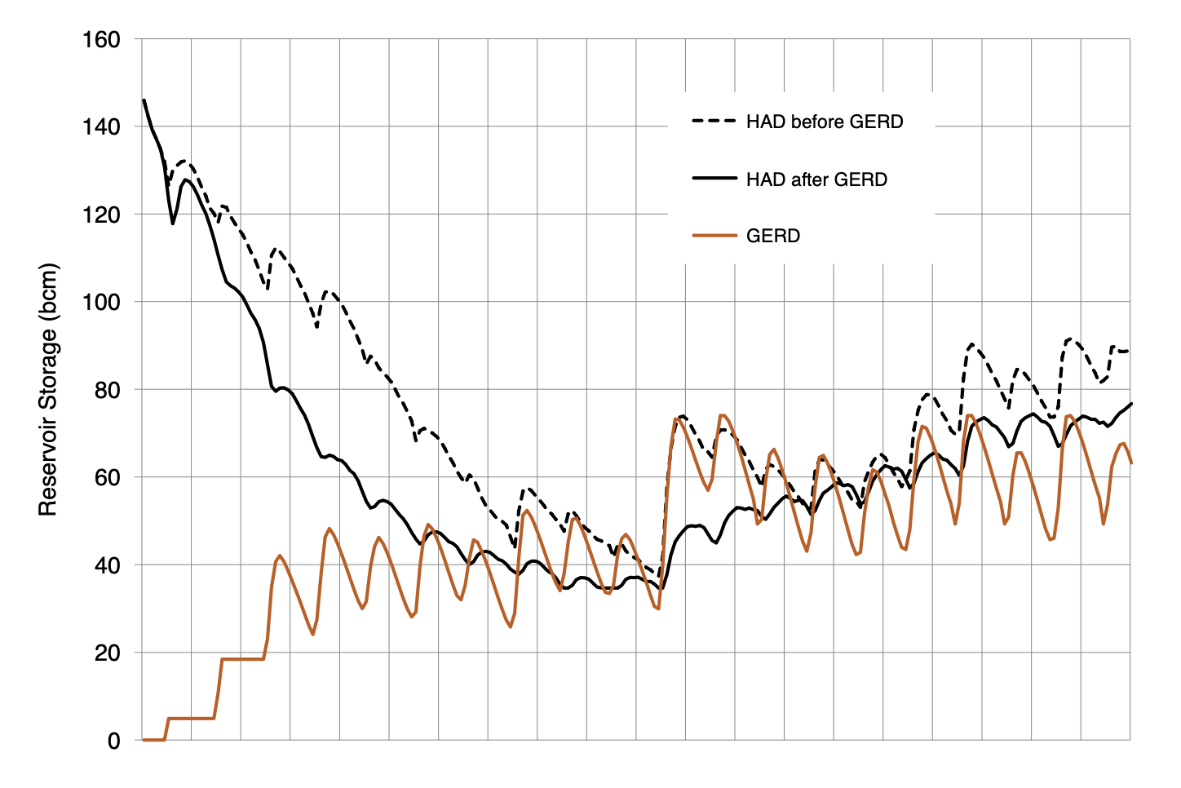
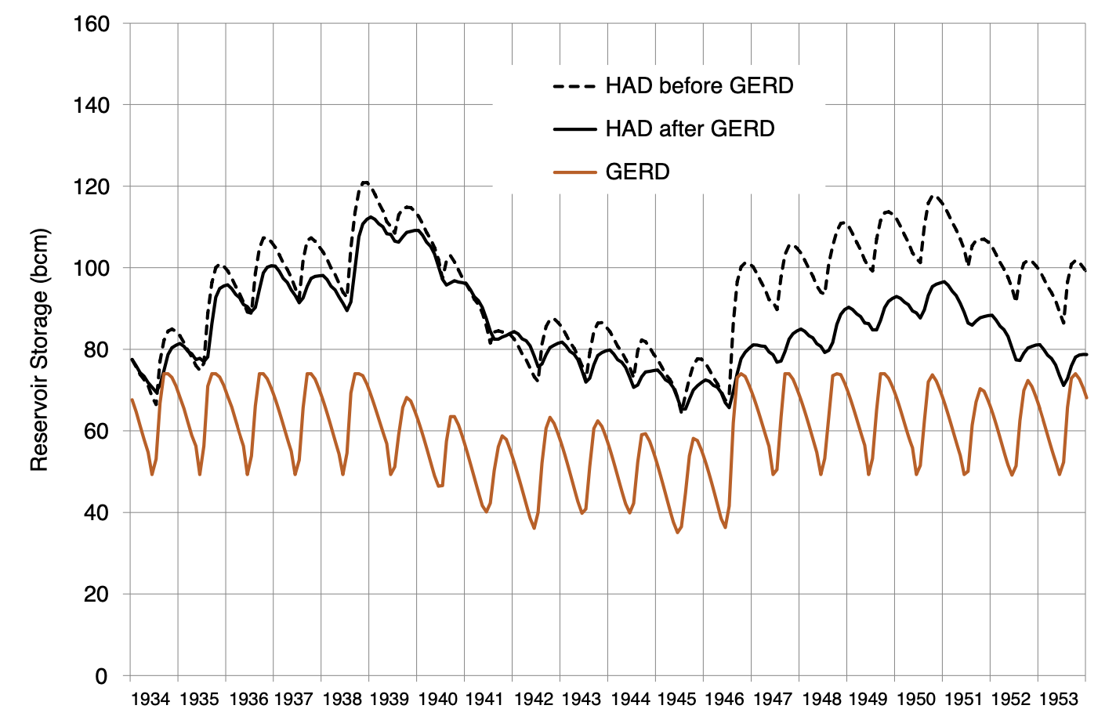
Analysis of Impact of GERD on Egypt (High Aswan Dam)
- during GERD Filling and operation
During filling of GERD, the High Aswan Dam’s reservoir level will fall, but the risk of additional water shortage in Egypt is low with drought management plans deployed.
Simulated Data during the worst historical 10 year drought
Simulated Data during the worst historical 20 year drought

Slide 10
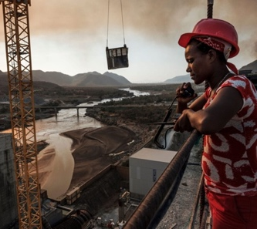
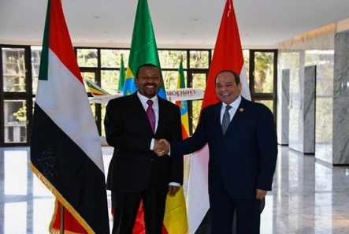
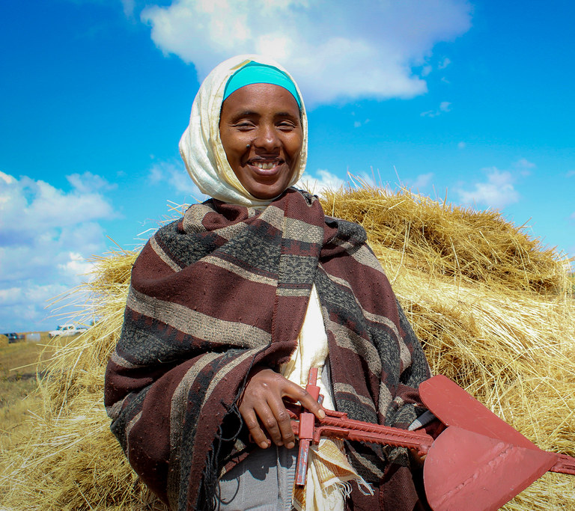
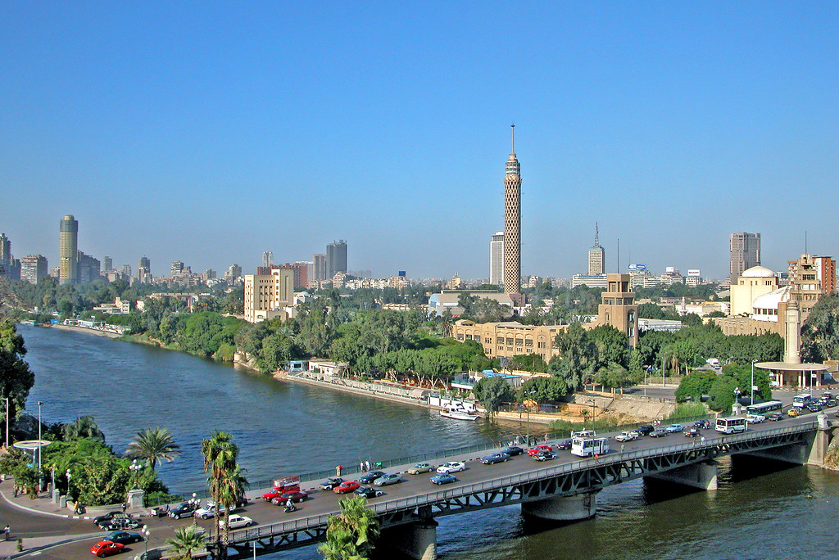
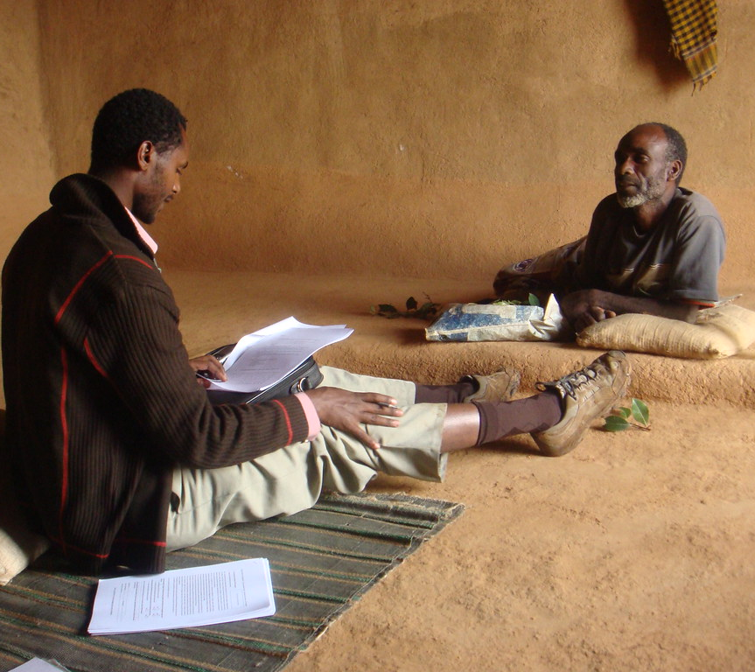
Ethiopia’s prime minister said “I want to make it abundantly clear that we have no intention to harm these countries….
Egypt President Sissi warned of the risk of conflict
https://www.youtube.com/watch?v=G45J9AavhMU

Slide 11
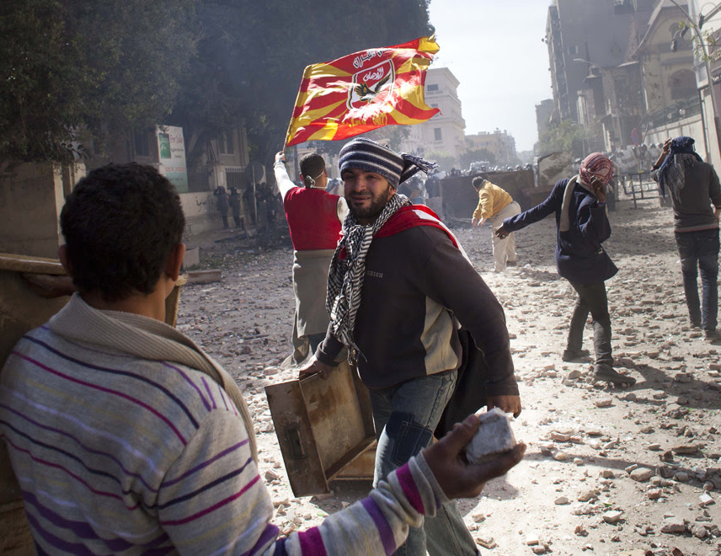
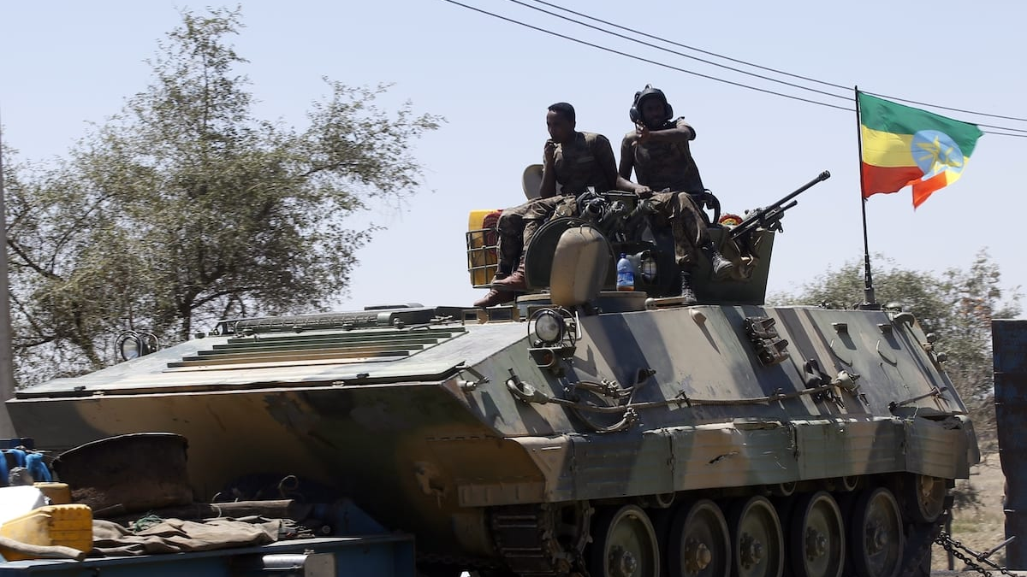
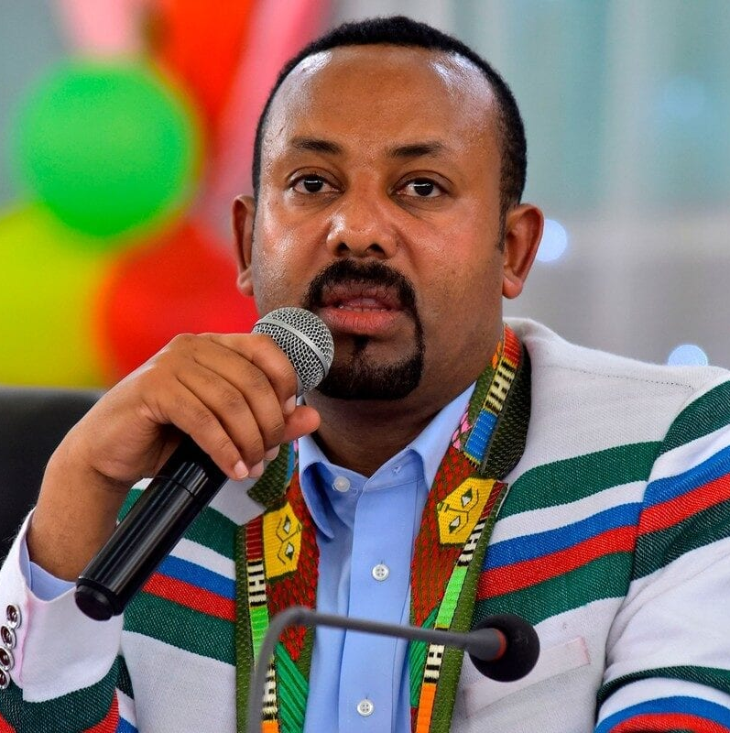
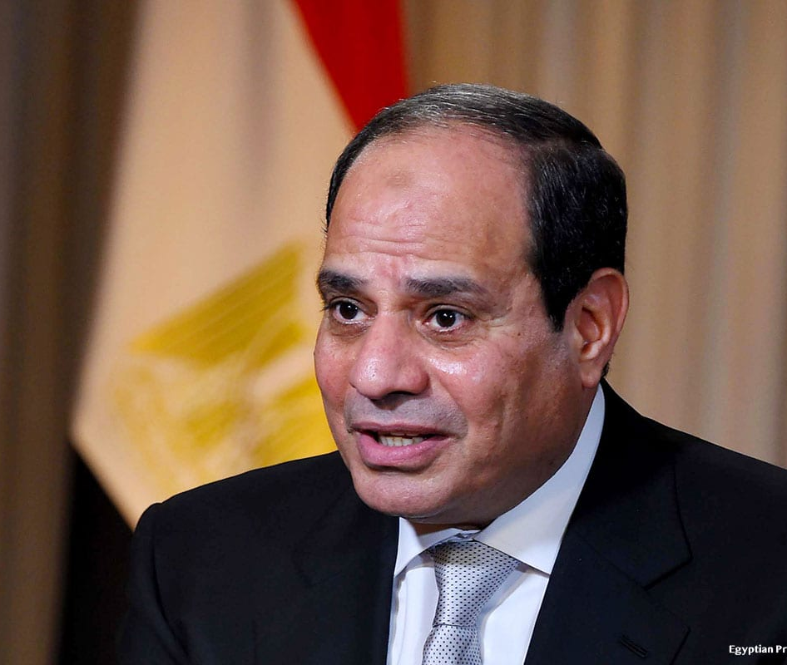
Why?
The Team will investigate:
Relevant Geography and History.
Dilemmas at Individual, regional and international levels.
Strategies to resolve these dilemmas.
This Photo by Unknown Author is licensed under CC BY-SA-NC
This Photo by Unknown Author is licensed under CC BY-SA
This Photo by Unknown Author is licensed under CC BY-SA-NC
This Photo by Unknown Author is licensed under CC BY-SA-NC

Slide 12
Geography

Slide 13
Key Country Information
Egypt is homogenous and Ethiopia has more than 13 ethnic groups.
Egypt population is 12 percent less but GDP is 4 times of Ethiopia’s.
Egypt produces electricity 12 times that of Ethiopia.
Egyptian consumes water 6 times that of Ethiopian.

Slide 14
Population Distribution in Eastern Nile Basin
Distribution influenced by climate, rainfall and water availability.
Egyptians live in narrow strip of flat terrain along Nile River.
For upstream waterway, certain strips are sparsely populated as water is difficult to access.
Egypt Society is homogenous Arabs and Ethiopia has more than 13 ethnic groups.
Egypt has about 12 percent less population but her GDP is about 4 times of Ethiopia GDP.
Egypt produces more than 12 times the electric power Ethiopia produces.
Egypt consumes 7 times the amount of water per capita Ethiopia consumes.
GERD

Slide 15
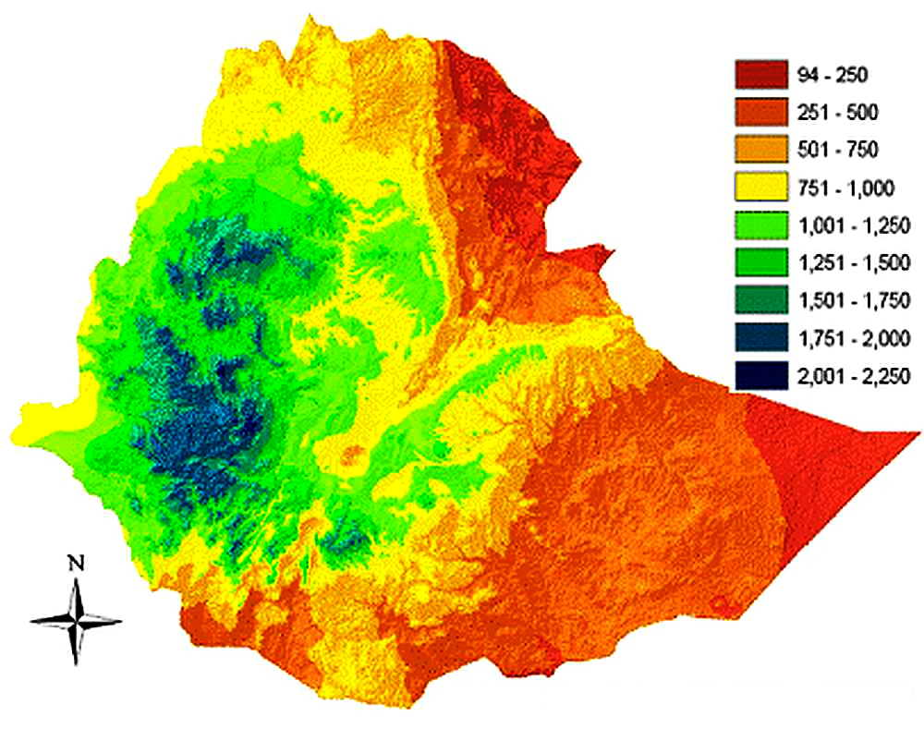
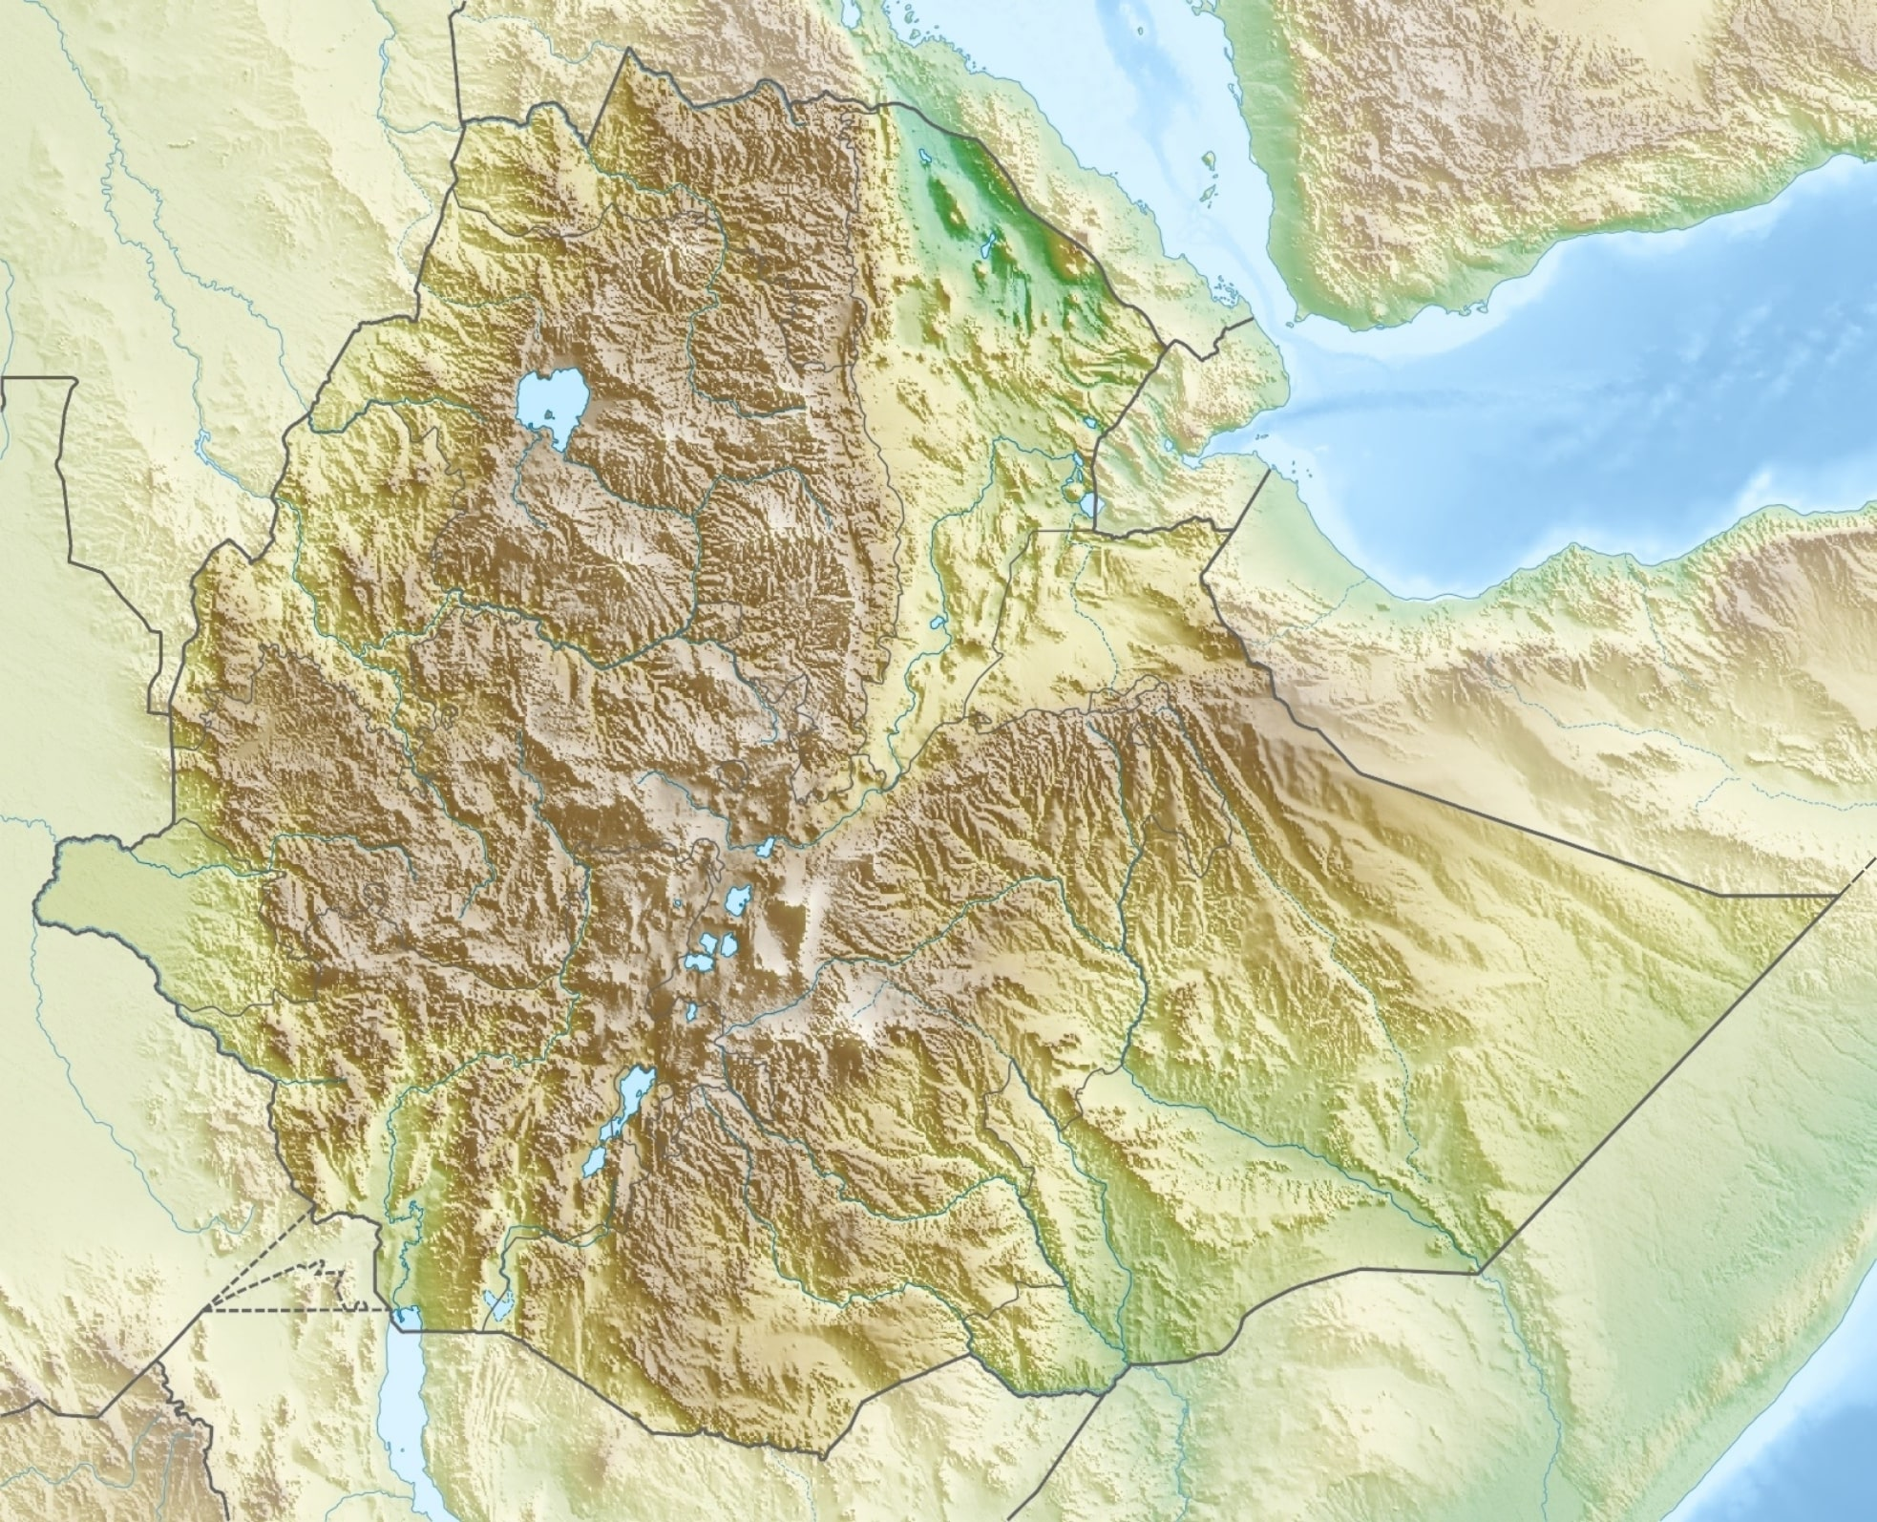
Rainfall and Terrain
Rainfall Map
GERD
Ethiopia plateaus divided by the Great Rift Valley, surrounded by lowlands, steppes, or semi-desert.
Human settlement follows rainfall pattern.
Elevation and natural barriers affects climate, rainfall and cultures.
Elevation
Map
GERD

Slide 16
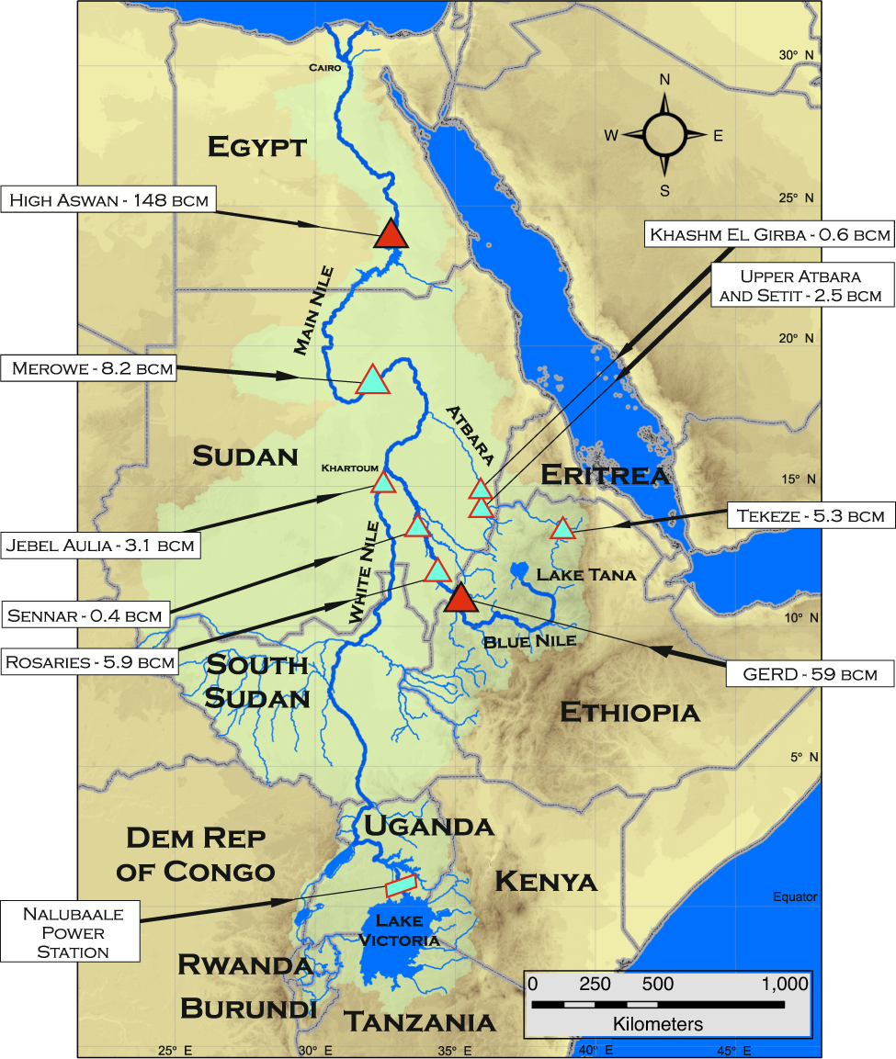
Hydrology Map
Sudan has 6 dams, Egypt 1 dam and Ethiopia 3 dams.
Egypt’s High Aswan Dam (HAD) has largest reservoir in Nile Basin and can store up to 1.71 times average annual flow of Main Nile.
Egypt’s total GDP gain from HAD is about 2.7-4.0 % from Hydroelectric power Irrigation and Transport.
Ethiopia GDP gain from GERD expected to contribute more than 1.5% to GDP.
Egypt Society is homogenous Arabs and Ethiopia has more than 13 ethnic groups.
Egypt has about 12 percent less population but her GDP is about 4 times of Ethiopia GDP.
Egypt produces more than 12 times the electric power Ethiopia produces.
Egypt consumes 7 times the amount of water per capita Ethiopia consumes.

Slide 17
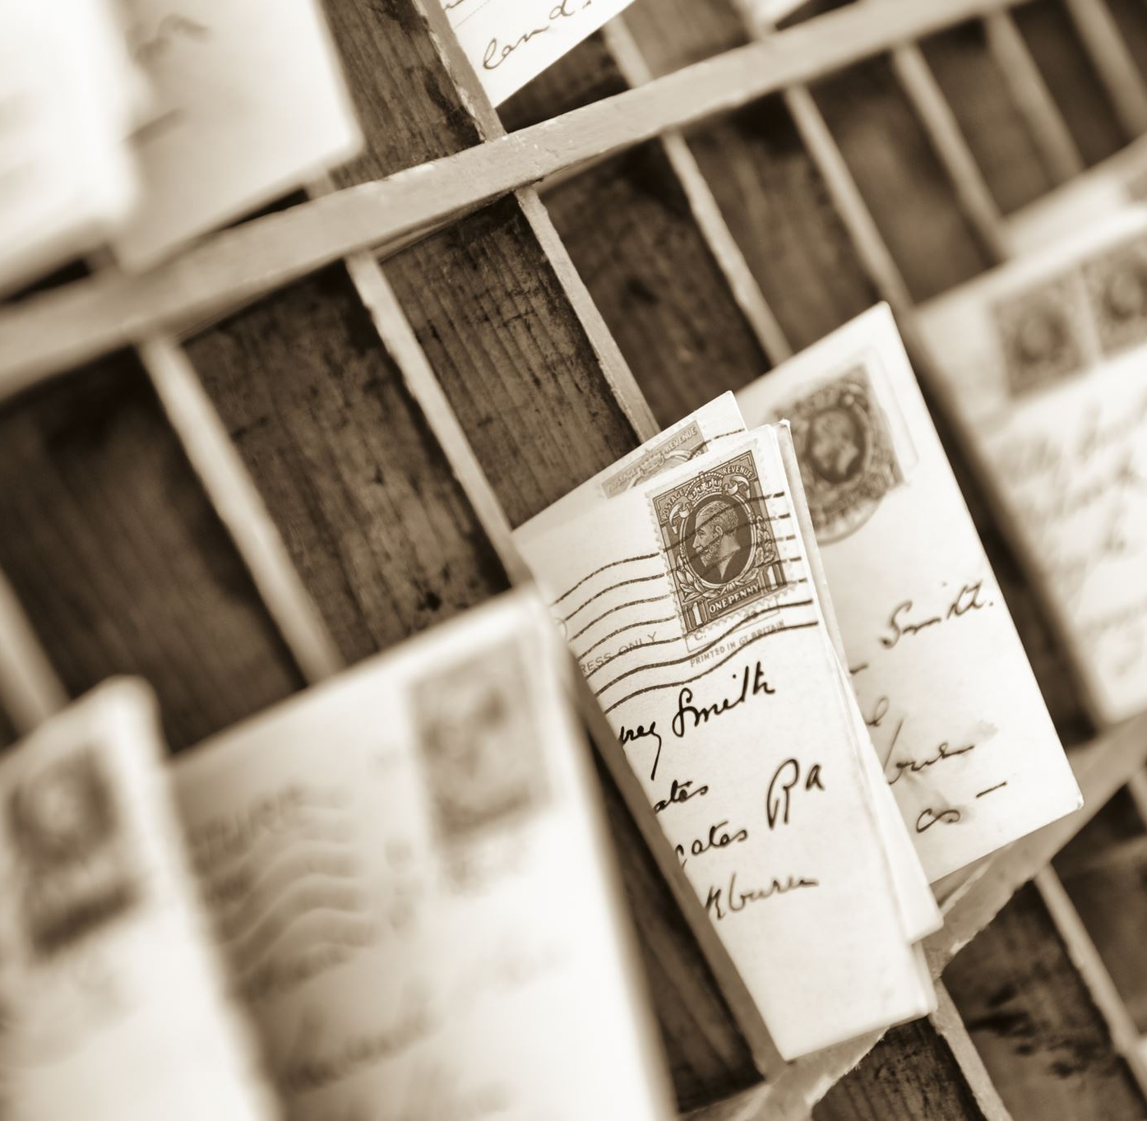
History

Slide 18
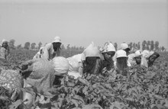
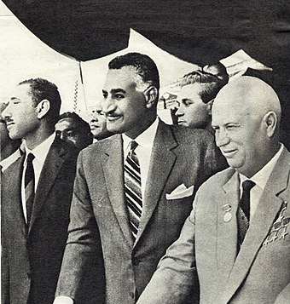
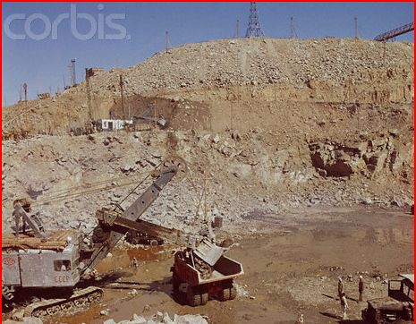
1909-1959
Colonial Agreements protected cotton crops in Egypt (a)1909- Ethiopia not to build dams (b) 1929- Egypt has veto rights to any development upstream and was allocated 57 % of Nile water.
After independence, Egypt and Sudan signed a bilateral agreement in 1959, increasing Egypt’s quota to 64%.

Slide 19
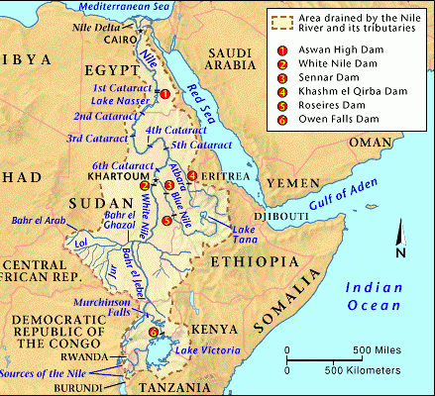
1999-2022
In 1999, Nile Basin Initiative (NBI) organization formed to develop the water resources together.
In 2010, upstream countries signed Agreement to nullify the 1929 historical water rights of Egypt and Sudan. Both countries quitted NBI.
In 2011, Ethiopia announced Grand Ethiopian Renaissance Dam construction Project when Mubarak was overthrown.
Egypt threatens war but opposition remains at the level of diplomacy and rhetoric.

Slide 20
Three Levels of Analysis using Realism Lens

Slide 21
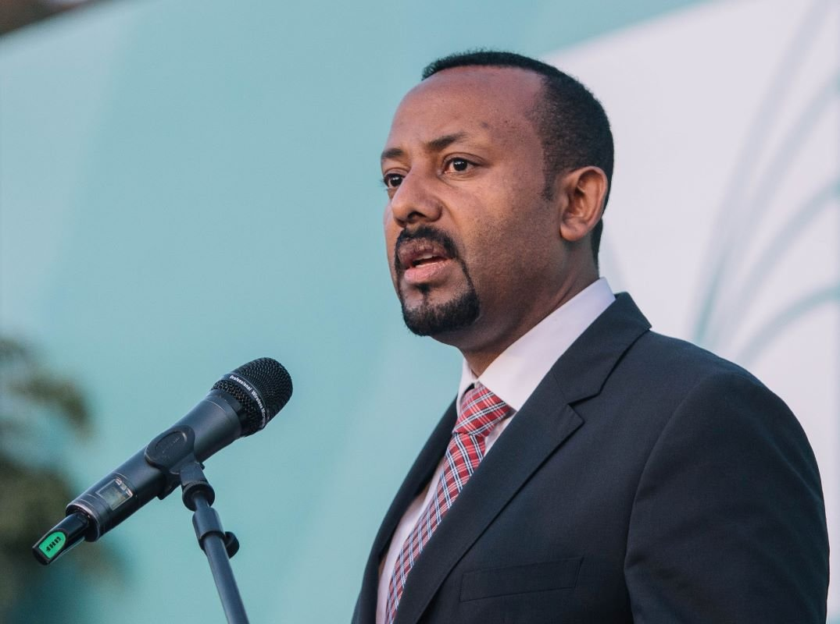
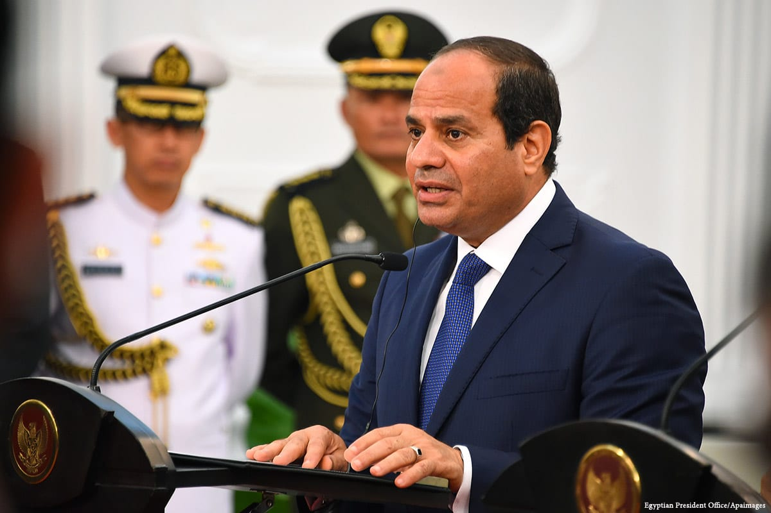
Prime Minister Abiy Ahmed, face civil war against Tigray People’s Liberation Front for nearly 2 years. Won election during war. His legitimacy is weak.
Not reaching agreement avails avenue for him to rally support of his people to fight the Neo-Colonial power.
President Abdul Fattah Sisi effectively has full control but l Turnout for last presidential election was only 40 percent.
An agreement risks him being portrayed as giving in to Ethiopians who are “stealing water” from Egypt. Future water crisis could also be blamed on GERD.

Slide 22
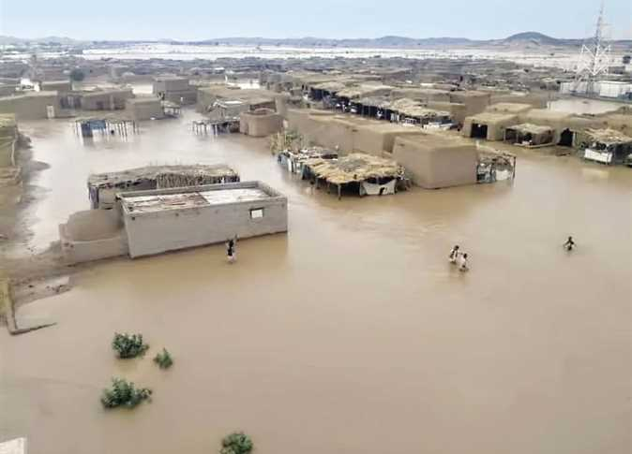
For Ethiopia, GERD lifts country out of poverty to prosperity. Ethiopians funded dam through bonds and private donations.
She pursues construction unilaterally even risking war.
For Egypt, 1929 agreements historical water allocation are binding. But. GERD threat is not existential. She is more unlikely to start war after filing started.
Opposition remains at the level of diplomacy and rhetoric.

Slide 23
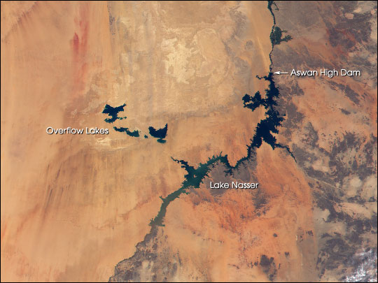
Egypt Mitigating Measures
Already filled to HAD Reservoir to of 1.71 times annual flow with overflow to lakes in the desert.
84 Desalination plants with 14 more under construction.

Slide 24
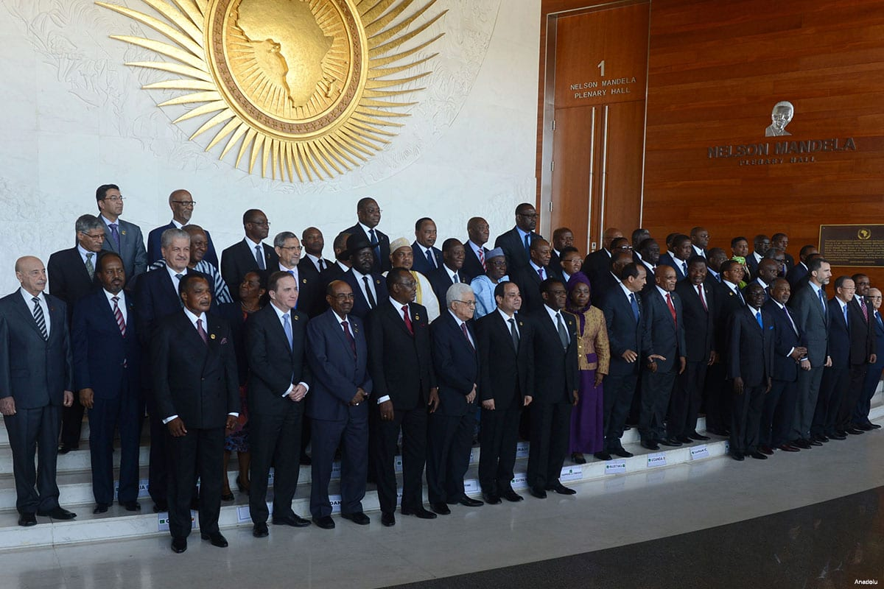
Sudan and Nile River Basin Countries
This Photo by Unknown Author is licensed under CC BY-SA-NC
Sudan doesn’t want to be seen as giving up their historic water rights.
Upstream countries support Ethiopia in breaking the water monopoly and continue to push for collective development of Nile

Slide 25
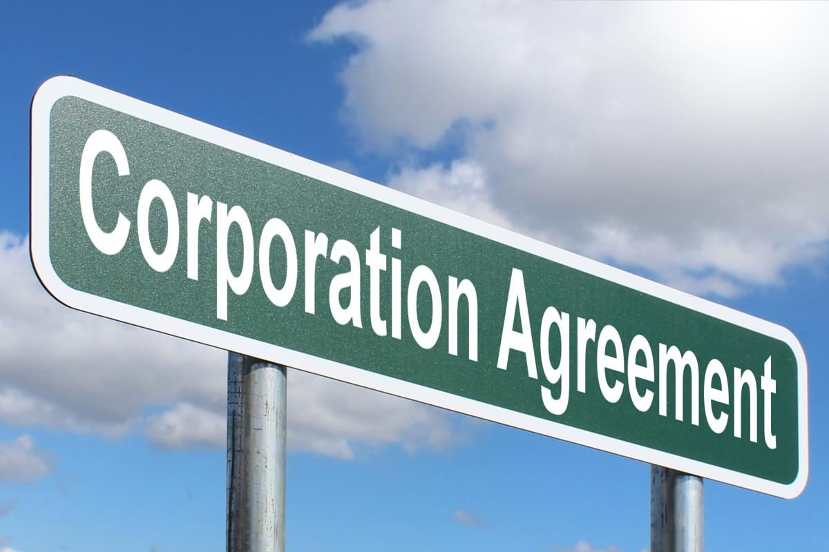
This Photo by Unknown Author is licensed under CC BY-SA
Transboundary Corporation
Corporation can start at different levels and Dam operators must coordinate their operations.
States can emulate success of Development of Senegal River Basin.
Replace apportionment of “water” with “benefits” like electricity and flood avoidance.

Slide 26
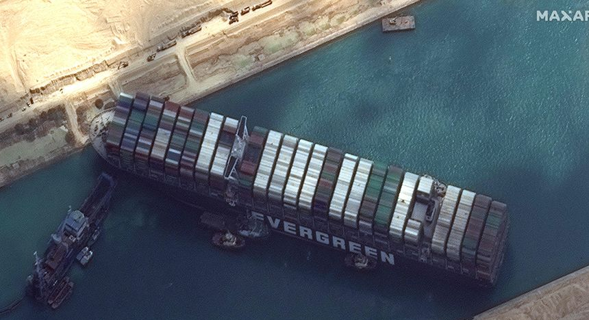
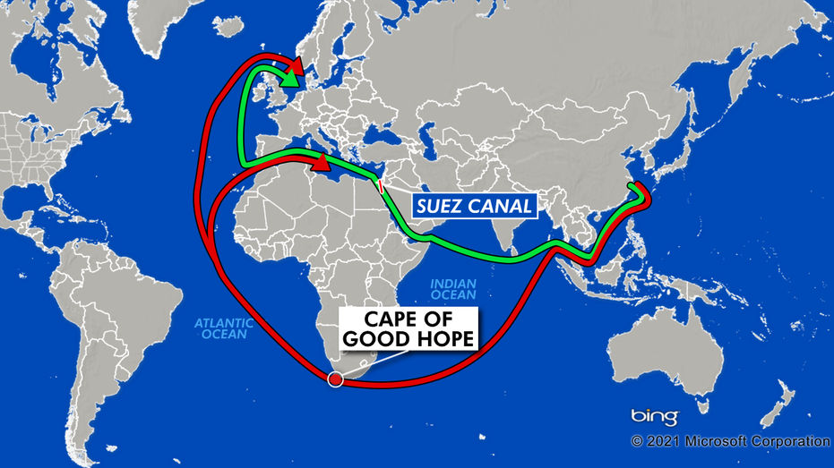
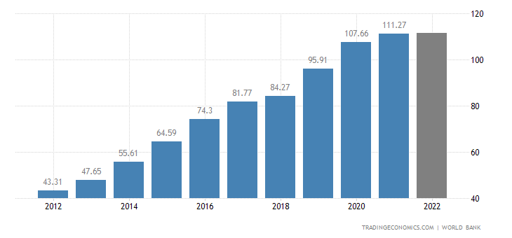
International Players
Egypt controls most critical maritime chokepoint - the Suez Canal.
Ethiopia is one of the world’s fastest growing in recent years, 6 to 12 %
Key players would want to have friendly ties with both states to serve their own national interests.

Slide 27
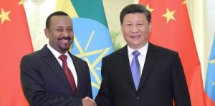
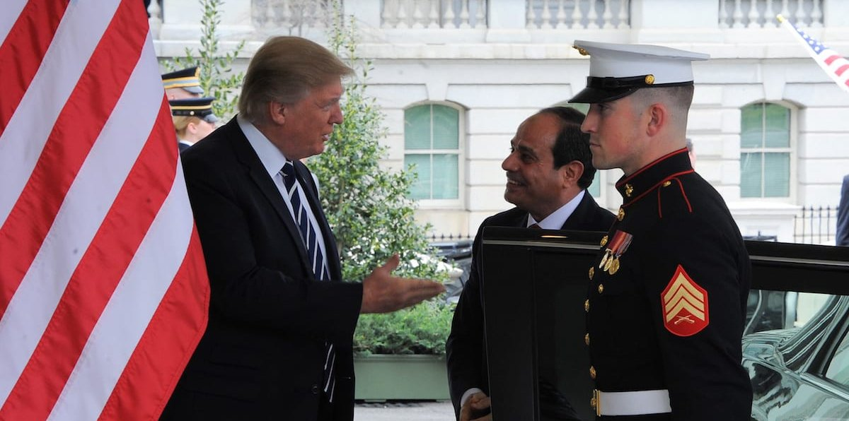
China is major investor in Egypt and Ethiopia but she does not want to intervene.
She has no water-sharing agreement with any downstream countries of Mekong, Indus and Ganges.
United States provided over $3.5 billion aid to Egypt and has less vested interests in Ethiopia.
U.S. sided with Egypt for negotiation under Trump in 2020 and froze the aid to Ethiopia.

Slide 28
Conclusions

Slide 29
Ethiopians are ready to go to war for GERD and Egypt, not ready.
Leaders at both sides would not desire to reach an agreement due to domestics politics.
International and regional players adopted different approaches based on their national interests. With the filling of the dam, they would assess that Egypt would not start a water conflict.

Slide 30
References
Staff, R. (2021, April 7). Egypt’s Sisi warns of potential for conflict over Ethiopian dam. Reuters. https://www.reuters.com/article/us-ethiopia-dam-egypt-sudan-idUSKBN2BU2C3
Reuters. (2021, September 16). U.N. council urges Egypt, Ethiopia, Sudan to restart dam talks. Reuters. https://www.reuters.com/world/africa/un-council-urges-egypt-ethiopia-sudan-restart-dam-talks-2021-09-15/
Welcome to Nile Basin Initiative (NBI). (n.d.). Www.nilebasin.org. https://www.nilebasin.org/
African countries sign Nile water-sharing treaty. (2010, May 14). France 24. https://www.france24.com/en/20100514-african-countries-sign-water-sharing-treaty-river-nile-Egypt-Sudan
Agreement on Declaration of Principles between The Arab Republic of Egypt, The Federal Democratic Republic of Ethiopia And The Republic of the Sudan On The Grand Ethiopian Renaissance Dam Project (GERDP) Preamble. (n.d.). https://www.internationalwaterlaw.org/documents/regionaldocs/Final_Nile_Agreement_23_March_2015.pdf
Water consumption Statistics - Worldometers. (2015). Worldometers.info. https://www.worldometers.info/water/
‌
Electricity production capacity by country, around the world. (n.d.). TheGlobalEconomy.com. https://www.theglobaleconomy.com/rankings/electricity_production_capacity/

Slide 31
References
‌Strzepek, K. M., Yohe, G. W., Tol, R. S. J., & Rosegrant, M. W. (2008). The value of the high Aswan Dam to the Egyptian economy. Ecological Economics, 66(1), 117–126. https://doi.org/10.1016/j.ecolecon.2007.08.019
Wheeler, K. G., Basheer, M., Mekonnen, Z. T., Eltoum, S. O., Mersha, A., Abdo, G. M., Zagona, E. A., Hall, J. W., & Dadson, S. J. (2016). Cooperative filling approaches for the Grand Ethiopian Renaissance Dam. Water International, 41(4), 611–634. https://doi.org/10.1080/02508060.2016.1177698
Negash, T., Ferede, T., & Diriba, G. (2020). The economic significance of the Grand Ethiopian Renaissance Dam (GERD) to the Eastern Nile Economies: A CGE modeling approach. https://eea-et.org/wp-content/uploads/2021/01/Policy-Working-Paper-05-2020.pdf
Filling the Grand Ethiopian Renaissance Dam is unlikely to…. (n.d.). Oxford Martin School. Retrieved October 28, 2022, from https://www.oxfordmartin.ox.ac.uk/news/gerd-drought-planning-is-essential/
Setting the record straight on the impacts of the Grand Ethiopian…. (n.d.). Oxford Martin School. https://www.oxfordmartin.ox.ac.uk/blog/setting-the-record-straight-on-the-gerd/

Slide 32
References
Egypt expands water desalination projects as Nile dam talks hit new snag - Al-Monitor: Independent, trusted coverage of the Middle East. (n.d.). Www.al-Monitor.com. https://www.al-monitor.com/originals/2022/06/egypt-expands-water-desalination-projects-nile-dam-talks-hit-new-snag#:~:text=There%20are%20currently%2082%20desalination
Egypt expands water desalination projects as Nile dam talks hit new snag - Al-Monitor: The Pulse of the Middle East. (n.d.). Www.al-Monitor.com. https://www.al-monitor.com/originals/2022/06/egypt-expands-water-desalination-projects-nile-dam-talks-hit-new-snag
The Senegal River Basin Development Organization (OMVS) Sets the Standard for Cooperative Management of a Transboundary River Basin. (n.d.). Blogs.worldbank.org. https://blogs.worldbank.org/nasikiliza/setting-example-cooperative-management-transboundary-water-resources-west-africa
Egypt president could rule until 2030 as constitutional changes backed. (2019, April 24). BBC News. https://www.bbc.com/news/world-middle-east-48035512
‌
Egyptian warning over Ethiopia Nile dam. (2013, June 10). BBC News. https://www.bbc.com/news/world-africa-22850124
Water Scarcity in Egypt. (n.d.). Www.unicef.org. https://www.unicef.org/egypt/documents/water-scarcity-egypt
Egypt: Background and U.S. Relations. (n.d.). https://sgp.fas.org/crs/mideast/RL33003.pdf
Gorvett, J. (2021, July 31). China in the middle of Nile mega-dam feud. Asia Times. https://asiatimes.com/2021/07/china-in-the-middle-of-nile-mega-dam-feud/
Kahsay, T. N., Kuik, O., Brouwer, R., & van der Zaag, P. (2015). Estimation of the transboundary economic impacts of the Grand Ethiopia Renaissance Dam: A computable general equilibrium analysis. Water Resources and Economics, 10, 14–30. https://doi.org/10.1016/j.wre.2015.02.003

Slide 33
References
Egypt: Background and U.S. Relations. (n.d.). https://sgp.fas.org/crs/mideast/RL33003.pdf
Gorvett, J. (2021, July 31). China in the middle of Nile mega-dam feud. Asia Times. https://asiatimes.com/2021/07/china-in-the-middle-of-nile-mega-dam-feud/
Kahsay, T. N., Kuik, O., Brouwer, R., & van der Zaag, P. (2015). Estimation of the transboundary economic impacts of the Grand Ethiopia Renaissance Dam: A computable general equilibrium analysis. Water Resources and Economics, 10, 14–30. https://doi.org/10.1016/j.wre.2015.02.003

