Slide 1
CULTURAL APPROACH
José and Terry

Slide 2
OUTLINE
Introduction
Theory (10 minutes)
Survey Results (15 minutes)
Canadian Political Culture (10 minutes)
Political Culture Around the World (or at least around the group)
Preparation (10 minutes)
Discussion (30 minutes)
Conclusion (5 minutes)
Instructor Wrap-up (10 minutes)

Slide 3
THEORY (1/5)
The Political culture of the State – according to Almond, political culture is a collection of attitudes, values, feelings, information and political skills among its citizens. Similar to the way people’s attitudes are affected by their behavior, the political culture affects the behavior of its citizens and leaders in the political system.
The Political Culture should be examined through three levels:
The system level
The policy level
The process level

Slide 4
THEORY (2/5)
THREE ASPECTS THE POLITICAL CULTURE
SYSTEM LEVEL
PRIDE IN NATION
GOVERNMENT POLICY PRIORITIES
PERCEPTIONS OF POLITICAL RIGHTS
POLICY LEVEL
LEGITIMACY OF GOVERNMENT
NATIONAL IDENTITY
ROLE OF CITIZENS
PROCESS LEVEL
ROLE OF GOVERNMENT

Slide 5
THEORY (3/5) The System Level
The System level examines the degree of legitimacy attributed by citizens to the fundamental values that make the political system. When citizens believe they must obey the rules, the legitimacy of the fundamental values and governance is high. When citizens see no reason to obey the rules or obey only out of fear, the legitimacy of government and fundamental values is low.
The source of legitimacy by virtue of tradition, ideology, policy or civic participation has important implications for the efficiency and stability of the political system

Slide 6
THEORY (4/5) The Process Level
The process level examines the extent of political participation of citizens in political processes in the country. The political involvement is measured according to the state division of citizens into three groups:
Participants - citizens that are involved and understand politics, can require political demands and divide their support among various political leaders.
Citizens-natives - citizens who humbly obey government officials and law, but do not vote and involve themselves in politics.
Narrow-minded citizens are only involved in family and community life and therefore are hardly aware of government and politics.

Slide 7
THEORY (5/5) The Policy level
The Policy level examines the level of political support that citizens provide to their governance. For that- they need to possess the understanding of the important issues for citizens of the their country and how the state should implement these issues.
There are different political views among different societies: some prefer private property, social mobility and materialism; others attach importance to acquire common, minimum standards and equality for all. There are societies that value more welfare and security, while others prefer more freedom and justice.

Slide 8
ONTOLOGY
EPISTEMOLOGY

Slide 9
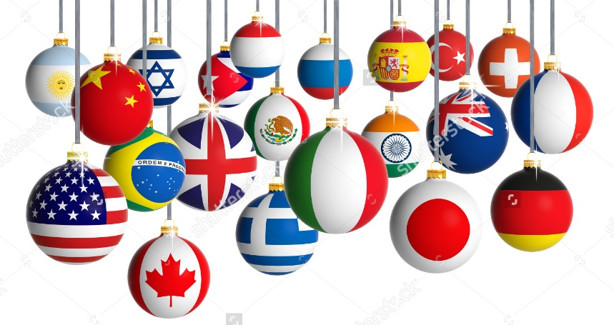
SURVEY RESULTS (Students Class 44th) Tool of Research – Google Forms
DIFFERENT COUNTRIES
INFLUENCE OF PERCEPTION

Slide 10
SURVEY RESULTS (Students Class 44th) Tool of Research – Google Forms
DIFFERENTS PERCEPTIONS

Slide 11
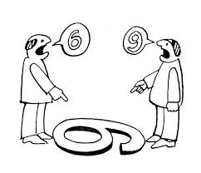
SURVEY RESULTS (Students Class 44th) Tool of Research – Google Forms
DIFFERENTS PERCEPTIONS

Slide 12
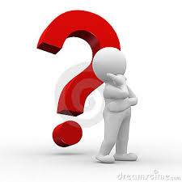
SURVEY RESULTS (Students Class 44th) Tool of Research – Google Forms
DIFFERENTS PERCEPTIONS

Slide 13
SURVEY RESULTS (Students Class 44th) Tool of Research – Google Forms

Slide 14
SURVEY RESULTS

Slide 15
SURVEY RESULTS

Slide 16
CANADIAN POLITICAL CULTURE
Canada as a bi-national state
English Canada
French Canada
Increasing relevance of people with different origins
How does the native population fit into the Canadian political landscape ?

Slide 17
CANADIAN POLITICAL CULTURE System Level
Bi-nationalism (French v. English)
Increasing patriotism
National v. provincial
National Identity – evolving
Decreasing confidence in government

Slide 18
CANADIAN POLITICAL CULTURE Process Level
Majority Rule
The large number takes precedence over the smaller number.
Minority rights, however, are protected.
Charter rights
Women
Visible minorities
Aboriginals
Political Equality (One person, one vote)
Political Freedom (Charter rights)
Conscience & religion
Thought, belief, opinion, expression, freedom of the press.
Peaceful assembly
Freedom of association

Slide 19
CANADIAN POLITICAL CULTURE Policy Level
Greater role for government in Quebec
Daycare
Automobile insurance
Pensions
Legal systems
English common law
French civil code

Slide 20
CANADIAN POLITICAL CULTURE Current State
Fragmented (beyond bi-national)
Regional and Provincial subcultures
Ethnic subcultures
Class subcultures
Lower confidence in institutions
Election reform

Slide 21
POLITICAL CULTURE AROUND THE WORLD
Pair up
Israel (Guy and Gilad)
United States (Don and Jim)
India (Raj)
Singapore (Wei How and Yael)
Germany (Markus)
Consider the three levels (10 minutes)
Discussion (30 minutes)

Slide 22
CONCLUSION
Criticism
Subjective
Opinion-based
Inadequate differentiation

Slide 23
INSTRUCTOR WRAP-UP
ORIENTATION

