Slide 1
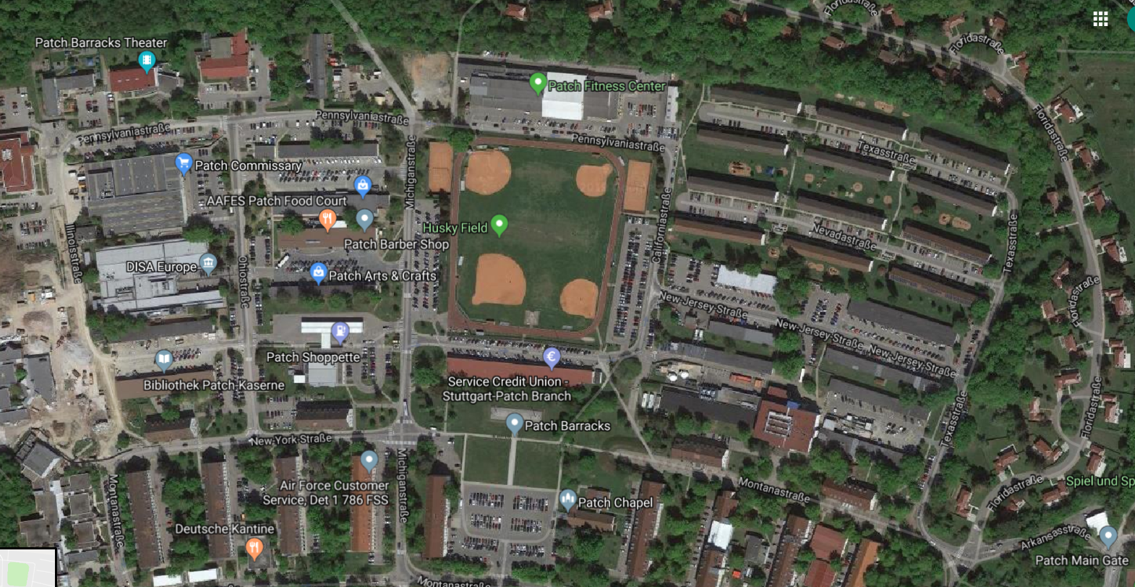
Community Center
Main Gate

