Slide 1
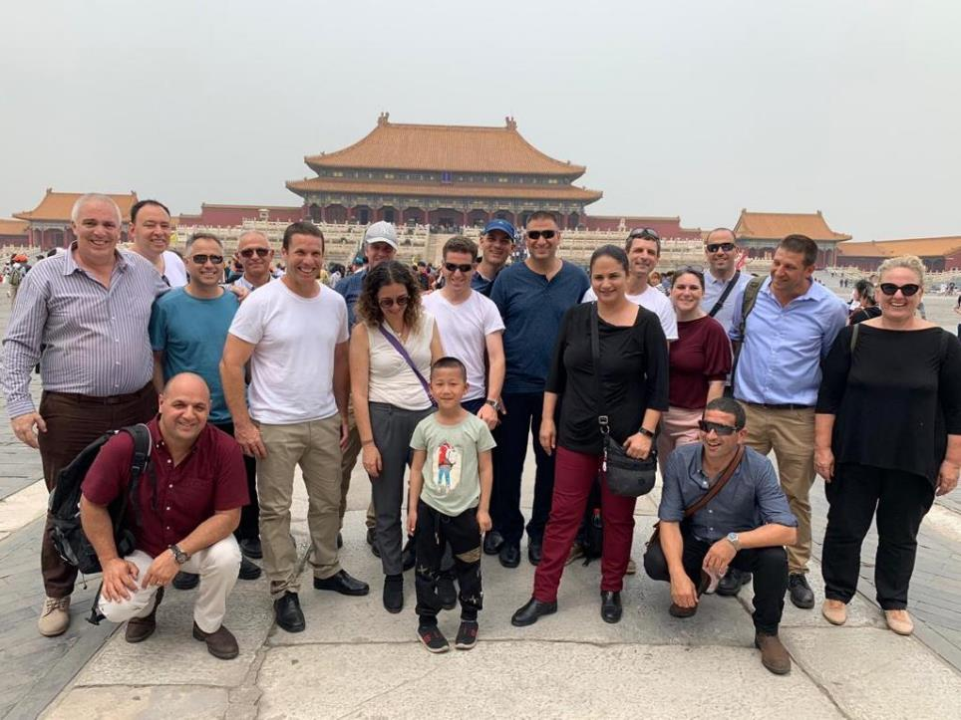
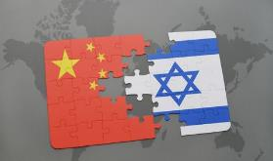
East Tour - China
Processing of 46th Class tour

Slide 2
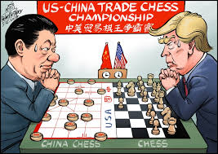
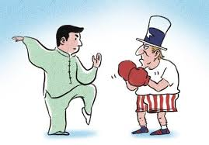
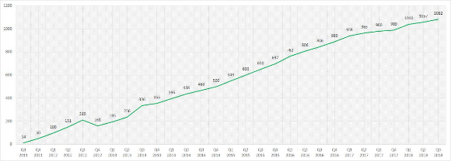
What is China?
Ma Jong VS Chess
Boxing VS Tai Chi

Slide 3
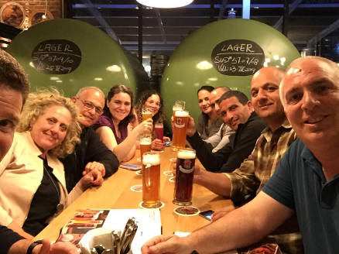
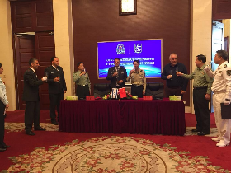
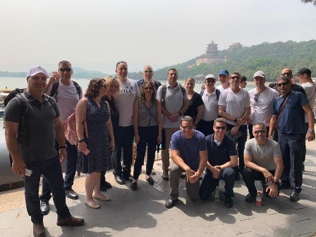
Tour Objectives
Recognizing China as a leading player in the international system and exploring its impact on dimensions of Israeli national security
Knowing Chinese culture and the concept of the other (trying to crack the Chinese riddle)
An experiential tour of the depths of Chinese culture (in Israel and China)
מחזור מו'

Slide 4
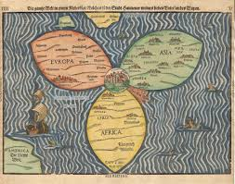
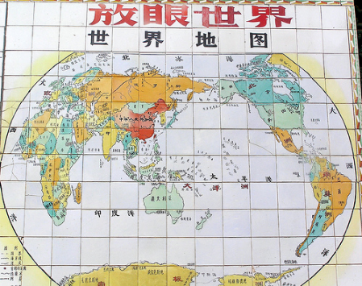
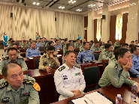
The strategic culture and the otherness of the other
Together China and Israel have about 1.5 billion people and a culture of 5,000 years
A civilizational state - vast territory, history, different peoples
מחזור מו'

Slide 5
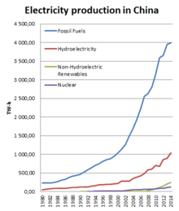
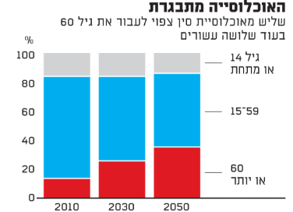
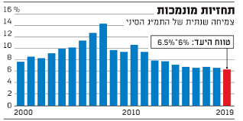
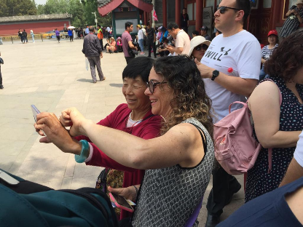
The strategic culture and the otherness of the other
China looks firstly inwards and only later outwards- the government will fall from within
Population aging
Dependence on energy
Preserving growth
מחזור מו'

Slide 6
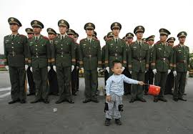
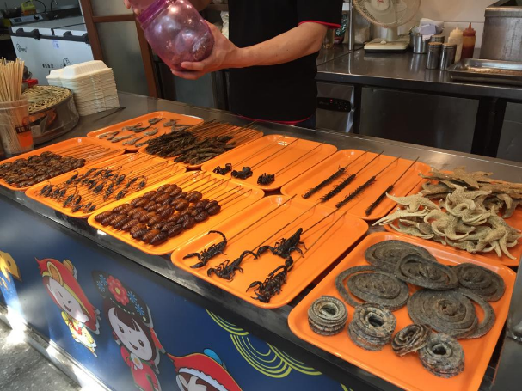
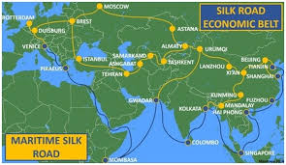
The strategic culture and the otherness of the other
Stability of government
Food, clean water
Flow of raw materials
מחזור מו'

Slide 7
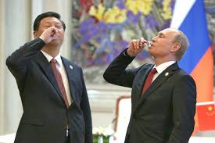
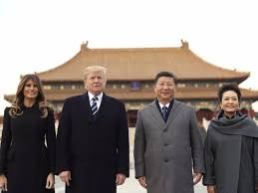
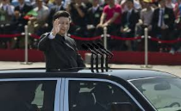
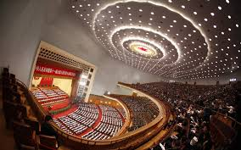
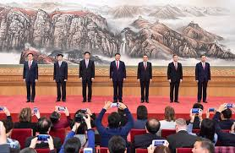
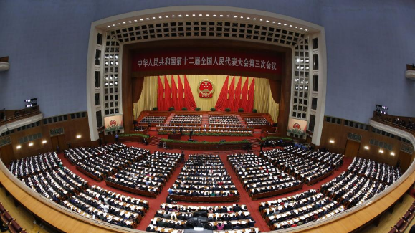
Structure of the government
The ruler of China today (and probably many more years to come), is Shi Jing Ping
Party ruling (Communist Party) - 7 senior party leaders make decisions - 2987 MPs
מחזור מו'

Slide 8
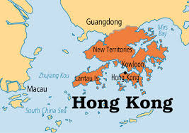
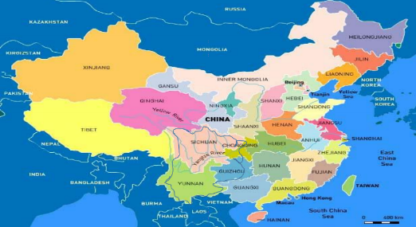
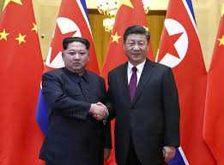
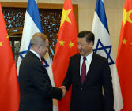
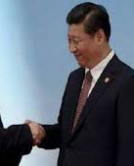
The structure of the government
23 Provincial governments (and Taiwan) reporting to the central government (one China)
The central government in Beijing is formulating and implementing the national, domestic and foreign strategy
מחזור מו'

Slide 9
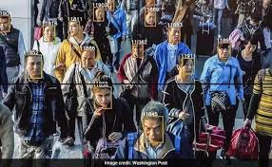
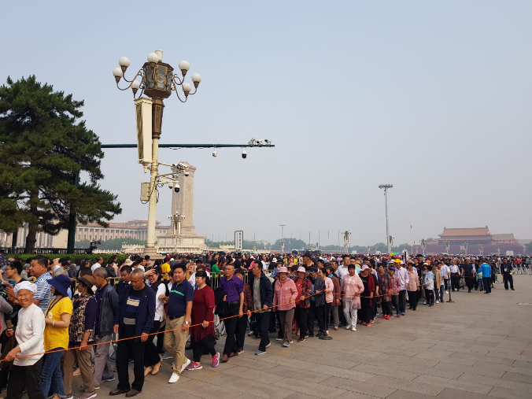
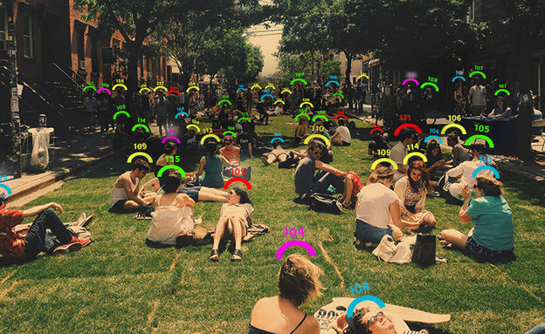
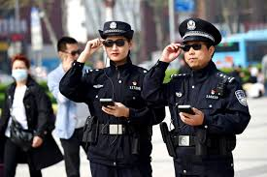
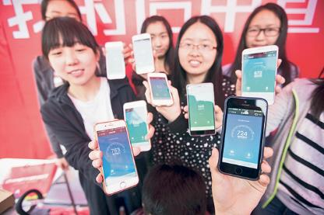
Structure of the government
Civil Rights in China

Slide 10
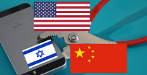
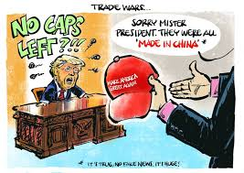
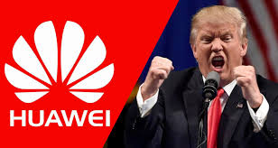
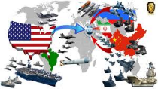
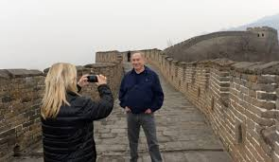
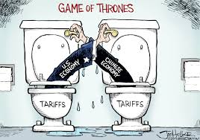
Major points in the triangle relationship
A central and significant triangle - the United States as influencing Israel-China relations
US interests and pressure on Israel
מחזור מו'

Slide 11
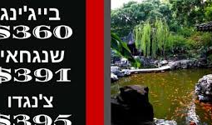
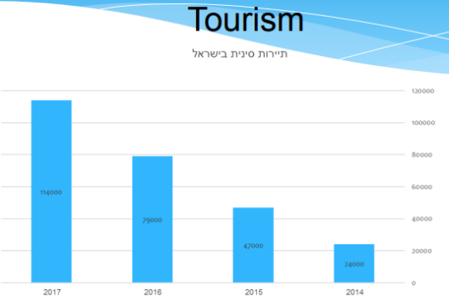
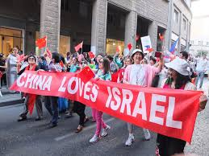
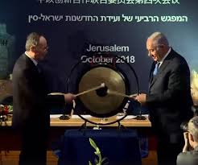
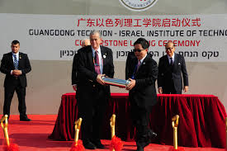
Trends of other collaborations
Significant increase in direct flight routes - Israel China (4 lines, over 30 flights per week)
Joint Innovation Conference JCIC - 30 cooperation agreements in various fields
מחזור מו'

Slide 12
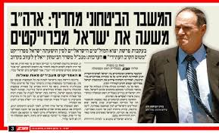
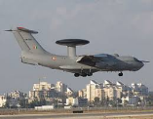
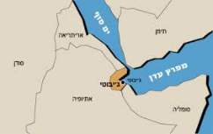
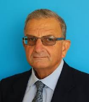
The impact of the Chinese penetration on security cooperation
The Falcon and Harpy deals erased a future chance for genuine security cooperation
Investment in infrastructure - risk or opportunity (chinaphobes or chainapheles)
מחזור מו'

Slide 13
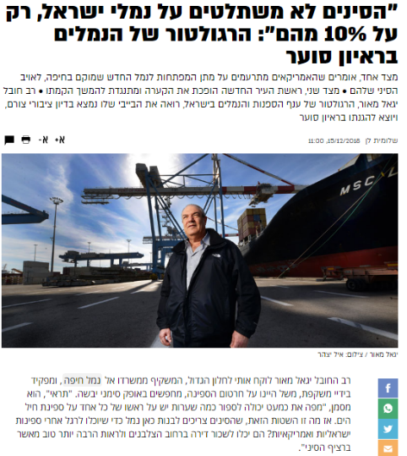
20 meters from the Kirya: The policeman of the world is trying to stop the Chinese in Israel
The Chinese are not taking over Israeli ports, only 10% of them
The ports should not be given to the Chineses

Slide 15
Economic Involvement - Trends
The “Belt and Road project”- open and covert strategy
Israel and the world countries from the Chinese point of view (Israel and China are not BFF)
מחזור מו'

Slide 16
General insights - in the Chinese context
A deep sense of otherness- makes it difficult to understand Chinese strategy with Western eyes
China does not see itself as a superpower (still developing)

Slide 17
General insights - in the Chinese context
A clear vision and a communist rule - is this the only way to move China forward?
The absence of a clear policy on the part of Israel (each government ministry works according to interests)

Slide 18
Personal insights from the tour preparation
A quality and diverse learning process (INSS, China Cultural Center)
Busy days combined with lectures and experiences

Slide 19
Personal insights from the tour preparation
A huge advantage for a small, high-quality group
China should come to our plenum!

