Slide 1
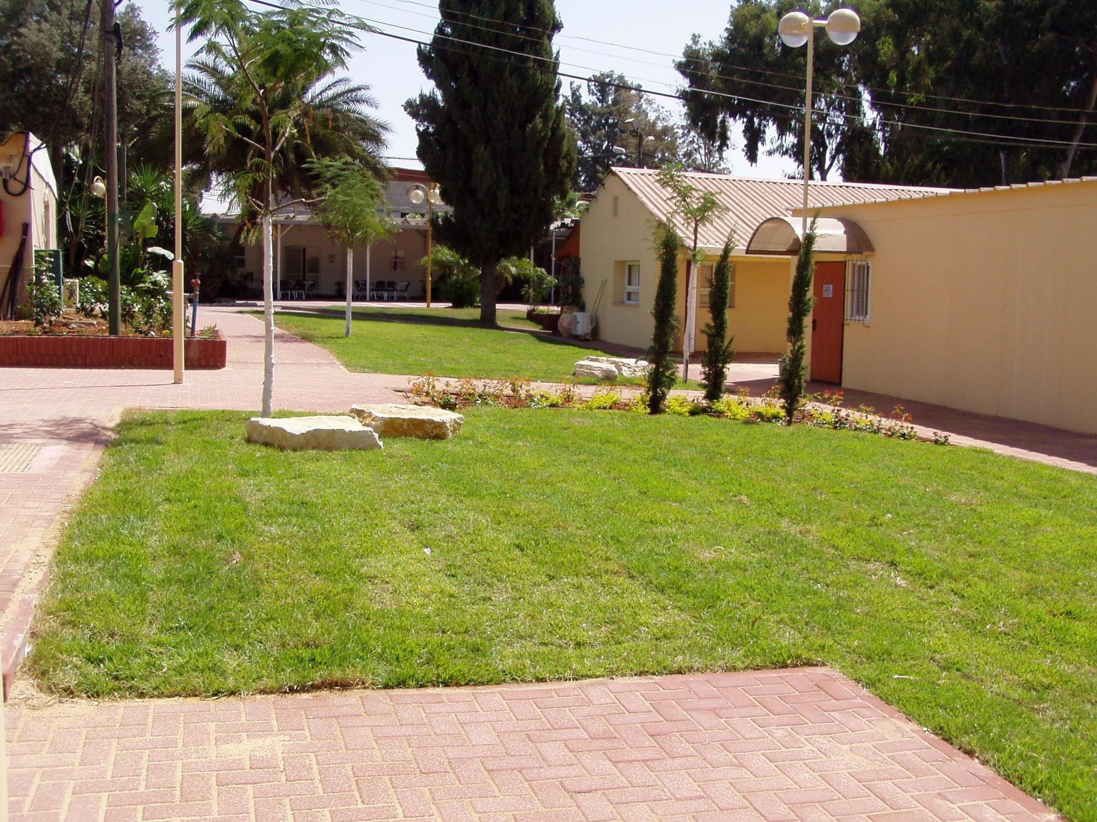
Israel National Defense College
46th Class

Slide 2
What will we talk about?
Summarizing the infrastructure and core seasons
Looking forward
Emphases

Slide 3
The Goals of the Academic Year
Learning and developing thinking and analytical tools, understanding processes and implementing them on the strategic level, in a way that will allow dealing with complex challenges in the field of national security
Acquainting knowledge – on Israeli national security and its scope – by learning and researching the components of national security
Analyzing the affinities between the different layers of national security

Slide 4
Learning Principles
An interdisciplinary program
Diversity in methods of learning – simulations, seminars, etc.
Diversity in the learning spaces – frontal, plenum, teams, etc.
The great diversity between the participants as a resource – partnership
Flexibility and relevancy to the changing reality
Participants leading some of the fields of study
A social network as a component of power
Tolerance, open-mind, sensitivity and intellectual courage

Slide 5
Structural Logic of the Academic Year - INDC 46th Class
Basic Concepts
Forefathers
Infrastructure Season

Slide 6
Structural Logic of the Academic Year - INDC 46th Class
Core Season
Regional National Security Tours and First Strategic Experience
Core Season
Middle East
Political and Diplomatic
Thinking
Israeli Society
Israeli Economy
Strategic
National Security
Thought
Infrastructure Season

Slide 7
Structural Logic of the Academic Year - INDC 46th Class
Third Strategic Experience – East Tour
And National Security Tours Abroad
Advanced Season
Mil-Socio
Integrative Deepening
Global Economy
Public Corruption
Media Seminar
Intl. Law Seminar
& Focused Tours
Cyber
Second Strategic Experience-
Political-Security Simulation
Regional National Security Tours and First Strategic Experience
Core Season
Middle East
Political and Diplomatic
Thinking
Israeli Economy
Israeli Society
National Security
Strategic
Thought
Infrastructure Season

Slide 8
INDC Curriculum Studies - 46th Class
Jul
Jun
May
Apr
Mar
Feb
Jan
Dec
Nov
Oct
Sept
Public Business Strategy
Design Approach
Strategy
National Defense
International Affairs and Diplomacy
Economy
Society
Conceptual Infrastructure and Zionist Base Values
Political-Security Simulation
Experience 1
Strategic Thinking
Strategic Thought
Public Security Tour
Military Intelligence Tour
Mossad Tour
Shin Bet Tour
Jordan Tour
National Defense
Middle East
Cyber Workshop
East Tour
NATO and EU Tour
MFA Tour
International Affairs and Diplomacy
USA Tour
Infrastructure Tour
Jerusalem Tour
South Tour
South Tour
Haifa Tour
North Tour
State Economy Seminar
Global Economy Seminar
Economy Tour
Events Analysis
Israeli Economy
Military-Societal Seminar
Society Tour
Israeli Society
Military Colleges Conference
Ben Gurion Seminar
The Founding Fathers
Government Corruption Seminar
Multi-disciplinary Seminar
Public Law
Geographical Aspects of National Defense
Basic Concepts
of National Defense
Approaches and Schools of Thought

Slide 9
Academic Curriculum (41 Hours Per Week)
Advanced School Season
Core Season
Foundations Season
Course | Hours/Week
Course and Tour of the USA | 3
East Tour | 3
Elective Workshops | 2
In Total | 8
Course | Hours/Week
Geographical Aspects of National Defense | 4
Approaches and Schools of Thought | 4
Policy and Diplomacy | 2
Israeli Society | 4
Israeli Economy | 2
Public Law | 4
In Total | 20
Course | Hours/Week
Basic Concepts in National Security | 4
In Total | 4
Final Paper
Strategic Thinking (5)
National Defense Tours (4)

Slide 10
Assignment Layout
Course / assignment | Task type | Evaluation | Date of Submission
 |  |  | September | October | November | December | January | February | March | April | May | June | July
Opening assignment | Personal assignment | Evaluation | 3.9
Basic Concepts of National Defense | Personal assignment | Grade |  | 25.10
Geographical Aspects of National Defense | Working in pairs | Grade |  |  |  |  | 24.1 |  | 17.3
National Defense Tours | Teamwork | Evaluation |  | North | South | Judea and Samaria | Jerusalem
Approaches and Schools of Thought | Test | Grade |  |  |  |  | 7.1
Public Law | Personal assignment | Grade |  |  |  |  | 24.1 |  | 17.3
Economy | Test | Grade |  |  |  |  | 23.1
Society | Personal assignment | Grade |  |  |  |  |  |  |  | 17.4
Politics and Diplomacy | Personal assignment | Grade |  |  |  |  |  | 14.2
East tour | Group work | Grade |  |  |  |  |  |  |  |  | 27.5
USA Tour | Teamwork | Grade |  |  |  |  |  |  |  |  |  |  | 3.7
Elective Workshop | Personal assignment | Grade |  |  |  |  |  |  |  | 29.4
Strategy | Personal assignment | Grade |  |  |  | 31.12 | 24.1
Strategy | Experiences | Commander's evaluation |  |  |  |  | 8-10.1 Experience 1 | 20-26.2 simulation
Final Paper | Personal assignment | Grade |  |  |  |  |  |  | 17.3 Report |  | 7.5 submission |  | 8.7 presentation

Slide 11
Important Dates
– 27.1-7.2.19 Final Paper Recess
– 3-7.3.19Europe Tour
– 21.3.19Purim Vacation
21-25.4.1 – Passover Vacation
– 8-9.5.19 Independence Day Vacation
– 12-16.5.19Tour to the East
– 9.6.19 Shavu’ot Vacation
16-24.6.19 – USA Tour
– 17.7.19 INDC Graduation Ceremony

Slide 12
Emphases
Senior friendship – Impressive dynamics
Focusing the learning break
Little assignments – mandatory in my view
Body of the paper
Organizing your time
Tours abroad – a designated meeting, but…
Advanced Season:
Integrative learning
Allows multidisciplinary learning
More significant leading by the participants
Optional topic seminars
Team versus group
Experiences
A new plenum order
Enjoy…

Slide 13
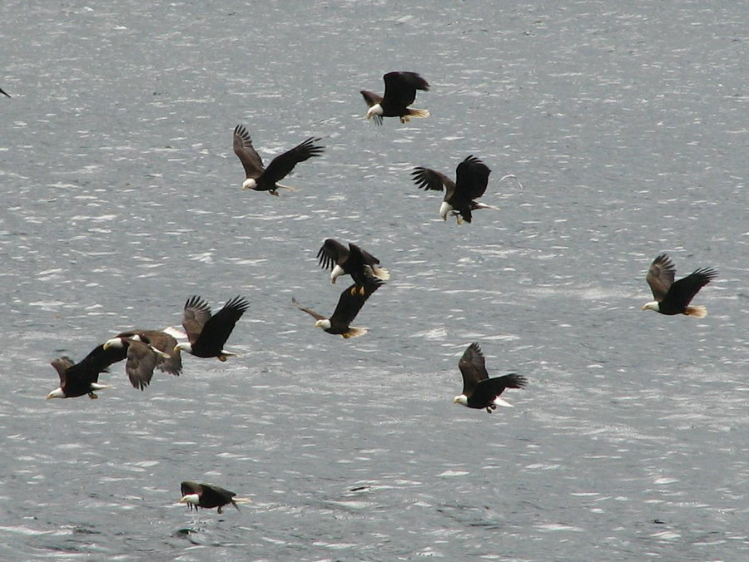
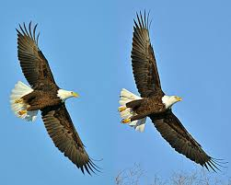
Wishing us all good luck!!

