Slide 1
Israel National Defense College
Welcome!
August 2019

Slide 2
The INDC
The Israel National Defense College is the highest institution in the country, which trains the senior staff of the IDF, the defense establishment and the government for senior command and management positions. Israeli government’s decision, 23 May, 1976

Slide 3
Goals of the Academic Year
Study and research of the components of national security.
Analysis of the interrelationships between the various components of national security.
Developing thinking tools on the strategic level which are suitable for senior officials’ dealing with challenges in the field of national security.

Slide 4
What Distinguishes the INDC?
The most prestigious and senior course in the State of Israel for the training of senior officials:
Training to rank and not to the position
The attendants
Israel's National Defense Studies Course, which enables in depth understanding by exposure to content
Integration of national security components - strategic thinking tools
Study methods tailored to the senior staff in small team simulations and experience tours and meetings with senior study members

Slide 5
Learning Fields in the INDC
Strategy
Society
Economy
National Defense
Statesmanship and Diplomacy

Slide 6
Study Seasons 1/4
The Global Season:
National Security Fundamentals in the Global Aspect – Dr. Anat Stern
Approaches and Schools of Thought: From Polis to Globalization – Dr. Doron Navot
3. The Development of Strategic Thought – Prof. Dima Adamski
4. Europe seminar and study tour

Slide 7
Seminar and Study Tour in Europe (November 10-14, 2019)
Team 1 - Germany
Team 2 - Greece
Team 3 - UK
Team 4 - Cyprus
Class Rules - Brussels (NATO, European Union)

Slide 8
Study Seasons 2/4
The Israeli Season:
Founding Fathers
Basic Topics in Israeli National Security
Strategic Thinking
Geography and National Security Tours (North, South, Judea and Samaria) – Prof. Yossi Ben-Artzi
Choice: Skills for senior officials (Dr. Michal Hershman) / decision making and planning (Prof. Shlomo Mizrahi)
Choice: Statesmanship and diplomacy / politics and Israeli society
Summarizing Political-Security Simulation

Slide 9
Study Seasons 3/4
Specialization Season:
Electives seminar: Economics/ Public Law/ Israeli Society
‘The Digital World’ (Prof. Dan Raz) and tours in the security organizations
Secondary Electives Seminar: Communications/ Cyber/ Intelligence/ Middle East (in the making)
East seminar and study tour

Slide 10
Study Seasons 4/4
Concluding Integrative Season:
Expanded US seminar and study tour
Summarizing the academic year
Final project: More information to come

Slide 11
Study Duties for INDC Graduates
Participation in all classes in the plenum, staff and university
Participation in all tours in Israel and abroad
Assignments in courses and tours
Submitting a research project
The studies also make an undergraduate degree in political science in national security and strategy studies.

Slide 12
Participant’s Composition
Military
Security Organizations
Civil Organizations
Internationals

Slide 13
47th Class - 39 Participants
Quantity and Organizational Affiliation
17 IDF officers
3 Israeli Police
3 Prime Minister’s office
2 Ministry of Foreign Affairs
1 Electrical Company
1 Finance Ministry
1 Bank of Israel
1 Israel Lands Administration
1 Israel Atomic Energy Commission
2 Ministry of Defense
1 Ministry of Diaspora Affairs
International Officers
2 USA
1 Italy
1 Singapore
1 India
1 Germany

Slide 14
Principles of Division into Teams
Distribute participants from the same organization between teams
Two teams with international participants
Heterogeneous teams:
Military people
Civilians
Roles / Practice Area
Gender

Slide 15
Division of Teams
Team 4 - Avi Almog | Team 3 - Yehuda Yochananof | Team 2 - Amir Maimon | Team 1 - Eran Kamin
Shlomo Toledano | Moshe Edri | Randal Allan | Michael Smith
Shahar Batz | Roman Goffman | Lars Maurischat | Davide Salreno
Aviad Atia | Amir Sagi | Nitin Kapoor | Wong Kiohng Seng
Amit Yamin | Guy Goldfarb | Zvika Hasid | Bar Chechek
Michal Mstey | Idan Katz | Gal Shekel | Simona Halperin
Shlomi Ben Moha | Avi Keinan | Ido Mizrahi | Yossi Mazliah
Sima Spitzer | Nitza Rogozinsky | Zvi Lekah | Nadav Turgeman
Benjamin De Levy | Udi Sheila | Amichai Levin | Harel Sharabi
Ofir Livius | Heli Contante | Noorit Kadosh | Ram Erez
 |  |  | Haim Malki

Slide 16
Participants’ Roles
Class presidency
Note taker
Photographer
Treasurer

Slide 17
English Lessons
Phone lesson
Private lesson - Berlitz - in the residential area
Group lesson - INDC

Slide 18
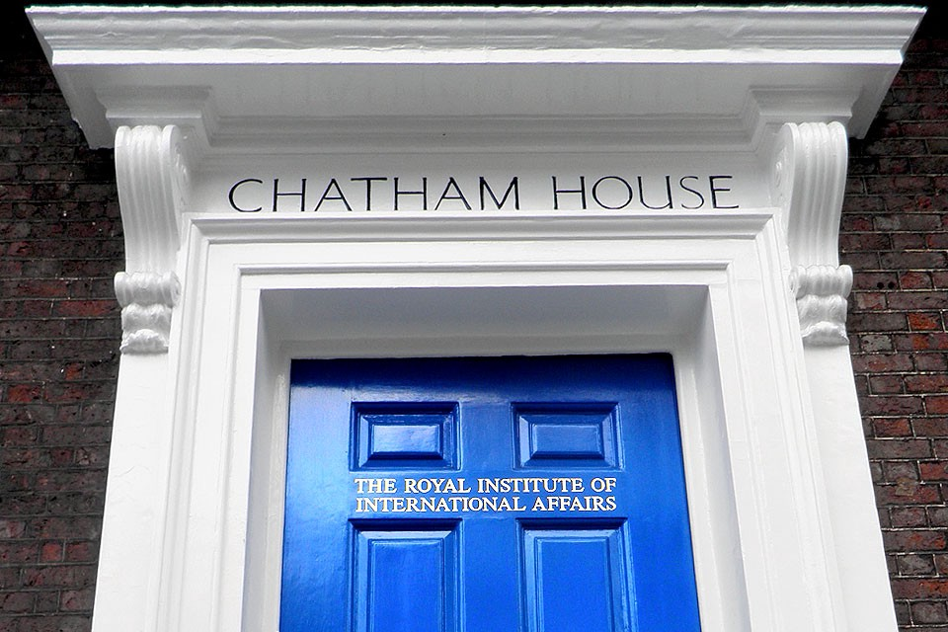
INDC Code
Chatham House Rule
Dress code and appearance
Cell phones
In the plenum: Speaking through
microphones
Respecting each other's time
Openness
Absences
Academic writing ethics

Slide 19
(Basic) Weekly Structure in the INDC
Thursday | Wednesday | Tuesday | Monday | Sunday | Hour/Day
Subject 1 | Subject 1 | Subject 1 | Subject 1 | Independent-Study | 08:30-10:00
Subject 2 | Subject 2 | Subject 2 | Subject 2 |  | 10:30-12:00
Subject 3 | Subject 3 | Subject 3 | Subject 3 |  | 13:00-14:15
Until 15:00 | Subject 4 | Team Hour | Subject 4 |  | 14:45-16:15

Slide 20
Opening Week Schedule
Thursday 5.9 | Wednesday 4.9 | Tuesday 3.9 | Monday 2.9 | Hour/Day
“Morning Coffee and Reading” | “Morning Coffee and Reading” | Approaches and schools of thought / Dr. Doron Nevot (08:30-09:30) |  | 08:30-09:00
Approaches and schools of thought - / Dr. Doron Nevot | Approaches and schools of thought / Dr. Doron Nevot | Guest Lecturer – Head of Hamlal (10:00-11:30) | Opening Conversation with the Major General of the Colleges | 09:00-10:30
Approaches and schools of thought - / Dr. Doron Nevot | Approaches and schools of thought / Dr. Doron Nevot | Approaches and schools of thought / Dr. Doron Nevot (12:30-14:00) | Opening conversation with with the Head Instructor of the INDC | 11:00-12:30
Team Hour | Creativity and International Management in a Changing Reality / Mr. Ron Prosor | Guide to – “Morning Coffee and Reading” (14:30-15:00) | Guest Lecture – Mr. Ron Prosor (13:00-14:15) | 13:30-15:00
 |  |  | Team Hour (14:45-16:15)

Slide 21
Looking forward…
Setting personal goals for the year at the INDC
Planning of vacations according to the planned yearly schedule
Farewell to your “home organizations” (you are now 100% an INDC participant)
Preparing for effective time utilization during the year

