Slide 1
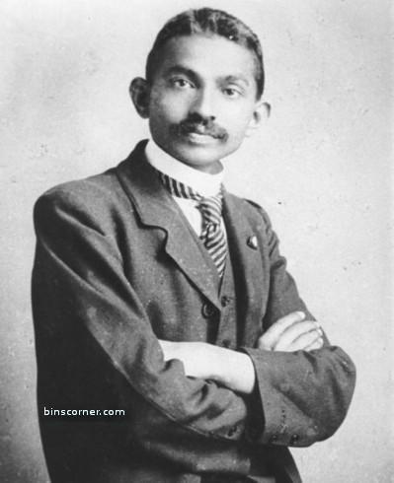
Positive Things
You Can Do to Change Your Life

Slide 2
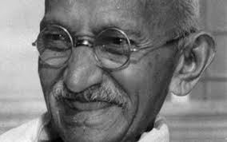
Some research suggests:
The mind does not register negatives
We force the mind to
“START doing this!”

Slide 3
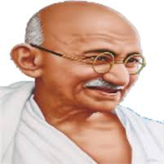
Start spending time with the right people
Surround yourself with the people who inspire, challenge, value, love, and appreciate you !
      Also, be with the ones who
      make you work harder

Slide 4

START FACING YOUR PROBLEMS
START FACING YOUR PROBLEMS
Step1 :
Start Acknowledging Something
Step2 :
Don’t sweep problems under the carpet
Step3 :
Face it head on
Step3 :
Solve it

Slide 5
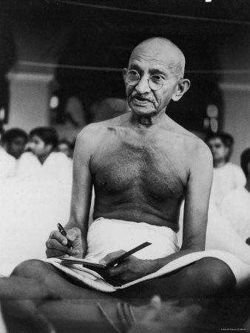
Start being honest with yourself
The only one who knows your needs, what is working and what is not is,
YOU.

Slide 6
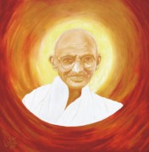

PUT NEEDS OF OTHERS BEFORE YOUR OWN

Slide 7
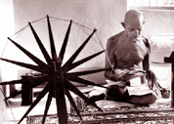
BE YOURSELF

Slide 8
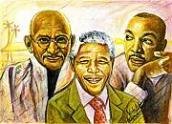
Live in the moment – We all have stories about our past but they are just that, stories.
The most powerful thing WE have on any given day is the moment WE are liVING IN …………
……………….and be where OUR feet are.

Slide 9
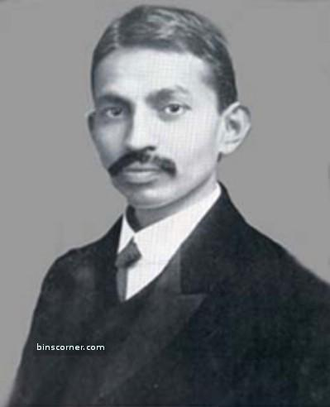
Feel free to fail – That’s right!
Know that mistakes are going to happen,
one of the best ways to succeed is to fail miserably,
correct, then dust out your shoes and run again….

Slide 10
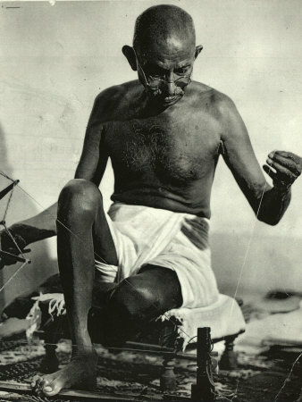
Practice self-forgiveness. Years spent in a certain relationship, career, addiction, negativity, poor health, fear, it is all okay.
You cannot really move on until you forgive yourself for being human.. And a soul forgiven is a soul motivated for wonders..

Slide 11
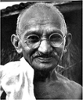
Buy groceries- not happiness –
There are certain things money can buy.
Other things, not so much- Like happiness!
Certain things create sensations of joy, passion, love AND pleasure… but ‘HAPPINESS’- that is a certain place inside OF you, accessible by choice only and can not be bought BY ANY AMOUNT OF MONEY….

Slide 12

Look Unto yourself for happiness –
It is not going to come from someone else.

Slide 13
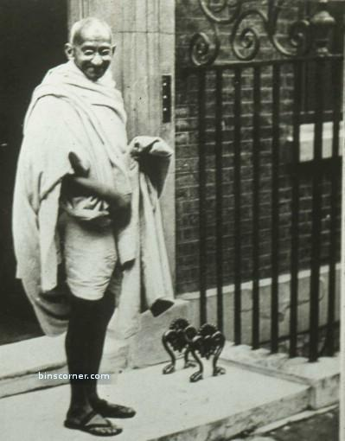
Get moving!
Don’t think that standstill water will SUPPORT life for long….

Slide 14
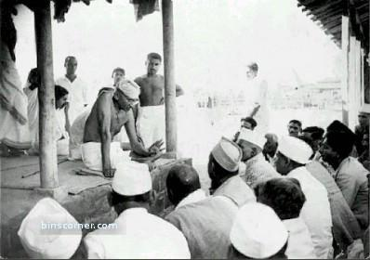
Believe you are ready now.
‘This is a perfect state of mind to be in….’
Only then you can work wonders….

Slide 15
Get involved in healthy relationships for the right reason.
If you are looking for someone to save, fix, complete, or solve any emptiness in your heart that is NOT the right reason to be with someone!
If you are looking for someone with whom to share your happiness, love, abundance, pleasure, joy and various highs/lows of life’s journey while maintaining your own sense of self, that is the RIGHT reason to be with someone!

Slide 16
Be open to new relationships
even if old ones didn’t work.

Slide 17
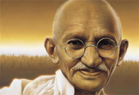
Compete with yourself.
You will save a lot of energy if you only seek to be YOUR BEST SELF
every moment of every day.

Slide 18
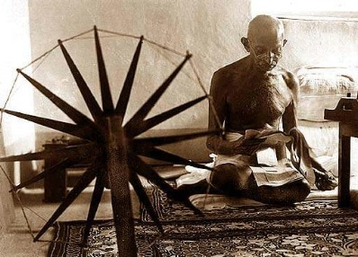
Be inspired instead of green eyed.
If someone else is manifesting greatness,
let that be a source of inspiration and motivation.

Slide 19

Let go of grudges.
Sometimes it’s fun to make a list of all the people
you are still ANNOYED WITH
and why?
then see that most, if not all of it,
is ridiculous

Slide 20

Rise to the level you deserve.
Not everybody shares the same standards
and this can be difficult to accept.

Slide 21

Follow your heart.
No need to explain yourself and
your choices to other people.
Just be you

Slide 22

Give yourself a break!
I know this is hard for us.
But, we are human beings not human doings,
so attempts to go-go-go without a break
will lead to a loss of perspective.
Breathe.

Slide 23
Accept your imperfections.
The world is full of flaws
and so are you, truly.
It makes you exquisite

Slide 24
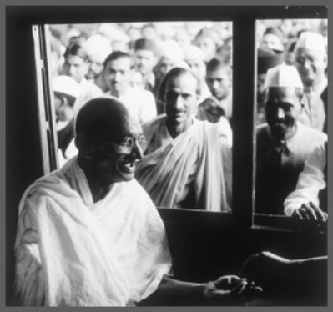
Be extraordinary
There are no shortcuts on the path
To BECOMING extraordinary

Slide 25
Be real.
If it’s not fine, don’t say it is.
If it’s not okay, don’t say it is.
If you don’t feel good, don’t fake it!
Be real, be real, be real.

Slide 26
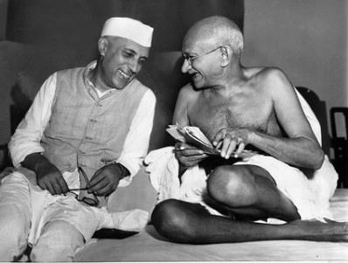
Take responsibility
“The extent to which you can achieve your dreams depends on the extent to which you take responsibility for your life.
When you blame others for what you’re going through, you deny responsibility – you give others power over that part of your life.”

Slide 27
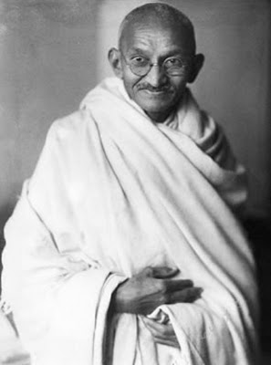
Keep your focus on the important people who matter.
Just keep the focus on your commitments
and people in your circles of choice.

Slide 28
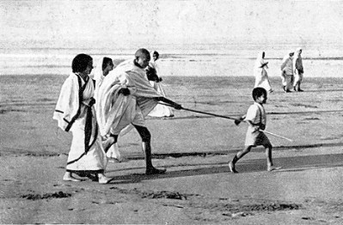
Focus on what you WANT to happen.
You have energy and you have a brain.
You can put your focus on what you WANT to happen.
You can visualize it to the extent that it feels real,
the details, the people, all of it.
It is just a choice of where you want to put your attention.

Slide 29

And finally,
Do more retail loans.
That’s my addition.
Because IN DOING SO YOU SERVE HUMANITY.
AND THE more people you serve ,
you will actualize GandhiJI's dream
of uplifting and empowering fellow INDIANS.
THUS stronger would be
OUR Swadeshi Inspired UCO Bank….

