Slide 1
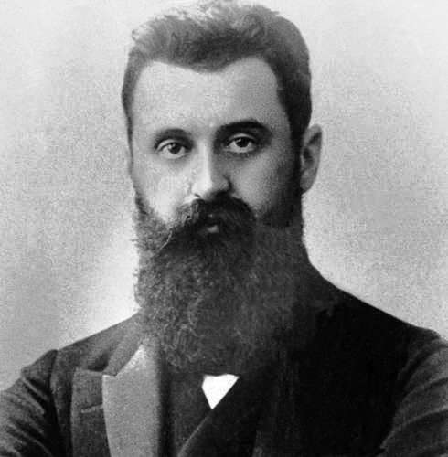
אם
אין זו אגדה"
"אם תרצו
Herzl
Political Leadership and the Rule of the Nation

Slide 2
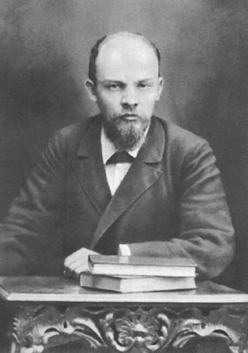
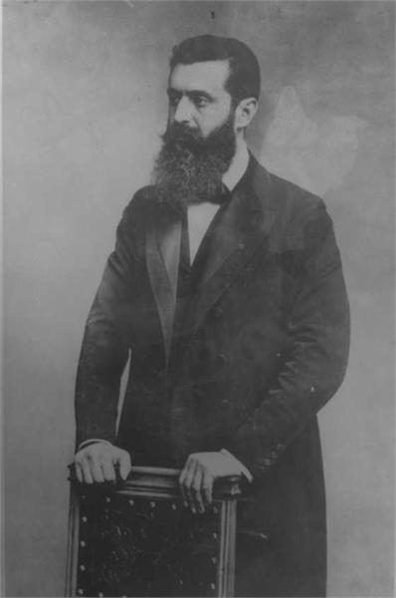
Lenin stated: “There are hundreds of years that pass as if they were days, and there are days that pass as if they were hundreds of years."
100 Years of the Bolshevik Revolution
The historical moment in which Jewish, political, and tangential life began to move at an accelerated pace occurred with the appearance of Herzl on the Jewish public stage.
The revolutionary political period in Zionism extends from two events: the first Zionist Congress in 1897, and the elections to the Constituent Assembly on 25 January 1949.
Lenin, 1897

Slide 4
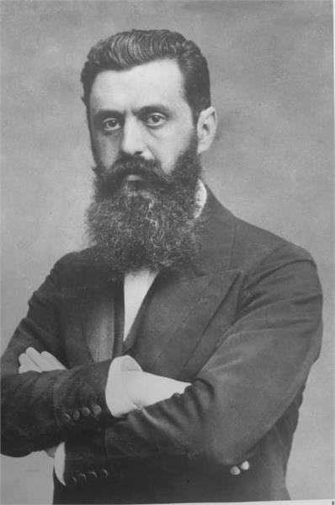
Herzl's premise was that the formation of a national movement was the result of an act of political will, and not merely the result of objective historical circumstances.
His first and primary goal was to revolutionize the Jewish consciousness - the modes of existence of the Jewish people.
His intention was to create an internal motive force that would serve as a catalyst for self-change in the way Jewish society existed, in order to adapt it to the reality of the increasingly living reality of modern civilization.

Slide 5
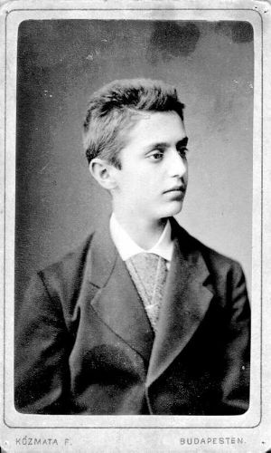
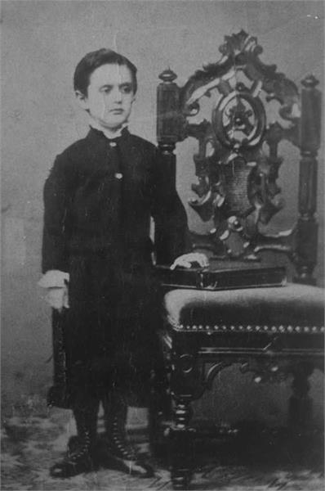
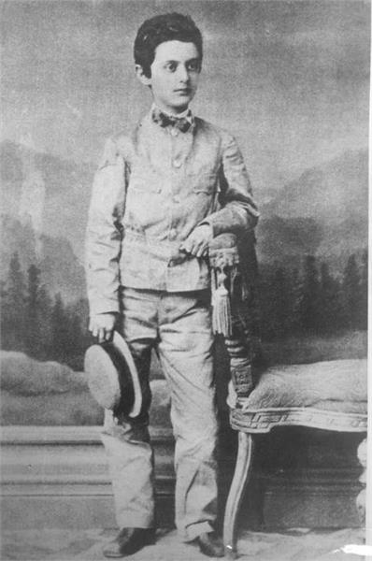
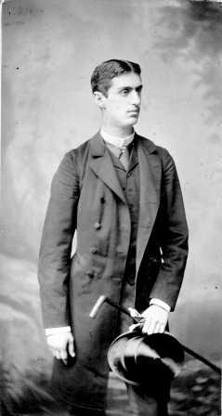
Herzl's political career lasted nine years,
From 1895 to 1904.
He was born in Pest (now Budapest) in Hungary in 1860. He began studying law at the University of Vienna in 1878, and in 1884 received a doctorate.
From 1891, Herzl worked as a journalist in Paris of the important Viennese newspaper "Neue Freie Presse".
Approximately in 1875
Age 4
Age 13
Student

Slide 6
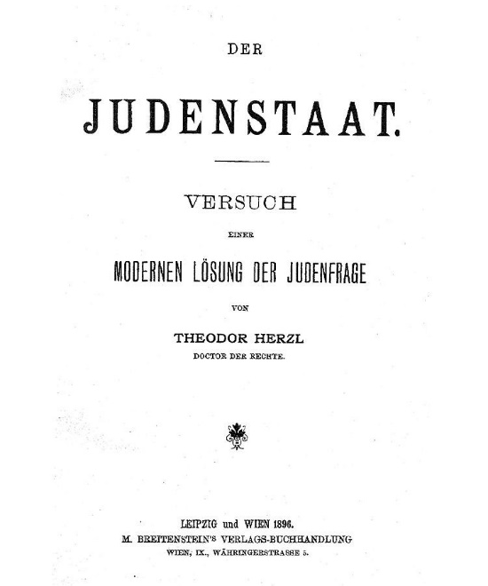
On February 14, 1896, Herzl's book was published,
"The Jewish State". The book was written
in German
And was published in 3,000 copies.
The Book “The Jewish State” begins with the following words: "The idea that I come to lecture in this essay is ancient, the establishment of the Jewish state.
The world reverberates in the cry against the Jews, and this awakens the dormant idea. I am not inventing anything; This should be made clear to us from the start at every point of my words. I am not inventing the situation of the Jews in its historical development, nor even the means to rectify it. The material elements of the structure, which I will draw, exist in reality, can be grasped by the hands; Anyone can see it. If one wishes to mention in one word this attempt to solve the Jewish question, it should not be called 'fantasy', but rather a 'combination”.

Slide 7
From Herzl’s diary, June 1895:
If anyone asks me how I know it, I tell him that I even know where the rolling stone will come on a sloping plain: down below, only mindless and insane people do not take into account the laws of nature. It is imperative that eventually we reach the bottom. What it would look like, what form it would wear, I could not imagine. Will it be expropriation of property due to a revolution from below, or its boycott in the wake of a reaction from above? They expelled us? Did they kill us? I suppose that more or less things will wear all the shapes I have listed, and others. In one country, probably in France, the social revolution will come, and its first victims will surely be the big banks and the Jews. Those who have lived in this country for a few years like me, as a single impartial observer, no longer have any doubt about it. Russia will simply boycott from above. In Germany, laws of discrimination will be enacted as soon as the emperor can no longer rule with the Reichstag. In Austria they would not face the terror of the Viennese mob and betrayed the Jews. After all, in Austria, the street can achieve anything if it wants to. But the streets are still not aware of it. The leaders will make sure they know.
“And so they will expel us from these countries and murder us in countries we escape to."

Slide 8
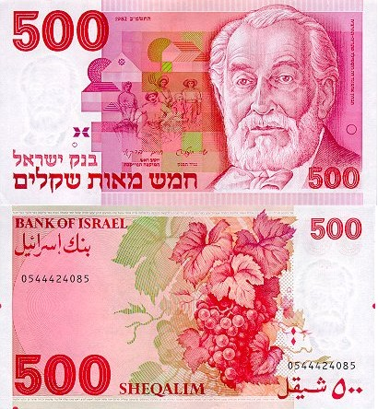
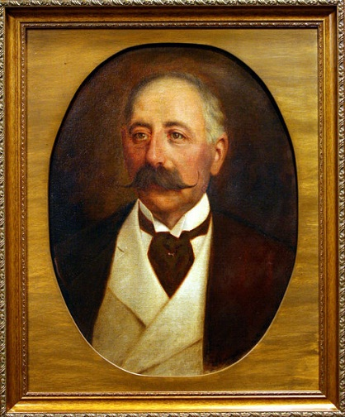
According to Herzl, the two keys to solving the problem of the physical existence of the Jews in Europe were financial power and creative diplomacy.
Herzl failed in his attempt to recruit Baron Maurice de Hirsch and the Rothschild family to join a solution he wished to promote - "a Jewish state." The Jewish financiers played a significant part of their wealth based on behind-the-scenes involvement in the thicket of European politics, which needs money to finance political conflicts and military conflicts.
"if I was Rothschild..."
At first Herzl wanted the help of the plutocratic leadership.
Advantage - with economic ability and political influence, and its involvement will help shorten the time required to solve the plight of the Jews.
Disadvantage - because it contradicted its structure and patterns of functioning, and concealed its interests.
Baron Hirsch

Slide 9
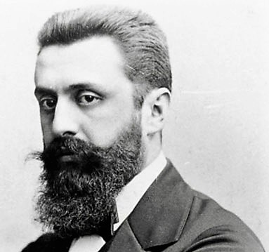
Making the Jewish public a political subject:
Politicization of the Jewish masses.
Democratization of the Jewish leadership.
Productivization of Jewish capital and labor.
Herzl had no choice but to turn to the democratic path, which was based on the popular strength of masses of Jews, in addition to those who had begun to organize themselves at the Hibat Zion branches for some 15 years.
The transformation of Jewish distress into a marginal problem in the European discourse on a fundamental issue in international politics. From his failures with the Jewish financiers, his strategy grew: Diplomatic activity in an attempt to find the Zionist idea an ally in the international arena.
Creating a political mass movement as a way to consolidate Jewish political will and as a basis for promoting Zionist diplomacy.
Creating organizational and financial tools for channeling political will into tangible achievements

Slide 10
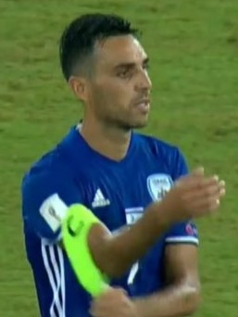
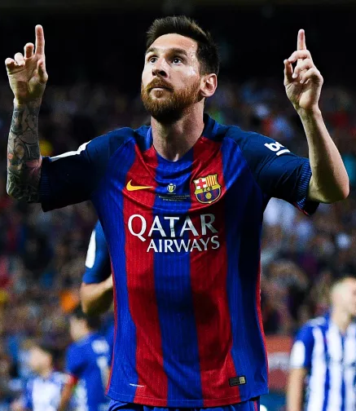
The Dilemma - Zahavi or Messi?
"Do you prefer Palestine or Argentina?" The association will take what will be given to it and what will be accepted by the public of the Jewish people.
Argentina is by nature one of the richest countries in the world, with a vast area, a sparse population and a temperate climate. The Argentine Republic is likely to find the greatest interest in the allocation of part of its territory to us. True, the current infiltration of the Jews aroused resentment; Argentina should be made aware of the essential difference in the immigration of the new Jews.

Slide 11
Palestine is our unforgettable historical homeland. That name in itself might be a cry for our hearts to gather together for our people. If His Majesty the Sultan will give us Palestine, we can commit ourselves in exchange for arranging the state of Turkey's finances. For Europe we may be part of the wall of protection against Asia, we may provide the vanguard of civilization against barbarism. As a neutral country we will continue to maintain contact with all of Europe, which will need to guarantee our existence. The Holy Places of Christianity can be found to find an extraterritorial origin under international law. We will be an honor guard around the holy places, and in our existence we will be in favor of fulfilling this duty. This honor vigil will be the great symbol of the solution of the Jewish question after the eighteen hundred years of our torment. "

Slide 12
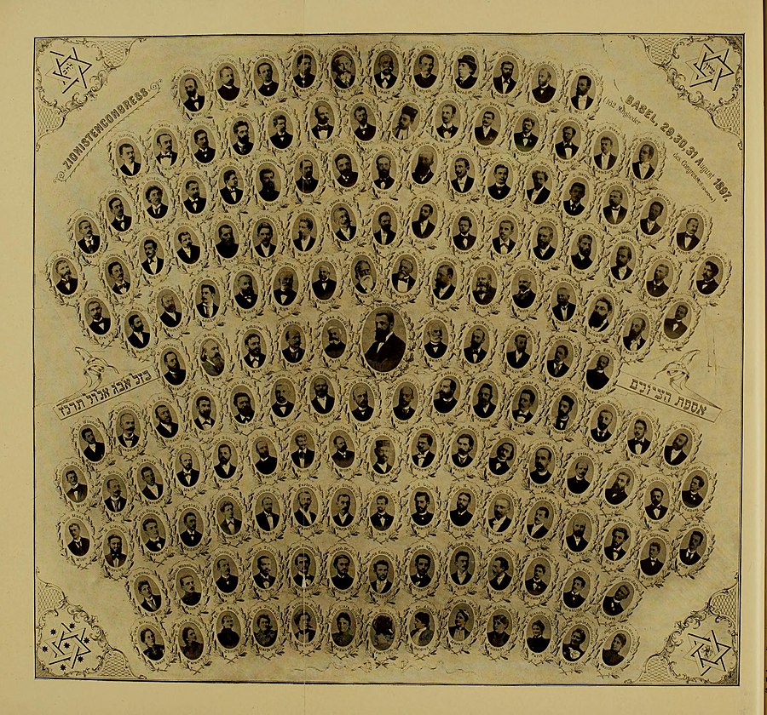
Resolutions of the First Zionist Congress, August 31-29, 1897:
"Zionism aspires to establish a homeland for the Jewish people in the Land of Israel, guaranteed by public law." In order to achieve this goal, Congress intends to take the following measures:
The purposeful settlement of the Land of Israel by land workers, artisans and merchants.
The organization of all Jewry and its capture by efficient enterprises, local and general, in accordance with the laws of every country.
Increasing Jewish national sentiment and Jewish national consciousness.
Preparatory actions in order to obtain the agreements of the governments, which are necessary to reach the goal of Zionism. "
Participants in the First Zionist Congress
(At the bottom of the poster are 13 women, with no voting rights)

Slide 13
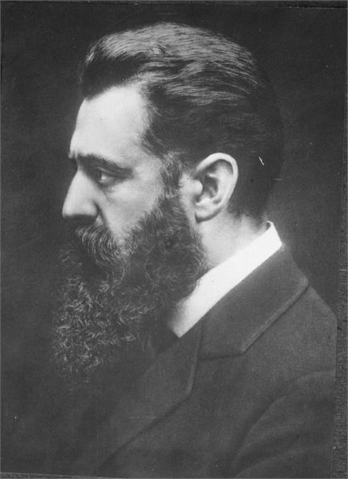
The principles of the moderate, cautious and vague formulation of the decisions of the Congress:
1. No one else but the Jews themselves have to solve their common problems as a group: to begin to be a working force and not to act in historical life.
2.Integration into Europe is hopeless because of the phenomenon of anti-Semitism. At the same time, immigration to America does not address t because the problem of Jewish for America didn't existence in the modern era.

Slide 14
3. The processes of disintegration of traditional Jewish civilization require the construction of a modern identity, and this can only occur in the natural environment in which Jewish civilization was created and maintained in the past independently.
Prof. Shlomo Avineri: The great innovation and historical perspective and the most significant political achievement of Herzel achieved was the establishment of the Zionist Congress - the parliament, and the Zionist Organization - the organization, as political tools for managing and making effective decisions about Jewish affairs.

Slide 15
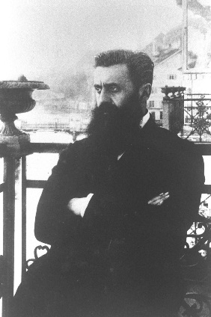
Herzl's diary, September 3, 1897
"Here are the last days, the most important days since I had the idea of those times in Paris, and in the way back I was too exhausted to write diary notes, which are more important now than ever, since others already notice that our movement has entered history.
If I adopt the Basel Congress in one word - which I shall caution against public pronouncement - it is this: In Basel I founded the Jewish state. If I said it aloud today, he would give me a general laugh. Perhaps in five years, certainly in fifty years, everyone would admit it.
If I adopt the Basel Congress in one word - which I shall caution against public pronouncement - it is this: In Basel I founded the Jewish state. If I said it aloud today, he would give me a general laugh. Perhaps in five years, certainly in fifty years, everyone would admit it.

Slide 16
The foundation of the state, in essence, lies in the aspirations of the people to the state and even in the wishes of an individual of sufficient strength. So I created in Basel this abstract thing, which, for that reason, is lost to most people. I did it with minimal means. Slowly I pushed the people into the state mindset and gave them the feeling that they were the National Assembly.
Months ago, it was one of my first ideas about what to do when you came to the opening seat dressed in a tuxedo and a white bow tie. This proved to be amazing. The holiday clothes equate most people with a rigid expression, and from this rigidity a measured tone was created that might not have been achieved in a light summer attire, and I did not refrain from raising this tone and raising it to a festive scale. "

Slide 17
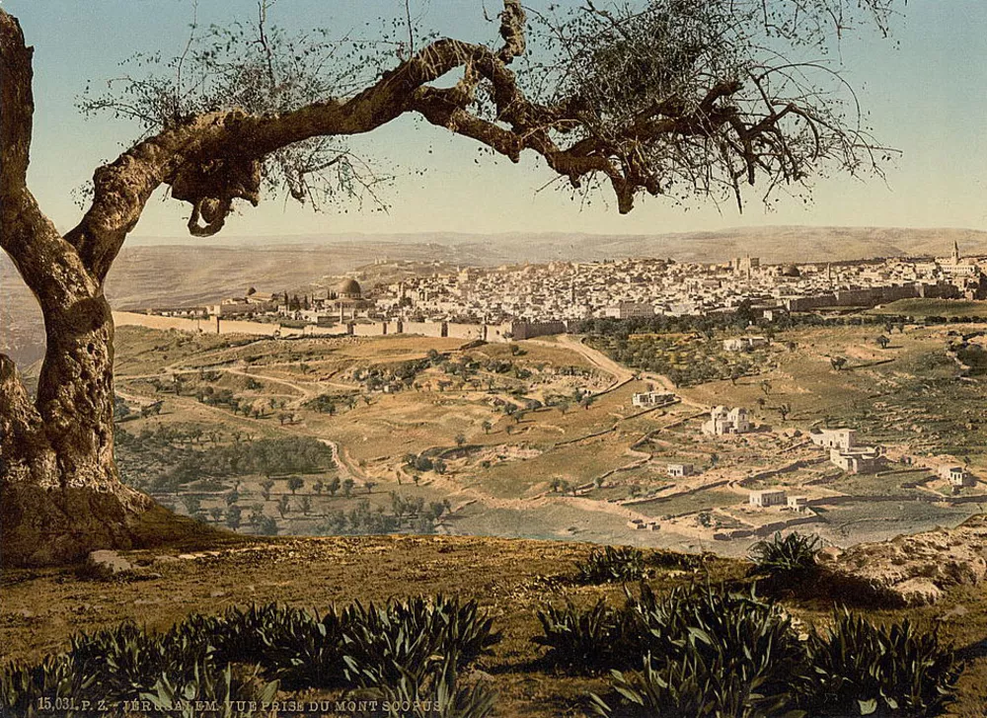
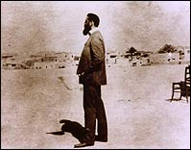
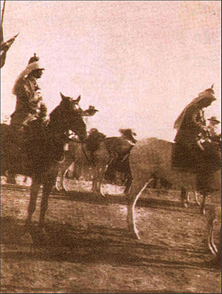
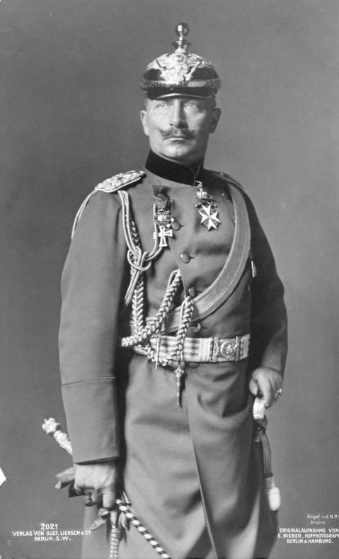
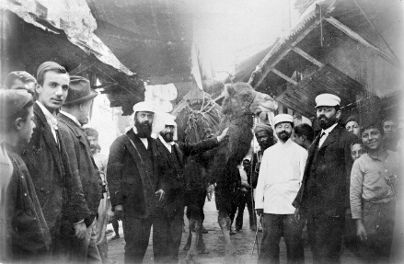
On November 3, 1898, Herzl met with the German Kaiser Wilhelm II in Jerusalem
In the New Testament a powerful emperor never met a Jewish leader with a in such circumstances.
Looking Back Some Achievements After all:
In the 19th century , no one of the leaders of the world did not hear a national Jewish plan in such a direct and clear manner.
The idea of establishing a nation-state for the Jewish people in the Land of Israel was raised as the issue that discussed in the international agenda.
Although the idea was rejected, but received some attention, a position was taken, and since then the issue of the fate and future of the Jews will be a subject that is an integral part of world politics.
Jerusalem at the end of the 19th century
Fake photography
Wilhelm II,
Emperor of Germany
Herzl in Izmir,
On the way to Eretz Israel

Slide 18
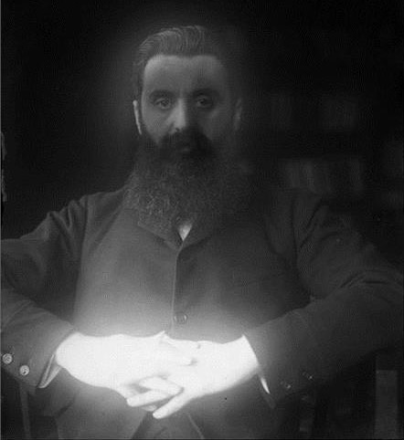
Herzl's diary, June 4, 1902
Now I'm an old man and famous. A priority in the eyes of youth, despite the depressions that accompanied them. The success of the lesser of them has made the purple man happy, as long as he himself passes through the crowd without being recognized. But once he has been recognized, the success of the lesser of him makes him sad. Happily, this happens very seldom, or in a very old age.
A virtuous person works in different fields. And then recognize him in a field that is not the center of gravity of his personality. I, for example, have gained world fame as an propagandist in a matter that only fools do not understand enough - the Jews; A field that spiritually I did not give him anything. I just acquired a political skill that any horse dealer could buy.
As a writer, especially as a playwright, I am not considered even less so. They say only that I'm a good journalist. And yet I feel, I know, that I was a capable writer who had not exhausted his full potential because he had been sickened by everything and had his hands folded.
Last picture

Slide 19
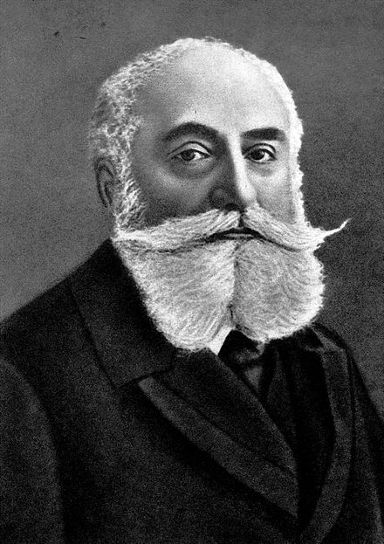
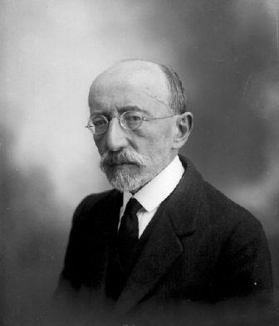
Nordau said in 1914, on the tenth anniversary of Herzl's death: "Herzl was loved and active, but he did not achieve anything, and he was not willing to admit it in public, he was an artist in creating illusions and, to put it bluntly, Especially when the people are so nervous and reluctant to be impressed by anything like the Jewish people. "
Max Nordau
Ahad Ha'am: "Herzl was the living man - it was possible and is possible to doubt much of what he said and what he did, and anyone who did not want to close his eyes was clearly opposed to it, but Herzl was the ideal painting as it was being created before our eyes in the spirit of the people. Will have the power to influence the shaping of the people's spirit. "
Ahad Ha'am

Slide 20
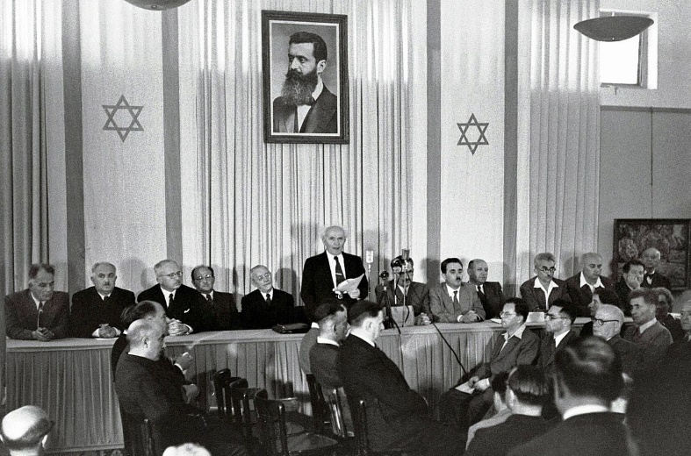
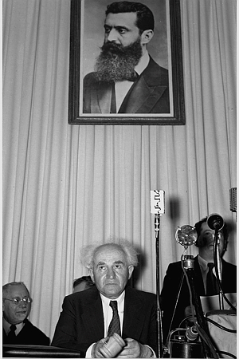
With the death of Herzl, an 18-year-old wrote: "Our hopes have been fulfilled, our dreams!" No one will ever stand up again, uniting the heroism of the Maccabees with David's machinations, the courage of Rabbi Akiva who died in "One" And the love of fire of Rabbi Judah Halevy, and only once in thousands of years will such a prodigy be born, the size of the sea is the size of our loss ... Yet today I am more confident than ever.
Later, at the height of the Second World War, it would be marked 40 years since the death of Herzl, and that same youth since then, the Chairman of the Jewish Agency Executive and the leader of Mapai, David Ben-Gurion, declared: "Not with the dead Herzl but with the living Herzl, His passionate belief in the national and political value of the Jewish people to stand on the stage of history as a people with equal rights and obligations is rooted in its independent homeland and stands on its own, and with the historic claim of the people of Israel.

Slide 21
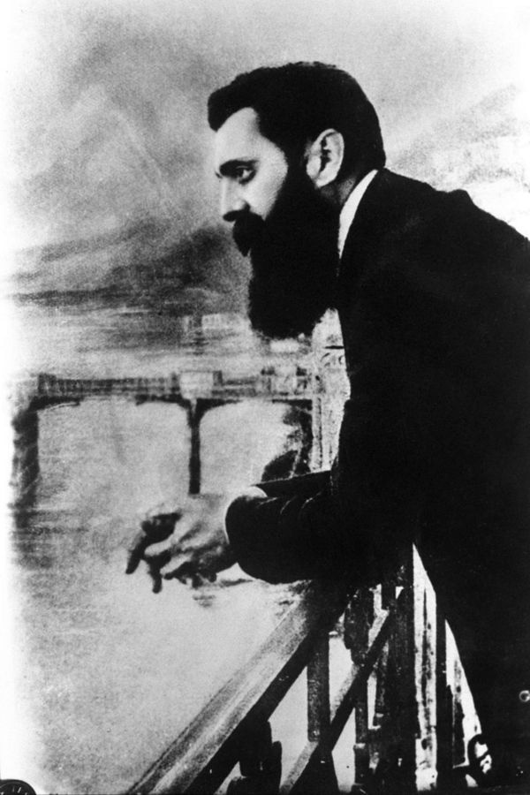
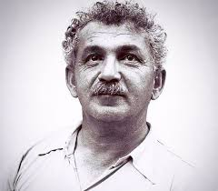
At the end of his speech at the first Zionist Congress in Basel in 1897, Herzl said:
"On the day the plow returns to the growing hand of the Jewish farmer, the question of the Jews will be solved."
On the 30th anniversary of Herzl's death:
"The next generation will not know Herzl, just as a slogan, as a flag, at best as a fine legend."
"Herzl was not short with Brina, but he grew sperm, political success was beyond him, but he created a precondition for every achievement: an Israeli political existence.
Berl Katznelson

