Slide 1
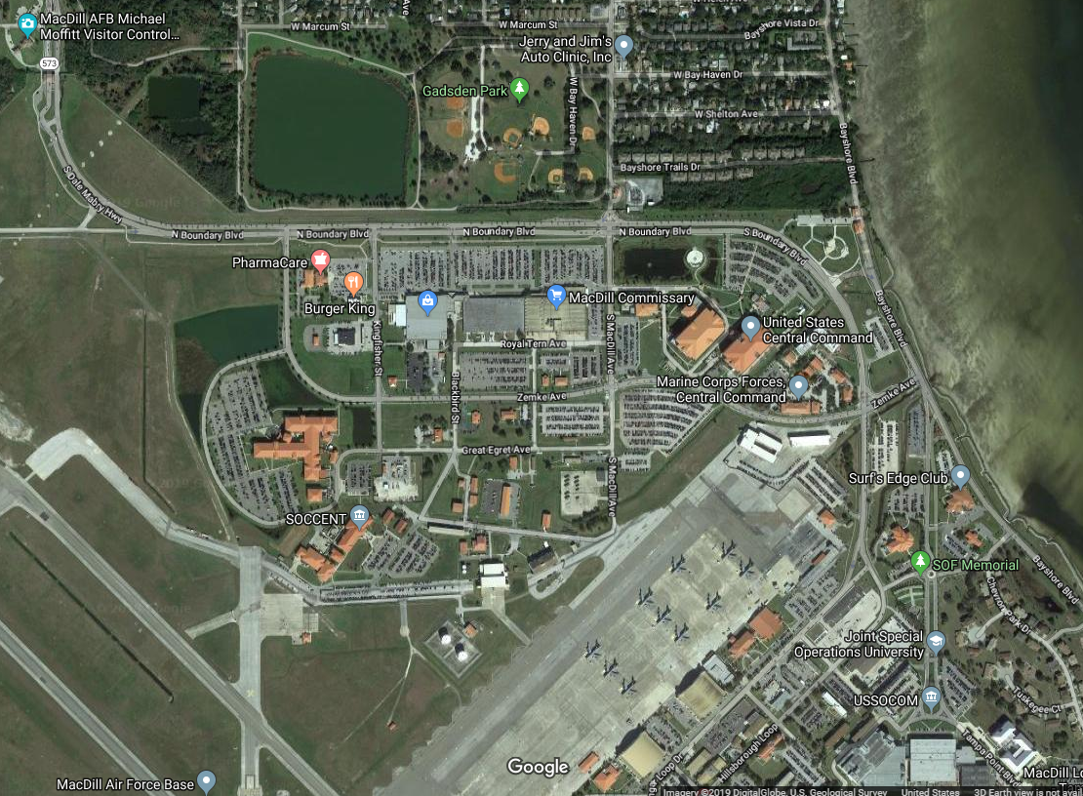
MacDill AFB Main Gate
POC:
Dennis Peoples
LTC, US ARMY
USCENTCOM, J7
Executive Officer
COM: 813-529-7004
DSN: 312-529-7004
Cell: 813-368-2542
Personal Cell: 321-302-1099
USCENTCOM

Slide 2
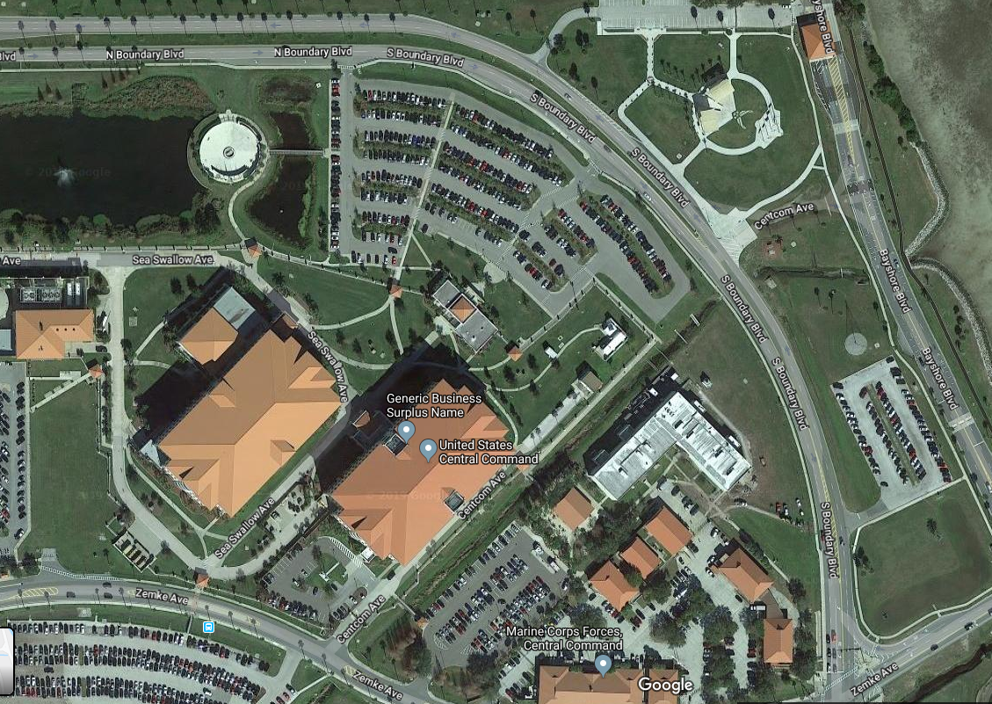
Parking marked for BG Bengo
USCENTCOM Visitor Center & Badge

