Slide 1
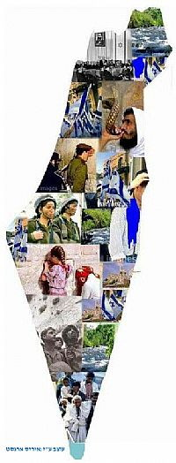
Society Echelon 46th Class, 2017-2018
National Defense College
Leading Instructor, Dr. Anat Stern

Slide 2
The Conceptual Basis
"The State of Israel will be open for Jewish immigration and for the Ingathering of the Exiles; it will foster the development of the country for the benefit of all its inhabitants; it will be based on freedom, justice and peace as envisaged by the prophets of Israel; it will ensure complete equality of social and political rights to all its inhabitants irrespective of religion, race or sex; it will guarantee freedom of religion, conscience, language, education and culture; ..We hereby declare the establishment of a Jewish state in Eretz-Israel, to be known as the State of Israel."
Israeli Declaration of Independence May 14, 1948

Slide 3
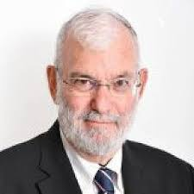
“The term National Security reflects the broad range of political power, economic ability,
Social Resilience,
And other fields such as: technology, ecology and environment“
(Major General Yaakov Amidror)

Slide 4
Echelon Goals
Study of the roots and characteristics of social phenomena that unite and shape the Israeli society.
Learn about the various social groups in Israel.
Focus on selected tensions / challenges and their impact on National Security.

Slide 5
Thematic Order
Israeli Society
Infrastructure Course
Academic Course
Seminar and Visit
Practical Workshop
Lecture by senior officials
National Defense Tours

Slide 6
Learning Material in the Israeli Society Echelons
Military-Society Workshop
Visit to the President's Residence
Lipkin-Shahak Seminar
Israeli Society Course
Society Tour
The Zionist Enterprise
Forefathers +
Ben-Gurion Seminar
Society Components in National Defense Tours

Slide 7
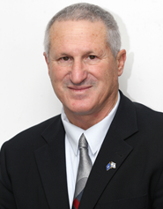
Infrastructure Season
The Zionist Enterprise- Forefathers Course
(12.9-11.10)
Prof. Yossi Ben Artzi

Slide 8
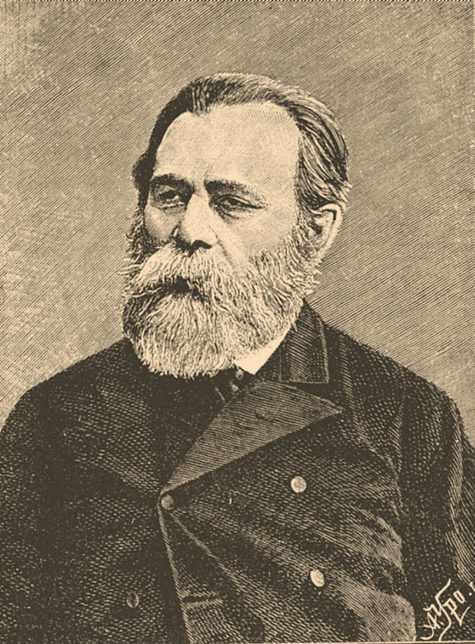
פינסקר אחד העם

Slide 9
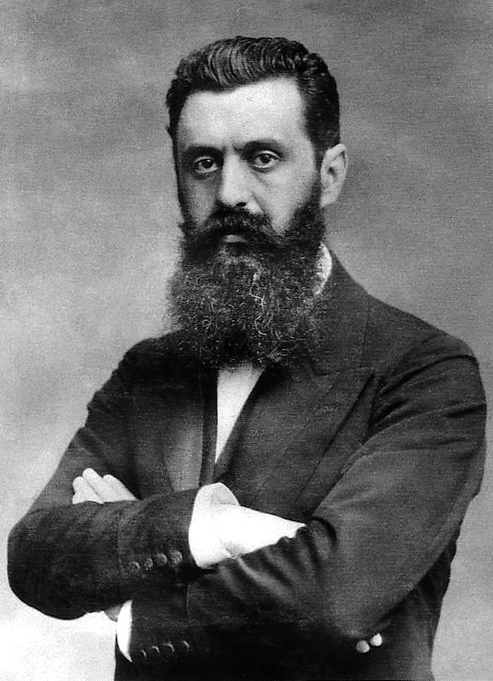
פינסקר

Slide 10
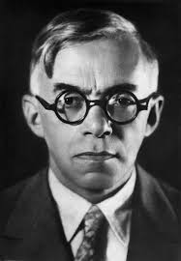

Slide 11
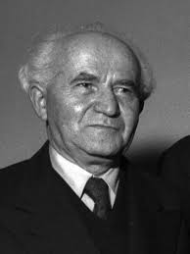
Ben Gurion Day 11.10.19
Constitutive decisions in the nation’s history.
The decision in the Altalena affair
Declaration of Independence: Phrasing the principles and the basis of the Constitution
The decision to dismantle the Palmach headquarters
Declaration of the Establishment of the State

Slide 12
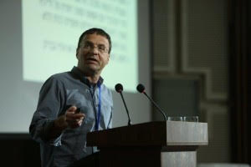
Core Season
Israeli society Academic Course, 4 Credits
Dr. Neri Horowitz
(7.11-2.4.19)
Social phenomena
Tensions in Society
Impact on National Security

Slide 13
A Map of the Israeli Society Components :
Social Worldviews
State
Local authority
A civil society
Governance
Social Resilience
The Israeli Society
Civil-Military Relations
Society and Economy
Identity Tensions and rifts in Society
Society and Military
statehood
Religionization / Gender
Reserve duty
People's Army / Professional Military
Military and Law
Economy and Military
Socioeconomic Concepts
Social Gaps / Poverty
Welfare State and Privatization
Designing an Economic Agenda
The Effects of Global Economy
National gap - Jews and Arabs
Ethnic gap - Ashkenazi / Mizrahi
Religious Gap - Ultra-Orthodox / Secular
Economic-Social Gaps
Center /Periphery

Slide 14
Course Topics
Israeli society in comparative terms
Israel as a nation building project: defining the boundaries of the Israeli collective
A. The place of religion in public life
B. The place of the Arabs in a Jewish and democratic state
Social Identity groups in Israeli society
Social stratification and mobility - the welfare state in Israel
Demarcation of society and state: between state and civil society and local government
6. Governance, statehood and Israeli society in terms of state-society

Slide 15
Course Topics
Identity and competing perceptions of good society: between conflicts and social solidarity
The implications of social processes on the IDF and course summary.
Method:
Frontal lectures
Practitioners’ lectures
Team Discussions.
Final assignment: paper on a topic related to the course topics

Slide 16
Core Season
Society Tour 25.3.19
Core topics of the course.
To be planned and led by the participants
under guidance of Dr. Neri Horowitz, and the responsible instructor.

Slide 17
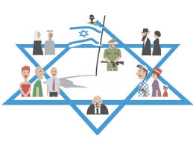
Core Season
A social component in the National Defense tours.

Slide 18
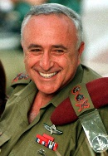
Core Season
Lipkin-Shahak Seminar – (23.12.18)
at the Interdisciplinary Center will cover Social Military Issues.

Slide 19
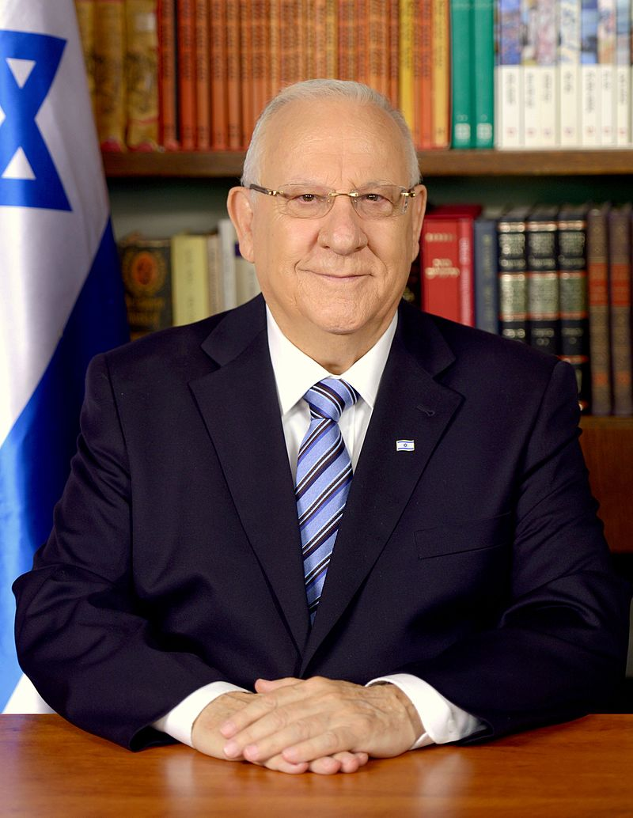
Core Season
Visit to the President's Residence:
President's strategy for Israeli society

Slide 20
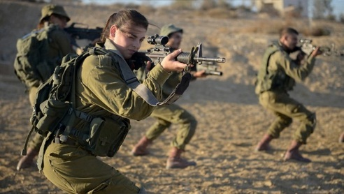
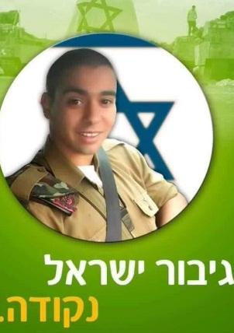
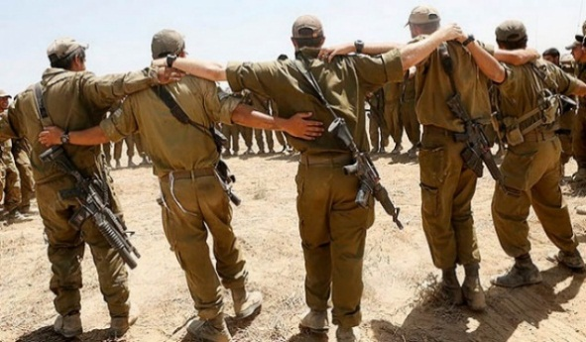
Advanced Season
Society-Military Workshop
In Cooperation with Israel’s Democracy Institute
Military-society relations as reflected in the cinema;
Social Networks;
Crossroads of gender and ethnicity in the military;
Social groups in the IDF;
Economy and military;
Military-society in war time;
The shooting incident in Hebron from the perspective of the relations between the military and the society
Israel’s hero Period.

Slide 23
ציר הזמן
Senior Lectures
14.11.18-26.3.19
9.4.19-11.4.19
Geographic Tours, Team Processing, Senior Lectures
Academic Course - Israeli Society
Society - Military Workshop
Tours Abroad, Team Processing, Senior Lectures
18.4.19
11.6.19
Lipkin - Shahak SEMINAR
Society Tour
Visit to the President's Residence

Slide 24
The goals of the National Defense College (from the INDC Handbook)
“To study and research the various components of the National Security of the State of Israel and to analyze their interrelationship”
The participant will understand the main components that constitute the national defense equation, including: national defense, foreign relations, economics, society, law and government “ (from the required achievements, INDC Handbook)

