Slide 1
College?
National?
Defense?
Israel National Defense College – 46th Class

Slide 2
Genesis, Chapters 2-3
8 And the LORD God planted a garden eastward, in Eden; and there He put the man whom He had formed. 9 And out of the ground made the LORD God to grow every tree that is pleasant to the sight, and good for food; the tree of life also in the midst of the garden, and the tree of the knowledge of good and evil. 10 And a river went out of Eden to water the garden; and from thence it was parted, and became four heads 15 And the LORD God took the man, and put him into the garden of Eden to dress it and to keep it. 16 And the LORD God commanded the man, saying: 'Of every tree of the garden thou mayest freely eat; 17 but of the tree of the knowledge of good and evil, thou shalt not eat of it; for in the day that thou eatest thereof thou shalt surely die.‘25 And they were both naked, the man and his wife, and were not ashamed.
1 Now the serpent was more subtle than any beast of the field which the LORD God had made. And he said unto the woman: 'Yea, hath God said: Ye shall not eat of any tree of the garden?'
2 And the woman said unto the serpent: 'Of the fruit of the trees of the garden we may eat; 3 but of the fruit of the tree which is in the midst of the garden, God hath said: Ye shall not eat of it, neither shall ye touch it, lest ye die.‘4 And the serpent said unto the woman: 'Ye shall not surely die; 5 for God doth know that in the day ye eat thereof, then your eyes shall be opened, and ye shall be as God, knowing good and evil.‘6 And when the woman saw that the tree was good for food, and that it was a delight to the eyes, and that the tree was to be desired to make one wise, she took of the fruit thereof, and did eat; and she gave also unto her husband with her, and he did eat.

Slide 3
7 And the eyes of them both were opened, and they knew that they were naked; and they sewed fig-leaves together, and made themselves girdles. 9 And the LORD God called unto the man, and said unto him: 'Where art thou?‘10 And he said: 'I heard Thy voice in the garden, and I was afraid, because I was naked; and I hid myself.‘11 And He said: 'Who told thee that thou wast naked? Hast thou eaten of the tree, whereof I commanded thee that thou shouldest not eat?‘12 And the man said: 'The woman whom Thou gavest to be with me, she gave me of the tree, and I did eat.‘13 And the LORD God said unto the woman: 'What is this thou hast done?' And the woman said: 'The serpent beguiled me, and I did eat.‘14 And the LORD God said unto the serpent: 'Because thou hast done this, cursed art thou from among all cattle, and from among all beasts of the field; upon thy belly shalt thou go, and dust shalt thou eat all the days of thy life. 16 Unto the woman He said: 'I will greatly multiply thy pain and thy travail; in pain thou shalt bring forth children; and thy desire shall be to thy husband, and he shall rule over thee.' {S} 17 And unto Adam He said: 'Because thou hast hearkened unto the voice of thy wife, and hast eaten of the tree, of which I commanded thee, saying: Thou shalt not eat of it; cursed is the ground for thy sake; in toil shalt thou eat of it all the days of thy life. 19 In the sweat of thy face shalt thou eat bread, till thou return unto the ground; for out of it wast thou taken; for dust thou art, and unto dust shalt thou return.‘22 And the LORD God said: 'Behold, the man is become as one of us, to know good and evil; and now, lest he put forth his hand, and take also of the tree of life, and eat, and live for ever.‘23 Therefore the LORD God sent him forth from the garden of Eden, to till the ground from whence he was taken. 24 So He drove out the man; and He placed at the east of the garden of Eden the cherubim, and the flaming sword which turned every way, to keep the way to the tree of life. {S}

Slide 4
From the Book of Genesis
1. Why did deterrence fail?
2. Why were they banished from heaven?
3. Who is the bad guy?
Deterrence
Deterrence is a strategic policy that is intended to prevent an adversary or an enemy from pursuing a specific action, by signaling that a certain action would cause more harm than good to the adversary

Slide 5
What’s the Message?
Read the text in a critical manner and do not take things for granted
Deterrence – Is it a threat to use force (with zero violence) or active prevention (since deterrence will surely fail)
What is the difference between deterrence through punishment and deterrence through prevention?
What are the four main pillars of the IDF National Defense Doctrine?

Slide 6
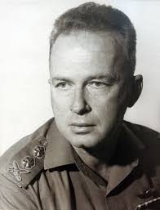
The Four Pillars - the “Defensive Square"
To prevent or delay the next war
Deterrence
“The goal of the IDF is to deter or if deterrence fails – to win decisively”
To enlist the reserve duty on time
Alertness
To renew the deterrence:
In the case of Israel there is no absolute deterrence; Deterrence is a biodegradable product, which is always temporary
Decisiveness
(Preferably Quickly)
Defense And Protection
Since the home front has become a front

Slide 7
What’s the Message?
Read the text in a critical manner and don’t take things for granted
Deterrence – Is it a threat to use force (with zero violence) or active prevention (since deterrence wills surely fail)
What is the difference between deterrence through punishment and deterrence through prevention?
What are the four main pillars of the IDF National Defense Doctrine?
National Defense Concept – An organized doctrine or a strategic norm?
What are the main sources for the Israeli Strategic Concept (narrative, norms, values, values, beliefs, and experiences)
There is no absolute truth, and we will always have to examine a strategy in relation to values and culture - to the other (deterrence is not a universal concept)

Slide 8
What’s the Message?
Seniority goes hand in hand with tolerance:
There is no one interpretation that takes precedent over another (difficulties and tensions)
Free choice (“tree of wisdom for good and evil”) requires making moral choices
Even God’s position may be changed:
Even modesty is implied in the story of the Garden of Eden

Slide 9
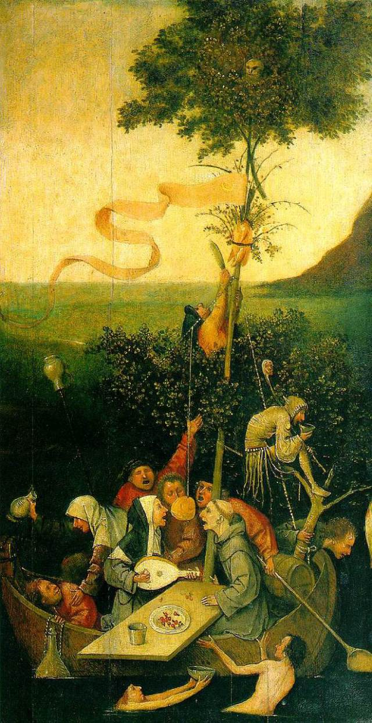
What’s the Message?
The importance of doubt should come from understanding the nature of man and his relation to the universe: turning the tree of wisdom into a ship mast as a metaphor for losing the future
Painting:
The Sheep of Fools, 1495
A man stands on his fate,
changes his fate,
drifts with his fate,
And affects his destiny!
Artist:
Hieronymus Bosch

Slide 10
Participants:
Influencing, Contributing, Enriching and Leading Group
Staff:
Learning, Developing, Committed and Experienced
Leaders, influencers, those with vast knowledge, military leaders
National Defense
Various customized fields of content are taught in numerous methods, incorporating academia and practical applications
National Defense
International Affairs and Diplomacy
Economy
Society
Strategy – The ability to discern the required change, the ability to realize plans by being familiar with the tools
Campaign – Realizing the strategy by the use of diverse practical actions that are uniquely incorporated
Action – Carrying out the operation within the professional and thematic expertise that is integrated into the entire campaign
The State of Israel: values, interests, and national interests

Slide 11
Strategy is not Science, but Art
Development of Strategic Thought
“Reasons & Justifications”
Strategic Thinking
“Applied Theory”
The Formation Method
“The Dado Center”
What Enters the Pantheon?
First Experience “Northern Arena”
Second Strategic Experience
Political Security Simulation
The Palestinian Conflict
Public and Economic Strategy
Third Strategic Experience
“East Tour”

Slide 12
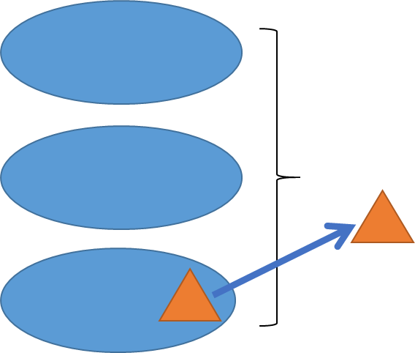
The Challenges of Teaching Strategy of National Defense
How do you develop a professional rank that can differentiate the relevance gaps created in a hierarchical system
How do you change the participants’ point of view from the tactical scope to understanding the multi-faceted aspects of the situation (strategic-operative-tactical), while creating a deeper understanding of the higher levels
How do you achieve all of this with a heterogeneous group of senior officials (difficulties alongside opportunities)
Strategy
Campaign
Action

Slide 13
8 Tensions in Learning at the INDC
Adapted and evolving content
Planned syllabus
How to think (Socrates)
What to think (Plato)
Knowledge - Tacit
Knowledge - Explicit
Participant
Student
Staff – Learning and guiding the learning process
Staff – Teaching and guiding
Team
Plenum
Depth
Width
College
Military Base

Slide 14
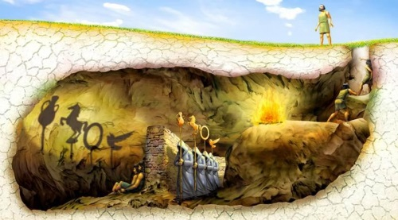
Plato’s Allegory of the Cave

Slide 15
Expectation Management
Learning by reference
Active participation, self-awareness, and senior learning
Motivation and dedication to the learning process
Group experiences and personal experience
Official decorum and ethics
Learning as a long term process
Learning to listen
Encouraging learning/Inhibiting learning
The international participants as “reflective voices”
Senior camaraderie
“He who learns, wins”
The course as an opportunity for personal improvement and prolonged
Lifelong learning

Slide 16
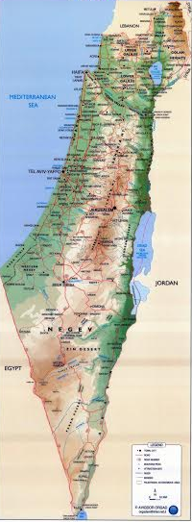
Summary

