Slide 1
and the Concept of the Israeli Commander
70 Years of the Israeli Commander

Slide 2
Characteristics of a Leader – Instructional Department, An Army Custom, December 1947
Decisiveness - Determination to carry out and assume your role, whatever it may be (strength)
Initiative - which allows you to handle any situation under your own responsibility - without waiting for orders (initiative)
Enthusiasm - which inspires people, and is the surest way to efficiency (motivation)
Thoroughness - which requires going into details regarding the treatment of your people, their weapons and equipment (professionalism)
Self-control - that will allow you to be cool in face of danger and thus serve as an example for your people to behave by (personal example)
Cheerfulness - at any time and in every situation, even at the bleakest time (fighting spirit)
Loyalty - Loyalty to land and the corps (Mission)
Notes:
העיסוק באופן הפיקוד הישראלי הנו עיסוק ותיק ששיא עצוב בשנים 1956-1936.

Slide 3
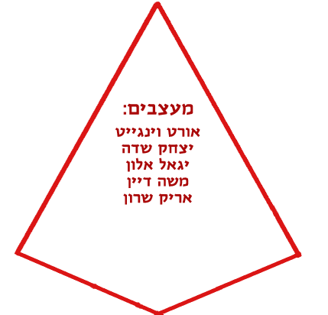
The Components that Influence the Character of the Israeli Commander
The ability to regroup, change, and the technological ability
Designers:
Orde Wingate
Its'hak Sadeh
Yigal Allon
Moshe Dayan
Ariel Sharon
Arising from conflicts and war
Tradition:
Command from the lines
"Leaving the
fence"
S.N.S.
“The
Wanderer"
Unit 101
The ideological basis:
Golomb and Jabotinsky
Characteristics of recruitment, conditions of the underground and Israeli society
Notes:
מסורת – אין מסורת מוקדמת ליהודי החדש הציוני.
בסיס אידיאולוגי- סוציאליסטי, שיויון ונכונות להלחם למען רעיון ולא למען שליט או שלטון
מענה מבצעי – גישה התקפית ע"פ גישה הגנתית כמענה לאיום
מענה מנהיגותי- המאפיינים של המונהג וכיצד להניע אותו באופן אפקטיבי.
גורמים משפיעים – מצב ביטחוני, מצב כלכלי, תנאי מחתרת, מאפייני הגיוס, ההשכלה, היכולת הטכנולוגית,
אישים משפיעים – האנשים שהנהיגו את הבסיס האידיאולוגי, קבעו את המענה המנהיגותי והמקצועי
וינגייט – הידיד, גושפנקא מקצועית ומנחיל ערכי לחימה.
שדה – הגישה הלא פורמאלית והחברית, חסיד האלתור והאי סדר אך מבטא הנועזות והחתירה למגע.
אלון – מנהיגות כריזמטית שקטה, אוטודידקטיות של המקצוע הצבאי וכישורי מצביאות גבוהים המבטאים יכולת תחבולנית.
דיין – מנחיל רוח הלחימה לצבא המתחדש.
שרון- המיישם של מדיניות דיין.
שגיא ירחיב בנושא בהרצאותו

Slide 4
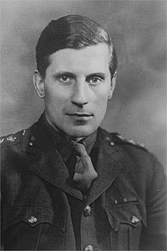
Charles Orde Wingate
"Lawrence of the Jews"
"Everything is written in the Bible,
All the places, all the tactics.
As it is written, "You can win a war with a plan"
Commander in front
diligent
scholar
Strict: operational discipline
tactician
"A bold and planning personality, a bit crazy"
"The Unappointed Commander"

Slide 5
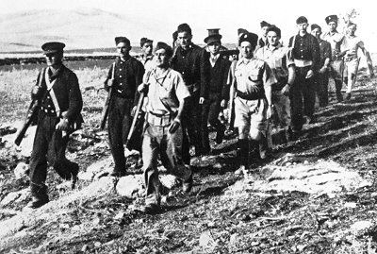
Reviving the Hebrew Military Tradition
In Tirat Zvi: "Two thousand years recess, tonight you form the nucleus of Israel's renewed military“

Slide 6
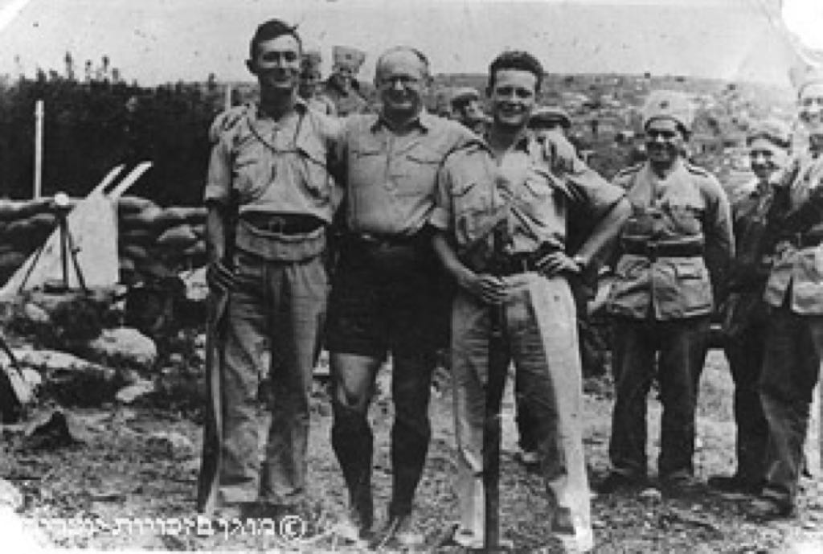
Its'hak Sadeh
"Garibaldi of the Jews"
Moshe Dayan
Its'hak Sadeh
Yigal Allon
"follow me" and not "lets go"
complete the task
initiative
Doesn't abandon the wounded
Discipline and not obedience
"Guderian? I do not know him"
Friendship
Mission oriented (Pioneering, Zionism)
Striving for contact
Courage
Improvisation
Education
professionalism
Leadership
Being critical
Indirect approach

Slide 7
A Night of Waiting
Wriiter: Natan Alterman (October 1948)
Composer: Yair Rosenblum (May 1973)
A night in the waiting, a night of song, a starry night
A night of hasted efforts, A night of steam of from the boilers
A night that melts the spell of evil spirits
While building a kingdom, a night of wandering
Stands over every person and the battalions as a whole.
He talks about love (with that he starts)
And on obligation and on battle and the burden, everything and everything
He does not say this in all the intricacy
Of poetry, but says in a great triumph
"Without a feeble heart or fear of the other."

Slide 8
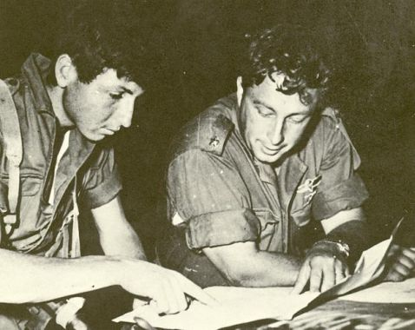
Ariel Sharon
"We do not return until we perform the task at hand"
courage
The spirit of the unit
Independence (Task Force)
Unit 101: Ariel Sharon and Meir Har-Zion Before Going on a Mission

Slide 9
About a Different Operational Culture
"Usually the soldiers turn to their officers using their first names, as if they were their colleagues, the salutes are very rare, the unshaven chin is common, but there is no outward sign of respect for the high class, In Hebrew, a word parallel to the English call "Sir." The soldier really feels himself equal to his commander - or like any other officer - but in battle, he accepts the military authority without hesitation. I can not explain, I cannot begin to understand how it works. All my military efforts in the British and American armies have taught me that iron discipline in battle is subject to good discipline in barracks "It turns out that the IDF contradicts this lesson"
Robert Hendrix, "One Hundred Hours to Suez" (1957)

Slide 10
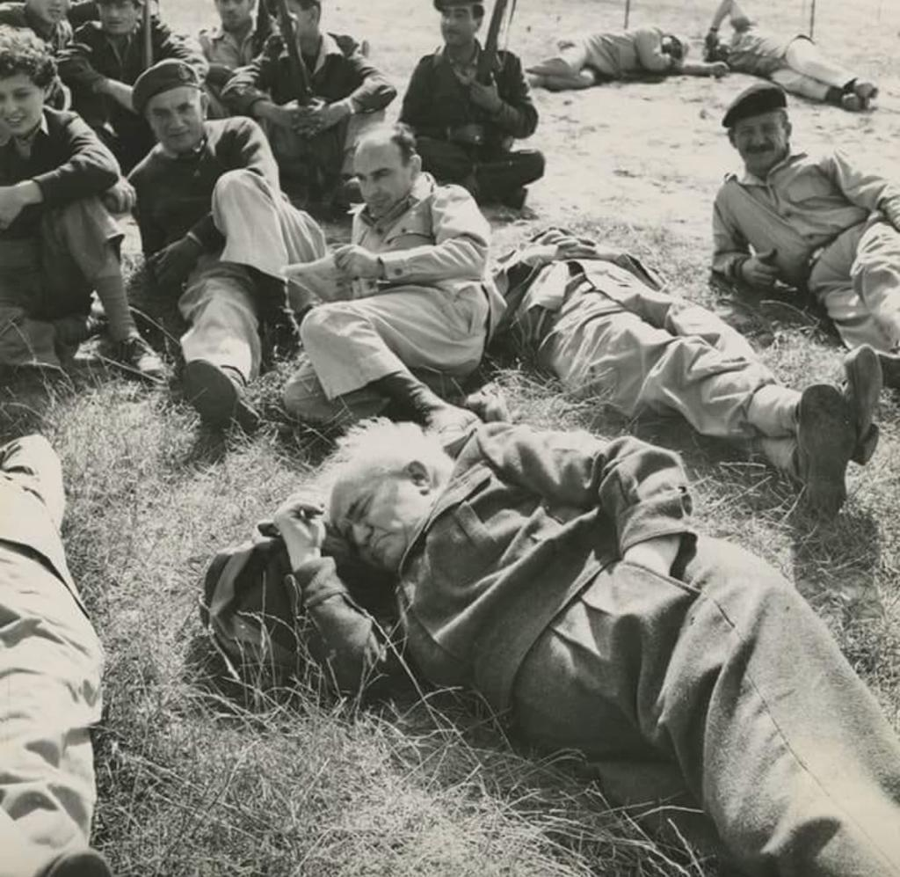
"The supreme truth of every IDF commander is to know that it is not enough that he knows the profession of the army and will deploy it to the best of his abilities. He must be an educator by divine grace. A man who lives exemplary.
Only the exemplary man and IDF commanders are committed to being exemplary people, and in Israel he will shape the image of his disciple.
Not in the power of discipline, of routine, of technique, although one must not belittle all of these things, but rather by the power of his great personality. "

Slide 11
An Israeli commander
The spirit of Zionism permeates him - the fate of the battle in his hands
Committed, worthy of his orders and instilling in them a fighting spirit
An in-depth professional, studying and teaching his subordinates
Initiates, dares and complicates
Independent, strong and commander in front
Has a fresh, innovative and critical thinking
Notes:
גילום היסטורי של המאפיינים של דמות המפקד הישראלי כפי שמלמדים כיום במכללות ובבה"ד 1
רוח הציונות מפעמת בו: תפיסת השרות כשליחות אל מול גישה מקצועית ששולבו יחדיו. מקורותיה של תפיסת השליחות בהגנה ובפלמ"ח והגישה המקצועית שמקורותיה בצבא הבריטי.
הוויכוח בשנות החמישים בין יוצאי ההגנה-פלמ"ח שדרשו לחנך לוחמים "ללמה" נלחמים לחינוך שדרשו יוצאי הצבא הבריטי "לאיך" נלחמים

Slide 12
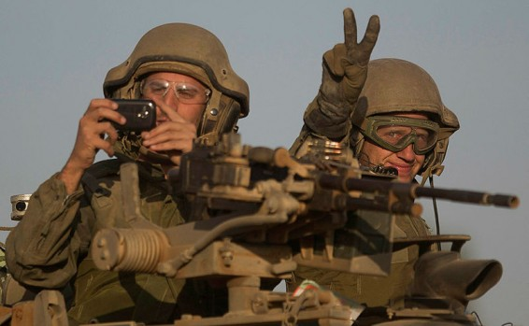
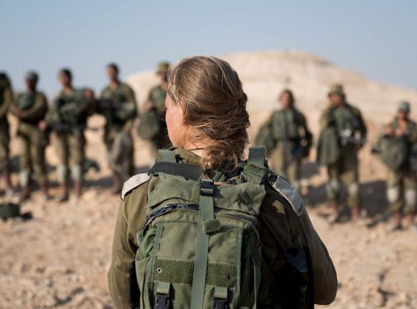
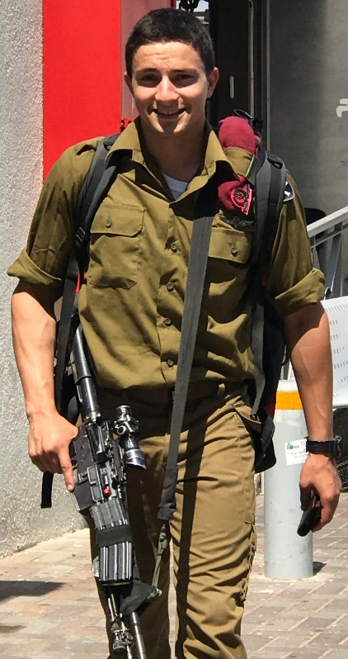
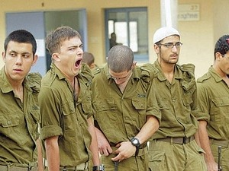
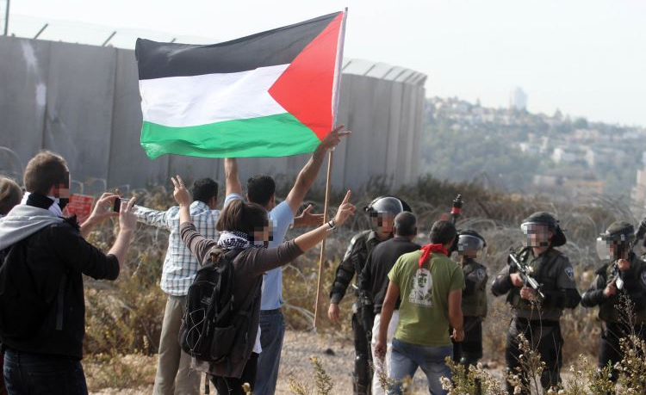
2018 Commanding Challenges
Notes:
אתגרי הפיקוד 2018
ימין למטה – מוטיבציה
מרכז- מסכים ורשתות חברתיות.
שמאל למטה – שילוב בנים בנות.
למעלה משמאל – כל דבר מצולם ומעולה לרשת.
תתווסף תמונה על אתגר הפיקוד מול אוכלוסיה אזרחית.

Slide 13
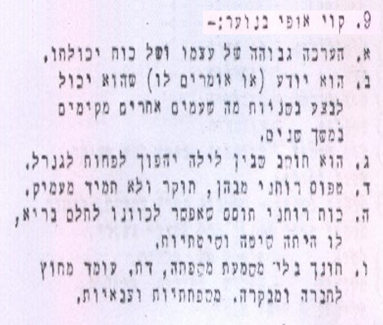
Main Characteristics of the Youth – 1948 Command Challenges
"Leadership, Discipline, Taking Care of People, Administration" Manual
Instructional Department, JANUARY 1948
They know that they can do in seconds what other nations have been building for years
He thinks that over night he will become a general
The spiritual type, investigative but does not go in depth.
Spiritual and lively force that could be directed in a positive direction could have been great, if only there was a method of a system behind it.
Was educated without any discipline, religion,
Standing outside and creating society

Slide 14
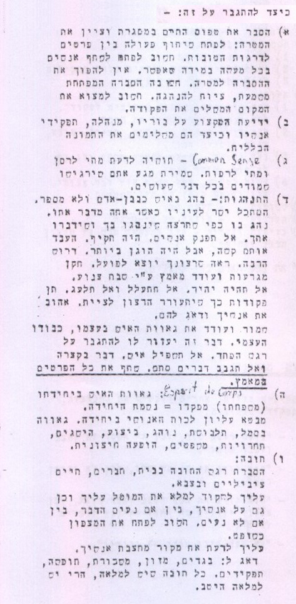
How to Overcome this?
"Leadership, Discipline, Care for People, Administration" Manual
Instructional Department, January 1948
Explain your lifestyle within the framework and state your goal
Knowing the position inside out
Common sense
Behavior - behave like a human, do not pamper people, be firm
A person's pride in their unit
Notes:
לה"ד- לשכת ההדרכה
מאפייני הנוער הישראלי – שיוך לאתגרי הפיקוד

Slide 15
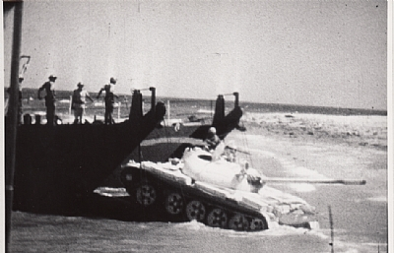
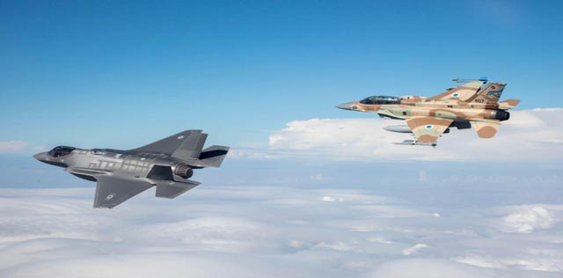
Power and Tactics - Do They Work Together?
The Israeli Commander in the Test of Time
1969
2018
1948
Notes:
האם צה"ל הפך מדוד לגוליית.
צבא קטן, דל משאבים, מול עוצמה צבאית של מדינות ערב הסובבות אותנו והפועל באופן תחבולני בלחימה נגדו.
האם היום העוצמה מייתרת את התחבולה והיא נעדרת מהתוכניות ומאופן הפעלת הכוח של כל הרמות בצה"ל?
תמונה שמאלית למעלה – מבצע רביב 1969. הנחתת טנקי ורק"ם שלל לפשיטה ממוכנת בדרום סואץ.

Slide 16
So What Did We Have?
Combat Commander - the most difficult job in the world that requires professionalism, personal risk, totality and leadership!
An Israeli Commander - "the non-commissioned commander," who grows up from the ranks, volunteers and serves as an emissary!
A state Commander - represents the desires of Israeli society in all its parts and is responsible for the settlement of variance, acts as a state interest in order to protect the land!
An Israeli Commander - even a female commander!
Initiates, validates and challenges - as a geopolitical necessity and it is necessary to change, to update and to renew!

