Slide 1

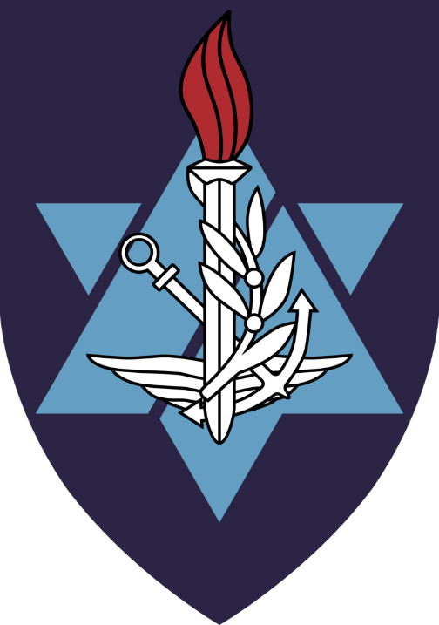

Command & Staff College, Alon
LTc. (res.) Dotan Druck, PhD.
Academic Instructor, Alon command & Staff College

Slide 2
Agenda
Structure of the IDF Military Colleges
Alon Command & Staff College
IDF - Military History & Development
Military History & Development
Battle analysis
Military Creativity & Flexibility
Questions?

Slide 3

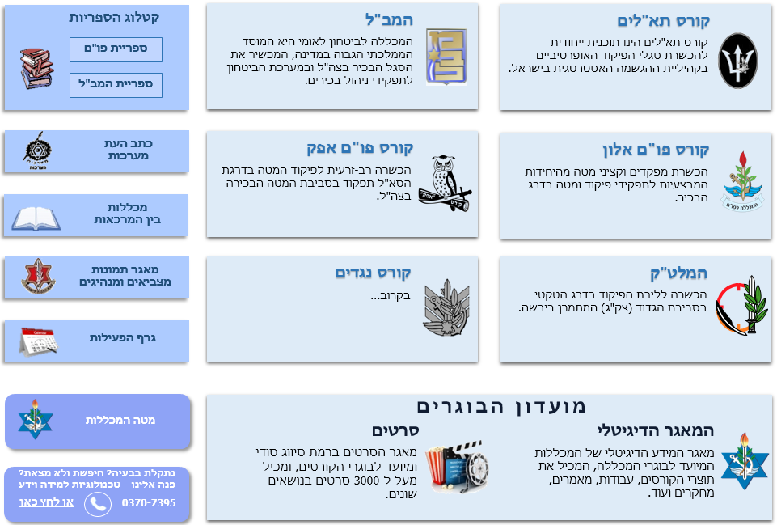
Structure of the IDF Military Colleges
Head of the IDF Military Colleges
(MG)
Israel National Defense College
Chief of Staff of the Colleges
(BG)
Brigadier Generals Course
Research Center
Research Center
“Maarachot” Publishing
Tactical and Command College
(COL)
Commander of “Alon” Course
(COL)
Commander of “Afek” Course
(COL)
Commander of the Operational Course for NCO
(LTC)
Head of the
Instruction Branch
Head of Logistic Branch
Head of Research
And Development

Slide 4
Command and Staff College:
Afek Course
General Information | Product | Duration | Target Audience
Students who enter the Afek Course come from senior positions in the General Staff. The main purpose of the course is to broaden their point of view and provide a more complete picture of the IDF and its structure. This includes exposure to the world of combat and to strategic considerations in that regard. Furthermore, the course attempts to strengthen leadership and command abilities. | Afek Course Graduation Certificate | 4 Months (3 Cycles per Year) | Majors (from the General Staff)

Slide 5
Alon Command & Staff College
General Information | Product | Duration | Target Audience
The studies at the Alon Course include analyzing combat doctrines from around the world, leadership abilities and education methods. As part of the program, cadets travel abroad and visit battle sites, as part of the attempt to constantly expose them to different perspectives regarding warfare and operational tactics. | M.A. in Political Science from Haifa University Alon Course Graduation Certificate | 10 Months | Majors (from Combat Units)

Slide 6
Alon Command & Staff College
Learning and analyzing the IDF Doctrine & Concept
Developing military leadership and self command identity
Developing multi-domain thinking
Consolidate critical thinking and the courage to express an opinion
Physical fitness as a culture
IDF values & spirit

Slide 7
IDF - Military History & Development
The development of Israeli military thinking 1900 – 2014:
The era before 1948
War of Independence – the stages of the war and the military thinking
1948 – 1956 and the building of the IDF and the Sinai Campaign
The six year war – 1967, attrition war, 1973
The war between Israel and the Palestinians – 1967 - 2014
The war at Lebanon – 1982, 1982 – 2000, 2006
Gaza wars – 2008, 2012, 2014 & beyond

Slide 8
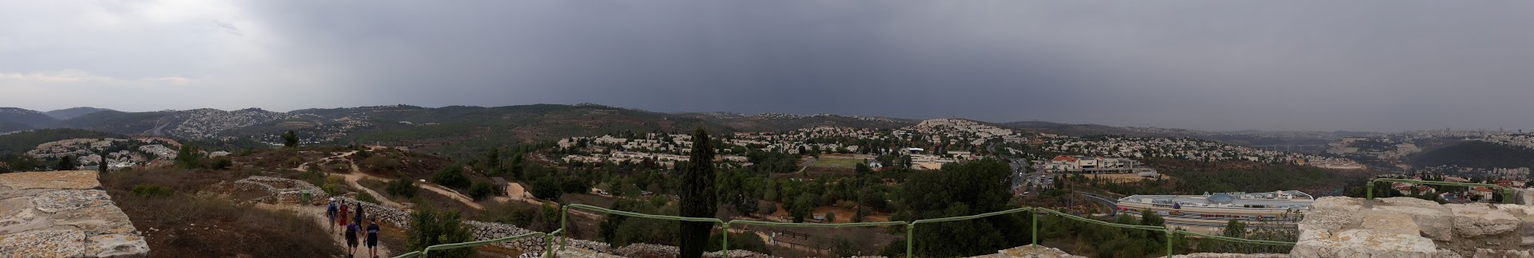
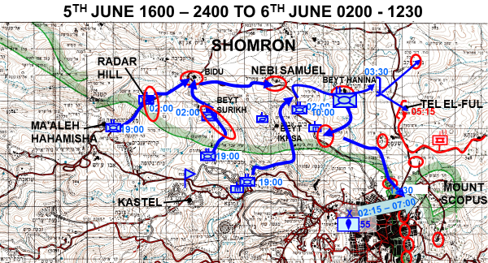
IDF - Military History & Development

Slide 9
Military History & Development
The development of military thinking 1914 – 2019:
Military thinkers (Clausewitz, Liddle-Hart…)
Strategy – conceptualization, levels
Decision & Victory
WW-I & WW-II
1945 as a turning point – RMA, 4GW, HYBRID..
Terror & Guerilla warfare
Urban Warfare
Air Warfare – decision from the air? Development
Afghanistan, Iraq & Syria – Case studies

Slide 10
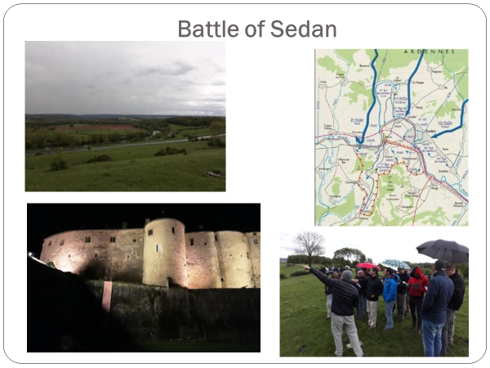
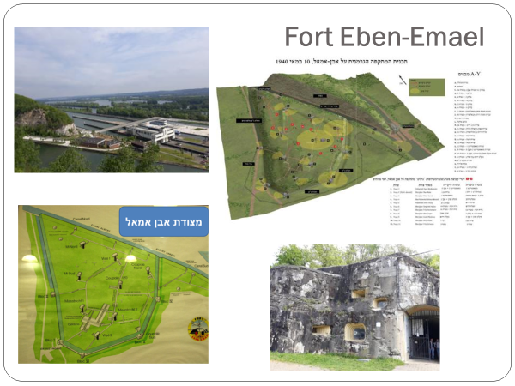
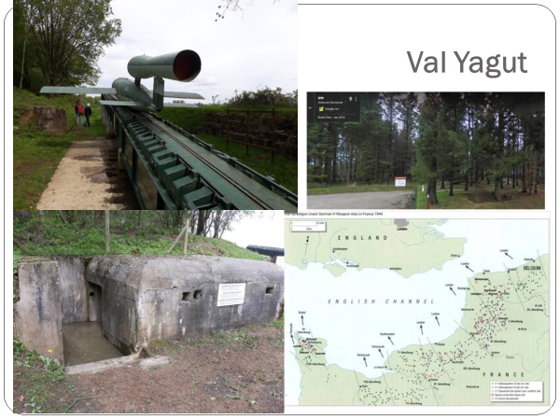
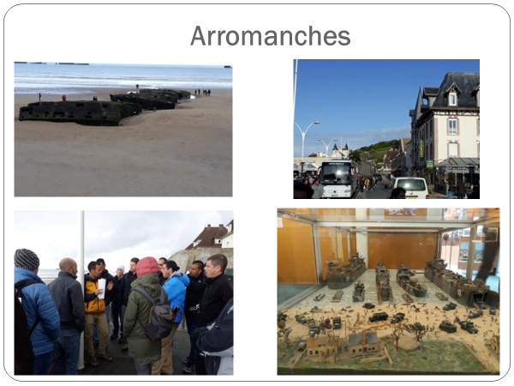
Military History & Development

Slide 11
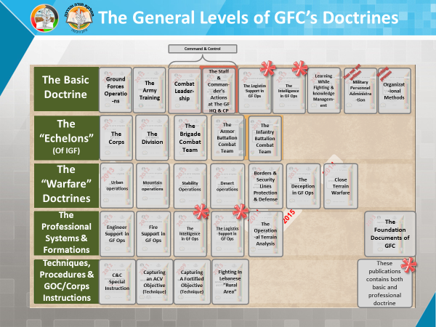
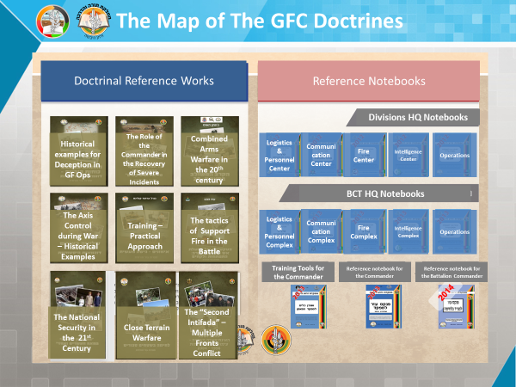
IDF - Military Doctrine & Concept

Slide 12
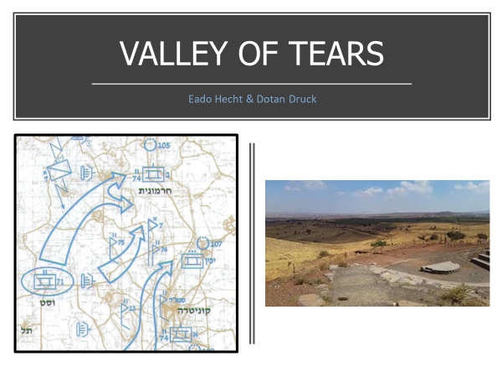
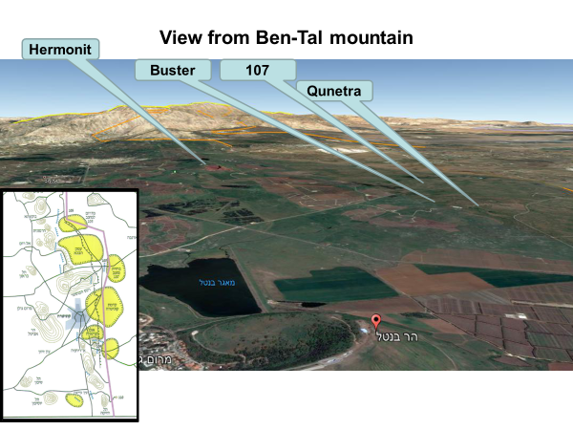
IDF - Military Doctrine & Concept
Battle analysis

Slide 13
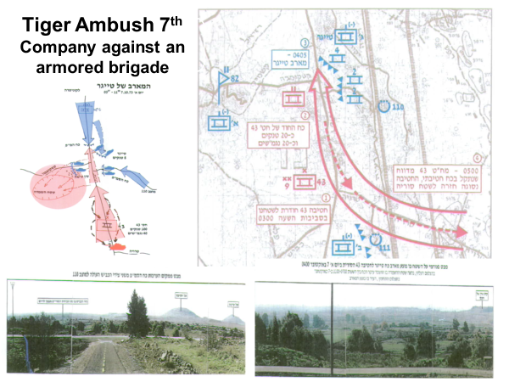
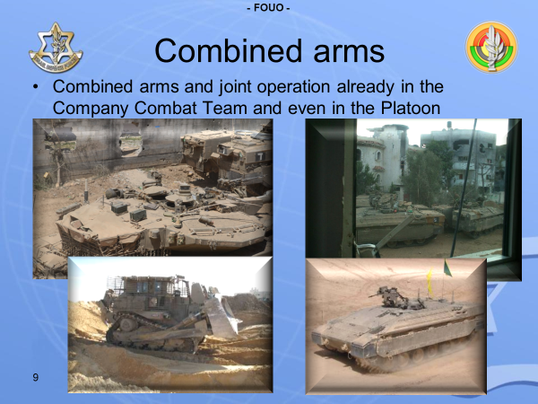
IDF - Military Doctrine & Concept
Battle analysis

Slide 14
Military Creativity & Flexibility
Creativity is a phenomenon whereby something new and somehow valuable is formed
Creativity depends on intellectual flexibility, which allows multi-dimensional and multi-directional thinking. One of the core characteristics of creative work is that it is innovative

Slide 15

Military Creativity & Flexibility
Vision of the Command & Staff College – “The IDF will have professional, brave, creative, sophisticated and intelligent senior officers…”

Slide 16

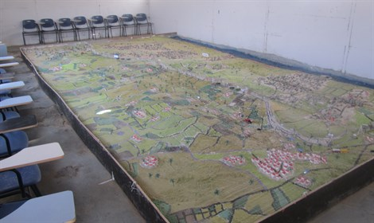
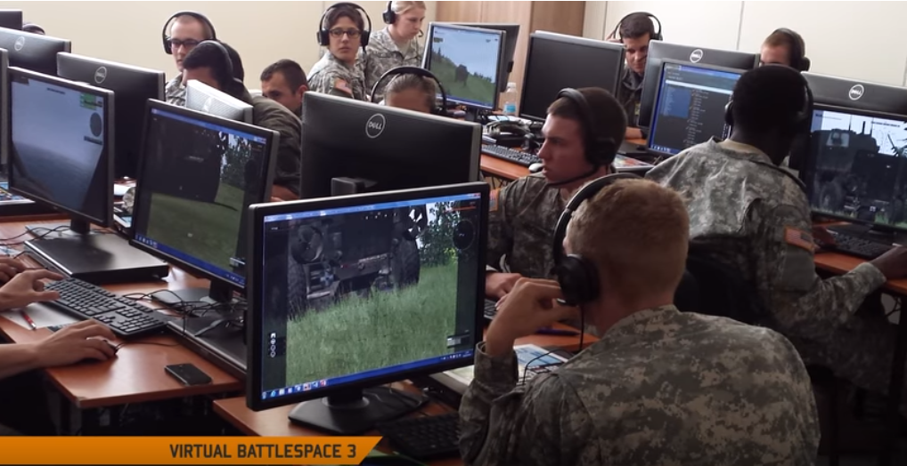
What do we do?
War games – developing tactical thinking, fostering creativity – problem solving, manipulating the enemy, stratagem…

Slide 17
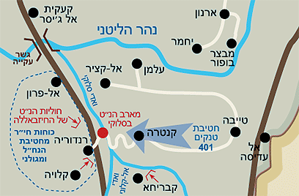

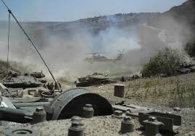
What do we do?
Learning case studies about failures in the battlefield;
Trying to understand the causes, how commanders thought;
Acting like the commander in the battle: “this is the assessment of the situation in the battle, you have to decide what has to be done!“

Slide 18
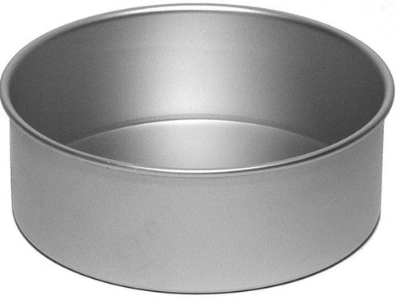
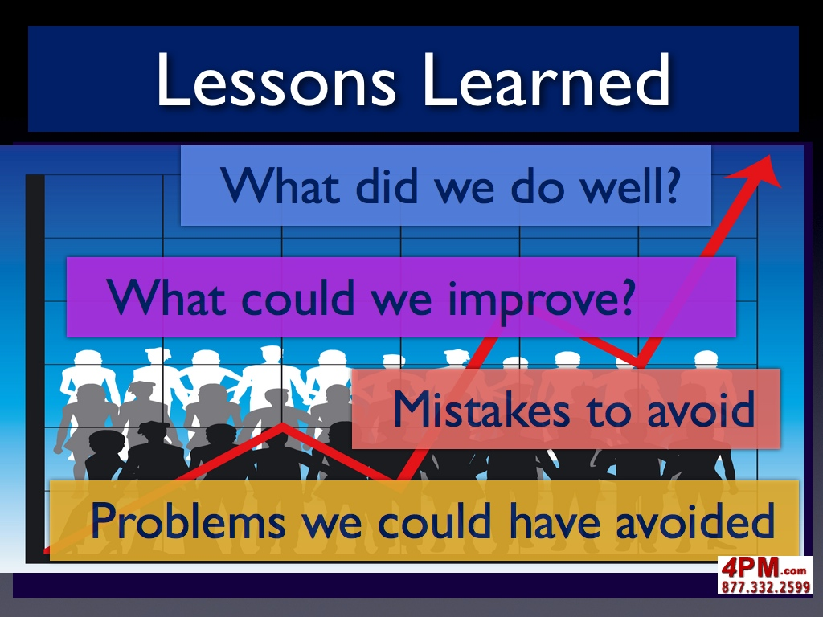
Creativity Delayers
Military Doctrine – patterns of thinking vs creativity & flexibility
The Doctrine is the general solution but might not your solution;
The operational and tactical learning contest – lessons learned, adaptation…

Slide 19
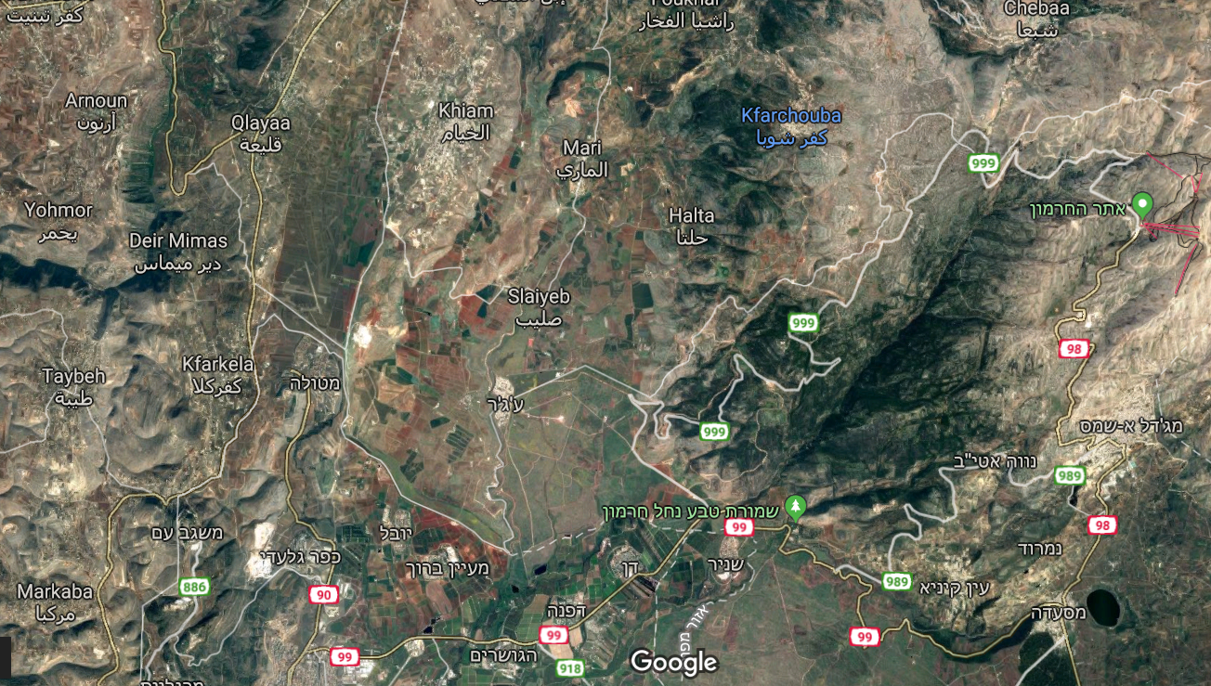
Part of a test in doctrine thought
Boundary
Linear
“Doctrinal”
With out any creativity

Slide 20
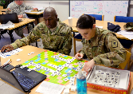
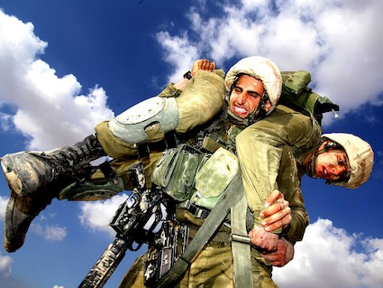



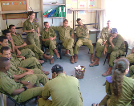
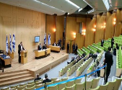

  Methods of Learning
1
2
3
Small Team (4-5)
Deeper learning, getting out of comfort zones
One-on-One
Mutual Strengthening of abilities, deeper learning
Self Teaching
4
5
Two Teams
Discourse, synergy
Team
Leadership and individual development – “hall of mirrors”
6
7
8
Integrative Team Processing at selected points
Debate
Critical thinking and developing “argument construction” abilities
Lecture Hall
Unique content, senior leaders’ lectures, leadership development, after learning processing

Slide 21




Slide 22
”Tnoofa” & Mind-Lab
“Tenoofa”(momentum) program – improve personal awareness and get adaptable senior officers.
Personal analysis – choose self development objectives, one on one and group workshop.
Use the Mind-Lab - game based learning – assess complex, higher order skills, analytical thinking, strategic thinking and execution.
Get a detailed report (12 sub-skills).
Personal development plan – “tnoofa”days, roles in the course, and personal awareness to the future.

Slide 23
