Slide 1
^{Meet The Moment With AJC}

Slide 2
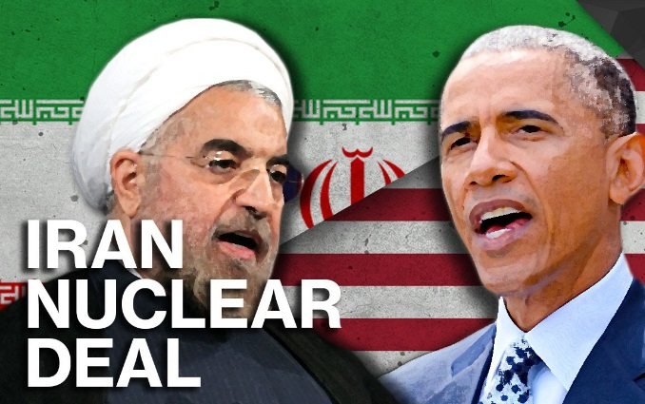
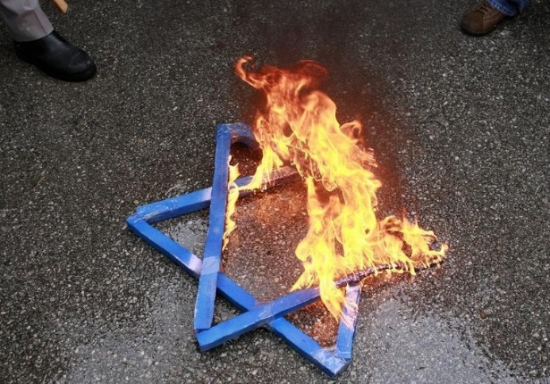
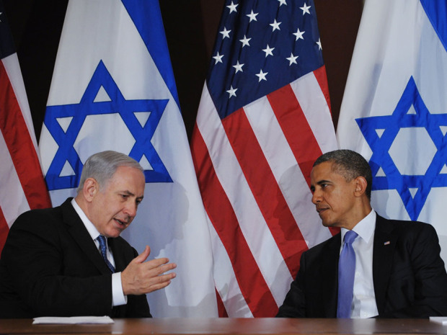
AJC 2016 Survey of American Jews
CONFLICTED CONCERNED WORRIED
*AJC’s 2016 Survey of American Jewish Opinion, conducted by the research company SSRS, is based on telephone interviews carried out August 8-28 with a national sample of 1,002 Jews over age 18. The margin of error is plus or minus 3.57%.

Slide 3
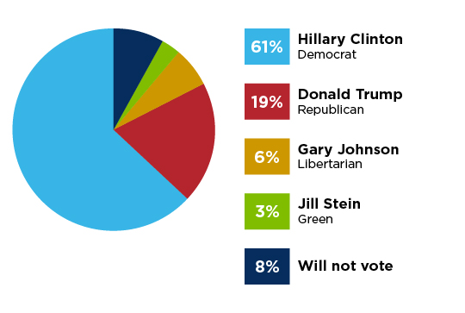
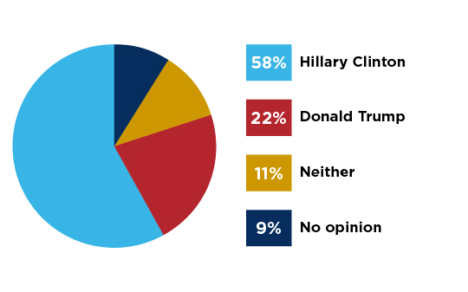
If the presidential election were held today, for whom would you most likely vote?
Which of the two major party candidates for president would be better at handling terrorism?
August 2016

Slide 4
16
26
18
8
39
23
51
12
Do you think of yourself as…
Orthodox
Conservative
Reconstructionist
Reform
August 2016
Just Jewish

Slide 5
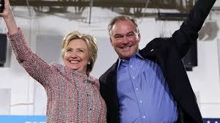
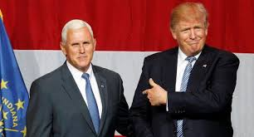
16
19
28
36

Slide 6
Among the following choices, what do you think is the most important issue in deciding how you will vote in the 2016 presidential election?
The Economy, Jobs 29%
Another issue 12%
Foreign Policy 10%
Terrorism and National Security 16%
Healthcare 9%
Climate change 9%
Immigration 4%
Race Relations 4%
Taxes 3%
Federal Deficit 2%

Slide 7
Among the following choices, what do you think is the second most important issue in deciding how you will vote in the 2016 presidential election?
The Economy, Jobs 22%
Healthcare 13%
Foreign Policy 12%
Terrorism and National Security 15%
Climate change 8%
Race Relations 8%
Immigration 6%
Another issue 6%
Taxes 5%
Federal Deficit 3%

Slide 8
How much confidence do you have in…
Congress
Police
Television news
A great deal
Quite a lot
Some
Very little
None
No opinion
A great deal
Quite a lot
Some
Very little
None
No opinion
A great deal
Quite a lot
Some
Very little
None
No opinion

Slide 9
2
4
10
26
58

Slide 10
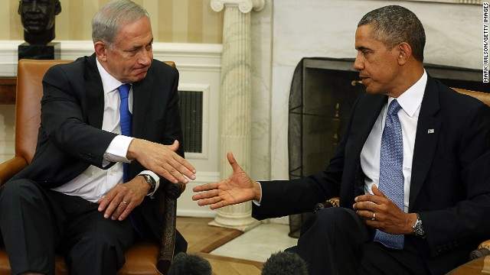
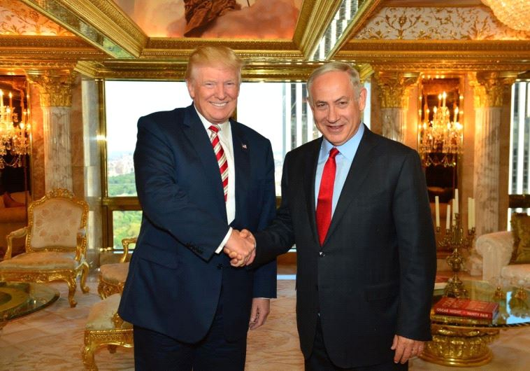
How would you characterize the U.S.-Israel relationship today?
Very good
Fairly good
Fairly poor
Very poor

Slide 11
How will the two major party candidates for president would be more likely to…
Unite the country
Promote US-Israel relations
Deal effectively with Iran
Donald Trump
Hilary Clinton
Neither
No opinion
Donald Trump
Hilary Clinton
Neither
No opinion
Donald Trump
Hilary Clinton
Neither
No opinion

Slide 12
Anti-Semitism
Is anti-Semitism currently on the American campus?
Is anti-Semitism currently a problem in the US?
4
1
16
21
23
22
6
21
34
52
Yes, a very serious problem
No, not a problem at all
Yes, somewhat a problem
No opinion
No, not much of a problem

Slide 13
Jewish Identity
What is your current marital status?
Unmarried
49%
Married to a born Jew
32%
Married to a convert to Judaism
3%
Married to a non-Jew
15%
How important is being Jewish in your life?
Very important
44%
Somewhat important
35%
Not too important
11%
Not at all important
10%

Slide 14
Peace Process
Do you believe that Israel and an independent Palestinian state can coexist peacefully?
Have you ever been to Israel ?
Yes, more than once
27
52
No
21
Yes, once
Yes
No
Undecided

Slide 15
Do you agree with the following statement: “Caring about Israel is a very important part of my being a Jew.“
Disagree strongly
10
Disagree somewhat
16
47
Agree strongly
26
Agree somewhat

Slide 16
Which of these statements best represent your opinion of the role of religion in the State of Israel?
Do you think the fact that Orthodox Judaism is the only denomination recognized by Israel as an official form of Judaism…
should play more of a role
6
6
should play less of a role
current relationship is best
39
48
there should be seperation of religion and state
no opinion
Strengthen Israel’s ties with American Jews
Weakens Israel’s ties with American Jews
Has no effect on Israel’s ties with American Jews
No opinion

Slide 18
^{Meet The Moment With AJC}

