Slide 1


Political and Diplomatic Components in National Security
Prof. Gabi Ben-Dor
Course Introduction: National Security Infrastructure

Slide 2

Political and Diplomatic Elements of National Security
2. Distribution of resources
1. Political - psychologicalcomponents
7 Clusters
4. Diplomatic Dimension: Alliances as a multiplicatively of power
3. Policy, strategy and doctrine:
7. Creativity and imagination
6. National security institution management: Socio Military Relations
5. Timing: initiation and the end of rivalries and wars
Prof. Gabi Ben-Dor
Course Introduction: National Security Infrastructure

Slide 3
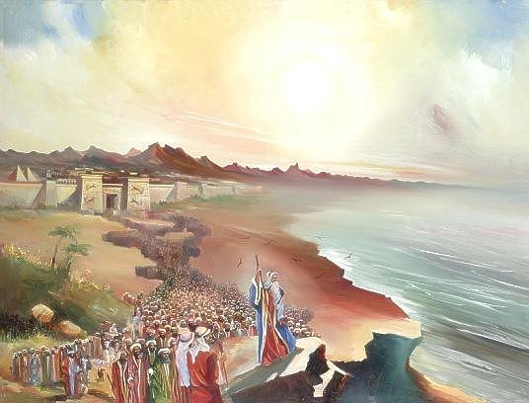
1. Political psychological Elements
Political and Diplomatic Elements of National Security
Leadership
Morale
Determination and desire
Prof. Gabi Ben-Dor
Course Introduction: National Security Infrastructure

Slide 4
2. Distribution of Resources
Political and Diplomatic Elements of National Security
How Much is Enough?
There are two opposing risks:
Low investment in national security because of the sense of security
Over-investment and neglecting of the needs of society
Prof. Gabi Ben-Dor
Course Introduction: National Security Infrastructure

Slide 5
3. Policy, strategy and doctrine:
Political and Diplomatic Elements of National Security
Thinking is usually basic political thinking, because it reflects the perception and priorities of senior leadership regarding threats to the country
Prof. Gabi Ben-Dor
Course Introduction: National Security Infrastructure

Slide 6

4. Diplomatic Dimension: Alliances as a multiplicatively of power
Political and Diplomatic Elements of National Security
Alliances of crucial importance to the smaller countries, not just for them. Effective means to double the power
History provides examples of successes and failures of this strategy as well as its absence
Prof. Gabi Ben-Dor
Course Introduction: National Security Infrastructure

Slide 7
5. Timing: Promotion and the End of Wars and Rivalries
Political and Diplomatic Elements of National Security
There is no solution to the problem of timing. It is an integral part of the art of politics
Wars must come to an end when the new order has a chance for a better order
Prof. Gabi Ben-Dor
Course Introduction: National Security Infrastructure

Slide 8
6. National security institution management: socio military - relationship
Political and Diplomatic Elements of National Security
The absence of control over the national security system, this institution might do greater force intervene in the affairs of country and thus obstruct normal political processes
Its necessary for a middle way that would satisfy the needs of community pride and confidence without allowing it to control the country
Prof. Gabi Ben-Dor
Course Introduction: National Security Infrastructure

Slide 9
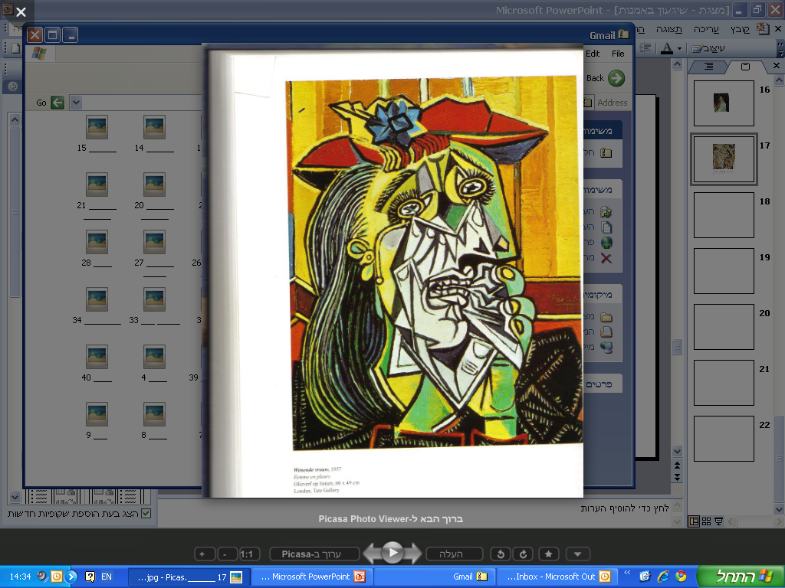
7. Creativity and imagination
Political and Diplomatic Elements of National Security
Dynamic national security
National security policy depends on the circumstances and must recognize the need for constant change
The worst enemy for quality decision making processes in national security matters is routine and the inability to notice the change and take into account the implications
Prof. Gabi Ben-Dor
Course Introduction: National Security Infrastructure

Slide 10
Thank You for Listening
Prof. Gabi Ben-Dor
Course Introduction: National Security Infrastructure

